Slide 1
EMORY Bank - Data Management Transformation Journey
Utilize capabilities for transformation
Establish data
foundation
Take agility
to the next level
Engineer advanced
platform capabilities
Reverse engineering of existing logic, Implementing design patterns to migrate from SQL based platforms to modern ETL packages
Data lineage
Data migration services
Enable
On a Cloud Native Data Platform that can auto-scale and handle diverse work loads of batch, realtime data pipelines as well as industrialized AI (including Deep Learning)
Big-data platform (Hadoop, No SQL), Simplified Transformation logic, Deep history, Embedded metadata, Analytics sandbox
Exposing the insights from the analytics to digital channels using APIs (leading to Microservices)
Data platform architecture
[2.0]
Data exploitation & monetization
Data interfaces
Data on cloud
[3.0]
Automate for efficiency
Siloed data marts or Legacy data warehouse
[1.0]
Data acquisition services
Realtime Data warehouse
Expensive, Redundant data &
Transformation logic,
Missing lineage & metadata,
Analytics use cases delivering business benefits utilizing advanced techniques including Graph analytics, AI & ML
If you started the journey today, you would begin here !
Industrialized, efficient, utilities based – hydration of Data Lake
Delivery of insights with reduced latency from batch to near real time
Devops for data
Data testing automation
Accelerating the Build of the new platform utilizing automated CI/CD pipelines for DevOps and Test automation for data
2016: 100 TechPartners >> 2018: 350 TechPartners >> 2022: 500 TechPartners

Slide 2
Mortgages Domain Automation of processes Automation driven by Data, Insights & AI to increase the efficiency of the Business Processes and Operations
Business Component
Client Targeting
Client Sales
&
Account Opening
Credit Approval
Funding
Client Servicing
Collections
Portfolio Monitoring
Level 1 Process
Marketing
Sales
Compliance Checks
Perform Credit Approval
Loan Funded
Client Servicing
Loan Repayments
Ongoing Monitoring
Automated case creation across branch, broker and online channels
Document verification using optical character recognition
Solicitor’s portal integration with Bank platform for e-COTs and e-Offers
ILA consent form automation
Fee reconciliation
Product change variation
Redemption statements via solicitors portal
Pre-payment propensity checks
Automation undertaken
Offer extensions
Rate switch process across channels
Product fee collection and refunds process
ILA and offer letter creation
Customer information request form simplification
Solutions
API Integration
Optical Character Recognition tools
RPA tools
Process Digitization
Process Simplification
Cognitive & AI
High Level Solution Overview
Prepopulated Form with existing customer data sets from Data Platform
Infused AI specifically OCR for document verification
Data Insights driven Process Digitization
API Integration (including 3rd Party APIs)
Process Leaning
ML based Modelling insights
Benefits
100+ FTE savings
Enhanced customer experience
Reduction in cycle time
Error-free processing
Automated audit trails
Notes:
Prepopulated form with existing customer data form – colour code
Applied Infused AI specifically OCR for document verification
3. fee collection is process digitisation – introducing digital payments
Put process slide back in

Slide 3
Client Sales & Account Opening: Specialised Letter – ILA : Consent form checks
High Level Overview
KEY PROCESS INFORMATION
Process SME | Michael Snow
Systems | MS Outlook, MortOrigS, PDF Reader
Time saved (mins) per Case | 5 minutes
Proposed Solution | Digitised Form, OCR, RPA & MortOrigS APIs
Solution Complexity | Medium
Open case in MortOrigS
Check ILA consent form (PDF with handwritten input) is present in MortOrigS and complete.
If incomplete or not present then exception pathway is triggered – send email to broker or mortgage specialist.
Check 1: Customer(s) Legal name on consent form matches MortOrigS.
Check 2: Customer(s) address on consent form matches MortOrigS
If either check fails then exception pathway is triggered – send email to broker of mortgage specialist
Check 3: That requested solicitor is already the one assigned to case in MortOrigS.
Move onto letter creation
Key Points
Process Changes Required
The process is triggered by a customer requesting independent legal advice (ILA). In order to do this they fill in a form that they get in branch. They either fill it in branch (if they have the solicitors details on them) or take it home and fill it in. Only 1/10 cases are filled in digitally by the broker/specialist. The form is then uploaded to MortOrigS.
The form will need to be filled in by the broker/specialist in branch to ensure it is in a digital format. This means customers need to bring their solicitor’s details to the meeting.
If the requested solicitor is different, an offer condition must be added by choosing from list and entering the customer’s name and solicitor’s name when prompted.
Potential Challenges
RPA or MortOrigS APIs (TBC)
PDF Forms are often handwritten therefore digital form needed for OCR to work
OCR

Slide 4
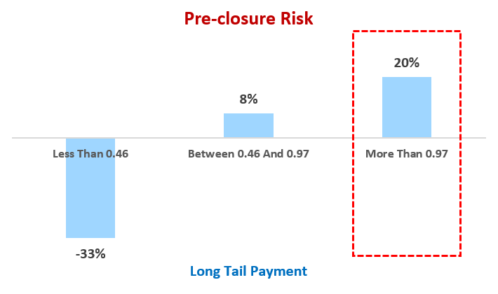
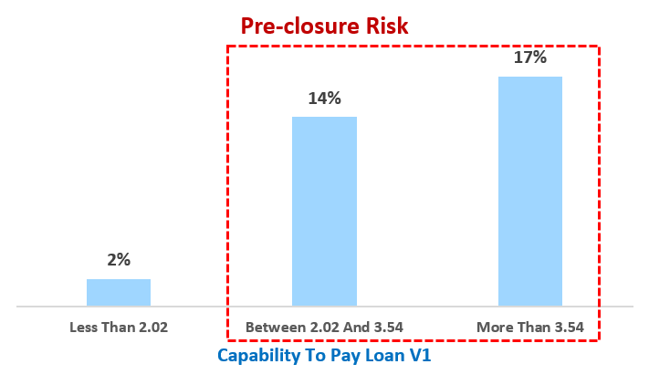
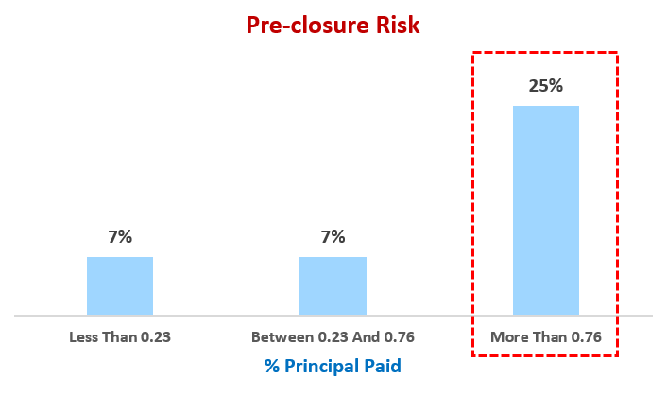
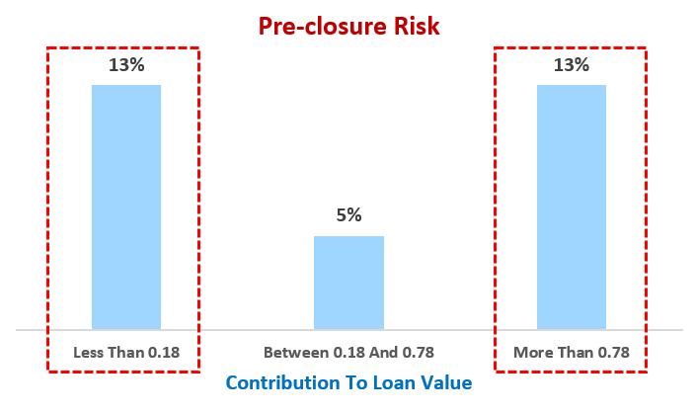

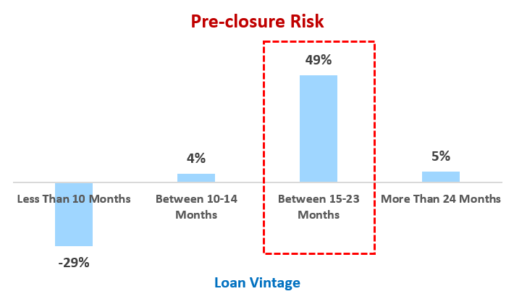
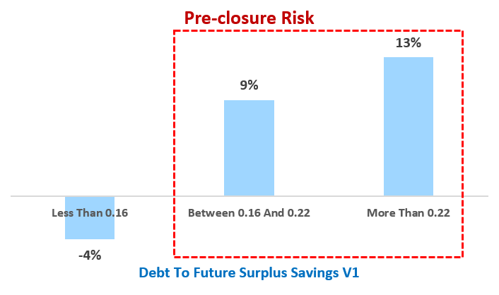
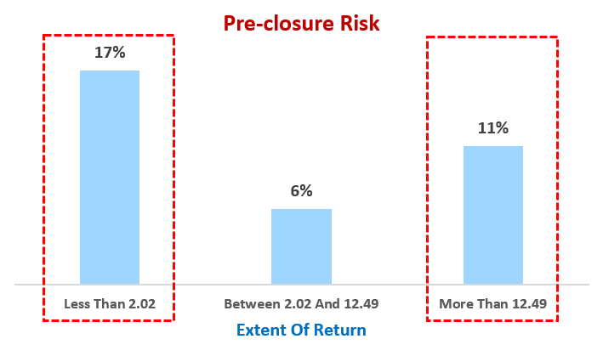

ML based Modelling for Pre-payment Risk
Discovered hidden patterns in mortgage data to understand the money mindset of the borrowers -> Applying Machine Learning
Predict pre-closure/prepayment propensity at application stage itself to drive optimal pricing for mortgages
Drive targeted offers based on customer mindset and triggers
6%
Of total interest income lost to early mortgage payments
To identify customers who may close their mortgages in next 3/6 months
ML based
Risk Model
Model Derived Mortgage Customer Segments
The “new insight” enables a new way of looking at and segmenting customers specific to this context. Further actions are derived by agents and relationship managers based on these segments.
This information can be utilized by the Operations Team (Agents) to proactively reach out to clients
NEW INSIGHTS
15% pre-closures due to servicing
related issues
This customer pays more than scheduled payments. The risk of pre-closure increases with increasing rate of payment
40% pre-closures - current home price is ~12 times the current outstanding
40% pre-closures - current outstanding is less than twice customers own contribution
Rate & Extent of Repayment
Size of Down Payment
Home Planner (Active Manager)
Home Budgeter (Passive Manager)
DATA ENGINEERING
Training/ Prediction datasets
Statistical Pattern Analysis of data
Data and modelling pipeline
Age of Loan
ENABLED BY
Pre-maturity Impact :
Rise in Drawing Power
FEATURE
ENGINEERING
Customer Behavior Maps
Design Financial KPIs from base data
Algorithm-led Best Features Selection
Debt To Future Surplus Savings
Customer Affluence :
Focus on Extent of ROI
50% more chance of this customer with active manager mindset , leaving in search of better floating interest rates
This customer is passive manager and increasing savings/income doesn’t show dramatic increase in pre-closure propensity
MACHINE
LEARNING
MODELLING
Predictive Model to using hybrid ensemble algorithmic design
66% accuracy in predicting mortgages which may close in next 3/6 months

