Slide 1
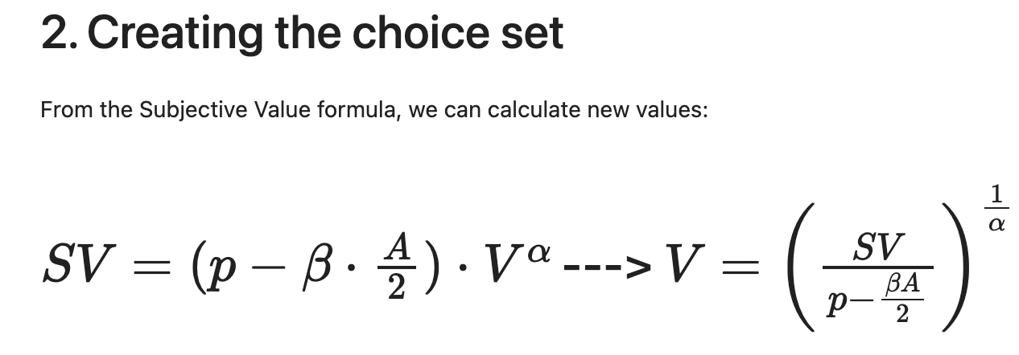
Determining SV from objective value (money)
Calculating objective value (money) from SV

Slide 2
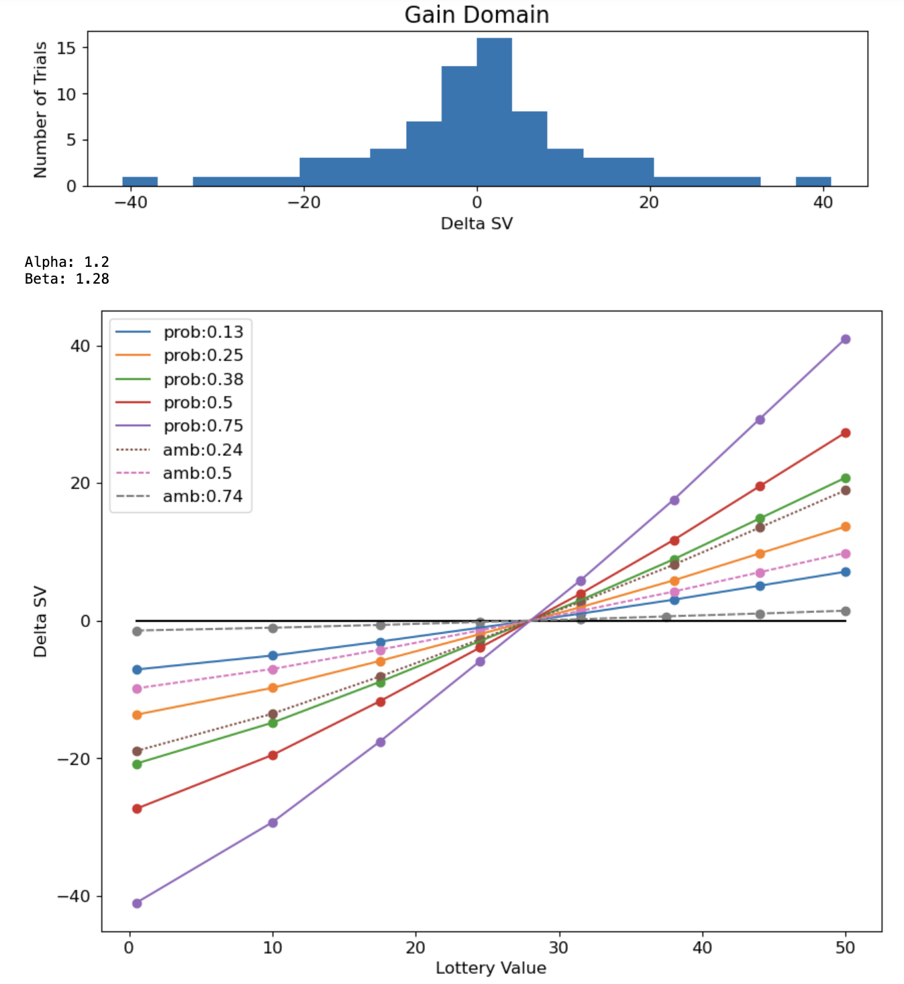
Design Document: Steps of the Process
For each probability and ambiguity:
Use max possible lottery value of $50 to calculate SV_Max
Max_SV = (probability – beta * ambiguity/2) * $50^{alpha}
Divide SV_Max value by 2 to obtain SV_Half (SE trial)
SV_Half = SV_Max/2
Use SV_Half to calculate:
Lottery value for SE trial: SV_Half / (probability-beta*ambiguity/2)^{1/alpha}
Safe value for SE trial: SV_Half^{1/alpha}
Use Max and SE to determine SV range for positive SV, define steps from min to max, and obtain $ values for safe and lottery from SV values at those points. Repeat for negative SV range.
Plot distribution of trials as sanity check

Slide 3
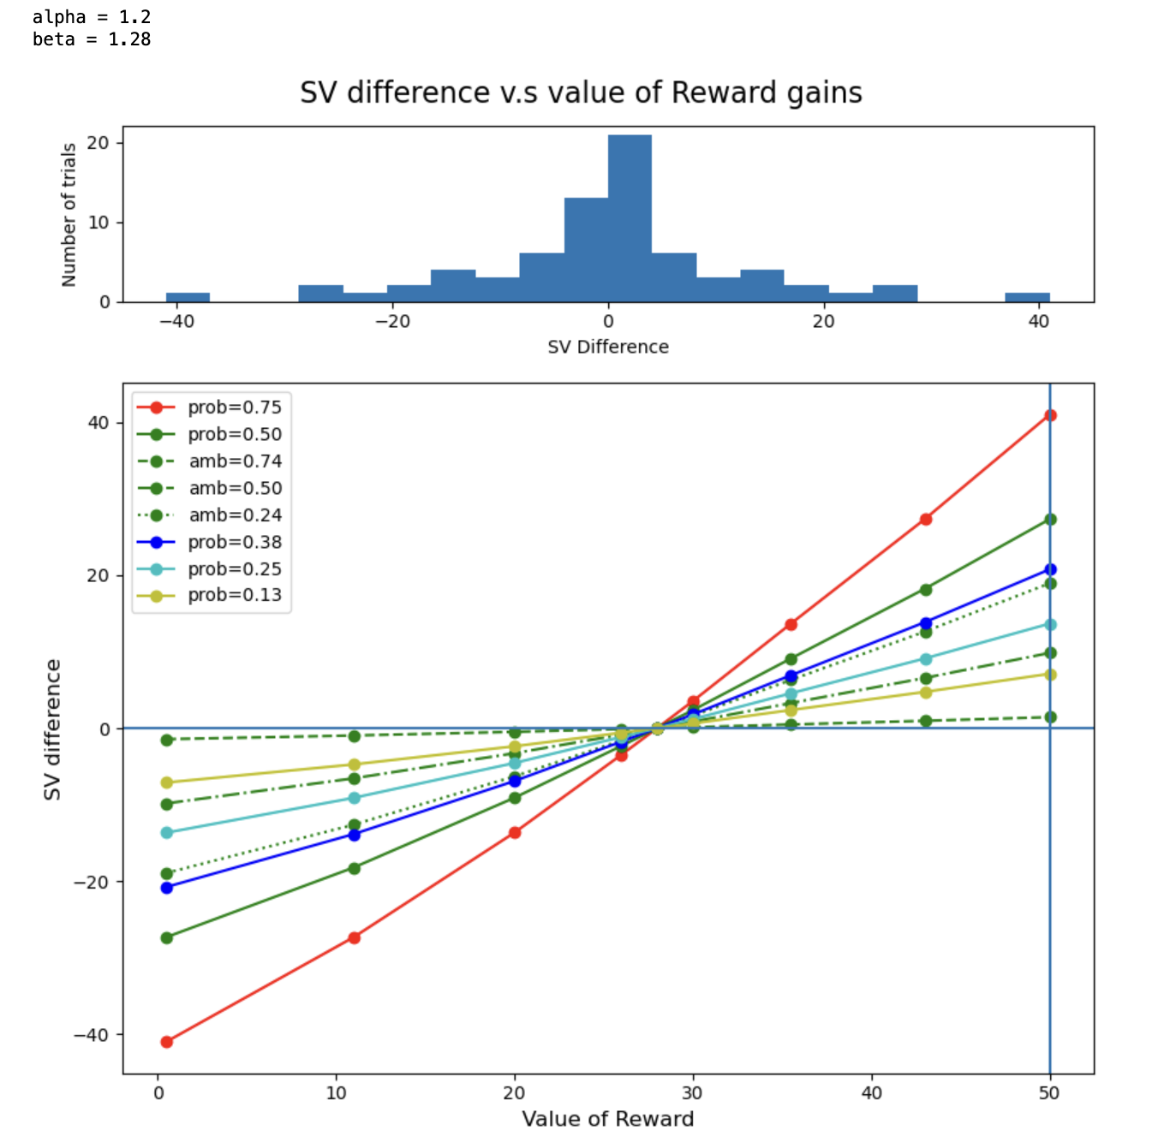
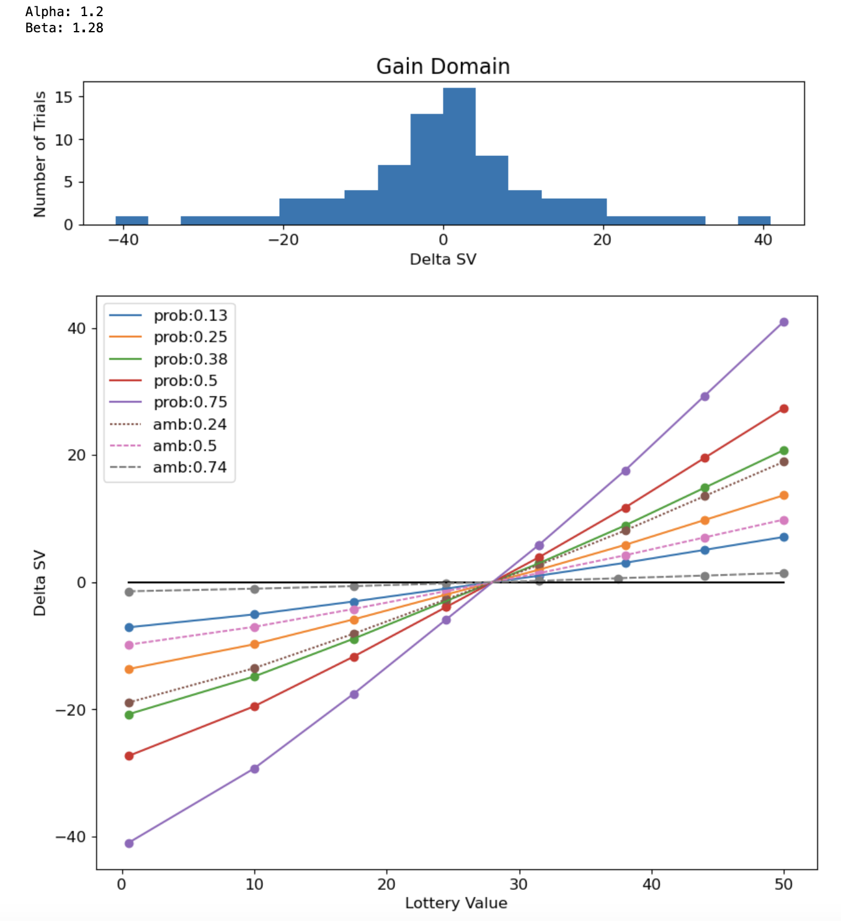
Original Python CRDM Trial Distribution
JavaScript Implementation

Slide 4
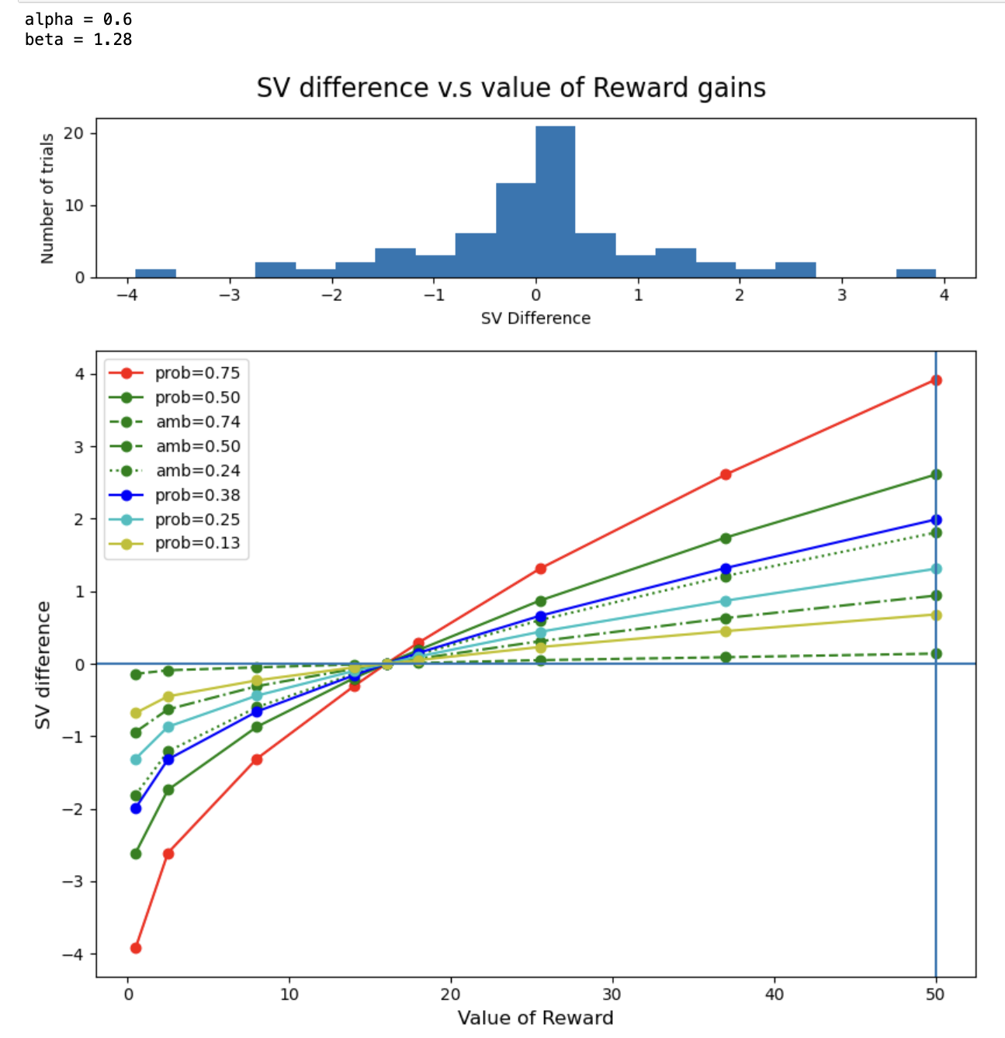
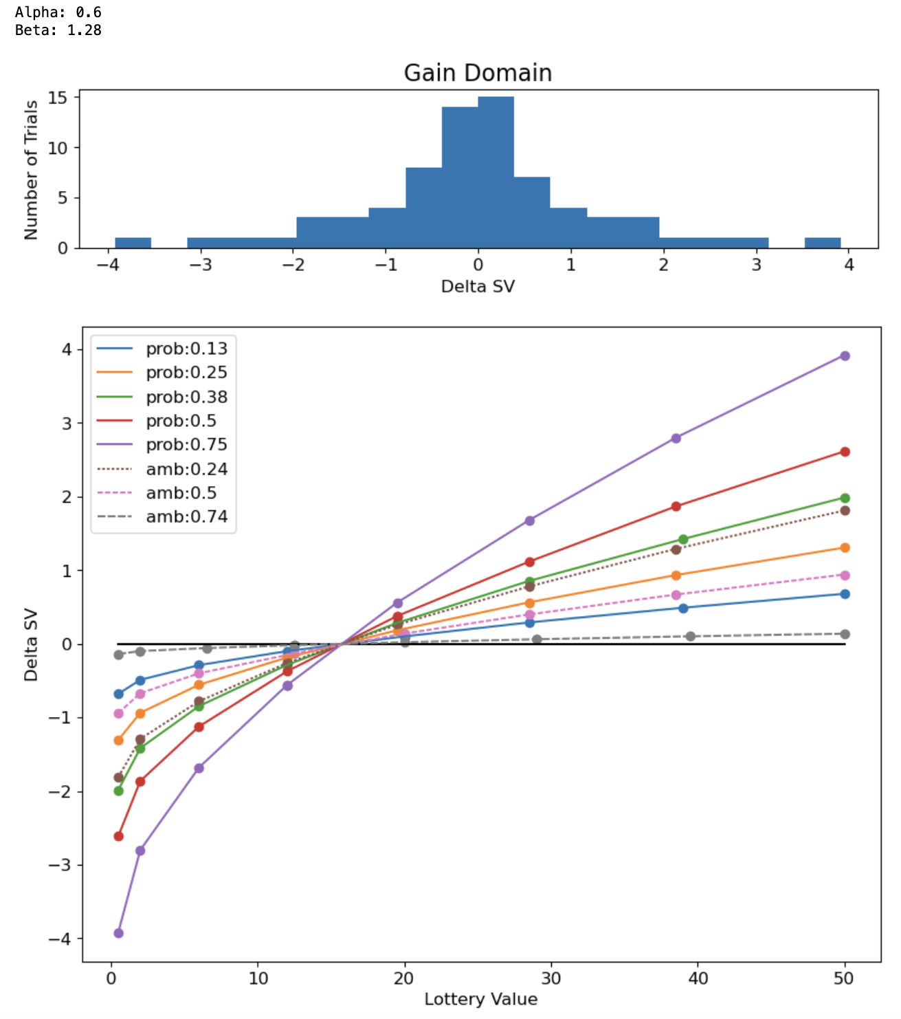
Original Python CRDM Trial Distribution
JavaScript Implementation

Slide 5
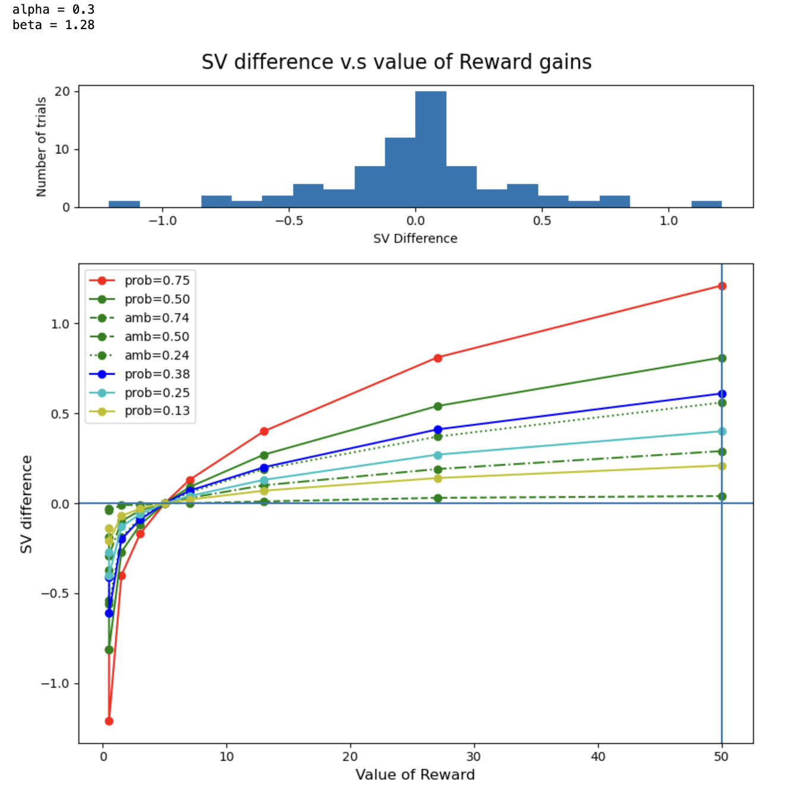
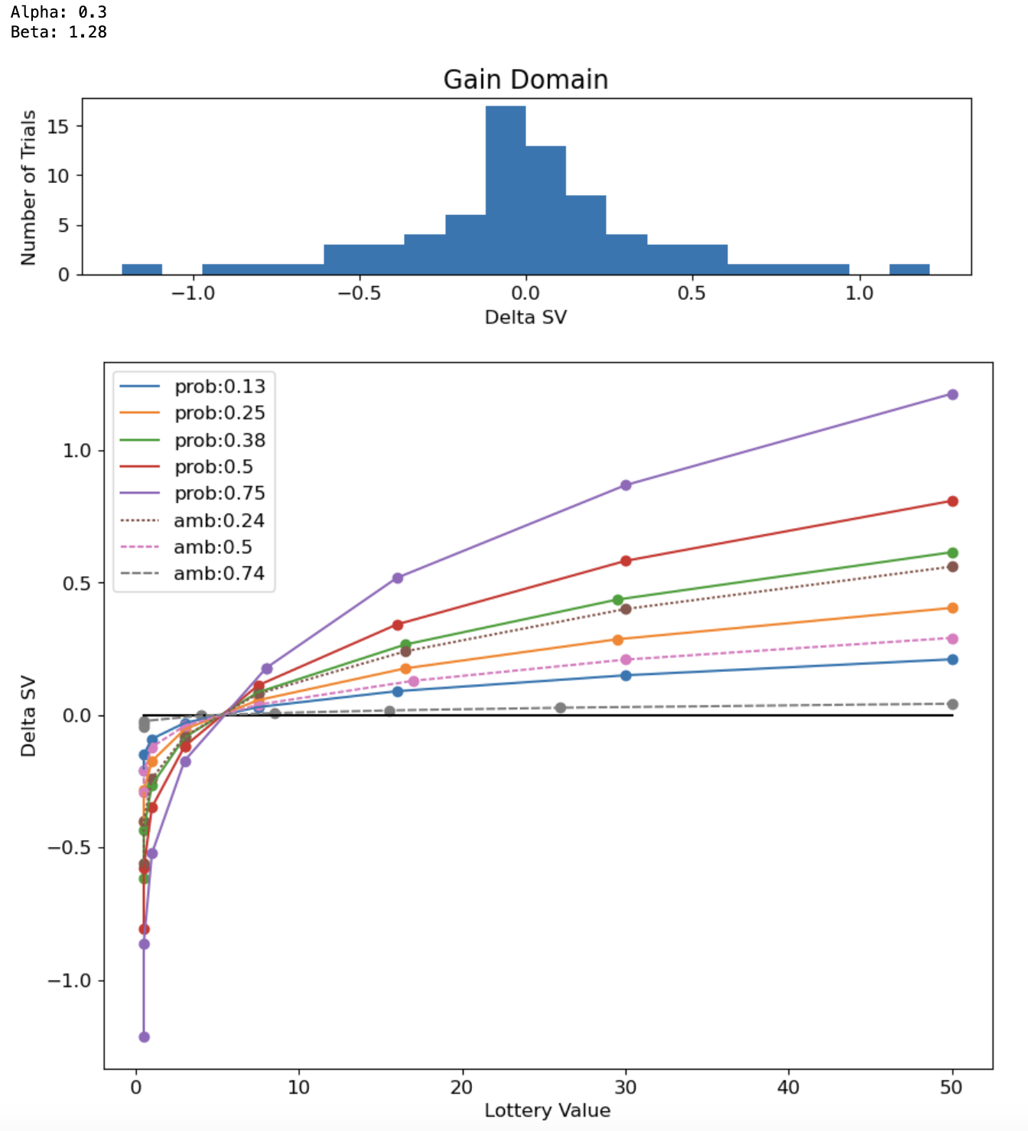
Original Python CRDM Trial Distribution
JavaScript Implementation

Slide 6
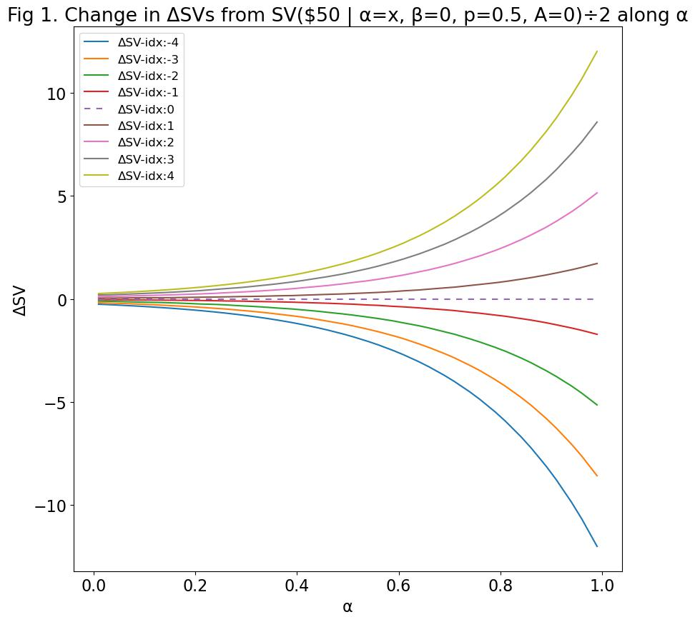
Figure 1. As alpha decreases, DeltaSV space becomes more compressed.
Each line represents a trial “category” or “step” relative to its position from DeltaSV = 0.

Slide 7
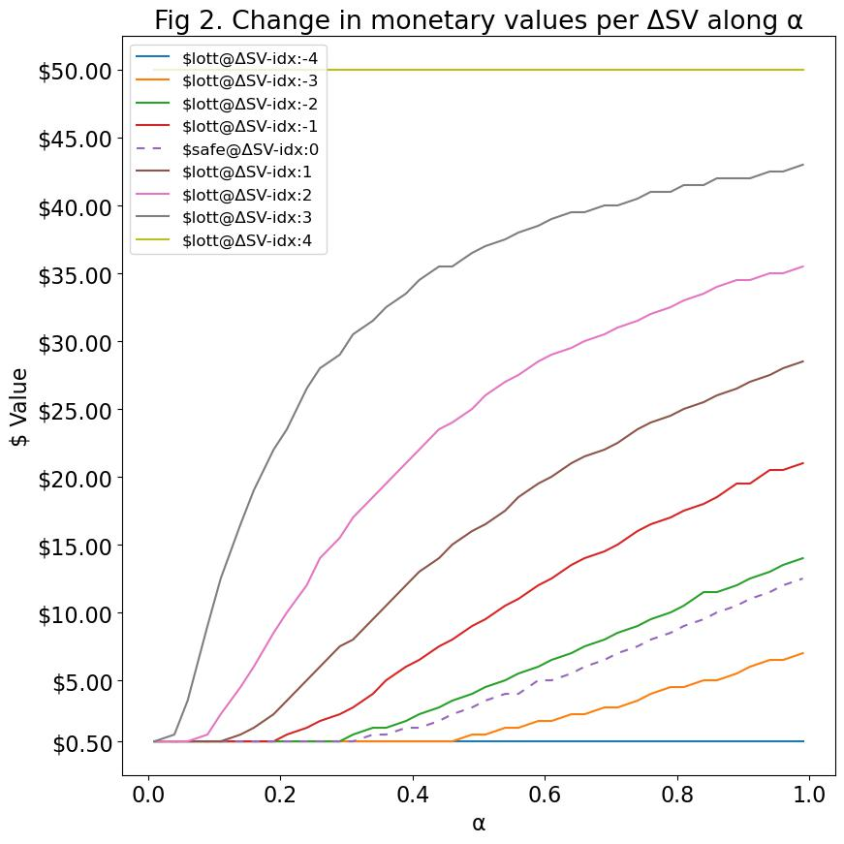
Figure 2
As alpha decreases, more DeltaSV values will produce $0.50 for both safe and lottery options.
This is because -with low alpha- the SV_half is so low that any change within this compressed DeltaSV space will be rounded up to $0.50 when translated into money space (w/ exception of SV_Max).
As alpha increases past ~0.6, differences in safe and lottery money values become discernible.
However, even when alpha exceeds 0.6 and beyond, DeltaSV indices -3 and -4 will always produce money values for lottery jackpot that are lower than the safe option (beta = 0, ambiguity = 0).

Slide 8
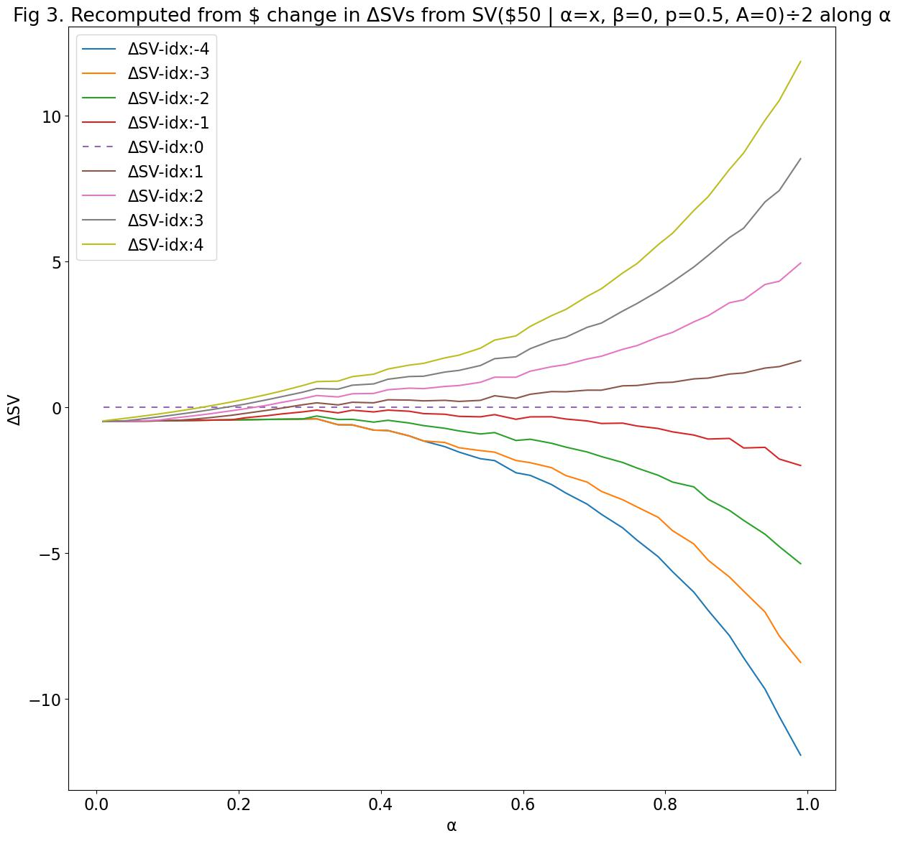
Figure 3. Rounding monetary values to $0.50, while necessary, leads to exacerbated problems with low alpha.
True SVs are based on the money values we actually present per trial. When we recompute the SV from rounded monetary values, unusual things happen.
Because of the difference in probability value when computing SV for lottery money value compared to safe money value, at low alpha, the lottery SV *even for SV_Max* will be lower than the safe SV after rounding.

Slide 9
TR; DR
Low alpha --> SV range compression (alpha's fault)
Rounding to $0.50 --> money range compression (rounding's fault)
Calculating true SV for rounded money --> insanely inflates safe SV relative to initial compressed SV scale such that true safe SV (p=1) exceeds SV_Max (p=0.5) (probability's fault)

Slide 10
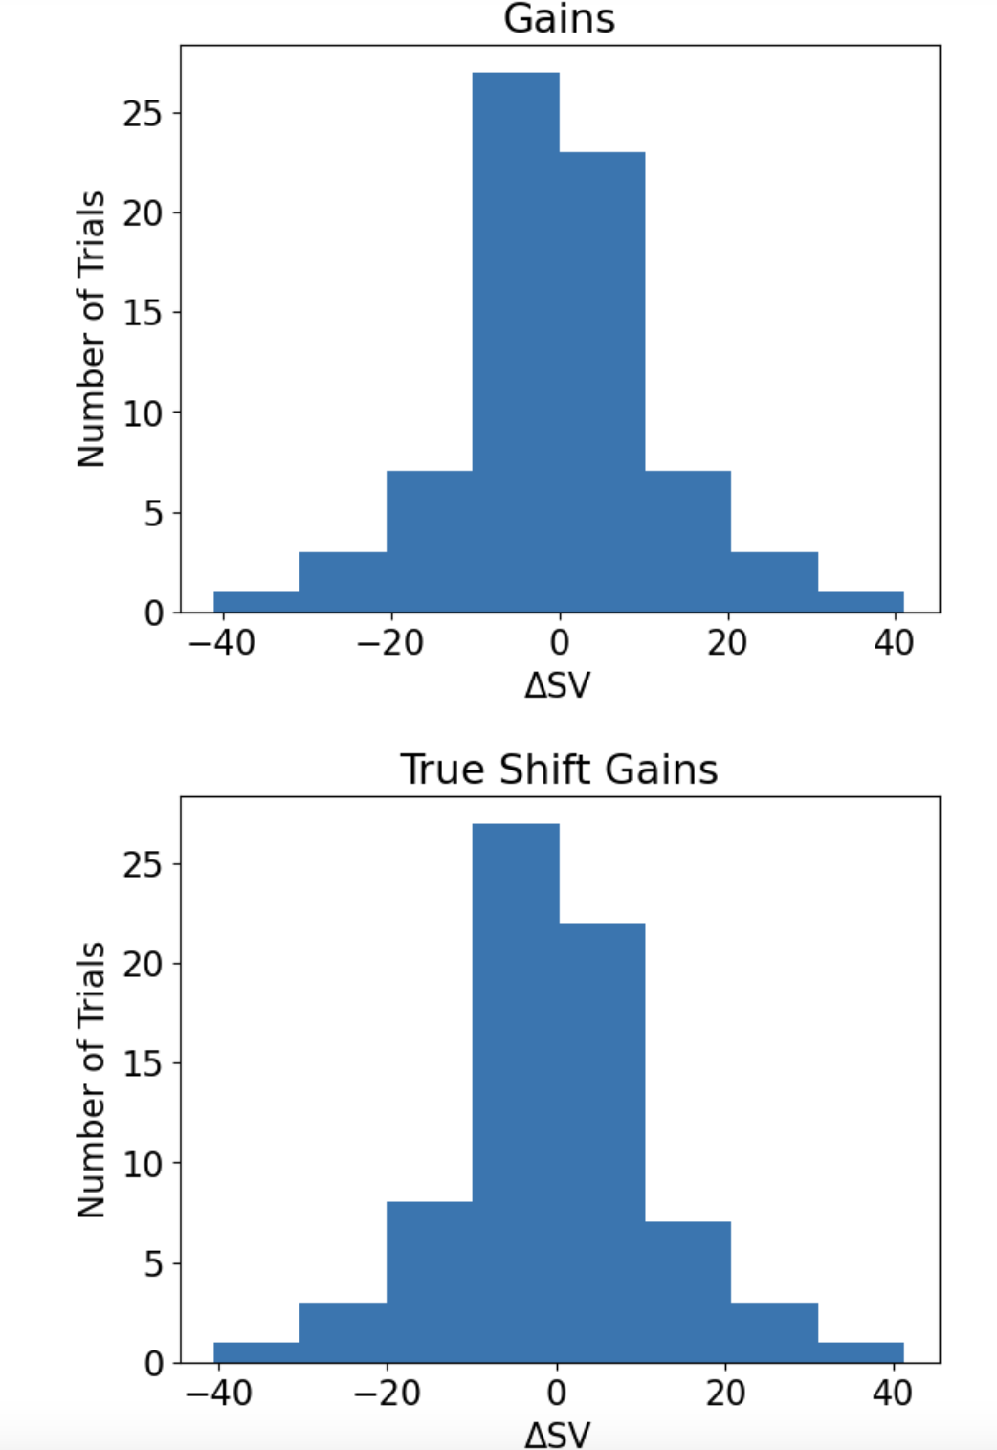
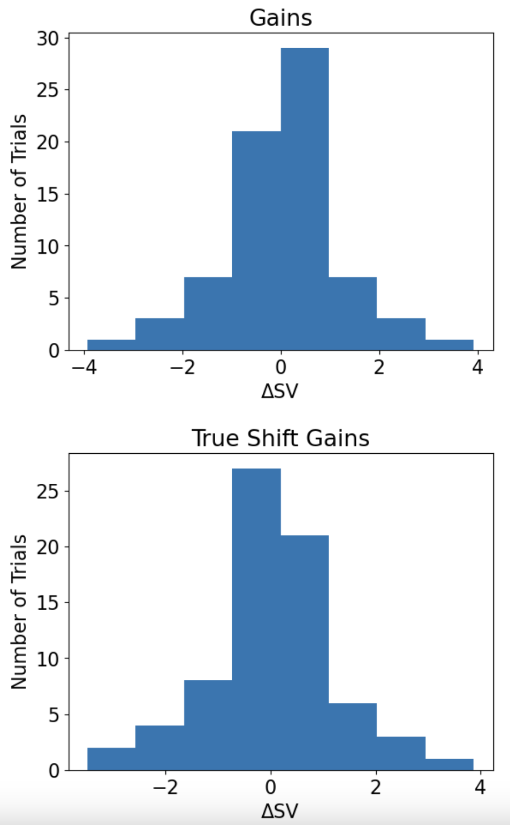
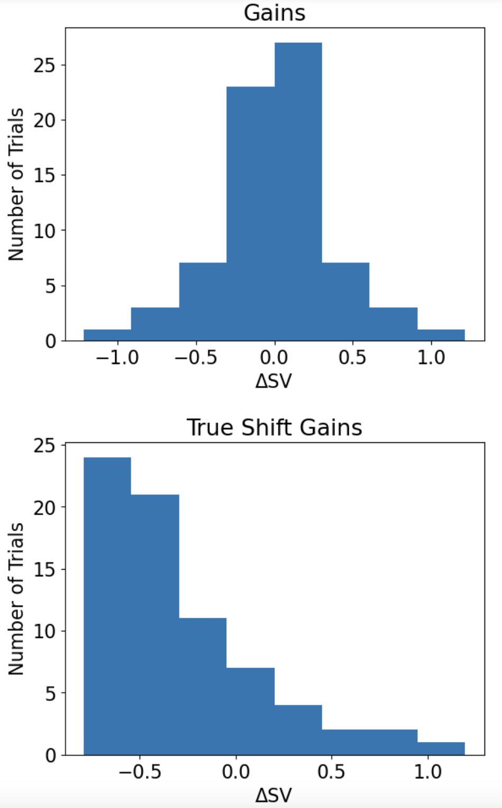
Alpha = 1.2
Alpha = 0.6
Alpha = 0.3

Slide 11
Subjective Value for Risk & Ambiguity: Reformulation Attempt #1

Slide 12
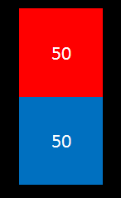
Parameter Definitions
Probability
Likelihood of a winning outcome
Alpha (risk tolerance) – range (0,∞)
⍺ < 1
Risk averse
⍺ = 1
Risk neutral
⍺ > 1
Risk seeking

Slide 13
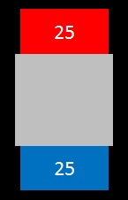
Parameter Definitions
Ambiguity
Proportion of lottery that is obscured
Beta (ambiguity tolerance) – range [0,1]
β = 0
Ambiguity averse
β = 0.5
Ambiguity neutral
β = 1
Ambiguity seeking

Slide 14
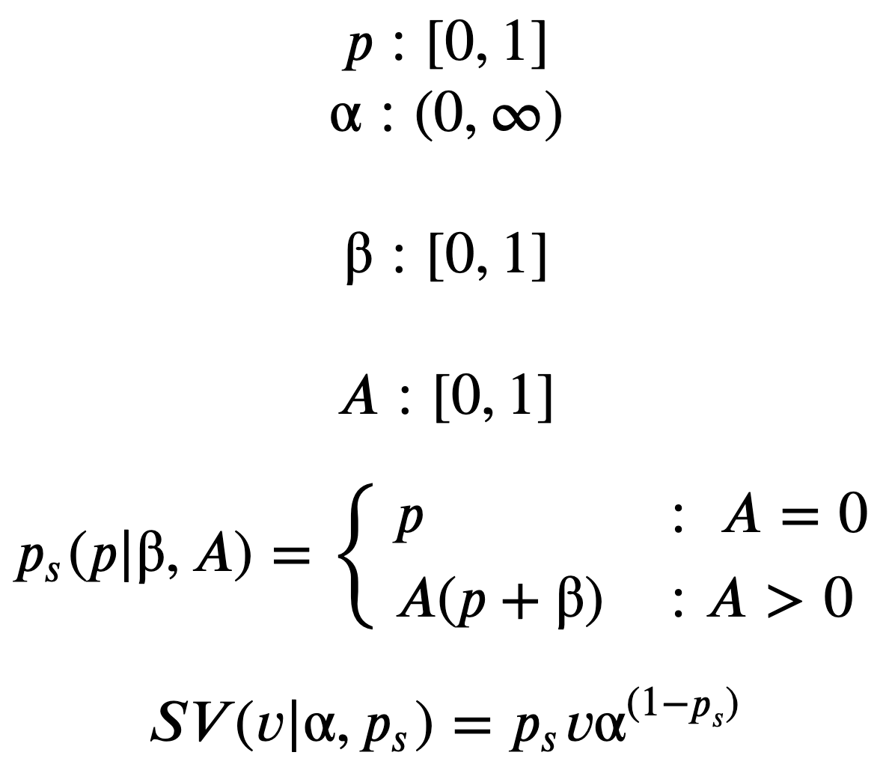
Gilboa & Schmeidler, 1989:
“Subjective Probability” Redefined
Probability, given alpha and beta:
If ambiguity = 0
SP = objective prob
If ambiguity > 0
SP = amb(objective prob + beta)
Subjective Value for Risk & Ambiguity Redefined
SV of value, given alpha and subjective prob:
SV = subjective prob of win*value*alpha^{(subjective prob of lose)}
No “funny business” of alpha sending value into the negative at low probabilities (i.e., p = 0.13)
Logic
The greater the chance of failure, the more emphasis given to alpha
At low probability of winning, alpha is more influential on SV
Low alpha diminishes SV
High alpha inflates SV
Reformulation Attempt #1:

Slide 15
Reformulation #1: Generating trial schedule while minimizing compression
For each probability and ambiguity:
Calculate SV_Max using $50 as value_max
Generate 10 SVs from 0 to SV_Max
Cut off first SV (0)
Take second SV as safe_value
Convert remaining 8 SVs into lottery money space
SV_Half = mean of 8 SVs used for lottery range
SV_Half serves as DeltaSV = 0

Slide 16
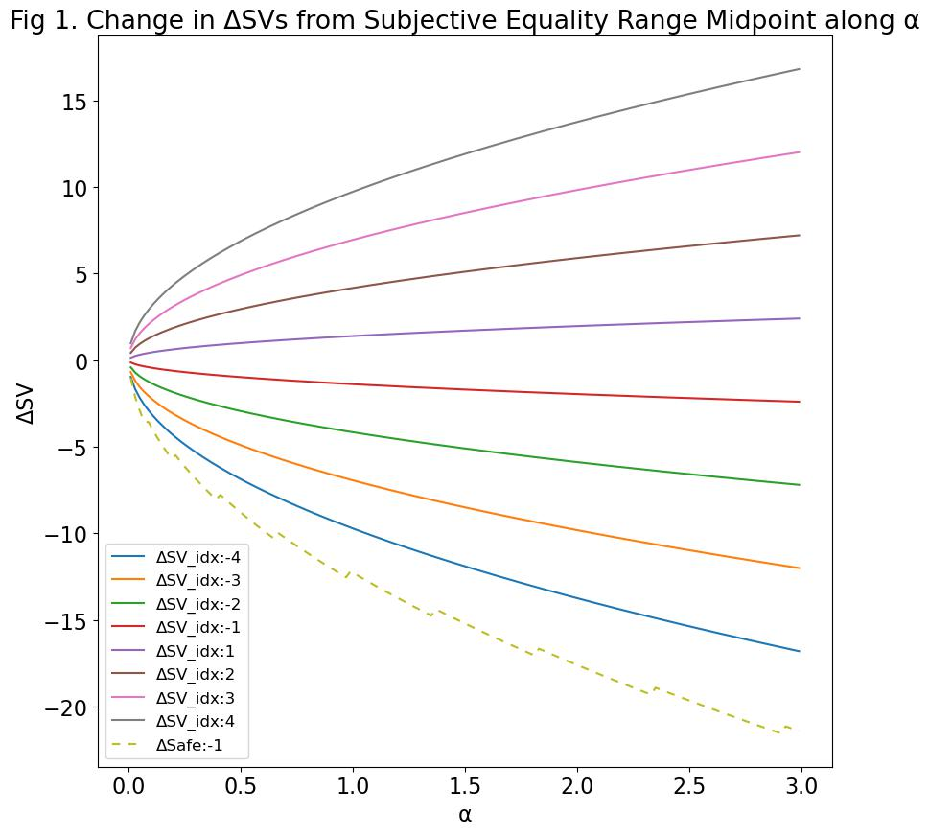
Issue 1: Effects of extreme values of alpha
Original Method
Reformulated Method #1

Slide 17
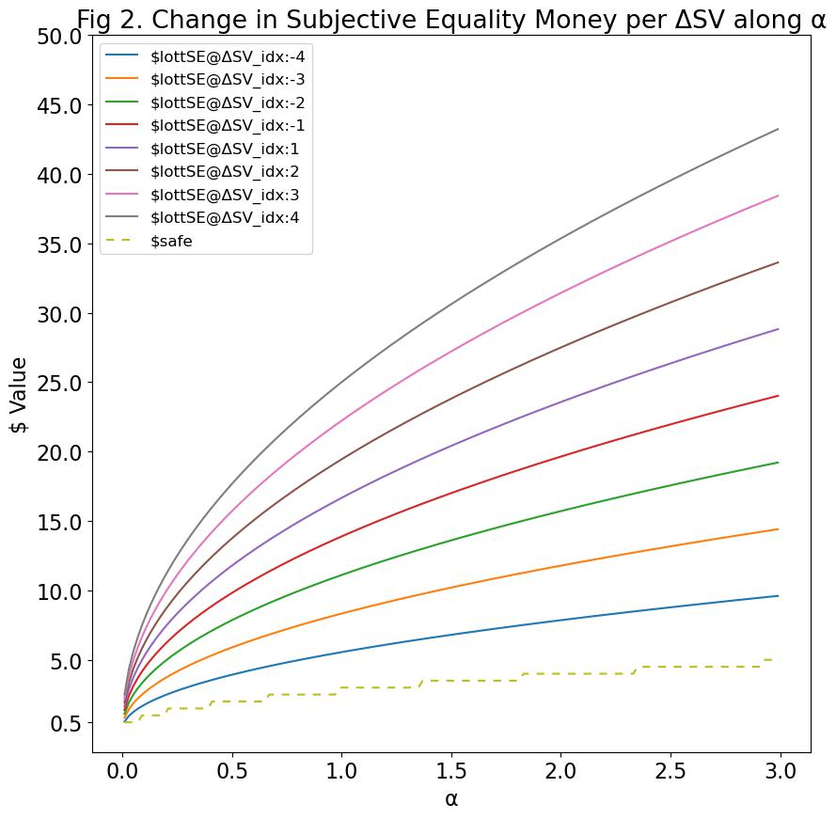
Issue 2: Low alpha causing more
Original Method
Reformulated Method #1

Slide 18
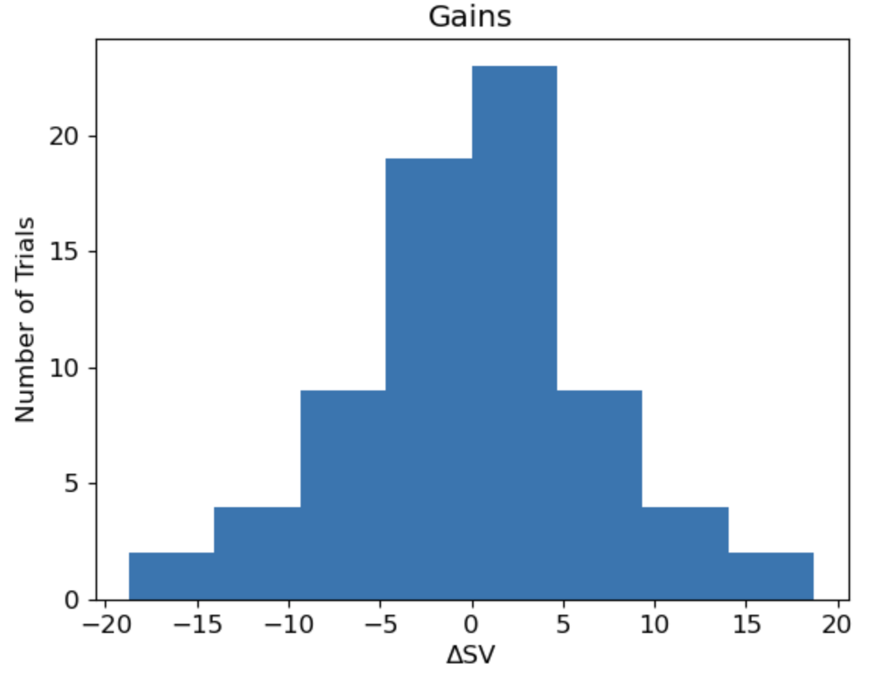
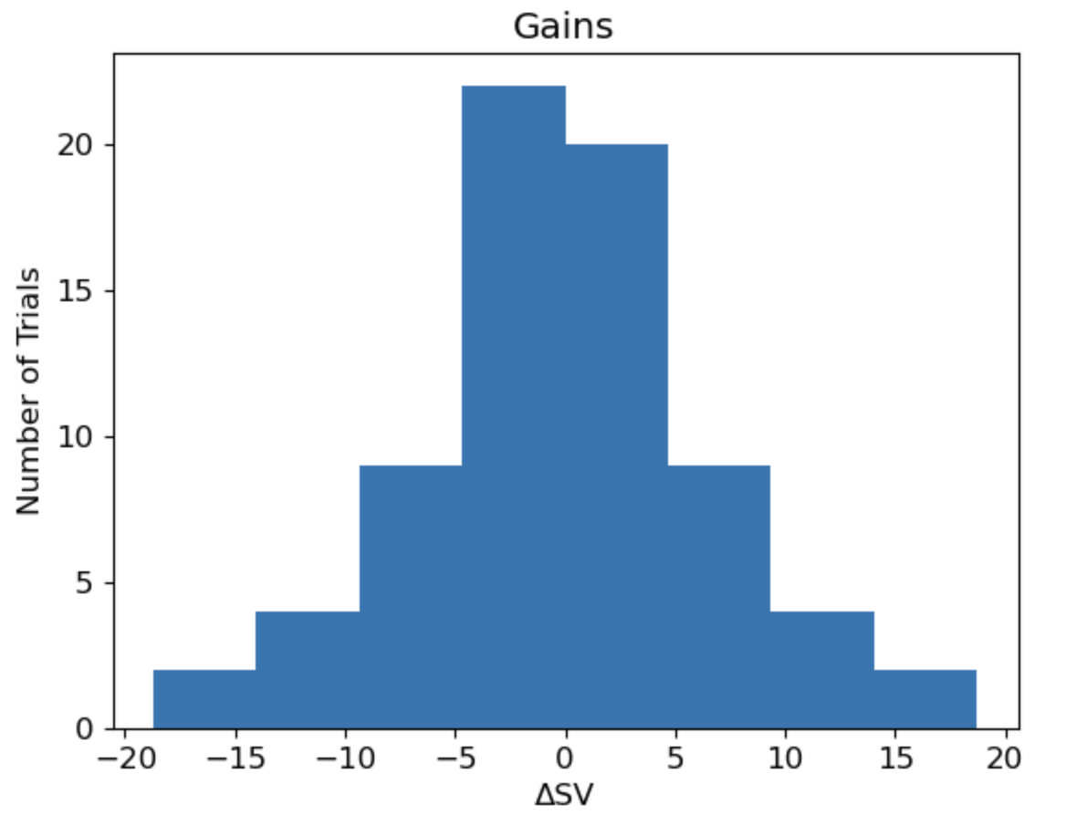
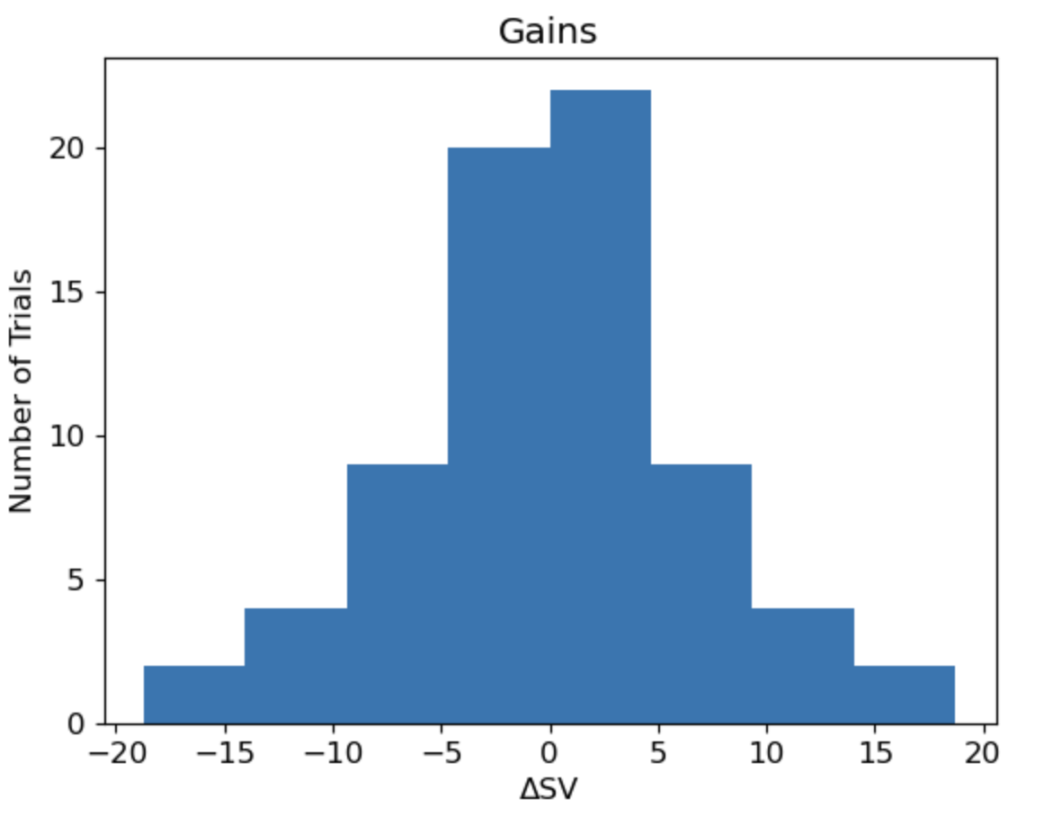
Alpha = 1.2
Alpha = 0.6
Alpha = 0.3

