Slide 1
Lottery Task
This is one of the decision making tasks you are asked to do today. All the choices you will make in this game are HYPOTHETICAL, but we ask you that you pretend that they are for real. To continue press “ENTER".

Slide 2
In this task, you will be asked to make choices. In the ”gain” portion of the task, each question will ask you to choose between taking $5 or playing a lottery for a chance to earn another amount.
In the ”loss” portion of the task, each question will ask you to choose between losing $5 or playing a lottery for a chance to lose another amount.

Slide 3
Understanding lottery display

Slide 4
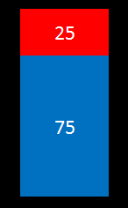
This is what the “lottery” will look like.
$0
$20

Slide 5
Each lottery is actually a bag with 100 poker chips (some red and some blue).
The size of the red and blue parts and the numbers written inside them tell you how many red and blue chips are in the bag.
In this bag most chips are blue (75 out of 100) and fewer are red (25 out of 100).
$0
# of chips in
this bag
$20

Slide 6
If you put your hand in this bag and pull out one chip at random, you would be more likely to get a blue chip than a red chip since there are more blue chips than red chips.
We call the process of putting your hand in the bag and pulling out a chip “playing the lottery”.
$0
# of chips in
this bag
$20

Slide 7
Why should you care which color chip you pull out?
Because each chip is worth some (hypothetical) money.
You know how much each chip is worth by the dollar amount next to each color.
If you chose to play this lottery and pulled out a blue chip, you get $20. If you pulled out a red chip you get $0.
$0
amount of $ you could win
$20

Slide 8
For each lottery, one color will be worth $0 and the other color will be worth more.
Half the time blue will be worth more and the other half the time red will be worth more.
$0
$20
$20
$0

Slide 9
For each lottery, one color will be worth $0 and the other color will be worth more.
But the color associated with the non $0 outcome changes from trial to trial
$0
$20
$20
$0

Slide 10
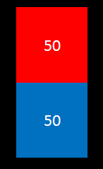
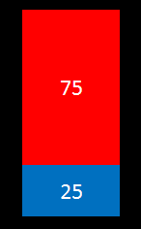
These are examples of lotteries that you could see
more red chips
more blue chips

Slide 11
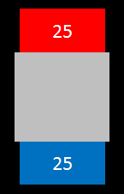
You will also see lotteries like this one. Here, part of the bag is hidden, so you only have partial information about how many of the 100 chips are red and how many are blue.
In this example, you can see that there are at least 25 blue chips and at least 25 red chips. The remaining 50 chips could be all red, all blue or any combination of red and blue.
$0
amount of hidden chips
$20

Slide 12
There could be many possible combinations of red and blue chips in the hidden part.
But the number of chips in these bags is fixed. It will not change during the experiment.
$0
amount of hidden chips
$20

Slide 13
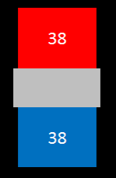

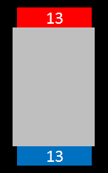
These are examples of lotteries with hidden chips you could see
more hidden chips

Slide 14
Every lottery in the task is linked to a real bag.
We have shown you some examples.
The bags will be in the room during the experiment and will not be touched.
If you wish, you can inspect the content of each bag after all study visits have been completed.

Slide 15
Understanding the task

Slide 16
You will answer many questions. Each question will ask you to choose between a certain gain (or loss) of $5 or playing the lottery. The lottery bag and the amount of money you could win (or lose) will be different for each question.
Your options will be presented this way:

Slide 17
$0
$5
$20

Slide 18
We ask that you think about which outcome you truly prefer on each trial (the certain outcome or you want to play the lottery) and pretend that at the end we will randomly choose one of your choices and play it out for real. In this case we will use toy money but please pretend it’s real!
This means you should always choose the option you prefer.

Slide 19
You will start the task with an automatic $50 “endowment”. Your bonus will be added to or subtracted from that amount.
At the end of the task, you will select which question counts by picking a number from 1 to 160 from the “Trials” bag.
If in the selected question you chose the certain gain of $5, you will receive $5 as your bonus. If you selected the lottery, you will play the lottery that was offered (by pulling out one chip).

Slide 20
If in the selected question you chose the certain loss of $5, you will lose $5 from your endowment. If you selected the lottery, you will play the lottery that was offered (by pulling out one chip).
If you did not make a choice or miss too many choices you risk losing your endowment.

Slide 21
Questions?

Slide 22
Suppose this question was randomly selected at the end and you chose the option on the LEFT. How much bonus would you get?
$0
$5
$34

Slide 23
Suppose this question was randomly selected at the end and you chose the option on the LEFT. How much bonus would you get?
$0
$5
$34
The correct answer is: $5

Slide 24
How about if you chose the option on the RIGHT?
$0
$5
$34

Slide 25
How about if you chose the option on the RIGHT?
$0
$5
$34
The correct answer is: You will have to play this lottery to find out. If you pull out a blue chip, you get $34. If you pull out a red chip, you get $0.

Slide 26
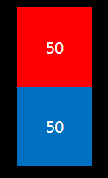
From which lottery are you more likely to pull out a blue chip? LEFT or RIGHT?
$0
-$20
-$50
$0

Slide 27
From which lottery are you more likely to pull out a blue chip? LEFT or RIGHT?
$0
-$20
-$50
$0
The correct answer is: RIGHT

Slide 28
From which lottery are you more likely to get $0? LEFT or RIGHT?
$0
$20
$50
$0

Slide 29
From which lottery are you more likely to get $0? LEFT or RIGHT?
$0
$20
$50
$0
The correct answer is: RIGHT

Slide 30

From which lottery are you more likely to pull out a red chip? LEFT or RIGHT?
$28
$12
$0
$0

Slide 31
From which lottery are you more likely to pull out a red chip? LEFT or RIGHT?
$28
$12
$0
$0
The correct answer is: RIGHT

