Slide 1
A Modest Proposal
The influence of schema valence and congruency on learning and memory

Slide 2
What’s in a Schema?
Top-down influence of higher-level information structures
Organize low-level representations in LTM
Conceptual template
Helps interpret and organize new information
Binds multiple features that repeatedly co-occur
Schema instantiation
Matching of current stimuli information to activated schema
Schema reinstatement
Activation and retention of a prototypical template representing interrelationships between co-occurring features

Slide 3
Fundamental Elements of a Schema
Complex relationships
Not unidimensional
Nonspecific
Relationships are not easily articulated (i.e. big red things, small blue things)
Reflect commonalities across multiple experiences
Requires more than one exposure
Considerable overlap and interconnectedness
Multiple schemas may share some features, but are still distinguishable

Slide 4
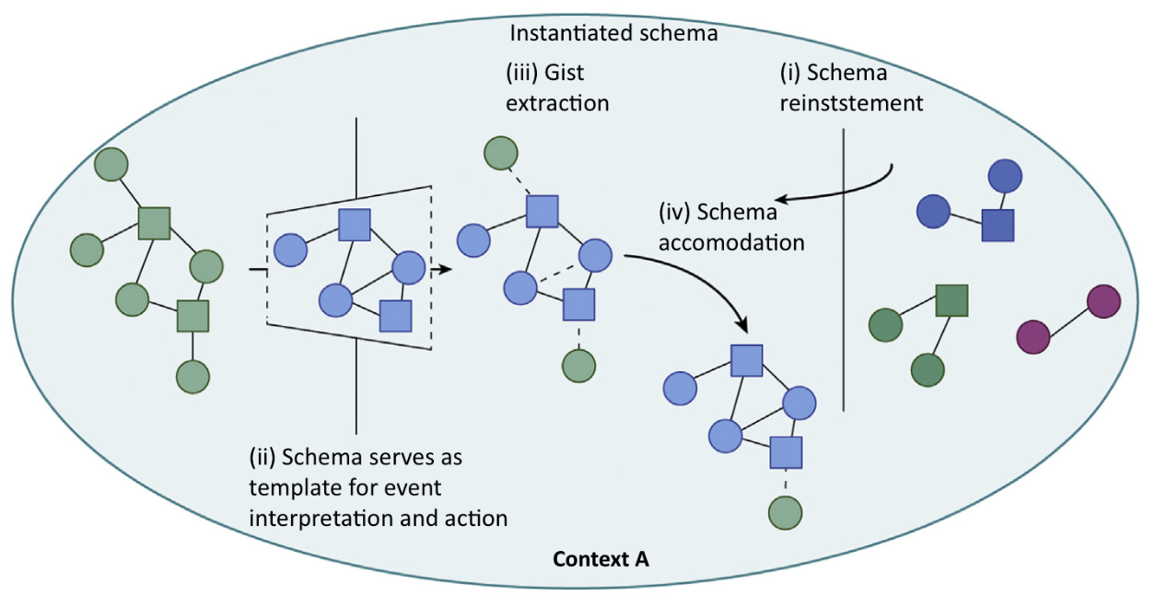
Schematic Influences: Instantiation
reinstatement
Circles → general concepts
Squares → associated action scripts
(Gilboa & Marlatte, 2017)
Notes:
Circles → general concepts
Squares → associated action scripts

Slide 5
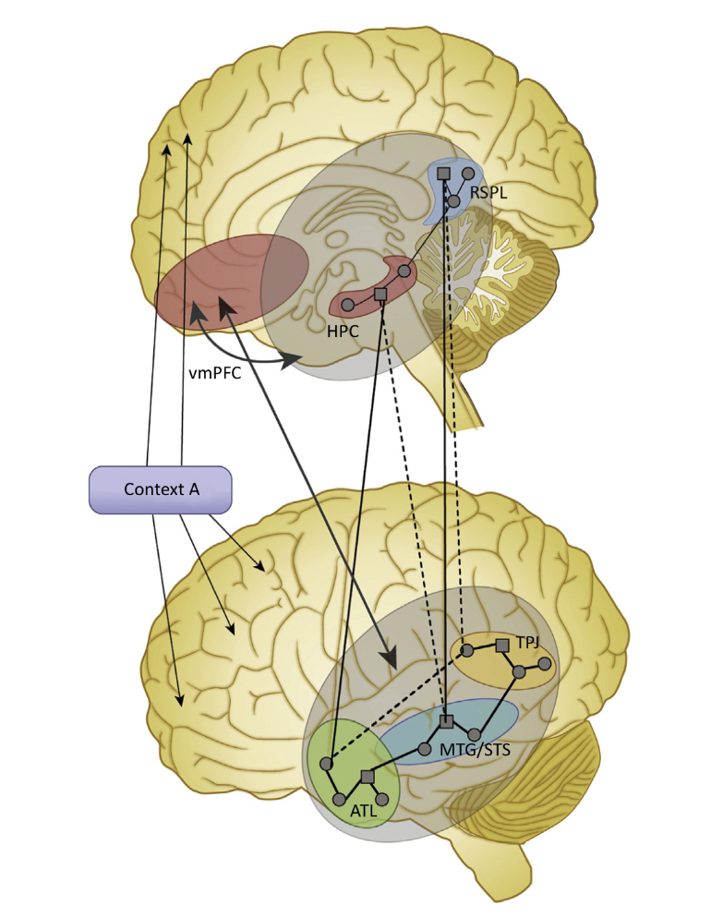
Neurobiological Mechanisms of Schemata
Ventromedial prefrontal cortex (vmPFC)
Hippocampus (HPC)
Posterior cortex
Retrosplenial cortex (RSPL)
Middle temporal gyrus (MTG)
Superior temporal sulcus (STS)
Anterior temporal lobe (ATL)
Temporal parietal junction (TPJ)
(Gilboa & Marlatte, 2017)
Notes:
vmPFC → bias specific associative pathways for context-relevant information
HPC → assist vmPFC during schema instantiation OR in assimilation/accommodation mechanisms
RSPL →
MTG →
ATL → retrieval of supramodal complex knowledge (semantic); integration of single concept into larger wholes
TPJ →

Slide 6
How do the nature of previously acquired schemas influence new learning?
Research Questions

Slide 7
Complex questions about the nature and strength of schematic influence
Is there a difference in schema influence when acquired under positive or negative feedback?
Valence
Does congruency of new information to acquired schemas influence the accuracy and rate of learning?
Congruence
Might valence or congruency moderate the effect of the other on accuracy and/or rate of learning?
Interaction between valence and congruency

Slide 8
Building an Interesting and Informative Experimental Design
The Methodological Details

Slide 9
Acquisition of Schemas (initial learning)
10 exemplars each for each schema group (20 total)
Creature Schema A
Optimal Choice (pet)
80% cute noise
20% no response
Suboptimal Choice (feed)
80% no response
20% cute noise
Creature Schema B
Optimal Choice (feed)
80% no response
20% growl
Suboptimal Choice (pet)
80% growl
20% no response
Continued performance until criterion of last 5 of 6 correct

Slide 10
Relearning of Schemas (reversal learning)
Schema-defining relationships are reversed
Concept relationships for Creature Type A ←→ Creature Type B
Only novel creatures are presented
New creatures vary in the degree of congruency/incongruency to their respective schemas
Continuous metric of similarity

Slide 11
General Overview: Variables of Interest
Independent/Predictor Variable
Categorical
Valence
Continuous
Degree of congruence/incongruence to schema
Dependent/Criterion Variables
Continuous
Accuracy
Rate of learning

Slide 12
Operationalization of Schemas
Step 1: Determine schema classes (concepts)
Step 2: Select method of quantifying subcomponents
Step 3: Determine relationships between for each schema
Step 4: Create several schema exemplars
Step 5: Creation of the “The One” for each schema

Slide 13
Step 1: What dimensions define each schema?
Appearance
Size
Color
Shape
Behavior
Movement
Vocalizations

Slide 14
Step 2: Quantification of Concept Levels
Dichotomous variation (2 levels) → not enough complexity
Small vs. Large
Black vs. White
Range of variation (3, 5, or 10 levels) → moderate complexity **Best
Range within a single color
Range of size
Continuous variation (~100 possible levels) → impossible complexity
Random RGB values for unlimited number of colors
Movement speed across animations
0 - 100

Slide 15
Step 3: Defining Schema Classification
Determine the relationships between concepts that define schema classification:
Color
Shape
Movement
Schemas must involve multiple features, be non-specific, and contain overlap and interconnections
Must be distinguished from statistical learning
Avoid unidimensional stimuli with relationships to simple motor responses

Slide 16
Step 4: Schema Exemplars
Create ten (10) exemplars for each schema class
Considering established concept relationships for each schema
Exemplars must be sufficiently varied within the parameters of the class

Slide 17
Step 5: ”The One” for Each Schema
Statistical average of all schema exemplars to produce “The One” for each schema class
Each concept (dimension) would be averaged individually
Creation of a pseudo-continuous manipulation metric for creature production (congruency with “The One”)
Cosine similarity vector function
Allows comparison across features that may not share a common metric
Similarity vs. dissimilarity will be determined for each new creature based on its relative orientation/distance from “The One”

Slide 18
Possible Neurobiological Mechanisms & Hypotheses
What do we expect?

Slide 19
Schema-linked interactions between mPFC and MTL model (SLIMM)
mPFC signals congruency between existing schema and current information (resonance)
Increased resonance signals the transfer from MTL to vmPFC memory processes
vmPFC activates relevant, while suppressing irrelevant, schema to assist mnemonic processing
If congruency is found between schema and current experience, vmPFC inhibits MTL from binding new arbitrary information (prevents noise)
Notes:
Definition of the interplay between HPC and mPFC
Well-established, rich schemas

Slide 20
Bidirectional Communication Between the Hippocampus & mPFC model
HPC creates hierarchical representation of overlaps and distinctions
Pattern separation
Pattern completion
Context-defining info is forwarded to the mPFC where “rules” are produced
Rules are then reactivated when the same conditions are experienced and relevant info is forwarded from HPC to the mPFC
Notes:
Joint contributions of both HPC and mPFC

Slide 21
What do we expect to see in our experiment?
Valence
Negative schema examples will be slower and more difficult to relearn
More preservation errors for relearning Creature Type B compared to Type A
Congruency
Instances of creatures with greater similarity to schema will be more easily and quickly learned
Interaction Effects
New instances of creatures who are strongly similar to the negative schema will be harder to learn early on, but more consistently in later learning

