Slide 1


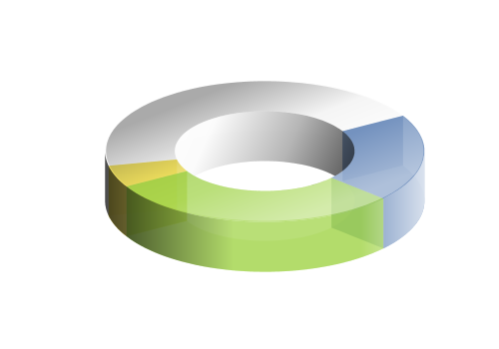
@JenSoftAPI

Slide 2
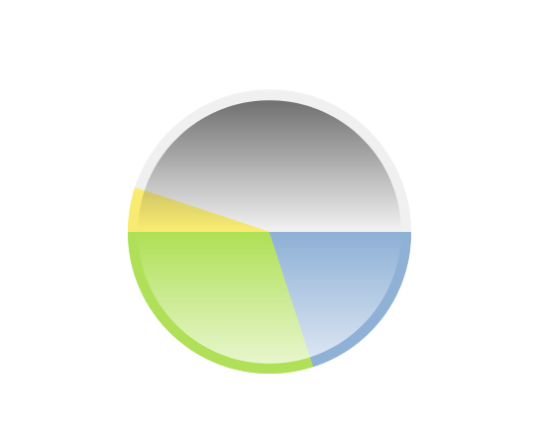
API
Pure Java Charting Framework
Clear design View-Window-Plugin
Desktop or Web
X2D
JenScript

Slide 3

Uniform Design
View2D
Window2D
Plugin
Widget

Slide 4
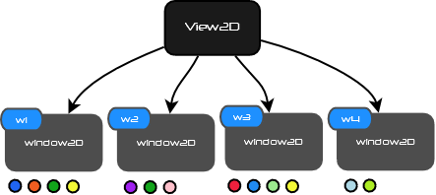
Hierarchy

Slide 5








Rich Composition

Slide 6
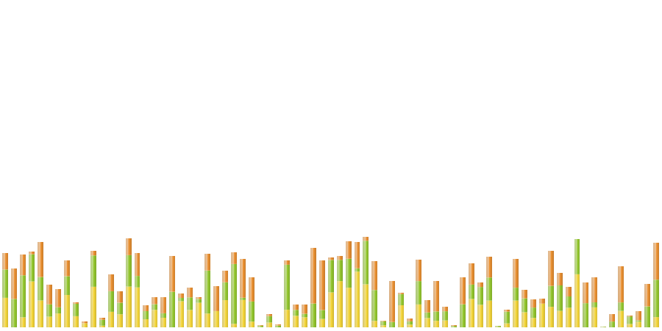
View2D Chart
Visible Chart
View2D hosts windows projection

Slide 7
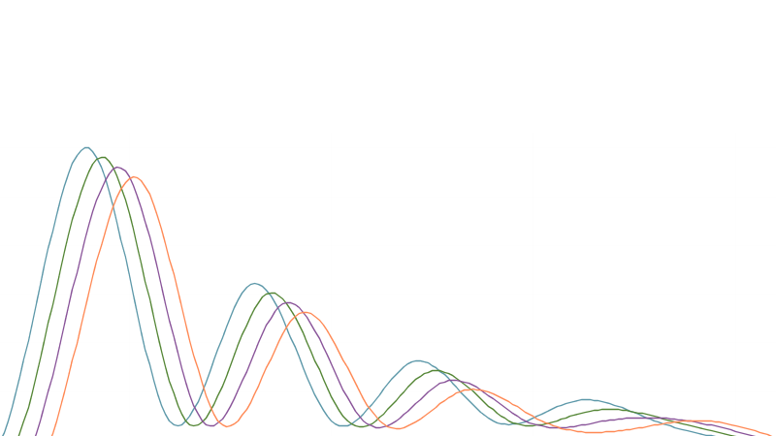
Window2D Projection
User Projection Linear, Log, Map
Hosts Plugins

Slide 8
Plugin is everything
Takes business responsibility
Paint each view parts
Event Listening
Context
Widget

Slide 9
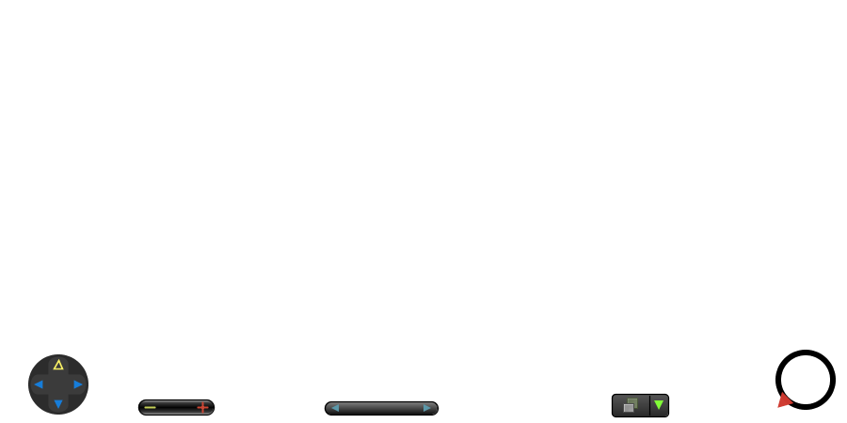
Widget
Process user action for parent plugin
User Interaction

Slide 10
Veteran Tutorial

Slide 11
API Intro

Slide 12
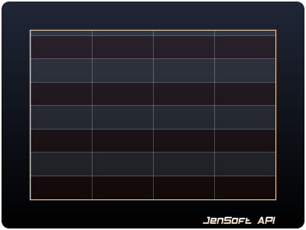
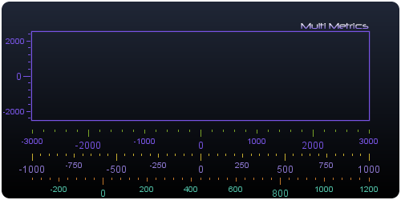
Common Plugins
Outline
Legend
Grid
Stripe
Metrics

Slide 13
Polar Type Plugins
Pie
Donut2D
Donut3D
Radar

Slide 14
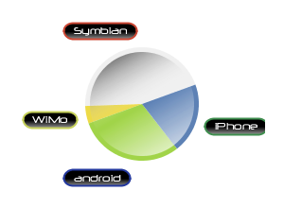
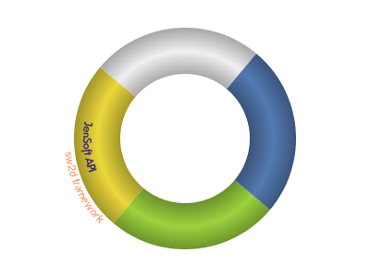
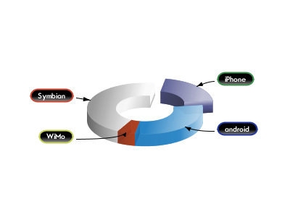
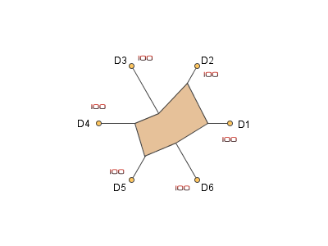
Polar Type Plugins

Slide 15
Symbol Plugin
Bar Symbol
Stacked Bar Symbol
Point Symbol
Curve Symbol

Slide 16
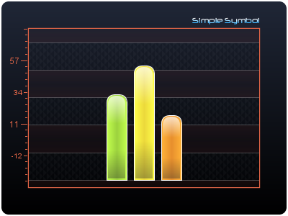
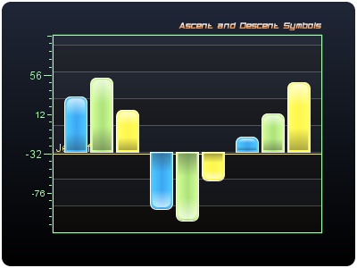
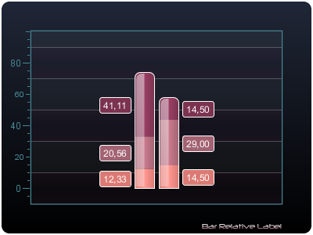
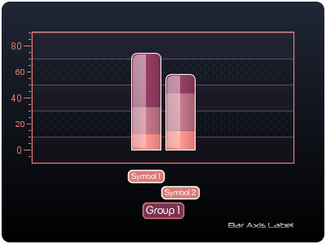
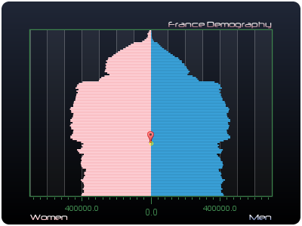
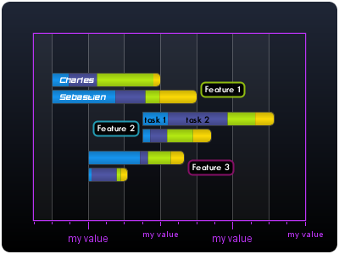
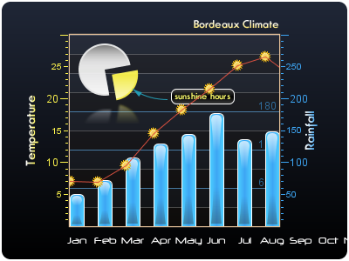
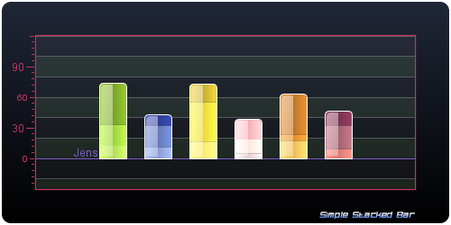
Symbol Plugin Samples

Slide 17
Curve Plugin
Curve Plugin
Area Plugin
Scatter Plugin
Serie
Tracker Plugins

Slide 18
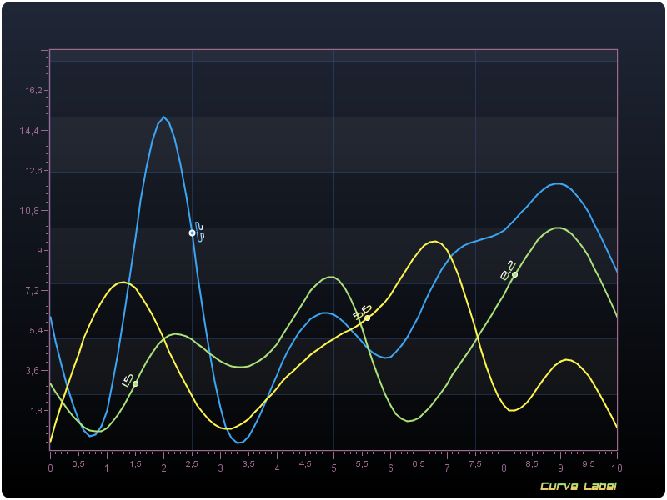
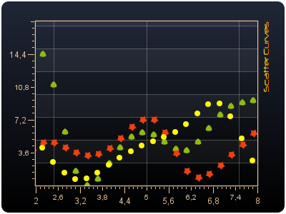
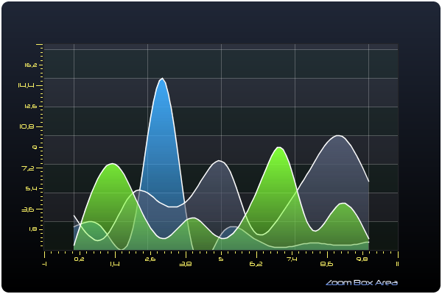
Curve Plugins Samples

Slide 19
Ray Plugin
Ray, Stacked Ray
Ray nature, X-Ray
XRay ray center on x, inflate on Y
XRay ray center on y, inflate on X
Thickness Projection Pixel or User

Slide 20
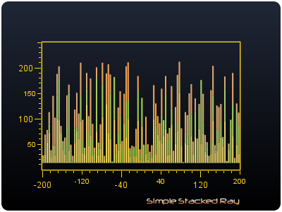
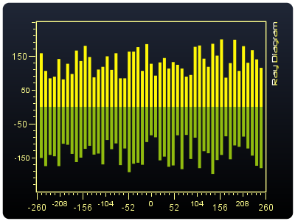
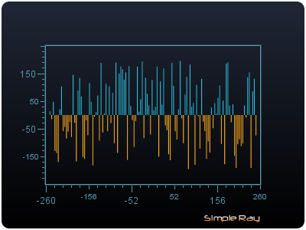
Ray Plugin Samples

Slide 21
Tools Plugins
Zoom Box
Zoom Lens
Zoom Percent
Zoom Wheel
Translate
Synchronizer
Markers
Trackers
Progress
Capture
Message

Slide 22
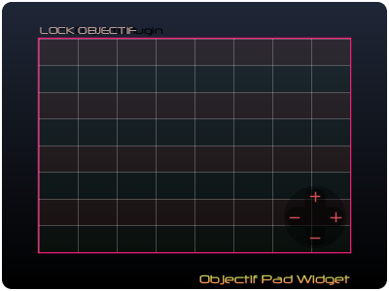
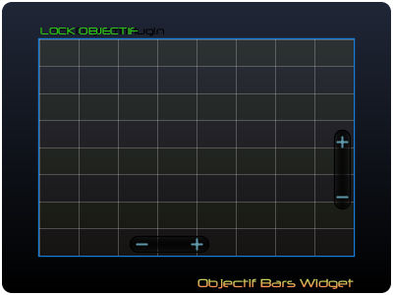
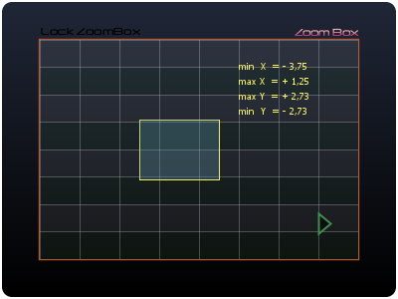
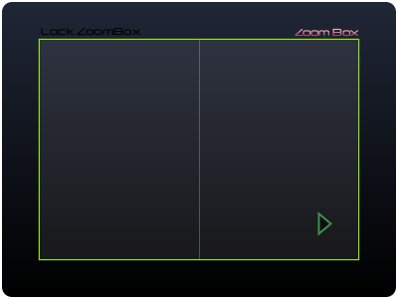
Zoom Plugins

Slide 23
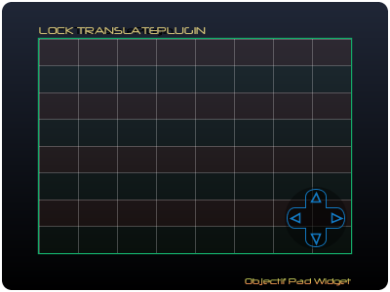
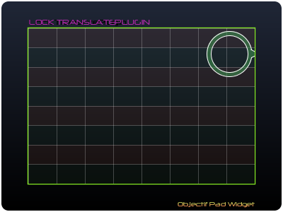
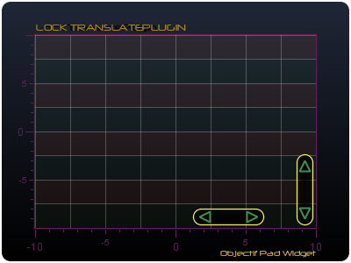
Translate Plugin

Slide 24
X2D
Lang
Schema
Inflater
Emitter
Connector

Slide 25
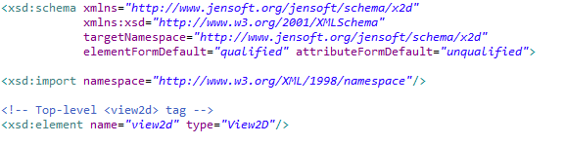
X2D Lang - Schema

Slide 26
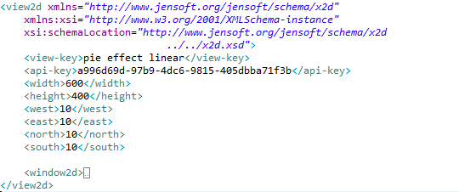
X2D Template – Part 1

Slide 27
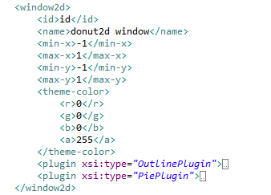
X2D Template – Part 2

Slide 28
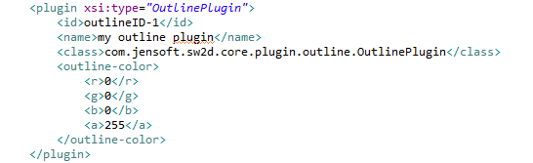
X2D Template – Part 3

Slide 29
X2D Mechanism - Goal
Inflater inflates plugin from x2d
Emitter emit view in multiple format

Slide 30



JavaScript
Browser
X2D
Server
JenScript.js
Outline.js
Pie.js
Donut2D.js
Donut3D.js
Curve.js
X2D
Inflater
Emitter
Connector

Slide 31
JavaScript - 2

Slide 32
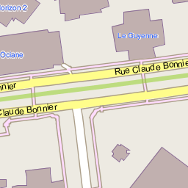
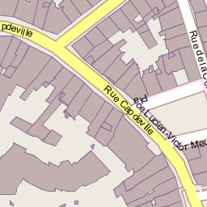
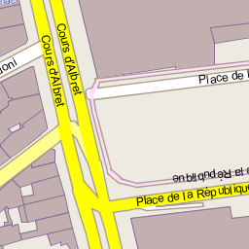
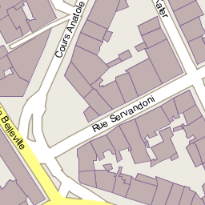
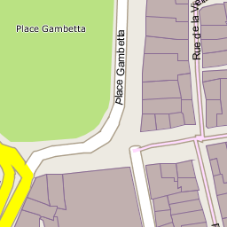
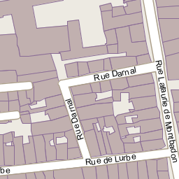
Map

Slide 33
Map
Map2D
Mercator / Tile Projection
Layers
Rendering Engine
OSM Rest Client
Tile Inflater/Deflater

Slide 34
Map objects

Slide 35
Map2D

Slide 36
Map ways lookup

Slide 37
Map rendering hints

Slide 38
Map rendering

Slide 39
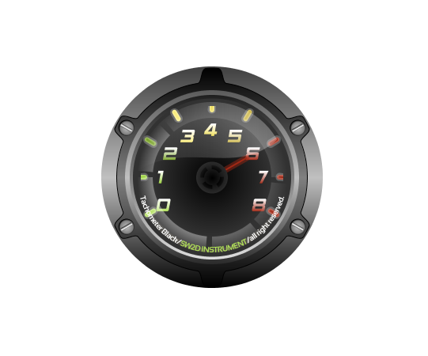
Gauge

Slide 40
2012?
Gauge

Slide 41
2012
X2D
SVG
JenScript
Plugins
Gauge
Map

Slide 42

2013

