Slide 1
Can an LLM pipeline reproduce
a published meta-analysis?
+0.099
ΔR² over the best
search-only baseline
(28 of 32 contrasts)
autonima — validation against 9 published neuroimaging meta-analyses
32 benchmark contrasts
Alejandro de la Vega · 9 September 2026
Notes:
Framing: this is a validation study, not a tool demo. The headline is the margin over a strong baseline, measured on 32 contrasts from 9 published meta-analyses.

Slide 2
The result unit lives below the paper
A meta-analysis pools contrasts, not papers. One paper contributes several — often only one of which is relevant.
Screening at the paper level is therefore not enough: you must also choose among the analyses inside each paper.
That selection step is what no existing automated tool performs, and what this pipeline is built to test.
Nothing in the field measures it, because the reference results are locked in PDFs.
FIGURE 1
pipeline + analysis-unit schematic
— to be added —
This is the claim the whole evaluation is organised around.
Notes:
Placeholder — Figure 1 is the schematic (pipeline stages, and the paper-vs-analysis distinction). Drop it in here.

Slide 3
The pipeline and the benchmark
Six LLM stages end to end, scored against the published result of each meta-analysis.
1
Search
2
Abstract screen
3
Retrieval
PubMed query
LLM, criteria from the paper
full text via pubget
4
Parsing
5
Annotation
6
Meta-analysis
coordinate tables → analyses
assign analyses to contrasts
MKDA → brain map
9
32
3
MKDA
published meta-analyses
benchmark contrasts scored
arms per contrast
(pipeline / search baseline / expert)
one estimator throughout,
for comparability
Each contrast is scored as a brain-map similarity against the published meta-analytic map for that contrast.
Notes:
The unit of evaluation is a contrast (a benchmark column), not a paper and not a project.

Slide 4
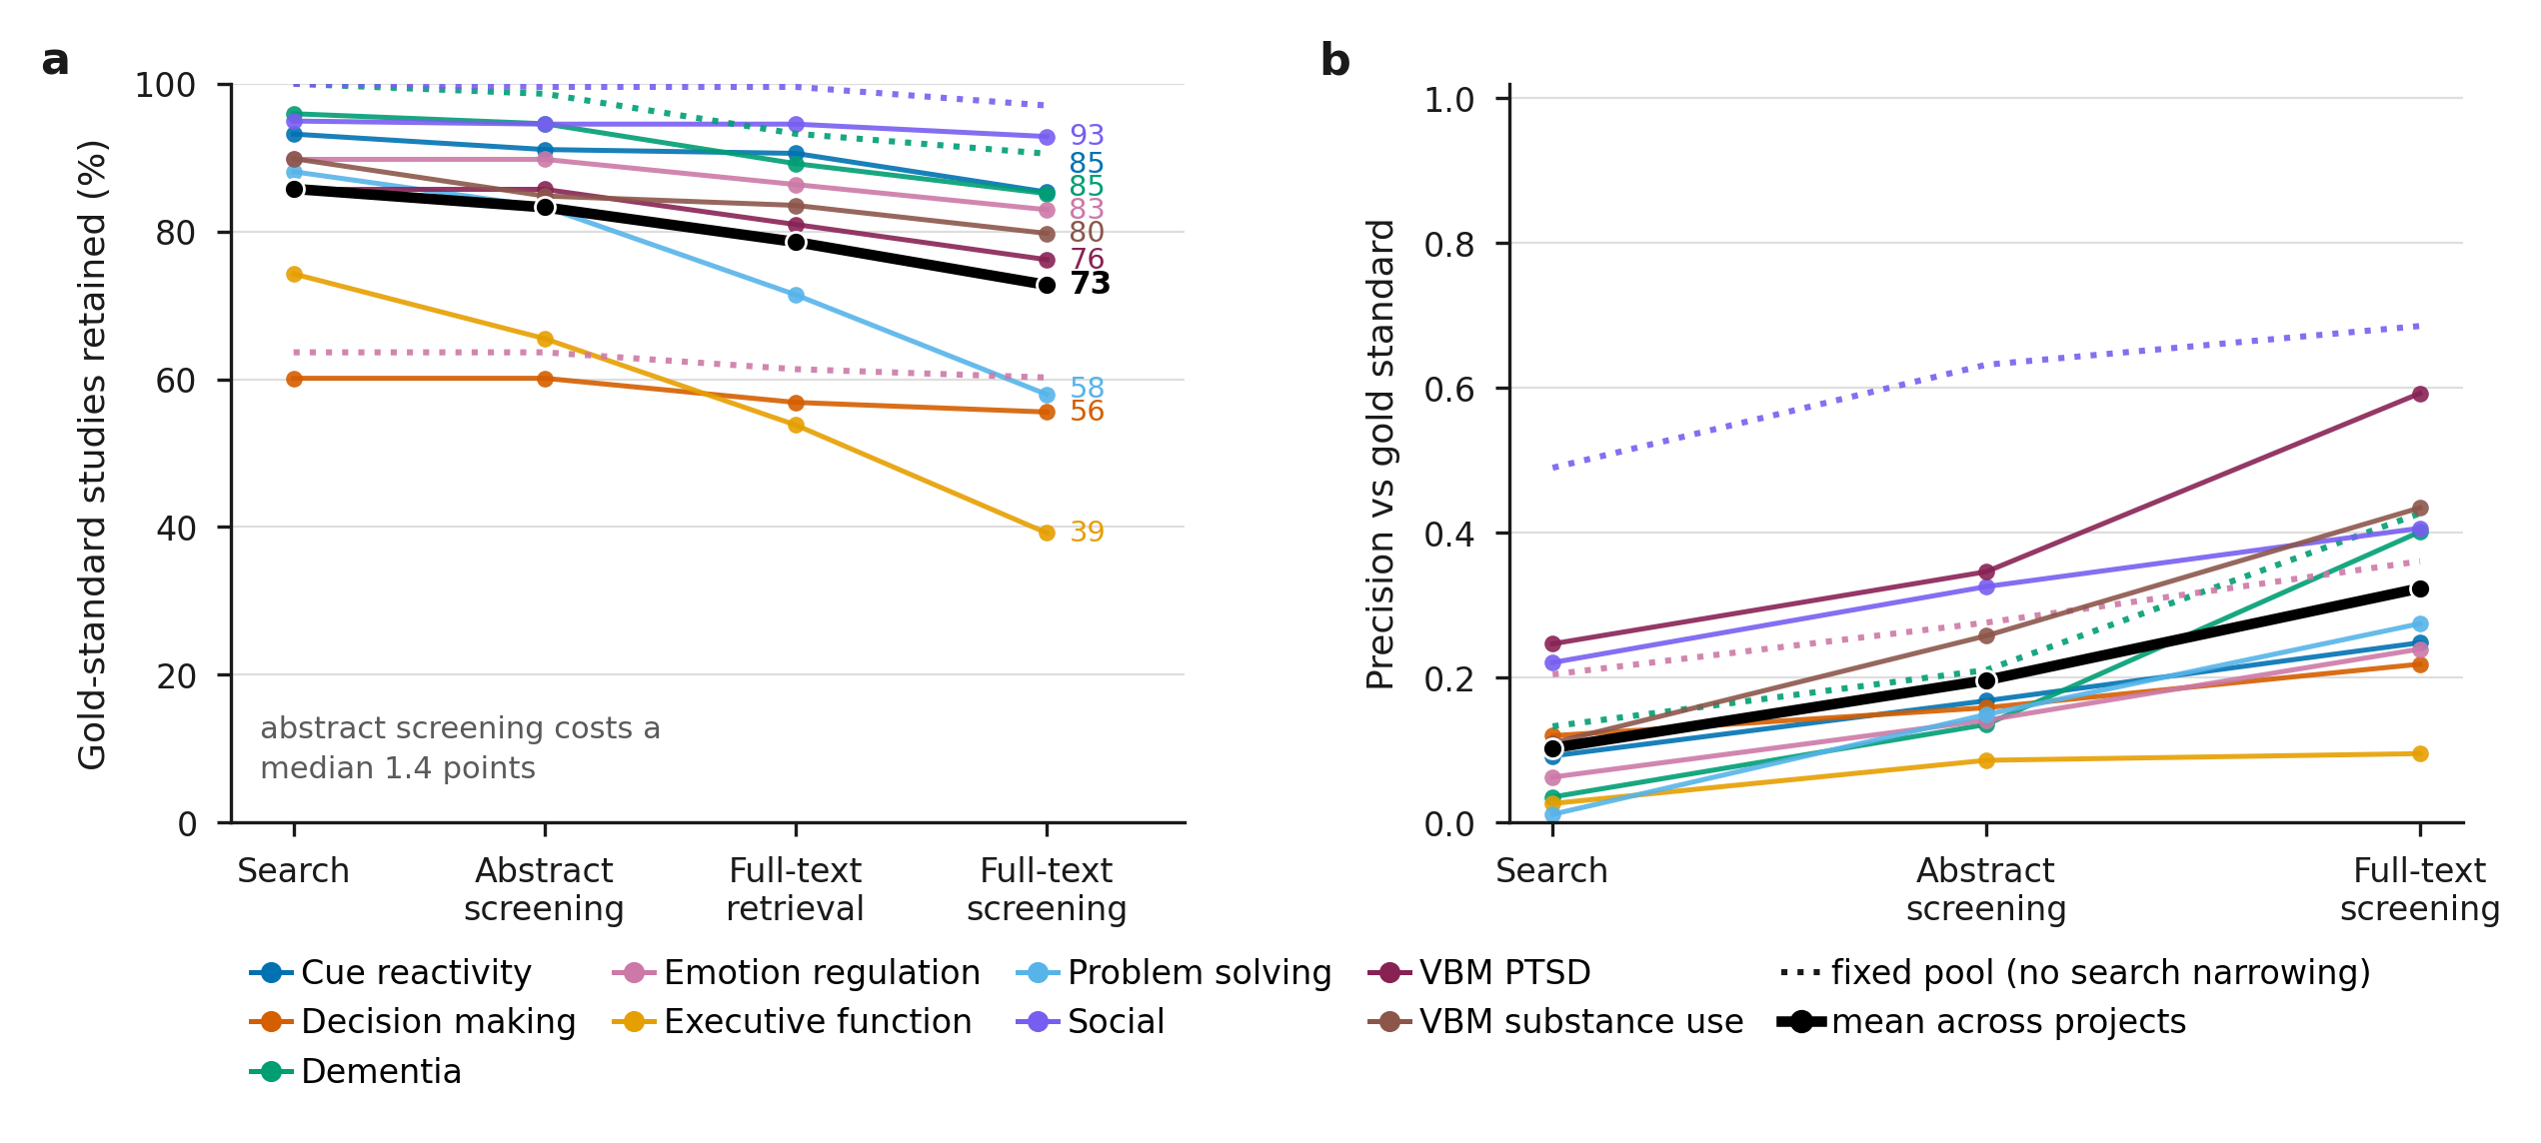
Screening raises precision at little cost to recall
73% of gold-standard studies survive to the end of the funnel; abstract screening costs a median 1.4 points of them. Mean precision rises 0.10 → 0.32.
Solid = search-driven pool; dotted = fixed pool; black = mean across projects. Retrieval is shown as its own stage — losing a full text is a supply problem, not a judgement.
Notes:
Two exceptions worth naming: executive function (74->39%) and problem solving (88->58%) lose most of their gold at retrieval and full-text screening, not at the abstract stage.

Slide 5
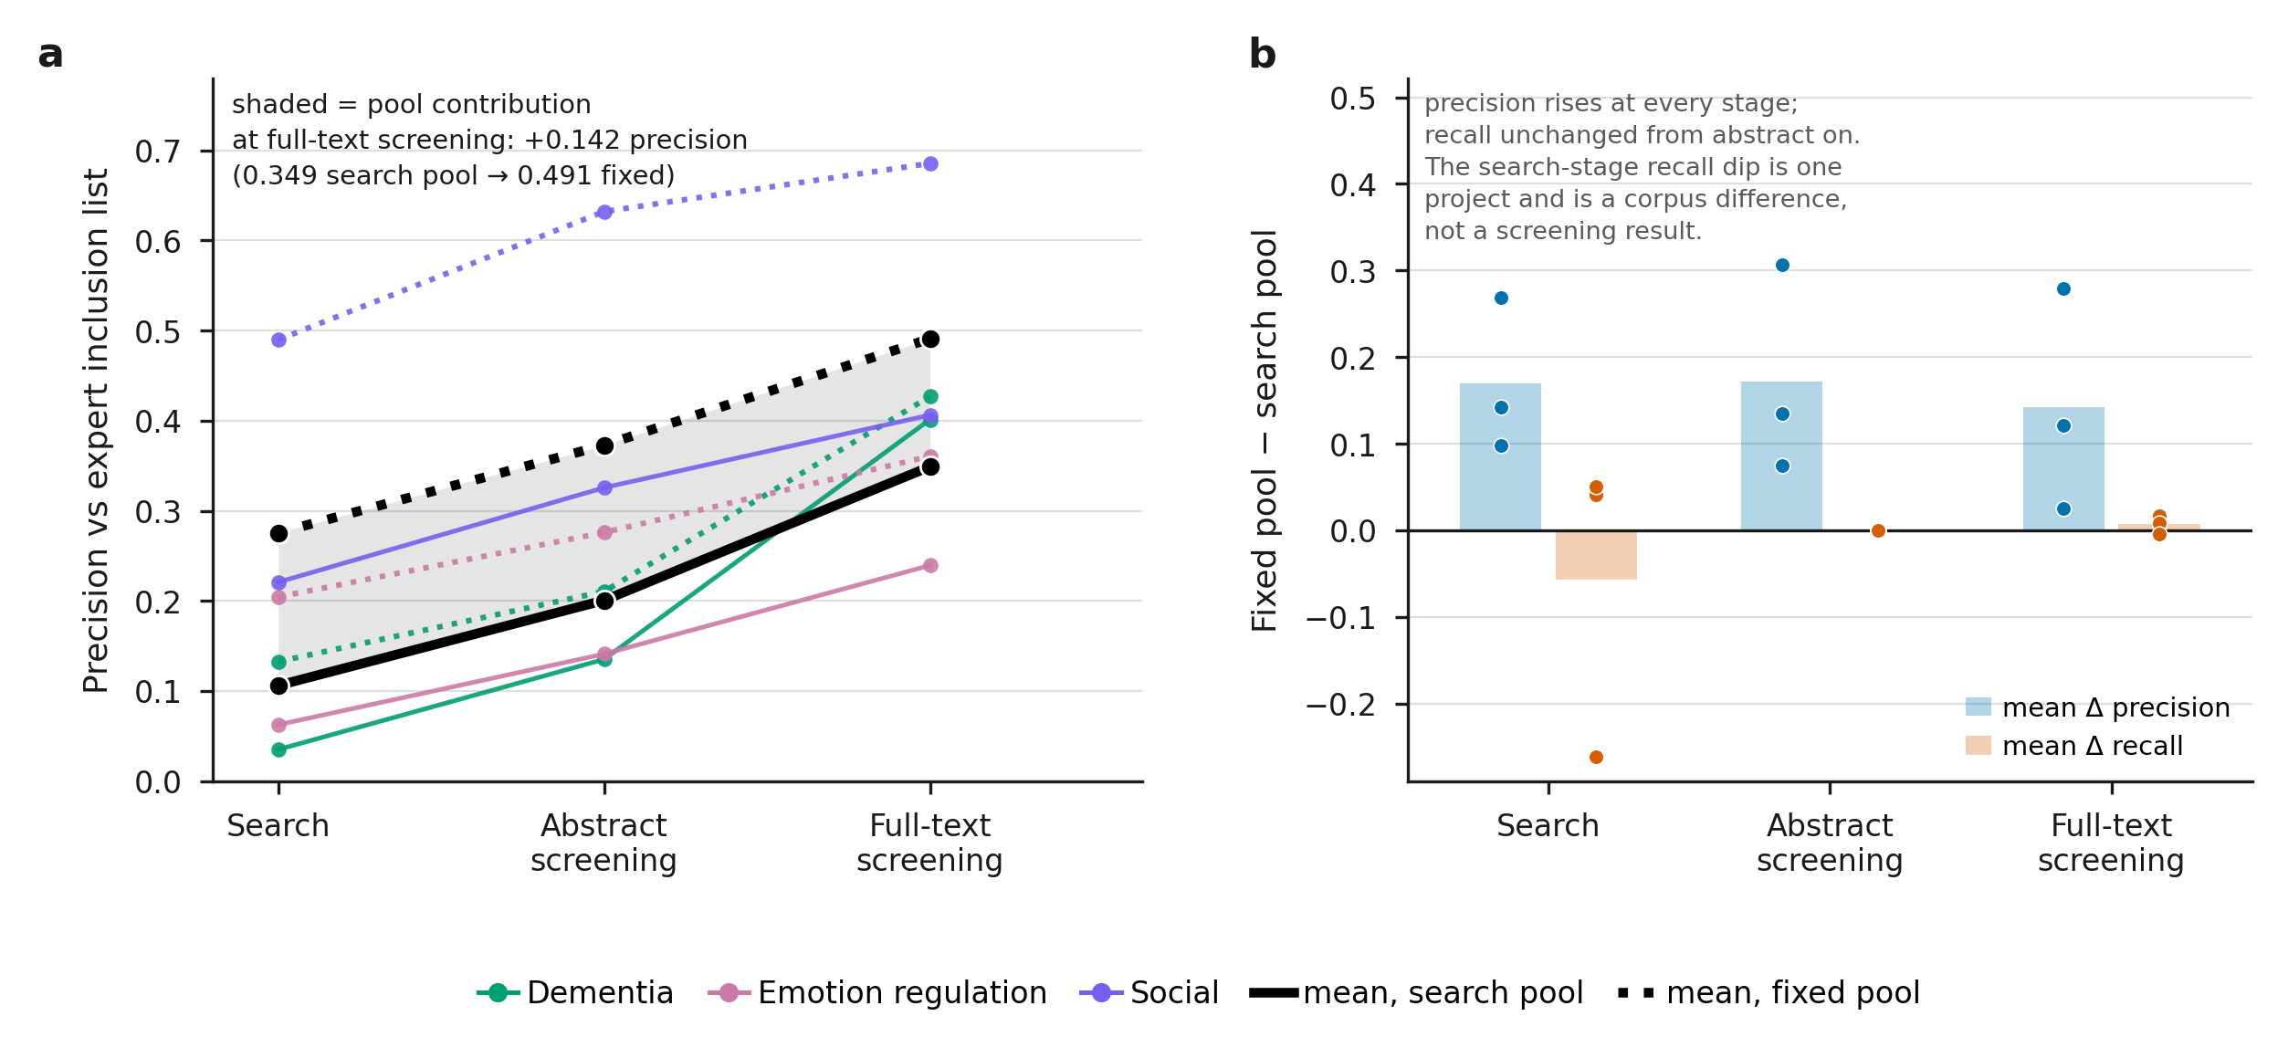
Much of the 'low' precision is a pool mismatch
Our PubMed query returns a different corpus than the published review's, so studies that could never have been included count as false positives.
+0.142 precision attributable to the pool alone at full-text screening (0.349 → 0.491), and it costs no recall (+0.007).
Three projects have a fixed-pool arm. Panel b is the control: a precision gain bought by discarding borderline true positives would show up as a recall loss, and does not.
Notes:
29% of the precision achievable at full-text screening is a corpus difference rather than a screening failure. Don't quote 0.35 as the pipeline's ceiling.

Slide 6
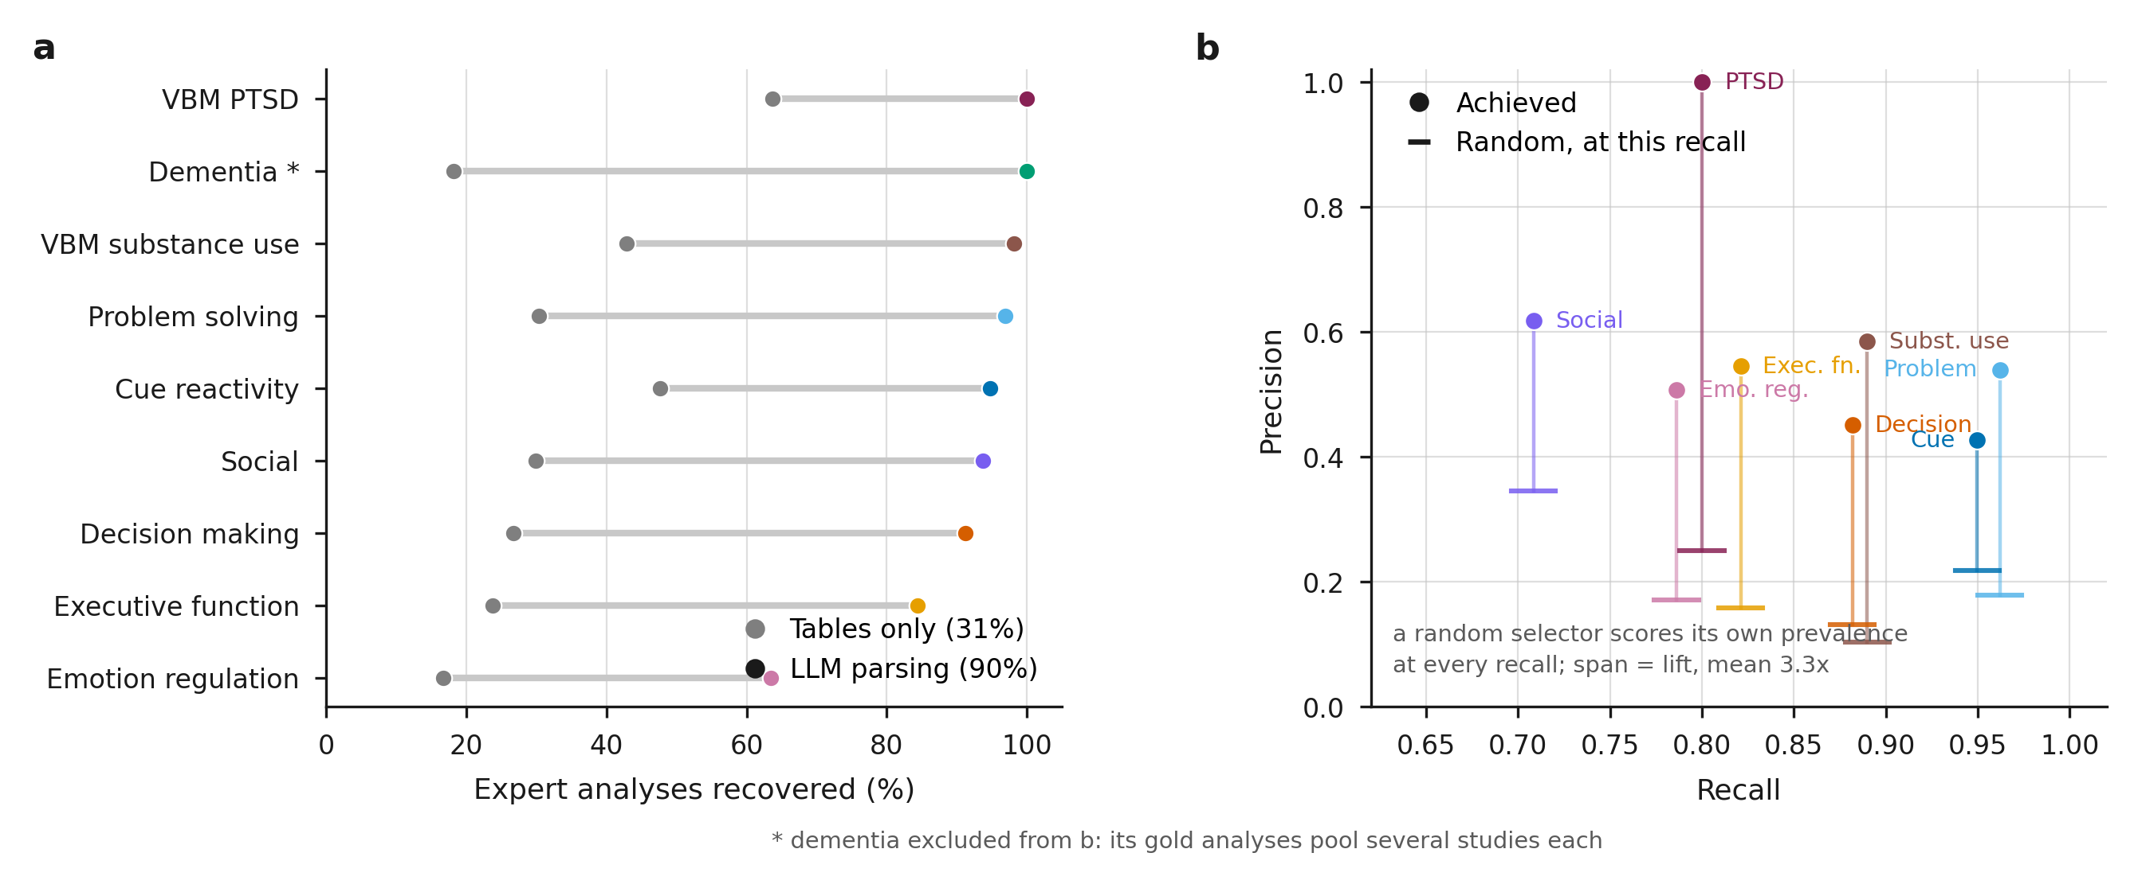
Recovering the analyses, then selecting among them
90%
of the experts' analyses recovered by parsing
range 63–100% across projects
33%
recovered by a table-only baseline
coordinate tables taken as parsed
0.668
mean annotation F1
assigning analyses to the right contrast
Two operations that both live below the paper: reconstruct the analyses at all, then decide which belong to the contrast.
Notes:
Parsing is close to solved; annotation is the harder and more interesting half, and it is what the next slides isolate.

Slide 7
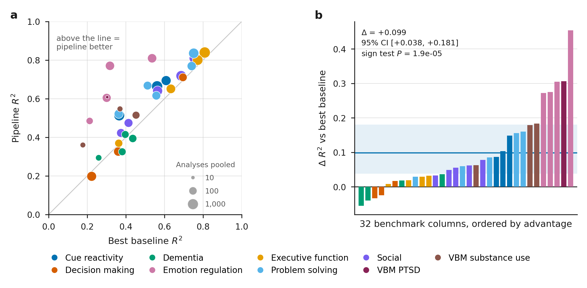
The pipeline beats the strongest available baseline
+0.099
mean ΔR² vs the best
available baseline per contrast
Ahead in 28 of 32 contrasts
95% CI [+0.038, +0.181], bootstrapped over projects — not contrasts, which share a corpus
Sign test P = 1.9 × 10⁻⁵
Wins while pooling fewer analyses in 23 of 30 — circle area is analyses pooled
Baseline per contrast is the stronger of a targeted search and the project-wide pool, so the comparison is against the best a competent practitioner could assemble.
Notes:
The baseline is deliberately strong: it retrieves a median 37% of the experts' own studies, so it is not a straw man.

Slide 8
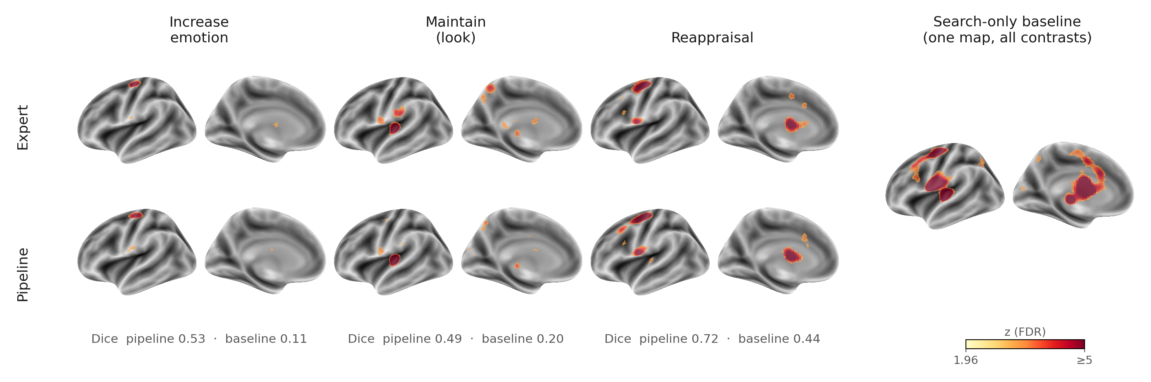
What that looks like on a brain
Emotion regulation: three contrasts, expert above and pipeline below, against the one search-only map that cannot tell them apart.
0.53 / 0.11
0.49 / 0.20
0.72 / 0.44
Increase — dice, pipeline vs baseline
Maintain — dice, pipeline vs baseline
Reappraisal — dice, pipeline vs baseline
Dice at the FDR q ≤ 0.05 boundary (z > 1.96) — the same threshold the panels are rendered at, so the number describes the picture. Cortical surface, so subcortex is not shown.
Notes:
The decrease contrast is deliberately excluded: its expert map correlates r = 0.972 with reappraisal's, because the benchmark's Decrease file holds the reappraisal union. Showing both would present one expert map twice.

Slide 9
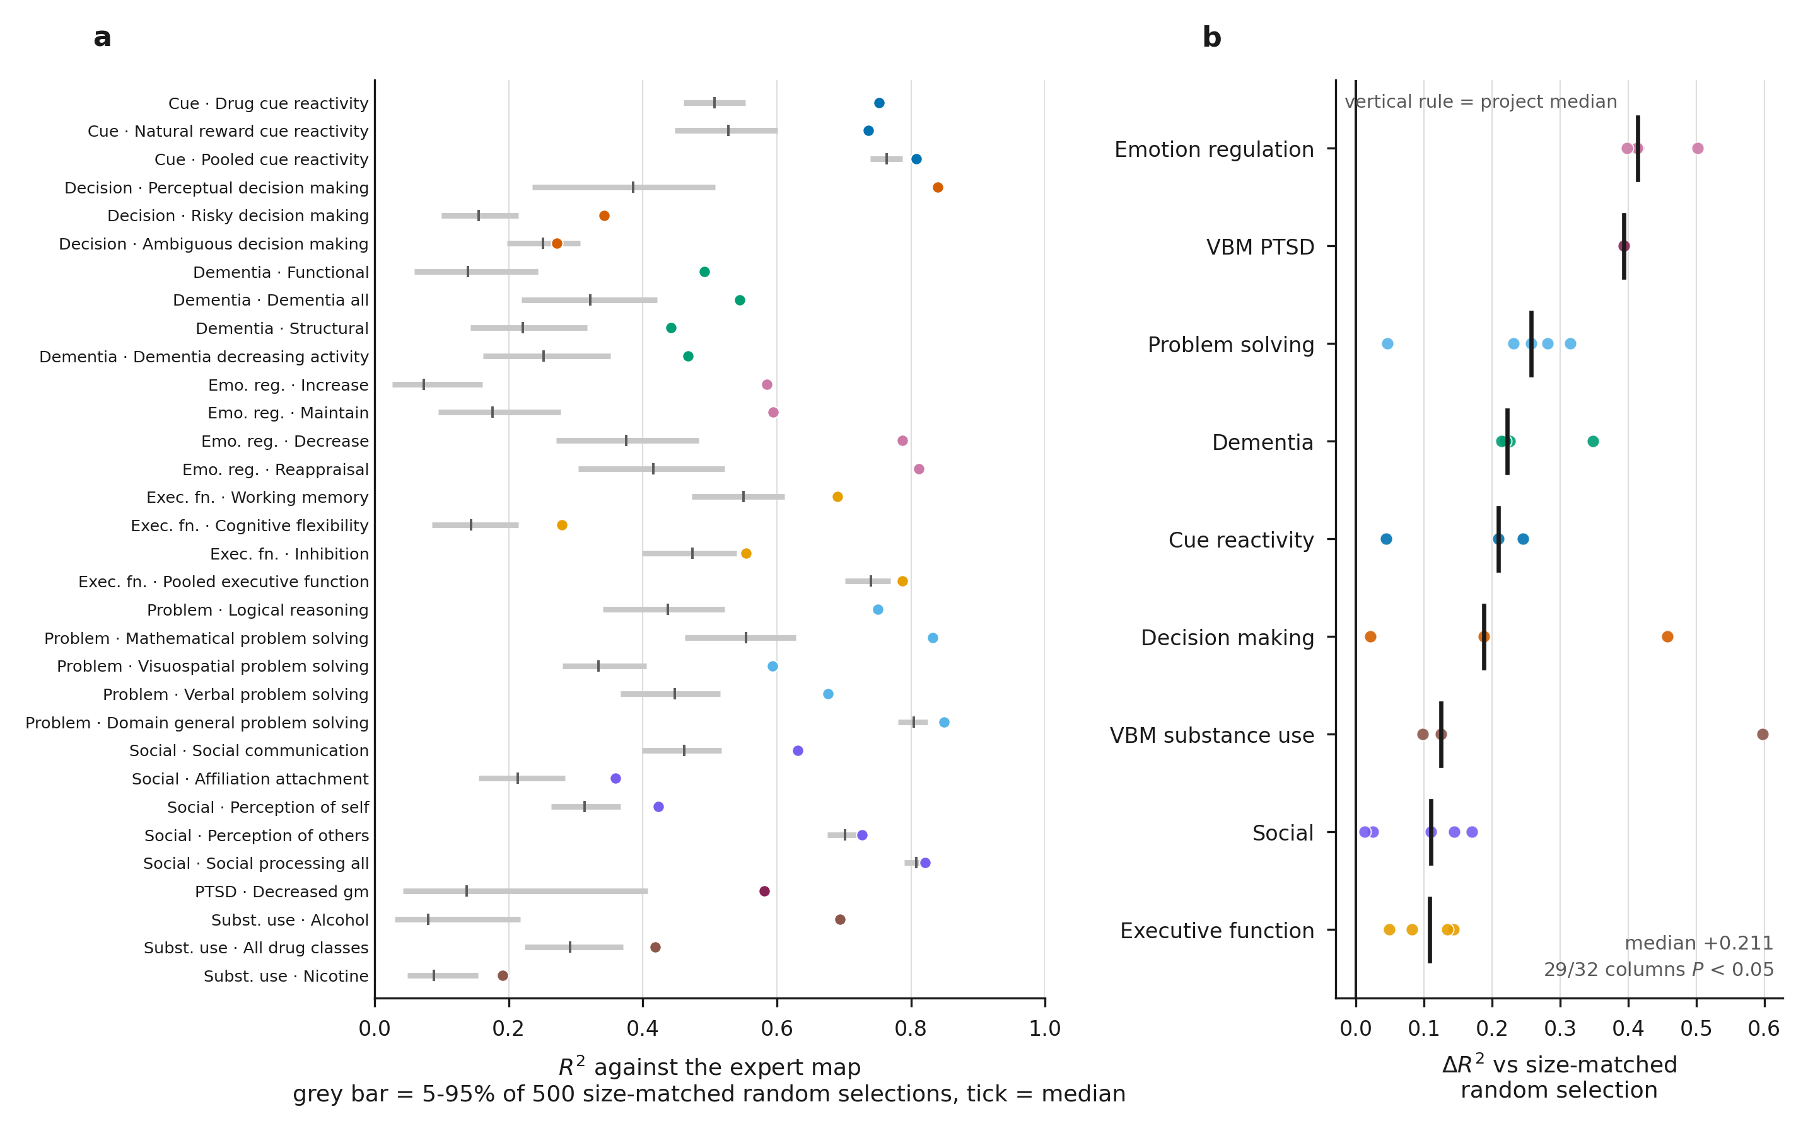
The gain is analysis selection, not paper selection
Hold the studies fixed. Draw 500 random subsets the same size as the annotated one. Does annotation beat chance?
+0.211
median ΔR² over a size-matched random selection
29 of 32 contrasts clear their own null at P < 0.05
24 sit outside all 500 draws
The 3 that fail all select 31–77% of their pool — little left to select
Grey bar = 5–95% of the null; dot = observed. Matching the subset size is what separates selecting well from merely selecting fewer.
Notes:
This replaces an earlier comparison against all-analyses, which confounded choosing analyses with using fewer of them.

Slide 10
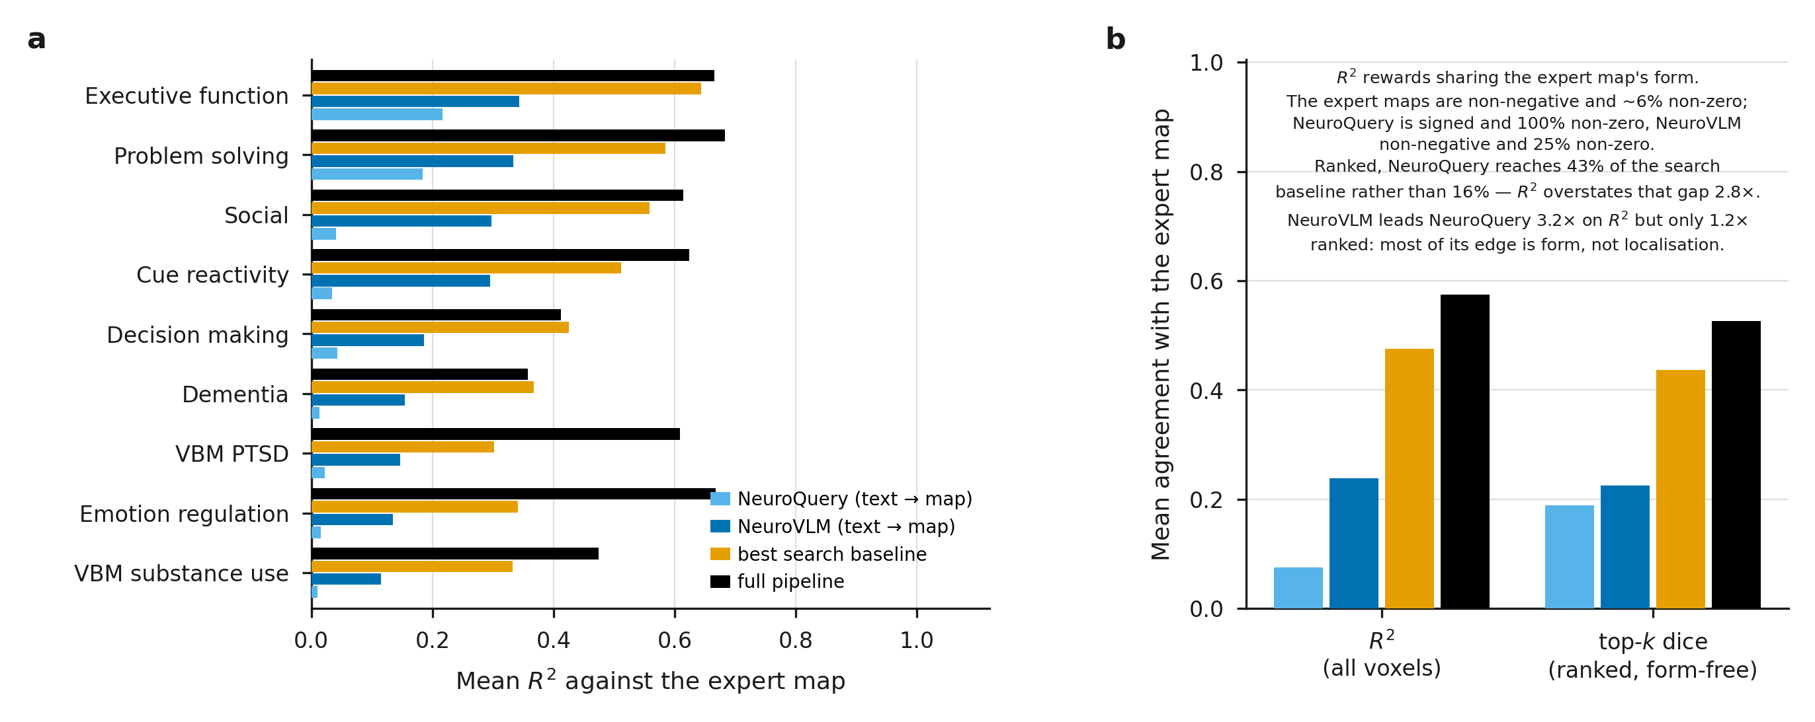
Could you skip the studyset and just ask a model?
Two text→map models, same queries, same scoring: NeuroQuery and NeuroVLM.
0.075
0.238
0.476
0.574
NeuroQuery, mean R²
NeuroVLM, mean R²
best search baseline
full pipeline
Both peak on canonical terms (executive function, working memory) and collapse on condition contrasts (all three emotion-regulation columns ≈ 0.002–0.08). A term is not an analysis.
Notes:
Caveat to say out loud: R2 rewards sharing the expert map's sparse non-negative form. Ranked (top-k dice) NeuroVLM leads NeuroQuery only 1.2x rather than 3.2x, and both still trail the search baseline. Not like-for-like either -- these answer a much cheaper question.

Slide 11
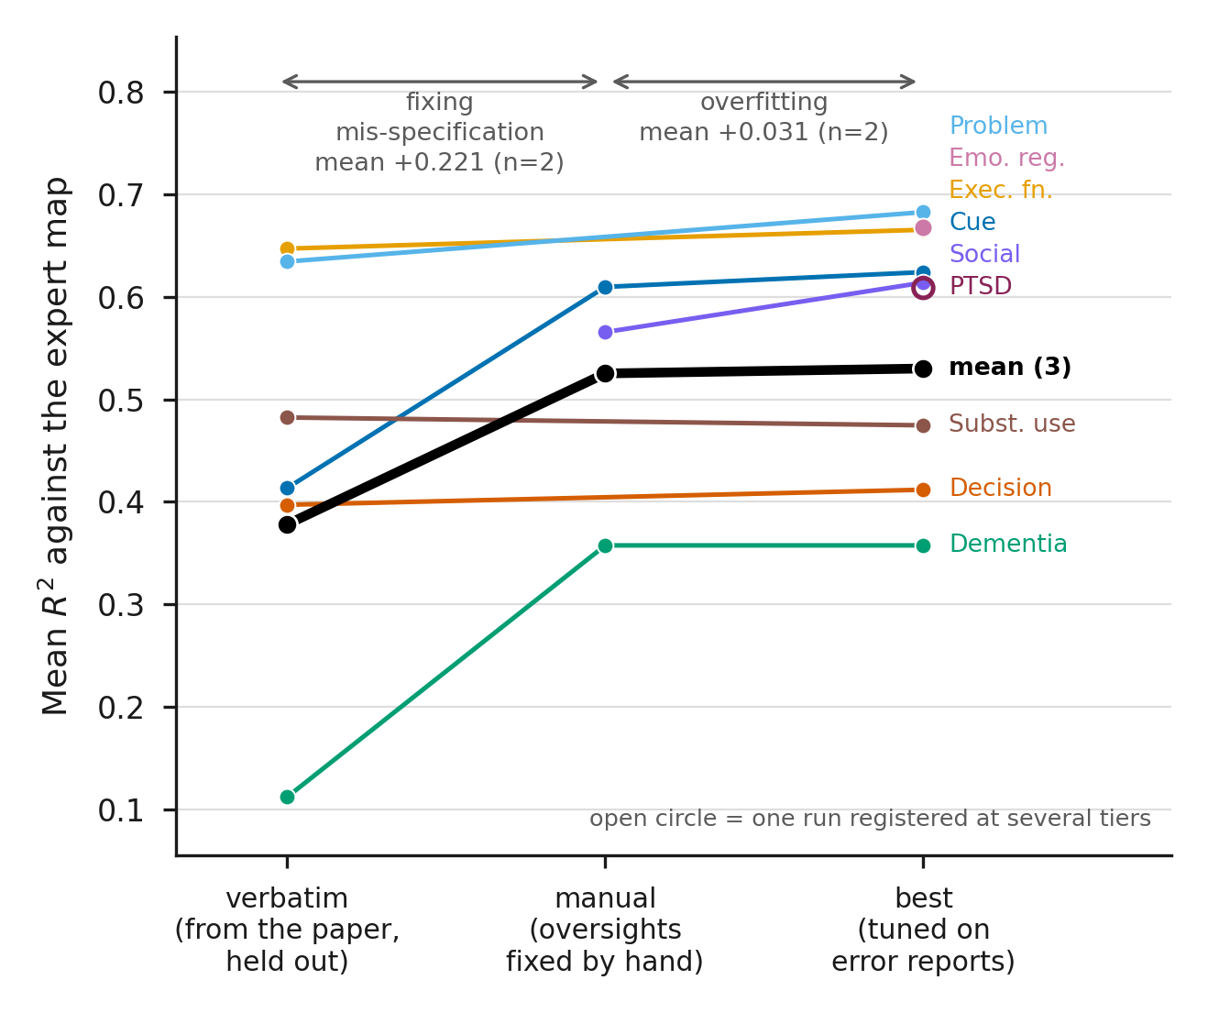
The real risk is mis-prompting, not overfitting
Runs are registered by how much of the benchmark shaped their criteria.
+0.221
+0.031
verbatim → manual
fixing major oversights in mis-specified criteria
manual → best
rewriting criteria against the error reports
Almost the whole rise is the cost of getting criteria wrong — not the benefit of having seen the answers.
It happened to us: dementia's verbatim criteria scored 0.112 against 0.358 once fixed, and nothing in the output announced it.
Both n = 2 — an indication, not an estimate.
Mean over the three projects with all three tiers: 0.378 → 0.525 → 0.530. Steep, then flat.
Notes:
This reframes the leakage objection into a finding about the danger of LLM screening: mis-specification is roughly seven times the size of the tuning effect.

Slide 12
How much does a re-run move?
Corpus frozen and verified identical; every LLM stage recomputed. Three projects.
±0.12
±0.04
r² 0.89–0.96
per-contrast reproducibility floor, dice
project-level floor, dice
map agreement between identical runs
project
margin over baseline
run drift
emotion regulation
+0.284
0.022
margin ≫ drift
social
+0.115
0.035
margin ≫ drift
executive function
+0.058
0.042
margin ≈ drift
Three of the 32 reported margins sit inside the noise band on a single run — decision making (+0.001), dementia (+0.005) and executive function (+0.031). That has to be said in the paper.
r² is stable across re-runs while dice is not — one re-run pushed a whole map below threshold. Three independent lines of evidence now favour r² as the primary metric.
Notes:
experiments/e2e_retest/. Only the full-text screening rate is a clean per-stage measurement; parsing and annotation ran on already-drifted inputs.

Slide 13
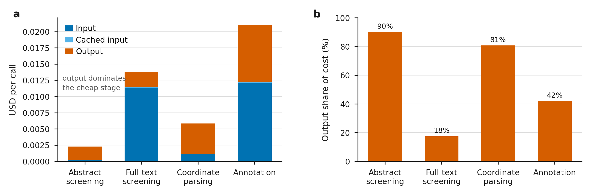
Cost is not the obstacle
Measured from per-stage token accounting, not estimated.
~$51 for three full projects end to end; $0.0023 per abstract screened, 88% of it output tokens. The pre-hoc estimate was 1.8× under — which is why the accounting exists.
Tens of dollars and hours against months of person time — which for a methods audience is the point, not an aside.
Notes:
The estimate missed because full texts in these projects are far longer than the corpus median it extrapolated from.

Slide 14
Decisions a reviewer will ask about
Denominator is 32, not 35
One metric rule, enforced in code
Three substance-use contrasts dropped: the source paper reports no significant result for cannabis, opioids or stimulants, so there is nothing to recover. This lowered our headline from +0.110 — which is the best evidence it wasn't chosen to flatter.
r² compares unthresholded maps; dice compares FDR-corrected thresholded maps. Both comparison scripts previously had one half wrong. Fixing it moved 26 of 35 contrasts.
MKDA everywhere
Precision has no human ceiling
Five of the nine source papers used ALE. We re-analyse all nine with MKDA for internal comparability, and report the one case where that substitution erases a published result (nicotine).
We score screening against one team's inclusion list as though it were truth. Human–human agreement on abstract screening runs κ ≈ 0.6–0.8, so our precision is a lower bound on agreement, not an accuracy estimate.
Each is a scope decision recorded with its reasoning in the paper outline — not an omission.
Notes:
Each of these is a scope decision recorded with its reasoning, not an omission. Say them before a reviewer finds them.

Slide 15
What is still open
Gates submission
A forward-looking case where the answer is not already published — the difference between demonstrating reproduction and demonstrating discovery.
Needs computing
Margin over baseline by tier, not just absolute R². The baselines don't move with tier so it should track, but that is load-bearing enough to measure.
Needs a DOI
neurometabench must be citable before submission. "In a paper we haven't submitted" is not an answer to "where is this benchmark".
Worth doing
Failure-mode taxonomy in the main text — separating supply failures from judgement failures. A methods audience adopts on the basis of how a tool fails.
Benchmark quality
Two substance-use contrasts disagree with the source paper's own foci counts (153 vs 37, 109 vs 236). That is an extraction audit for the data paper.
Everything above is tracked in NATURE_METHODS_SKELETON.md and PAPER_OUTLINE.md, with the reasoning attached.
Notes:
The first item is the gate. The rest are finishable.

Slide 16
Where this leaves us
1
Selection below the paper is measurable, and it matters.
+0.211 median R² over a size-matched random draw of the same analyses; 29 of 32 contrasts beat their own null.
2
It beats the strongest baseline we could build.
+0.099 mean ΔR², ahead in 28 of 32, and usually while pooling fewer analyses.
3
Asking a model for the map is not a substitute.
Both text→map models collapse on condition contrasts. A term is not an analysis.
4
The dangerous failure is mis-specified criteria.
Worth roughly seven times the tuning effect — and nothing in the output announces it.
Target: Nature Methods, with neurometabench as a companion data paper.
Notes:
Close on the forward-looking case: it is the gate for submission.

