Slide 1






TEAM ID: ST-911
Vāyu Lekha
The air ledger: finds India's biggest methane leaks from free satellite data, proves each one statistically, and ranks them by warming avoided per rupee.
Problem Statement: PS-13-S3 · Finding India's Methane Super-Emitters From Orbit
Team Prahari L. Vishwa · Vikranth Jayasarathy · Yateesh
ieeepecsb | sustain-a-thon.netlify.app
Notes:
L. Vishwa · about 0:30
Good morning, everyone. We are Team Prahari, team ID ST-911. I'm Vishwa, and with me are Vikranth and Yateesh.
Our problem statement is PS-13-S3: finding India's methane super-emitters from orbit.
We call our project Vāyu Lekha. It means "the air ledger". In one line: it finds India's biggest methane leaks from free satellite data, proves each one with statistics, and ranks them by how much warming we can stop for every rupee spent.
One thing before we start: this is not a mock-up. It is running right now, on real satellite data, and we'll show you.
On screen: Stay on the title slide while you introduce the team. Point to each teammate as you say their name.

Slide 2


PROBLEM STATEMENT
PS-13-S3 · Finding India's Methane Super-Emitters From Orbit
India is the world's second-largest methane emitter, yet no public map says which sites leak.
~80×
30 Mt
~30%
the warming of CO₂ over 20 years, tonne for tonne (IPCC AR6)
methane from India in 2023, second only to China (IEA)
of global warming since the Industrial Revolution is methane (IEA)
1
No site-level inventory
India reports national totals. Nobody publishes which landfill or coal field leaks how much.
July sees ~44× fewer clear pixels than December. Our measurement: 2,597 Sentinel-5P files, Jan 2023 to Sep 2026.
2
Raw satellite data is not an answer
7 km pixels, bright-desert and haze bias, and a monsoon that hides most of India from June to September.
Landfills are the fastest methane to fix. India has 2,438 legacy dumpsites under Swachh Bharat, and waste-sector emissions are projected to rise from 20 to 76 Mt CO₂e by 2030 (Harvard Salata Institute, 2024).
3
A wrong accusation is costly
Naming a site needs statistical proof, an independent check and a human sign-off, not a bright pixel.
TEAM ID: ST-911 | Team Prahari
Sustain-a-thon 2026 · Panimalar Engineering College
2
Notes:
L. Vishwa · about 1:00
So why methane?
Tonne for tonne, methane traps about 80 times more heat than carbon dioxide over twenty years. The IEA says it's behind roughly 30 percent of all the warming since the Industrial Revolution. And India released about 30 million tonnes of it in 2023. That's second in the world, after China.
There's good news hidden in that. Methane only stays in the air for about 12 years. So if we cut it today, we feel it within our own lifetime.
But when we tried to find out where India's methane actually comes from, we hit three walls.
One: India reports methane as one national number. There's no public list that says: this landfill, this coal field, this many tonnes.
Two: the satellites exist, but raw satellite data is not an answer. Look at this chart. It's our own count from 2,597 satellite files. In December we get about 26 thousand clear pixels a day over India. In July, about 600. The monsoon simply hides the country. Bright deserts and haze fool the instrument too.
Three: if you point at a site and say "you are leaking", you had better be right. One bright pixel is not proof.
And this matters most for landfills. We have 2,438 old dumpsites, and waste methane is expected to nearly quadruple by 2030.
On screen: Point at the orange monsoon bars when you say "about 600". Hand over: "Vikranth will show you what we built."

Slide 3
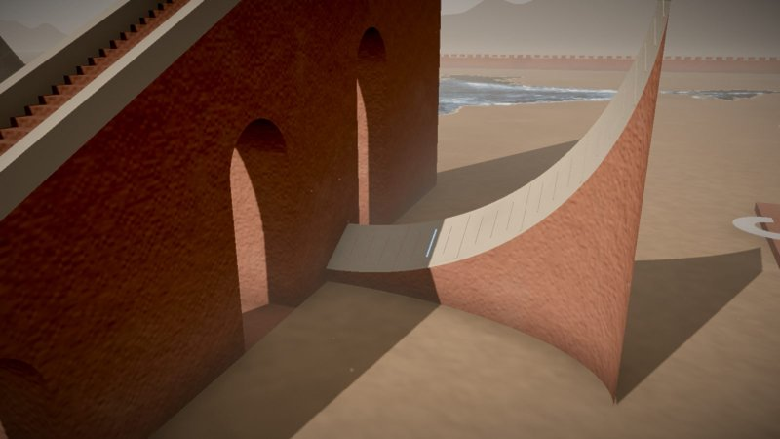
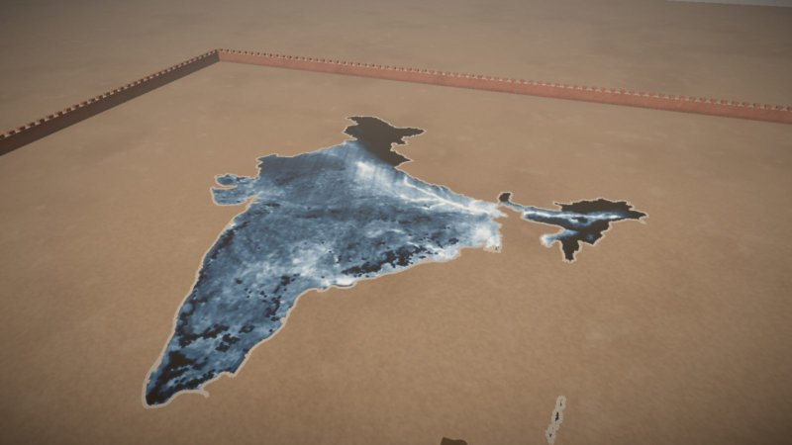
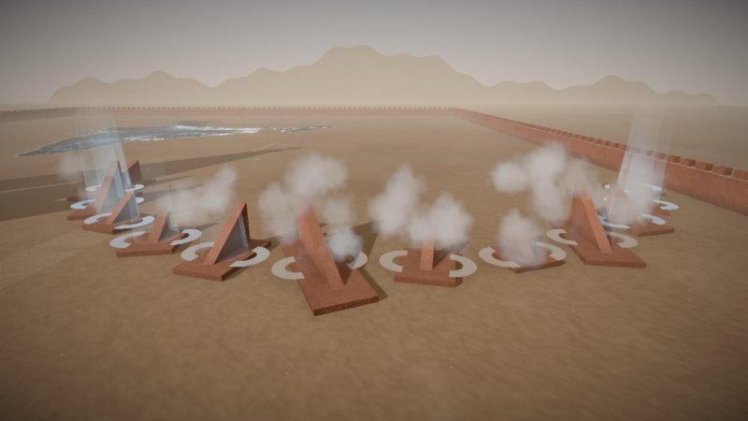
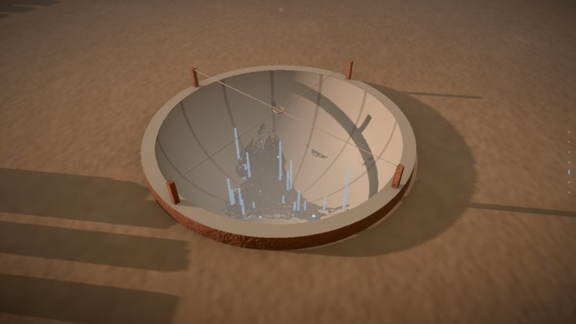
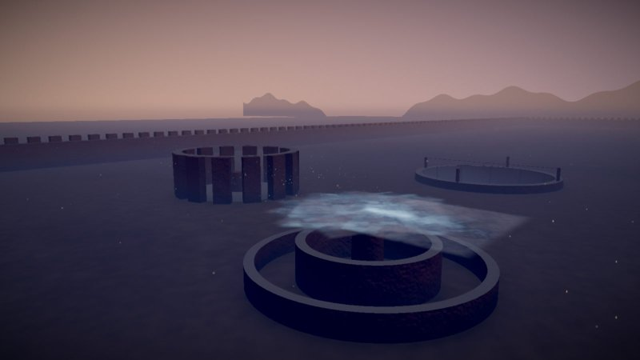
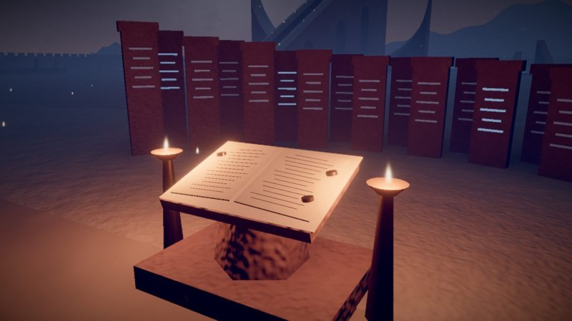
PROPOSED SOLUTION
In one line: Vāyu Lekha turns every clear Sentinel-5P pass over India into a statistically checked, ranked ledger of the methane sources worth fixing first, refreshed every 3 hours and free to read.
1 · INGEST
2 · CLEAN
3 · SEASONS
4 · FIND
5 · MEASURE
6 · DECIDE
Samrat Yantra
TROPOMI floor map
Rashivalaya Yantra
Jai Prakash Yantra
Digamsha & Rama Yantra
The ledger
Newest pass every 3 h; each file checksum-matched to Copernicus
Remove surface-brightness and haze bias; weight each pass by its noise
Drop monsoon months; subtract paddy and regional background per site
Continuity equation: where more methane leaves than arrives
Turn each pass to its wind, stack, calibrate the rate, read CO
5% false-discovery gate + independent check; rank by warming per ₹
Checksum · qa ≥ 0.5
ABD · SRECE
Monsoon exclusion · Plane bg
Flux divergence · Blind screen
Wind · DiverSR · KPW · OBC · EIV
BY-FDR · WRPI · VOIT
Solves problem 1
Solves problem 2
Solves problem 3
A site-level ledger, not a national total
Reads through cloud, bias and noise
Proof before blame
Every site gets a rate in t CH₄/h with its uncertainty, a CO fingerprint (burning or decay), and a rank by warming avoided per rupee.
Wind-rotated, footprint-drizzled stacking over 3.4 years; albedo and aerosol bias removed; monsoon reported as unseen, never guessed.
Each site is tested against 24 pseudo-sites, a 5% false-discovery gate across all sites, an independent check and a human sign-off.
2,597
17.3 M
3.4 yrs
54
12
3 h
files verified
clear pixels read
of record
places tested
confirmed · 7 in India
live refresh
TEAM ID: ST-911 | Team Prahari
Sustain-a-thon 2026 · Panimalar Engineering College
3
Notes:
Vikranth Jayasarathy · about 1:15
Here is our answer in one sentence: Vāyu Lekha turns every clear Sentinel-5P pass over India into a checked, ranked list of the methane sources worth fixing first. It refreshes every three hours, and anyone can read it.
We told the story through Jantar Mantar in Jaipur. Those instruments were built to read the sky, so we made each one a step of our pipeline.
Step one, ingest. Every three hours a job picks up the newest satellite pass and checks each file's checksum against the official Copernicus catalogue. If it doesn't match, we throw it away.
Step two, clean. Bright ground and haze bend the methane reading. We remove that, and we trust each pass according to how noisy it is.
Step three, seasons. We don't guess the monsoon months. We leave them out and say so. And we subtract the background from rice paddies and the region around each site.
Step four, find. We use the continuity equation. In simple words: if more methane leaves a place than arrives, something there is emitting.
Step five, measure. We turn every satellite pass to face its own wind, stack hundreds of them, and calibrate the rate in tonnes per hour.
Step six, decide. A strict statistical gate, an independent check, and then a ranking by warming avoided per rupee.
Each feature answers one of the three problems Vishwa showed you: a site-level ledger instead of a national total; a method that reads through cloud, bias and noise; and proof before blame.
And the size of it: 2,597 verified files, 17.3 million clear pixels, three and a half years of data, 54 places tested, 12 confirmed, and 7 of them in India.
On screen: Move your hand left to right across the six pictures as you go through the steps. Finish on the orange "12 confirmed · 7 in India".

Slide 4
TECHNICAL ARCHITECTURE
INPUTS
INGEST
SCIENCE
DATA CONTRACT
API
EXPERIENCE
Sentinel-5P TROPOMI CH₄ + CO · ERA5 winds · OpenStreetMap · ECB FX
GitHub Actions every 3 h + daily · MD5 vs Copernicus · qa ≥ 0.5
Python · NumPy · SciPy: stack → divergence → null → gates → rates
Versioned JSON / Parquet · public and partner views
Next.js 16 on Vercel · rate limits · CSP · partner login · CSV
React Three Fiber 3D story · live ledger · site dossiers
10 algorithms passed a pre-set test and run on every refresh 19 designed · 5 failed, published · 4 not built
A1 SRECE
A2 ABD
C1 MSFD
C2 KPW
D2 DiverSR
Noise weighting
Albedo / aerosol debias
CO co-emission leg
Kuṭṭaka phase weighting
Footprint drizzle
each pass by its own noise
mean z 3.74 → 4.06
CO found at all 5 emitters
mean z 4.06 → 4.37
every emitter above 3σ
F1 EIV-CRF
G1 OBC
G2 BY-FDR gate
G3 WRPI
H1 VOIT
CO/CH₄ fingerprint
Injection-recovery
5% FDR + independent check
Warming per rupee
Value-of-info tasking
burning vs decay
slope 0.992 · R² 0.9999
1 of 36 fakes gets through
cited costs · Monte Carlo
54% vs 18% re-detected
9
3
6
KPW · Āryabhaṭa's Kuṭṭaka (499 CE) meets Sentinel-5P
2
12
4
The orbit repeats every 16 days (227 orbits), so the site falls at a different spot inside its 5.5 × 7 km pixel on each pass (grid: passes per spot, illustrative). Kuṭṭaka solves the whole-number congruence that says which orbits land where; KPW weights each pass by mean count ÷ its bin's count, so every spot counts equally.
7
5
3
Controlled ablation: 6 reference sites, same 24-pseudo-site null, one component added per row (r4_ablation.py).
TEAM ID: ST-911 | Team Prahari
Sustain-a-thon 2026 · Panimalar Engineering College
4
Notes:
Vikranth Jayasarathy · about 2:30
The data flows left to right. Satellite methane and carbon monoxide from Copernicus, wind from ERA5, facilities from OpenStreetMap, and exchange rates from the European Central Bank. GitHub Actions pulls and verifies the data. Our Python code does the science. It writes versioned files, and the website only reads those files. So what you see on screen is exactly what the pipeline computed. Nothing is typed in by hand.
We designed 19 algorithms. For each one we wrote down a pass mark before we ran it on real data. Ten passed, and those ten run on every refresh. Five failed, and we publish the failures too. Let me explain four of them.
First, the core: flux divergence, with wind rotation and footprint drizzle. The satellite takes a picture of methane in the air. Methane from a landfill drifts with the wind, so on every day the plume points a different way. We rotate each day's picture so the wind always blows the same direction, then stack them. A real source stays in one place and adds up. Noise points everywhere and cancels out. Drizzle means each pixel is spread over the real patch of ground it saw, not dropped into one grid box. The chart on the right shows each step on the same six known sites. Raw data can only pick out a leak of about 7.3 tonnes an hour. Turning to the wind brings that to 5.9. That's the biggest single jump. Drizzle brings it to 5.4, and it's the step that lifts every known emitter above three sigma.
Second, KPW. This one comes from Indian mathematics. The satellite's orbit repeats every 16 days, 227 orbits. So a landfill does not sit in the same spot of its pixel every day. Sometimes it's near the edge, sometimes in the middle. If one position happens to get more clear days, the stack gets smeared toward it. Working out which orbit lands the site on which spot is a whole-number puzzle, and Āryabhaṭa solved exactly this kind of puzzle in 499 CE with his method called Kuṭṭaka, the pulveriser. KPW sorts every pass into nine spots and weighs them so each spot counts the same. The result: average significance went from 4.06 to 4.37, and the smallest detectable leak dropped from 4.96 to 4.76 tonnes an hour. To be exact about it: we measure the spot directly on every pass, and we use Kuṭṭaka to plan which future orbits will fill the gaps.
Third, OBC, our calibration. How do you check your numbers when there's no meter on the landfill? We take real satellite data, add a fake plume of a known size, run the whole pipeline, and see what comes out. We get back 99.2 percent of what we put in, with an R-squared of 0.9999. That also tells us our honest limit: we catch a 10 tonne-per-hour leak about half the time, and 20 tonnes an hour every time.
Fourth, the gate. When you test 54 places, a few will look significant just by luck. The Benjamini-Yekutieli method keeps the expected share of false entries under 5 percent, even when sites are related to each other. We tested it with 36 fake sites. The statistics alone let 2 through. Add our independent check, and only 1 of 36 got through, while 4 of 5 real emitters were confirmed.
The other six are on the slide: noise weighting, bias removal, the carbon monoxide leg, the CO-to-methane fingerprint, the warming-per-rupee ranking, and tasking, which we'll come back to.
On screen: Point at the flow row first, then the yellow KPW card, then the ladder chart. If time is short (Round 2), explain only the core method and KPW, and say "the rest are on the slide and in our repository".

Slide 5
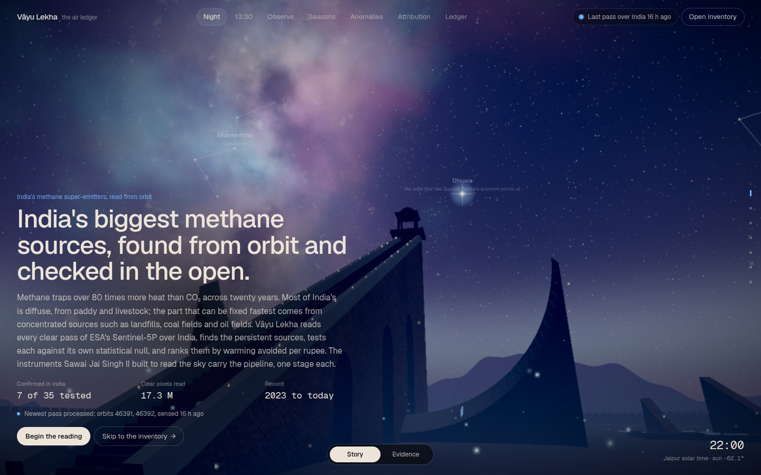
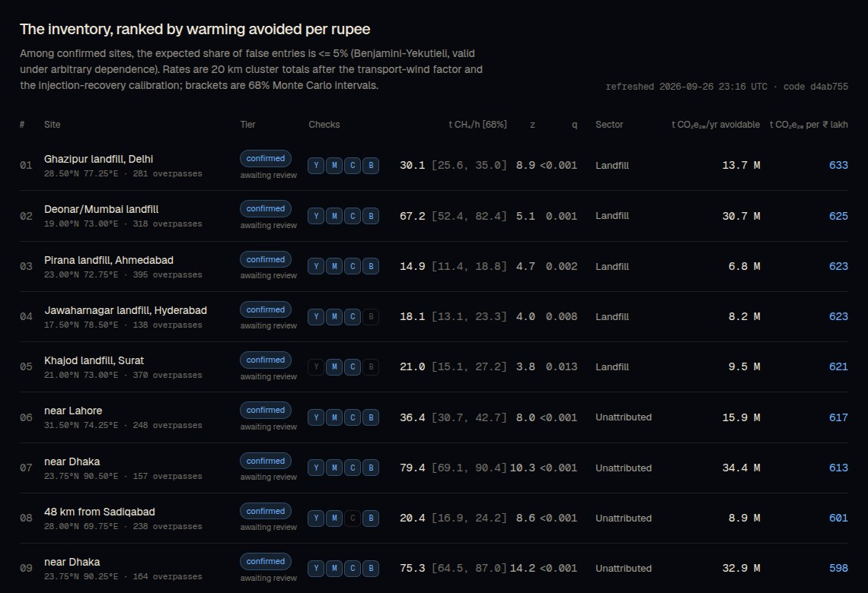
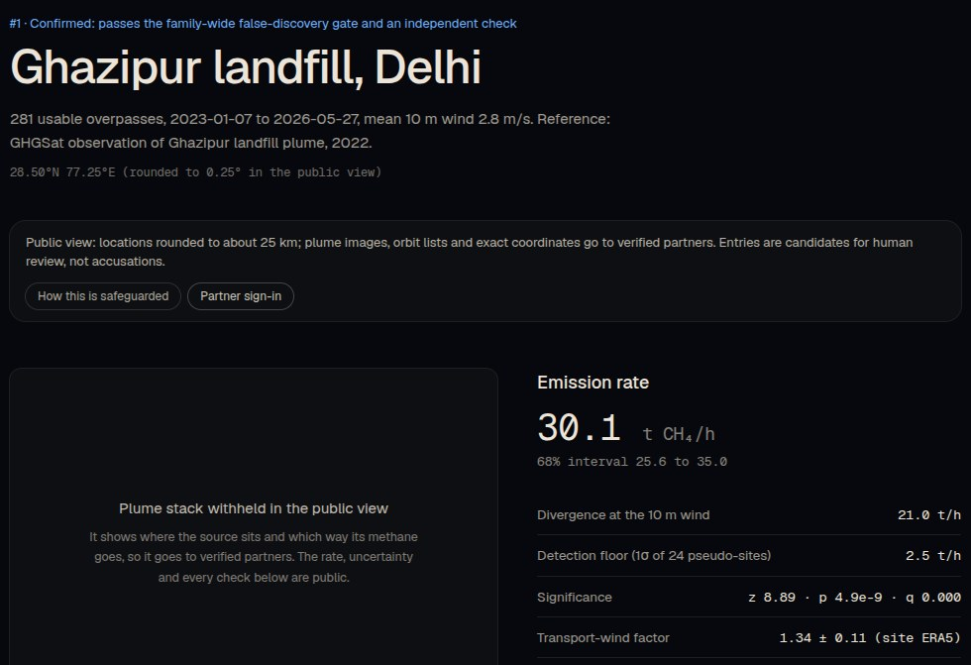

PROTOTYPE & DEMO
/ledger: ranked inventory + 4 checks
Site dossier: Ghazipur, Delhi
The 3-minute demo path
1
Night-sky hero newest pass time; 7 of 35 Indian sites confirmed
2
Six story stages each Jantar Mantar instrument = one pipeline step
3
/ledger live pass map, ranked inventory, per-site checks
4
Ghazipur dossier 30.1 t/h, z 8.9, CO/CH₄ 0.54 → decay, not fire
5
/partner sign-in exact coordinates unlock; public stays at 25 km
Scan to open the live site
Backup: full screen recording of this path on the laptop and a USB drive. Code and every result file: github.com/neurosyncx7/sustain-a-thon
Live now sustain-a-thon-plum.vercel.app
Real Sentinel-5P passes, processed every 3 hours by GitHub Actions. Nothing on the site is simulated.
TEAM ID: ST-911 | Team Prahari
Sustain-a-thon 2026 · Panimalar Engineering College
5
Notes:
Yateesh · about 1:30 (live) / 0:45 (recording)
Now let me show you the product. [Switch to the browser, full screen.]
This is the opening screen: Jantar Mantar under the real night sky. Top right, you can see when the last satellite pass over India was processed. The headline says 7 of 35 places tested in India are confirmed.
[Scroll through two or three stages.] Each stage is one step of the pipeline, and the small tags under the title are the algorithms running at that step.
[Open /ledger.] This is the live part. The map is the newest pass over India. Gaps are clouds. Below it, the full inventory, ranked. These four boxes are the four independent checks: found again in separate years, a second method agrees, carbon monoxide found, and found by the blind screen.
[Open the Ghazipur dossier.] Ghazipur in Delhi: about 30 tonnes an hour, z-score 8.9. The carbon monoxide ratio is 0.54, which points to rotting waste, not fire.
[Open /partner, sign in with the demo key, reopen the dossier.] The public sees locations rounded to about 25 kilometres. A verified partner, like a pollution control board, sees the exact coordinates and the plume image. Every view is logged.
If the internet fails, we have the same walk-through recorded, and we'll play that instead.
On screen: Demo tabs open in advance: home, /ledger, /site/ghazipur, /partner. Demo key: vayu-lekha-partner-demo. If the 3D is slow, add ?render=static to the URL. If the network is down, play the backup recording straight away. Don't troubleshoot on stage.

Slide 6
IMPACT & SUSTAINABILITY
7
SDG
13
Climate Action
the fastest lever on near-term warming (13.2, 13.3)
super-emitter clusters confirmed in India (5% false-discovery gate + an independent check)
SDG
11
Sustainable Cities
dumpsites of Delhi, Mumbai, Hyderabad, Ahmedabad, Surat (11.6)
187 t/h
of methane from those 7 places combined: about 1.6 Mt a year (20 km cluster totals)
SDG
3
Good Health
landfill fires and air pollution near homes (3.9)
₹160
SDG
12
Responsible Consumption
waste diversion and gas capture where it pays most (12.5)
per tonne CO₂e (20-yr) to abate at landfills: about 620 t avoided per ₹ lakh (EPA cost curve, IPCC AR6)
Navy: landfill · grey: coal · blue: *found by the blind screen, sector unknown
84 Mt
Independent check. Carbon Mapper's 2025 survey named landfills in Hyderabad (Secunderabad) and Mumbai among the world's 25 largest methane emitters. We flag both from free public data alone.
Sustainable by design
Free public data, free-tier compute, open code: running cost today is about ₹0 a month.
CO₂e (20-yr) a year avoidable at these 7 if 50-85% of their methane is captured
TEAM ID: ST-911 | Team Prahari
Sustain-a-thon 2026 · Panimalar Engineering College
6
Notes:
Yateesh · about 1:00
So what does it add up to?
Seven super-emitter clusters confirmed in India. Together they put out about 187 tonnes of methane an hour. That's around 1.6 million tonnes a year, roughly five percent of India's total, from just seven places. To be fair about it, these are totals for a 20 kilometre circle, so they include everything in that circle, not only the landfill.
Fixing them is cheap. At landfills, capturing the gas costs about 160 rupees per tonne of CO2-equivalent avoided. If 50 to 85 percent of it were captured at these seven, that avoids about 84 million tonnes of CO2-equivalent a year, on a 20-year basis.
And we're not the only ones who see this. Carbon Mapper's 2025 satellite data named landfills in Hyderabad and Mumbai among the 25 biggest methane emitters in the world. We flag both of them using only free public data.
On the SDGs: Goal 13, climate action, is the main one, because methane is the fastest lever on warming in the next twenty years. Goal 11, because these are city dumpsites. Goal 3, because landfill fires and smoke hurt the people living next to them. And Goal 12, because it shows where waste diversion and gas capture pay off most.
And the system itself is sustainable. Free public data, free-tier computing and open code. Today it costs us about zero rupees a month to run.
On screen: Point at the Deonar and Ghazipur bars, then the yellow Carbon Mapper box.

Slide 7
BUSINESS APPROACH
Who uses it
Value proposition
The cheapest first look: a free satellite screen says where to send a costly aircraft, drone or high-res satellite, and later proves the fix worked.
Regulators
CPCB, 28 SPCBs, MoEFCC: which sites to inspect first, with evidence
REG
54% vs 18% re-detection of the sites VOIT ranks top vs the rest (backtest, p = 0.025)
City corporations
2,438 legacy dumpsites: is remediation actually cutting methane?
CITY
Public Free
ranked ledger, rates, checks; locations rounded to 25 km
Coal and oil & gas
field-wide leak triage before sending ground crews
PSU
Partner ₹8 L / board / yr
exact coordinates, plume stacks, orbit lists, alerts
How we got these (planning estimates)
Y1 6 boards × ₹8 L + 10 cities × ₹3 L + 10 site-yrs × ₹2 L = ₹0.98 Cr
Y2 15 boards, 40 cities, 50 site-yrs = ₹3.4 Cr
Y3 25 boards, 100 cities, 150 site-yrs = ₹8.0 Cr
Year 3 still reaches under 5% of India's legacy dumpsites. Infra cost stays near zero: public data, serverless hosting.
Verification ₹2 L / site / yr
before/after MRV report for a capture or remediation project
Carbon market and finance
CCTS project developers, verifiers, ESG lenders: independent evidence
MRV
Tasking brokered
VOIT-ranked targets for commercial high-res satellites
TEAM ID: ST-911 | Team Prahari
Sustain-a-thon 2026 · Panimalar Engineering College
7
Notes:
Yateesh · about 1:00
Who would use this, and who would pay?
Four groups. Regulators: the Central and State Pollution Control Boards need to know which sites to inspect first. Cities: municipal corporations are spending money to clean up 2,438 old dumpsites, and they need to show it cut methane. Coal and oil-and-gas companies, to find leaks across a whole field before sending crews. And the carbon market: under India's Carbon Credit Trading Scheme, projects need independent measurement.
Our value is simple. We're the cheapest first look. A free satellite screen tells you where to send an expensive aircraft or high-resolution satellite, and later proves the fix worked.
And that targeting works. When we back-tested our tasking ranking, the sites it put on top were found again 54 percent of the time, against 18 percent for the rest.
The model has four levels. The public ledger stays free. Partners, like pollution boards, pay about 8 lakh rupees a year for exact locations and alerts. Verification reports for capture projects, about 2 lakh per site per year. And we can broker targets for commercial high-resolution satellites.
These are planning estimates, and the working is on the slide: about 1 crore in year one, 3.4 in year two, and 8 crore in year three. Even in year three that covers less than 5 percent of India's old dumpsites, so there's plenty of room.
On screen: Point at the four user cards, then the price steps, then the chart.

Slide 8
FEASIBILITY & ROADMAP
Feasible because it already runs
✓
Live on Vercel; the pipeline runs every 3 hours on GitHub Actions
✓
₹0 data cost: Copernicus, ERA5 and OpenStreetMap are free and open
✓
3.4 years, 2,597 files, 17.3 M clear pixels already processed
✓
10 of 19 algorithm designs passed pre-set tests; 5 failures published
✓
Tiered access and human review built in, not bolted on
Risks, and what we do about them
7 km pixels see clusters, not single facilities
VOIT sends the top 5 to Carbon Mapper, EMIT or GHGSat
Roadmap
Monsoon hides India June to September
reported as unobserved, never guessed; more passes each year
1
2
3
4
Now · Sep 2026
Q1 2027
Q2-Q3 2027
2028
A wrong accusation
5% FDR + independent check + human sign-off; public coordinates rounded
10 algorithms live · 54 sites · public ledger and partner view
Pilot with one State PCB; first human-reviewed entries
Facility registry → EFA re-test; NO₂ leg; high-res tasking
MRV layer for India's carbon market (CCTS); Sentinel-5 data
OpenStreetMap too thin to name the sector
EFA failed its test (5 of 7), so it stays off; next: SPCB facility lists
A data source goes down
checksum-verified mirror, daily backfill; the last good output stays live
Our ask: one pilot partner (a State PCB or city) to review our first entries with us.
TEAM ID: ST-911 | Team Prahari
Sustain-a-thon 2026 · Panimalar Engineering College
8
Notes:
L. Vishwa · about 1:00
Is this practical? It's already running. The site is live, the pipeline runs every three hours, and the data costs nothing.
We also want to be honest about the limits, because you'd find them anyway.
The satellite's pixels are about 7 kilometres wide, so we see clusters, not single chimneys. That's why our tasking step sends the top five sites to high-resolution satellites like Carbon Mapper, EMIT or GHGSat.
The monsoon hides India for four months. We report those months as unobserved. We never fill them in.
A wrong accusation would hurt people. So we have the 5 percent gate, an independent check, a human sign-off, and rounded public locations.
One of our own algorithms failed. It tried to name the sector from OpenStreetMap, and the map is too thin in India. So it's switched off, and our next step is official facility lists from the pollution boards.
This chart is our honest detection limit: about half of 10 tonne-per-hour leaks, and every leak of 20 tonnes an hour or more.
The roadmap: a pilot with one State Pollution Control Board early next year, with the first human-reviewed entries. Then facility registries, a nitrogen dioxide leg and high-resolution tasking. And by 2028, a measurement layer for India's carbon market.
Our ask is simple: one pilot partner to review our first entries with us.
Thank you. We're Team Prahari, and we're happy to take your questions.
On screen: End on the yellow "Ask" box. Everyone steps forward for questions.

