Slide 1
Convention of electrode numbering
(in FMA_channel-mapping.csv)
REF
1
2
3
4
5
6
7
8
9
10
11
12
13
14
15
16
GND
GND
17
18
19
20
21
22
23
24
25
26
27
28
29
30
31
32
REF
BUNDLE

Slide 2
Headstage channels (as seen on OpenEphys)
displayed on the FMA
(seen from the side opposite to the electrodes)
REF
9
10
11
12
13
14
15
16
17
18
19
20
21
22
23
24
GND
GND
8
7
6
5
4
3
2
1
32
31
30
29
28
27
26
25
REF
BUNDLE

Slide 3
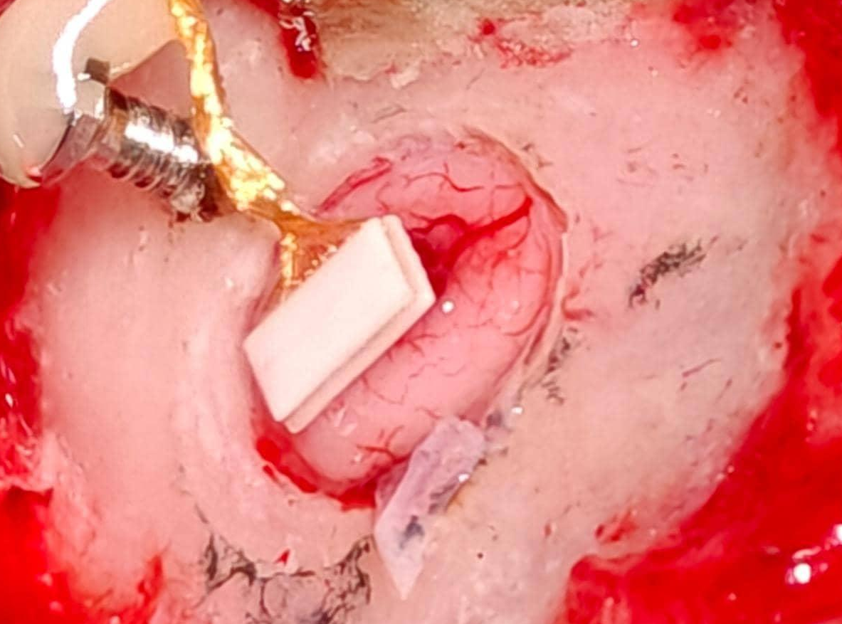
32
31
GND
30
BUNDLE
17
8
29
18
7
28
19
REF
6
27
20
9
5
26
21
10
4
25
22
11
3
REF
23
12
2
24
13
1
GND
14
15
16

