Slide 1
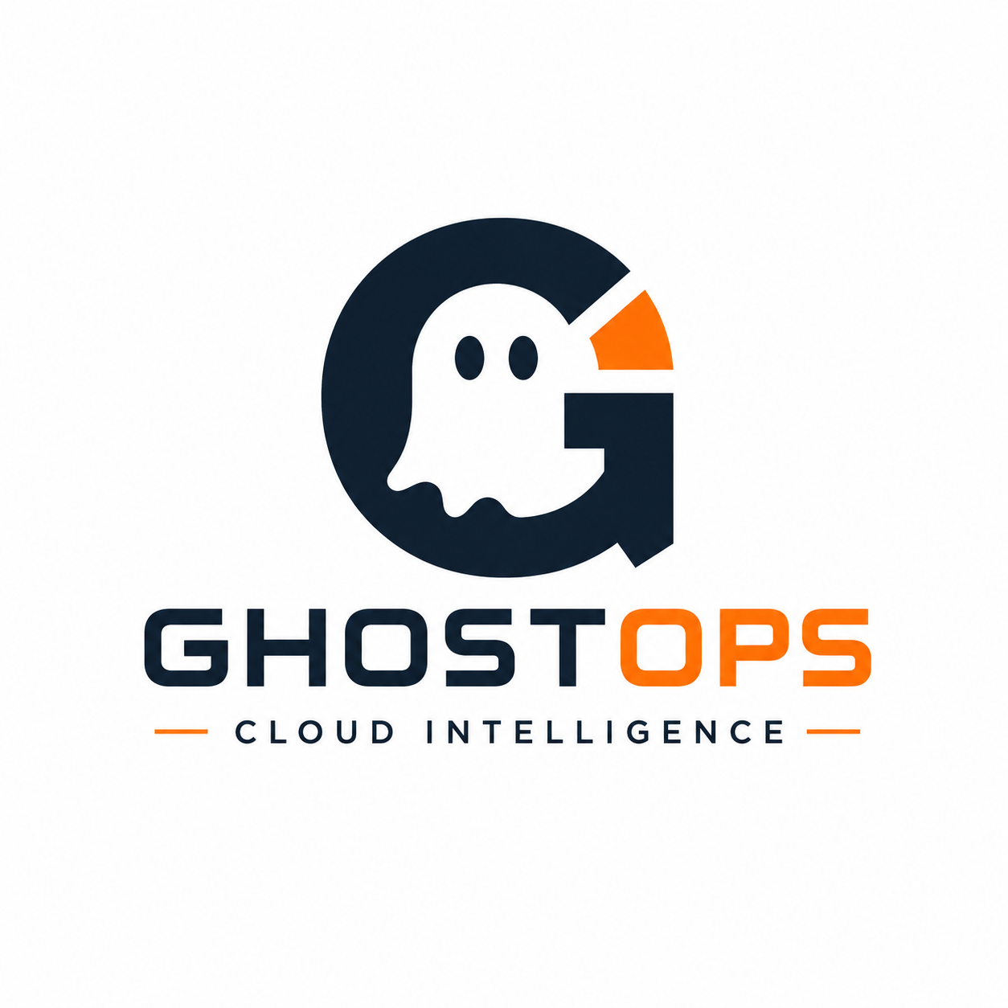
NEUROX 1.0 · PHASE 2
GhostBusters
A controlled autonomous FinOps agent for safe cloud-cost remediation
From a high-level objective to evidence, policy, human review, and an auditable remediation proposal.
Goal-directed autonomy
Multi-tool evidence
Human-controlled action
Team: [Add team name / members]
GhostBusters · NeuroX Phase 2
1

Slide 2
02
Built to answer the Phase 2 rubric
Every core requirement is visible in the product and deliberately highlighted in this presentation.
25%
25%
20%
B2B impact & viability
Autonomous reasoning
Technical architecture
FinOps cost-control workflow for cloud and Terraform teams
Goal → plan → selective tools → branch/retry → decision
FastAPI, Pydantic contracts, adapters, PostgreSQL, Redis, policy
15%
15%
Human in the loop
Live demo
Approve, reject, modify, request evidence, add context, waive
A controlled, explainable end-to-end agent run
Presentation principle
We demonstrate genuine, bounded autonomy—not a chatbot, a fixed pipeline, a single API call, or a fake demo.
GhostBusters · NeuroX Phase 2
2

Slide 3
03
The B2B problem: cloud waste is easy to see, hard to change safely
Teams need savings opportunities with enough evidence and governance to act—not another noisy dashboard.
1
The friction
2
The gap
3
GhostBusters
Low utilization alone cannot justify a change. Ownership, dependencies, production risk, business context, pricing, and recent engineering activity may tell a different story.
FinOps findings often become manual investigations spread across Terraform, cloud consoles, GitHub, Jira, and people. Decisions are slow and hard to audit.
A controlled agent converts a broad objective into a traceable recommendation: what it investigated, why it chose each tool, what it found, and where a human must decide.
B2B value: safer savings discovery + lower investigation effort + auditable decisions
GhostBusters · NeuroX Phase 2
3

Slide 4
04
What makes GhostBusters an autonomous agent?
It decides what to investigate next from the goal, resource state, evidence quality, and safety constraints.
1
Goal
2
Plan
3
Observe
4
Reason
5
Branch
6
Deliver
Interpret an objective
Choose questions & tools
Collect structured evidence
Compare alternatives
Retry / escalate / abstain
Proposal + decision trail
Dynamic rather than fixed
Bounded rather than black-box
Production/destructive signals skip normal optimization. Missing evidence triggers a request for evidence or abstention. Active dependencies block remediation. New human context re-runs the evaluation.
Optional Gemini may propose an explanation or registered read-only tool. Deterministic validation, verifier checks, policy, and human approval retain final authority.
GhostBusters · NeuroX Phase 2
4

Slide 5
05
Clean architecture: orchestration separated from evidence and authority
The agent is testable without live infrastructure; integrations are narrow adapters, not hidden logic.
1
GhostOps UI
Overview · Goals · PR Reviews · Cloud Hunt · Approvals · Audit
2
FastAPI + Pydantic
Authenticated API, role checks, validation, webhooks, readiness
3
Workflow services
WorkflowService · CloudHuntService · outcome verification · assistant
4
Decision engine
Planner · investigator · conflicts · alternatives · verifier · confidence · policy
5
Adapter + storage boundary
GitHub · Jira · AWS · Terraform · PostgreSQL · Redis
Why it matters: tool calls, policy, storage, and UI can evolve independently—while the safety contract stays explicit.
GhostBusters · NeuroX Phase 2
5

Slide 6
06
Multi-tool integration: the agent selects evidence, not just APIs
The guideline asks for 3+ external tools/APIs and intelligent tool choice. GhostBusters implements both.
1
Terraform
2
GitHub
3
Jira
Change, environment, destructive/replacement signals
PR files, reviews, commits, CODEOWNERS
Business state, owner, decommission/migration signals
4
AWS
5
Dependencies
6
Pricing
Inventory, CloudWatch utilization, pricing provenance
Active downstream protections
Savings estimate with source/provenance
Example of agent selection
A GitHub-related goal activates PR context, ownership, activity and review tools. An AWS-related goal activates inventory, CloudWatch, tags and pricing. The planner records selected and skipped tools with reasons.
GhostBusters · NeuroX Phase 2
6

Slide 7
07
Autonomous workflow in action: Terraform PR Review
An end-to-end loop from a high-level goal to a human-reviewed remediation proposal.
1
Goal / webhook
2
Parse change
3
Plan evidence
4
Collect + retry
5
Detect conflicts
6
Policy + confidence
7
Human decision
Safe result
Ambiguous result
Unsafe result
Eligible staging right-sizing recommendation; approval produces a simulated PR by default, or a narrowly validated real PR only when explicitly enabled.
Conflicting Jira and Git signals lower confidence and route the case to request evidence / human context rather than pretending certainty.
Production, destructive changes, active dependencies, unknown ownership, or critical missing evidence block remediation.
GhostBusters · NeuroX Phase 2
7

Slide 8
08
Adaptive behavior and failure recovery—not a scripted pipeline
The agent changes course when tools fail or evidence changes the safety picture.
1
Missing evidence
2
Conflicting evidence
Tool timeout/unavailability is recorded as unavailable evidence. Bounded retry/backoff runs. The agent requests evidence or abstains; it never invents data.
Recent Git activity can contradict a completed Jira issue. Conflict detection penalizes confidence and routes to human context.
3
Protection signal
4
Human feedback
Production or an active dependency changes the plan: normal optimization stops and policy blocks remediation.
A reviewer can add context, modify, request new evidence, reject, waive, revoke approval, or reopen. The case state and audit trail update.
Demo proof point: run Safe → Conflicting → Missing Evidence to show three different agent branches
GhostBusters · NeuroX Phase 2
8

Slide 9
09
Human-in-the-loop: autonomy with meaningful control
GhostBusters prepares the decision; authorized people own the decision to proceed.
1
Before action
2
At the decision
3
After the decision
The system surfaces evidence, conflicts, alternatives, confidence, verifier findings, policy result, estimated savings, and explicit risks. Human approval is mandatory for remediation.
Reviewers can approve, reject, modify the recommendation, request evidence, add context, create a waiver, revoke approval, or reopen a case. Roles and organization boundaries are enforced.
The result is an auditable proposal—not infrastructure mutation. Outcome verification can record deployment confirmation, observed savings, health signals, partial outcomes, or regressions.
Non-negotiable safety boundary: no terraform apply · no automatic merge · no cloud mutation
GhostBusters · NeuroX Phase 2
9

Slide 10
10
Transparent decision trail: judges can inspect the agent’s work
The platform is designed to answer: Why this action? Why these tools? What evidence changed the outcome?
1
Goal received
2
Plan created
3
Tools executed
Objective + source
Questions, selected/skipped tools
Input, output, freshness, reliability
4
Reasoning
5
Safety gate
6
Human decision
Conflicts, alternatives, confidence
Verifier + Rego/Conftest policy
Actor, action, comment, version
Where to show it live
Technical Audit → tool executions / planning decisions / policy results • Activity Log → shared correlation trail • Review details → evidence and rationale
GhostBusters · NeuroX Phase 2
10

Slide 11
11
Live demonstration plan: show the reasoning, not only the UI
A seven-minute sequence aligned with the guideline’s core test.
0:00–0:45
1
Set the objective
Explain the business goal and the agent’s safety boundary.
0:45–2:30
2
Safe case
Start Safe; show tool selection, evidence, recommendation, and approval proposal.
2:30–4:20
3
Conflict branch
Start Conflicting; explain why Git vs Jira disagreement changes the outcome.
4:20–5:40
4
Failure branch
Start Missing Evidence; show retry/unavailable evidence and safe escalation or abstention.
5:40–7:00
5
Trace & close
Open Technical Audit and Activity Log; connect actions to the rubric.
Use a controlled real GitHub PR only if your credentials/configuration are ready; otherwise label fixture data honestly.
GhostBusters · NeuroX Phase 2
11

Slide 12
12
Technical credibility: allowed stack, production-aware controls
Built in Python with conventional services and explicit safety engineering—not an agent-as-a-service or no-code wrapper.
1
Application stack
2
AI + policy
3
Operational controls
Python · FastAPI · Pydantic · JavaScript frontend · PostgreSQL · Redis · Docker Compose · Render deployment blueprint
Optional Gemini / mock provider for constrained planning and explanation; deterministic fallback; Rego policy via Conftest with safe Python fallback
Auth/RBAC · sessions/CSRF · secret redaction · idempotency · row versions · retries/timeouts · allowlists · readiness checks · migrations
The architecture makes the agent inspectable: integration calls are recorded, decisions are explainable, and external mutation remains deliberately constrained.
GhostBusters · NeuroX Phase 2
12

Slide 13
13
What the judges should remember
GhostBusters is an autonomous investigation agent with bounded action and full accountability.
1
Autonomy
It turns broad objectives into a dynamic investigation plan and branches on what it learns.
2
Tools
It selects and interprets multiple external evidence sources rather than calling one API.
3
Control
It elevates ambiguity and gives humans meaningful, role-governed choices.
4
Trust
It exposes evidence, conflicts, policy, confidence, retries, and decisions in an audit trail.
5
Impact
It shortens the path from a cost signal to a safe, reviewable remediation proposal.
GhostBusters · NeuroX Phase 2
13

Slide 14
14
GhostBusters
Autonomous investigation. Human-controlled remediation. Evidence you can trust.
Questions?
Goal-directed · multi-tool · adaptive · auditable · human-controlled
Live demo: GhostOps dashboard → PR Review / Cloud Hunt → Technical Audit
GhostBusters · NeuroX Phase 2
14

