Slide 1
Safety not guaranteed: Using formal methods in human factors engineering
Adam Houser
PhD Candidate, UB Department of Industrial and Systems Engineering
Inter-University Workshop 2014
Work Supported by Scenario Development Through Computational and Formal Modeling for Verification and Validation of Authority and Autonomy (A&A) Constructs in Aviation, subcontract from the Georgia Institute of Technology, sponsored by the NASA Ames Research Center.

Slide 2
Safety and simulation
Safety-critical systems: our lives and safety depend on them
More specifically, on their correctness and robustness (among other attributes)
Size and complexity concerns
The use of simulation

Slide 3
Safety and simulation
Why simulate?
Cost-effective (comparatively)
Useful event traces
Scalable
Diverse scenario exploration
Why not simulate?

Slide 4
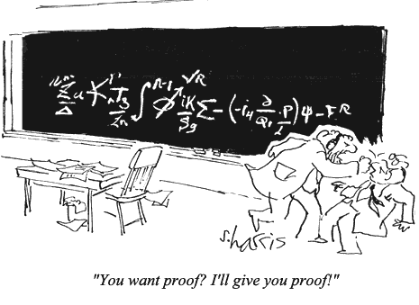
Formal Methods
Formal methods: collections of tools and techniques to prove (guarantee) a system will perform as intended
Modeling
Specification
Verification

Slide 5
Formal Methods
System
Model
Model
Checker
Verification Report
Specification

Slide 6
Formal Methods
System
Model
Model
Checker
Verification Report
Specification

Slide 7
Formal Methods
System
Model
Model
Checker
Verification Report
Specification

Slide 8
Formal Methods
System
Model
Model
Checker
Verification Report
Specification

Slide 9
Simulation and Formal Methods
Simulations are better at…
Scalable computability
Large-scope, scenario exploration
Producing diverse performance and/or stochastic measures of system performance
Formal methods are better at …
Complete state-space evaluation
Small-scope, area of interest exploration
Making specific guarantees about system model behavior or finding specific (potential unusual) occurrences of system conditions

Slide 10

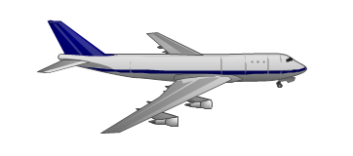
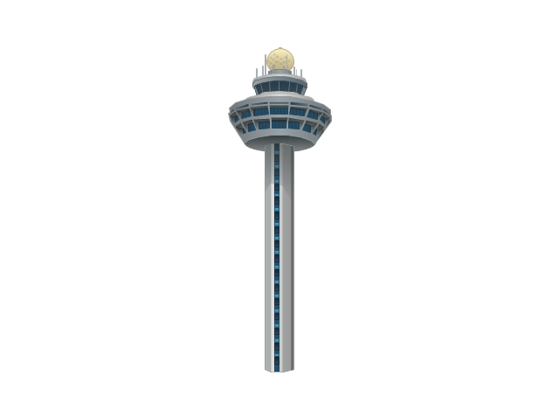
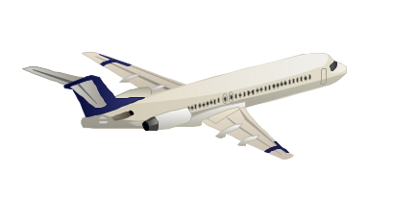
Current Research
Working with Georgia Tech, Honeywell, and Drexel U, sponsored by NASA
Our slice: Using formal methods to do sensitivity analysis on simulation scenarios for evaluating authority and autonomy in NextGen Air Traffic Control
System
Model
Model
Checker
Trace
WMC Simulation Scenario
Specification

Slide 11
Current Research
Modeling WMC concepts in SAL to facilitate WMC ↔ SAL scenario translations
Agents, a series of actions the agents must perform, a scheduler to arrange incoming actions, and flight “resources” (ex: altitude, speed)
Developing formal specification properties capable of finding interesting authority and autonomy conditions in air traffic scenarios:
Authority-responsibility double-bind
Multistep action interruptions
Clumsy automation / bad function allocation
Excessive human task load

Slide 12
Conclusions and Future Work
Automated translation: SAL ↔ WMC
Examining real-world scenarios, backfeed into WMC
Applications to novel scenarios at previously-unexplored levels of rigor
Adam’s interests: autonomy, authority and responsibility;
dynamic function allocation;
trust (guarantees?) in automation.
Formal Methods

Slide 13
Fin.
References upon request.
Constructive commentary and questions to:
adamhous@buffalo.edu
Thanks for listening!

Slide 14
Additional Slides

Slide 16
Scenario
Generic Graphical Model
WMC
Model
WMC Simulation
Simulation Results
Inputs (preconditions, post-conditions, scripted events)
Translation
Modified Scenarios
Modified Scenarios
Translation
Generated WMC Models
Abstract Model
Model
Checker
Test Cases
Constraints
Coverage Criteria & Specifications
Coverage Criteria & Specifications
Coverage Criteria & Specifications

Slide 17
Scenario
Generic Graphical Model
WMC
Model
WMC Simulation
Simulation Results
Inputs (preconditions, post-conditions, scripted events)
Translation
Modified Scenarios
Modified Scenarios
Translation
Generated WMC Models
Abstract Model
Model
Checker
Test Cases
Constraints
Coverage Criteria & Specifications
Coverage Criteria & Specifications
Coverage Criteria & Specifications

Slide 18
Scenario
Generic Graphical Model
WMC
Model
WMC Simulation
Simulation Results
Inputs (preconditions, post-conditions, scripted events)
Translation
Modified Scenarios
Modified Scenarios
Translation
Generated WMC Models
Abstract Model
Model
Checker
Test Cases
Constraints
Coverage Criteria & Specifications
Coverage Criteria & Specifications
Coverage Criteria & Specifications

Slide 19
Scenario
Generic Graphical Model
WMC
Model
WMC Simulation
Simulation Results
Inputs (preconditions, post-conditions, scripted events)
Translation
Modified Scenarios
Modified Scenarios
Translation
Generated WMC Models
Abstract Model
Model
Checker
Test Cases
Constraints
Coverage Criteria & Specifications
Coverage Criteria & Specifications
Coverage Criteria & Specifications

Slide 20
Scenario
Generic Graphical Model
WMC
Model
WMC Simulation
Simulation Results
Inputs (preconditions, post-conditions, scripted events)
Translation
Modified Scenarios
Modified Scenarios
Translation
Generated WMC Models
Abstract Model
Model
Checker
Test Cases
Constraints
Coverage Criteria & Specifications
Coverage Criteria & Specifications
Coverage Criteria & Specifications

