Slide 1
A Tour of the Lambda Calculus
Adam Houser
Formal methods guest lecture
28 Nov 2016

Slide 2
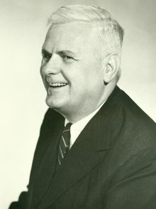

$λ$-calculus, defined
Model of computation (i.e., a formal system for defining computable functions) that is Turing complete.
POWER: computation through simplest
possible functions, with focus
on transformation rules for those functions.
Underpins functional programming languages
(ex: Haskell, Coq, Elm).
Note: no Newtonian calculus is involved.

Slide 3
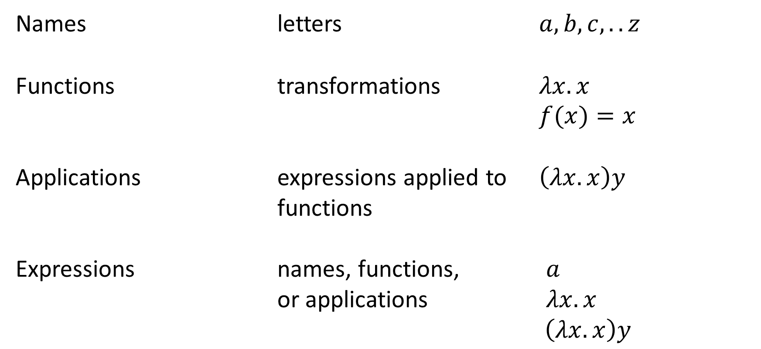
Fundamentals
Names letters $a, b, c, .. z$
Functions transformations $λx.x$
$f(x)=x$
Applications expressions applied to $\left(λx.x\right)y$
functions
Expressions names, functions, $a$
or applications $λx.x$
$\left(λx.x\right)y$
Notes:
Functions: this is the identity function for x. Notice the similarity between the algebraic identity function and the λ-calculus implementation of the identity function. Resolving this function returns x. The name after the λ operator is the “argument” of the function (the expression before the dot is called the head), with the expression after the dot is called the body of the function. Again, both of these are expressions. The λ just signifies where the function starts and says, “This function is a λ-calculus function.”
This is the identity function (the parentheses group the identity function, so you know to think about that as its own function) applied to y, rather than x. Resolving this function now returns y, rather than x.
It should also be noted that the parentheses are inserted just to keep things clear. We could also have fx = x and it would still be understood.

Slide 4
Fundamentals, continued
Everything in pure (untyped) λ-calculus is a function; only concern is computation via name substitution.
All names are local to expressions.
There are only a few different strategies used to evaluate functions, which we will cover in a bit.
Notes:
All names are local to functions: in other words, you have to “redeclared” names for every operation performed. Names do not carry definitions across functions (something I think contributes to strong typing).

Slide 5
Evaluation
When λ-calculus functions are evaluated, they are resolved.
Resolution goes as far as it can by using substitution.
Completion occurs when there are no more functions to evaluate. This simplest form is called normal form.
Next, we look at some resolution rules and strategies.

Slide 6
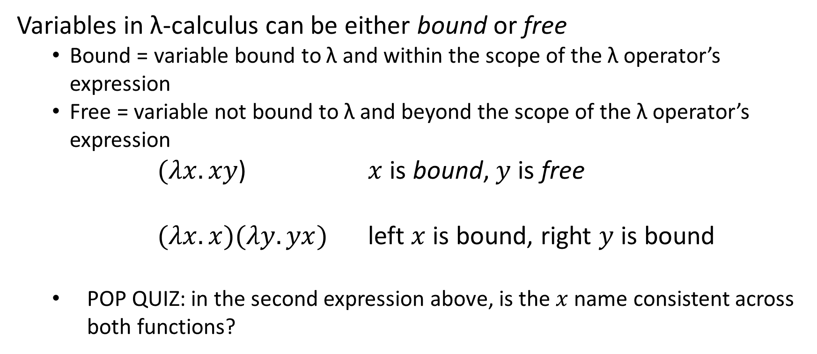
Evaluation rule: binding
Variables in λ-calculus can be either bound or free
Bound = variable bound to λ and within the scope of the λ operator’s expression
Free = variable not bound to λ and beyond the scope of the λ operator’s expression
$(λx.xy$) $x$ is bound, $y$ is free
$(λx.x)(λy.yx)$ left $x$ is bound, right $y$ is bound
POP QUIZ: in the second expression above, is the $x$ name consistent across both functions?
Notes:
Answer: no. Names are only completely independent between functions and must be redefined for each function in which they’re called.

Slide 7


Evaluation strategy: $β$-reduction
Purpose: simplifying expressions down to normal form.
$\left(λx.λz.x z\right)y$
$\left(λx.\left(λz.\left(x z\right)\right)\right)y$
$\left(λy.\left(λz.\left(y z\right)\right)\right)y$
$\left(λz.\left(y z\right)\right)$

Slide 8


Evaluation strategy: $β$-reduction, with practice
Simplify the following expression to normal form.
$\left(λy.x\left(yz\right)\right)\left(ab\right)$
$\left(λab.x\left(\left(ab\right)z\right)\right)\left(ab\right)$
$x((ab)z) or x(ab z)$

Slide 9

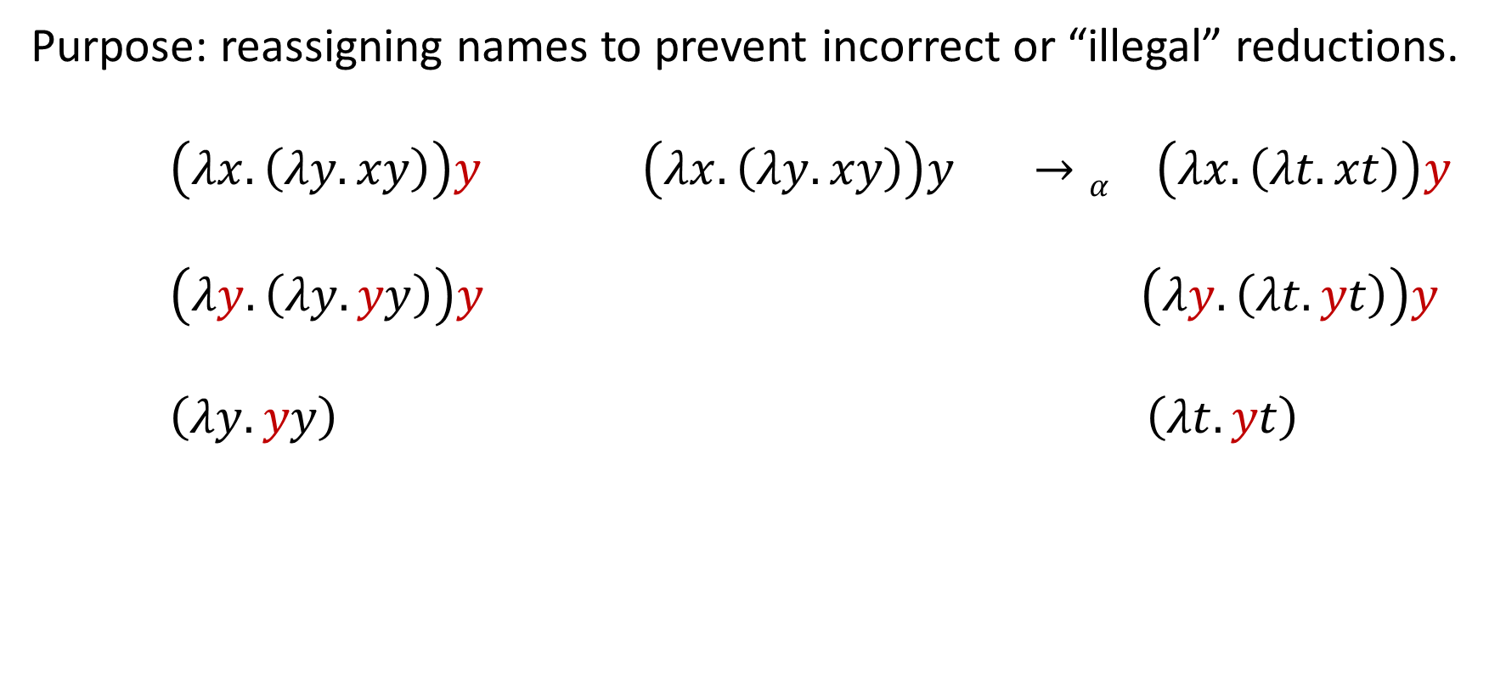
Evaluation strategy: $α$-conversion
Purpose: reassigning names to prevent incorrect or “illegal” reductions.
$\left(λx.\left(λy.xy\right)\right)y$ $\left(λx.\left(λy.xy\right)\right)y →α \left(λx.\left(λt.xt\right)\right)y$
$\left(λy.\left(λy.yy\right)\right)y$ $\left(λy.\left(λt.yt\right)\right)y$
$\left(λy.yy\right)$ $\left(λt.yt\right)$

Slide 10
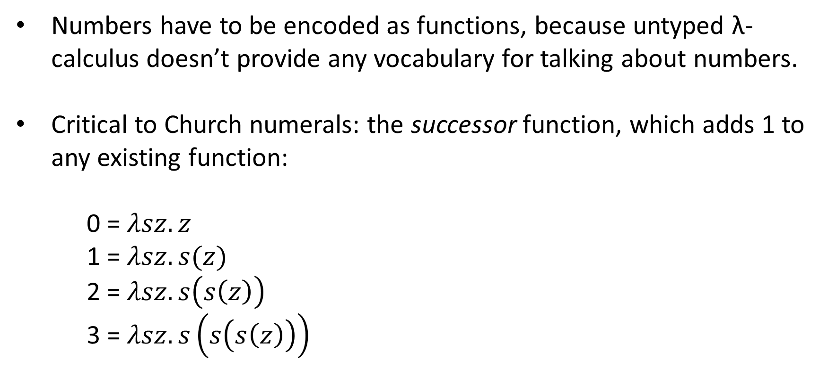
Church numerals
Numbers have to be encoded as functions, because untyped λ-calculus doesn’t provide any vocabulary for talking about numbers.
Critical to Church numerals: the successor function, which adds 1 to any existing function:
0 = $λsz.z$
1 = $λsz.s(z)$
2 = $λsz.s\left(s\left(z\right)\right)$
3 = $λsz.s\left(s\left(s\left(z\right)\right)\right)$
See the bonus slides for the successor function!
Notes:
Adding to existing functions: remember, λ-calculus is just functions all the way down.
In order for any mathematical computation to be performed, we have to define the numbers we wish to use.
Remember: $λ$sz.z is the same as $(λ$s.($λ$z.z)). It’s just shorthand to help people see what’s happening with the successor function here.

Slide 11
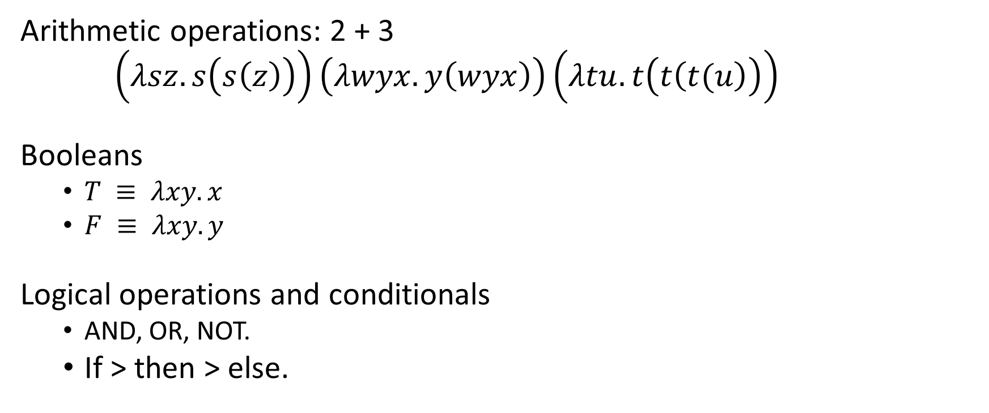
Additional capabilities
Arithmetic operations: 2 + 3
$\left(λsz.s\left(s\left(z\right)\right)\right)\left(λwyx.y\left(wyx\right)\right)\left(λtu.t\left(t\left(t(u\right)\right)\right)$
Booleans
$T ≡ λxy.x$
$F ≡ λxy.y$
Logical operations and conditionals
AND, OR, NOT.
If > then > else.

Slide 12
Implementation
“A formal approach to modeling and analyzing human taskload in simulated air traffic scenarios.”
Background:
Using simulation and formal methods synergistically to discover interesting, potentially dangerous human taskload conditions.
This particular WMC scenario used one ATC, three aircraft agents in a simulated landing at an airport.
NextGen Air Traffic Control system: shifting authority and autonomy allocation of current air navigation paradigm.
As actions are executed by all agents during landing, can we use formal methods to find problematic corner cases in the simulation trace?
Notes:
Agents and priority queues (push and pop)
Reasoning about the movement of actions in/among queues
Difficult: complex operations for determining where actions should be (tortured logic)
Potential solution: λ calculus
Why? Computation a little more straightforward, SAL’s life a little easier

Slide 13
Representing action queues efficiently
Assigning actions to queues (explained in a bit) is computationally intensive for SAL:
Agent modules must keep track of all actions in their Active and Inactive sets, with the goal of identifying violations (e.g., exceeding maxInactive)
Action modules must determine (based on whether their status is doing, assigning, or shuffling) if their state is set to active, interrupted, or delayed.
This must be computed for each simulation tick, maintained in memory, then manipulated and stored in memory during the following tick.

Slide 14

Solution: using $λ$-calculus sets with queues
Much more efficient way to handle complex operations.
Maps elements to Boolean values:
True = in the set
False = not in the set
Efficiency improvement results from set mapping: concern is now about set membership, rather than computing arrays or manipulating array data.

Slide 15
Formal model
This is the formal model architecture used in our evaluation.
Actions
status
Scheduler
assignment
Action
globalTime
agents
actions
Agents
Agent

Slide 16
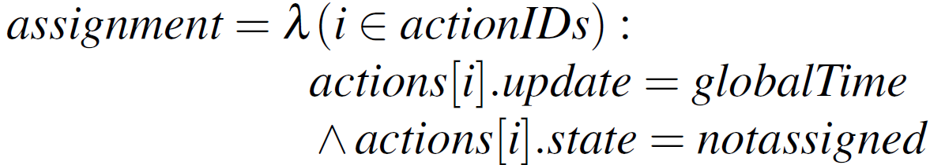
Formal Model
Actions
status = assigning
Scheduler
assignment
Action
globalTime
The scheduler examines the globalTime and indicates to the actions if they are assigned to an agent:
Assigned actions are set to waiting.
agents
actions
Agents
Agent

Slide 17
Formal Model
Actions
status = shuffling
Scheduler
assignment
Action
globalTime
agents
The Action modules reshuffle their states (Active, Waiting, or Delayed) based on:
The size of the associated agent’s queue
The cardinality of the active agent’s queue
The agent’s minimum priority active action
The agent’s maximum priority inactive action
actions
Agents
Agent

Slide 18
Formal Model
Actions
status = doing
Scheduler
assignment
Action
globalTime
Once there is nothing else to move:
The globalTime is updated
agents
actions
Agents
Agent

Slide 19
Formal Model
Actions
status = doing
Scheduler
assignment
Action
globalTime
agents
Once there is nothing else to move:
The globalTime is updated
Active actions are performed (their time is correspondingly reduced)
Completed actions (0 time) are unassigned
actions
Agents
Agent

Slide 20
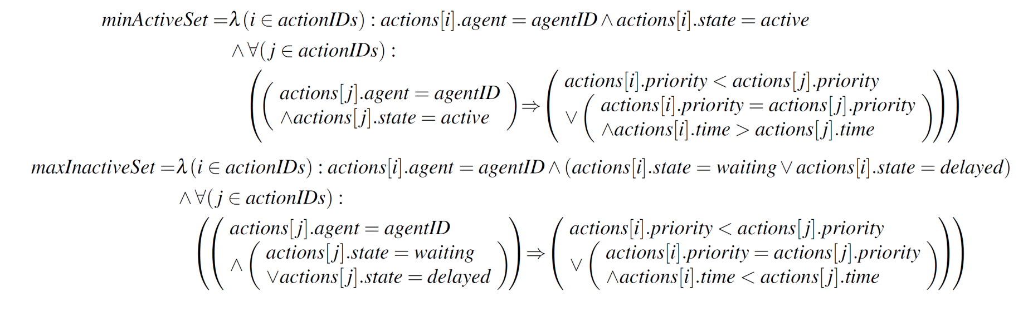
Formal Model
The agent dynamically updates queue metrics based on the shuffling, performance, and completion of actions:
Cardinality of active and inactive priority queues
Minimum priority active actions
Maximum priority inactive actions
Actions
status
Scheduler
assignment
Action
globalTime
agents
actions
Agents
Agent

Slide 21

Formal Model
Actions
status = assigning
Scheduler
assignment
Action
globalTime
The process restarts with the scheduler assigning new actions based on the new globalTime
agents
actions
Agents
Agent

Slide 22
Useful resources
http://www.inf.fu-berlin.de/lehre/WS03/alpi/lambda.pdf
http://worrydream.com/AlligatorEggs/
https://zeroturnaround.com/rebellabs/what-is-lambda-calculus-and-why-should- you-care/
http://people.eecs.berkeley.edu/~gongliang13/lambda/#firstPage
https://www.cs.umd.edu/class/spring2012/cmsc330/lectures/22-lambda.pdf

Slide 23

Bonus Slides
A successor function:
S≡$\left(λwyx.y\left(wyx\right)\right)$
Apply it to zero, with the hopes of getting 1:
S₀≡$\left(λwyx.y\left(wyx\right)\right)\left(λsz.z\right)$
$$λyx.y\left(\left(λsz.z\right)yx\right)$$
$$λyx.y\left(\left(λz.z\right)x\right)$$
$$\left(λyx.y\left(x\right)\right)$$
$$λsz.s(z)$$
S₀≡1

Slide 24
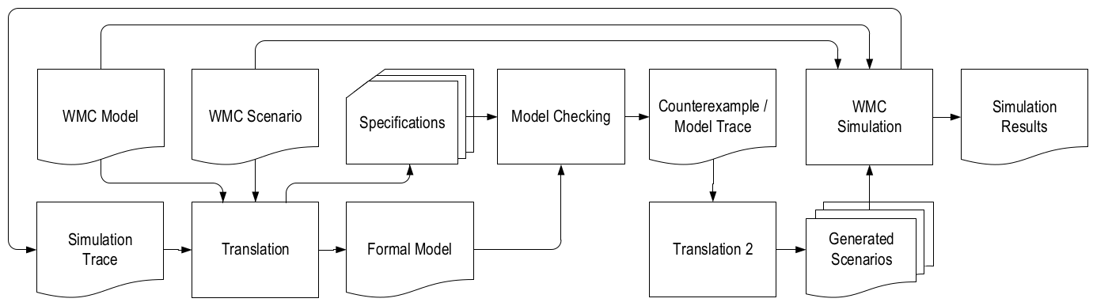
Bonus Slides

