Slide 1
Matplotlib via Designer

Slide 2
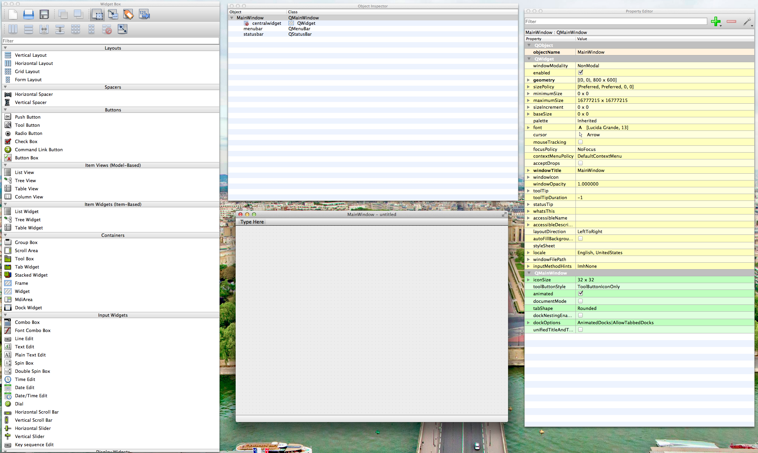
Start by creating a blank MainWindow.

Slide 3
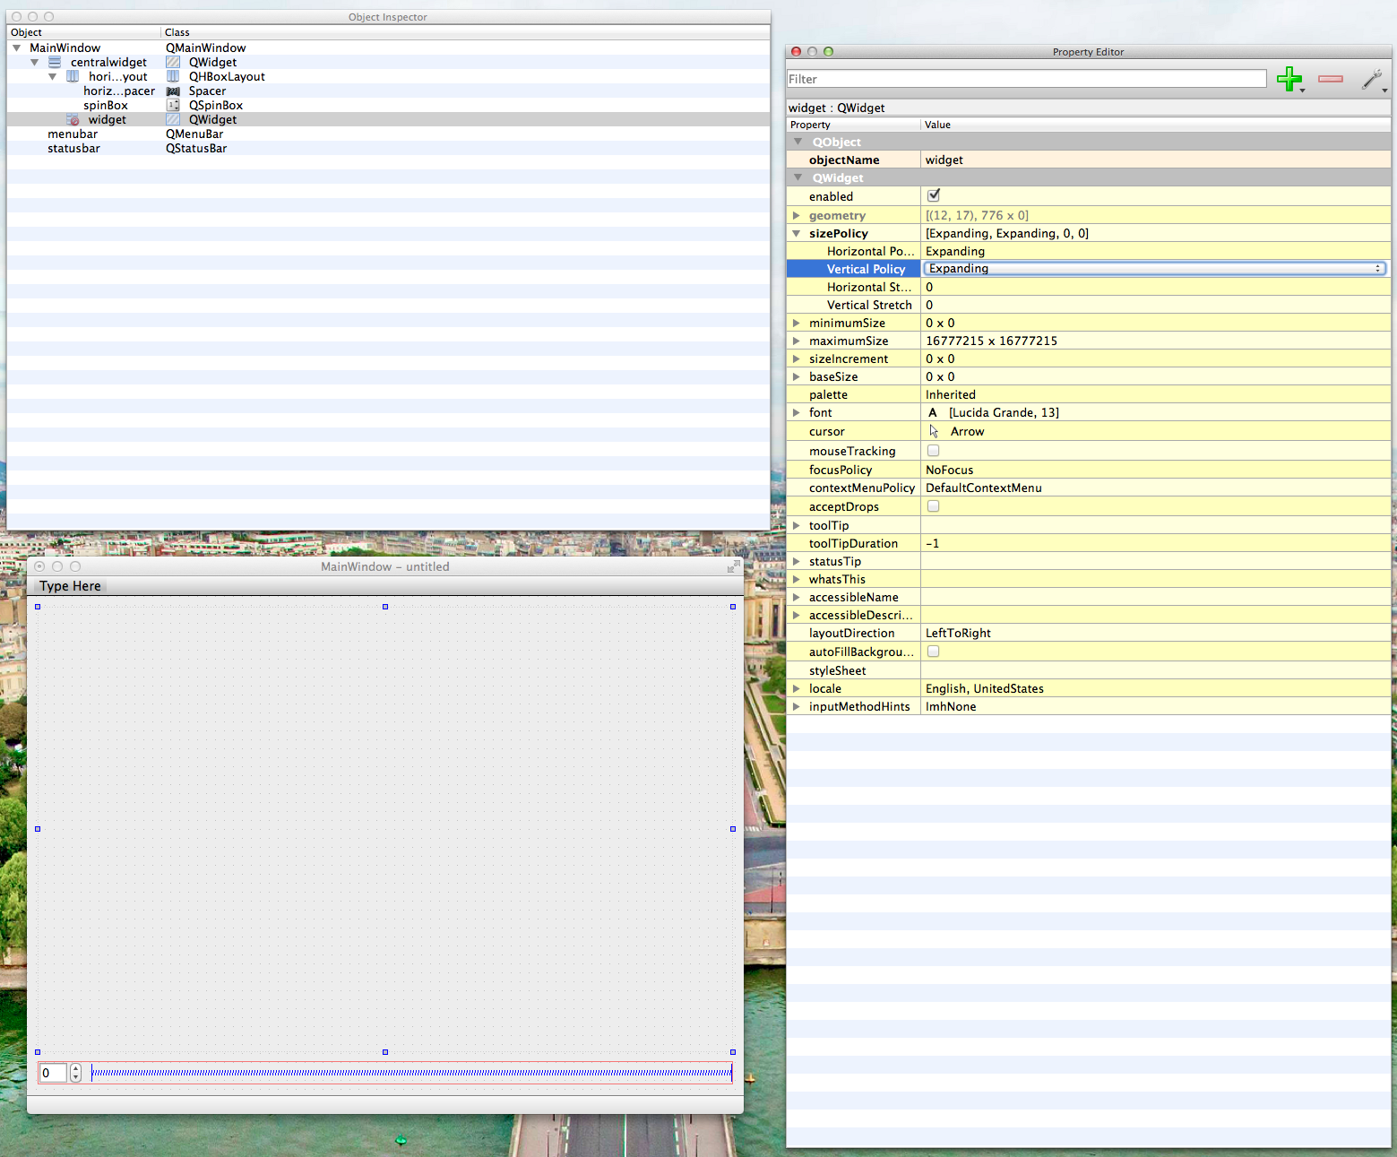
Add a Qwidget, QSpinBox and and horizontal Spacer
Make sure Vertical Policy of Qwidget is Expanding

Slide 4
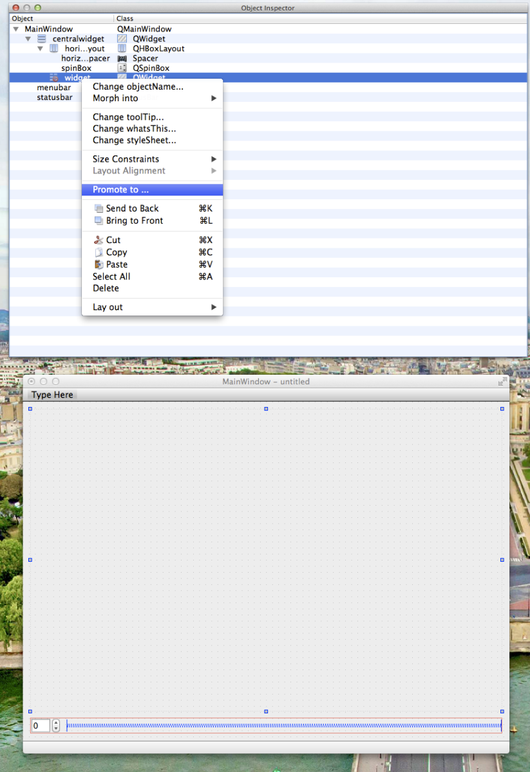
Right click Qwidget and select Promote to …

Slide 5
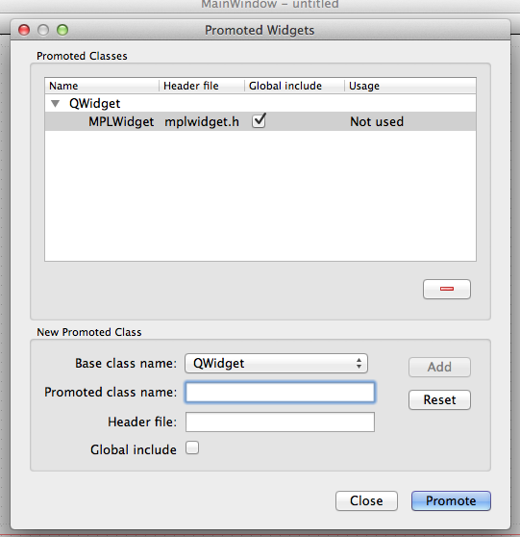
Define a new Base class name:
MPLWidget
We will use this class to modify thebehavior of the Matplotlib window.

Slide 6
Build the interface .py file
Pyuic4 myGUI.ui –o myGUI.py
Implement main function run_me.py
from myGUI import Ui_MainWindow
from PyQt4 import QtGui
import sys
class MyApplication(QtGui.QMainWindow):
def __init__(self, parent=None):
QtGui.QMainWindow.__init__(self)
self.ui = Ui_MainWindow()
self.ui.setupUi(self)
if __name__ == "__main__":
app = QtGui.QApplication(sys.argv)
mplQt = MyApplication()
mplQt.show()
sys.exit(app.exec_())

Slide 7
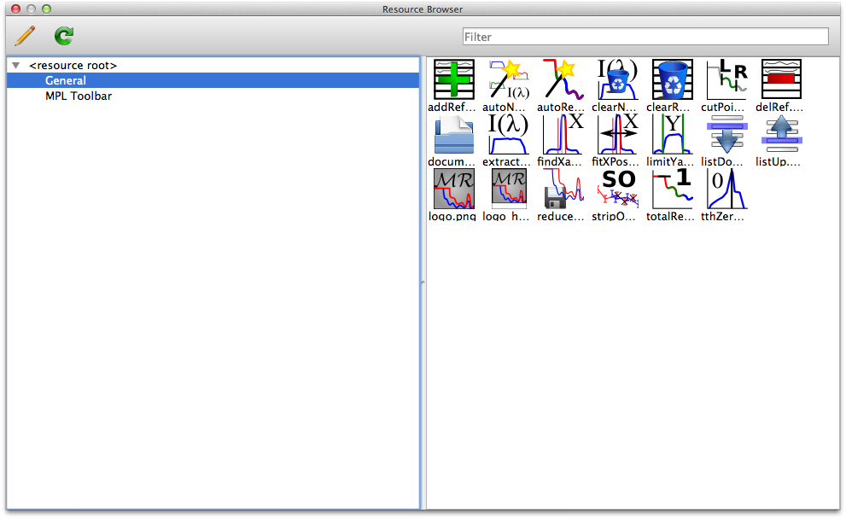
Copy the mplwidget.py into your folder. This is the file you will be able to personalize to add widgets to the toolbar for example.
Icons
Copy Icons/resources folder (from GUI_Tools) and paste into folder projects.
In designer, open Resource Browser and click edit resources and select icons.qrc file found in Icons folder.

Slide 8
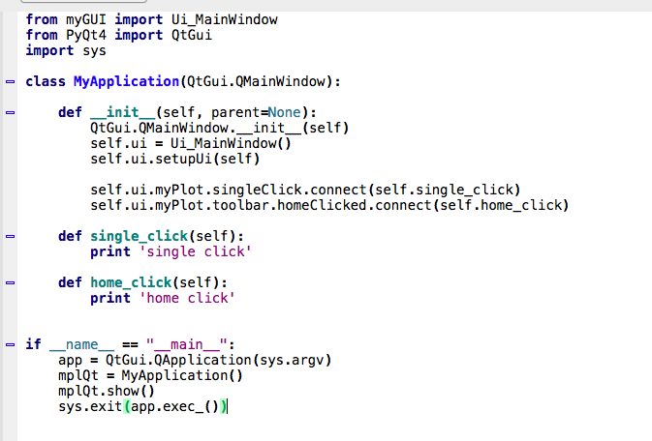
In the mplwidget.py file, the relative path of the icons will then be defined as shown here:
Here is the way to connect the signals defined in mplwidget

Slide 9
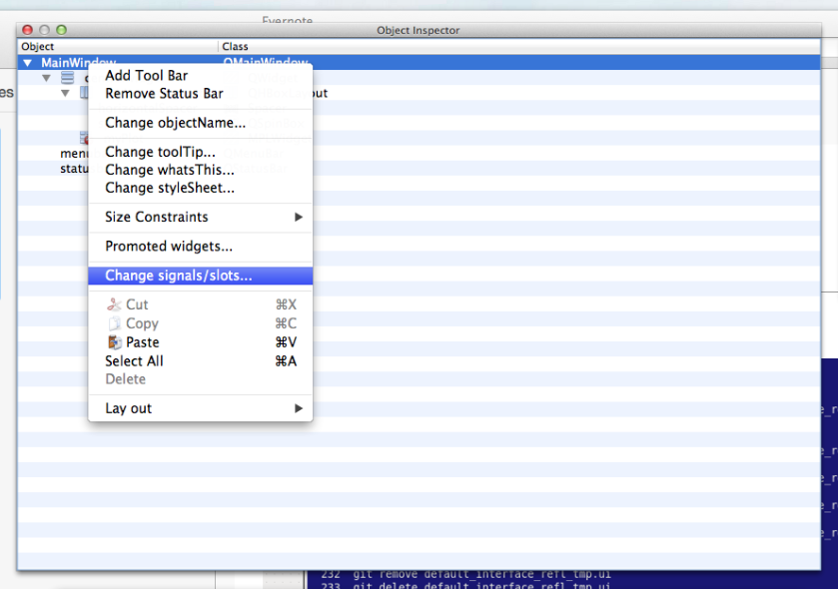
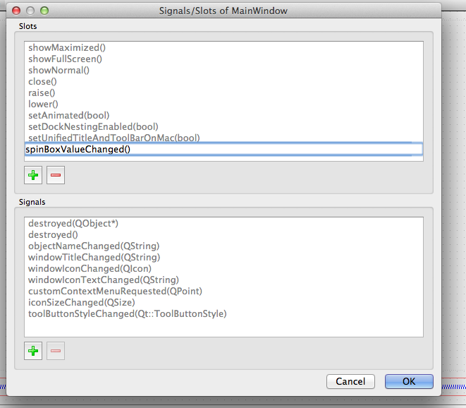
How to connect a button via designer
> Right click, in the Object inspector, the MainWindow and select Change signals/slots…
> Define the name of the function (used in the main program)

Slide 10
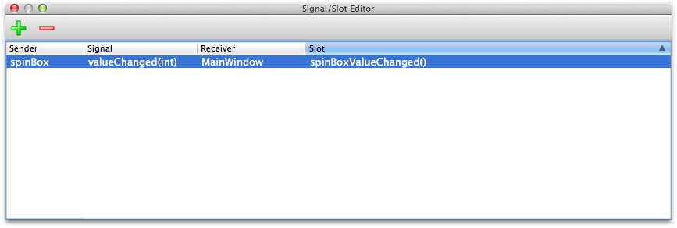
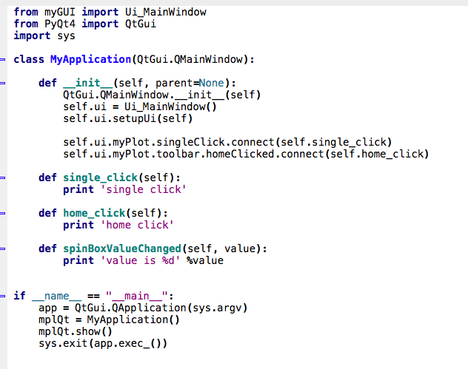
> Then in the Signal/Slot Editor window, select the widget, the signal, the receiver (always the MainWindow) and the name of the function defined in the previous step.
> Then implement main function

