Slide 1
PyVDrive Quickstart
(Cheat Sheet)

Slide 2
Starting PyVDrive
In terminal, enter > vulcan.lava
PyVDrive command UI will be launched (see next page)

Slide 3
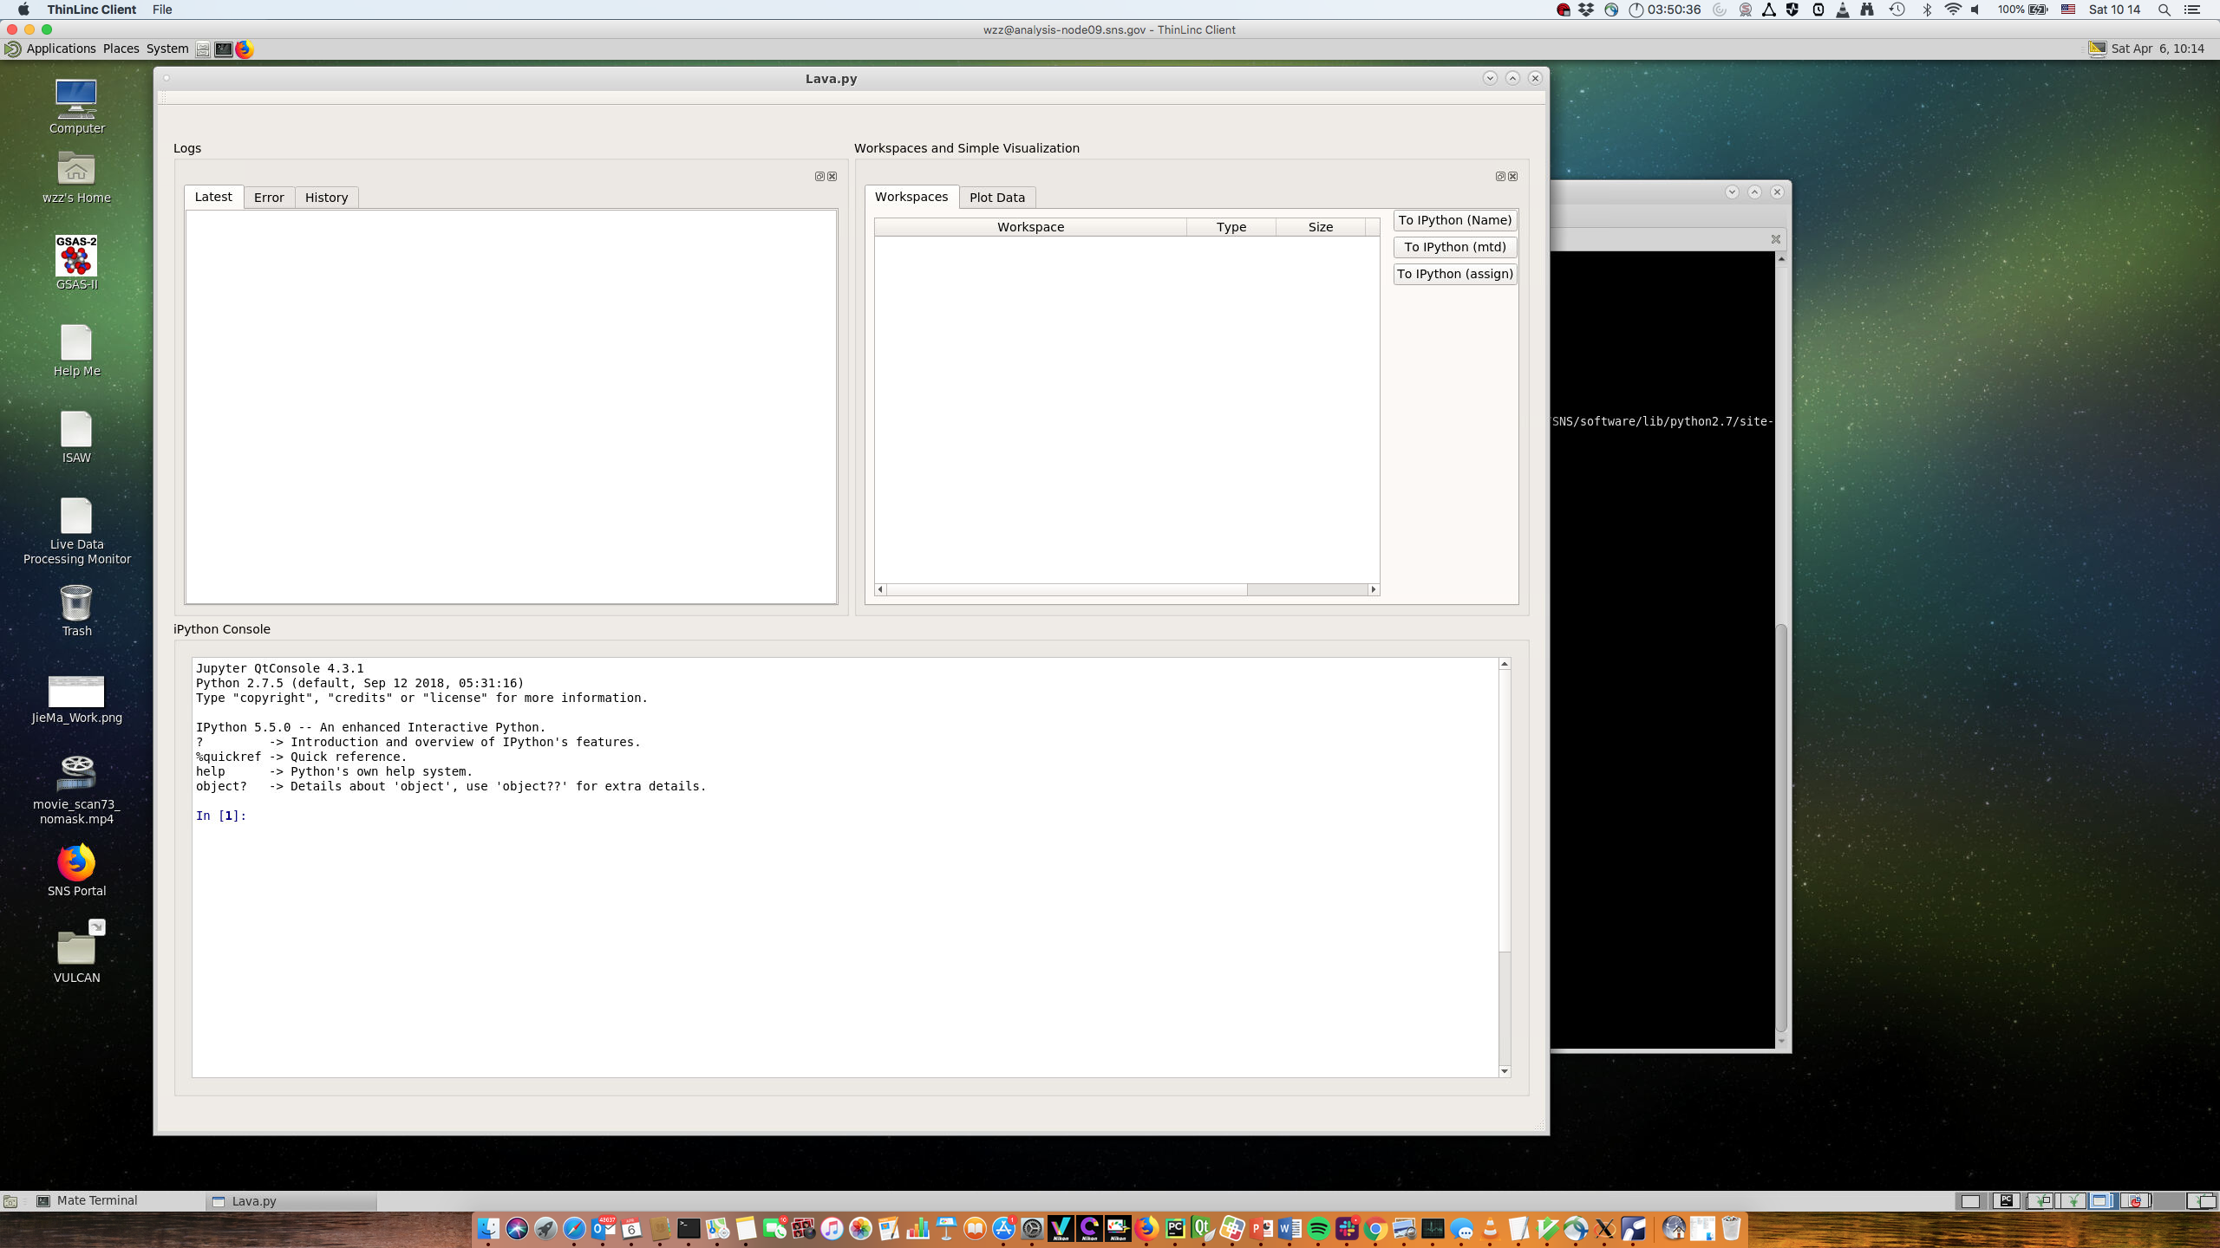
PyVDrive Command UI
IPython Console
1. Support Python
2. Support VDRIVE IDL commands

Slide 4

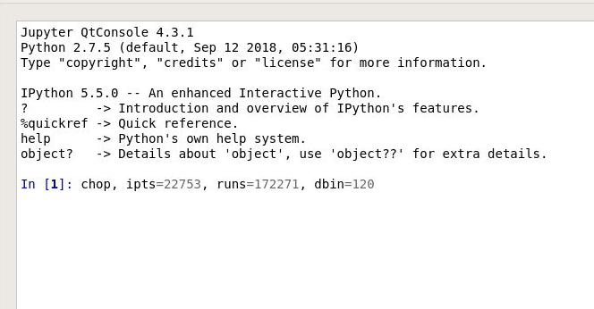

Example: Chop data
Command ”CHOP” > CHOP, IPTS=, RUNS=, DT=,

Slide 5
Example: View Chopped Data
View 4th slice > view, ipts=…,choprun=…,runs=4

Slide 6
Example: View Chopped Data (2)
View all the sliced and reduced runs > VIEW,IPTS=..,CHOPRUN=…,RUNS=1,RUNE=300
3 windows will be popped out for contour view for each bank
3 windows will be popped out for single run diffraction pattern

Slide 7
Example: Compare reduced data
In 1D diffraction data visualization UI

Slide 8
Example: VBIN

