Slide 1
High-Throughput Calculations with Thermochemical Library: TC-Python
DOE Vehicle Technologies Office (VTO)
Powertrain Materials Core Program (PMCP) Consortium
Sunyong Kwon
May 26th, 2023
ASM 2023

Slide 2
Agenda
Introduction on computational thermodynamics (CALPHAD)
2. Application of high-throughput CALPHAD
3. TC-Python tutorial

Slide 3


Computational thermodynamics (CALPHAD) provide equilibrium information when NTP are given.
Initial state
Final state (equilibrium)
Introduction to CALPHAD
N | Fe | Cr | Mn | Mo
wt % | BAL | 20. 1 | 9.8 | 1.8
T = 1200 °C
P = 1bar
Mo
Mn
Fe
$$t=∞$$
Cr

Slide 4
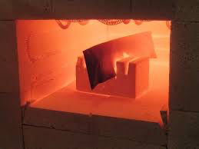
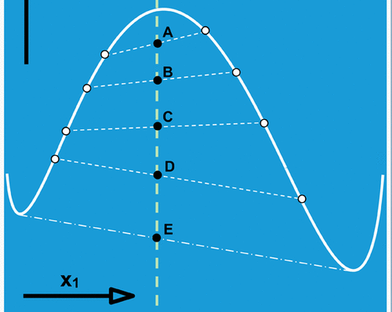
Computational thermodynamics (CALPHAD) provide equilibrium information when NTP are given.
In computation
Alloy | Fe | Cr | Mn | Mo | Nb
wt % | BAL | 20. 1 | 9.8 | 1.8 | 3
Introduction to CALPHAD
Input: Composition, Temperature, Pressure
Prepare equipment
Calibration
Gibbs energy database
Select phases (default: all)
Output: Equilibrium phases
Output: Equilibrium phases

Slide 5
Challenges in alloy design reside in high dimensionality and multiple mechanisms
Example: Creep-resistant alumina forming austenitic (AFA) stainless steel
developed by ORNL
High dimensional composition space
Multiple precipitation strengthening phases
Application of high-throughput CALPHAD
AFA alloy chemistry (17 elements)
By carbides (MC, M₂₃C₆)
By Laves (Fe₂Nb)
at % | Al | B | C | Cr | Cu | Fe | Mn | Mo | Nb
Max. | 9.85 | 0.41 | 2.01 | 20.08 | 2.64 | BAL | 9.8 | 1.8 | 3
Min. | 0 | 0 | 0 | 9.99 | 0 | BAL | 0 | 0 | 0
Ni | P | Si | Ti | V | W | Y | Zr
31.93 | 0.07 | 1.87 | 3.19 | 0.28 | 1.22 | 0.03 | 0.19
11.01 | 0 | 0 | 0 | 0 | 0 | 0 | 0
MC(NbC)
Laves (Fe₂Nb)
↑ Fe-14Cr-2.5Al-20Ni-0.9Nb-0.08C base, wt.%
↑ Fe-18Cr-0Al-31Ni-3.3Nb-0.2Si base, wt.%
Yamamoto et al., Met. Mat. Trans. A (2011)
Yamamoto et al., Intermetallics (2008)

Slide 6


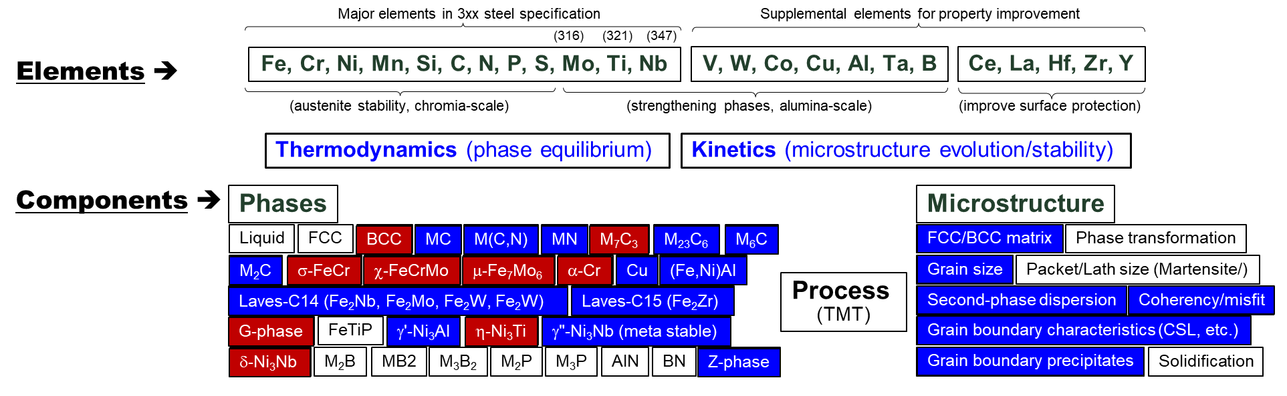

Designing AFA alloy requires in-depth understanding of thermochemical properties and kinetics.
High dimension (17)
Fe, Cr, Mn, Ni, Si, Nb , Ti, Mo, C, P
Al, Cu, V, W, Y, Zr, B
Major elements in 3xx steel
Elements for property improvement
Application of high-throughput CALPHAD
Thermodynamics (Equilibrium)
Kinetics (microstructure evolution)
Multiple mechanisms
Phase fraction(Vol%)
Solubility(Fe_X)
Supersaturation(dVol%)
Microstructure
Computational thermodynamics
Multiple properties

Slide 7

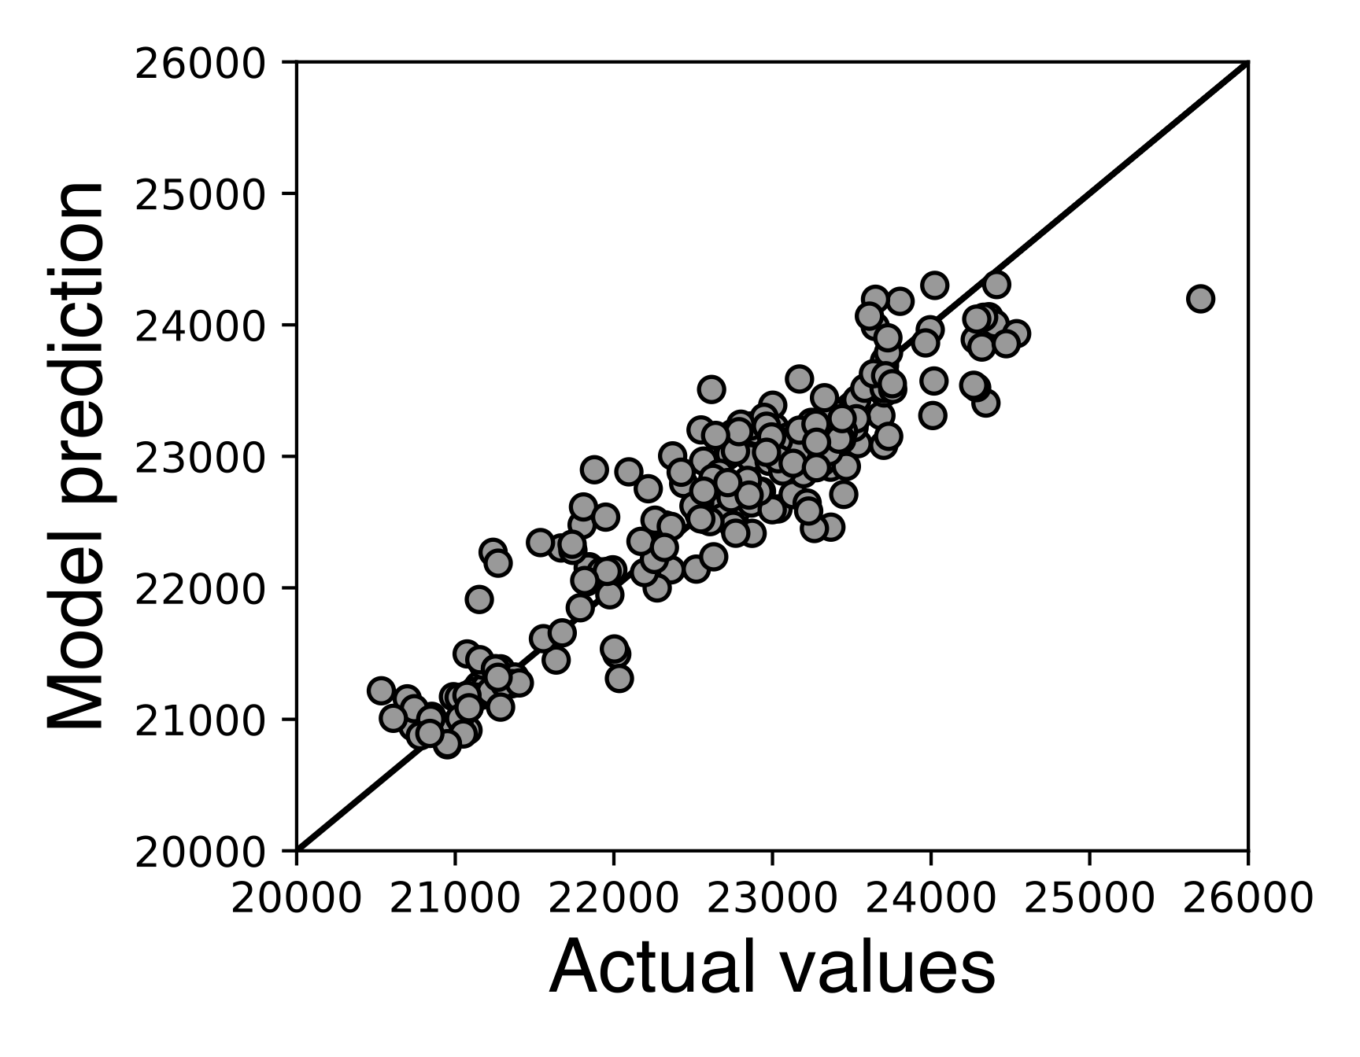
Massive calculations (>1million) are required to rapidly explore alloy chemistries by machine learning models.
Coupling Physics (Input)*
Machine Learning Modeling
Input feature type
Alloy Composition
Surrogate
AI/ML
model
Application of high-throughput CALPHAD
Testing Stress
Experimental data
Testing Temperature (T2)
Solutionizing Temperature (T1)
Raw data
Creep property (LMP)
Phase fraction, Vol%
Equilibrium
⋮
Solubility, Fe_X
Computational thermodynamics
Supersaturation, ΔVol% (T2-T1)
Kinetics
⋮
*Shin et al., Acta Materialia, 2019

Slide 8
TC-Python tutorial
Simple equilibrium calculation
Batch equilibrium calculations
Batch equilibrium calculations with multiple processors

Slide 9
Simple equilibrium calculation
Fe-Cr-C phase diagram
Procedure
Example 1
1. Set a NTP condition
2. Select database and phases
Bulk composition
3. Calculation
4. Data processing

Slide 10

Batch equilibrium calculations
Fe-Cr-C phase diagram
Multiple NTP conditions
Example 2
ID | Cr | Mn | ⋯ | T | P
1 | 8 | 9 | ⋯ | 1273 | 1E5
2 | 10 | 8 | ⋯ | 1523 | 1E5
3 | 5 | 10 | ⋯ | 1773 | 1E5
⋮ | ⋮ | ⋮ | ⋮ | ⋮ | ⋮
20k | 10 | 2 | ⋯ | 973 | 1E5
1. Set multiple NTP conditions
2. Select database and phases
3. Calculation
4. Data processing

Slide 11
Batch equilibrium calculations with multiple processor
Example 3
Multiple NTP conditions
Multi processors
Each processor
ID | Cr | Mn | ⋯ | T | P
1 | 8 | 9 | ⋯ | 1273 | 1E5
2 | 10 | 8 | ⋯ | 1523 | 1E5
3 | 5 | 10 | ⋯ | 1773 | 1E5
⋮ | ⋮ | ⋮ | ⋮ | ⋮ | ⋮
20k | 10 | 2 | ⋯ | 973 | 1E5
1. Set multiple NTP conditions
2. Select database and phases
3. Calculation
⋯
4. Data processing

