Slide 1
High-Throughput Calculations with Thermochemical Library: TC-Python
DOE Vehicle Technologies Office (VTO)
Powertrain Materials Core Program (PMCP) Consortium
Sunyong Kwon
May 26th, 2023
ASM 2023

Slide 2
Challenges in alloy design reside in high dimensionality and multiple mechanisms
Example: Creep-resistant alumina forming austenitic (AFA) stainless steel
developed by ORNL
High dimensional composition space
Multiple precipitation strengthening phases
Alloy design
AFA alloy chemistry (17 elements)
By carbides (MC, M₂₃C₆)
By Laves (Fe₂Nb)
at % | Al | B | C | Cr | Cu | Fe | Mn | Mo | Nb
Max. | 9.85 | 0.41 | 2.01 | 20.08 | 2.64 | BAL | 9.8 | 1.8 | 3
Min. | 0 | 0 | 0 | 9.99 | 0 | BAL | 0 | 0 | 0
Ni | P | Si | Ti | V | W | Y | Zr
31.93 | 0.07 | 1.87 | 3.19 | 0.28 | 1.22 | 0.03 | 0.19
11.01 | 0 | 0 | 0 | 0 | 0 | 0 | 0
MC(NbC)
Laves (Fe₂Nb)
↑ Fe-14Cr-2.5Al-20Ni-0.9Nb-0.08C base, wt.%
↑ Fe-18Cr-0Al-31Ni-3.3Nb-0.2Si base, wt.%
Yamamoto et al., Met. Mat. Trans. A (2011)
Yamamoto et al., Intermetallics (2008)
Notes:
-Through out the presentation, Id like to introduce two case studies where we applied data-drive modeling to predict mechanical properties that involves multiple strengthening mechanism.
-The first project is about Alumina Forming Austenitic alloys. This alloy is a special type of stainless steel that is developed by ORNL. Our goal was to develop a data-driven model to predict Creep-rupture time.
-For both projects, we had limited amount of data that are not enough to describe multiple mechanism.
- In this presentation, I will

Slide 3


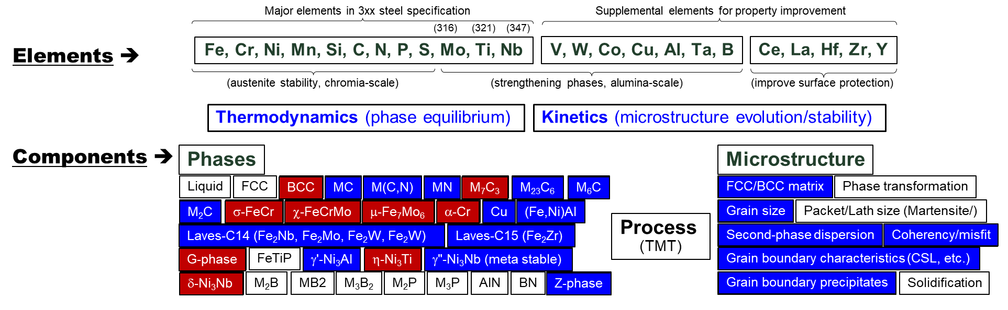

Designing AFA alloy requires in-depth understanding of thermochemical properties and kinetics.
High dimension (17)
Fe, Cr, Mn, Ni, Si, Nb , Ti, Mo, C, P
Al, Cu, V, W, Y, Zr, B
Major elements in 3xx steel
Elements for property improvement
Traditional alloy design
Thermodynamics (Equilibrium)
Kinetics (microstructure evolution)
Multiple mechanisms
Phase fraction(Vol%)
Solubility(Fe_X)
Supersaturation(dVol%)
Microstructure
Computational thermodynamics
Multiple properties
Notes:
Designing alloy chemistry is challenging and time consuming, since it involves multiple strengthening mechanism and phases. Here is a glance of what is going on in Domain’s expert mind when they design the AFA materials.
First, there are17 different elements where one part is essential to compost 3xx steel alloy, and other part is important for improving properties.
The combinations of these alloys yield multiple phases where some plays beneficial role in alloys properties. The amount of those beneficial phase, solubility of elements must be considered

Slide 4

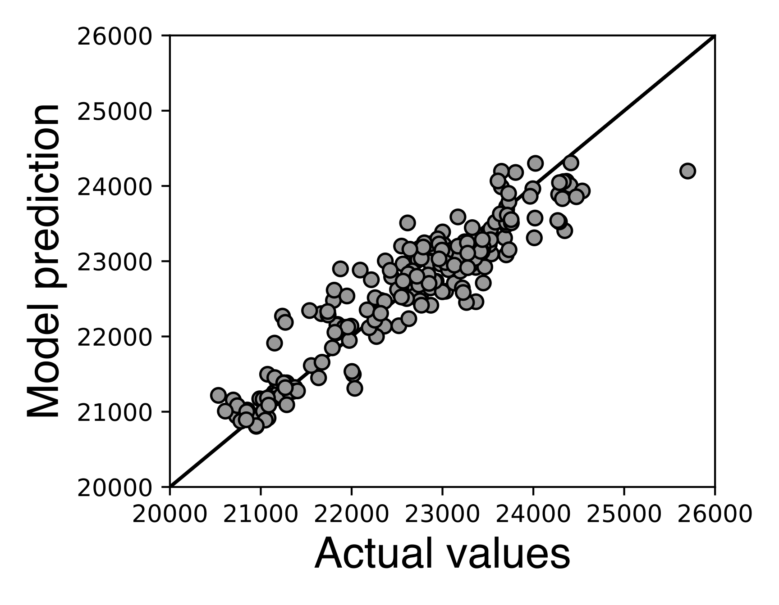
Massive calculations (>1million) are required to rapidly explore alloy chemistries by machine learning models.
Coupling Physics (Input)*
Machine Learning Modeling
Input feature type
Alloy Composition
Surrogate
AI/ML
model
ML based alloy design
Testing Stress
Experimental data
Testing Temperature (T2)
Solutionizing Temperature (T1)
Raw data
Creep property (LMP)
Phase fraction, Vol%
Equilibrium
⋮
Solubility, Fe_X
Computational thermodynamics
Supersaturation, ΔVol% (T2-T1)
Kinetics
⋮
*Shin et al., Acta Materialia, 2019
Notes:
Therefore, we are using physics coupled machine learning models to rapidly explore alloy chemistry and select a set of candidate for further experimental validation
To be more specific on what we meant by coupling physics in ML, conventional ML only use raw experimental data: experimental conditions and measurements, which is lack on scientific features that we use for our own sake of understanding.
For this project, we are combining computational physics results (one example is CALPHAD), which can provide the information on what phases would form, and what are the driving forces.
Using all these data, we trained surrogate models, but we ended up getting low accuracy.

Slide 5
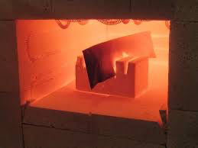
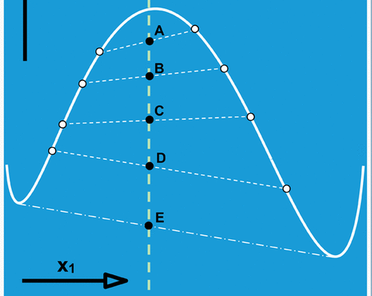
Computational thermodynamics (CALPHAD) method closely mimics experimental procedure.
In reality
In computation
Phase equilibria
Input: Composition, Temperature, Pressure
Input: Composition, Temperature, Pressure
Prepare equipment
Calibration
Gibbs energy database
Select phases (default: all)
Output: Equilibrium phases
Output: Equilibrium phases

Slide 6
TC-Python tutorial
Simple equilibrium calculation
Batch equilibrium calculations
Batch equilibrium calculations with multiple processors

Slide 7
Simple equilibrium calculation
Fe-Cr-C phase diagram
Procedure
Example 1
1. Set a NTP condition
2. Select database and phases
Bulk composition
3. Calculation
4. Data processing

Slide 8

Batch equilibrium calculations
Fe-Cr-C phase diagram
Multiple NTP conditions
Example 2
ID | Cr | Mn | ⋯ | T | P
1 | 8 | 9 | ⋯ | 1273 | 1E5
2 | 10 | 8 | ⋯ | 1523 | 1E5
3 | 5 | 10 | ⋯ | 1773 | 1E5
⋮ | ⋮ | ⋮ | ⋮ | ⋮ | ⋮
20k | 10 | 2 | ⋯ | 973 | 1E5
1. Set multiple NTP conditions
2. Select database and phases
3. Calculation
4. Data processing

Slide 9
Batch equilibrium calculations with multiple processor
Example 3
Multiple NTP conditions
Multi processors
Each processor
ID | Cr | Mn | ⋯ | T | P
1 | 8 | 9 | ⋯ | 1273 | 1E5
2 | 10 | 8 | ⋯ | 1523 | 1E5
3 | 5 | 10 | ⋯ | 1773 | 1E5
⋮ | ⋮ | ⋮ | ⋮ | ⋮ | ⋮
20k | 10 | 2 | ⋯ | 973 | 1E5
1. Set multiple NTP conditions
2. Select database and phases
3. Calculation
⋯
4. Data processing

