Slide 1
Basics of python and applications to neutron scattering

Slide 2
Python
“At its core, Python is a tool for telling a computer what to do through a series of instructions. Python's syntax is designed to be readable and easy to understand, making it a good choice for beginners to programming.”
“Python is particularly well-suited to scientific computing because of its extensive libraries. These libraries provide a wide range of functions and tools.”
“Python also supports interactive computing, which allows scientists to work with their data in real time and quickly iterate on their analysis.”
- ChatGPT

Slide 3
Overview
python basics: a practical guide to accessing scientific libraries in python
the python ecosystem
repositories (git and github)
conda environments
an example: the Mantid package for analysing and visualizing neutron data.
Material science application: analysing diffraction data using python and mantid.

Slide 4
The python scientific ecosystem
Many python modules and packages for almost any application
core numeric libraries: numpy, scipy, matplotlib,…
domain specific: pandas, seaborn (statistics), sympy (symbolic computing), scikit-image (image processing)
Many applications built around python or have python API that enable them to be scripted.

Slide 5
Installing code: repositories
most code is developed, maintained and distributed in a repository
git is a tool that provides version control for repositories
manage, track and revert changes
create separate branches to develop new features
maintain dev,qa and production branches
github is a hosting site for git repositories
extremely popular (> 372M)
many useful features for code development

Slide 6
Managing your environment
Modules and packages constantly evolve
Software with multiple dependencies are vulnerable to conflicts when versions change.
Environment management systems, such as anaconda, solve this problem.

Slide 7
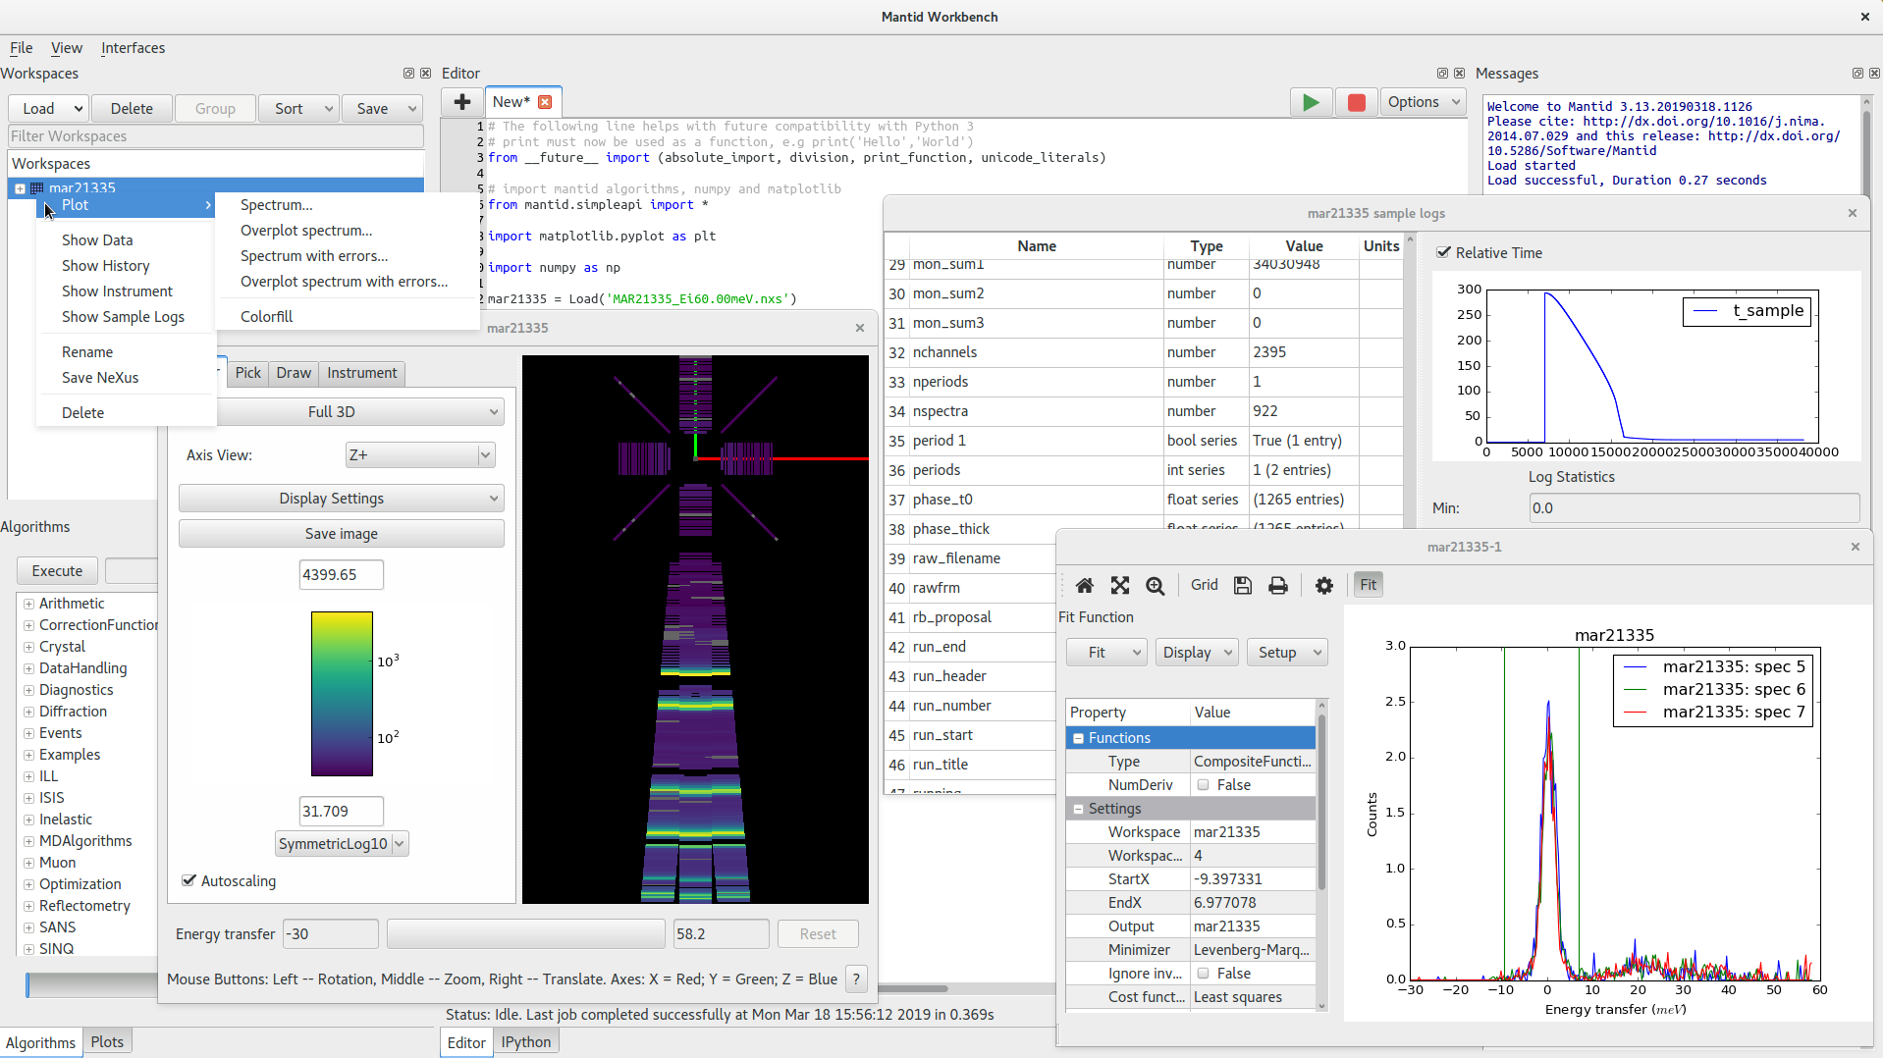
Mantid (Manipulation and Analysis Toolkit for Instrument Data)
scope includes:
many neutron-specific algorithms
a user interface (supporting scripting, visualization, GUIs for algorithms, fitting tools…)
Current version 6.6.0
install via bundles for mac, PC,Linux
or via conda
https://doi.org/10.1016/j.nima.2014.07.029

Slide 8
mantidworkbench GUI

Slide 9
Algorithms

Slide 10
Workspace

Slide 11
Python scripting

