Slide 1
Jupyter notebooks and their widgets
Jean Bilheux
Neutron Imaging Computer Instrument Scientist
Materials Engineering Group
Neutron Scattering Division
ASM - 2023
Development

Slide 2
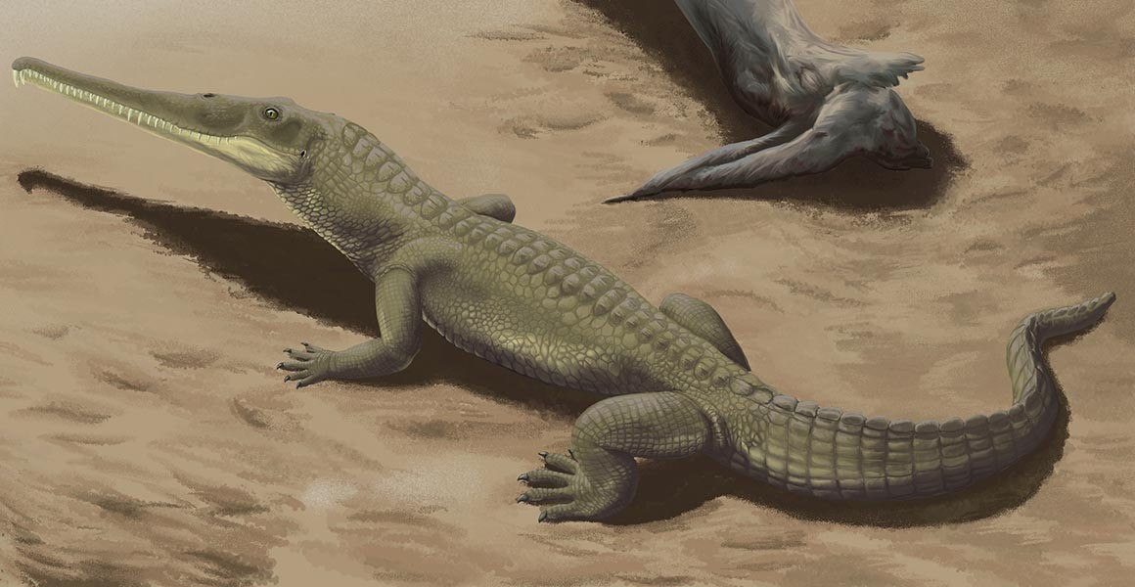
Table of Contents
Neutron imaging technique
Jupyter notebooks
Hands on using simple jupyter notebooks
Make a Jupyter notebook interactive
Demo of notebooks with widgets
Integrating a full user interface with a Jupyter notebook
Sample: Phytosaur teeth
https://github.com/neutrons/asm_2023/tree/main/jean
Notes:
Here is how we gonna spent the next 45 minutes.
I will start by showing you what I have been doing before joining the imaging team.
Then in the first part I will describe my work as an imaging software developer
In the second part, I will talk about my work as Embedded imaging software developer and you will see how much the *embedded* word is important.
Finally I will give my vision of the CIS position

Slide 3
Neutron Imaging
MARS
VENUS

Slide 4
Neutron Imaging
Type of science

Slide 5
Jupyter notebooks
Notes:
Presentation of what they are, how to get them, and to run them

Slide 6
Hand-on – cropping a stack of images
PLAN
Load the images
Visualize
Select region to crop
Visualize result
Export new images
jean/exercises/notebook_without_widgets_example1.ipynb

Slide 7
Hand-on – cropping a stack of images
NEW PLAN using widgets
Load the images
Visualize
Select region to crop
Visualize result
Export new images

Slide 8
More advanced used of widgets
Topaz config file
Timepix3
Group images per cycle for panoramic stitching
Advanced normalization

Slide 9
Integrating a full user interface with a Jupyter notebook
neutronimaging.ornl.gov/tutorials/imaging-notebooks/

Slide 11
Jupyter notebooks

Slide 12
Jupyter notebooks
Courtesy of Hongyu Zhou.

Slide 13
Jupyter notebooks
Sort images according to a couple of metadata values (motor positions)
Group images and combine images with same metadata values within the same group
Generate excel file, used by grating software Angel to run in batch mode

Slide 14
Jupyter notebooks

Slide 15
Jupyter notebooks

Slide 16
Table of Contents
General tools
Jupyter Notebooks
Strain mapping
Notebook
iBeatles
Grating Interferometry
Angel
Maverick
CT reconstruction
Rockit
pyMBIR
ASUI
Software support and tutorial
Notes:
Here is how we gonna spent the next 45 minutes.
I will start by showing you what I have been doing before joining the imaging team.
Then in the first part I will describe my work as an imaging software developer
In the second part, I will talk about my work as Embedded imaging software developer and you will see how much the *embedded* word is important.
Finally I will give my vision of the CIS position

Slide 17
Strain mapping – notebook

Slide 18
Software Support and Tutorial
neutronimaging.ornl.gov
neuit.sns.gov

Slide 19
Free Stuff
github.com/neutronimaging
github.com/ornlneutronimaging
github.com/scikit-beam

Slide 20
Acknowledgements
Research sponsored by the Laboratory Directed Research and Development Program of Oak Ridge National Laboratory, managed by UT-Battelle LLC, for DOE.
Resources at the High Flux Isotope Reactor (HFIR) and Spallation Neutron source (SNS), U.S. DOE Office of Science User Facilities operated by ORNL, were used in the research.
Research at Manufacturing Demonstration Facility (MDF) was sponsored by the U.S. Department of Energy, Office of Energy Efficiency and Renewable Energy, Advanced Manufacturing Office, under contract DE-AC05-00OR22725 with UT-Battelle, LLC.
Research at National Transportation Research Facility was sponsored by the U.S. Department of Energy, Office of Energy Efficiency and Renewable Energy, Vehicle Technologies Office.
Notes:
LDRD

Slide 21
Thank you! Questions?
https://neutronimaging.ornl.gov/

Slide 22
Grating Interferometry – Maverick

