Slide 1
When Things Go Wrong
Mathieu Doucet
Oak Ridge National Laboratory

Slide 2
Plan for the next few weeks
Topics to cover:
General overview
Workflow manager and DASMON listener – Installation & maintenance [this presentation]
Web monitor – Installation and maintenance
Autoreduction service – Installation and maintenance
Autoreduction setup through webmon – how-to and future vision
The IHC call – when things go wrong & recovery strategies
Vision for the future – what I would do differently

Slide 3
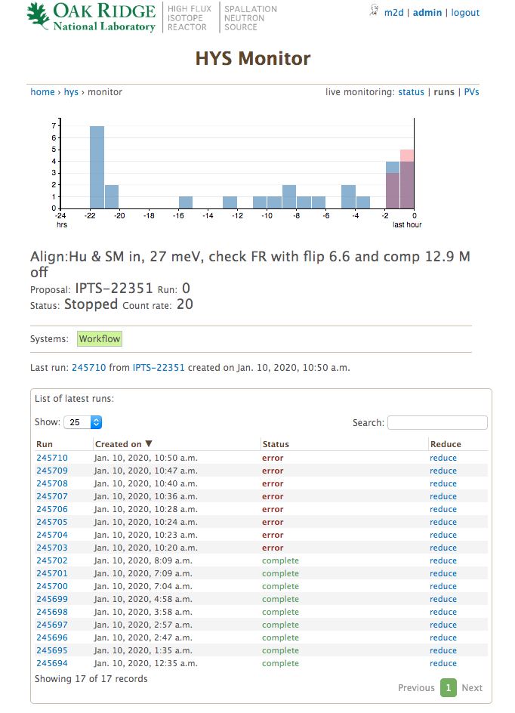
The IHC is calling… now what?
You might need this link
These are the top reasons to get called:
There are reduction errors
This is rarely your problem. Go to the monitor and look at the latest runs across all instruments. If most instruments are reducing data just fine, tell the IHC to call the CIS.
Recent runs are not appearing on the monitor
If there’s a network issue, the AMQ clients might be stuck.
Restart the workflowmgr, dasmon_listener, AR services.
If that doesn’t work, restart AMQ and restart those services again.
You may need to recover unprocessed runs.
The instrument status is not updating on the monitor
That’s usually a DASMON issue. Ask the IHC to call DAS.
User can’t see his data
Ask them to log in...
500
Someone touched something without letting you know…
Errors!

Slide 4
The dangerous admin page
We use this to resubmit a range of runs for which the DAS message got lost.
The DAS has recently been updated to resubmit when the original request failed. This will help.
Pick the instrument, and start typing the experiment number. The combo box uses ONCat for auto-completion.
The “create as needed” checkbox is dangerous, because it WILL create new run entries.
When clicking submit, a sanity check is run to verify that the runs you asked for don’t already exist as part of another IPTS.
The “find” button simply runs through the run entries and lists out missing runs. It doesn’t write anything.

Slide 5
The most annoying errors
#1. PV entries come in at a high rate. These are only used for instrument monitoring and are deleted after 2 hours.
The postgres IDs will eventually run out!
ALTER SEQUENCE pvmon_pv_id_seq RESTART WITH 1;
#2. The way the services are set up tends to leave old processes behind after a restart. Always check otherwise restarting might not fix the problem.

