Slide 1
Web monitor: installation and maintenance
Mathieu Doucet
Oak Ridge National Laboratory

Slide 2
Plan for the next few weeks
Test environment:
New RHEL8 machines are being set up so we can install them together
Topics to cover:
General overview
Workflow manager and DASMON listener – Installation & maintenance
Web monitor – Installation and maintenance [this presentation]
Autoreduction service – Installation and maintenance
Autoreduction setup through webmon – how-to and future vision
The IHC call – when things go wrong & recovery strategies
Vision for the future – what I would do differently

Slide 3
Post-Processing Architecture
ActiveMQ message
direct access
Translation Service
workflowmgr.sns.gov
Owned by DAS
webmon.sns.gov
announces new file
Workflow Manager
Web Monitor
Runs script that can be changed by IS
autoreducer[1-4].sns.gov
Post Processing
instructions & status
Users love this
heartbeat
heartbeat
DASMON
DASMON Listener
PostgreSQL Database
Owned by DAS
Local to instrument
All involved would like to see it go.
Known issue: DAS GL doesn’t like that a tool not owned by DAS report on DAS
heartbeat, status
PV updates
workflowdb2.sns.gov
pvsd
heartbeat
AMQ broker
+ PostgreSQL
livedata.sns.gov
Plot server
amqbroker[1-2].sns.gov

Slide 4
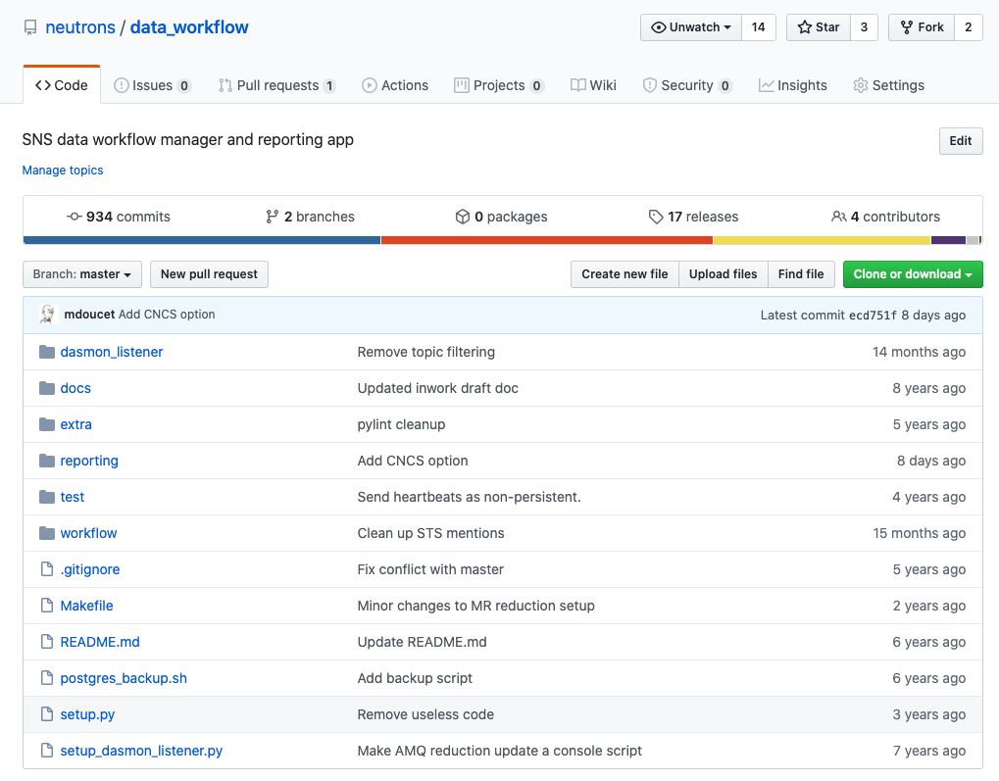
Installation
https://github.com/neutrons/data_workflow
The web monitor offers a view on the workflow manager’s data. It shares a database with the workflow manager.
The dasmon listener and DAS also write instrument information to the same DB so the monitor can report instrument status.
The database is hosted on workflowdb2.sns.gov
The monitor is also used to set up AR and reprocess runs. For this reason it also connects to the AMQ brokers to submit requests.
… more on the AR configuration in a couple of weeks.
Web monitor application code

Slide 5
Web monitor configuration
local_settings.py
The DB settings are shared between the workflow app and the monitor app.
A number of places are available to write configs.
You could just write a local_settings.py file.
from django_auth_ldap.config import LDAPSearch, PosixGroupType
import ldap
[ database info here ]
[ LDAP info here ]
ALLOW_GUESTS = True
GRAVATAR_URL = "https://www.gravatar.com/avatar/"
ALLOWED_DOMAIN = ('ornl.gov','sns.gov')
LIVE_PLOT_SECRET_KEY=”xxx"
FITTING_URLS = {'ref_l': 'https://reflectivity.sns.gov/fit/ref_l/$run_number'}
CATALOG_URL = 'https://oncat.ornl.gov'
CATALOG_ID = ”xxxxx"
CATALOG_SECRET = ”xxxxxx"
FACILITY_INFO = {'hb2c': 'HFIR','cg1d': 'HFIR', 'hb2a': 'HFIR', 'hb2b': 'HFIR', 'hb3a': 'HFIR', 'cg2': 'HFIR', 'cg3': 'HFIR’}
[ AMQ info here ]
data_workflow/reporting/reporting_app/settings.py
imports
data_workflow/workflow/database/settings.py
imports (optional, not in repo)
data_workflow/workflow/local_settings.py

Slide 6
Deploying the web monitor
Runs on webmon.sns.gov. A new test node is available on webmondev.sns.gov
sudo /usr/sbin/deploy-webmonitor [path to code]
Once deployed, you just need to restart apache
Logs are in /var/log/httpd
Installation for a bare machine:
> sudo yum install mod_wsgi (with python 2.7)
> sudo chown -R apache /var/www
- Install easy_install
> wget https://bootstrap.pypa.io/ez_setup.py -O - | sudo python
> sudo easy_install django==1.7
> sudo easy_install django_auth_ldap
> sudo yum install python-devel
- postgresql installation
> sudo yum install postgresql postgresql-devel postgresql-server
> sudo yum install postgresql-libs postgresql-contrib
> sudo easy_install psycopg2
- Make sure port 5432 on workflowdb.sns.gov is reachable from webmon.sns.gov
- Modify reporting/apache/apache_django_wsgi.conf as needed, then copy it to /etc/httpd/conf.d
> cd /var/www/workflow/app; python manage.py createcachetable webcache
data_workflow/reporting/apache/apache_django_wsgi.conf
Alias /static/ /var/www/workflow/static/
<Directory /var/www/workflow/static>
Order deny,allow
Allow from all
</Directory>
WSGIScriptAlias /workflow /var/www/workflow/app/reporting_app/reporting.wsgi WSGIPythonPath /var/www/workflow/app
<Directory /var/www/workflow/app/reporting_app>
Order allow,deny
Allow from all
</Directory>

Slide 7
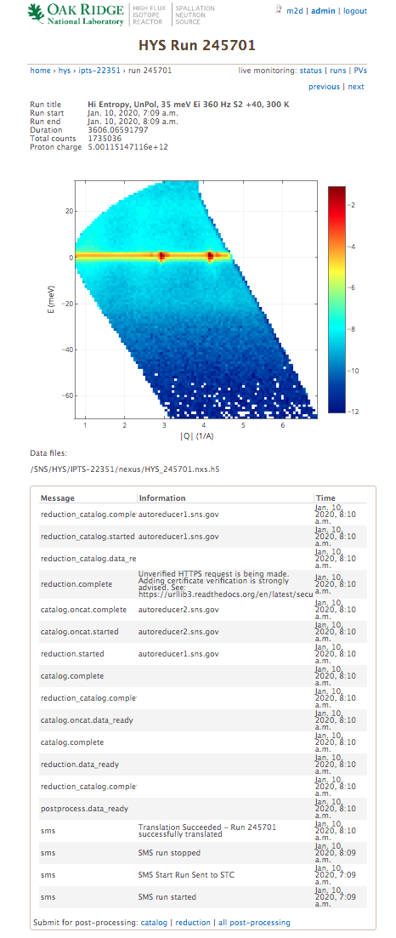
Web monitor features
Info from ONCat
HTML from livedata.sns.gov
AR workflow AMQ log
Some tasks can be requested
[sends AMQ message]

Slide 8
livedata.sns.gov
https://github.com/neutrons/live_data_server
Runs on livedata.sns.gov. A new test node is available on livedatadev.sns.gov
This application is only used to store/read html data in a table. It doesn’t hold critical data.
Read access is done by comparing hash with a secret key.
Same deal with the local_settings, but it’s mostly empty.
There’s a postgres DB running but not accessible from outside the machine.
Same type of configuration as the web monitor, but just run make install
Once deployed, you just need to restart apache
Installation for a bare machine:
- postgresql installation
> sudo yum install postgresql postgresql-devel postgresql-server
> sudo yum install postgresql-libs postgresql-contrib
> sudo yum install pgadmin3
- postgres setup, performed as postgres user
> sudo su - postgres
> initdb
> pg_ctl -D /var/lib/pgsql/data -l /var/lib/pgsql/server.log start
> createuser livedata -W [pwd = XXX]
> createdb -O livedata livedata_db
> exit
- install django [prod version runs 1.9.6]
> sudo yum install mod_wsgi
> sudo yum install mod_ssl
> sudo chown -R apache /var/www
> wget https://bootstrap.pypa.io/get-pip.py -O - | sudo python
> wget https://bootstrap.pypa.io/ez_setup.py -O - | sudo python
> sudo pip install django
> sudo yum install python-devel
> sudo pip django_auth_ldap
> sudo pip install psycopg2
# https://github.com/ottoyiu/django-cors-headers
> sudo pip install django-cors-headers
> sudo chmod a+r /var/log/httpd
> sudo chmod a+x /var/log/httpd
> Create user livedata to be used by auto reduction to post data

