Slide 1
Overview of current workflow
Mathieu Doucet
Oak Ridge National Laboratory

Slide 2




Timeline
Cataloging
Event data
”translation”
To NeXus file
Auto reduction
https://monitor.sns.gov/
The first DAS implementation at SNS only dealt with histograms
“Translation” to Nexus files was done after a run completed and took a lot of time
Around 2012, the ADARA project changed everything to event streaming
“Translation” now starts at the beginning of the run.
As part of that effort, the automated reduction workflow was created
The web monitor was initially a diagnostics tool for developers but quickly became popular
The scope of how we use the auto-reduction and what we want it to do has changed since it was designed and implemented.
https://github.com/neutrons/data_workflow

Slide 3
Plan for the next few weeks
Test environment:
New RHEL8 machines are being set up so we can install them together
Topics to cover:
General overview [this presentation]
Workflow manager and DASMON listener – Installation & maintenance
Web monitor – Installation and maintenance
Autoreduction service – Installation and maintenance
Autoreduction setup through webmon – how-to and future vision
The IHC call – when things go wrong & recovery strategies
Vision for the future – what I would do differently

Slide 4
Post-Processing Architecture
ActiveMQ message
direct access
Translation Service
workflowmgr.sns.gov
Owned by DAS
announces new file
Workflow Manager
Runs script that can be changed by IS
autoreducer[1-4].sns.gov
Post Processing
instructions & status
PostgreSQL Database
workflowdb2.sns.gov
AMQ broker
+ PostgreSQL
amqbroker[1-2].sns.gov

Slide 5
Post-Processing Architecture
ActiveMQ message
direct access
Translation Service
workflowmgr.sns.gov
Owned by DAS
webmon.sns.gov
announces new file
Workflow Manager
Web Monitor
Runs script that can be changed by IS
autoreducer[1-4].sns.gov
Post Processing
instructions & status
Users love this
PostgreSQL Database
workflowdb2.sns.gov
AMQ broker
+ PostgreSQL
livedata.sns.gov
Plot server
amqbroker[1-2].sns.gov

Slide 6
Post-Processing Architecture
ActiveMQ message
direct access
Translation Service
workflowmgr.sns.gov
Owned by DAS
webmon.sns.gov
announces new file
Workflow Manager
Web Monitor
Runs script that can be changed by IS
autoreducer[1-4].sns.gov
Post Processing
instructions & status
Users love this
heartbeat
heartbeat
DASMON
DASMON Listener
PostgreSQL Database
Owned by DAS
Local to instrument
All involved would like to see it go.
Known issue: DAS GL doesn’t like that a tool not owned by DAS report on DAS
heartbeat, status
PV updates
workflowdb2.sns.gov
pvsd
heartbeat
AMQ broker
+ PostgreSQL
livedata.sns.gov
Plot server
amqbroker[1-2].sns.gov

Slide 7
ActiveMQ Communication Flow
Cataloging
NX cataloging
CATALOG.DATA_READY
CATALOG.STARTED
CATALOG.COMPLETE
Translation
ActiveMQ
broker
web service API
POSTPROCESS.DATA_READY
ONCat web service
Auto-reduce
autoreduce
PFS
REDUCTION.DATA_READY
REDUCTION.STARTED
REDUCTION.COMPLETE
WM makes sure that every run goes through the full processing
Reduced data cataloging
Workflow Manager
reduced data cataloging
Workflow Manager
POSTPROCESS.DATA_READY
CATALOG.STARTED
CATALOG.COMPLETE
REDUCTION.STARTED
REDUCTION.COMPLETE
REDUCTION_CATALOG.STARTED
REDUCTION_CATALOG.COMPLETE
CATALOG.DATA_READY
REDUCTION.DATA_READY
REDUCTION_CATALOG.DATA_READY
REDUCTION_CATALOG.DATA_READY
REDUCTION_CATALOG.STARTED
REDUCTION_CATALOG.COMPLETE
Reporting DB
Messaging legend:
Message received
Message sent

Slide 8
Workflow Manager
Single instance runs as a service on workflowmgr.sns.gov
A python AMQ client
A state machine
States/tasks are defined in a DB
Work is getting done by AR processes elsewhere (next slide)
State is written in a DB
All transactions are logged in the DB
Sends a heartbeat that is logged by another process
The initial message from the DAS is, at a minimum, a file path.
The system will also understand (prefers) a json package containing:
Instrument name
IPTS
Facility (SNS or HFIR)
File path
Translation Service
workflowmgr.sns.gov
announces new file
Workflow Manager
Runs script that can be changed by IS
autoreducer[1-4].sns.gov
Post Processing
instructions & status

Slide 9
Service on AR nodes
https://github.com/neutrons/post_processing_agent
Python AMQ client running as a service on dedicated nodes with access to /SNS and /HFIR
No DB connection
It spawns a process for each task
Started out with a static design for the list of tasks it could handle.
Now “processors” can be written that automatically register themselves and create new available tasks
Not a batch system. The ”queue” is the AMQ server…
It can be configured to limit the number of jobs it can run per instrument at any given time.
When the limit is reached, it throws the request back to AMQ…
… which then loses the order the requests came in as
The script that is run can be modified by IS
It upload plot data (HTML block) to livedata.sns.gov

Slide 10
DASMON listener
https://github.com/neutrons/data_workflow
workflowmgr.sns.gov
Listens to AMQ for instrument status info and logs it
That info is then displayed on the web monitor
Not a critical process…
… but users, IS, and IHCs use the web monitor
In addition to listening to DAS info, it receives heartbeats from all services
Workflow Manager
autoreducer[1-4].sns.gov
Post Processing
heartbeat
heartbeat
DASMON
DASMON Listener
heartbeat, status
Jim Kohl (DAS) has it on his plate to provide another service for DAS monitoring that would not require AMQ
PV updates
pvsd
heartbeat
PostgreSQL Database
workflowdb2.sns.gov

Slide 11
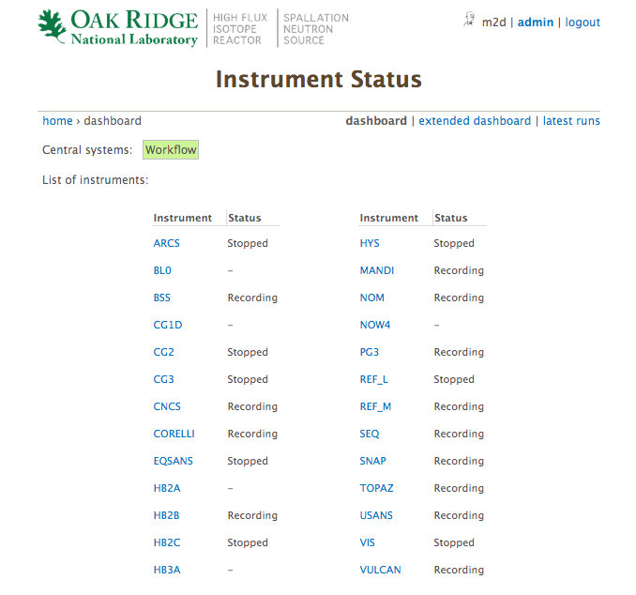
Web Monitor
https://github.com/neutrons/data_workflow/
Landing page is used by IHCs
With the number of instruments increasing, this is slower to load than we would like
Reduced data plots are kept in a separate DB at livedata.sns.gov
Code is here:
https://github.com/neutrons/live_data_server

Slide 12
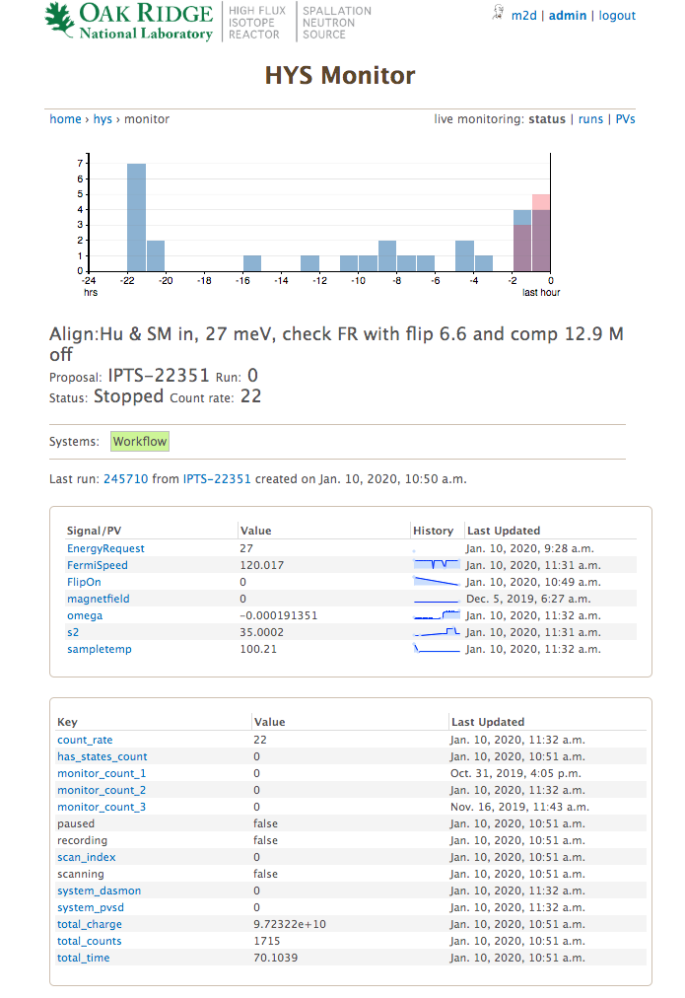
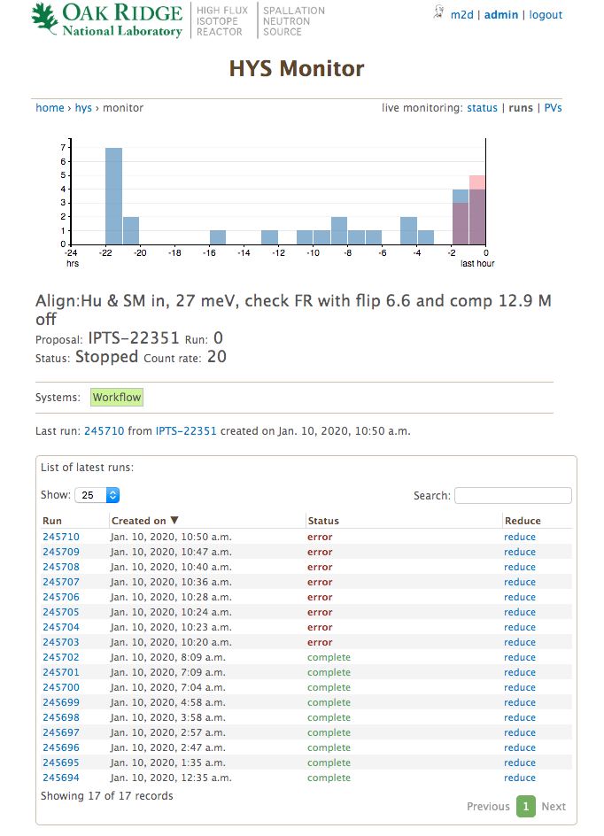
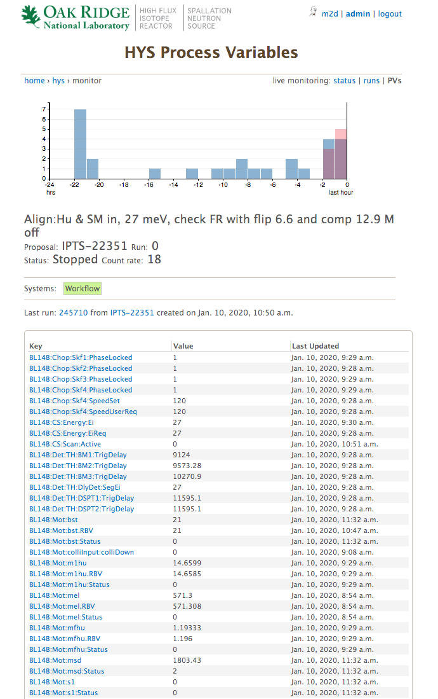
Instrument Status

Slide 13
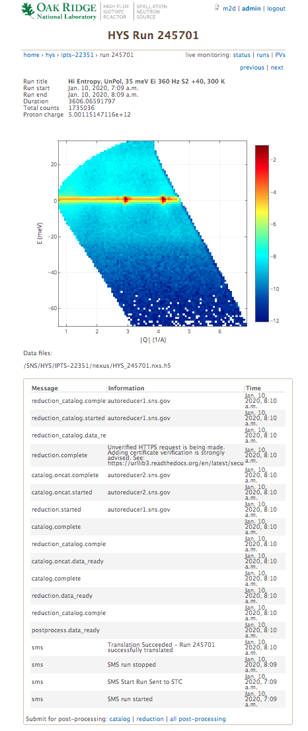
Status of a Run
Meta data from data catalog
The status page for a run is only available to users for that experiment and IS
Data pulled from livedata.sns.gov
Meta data is pulled from ONCat
IS can resubmit a job
Reduced data
AR workflow AMQ log
Some tasks can be requested

Slide 14
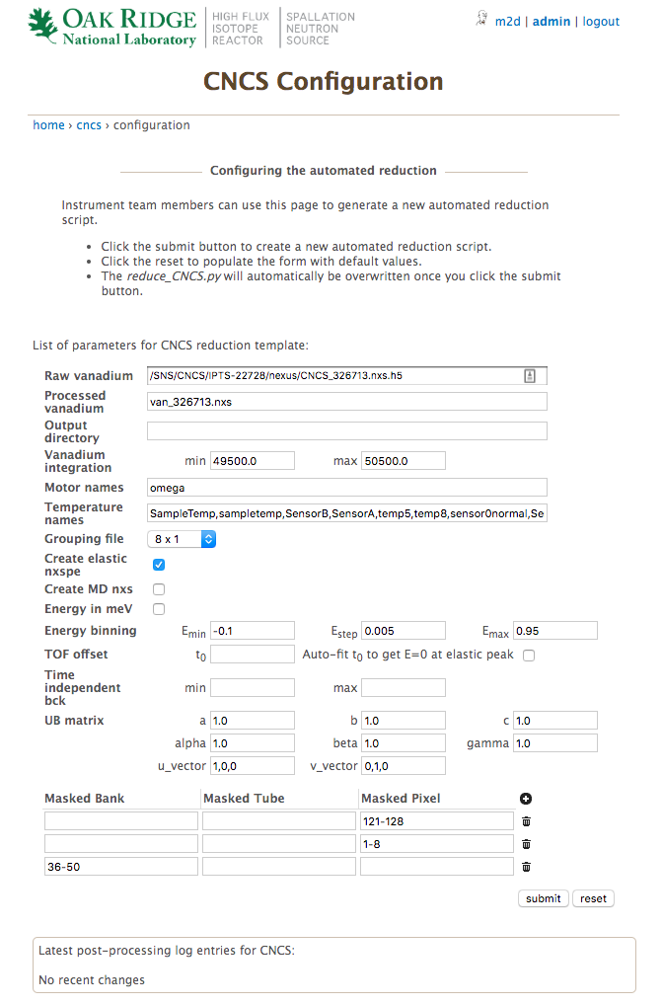
Setting up the auto-reduction
IS can modify their reduction script at
/SNS/<instrument>/shared/autoreduce/reduce_<instrument>.py
They can also us a custom form on the web monitor
This avoids typos…

Slide 15
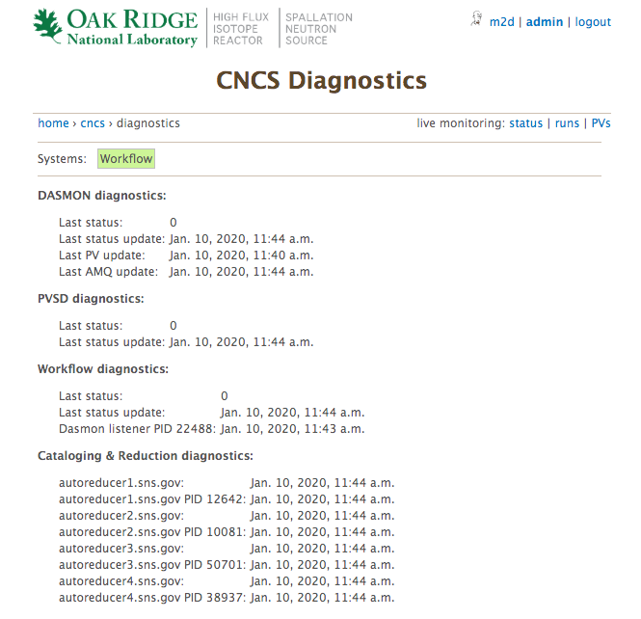
Online Diagnostics
A diagnostics page allows us to verify the health of the system.
Pinpoints the issue for common problems.
The system tries to self-diagnose as much as possible.
DASMON and PVSD status are typically hidden by request of the DAS GL.

Slide 16
Thoughts on Transition
The monitor present both post-processing status and instrument status.
We get IHC calls when the instrument status info is down.
The instrument status monitoring is clunky and should not be in our scope.
Our workflow system would be leaner without the DAS info.
Would suggest dropping PV monitoring, and DAS STC message monitoring.
High-level instrument monitoring is crucial, so we might want to develop a phased approach to shed that functionality.

Slide 17
Failure Rates
Web monitor: never
AR clients: never
Workflow manager: < 2/yr
AMQ brokers: once per 2-3 months
Workflow DB: almost never, but the disk can get full
DASMON listener: once per quarter, due to high traffic and WorkflowDB IO problems.

