Slide 1
Workflow Management and Instrument Web Monitoring
Mathieu Doucet
Neutron Data Analysis and Visualization Division
NDAV Training / Nov 2016

Slide 2
Post-Processing Overview
Translation service notifies the workflow manager when a new data file is ready.
sns-sts[1-2].sns.gov
Streaming Translation Service
The auto-reduction service takes care of reduction and cataloging.
Reduction script can be modified by instrument staff.
/SNS/REF_L/shared/autoreduce/reduce_REF_L.py
announces new file
autoreducer[1-4].sns.gov
Post-processing
Service
Workflow Manager
instructions & status
Local to instrument
DASMON
PostgreSQL Database
DASMON reads in the stream and performs diagnostics.
status information
Web Monitor
The web monitor allows us to keep track of what’s happening.
Notes:
Central services
Autoreducer nodes = big analysis machines.
Fermi cluster: 32 nodes x 16 core x 64 Gb

Slide 3
Workflow Management of Post Processing Services
Manages all aspects of the post processing workflow, which can be individualized for each beam line.
Updates the database as services complete tasks.
Translation service can send the message and forget. The workflow manager will be responsible for ensuring that the post processing completes.
Transacts with other workflow components through ActiveMQ using dedicated queues for each task.
Notes:
Individualized = which process to run, in which order, and on which node.

Slide 4
Post-Processing Architecture
ActiveMQ message
direct access
Translation Service
workflowmgr.sns.gov
webmon.sns.gov
announces new file
Workflow Manager
Web Monitor
livedata.sns.gov
autoreducer[1-4].sns.gov
Post Processing
instructions & status
heartbeat
heartbeat
DASMON
DASMON Listener
PostgreSQL Database
heartbeat, status
PV updates
workflowdb2.sns.gov
pvsd
heartbeat
AMQ broker
+ PostgreSQL
amqbroker[1-2].sns.gov

Slide 5
ActiveMQ Communication Flow
Cataloging
NX cataloging
CATALOG.DATA_READY
CATALOG.STARTED
CATALOG.COMPLETE
Translation
ActiveMQ
broker
web service API
POSTPROCESS.DATA_READY
ICAT server
Auto-reduce
autoreduce
PFS
REDUCTION.DATA_READY
REDUCTION.STARTED
REDUCTION.COMPLETE
WM makes sure that every run goes through the full processing
Reduced data cataloging
Workflow Manager
reduced data cataloging
Workflow Manager
REDUCTION_CATALOG.DATA_READY
REDUCTION_CATALOG.STARTED
REDUCTION_CATALOG.COMPLETE
POSTPROCESS.DATA_READY
CATALOG.STARTED
CATALOG.COMPLETE
REDUCTION.STARTED
REDUCTION.COMPLETE
REDUCTION_CATALOG.STARTED
REDUCTION_CATALOG.COMPLETE
CATALOG.DATA_READY
REDUCTION.DATA_READY
REDUCTION_CATALOG.DATA_READY
Reporting DB
Messaging legend:
Message received
Message sent

Slide 6
ActiveMQ Messaging
The workflow manager and the services communicate through ActiveMQ.
http://activemq.apache.org/
Messages delivered to brokers are durable and will be preserved should a broker fail.
Clustered brokers provide failover functionality to support high-availability.
Load balancing across all components is managed automatically.
Separate queues are used for each task, and balancing occurs as worker nodes pick up the messages.

Slide 7
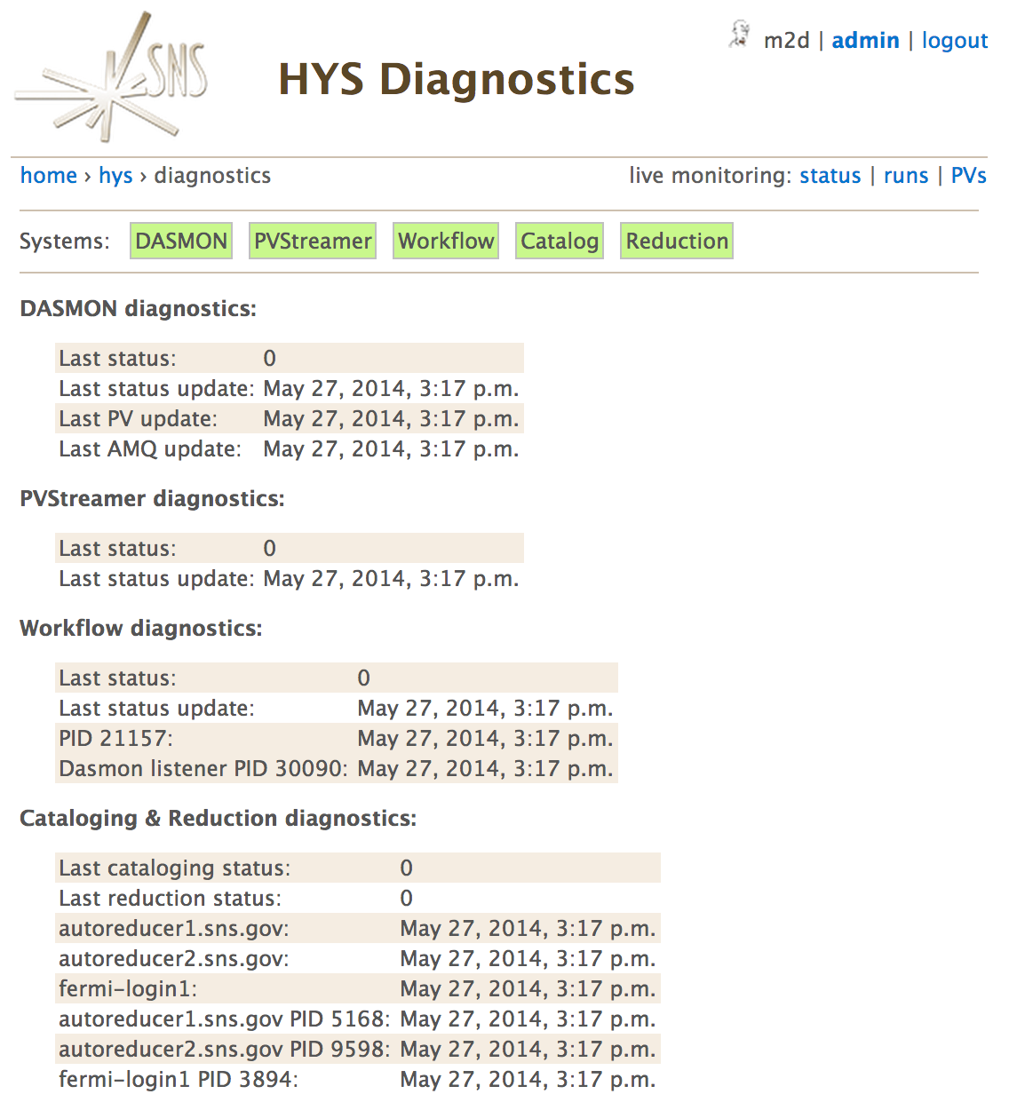
Online Diagnostics
A diagnostics page allows us to verify the health of the system.
Pinpoints the issue for common problems.
The system tries to self-diagnose as much as possible.

Slide 8
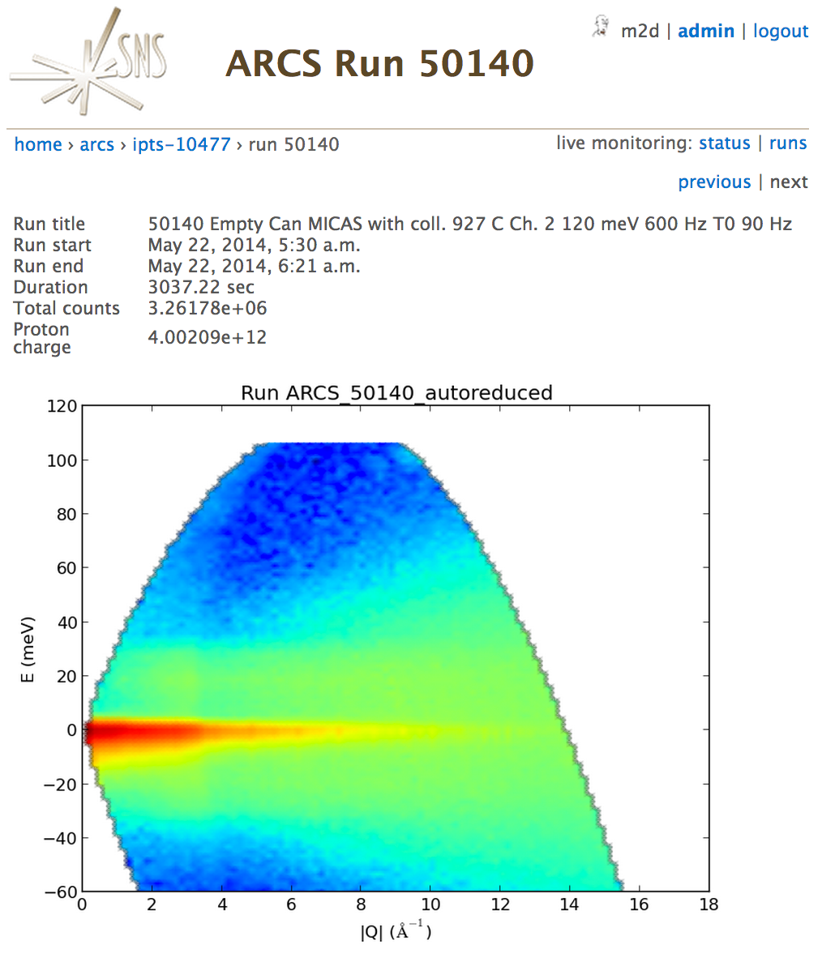
Run Details
Information about each run is available.
Allows for image upload by the auto-reduction.

Slide 9
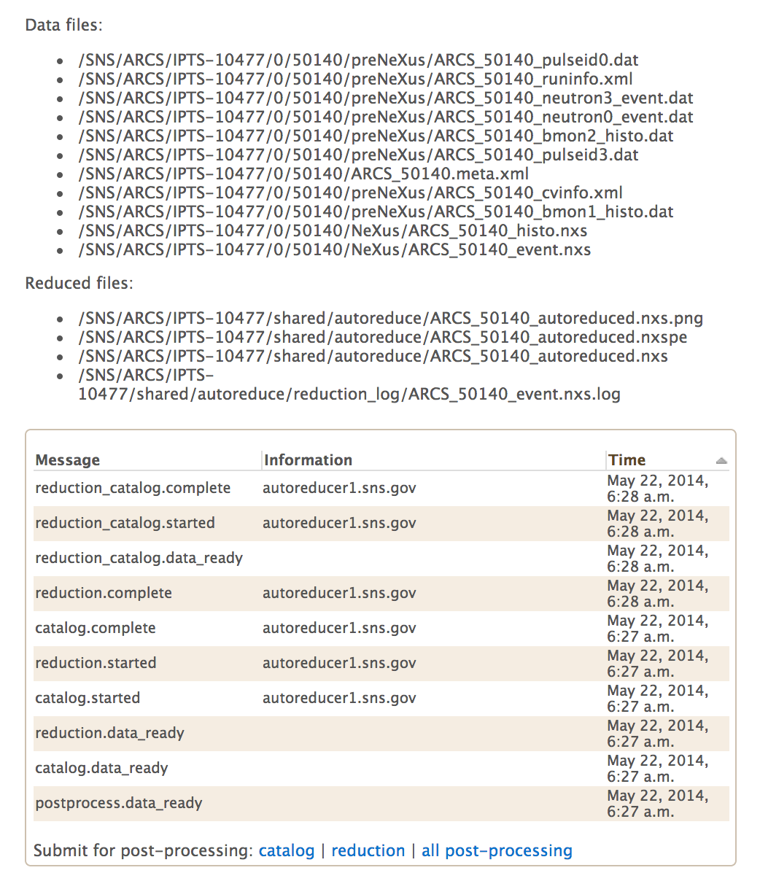
Run Details
Shows you a list of all cataloged files.
Both raw and reduced files are cataloged.
Gives you a timeline of the workflow progress.
Allows instrument team to reprocess their data.

Slide 10
Failure Rates
Web monitor: never
AR clients: never
Workflow manager: < 2/yr
AMQ brokers: once per 2-3 months
Workflow DB: frequent high IO due to system. No actual problem. The issue is being resolved.
ICAT: has to be restarted once every 6 weeks
DASMON listener: once a month, due to high traffic and WorkflowDB IO problems.

Slide 11
Where’s the code?
Web monitor and workflow manager:
https://github.com/neutrons/data_workflow
Auto-reduction clients:
https://github.com/neutrons/post_processing_agent
Reduction script repo:
https://github.com/mantidproject/autoreduce/tree/master/ReductionScripts/sns

