Slide 1
Autoreduction service: installation and maintenance
Mathieu Doucet
Oak Ridge National Laboratory

Slide 2
Plan for the next few weeks
Test environment:
New RHEL8 machines are being set up so we can install them together
Topics to cover:
General overview
Workflow manager and DASMON listener – Installation & maintenance
Web monitor – Installation and maintenance
Autoreduction service – Installation and maintenance [this presentation]
Autoreduction setup through webmon – how-to and future vision
The IHC call – when things go wrong & recovery strategies
Vision for the future – what I would do differently

Slide 3
Post-Processing Architecture
ActiveMQ message
direct access
Translation Service
workflowmgr.sns.gov
Owned by DAS
webmon.sns.gov
announces new file
Workflow Manager
Web Monitor
Runs script that can be changed by IS
autoreducer[1-4].sns.gov
Post Processing
instructions & status
Users love this
heartbeat
heartbeat
DASMON
DASMON Listener
PostgreSQL Database
Owned by DAS
Local to instrument
All involved would like to see it go.
Known issue: DAS GL doesn’t like that a tool not owned by DAS report on DAS
heartbeat, status
PV updates
workflowdb2.sns.gov
pvsd
heartbeat
AMQ broker
+ PostgreSQL
livedata.sns.gov
Plot server
amqbroker[1-2].sns.gov

Slide 4
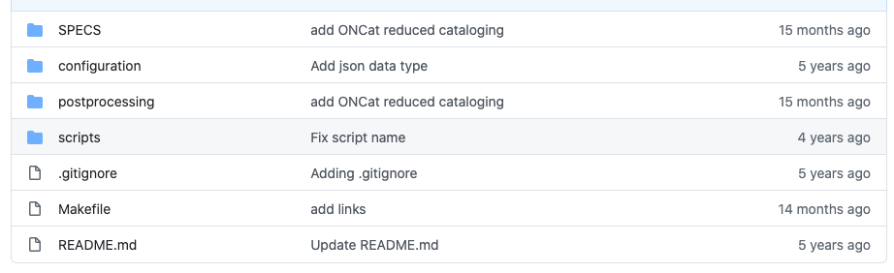
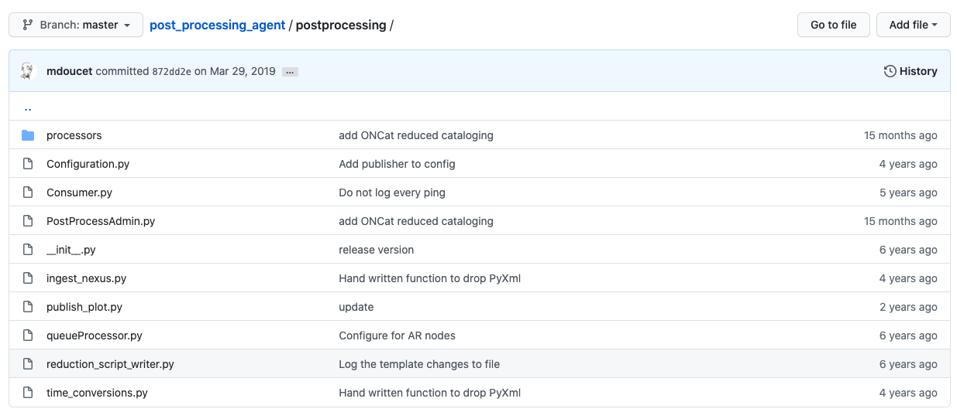
Overview
https://github.com/neutrons/post_processing_agent
There help on the repo (probably outdated)
This is an old refactor (2014) of old software (2012-ish).
As we migrated away from ICAT for cataloging, some code has been cleaned up. Some cleaning up didn’t get done yet.
This is where the newer job classes are
Some code is no longer needed
This is the service script

Slide 5
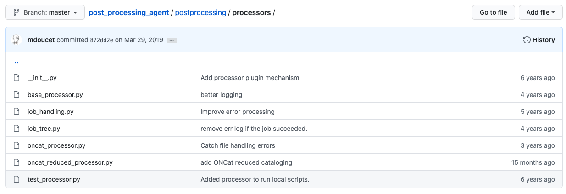
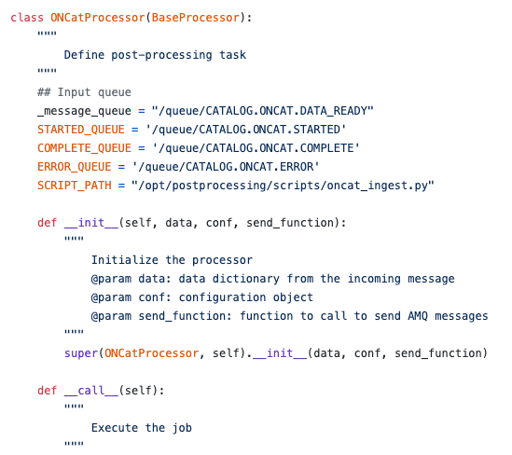
Processors
Job_tree is no longer in use.
It allowed for job hierarchy.
Newer jobs are done this way

Slide 6
Configuration & Installation
/etc/autoreduce/post_processing.conf
{
"failover_uri": "failover:(tcp://amqbroker.sns.gov:61613)?randomize=false,startupMaxReconnectAttempts=100,
initialReconnectDelay=1000,maxReconnectDelay=5000,maxReconnectAttempts=-1",
"amq_queues": ["/queue/REDUCTION.DATA_READY",
"/queue/REDUCTION.CREATE_SCRIPT", "/queue/CATALOG.DATA_READY"],
"amq_user": "wfclient",
"amq_pwd": ”XXXXX",
"sw_dir": "/opt/postprocessing",
"python_dir": "/opt/postprocessing/postprocessing",
"start_script": "python",
"python_exec": "/opt/postprocessing/scripts/mantidpython.py",
"task_script": "PostProcessAdmin.py",
"task_script_queue_arg": "-q",
"task_script_data_arg": "-d",
"log_file": "/var/log/SNS_applications/postprocessing.log",
"postprocess_error": "POSTPROCESS.ERROR",
"catalog_started": "CATALOG.STARTED",
"catalog_complete": "CATALOG.COMPLETE",
"catalog_error": "CATALOG.ERROR",
"reduction_started": "REDUCTION.STARTED",
"reduction_complete": "REDUCTION.COMPLETE",
"reduction_error": "REDUCTION.ERROR",
"reduction_disabled": "REDUCTION.DISABLED",
"reduction_catalog_started": "REDUCTION_CATALOG.STARTED",
"reduction_catalog_complete": "REDUCTION_CATALOG.COMPLETE",
"reduction_catalog_error": "REDUCTION_CATALOG.ERROR",
"heart_beat": "/topic/SNS.COMMON.STATUS.AUTOREDUCE.0",
"dev_output_dir": "",
"webmon_url_template": "https://monitor.sns.gov/files/$instrument/$run_number/submit_reduced/",
"catalog_data_ready": "CATALOG.DATA_READY",
"reduction_data_ready": ["REDUCTION.DATA_READY", "REDUCTION.AR4.DATA_READY"],
"reduction_catalog_data_ready": "REDUCTION_CATALOG.DATA_READY",
"communication_only": 0,
"max_procs": 10,
"jobs_per_instrument": 4,
"remote_execution": 0,
"processors": ["job_tree.JobTreeProcessor", "oncat_reduced_processor.ONCatProcessor",
"oncat_processor.ONCatProcessor"],
"publisher_username": "plot_publisher",
"publisher_password": ”xxxxxxx",
"publish_url_template": "https://livedata.sns.gov/plots/$instrument/$run_number/upload_plot_data/",
"exceptions": ["Unverified HTTPS", "InsecureRequestWarning", "plotly", "operands could not be broadcast", "Publish plot failed","cann
ot import name factorial", "tcmalloc: large alloc", "dPS_array", "wks_utility", "The proton charge is zero", "Error in logging framework"
, "Found no integrated charge value in gd_prtn_chrg"]
}
make rpm
Copy rpm to packages.sns.gov
Check configuration and update it as needed

