Slide 1
Workflow manager: installation and maintenance
Mathieu Doucet
Oak Ridge National Laboratory

Slide 2
Plan for the next few weeks
Test environment:
New RHEL8 machines are being set up so we can install them together
Topics to cover:
General overview
Workflow manager and DASMON listener – Installation & maintenance [this presentation]
Web monitor – Installation and maintenance
Autoreduction service – Installation and maintenance
Autoreduction setup through webmon – how-to and future vision
The IHC call – when things go wrong & recovery strategies
Vision for the future – what I would do differently

Slide 3
Post-Processing Architecture
ActiveMQ message
direct access
Translation Service
workflowmgr.sns.gov
Owned by DAS
webmon.sns.gov
announces new file
Workflow Manager
Web Monitor
Runs script that can be changed by IS
autoreducer[1-4].sns.gov
Post Processing
instructions & status
Users love this
heartbeat
heartbeat
DASMON
DASMON Listener
PostgreSQL Database
Owned by DAS
Local to instrument
All involved would like to see it go.
Known issue: DAS GL doesn’t like that a tool not owned by DAS report on DAS
heartbeat, status
PV updates
workflowdb2.sns.gov
pvsd
heartbeat
AMQ broker
+ PostgreSQL
livedata.sns.gov
Plot server
amqbroker[1-2].sns.gov

Slide 4
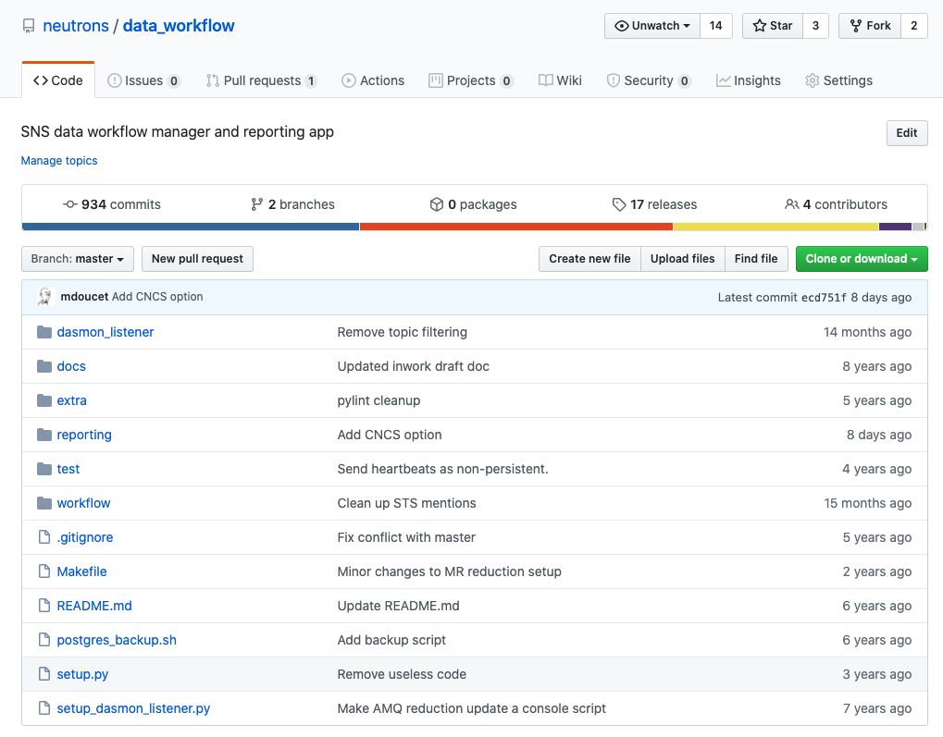
Installation
https://github.com/neutrons/data_workflow
The workflow service runs on workflowmgr.sns.gov
The dasmon_listener service also runs on workflowmgr.sns.gov
The database is hosted on workflowdb2.sns.gov
The service is an AMQ client, but it uses Django to abstract out DB calls.
Dasmon listener code
Web monitor application code
This installs the workflow package… but use the Makefile

Slide 5
Setting up the database
Installation for a bare machine:
Currently runs on workflowdb2.sns.gov
A new test node is available:
workflowdbdev.sns.gov
Linux Support configures it and maintains it.
pg_hba.conf changes are made through Linux Support.
The stored procs are in the workflow repo
data_workflow/reporting/report/sql/stored_procs.sql
- postgresql installation
> sudo yum install postgresql postgresql-devel postgresql-server
> sudo yum install postgresql-libs postgresql-contrib
> sudo yum install pgadmin3
- postgres setup, performed as postgres user
> initdb
> pg_ctl -D /var/lib/pgsql/latest/data -l /var/lib/pgsql/server.log start
> createuser workflow -W [password will need to be chosen]
> createdb -O workflow reporting_db
- Update pg_hba.conf and add the webmon and workflowmgr nodes.
- Install stored proc
PV entries come in at a high rate. These are only used for instrument monitoring and are deleted after 2 hours.
The postgres IDs will eventually run out!
ALTER SEQUENCE pvmon_pv_id_seq RESTART WITH 1;

Slide 6
workflow manager configuration
local_settings.py
DATABASES = {
'default': {
'ENGINE': 'django.db.backends.postgresql_psycopg2',
'NAME': 'reporting_db’,
'USER': 'workflow',
'PASSWORD’: ‘XXXXXX’,
'HOST': 'workflowdb.sns.gov’,
'PORT': '5432',
}
}
SECRET_KEY = '-0zoc$fl2fa&amp;rmzeo#uh-qz-k+4^1)_9p1qwby1djzybqtl_nn'
TIME_ZONE = 'America/New_York'
USE_TZ = True
INSTALLED_APPS = (
'report',
)
"""
ActiveMQ settings
"""
# List of brokers
brokers = [("amqbroker1.sns.gov", 61613),
("amqbroker2.sns.gov", 61613)]
# The is the user that listens only (damson_listener)
icat_user = "wfclient"
icat_passcode = "XXXXXX"
# This is the user for the workflow
wkflow_user = "wkflowmgr"
wkflow_passcode = "XXXXXX"
The DB settings are shared between the workflow app and the monitor app.
A number of places are available to write configs.
You could just write a local_settings.py file.
data_workflow/workflow/settings.py
imports
data_workflow/workflow/database/settings.py
imports (optional, not in repo)
data_workflow/workflow/local_settings.py

Slide 7
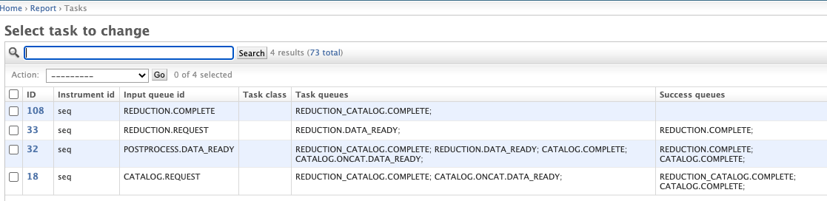
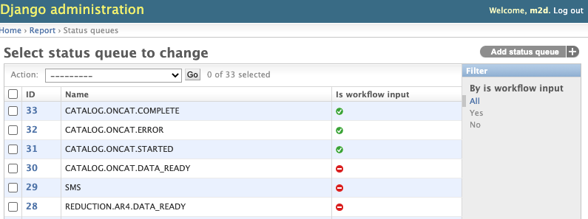
workflow manager messaging configuration
Tasks as defined in the DB:
Message queues to listen to are read from the DB.

Slide 8
dasmon_listener configuration
local_settings.py
DATABASES = {
'default': {
'ENGINE': 'django.db.backends.postgresql_psycopg2',
'NAME': 'reporting_db’,
'USER': 'workflow',
'PASSWORD’: ‘XXXXXX’,
'HOST': 'workflowdb.sns.gov’,
'PORT': '5432',
}
}
INSTALLATION_DIR = "/var/www/workflow/app"
PURGE_TIMEOUT = 0.125
FROM_EMAIL = ”xxxx@ornl.gov"
ALERT_EMAIL = []
IMAGE_PURGE_TIMEOUT = 30
brokers = [("amqbroker1.sns.gov", 61613),
("amqbroker2.sns.gov", 61613)]
amq_user = "wfclient"
amq_pwd = ”XXX"
queues = ["/topic/SNS.COMMON.STATUS.WORKFLOW.0",
"/topic/SNS.COMMON.STATUS.AUTOREDUCE.0",
"/topic/SNS.*.APP.DASMON",
"/topic/SNS.*.STATUS.DASMON",
"/topic/SNS.*.SIGNAL.DASMON",
"/topic/SNS.*.APP.SMS",
"/topic/SNS.*.STATUS.SMS",
"/topic/SNS.*.STATUS.POSTPROCESS",
"/topic/SNS.COMMON.STATUS.ACK",
"/topic/SNS.*.STATUS.PVSD",
"/topic/HFIR.*.APP.DASMON",
"/topic/HFIR.*.STATUS.DASMON",
"/topic/HFIR.*.SIGNAL.DASMON",
"/topic/HFIR.*.APP.SMS",
"/topic/HFIR.*.STATUS.SMS",
"/topic/HFIR.*.STATUS.POSTPROCESS",
"/topic/HFIR.COMMON.STATUS.ACK",
"/topic/HFIR.*.STATUS.PVSD",
]
Same story with the config hierarchy.
You could just write a local_settings.py file.
data_workflow/dasmon_listener/settings.py
imports
data_workflow/workflow/database/settings.py
and imports (optional, not in repo)
data_workflow/dasmon_listener/local_settings.py

Slide 9
Setting up the workflow manager
Runs on workflowmgr.sns.gov. A new test node is available on workflowmgrdev.sns.gov
sudo /usr/sbin/deploy-workflow [path to code]
sudo /usr/sbin/deploy-dasmonlistener [path to code]
sudo /sbin/service workflowmanager [start|stop|restart]
sudo /sbin/service dasmonlistener [start|stop|restart]
Linux support has workflowmgr and dasmonlistener in /etc/rc.d/init.d
The services tend to leave dead processes behind… it’s always good to check
Installation for a bare machine:
> sudo useradd workflowmgr
> wget https://bitbucket.org/pypa/setuptools/raw/bootstrap/ez_setup.py -O - | sudo python
> sudo easy_install django==1.6 [We need 1.6]
> sudo yum install python-devel
> sudo yum install postgresql postgresql-devel postgresql-server
> sudo yum install postgresql-libs postgresql-contrib
> sudo easy_install psycopg2
- run deploy-workflow and deploy-dasmonlistener scripts
- Copy service files (workflowmgr and dasmonlistener) in /etc/rc.d/init.d

Slide 10
How does it break
It doesn’t really break
You might want to restart it after restarting the AMQ brokers as a safety measure
The workflow and dasmon_listener status are on the web monitor
The main problem is that the way the service was set up is not optimal and dead processes can be left behind after a restart.

Slide 11
ActiveMQ Communication Flow
Cataloging
NX cataloging
CATALOG.DATA_READY
CATALOG.STARTED
CATALOG.COMPLETE
Translation
ActiveMQ
broker
web service API
POSTPROCESS.DATA_READY
ONCat web service
Auto-reduce
autoreduce
PFS
REDUCTION.DATA_READY
REDUCTION.STARTED
REDUCTION.COMPLETE
WM makes sure that every run goes through the full processing
Reduced data cataloging
Workflow Manager
reduced data cataloging
Workflow Manager
POSTPROCESS.DATA_READY
CATALOG.STARTED
CATALOG.COMPLETE
REDUCTION.STARTED
REDUCTION.COMPLETE
REDUCTION_CATALOG.STARTED
REDUCTION_CATALOG.COMPLETE
CATALOG.DATA_READY
REDUCTION.DATA_READY
REDUCTION_CATALOG.DATA_READY
REDUCTION_CATALOG.DATA_READY
REDUCTION_CATALOG.STARTED
REDUCTION_CATALOG.COMPLETE
Reporting DB
Messaging legend:
Message received
Message sent

