Slide 1
WebMon – overview and recent work
Marie Backman
June 5, 2024

Slide 2




Background
Cataloging
Event data
”translation”
to Nexus file
Originally, “translation” to Nexus files was done after a run completed and took a lot of time
Around 2012, the ADARA project changed everything to event streaming
“Translation” now starts at the beginning of the run
As part of that effort, the automated reduction workflow was created
The web monitor was initially a diagnostics tool for developers but quickly became popular
Auto reduction
https://monitor.sns.gov/

Slide 3
Post-Processing Architecture
ActiveMQ message
direct access
Translation Service
workflowmgr.sns.gov
Owned by DAS
announces new file
Workflow Manager
Runs script that can be changed by instrument scientist
autoreducer[1-4].sns.gov
Post Processing
instructions & status
PostgreSQL Database
workflowdb2.sns.gov
AMQ broker
amqbroker[1-2].sns.gov

Slide 4
Post-Processing Architecture
ActiveMQ message
direct access
Translation Service
workflowmgr.sns.gov
Owned by DAS
monitor.sns.gov
announces new file
Workflow Manager
Web Monitor
Runs script that can be changed by IS
autoreducer[1-4].sns.gov
Post Processing
instructions & status
Users love this
PostgreSQL Database
workflowdb2.sns.gov
AMQ broker
livedata.sns.gov
Plot server
amqbroker[1-2].sns.gov

Slide 5
Post-Processing Architecture
ActiveMQ message
direct access
Translation Service
workflowmgr.sns.gov
Owned by DAS
monitor.sns.gov
announces new file
Workflow Manager
Web Monitor
Runs script that can be changed by IS
autoreducer[1-4].sns.gov
Post Processing
instructions & status
Users love this
heartbeat
heartbeat
DASMON
DASMON Listener
PostgreSQL Database
heartbeat, status
Owned by DAS
Local to instrument
PV updates
workflowdb2.sns.gov
pvsd
heartbeat
AMQ broker
livedata.sns.gov
Plot server
amqbroker[1-2].sns.gov

Slide 6
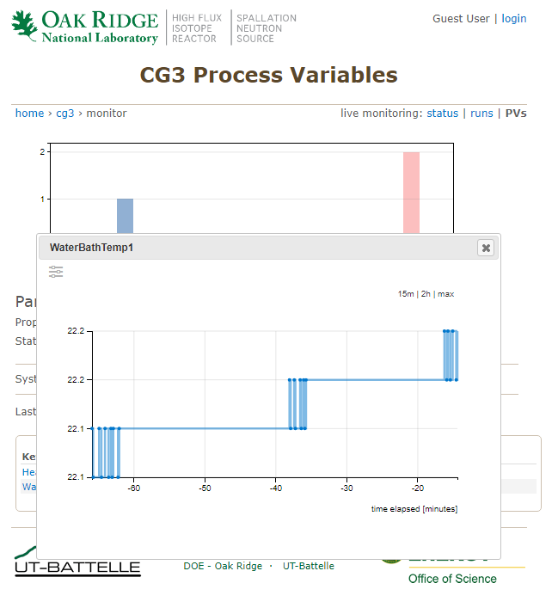
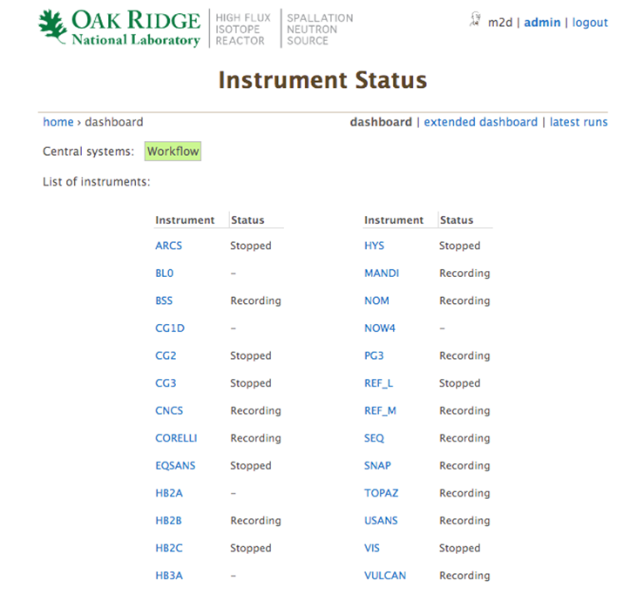
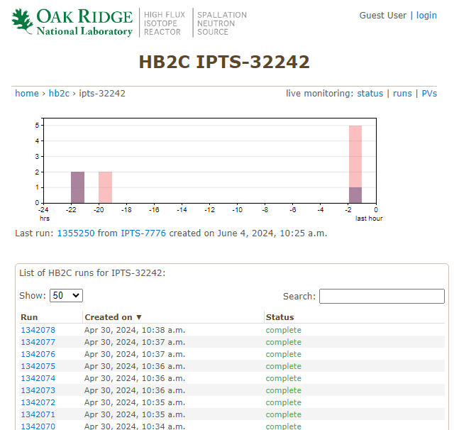
Web monitor – monitor.sns.gov
User-facing part of WebMon

Slide 7
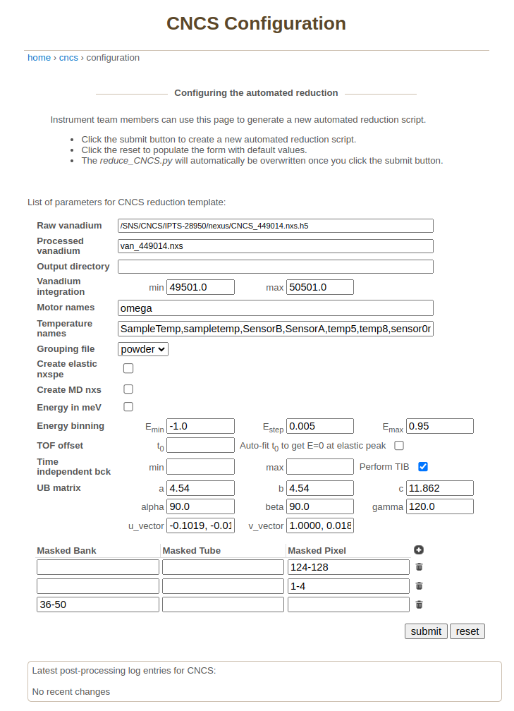
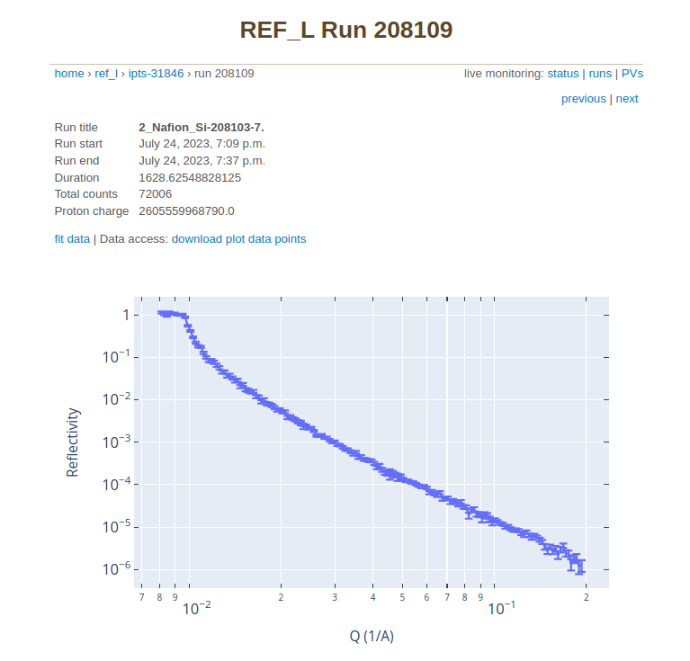
Web monitor – monitor.sns.gov
Rerun cataloging and reduction
Configure autoreduction (IS only)

Slide 8
Technologies
ActiveMQ Classic message broker
Python clients using the STOMP messaging protocol
Workflow manager
Dasmon listener
Autoreducer
2 Django apps
Web monitor (monitor.sns.gov)
Live Data Server (livedata.sns.gov)
2 PostgreSQL databases (workflowdb2.sns.gov and livedata.sns.gov)

Slide 9
Autoreducers / post-processing agent
Repo: https://github.com/neutrons/post_processing_agent
Postprocessing tasks it handles:
Cataloging of raw data in ONCat (https://oncat.ornl.gov/)
Users can download their data from ONCat
Autoreduction
Runs instrument-specific data reduction script
Publishes plots to Live Data Server
Cataloging of reduced data in ONCat
Adjusting parameters in the autoreduction scripts (available to instrument scientists)
4 instances running on autoreducer[1-4].sns.gov

Slide 10
Testing strategy
Unit tests
System tests part of CI and for local development
System of 11 docker containers for message broker, clients, DB, web server etc.
https://github.com/neutrons/data_workflow/blob/next/docker-compose.yml
Developer test environment in CADES – webmon-test.ornl.gov
https://code.ornl.gov/sns-hfir-scse/infrastructure/neutrons-test-environment
https://data-workflow.readthedocs.io/en/latest/developer/index.html

Slide 11
RHEL 7 – RHEL 9 upgrade
The SNS/HFIR servers were running Red Hat Enterprise Linux 7 (RHEL 7) (EOL: 2024-06-30)
Neutrons Data Project responsibility: port our (mainly data reduction) software from RHEL 7 to RHEL 9
Python 2 is not distributed with RHEL 9
Why not containerize everything?
Growing tech debt
Cyber security!

Slide 12
Porting Post-Processing Agent
Removed obsolete code
Added integration tests with containerized ActiveMQ broker and agent
Migrated from Python 2.7 to Python 3.9 (RHEL 9 default Python version)
Still distributed as RPM (RPM Package Manager)

Slide 13
Porting Live Data Server
Serves plots to monitor.sns.gov
Production instance used Apache HTTP Server, but initial work had been done in the test environment to move to Nginx and containerize Live Data Server
Migrated from Python 2.7 + Django 1.9 to Python 3.6 + Django 2.0
Story in the backlog to move to latest Python, Django and PostgreSQL
Tested new RHEL 9 production with WebMon test environment
Purged old data to shrink PostgreSQL DB from 1.4 TB to 550 GB

Slide 14
Migration from ActiveMQ Classic to ActiveMQ Artemis
Main difference was message addressing and routing
Classic has queues (point-to-point) and topics (publish-subscribe)
Artemis only has queues and uses addresses to achieve different routing mechanisms.
Multicast routing: all subscribers to the address get their own queue
Anycast routing: only one queue for the address that all consumers subscribe to
https://activemq.apache.org/components/artemis/migration-documentation/

Slide 15
Thank you!

