Slide 1
Some LLM Practices
Yuanpeng Zhang
Neutron Scattering Division
Sep-12-2025

Slide 2
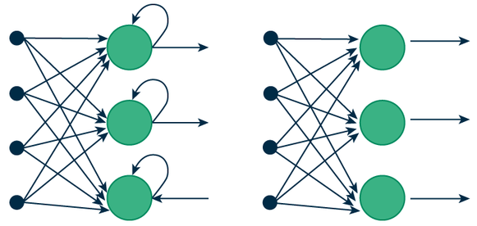
A Bit About LLM
Recurrent Neural Network
Feed-Forward Neural Network
Attention Is All You Need
2017
Transformer
Input
Output
BERT, LaMDA, GPT, Gemini, Sonnet, Opus,
DeepSeek, Mistral, Llama, …

Slide 3
A Bit About LLM
Transformer
Input
Output
Encoder
Decoder
Embedding, Positional Encoding, Multiple Head Attention, SoftMax, Output Weighting, Normalization & Residual Connection
https://www.datacamp.com/tutorial/how-transformers-work
https://epichka.com/blog/2023/qkv-transformer

Slide 4
LLM From a User Perspective
Normal LLM Generation
Prompt
Generation
RAG
Prompt
Retrieval?
Knowledge
Generation

Slide 5
Some Useful LLM Tools for Research – Text & Image Generation
Google NotebookLM, https://notebooklm.google.com/
Enabling Rapid Magnetoelectrics Exploration with Neutrons
How can advanced AI models, particularly flow-based methods, enhance the prediction and design of novel magnetoelectric materials?
Show me some statistics about energy consumption regarding AI model training.
What is the trend for AI agent development in 2025.
Napkin, https://app.napkin.ai
It is probably never generating exactly what we want but could be used for stimulating ideas.
Text polishing with general tools
Controversial but still could be useful

Slide 6
Some Useful LLM Tools for Research – Coding
Web-based chat services,
https://chat.com
https://gemini.google.com
https://claude.ai
…
CLI Tools
A little demo with Warp and Gemini CLI
Other tools available, Codex by OpenAI, Claude Code by Anthropic
IDE Tools
A little demo with GitHub Copilot in VSCode (paid feature)
Other tools available, Cursor, Zed, VSCodium, …

Slide 7
LLM Integration into Platforms
Unified API to LLMs, OpenRouter, https://openrouter.ai
Self-hosted options,
Self-hosting frontend, talking to LLMs via API calls
Pay by API calls, counting input & output tokens
LobeHub, Dify, …
A little showcase with Dify
Model selection
Tools integration, Google, Perplexity, Slack, DALL-E, …
Knowledge base
Workflow
Implementation into Workflows
Chat to LLMs in Slack
AI summary and auto posting to email
Other tools in n8n showcase, Slashdot2Gmail, Msg2NocoDB, Dict2Slack

Slide 8
Some More Tools
Google AI Studio, https://aistudio.google.com
Text generation
Image generation & editing, e.g., Nano Banana
Video generation, e.g., with Veo
Whisk for image generation and animation, https://labs.google/fx/tools/whisk
Google Labs, AI experiment at Google, https://labs.google
Flowchart & Mindmap generation,
https://flowchartai.org, https://mindmap.im
To fine tune our own LLM, try,
HuggingFace, https://huggingface.co
Ollama, https://ollama.com
Langchain, https://www.langchain.com
MLX, https://github.com/ml-explore/mlx

Slide 9
Thank you!

