Slide 1


Environment management
Running Python Options

Slide 2
Environment management
Why
Environment manager available
conda
Mamba (micromamba)
pixi
How it works

Slide 3





Environment management Why

Slide 4
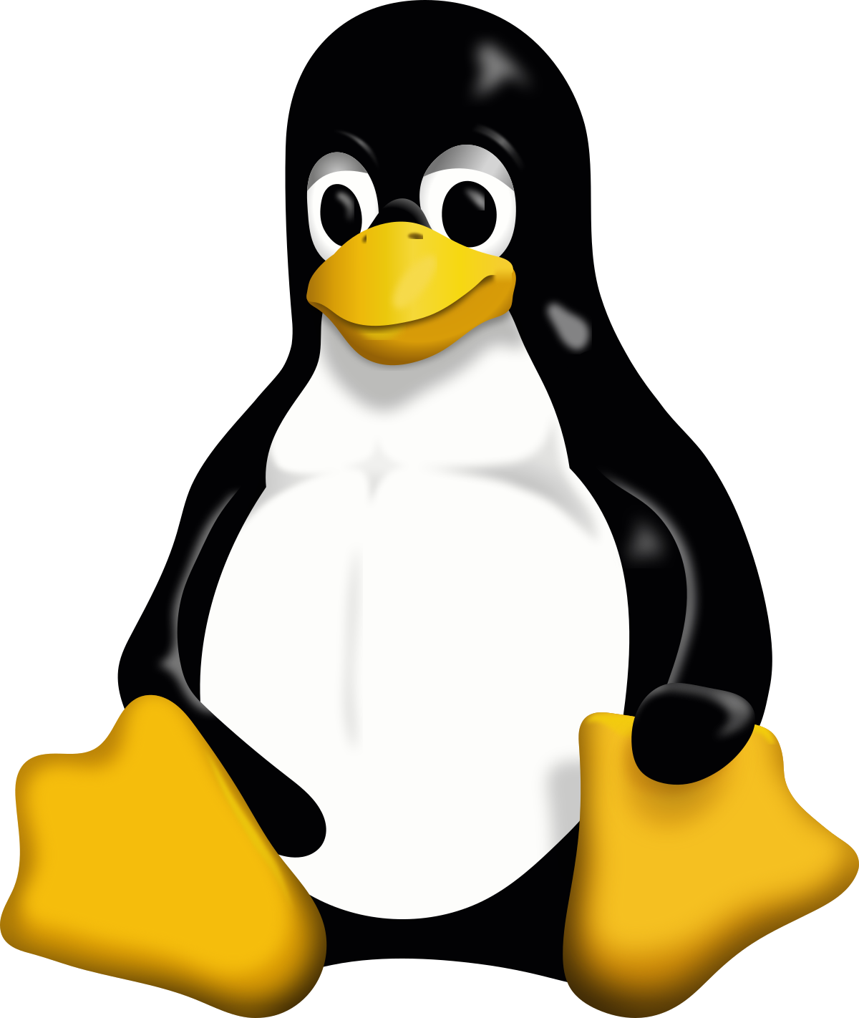


Environment management How
myenv1
Python 3.13
Matplotlib 3.7.2
Numpy 1.25.2
$ micromamba create –n myenv1 python=3.13
py310
Python 3.10
Matplotlib 3.6.0
Scipy 1.11.1
Pyqtgraph 1.13
Pandas 2.03
Qt 5.0
p311
Python 3.11
Pandas 2.02
Qt 5.0
$ micromamba remove –name p311 --all

Slide 5
Environment management basic commands
$ micromamba env list
$ micromamba activate <environment name>
$ micromamba deactivate <environment name>
$ micromamba remove –n <environment name> --all

Slide 6
Pixi – package management tool
WITHOUT PIXI
Clone a repository
Create environment using micromamba and requirements.py
Activate environment
Install software (pip install .)
Execute program
WITH PIXI
Clone a repository
Execute program (pixi run my_program)
https://pixi.sh/latest/

Slide 7
Pixi – package management tool
Key features
Free
Adding new library to project will automatically update the pixi setup script
Simple command to launch notebook, execute script, start UI …
Very good documentation
https://pixi.sh/latest/

Slide 8
Running python options
Python terminal (iTerm, warp …)
Ipython
Notebook (anaconda navigator, jupyter lab, jupyter notebook)
Editor + command line (emacs, brackets, Atoms, …)
IDE (PyCharm, Visual Studio, Eclipse, …)

Slide 9
Running python options
Python terminal (iTerm, warp …) – to try a command, to check if a library has been installed and check its version, …
Ipython – to try a command
Notebook (anaconda navigator, jupyter lab, jupyter notebook)
to test a routine, to play with data, to give a script to others, to learn python
Editor + command line (emacs, brackets, Atoms, …)
to create batch scripts
IDE (PyCharm, Visual Studio, Eclipse, …)
to implement long term-use programs, to create libraries, to use copilot

