Slide 1
Intro: What is Scientific Computing?
Malcolm Guthrie

Slide 2

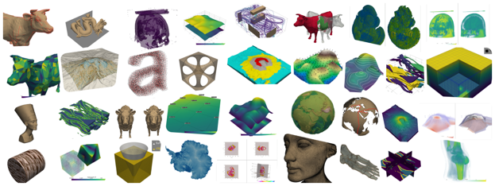

Science creates, processes and interprets data
Many tasks are common across the scientific sphere
ANALYSIS
MACHINE LEARNING
VISUALISATION
https://numpy.org/
https://scikit-learn.org/
https://pyvista.org/

Slide 3
Science creates, processes and interprets data
Many tasks are common across the scientific sphere
Collaboration is extremely powerful
ANALYSIS
MACHINE LEARNING
VISUALISATION
https://numpy.org/
https://scikit-learn.org/
https://pyvista.org/

Slide 4
Science creates, processes and interprets data
Many tasks are common across the scientific sphere
Collaboration is extremely powerful
But comes with challenges
ANALYSIS
MACHINE LEARNING
VISUALISATION
https://numpy.org/
https://scikit-learn.org/
https://pyvista.org/

Slide 5
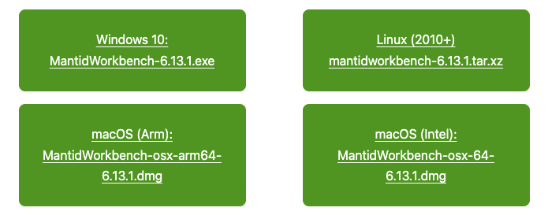
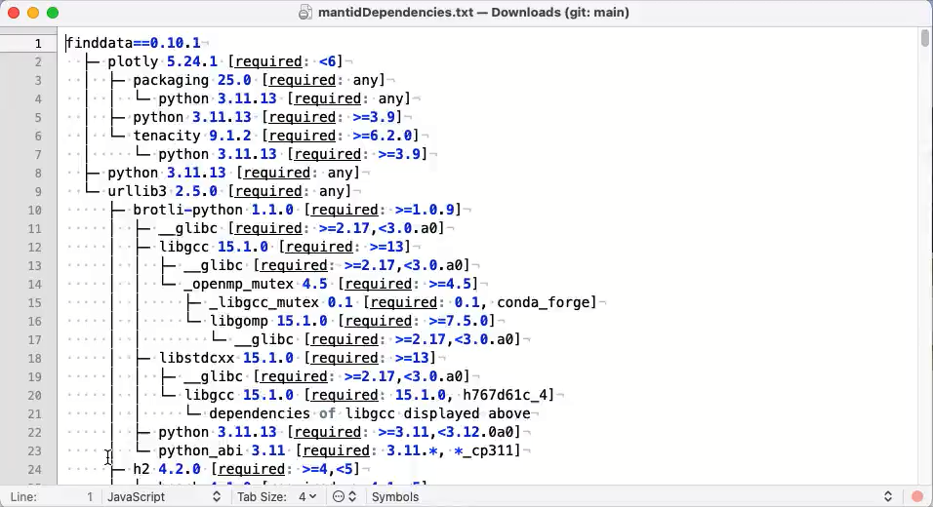

Example: mantid
Extensive toolbox for processing and visualizing neutron data
OPEN SOURCE GITHUB REPO
CROSS-PLATFORM SUPPORT
MANY DEPENDENCIES
https://github.com/mantidproject/mantid

Slide 6
Some questions to ask when creating software in 2025
Is my problem already solved?
How can I collaborate?
Can my work help others?
Navigating this requires certain knowledge and skills

Slide 7


Some questions to ask when creating software in 2025 2026
Is my problem already solved?
How can I collaborate?
Can my work help others?
Navigating this requires certain knowledge and skills
AI is impacting everything!
What are best practices for interacting with agentic coders?
Are my datasets going to be ingested by humans or agents?
Is my approach to data processing and provenance impeccable?

Slide 8
Presentations
Version control and collaboration (Malcolm)
Environment management (Jean)
Running Python scripts (Jean)
Introduction to ORNL file systems (Andrei)
AI (Mat)

Slide 9
Tutorials
Create a git repo (Malcolm)
Jupyter notebooks (Jean)
Fitting data (Zach)
Vibe coding Tutorial (All)

