Slide 1
Version control: an insanely useful tool for creation and collaboration
Malcolm Guthrie

Slide 2
1. git noun
(British slang)
a foolish or worthless person
Examples | Give it a break, you old git.
| oh, don't be such a silly git.
2. git noun
a free, open-source version control system

Slide 3
Version control and git
Version control allows the creation and management of snapshots of a project’s state.
This enables editing of content without risk of losing anything
Retains history of edits
Enables vital control over code edits in everything from personal projects to collaborative repos
Writing a paper
Supporting a large collaborative open-source project with 100s of contributors
Organizing a small single user repo

Slide 4
Some helpful git terminology
Repository (universally called a “repo”)
A collection of folders and/or files containing data. Can be anything (source code, text files, images, mp3s etc)
Commit
A specific snapshot of the state of the repo at an instant in time. Each commit has a unique identifier a 40-character hexadecimal string.
Branch
A copy of a repo, where changes can be made without altering other branches
Master or Main
The default name for the first branch in a repo
Merge
The process of combining two or more commits or branches

Slide 5
Typical git workflow
Create a repo
meMyself:$ git init
2. Add some content to the repo
3. When your reach a good stopping point. You first stage and then commit your work with a helpful message. your work is now safe!
meMyself:$ git add .
meMyself:$ git commit –m “my first draft”
4. You want to experiment with a new approach (say adding a new feature to code) so you create a new branch
meMyself:$ git switch –c newBranch
5. You get the new feature working nicely, you commit it
meMyself:$ git add .
meMyself:$ git commit –m “my new feature works!”

Slide 6
Typical git workflow
6. Now your new feature is working, you can merge it into the main branch
meMyself:$ git switch main
meMyself:$ git merge newBranch
7. You clean up by deleting the feature branch, which isn’t needed any more.
meMyself:$ git branch –d newBranch

Slide 7
github
github is a cloud platform that hosts git repositories (there are others: gitlab, bitbucket, SourceForge…)
Owned by Microsoft, extremely popular, many features for code development
Neutron Sciences has many repositories https://github.com/neutrons
Mantid is on github too https://github.com/mantidproject/mantid

Slide 8
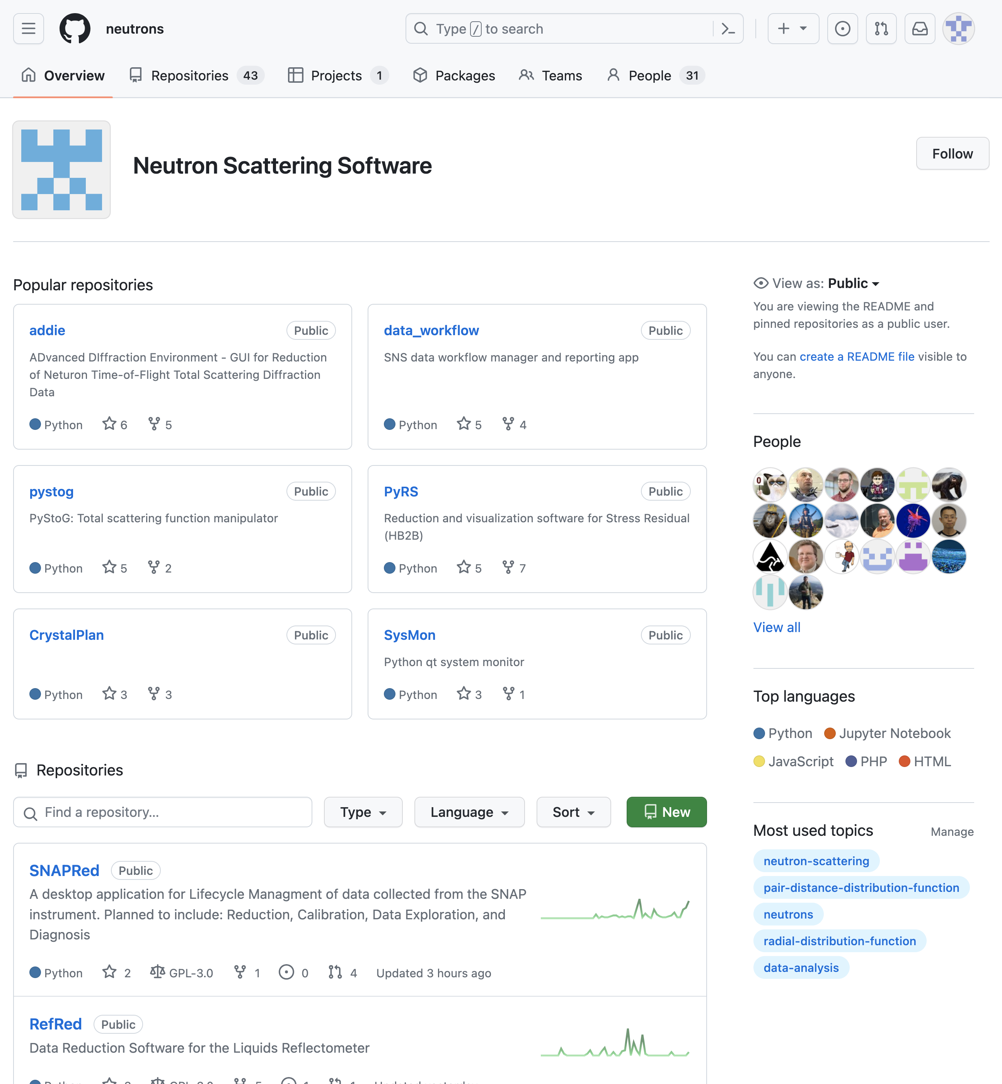

Slide 9
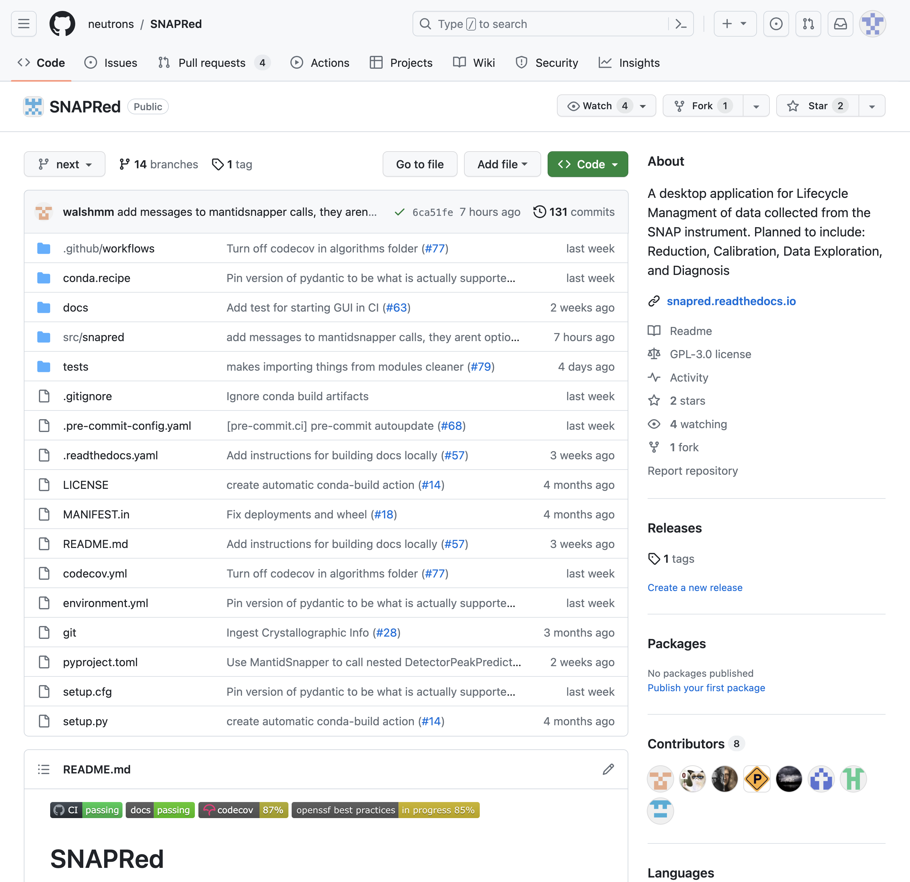
Title of repo

Slide 10
Short description
of project

Slide 11
Branch

Slide 12
readme contains
more detailed
information on project

Slide 13
Contents of repo
(folders and files)

Slide 14
most recent commit
messages

Slide 15
github users who have
committed to repo

Slide 16
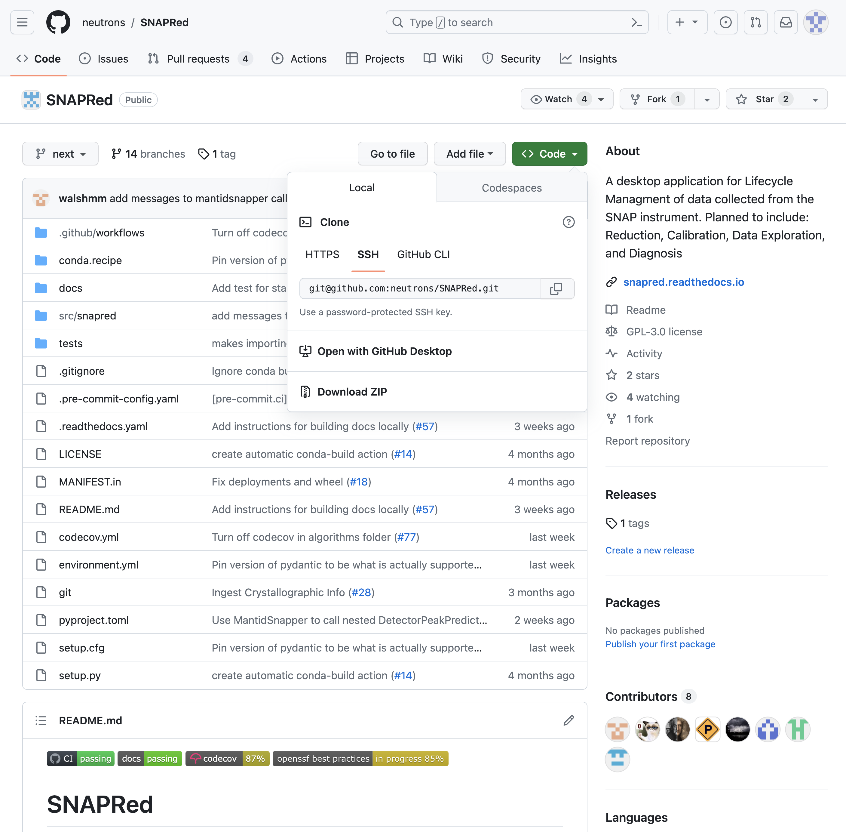
Clicking the green
“Code” button
reveals ways to
download the repo

Slide 17
Some helpful github terminology
Fork
Your own personal copy of someone else’s project
Pull Request
A formal request that your code be merged into the main branch of a repositoty
Push
Uploading local code commits from your computer to github
Pull
Downloading the latest commits from github to your computer

Slide 18
Some helpful git commands/tips!
You can check exactly what’s being tracked and what’s being changed with status
meMyself:$ git status
On branch malcolm_2026_update
Changes not staged for commit:
(use "git add/rm <file>..." to update what will be committed)
(use "git restore <file>..." to discard changes in working directory)
deleted: NXS_git_github.pptx
Untracked files:
(use "git add <file>..." to include in what will be committed)
NXS_git_github_2026.pptx
no changes added to commit (use "git add" and/or "git commit -a")

Slide 19
Some helpful git commands/tips!
If you create a file called .gitignore in your repo, you can specify files/folders that git will literally ignore
git log gives you access to metadata of all commits and their messages. If its TMI, adding –oneline will just give. the hash and the commit message
meMyself:$ git log –-oneline
c687343 (HEAD -> malcolm_2026_update, origin/main, origin/HEAD, main) add in demo data for tutorial 3
63ae4d9 Removed obsolete lecture.
ea762e6 Diffferential evolution
76cac6e updated tutorial03
4f75458 add in tutorial 3 files
10308bc replacing conda by micromamba in tutorial0
92471a3 Merge pull request #3 from mguthriem/main
ee56a81 added 2025 intro slide
03d1f9d Merge pull request #2 from mguthriem/main
8bbbe5f Malcolm edits for 2025
d1b2e02 Update README.md

Slide 20
Some helpful git commands/tips!
You can check the where push and pull will connect to with remote
meMyself:$ git remote -v
origin git@github.com:neutrons/ns-computation-tutorial.git (fetch)
origin git@github.com:neutrons/ns-computation-tutorial.git (push)
You can see the exact changes you’ve made relative to another branch with diff. If you are on your own branch
meMyself:$ git diff main
more to come in the git tutorial!

