Slide 1
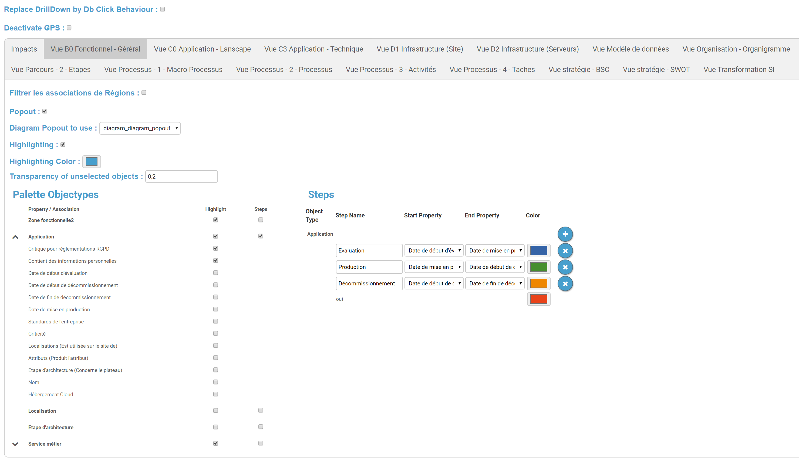

When clicking on exploded region, you will be bring to the objectPage (like a double click)
Remove the GPS button
Select the template to configure
This option allow you to filter custom association region, and display the number of object on the custom and standard association region
Display a new icon on the diagram option, when clicking on it will open a popout of the diagram or a diagram template for auto diagram, in this popout you can for exemple display the legend
Select which popout to use
Enable highlighting

