Slide 1
Naïve Bayes classification for spam detection.
Nevan O’Keeffe
R00157703
Data Science & Analytics, CIT

Slide 2
Background
Spamming is the use of electronic messaging systems to send unwanted messages, often containing advertising or malicious content.
The purpose of spam detection is to filter spam messages into a separate folder.
Clearly, we want to correctly identify all spam so it does not reach our inbox but it is very important that regular emails are not incorrectly flagged as spam.

Slide 3
Naïve Bayes
Naïve Bayes is a classification algorithm which calculates the probabilities of a sample belonging to a different categories, and then outputs the category with the highest probability.
The probabilities are calculated based on features which, in our application, will be the word count of each word in the sample messages. The messages will be treated as the set of the words they contain.
The approach is called “Naïve” because it assumes every word in a sentence is independent of the others.
“The dog jumped” = “Jumped the dog”

Slide 4
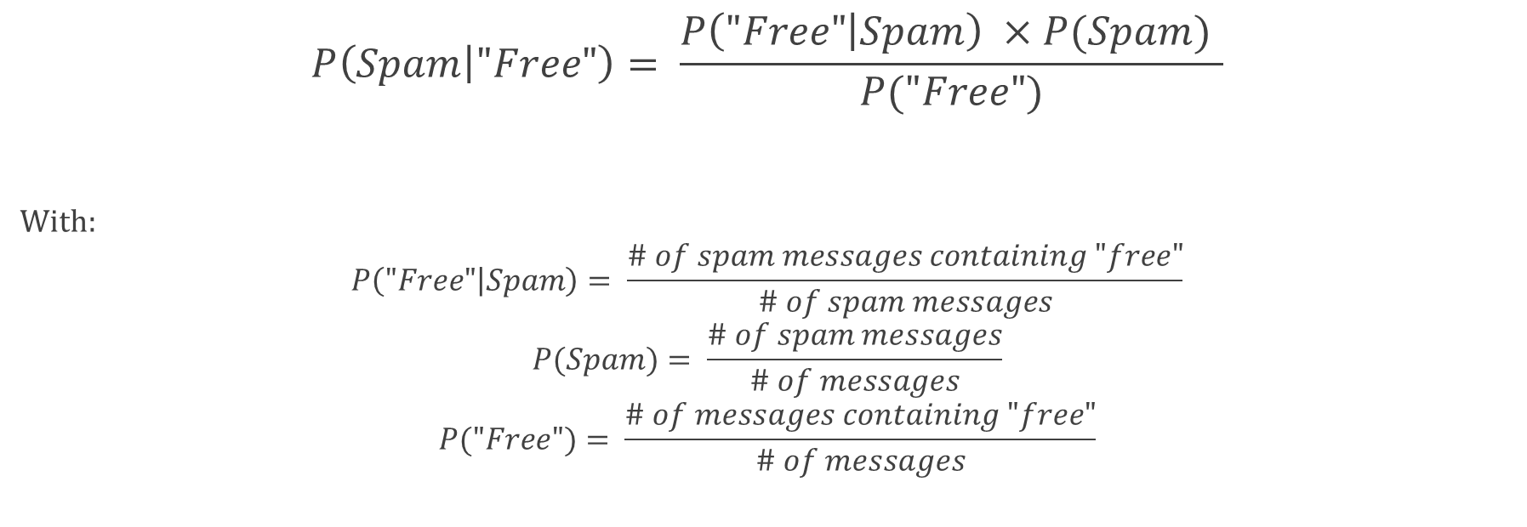
Bayes Theorem
$$P\left(Spam | "Free"\right)= \frac{P\left("Free" | Spam\right) ×P(Spam) }{P("Free")}$$
With:
$$P\left("Free" | Spam\right)= \frac{\# of spam messages containing "free"}{\# of spam messages}$$
$$P(Spam)= \frac{\# of spam messages}{\# of messages}$$
$$P("Free")= \frac{\# of messages containing "free"}{\# of messages}$$

Slide 5
Implementation
My implementation of Naïve Bayes was guided by this article:
https://rpubs.com/mzc/mlwr_nb_sms_spam
The model was trained and evaluated on a dataset of 5574 text messages, each labelled as “spam” or “ham”.
 | Count | Percentage
Spam | 747 | 13.4%
Ham | 4827 | 86.6%

Slide 6
Implementation cntd.
There were 6 major steps to implement the Naïve Bayes classifier:
Text cleaning – Removed numbers, stopwords, punctuation and white space, and made all letters lowercase. ‘tm’ library.
Document-term matrix – Matrix to describe frequency of words in each document. ‘tm’ library.
Split datasets – Split datasets into training and test sets, 75:25.
Feature reduction – Removed words with frequency < 5, set of words: 7943 to 1231.
Factor creation – Converted wordcounts into “yes” or “no” factors.
Run model – Trained the model on the training set, and predicted on the test set. ‘e1071’ library.

Slide 7
Results
Predicted
Actual
 | Ham | Spam | Total
Ham | 1190 97.7% 99.5% | 28 2.3% 15.7% | 1218 88.6%
Spam | 6 3.8% 0.5% | 150 96.2% 84.3% | 156 11.4%
Total | 1196 87% | 178 13% | 1374
28 spam messages were not flagged, 15.7% of spam got through.
6 messages were incorrectly flagged, 0.5% of regular emails were lost.

Slide 8
Results after Laplace Smoothing
Predicted
Actual
 | Ham | Spam | Total
Ham | 1192 97.5% 99.7% | 30 2.5% 16.9% | 1222 88.9%
Spam | 4 2.6% 0.3% | 148 97.4% 83.1% | 152 11.1%
Total | 1196 87% | 178 13% | 1374
30 spam messages were not flagged, meaning 16.9% of spam got through.
4 messages were incorrectly flagged, meaning 0.3% of regular emails were lost.

Slide 9
Limitations and Recommendations
Bayesian poisoning – Practice among spammers of inserting legitimate text in spam to confuse filters.
N-grams – Look at sequences of words rather than single words, “call now” rather than “call” and “now”.
Lemmatisation – Count inflections of words as one word: “claim”, “claims”, “claimed”.
Multinomial document model – Use word counts, rather than factors, as features for classification.
Laplace smoothing – Add 1 to the count of every word to avoid 0 probability calculations.
TF-IDF – Penalise words which occur frequently in corpus.
Checksum-filter – Strip everything that may vary between messages, and then compare this checksum to a database of checksums identified as spam.
DNS/URL blacklists – Block emails originating from certain DNS or emails containing specified URLs.

