Slide 1
Using EPA to Optimize Play Selection on 2nd & Short
Neva Williams
Expected Points Added (EPA)
EPA captures how a play changes scoring value within its situation. The examples on the right show where context defines value, and where traditional metrics story telling the full story. EPA shows what the play was actually worth within its context, not just what it gained.
Play & Game Context
Yards
Success
EPA
What EPA Sees
Herbert to Q Johnston (TD)
+60
YES
+5.69
All metrics agree:
explosive, +5.7 pts
Wk 2 vs LV · LV 40-yd line · 2nd & 3
Hampton run (TD)
+54
YES
+4.51
All metrics agree:
explosive run
My model considers more detailed context in the calculation of EPA by adjusting for:
Score differential
Opponent defensive strength
Game state (“garbage time” removed)
Wk 4 vs NYG · LAC 46-yd line · 1st & 10
Harris run (First Down)
+1
YES
−1.45
Success rate misses:
scoring prob. dropped
Wk 2 vs LV · LAC 29-yd line · 2nd & 1
2nd & Short
Herbert run (First Down)
+4
YES
−2.18
Converted but
EPA still negative
Wk 7 vs IND · LAC 43-yd line · 3rd & 1
One of the best spots on the field. The playbook is wide open, defense has to respect everything, risk floor is low. EPA gives us a sharper lens on this situation by understanding exactly where the value is and where there's an opportunity to gain a competitive edge.
Lance pass (INT)
0
NO
−7.42
All metrics agree:
catastrophic
Wk 18 vs DEN · LAC 40-yd line · 3rd & 5

Slide 2
What the Data Shows on 2nd & Short
2025 NFL Season
Context-Adjusted EPA by Situation
2025 LAC Play Call Tendencies on 2nd & Short
Situation
Run
Short Pass
Deep Shot
Situation
Run
Short Pass
Deep Shot
2nd & 1
0.078
−0.160
0.067
2nd & 1 (n=11)
90.9%
9.1%
0%
2nd & 2
0.065
−0.173
0.728
2nd & 2 (n=18)
77.8%
22.2%
0%
2nd & 3
0.092
0.009
0.174
2nd & 3 (n=17)
52.9%
29.4%
17.6%
LAC Ranked #29 in the league on 2nd & Short EPA in 2025
The Story
Team
EPA
Run%
Shot%
LAC ran the ball on 2nd & 1 or 2nd & 2 nearly every time in 2025 in the exact situations where the data shows the highest value for a different call. LAC ran more than almost anyone and threw zero shots on their two most valuable 2nd down situations. The stark difference in EPA values, particularly on 2nd & 2 challenge the conservative ”establish the run” approach represented in the play call tendencies.
1. Cincinnati Bengals
+0.437
61.4%
6.8%
2. Los Angeles Rams
+0.396
58.6%
10.0%
29. Los Angeles Chargers
−0.154
71.7%
6.5%

Slide 3
Example Call Sheet — Where Is the Value on 2nd & Short?
Close game situations (score diff ≤7) | Best call type by field zone and distance
Zone
Dist
Best Call
EPA
1st Down %
Explosive %
Notes
Own Territory
&1
Run
+0.160
84.8%
6.1%
Defense is set — run it, get the first down and move on.
Own Territory
&2
Run
+0.165
70.0%
6.2%
Deep enough that field position risk outweighs shot upside.
Midfield
&1
Run
+0.156
79.2%
10.4%
Run works here — but defense must respect the pass to keep it that way.
Midfield
&2
Deep Shot
+0.524
50.0%
50.0%
Defense in run mode. Shot play catches them off guard.
Scoring Pos.
&1
Short Pass
+0.445
92.3%
15.4%
Quick pass in tight quarters — 92% first down rate, almost no risk.
Scoring Pos.
&2
Deep Shot
+1.210
80.0%
80.0%
Highest value play in any 2nd & short situation. Take the shot.
Red Zone
&1
Short Pass
+0.217
50.0%
0%
Condensed space limits deep shot. Quick pass or run to the end zone.
Red Zone
&2
Run
−0.022
50.9%
0%
Tight space. All options are difficult here.

Slide 4
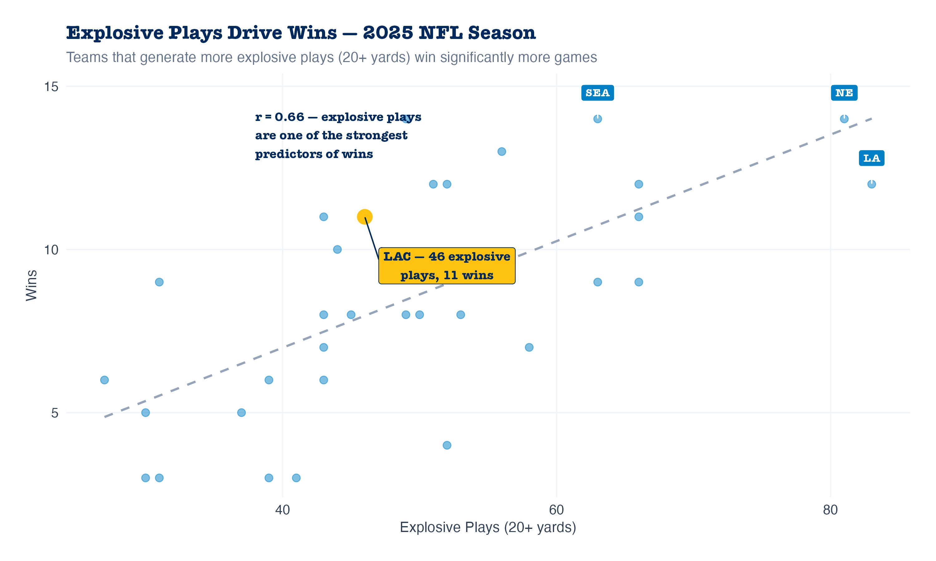
Reframing the Risk on 2nd & Short
Explosive plays win games. 2nd & short is where you create them.
"What if the Shot Doesn't Work?"
3rd & short conversion rates (2025 NFL Season)
Situation
n
League Rate
LAC Rate
Verdict
3rd & 1
737
67.8%
77.8%
Manageable
3rd & 2
483
59.0%
56.0%
Manageable
If a deep shot fails on 2nd & 2, LAC faces 3rd & 2, a situation they convert 56% of the time. The risk coaches are avoiding by running conservative is not as large as it may appear.
Herbert elevates EPA by turning 2nd & short into a true scoring window. His ability to attack downfield makes aggressive calls more efficient, increasing expected points rather than just moving the chains.
Why This Matters Beyond 2nd & Sort
Explosive plays are one of the strongest predictors of winning in the NFL. The offense ran 64 plays per game in 2025. Every single one has weight. Routine conservative runs on 2nd & short limit what is otherwise a low-risk opportunity to generate explosives. The defense is in run mode, the playbook is wide open, and the risk floor is a manageable 3rd & short. This is the spot.
EPA already shows the advantage of taking these shots, but it doesn’t full capture the defensive stress they create. Forcing the defense to defend vertically creates space, increasing the overall upside of the decision.

