Slide 1


Java Programming Project Presentation
  Project Title: Event Registration And Participant Management System
  Course: Java Programming Mini Project
  Student Name & Roll No: Nevethaa R S [25BCS036]
  Department: Computer Science
  Mentor / Guide: Dr.Boopalan Sundaramoorthy

Slide 2
Java Programming Project Presentation
Introduction
Overview of the Project and its Purpose:
• Java-based system to efficiently manage and organize event registrations
Problem Background and Motivation:
• Manual registration causes errors, duplication, and delays in data handling
Significance of the Project in Solving Real-World Issues:
• Improves accuracy, reduces manual work, and enables efficient event management

Slide 3
Java Programming Project Presentation
Objective
To develop a Java-based system for efficient event registration and participant management
• To apply core programming concepts like classes, objects, and data handling
• To automate data storage, search, and management processes to reduce manual effort

Slide 4
Java Programming Project Presentation
Problem Statement
Current Issue / Gap:
Manual registration leads to errors, duplication, and poor data management.
Limitations / Inefficiencies:
• Slow process and high workload
• Data errors and duplication
• Difficult to manage large participants
• No quick access to data
How the Project Solves It:
• Automates registration process
• Ensures accurate and organized data
• Provides quick access and easy management
• Improves overall efficiency and coordination

Slide 5
Java Programming Project Presentation
System Requirements
Hardware Requirements:
• Computer/Laptop with minimum 4GB RAM
• Processor: Intel i3 or above
• Hard Disk: 500GB (minimum)
Software Requirements:
• Operating System: Windows
• Programming Language: Java
• IDE: Eclipse
• JDK (Java Development Kit)

Slide 6
Java Programming Project Presentation
System Design
System Structure & Workflow:
The system allows users to enter participant details, which are stored and managed efficiently. Users can search, view, and update records as needed. The system also generates participant reports and ensures smooth operation until the user exits the system.
Algorithm Outline:
• Start the program
• Display menu options (Register / View / Update / Exit)
• Get user choice
• If Register → Enter and store participant details
• If View → Display participant records
• If Update → Modify existing details
• Repeat until user selects Exit
• End the program

Slide 7
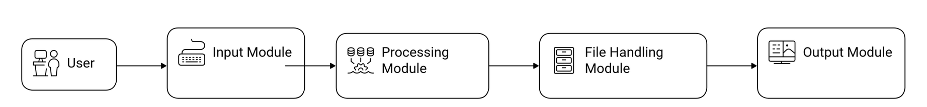
Java Programming Project Presentation
System Design
Block Diagram

Slide 8
Java Programming Project Presentation
Module Description
Input Module:
This module collects user input such as participant name, event details, and contact information required for registration.
Processing Module:
This module processes the entered data, applies necessary logic, and manages operations like adding, updating, and organizing participant records.
Output Module:
This module displays the processed information, including participant details and generated reports, in a clear and readable format.
File Handling Module:
This module is responsible for storing participant data in files and retrieving it whenever required for future use.

Slide 9
Java Programming Project Presentation
Algorithm
• Start the program
• Display menu options (Register / View / Update / Exit)
• Get user choice
• If Register → Enter and store participant details
• If View → Display participant records
• If Update → Modify existing details
• Repeat until user selects Exit
• End the program

Slide 10
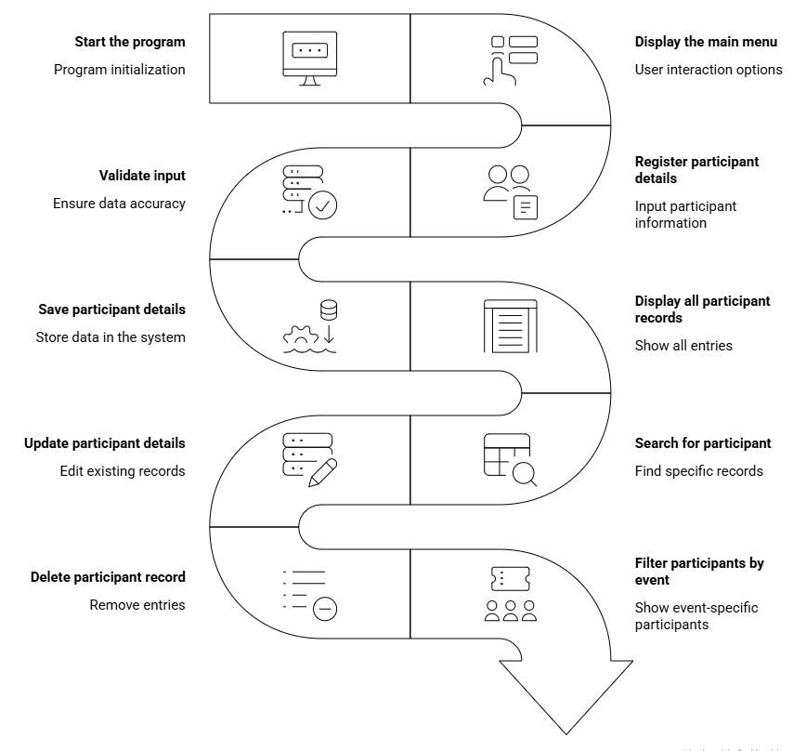
Flowchart
Java Programming Project Presentation

Slide 11
Java Programming Project Presentation
Implementation
The Event Registration and Participant Management System is implemented using programming techniques that ensure efficient handling of participant data and smooth system operation.
Techniques Used:
• Loops and conditional statements are used to control the menu-driven system and manage user choices like registration, viewing, and updating participant details.
• Functions and arrays are used to store and manage multiple participant records efficiently and to organize the program into reusable components.
• File handling is used to save participant details and retrieve them when needed, ensuring proper data storage and management.

Slide 12
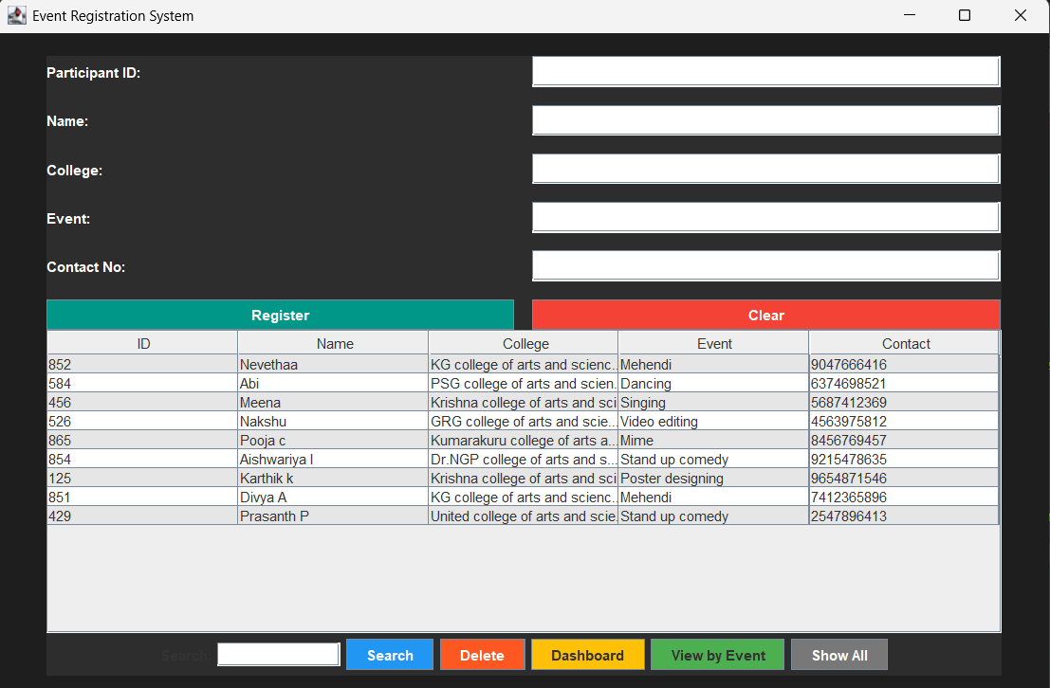
Java Programming Project Presentation
Output Screens
Shows the menu options for registration, search, update, delete, filter, dashboard, and exit.

Slide 13
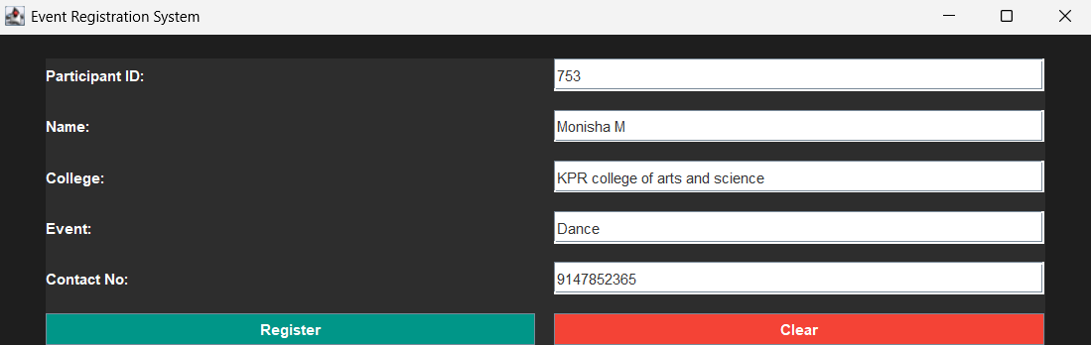
Java Programming Project Presentation
Output Screens
Shows the input fields for entering participant details: ID, Name, College, Event, Contact.

Slide 14
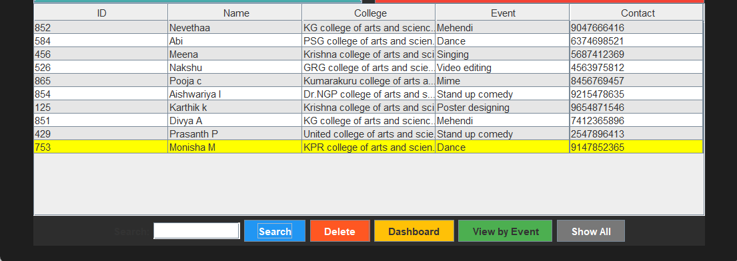
Java Programming Project Presentation
Output Screens
Shows the registered participants in a table format after registration.

Slide 15
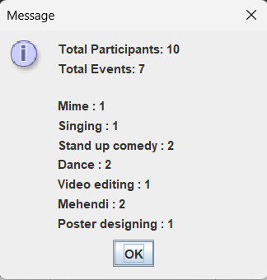
Java Programming Project Presentation
Output Screens
Shows the participant statistics for all events.

Slide 16
C Programming Project Presentation
Results & Discussion
• The system successfully registers participants, stores data, and generates accurate participant details as output.
• The results obtained match the expected outcomes, ensuring correct data storage, retrieval, and display.
• The system shows good accuracy and performance with fast data processing and minimal errors.
• Some challenges like handling duplicate entries and managing file operations were faced and resolved using proper validation and error handling techniques.

Slide 17
Java Programming Project Presentation
Conclusion & Future Enhancement
Conclusion:
• The project successfully achieved its objectives by automating event registration and participant management
• Improved understanding of Java programming concepts and system design
Future Enhancements:
• Add GUI using Java Swing for better user interaction
• Integrate with a database for efficient data storage
• Extend features for handling large-scale events and online registrations

Slide 18
Java Programming Project Presentation
References / Acknowledgement
References:
  Herbert Schildt – Java: The Complete Reference
  E. Balagurusamy – Programming with Java
  TutorialsPoint & GeeksforGeeks (for code logic and examples)
  Academic project materials and classroom notes
Acknowledgement:
We sincerely thank our project guide, faculty members, and institution for their valuable guidance and support throughout the development of the Simple Payroll Slip Generator.We also acknowledge the contributions of our team members for their dedication and teamwork in successfully completing this project.

Slide 19
Thank You
“In conclusion, this project demonstrates how automation can simplify event registration and participant management, improving efficiency, accuracy, and overall user experience.”

