Slide 1
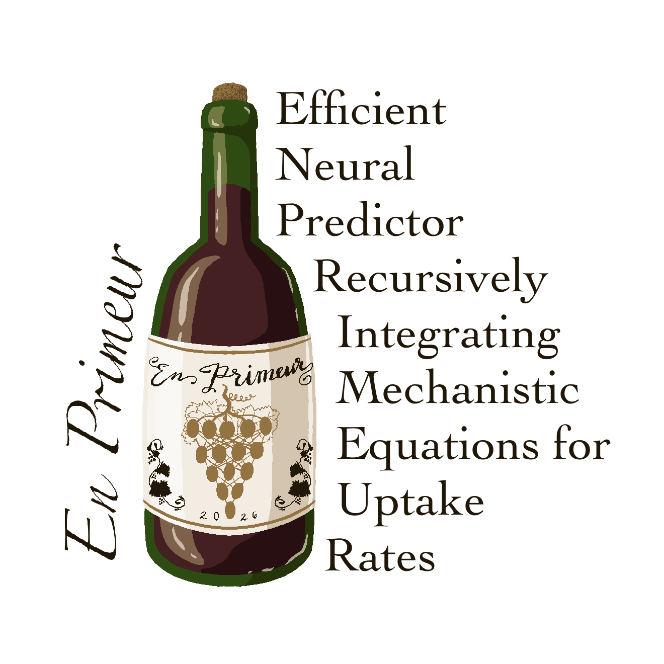
A fast neural surrogate of a
mechanistic CHO bioreactor model
Forecasting final conditions from the first few days
Neve Callaway Lewis Lab meeting · 2026
Intern from Brigham Young University
B.S., Bioinformatics April 2027 expected graduation
Kimberly Robasky, Sarat Gopalakrishnan

Slide 2

Can We Train a Small Surrogate NN for COSMIC-dFBA?
Reference model: COSMIC dynamic flux balance analysis (dFBA) solves a system of ODEs to predict daily cell culture dynamics from metabolic rates (feed, washout, uptake, and secretion).
Accurate, but computationally slow
EN PRIMEUR
French term for the tradition of tasting a young wine from the barrel and predicting the final vintage before purchase.
Goal: Create a NN to model cell culture
Create a small neural network trained on ODE computed synthetic data to forecast the remaining culture trajectories from early observations and operating conditions.
Similarly, this framework learns to forecast a bioreactor’s trajectory and final conditions from early-run data.

Slide 3
Why EN PRIMEUR
1 Feature importance → media design
If the neural network learns predictive relationships, feature attribution methods can identify which conditions and media components most influence the predictions.
2 Differentiable
3 Confidence limits
4 Faster
inherent
next step
to confirm
The neural network is end-to-end differentiable, enabling gradient-based optimization of inputs (e.g., maximizing titer).
The model can report prediction confidence intervals as a range.
Milliseconds per run: cheap to scan conditions and retrain on demand.
The speed-vs-solver comparison is still to pin down (depends how COSMIC uses linear solvers).
Accuracy is another payoff that helps us optimize the production process.

Slide 4
Model architecture
The small model: one 1D conv layer, 32 hidden nodes. Every node drawn as a dot.
Weighted summary of all
6 previous days
Concentration head
input
1D CNN → Attention pool
+ DoE
hidden
next day
9 (x 6 days)
32 (x 6 days)
32
35
32
8
Arrows = flow between layers, not full connectivity. Gold dots = the 3 DoE (operating-condition) inputs.
Each prediction feeds back in to forecast the rest of the run. The hybrid and PINN variants add a flux head (32 → 8), feeding an ODE step or a physics penalty.

Slide 5
Two potential models, in order of how much physics they embed
1
2
3
Pure NN
Hybrid neural-ODE
Predicts next-day concentrations directly, no ODE or physics inside the model. It's the baseline model: it shows the ODE isn't what makes the prediction accurate.
The network predicts per-cell fluxes, and a fixed ODE step integrates them into the next-day concentrations. Mass balance is guaranteed. The ODE runs in the forward pass.

Slide 6
Inference speed: NN vs. the mechanistic model
COSMIC-dFBA takes ~15 minutes per reactor. The NN predicts the same run in 0.0003 ms, billions of times faster.
model / method | ms/reactor | × faster than generator | × faster than COSMIC
closed-form ODE (our synthetic data generator) | 0.0005 | 1× (reference) | 1,800,000,000×
pure NN | 0.0003 | 1.7× | 3,000,000,000×
hybrid (solver-free at inference) | 0.0003 | 1.7× | 3,000,000,000×
COSMIC-dFBA (real model) | ~900,000 (15 min) | — | 1× (baseline)
The NN matches or slightly beats our closed-form generator, and both are billions of times faster than the real COSMIC-dFBA.
Speed enables running it at scale; it is not the ultimate contribution.
A100 GPU · small model (1 conv, 32 nodes) · n = 20,000. Speedup = the reference's ms ÷ each model's ms (generator 0.0005, COSMIC 900,000).

Slide 7
Pure NN captures cell culture performance
Under these conditions, you can predict:
feature | R² | ρ
Cell density | 0.98 | 0.91
Cell size | 0.98 | 1.00
Titer | 0.95 | 0.97
Glucose | 0.99 | 0.97
Glycine | 0.95 | 0.53
Glutamine | n/a | 0.62
Asparagine | n/a | 0.63
Serine | n/a | 0.49
R² = how much of the true variation the model explains (1 = exact, 0 = no better than the mean). It is unitless and stricter than just shape.
ρ = does the prediction move up and down with the truth (trend agreement). n/a on a flat signal: nothing to correlate.
5 of 8 variables score R² 0.95–0.99. 3 amino acids are too flat to score (n/a) but the model still tracks them.

Slide 8
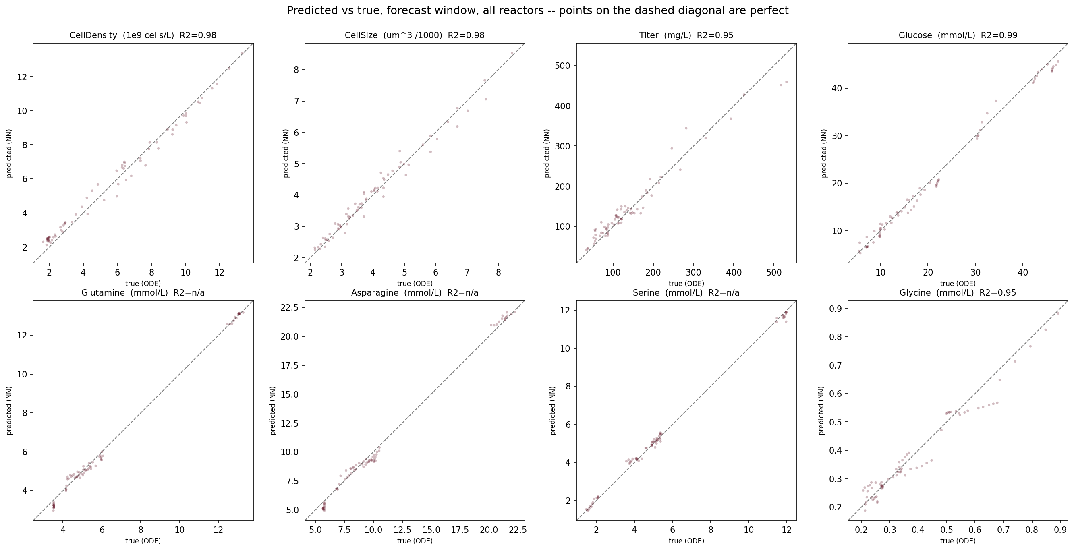
The Model’s Predicted v. True

Slide 9
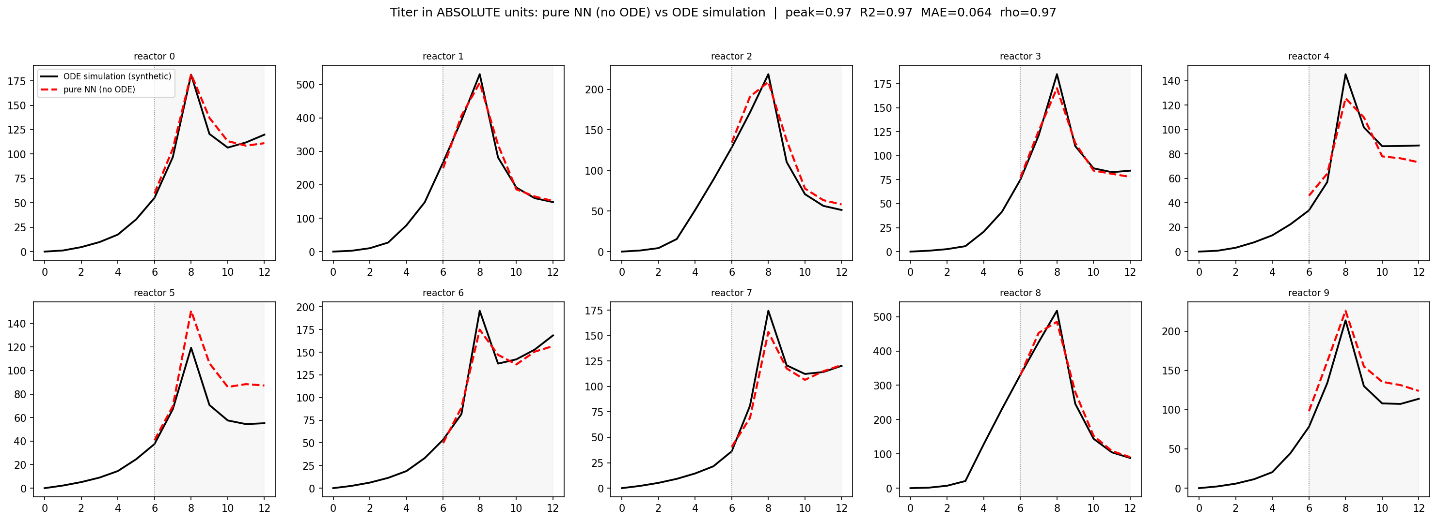
Titer Predictions
Black = the ground truth synthetically generated run. Red dashed = the NN's forecast. The model sees only days 0–6 (left of the line), then predicts days 6–12 on its own.

Slide 10
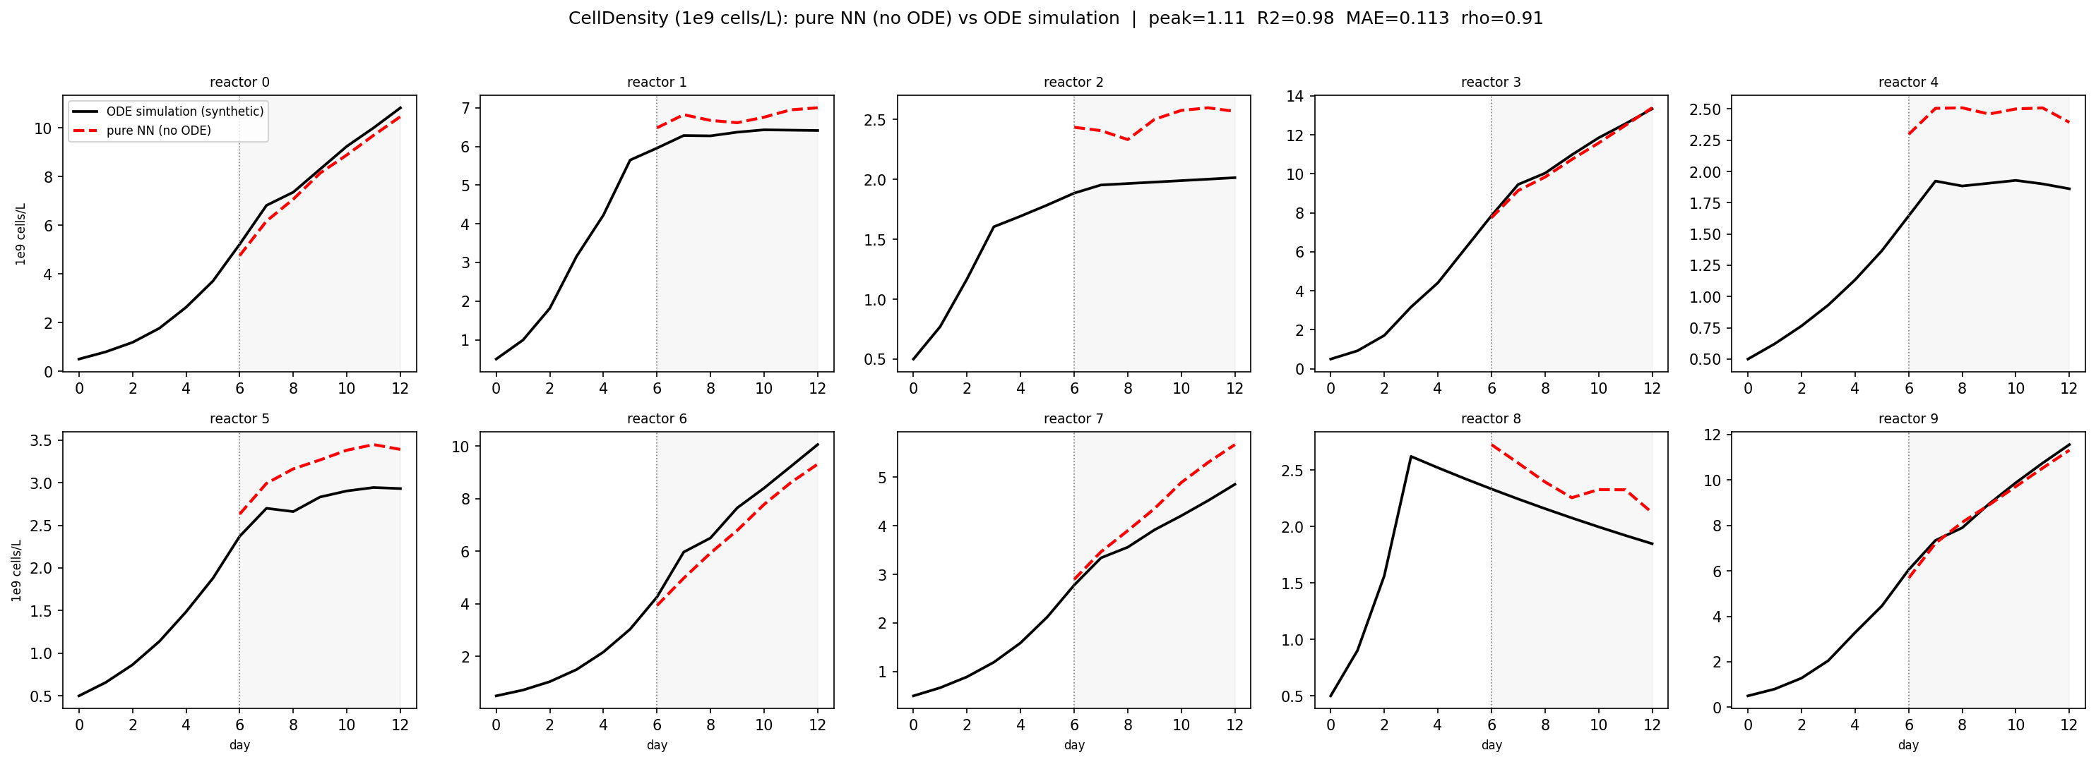
Cell Density Predictions
Black = the ground truth synthetically generated run. Red dashed = the NN's forecast. The model sees only days 0–6 (left of the line), then predicts days 6–12 on its own.

Slide 11
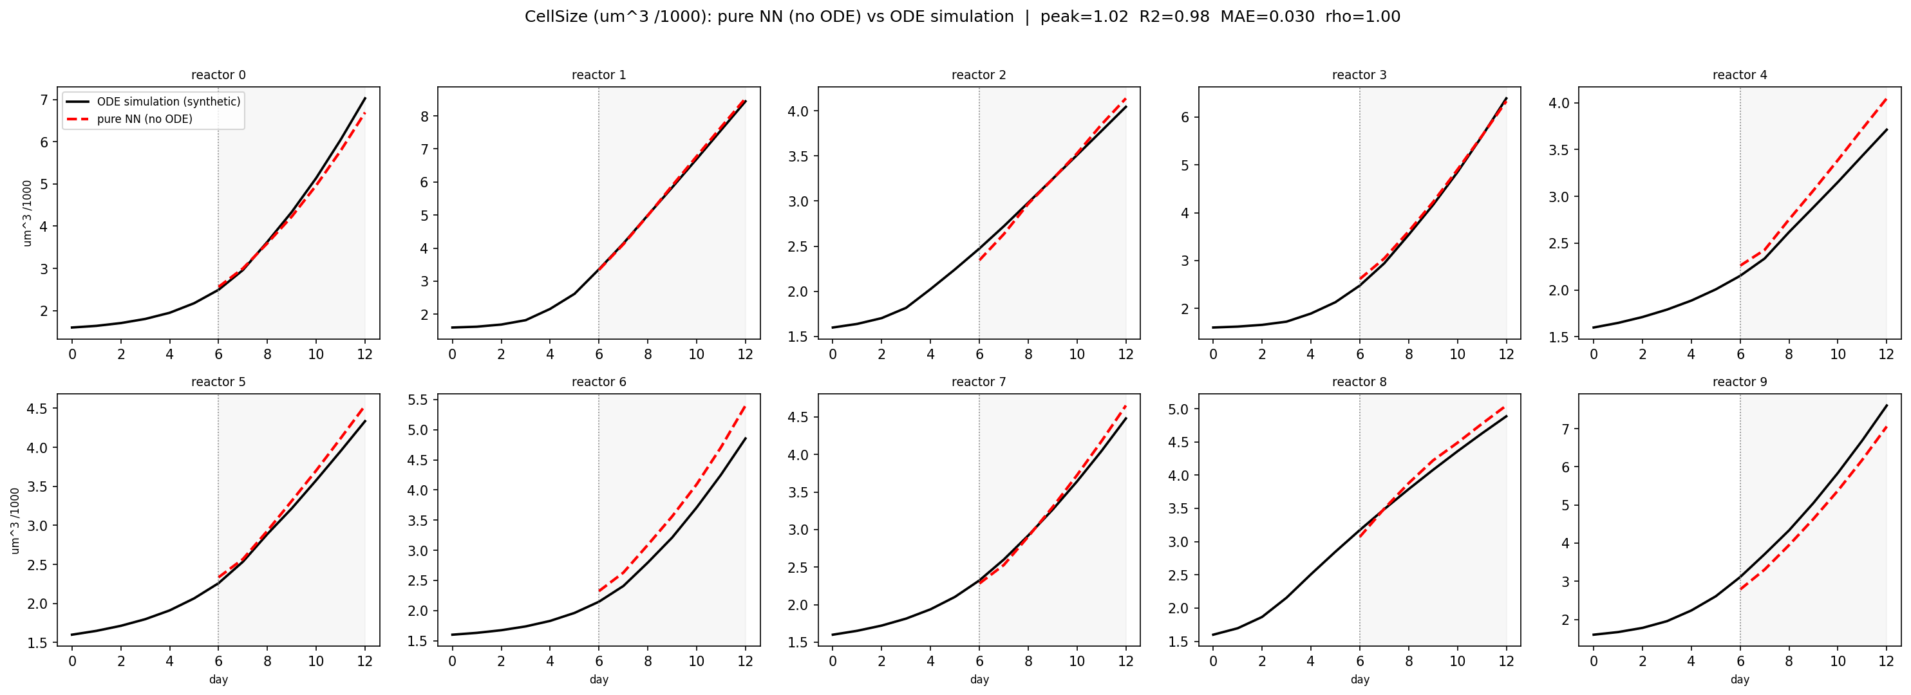
Cell Size Predictions
Black = the ground truth synthetically generated run. Red dashed = the NN's forecast. The model sees only days 0–6 (left of the line), then predicts days 6–12 on its own.

Slide 12
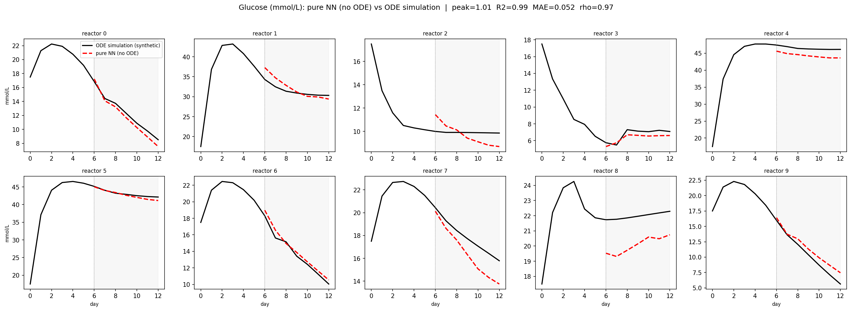
Glucose Predictions
Black = the ground truth synthetically generated run. Red dashed = the NN's forecast. The model sees only days 0–6 (left of the line), then predicts days 6–12 on its own.

Slide 13
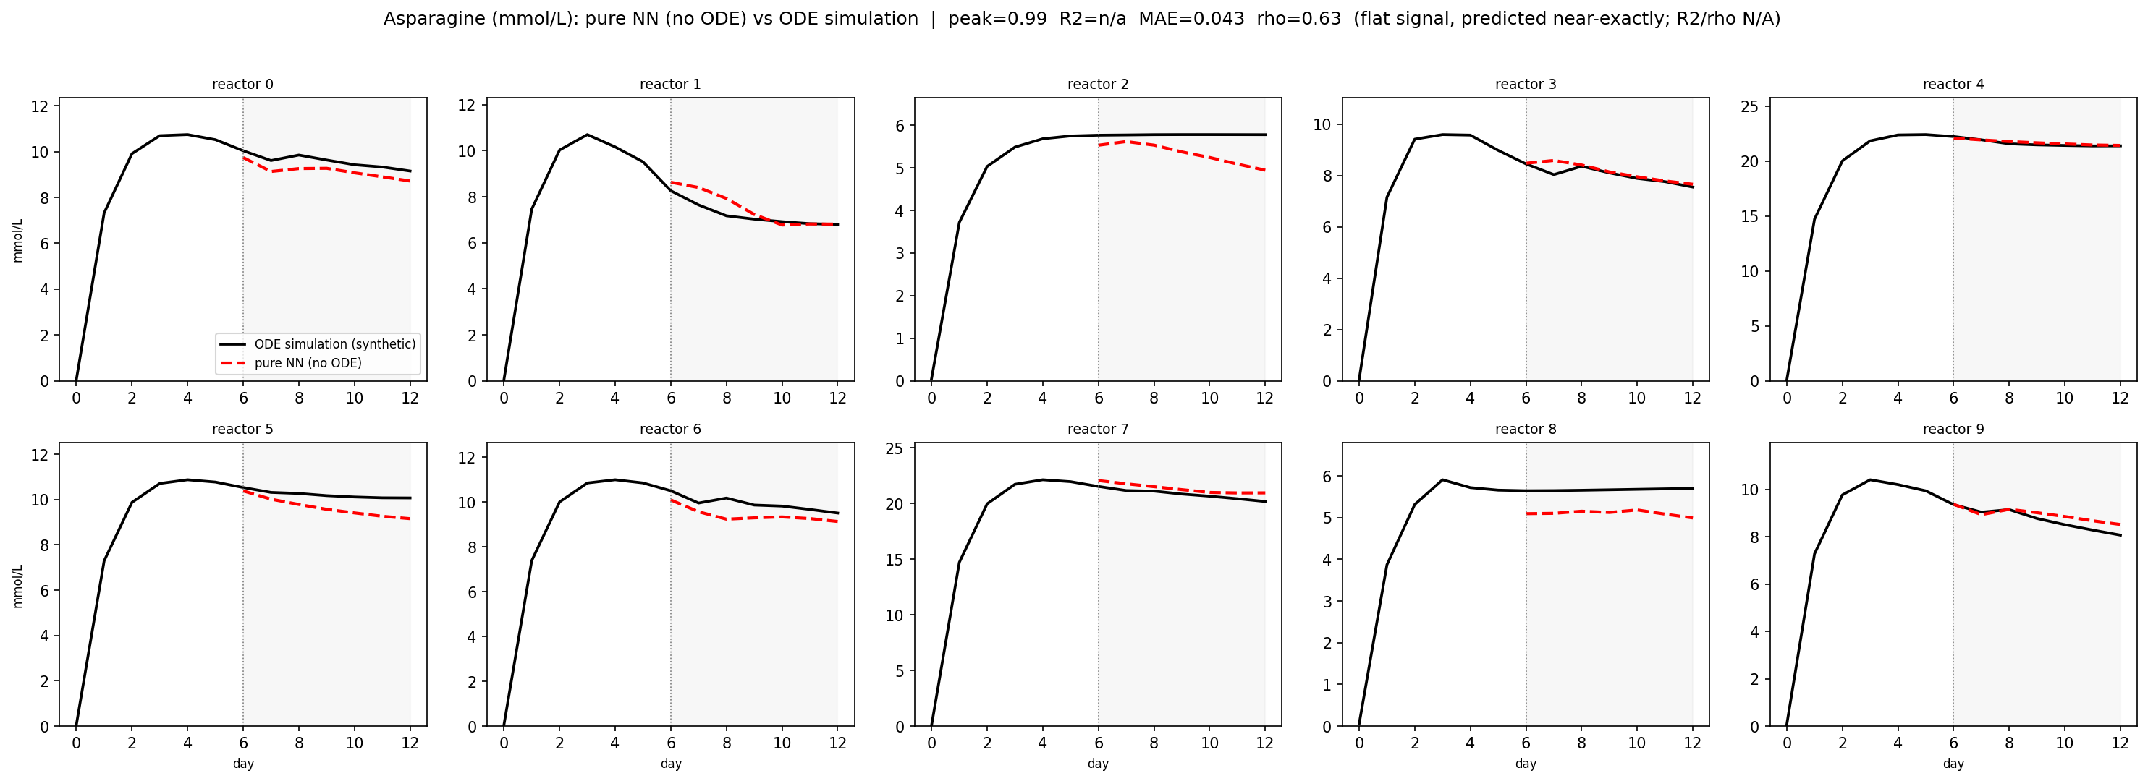
Asparagine Predictions
Black = the ground truth synthetically generated run. Red dashed = the NN's forecast. The model sees only days 0–6 (left of the line), then predicts days 6–12 on its own.

Slide 14
Scope & next steps
Scope & limitations
Next steps
Trained on synthetic COSMIC-dFBA runs (a physics analog).
Real data not used for training or magnitudes.
Normalized after pooling all data.
Scaling stays invertible, units interpretable. Cross-sample variance preserved.
Validated against the simulator.
Window-level holdouts (1–2 windows per reactor).
Generated with the aid of AI tools
Potential internal bugs
Real-data validation.
Shape / trend check only, never magnitude.
Conditions differ. Shared: perfusion, η switch, O₂.
Generalize to new conditions with new data.
Incremental “lazy” retraining.
Add each new condition, retrain (~4 min).
Continuous-time PINN.
Hybrid ODE-in-forward inference timing.
Trained and scored on the mechanistic simulator alone; treat as a surrogate, not a wet-lab-validated model.

Slide 15
Acknowledgements
Thank you to:
Nathan Lewis
Kimberly Robasky
Sarat Gopalakrishnan
BYU College of Life Sciences
Funded Internships
Let’s get to tasting!
Other per-variable prediction trajectories to follow upon request.

Slide 16
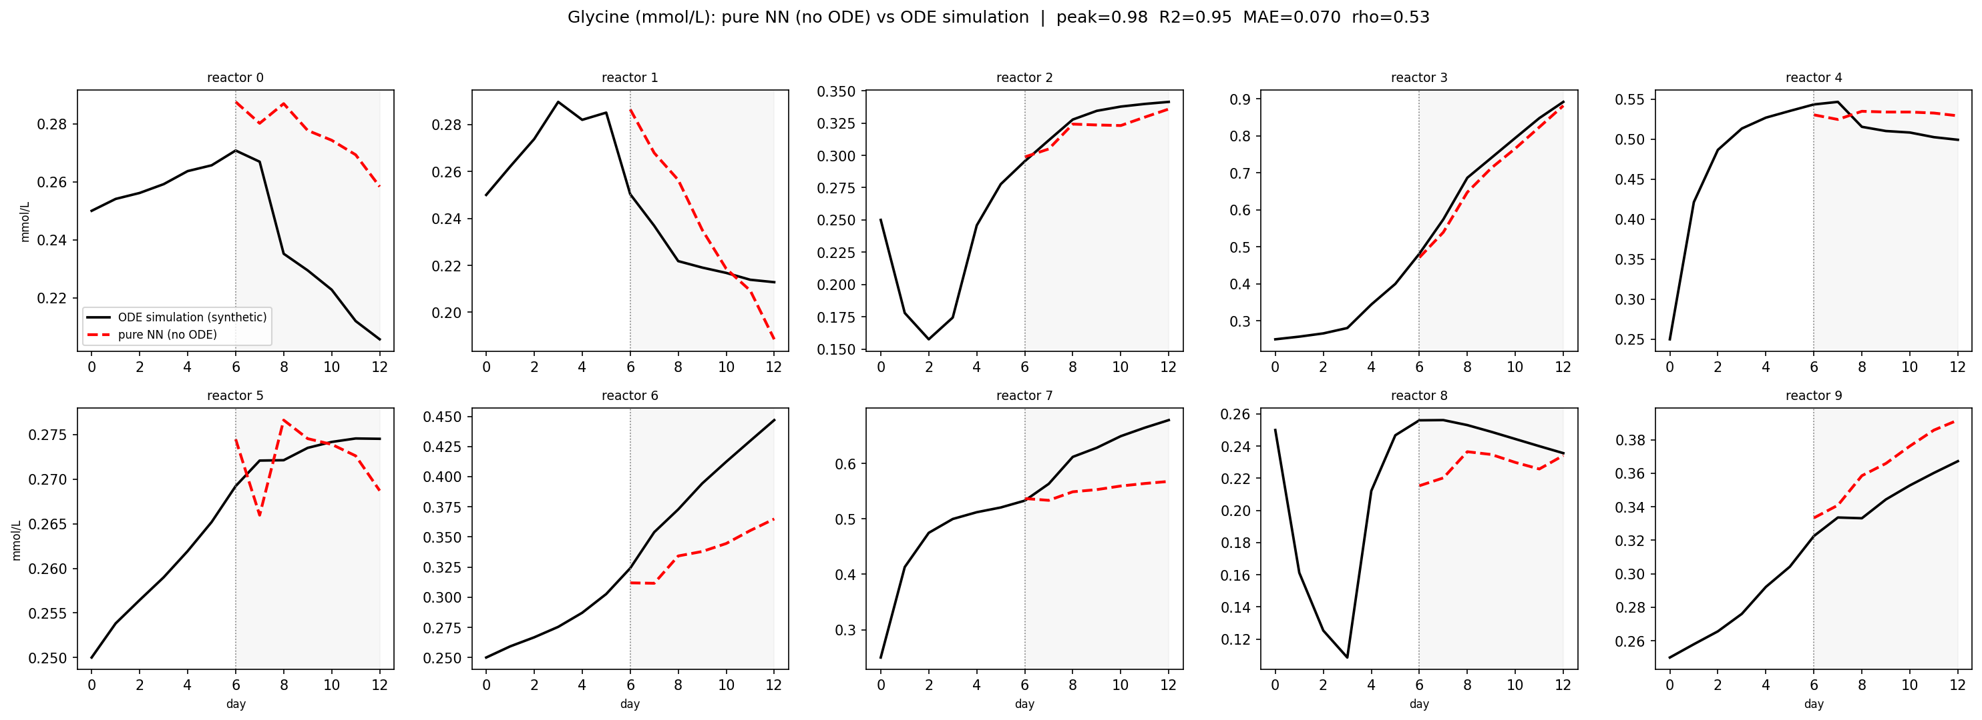
Glycine Predictions
Black = the ground truth synthetically generated run. Red dashed = the NN's forecast. The model sees only days 0–6 (left of the line), then predicts days 6–12 on its own.

Slide 17
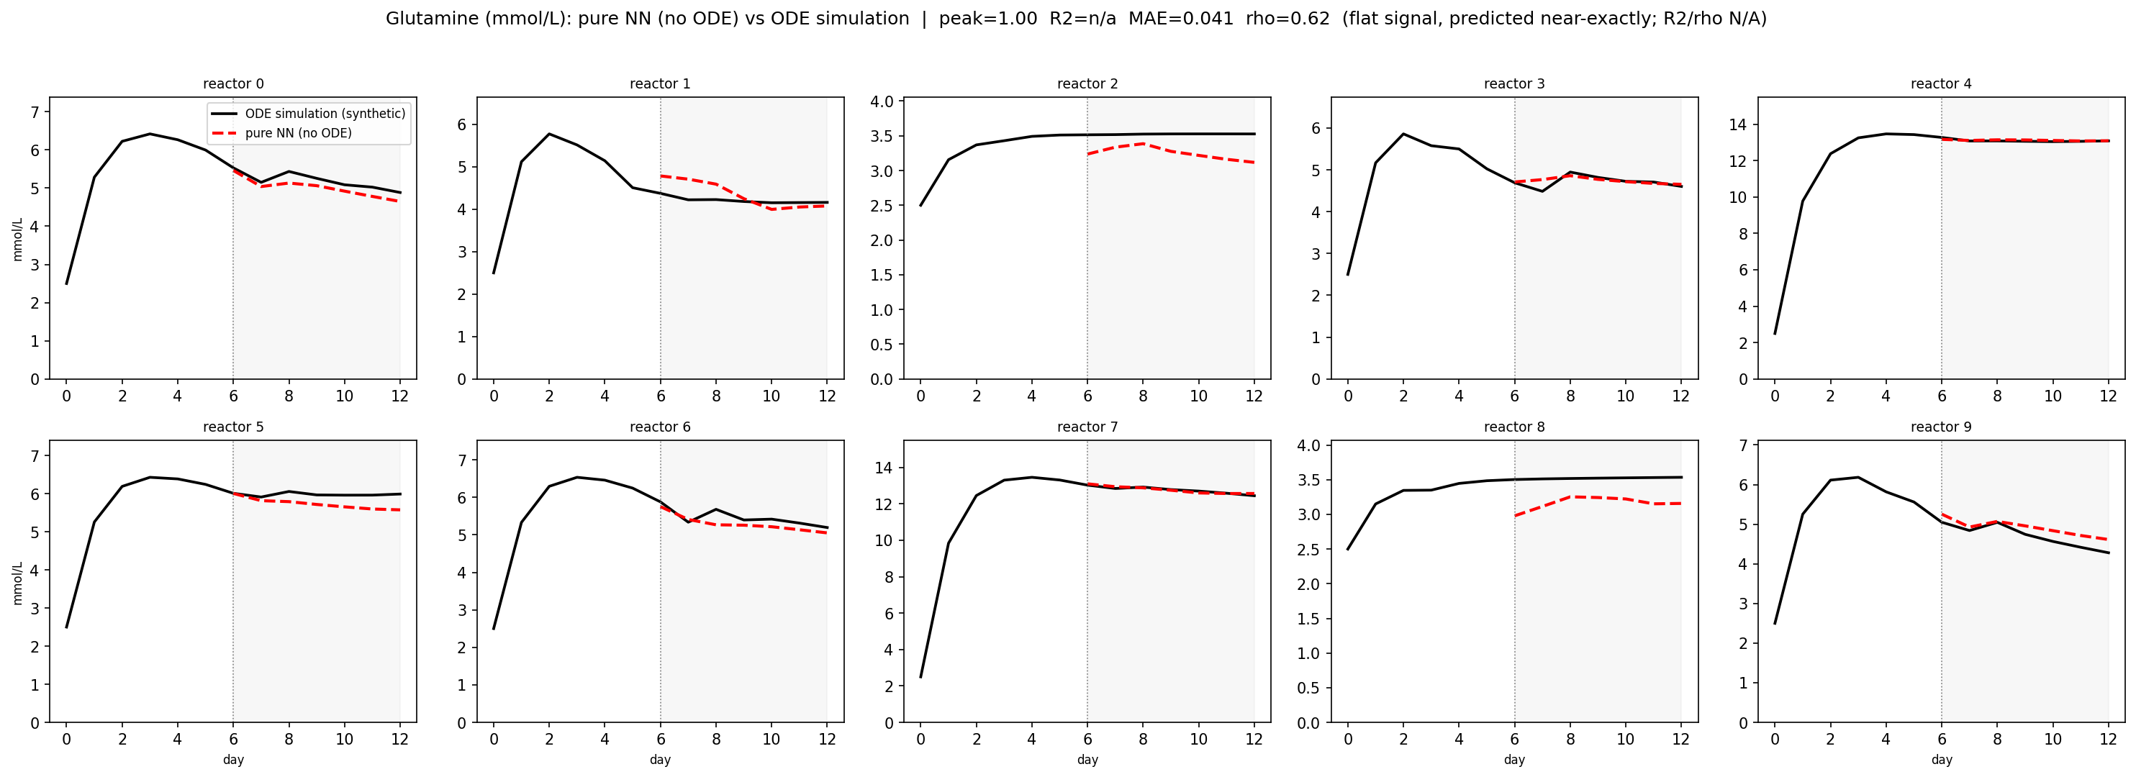
Glutamine Predictions
Black = the ground truth synthetically generated run. Red dashed = the NN's forecast. The model sees only days 0–6 (left of the line), then predicts days 6–12 on its own.

Slide 18
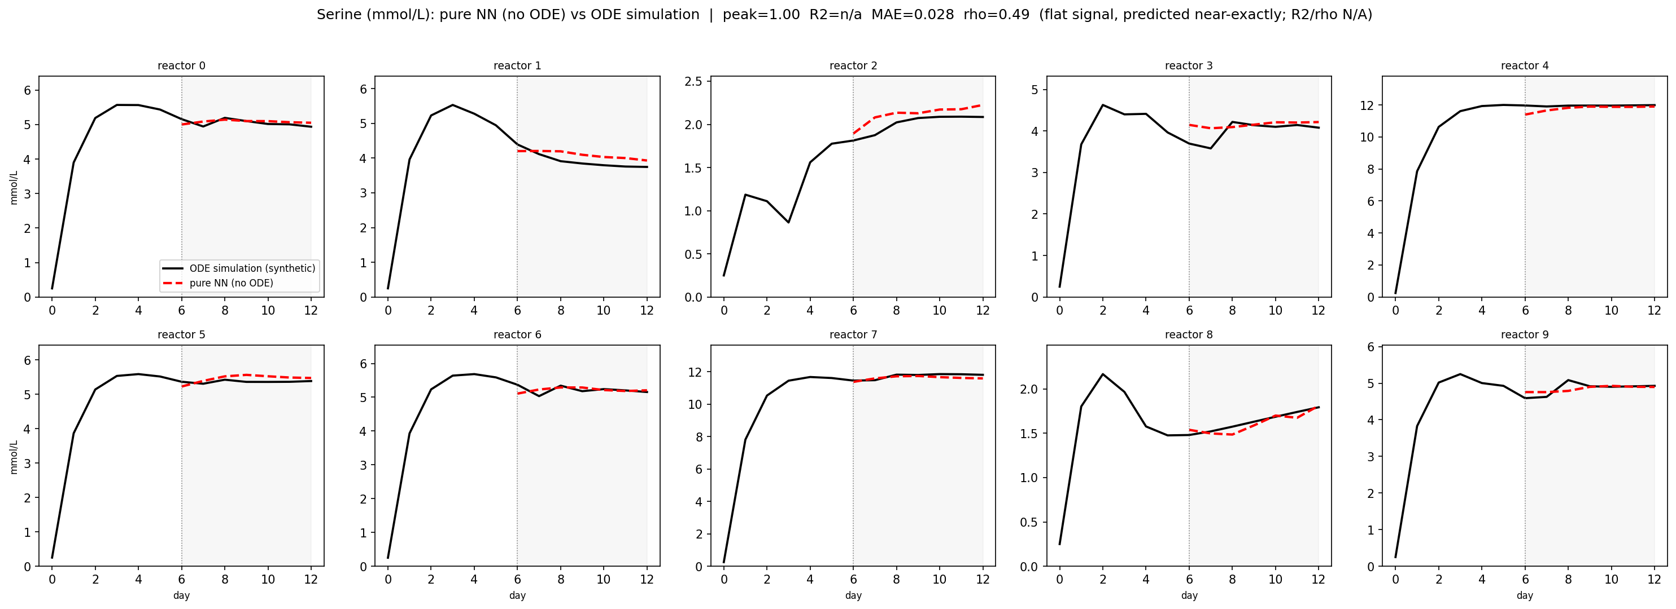
Serine Predictions
Black = the ground truth synthetically generated run. Red dashed = the NN's forecast. The model sees only days 0–6 (left of the line), then predicts days 6–12 on its own.

