Slide 1
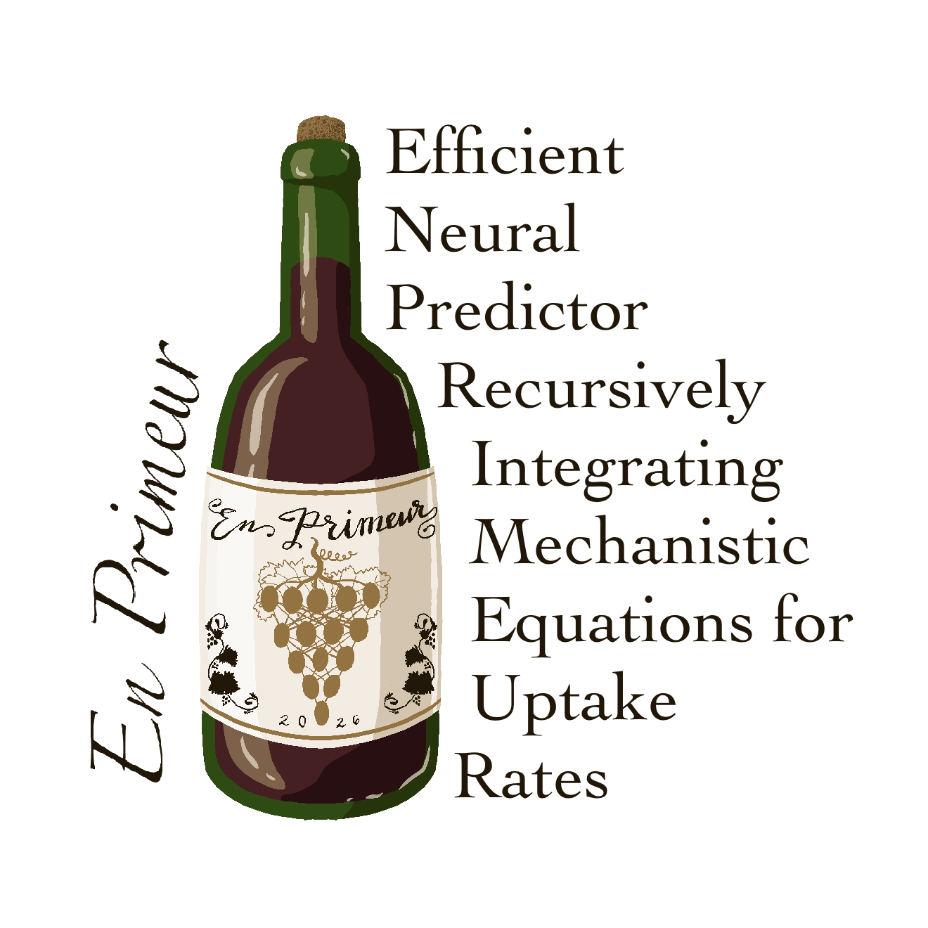
A fast neural surrogate of a mechanistic
CHO bioreactor model
Forecasting a full cell-culture run from its first few days
Neve Callaway Lab meeting · 2026

Slide 2
The problem, and the goal
The reference model. COSMIC dynamic flux-balance analysis: a system of ODEs that turns fluxes and feed conditions into the daily trajectory of a cell culture. Accurate, but slow to solve.
en primeur
Judging a wine before it is bottled, tasting the young vintage to forecast the finished product.
The goal. Replace the solver with a small neural network that forecasts the whole run, cell density, metabolites, antibody titer, from the early days plus the operating conditions.
This project does the same for a bioreactor: predict the finished run from its first few days.
Why it matters. Thousands of times faster, and differentiable, so it plugs into design and optimization.

Slide 3
Three models, in order of how much physics they embed
1
2
3
Pure NN
Hybrid neural-ODE
Physics-informed (PINN)
Predicts next-day concentrations directly. No ODE at all. The control that shows the ODE is not what makes it accurate.
The network predicts per-cell fluxes; a fixed ODE step integrates them. Mass balance by construction. ODE in the forward pass.
Predicts concentrations, with the ODE only as a soft training penalty. Solver-free at inference, so it keeps the speedup.

Slide 4
Model architecture
The small model: one 1D conv layer, 32 hidden nodes. Every node drawn as a dot.
input
1D CNN → attn
+ DoE
hidden
next day
9
32
35
32
8
Lines show flow, not full wiring: conv is local, attention pools the 6 days; the head (35 → 32 → 8) is fully connected. Gold = the 3 DoE inputs.
The output feeds back autoregressively to forecast the whole run. Hybrid / PINN add a flux head (32 → 8) → ODE step or physics penalty.

Slide 5
You were right #1: look at the loss curves
We had no validation split. We added one, and it changed the story twice:
The small-data model was under-training, not over-fitting.
It corrected an earlier result we had overstated.
Best-epoch numbers alone were misleading, the curve is what showed it.
Demanding the curves is what surfaced this.

Slide 6
Accuracy: on R², the metric you asked for
R² = how much of the true variation the model explains (1 = exact, 0 = no better than the mean). Unitless, and stricter than shape alone.
feature | R² | ρ
Cell density | 0.98 | 0.91
Cell size | 0.98 | 1.00
Titer | 0.95 | 0.97 | scored
Glucose | 0.99 | 0.97
Glycine | 0.95 | 0.53
Glutamine | n/a | 0.62
Asparagine | n/a | 0.63 | dynamic,
Serine | n/a | 0.49 | tracked
ρ = does the prediction move up and down with the truth (shape only). n/a on a flat signal: nothing to correlate.
Zero-negative synthetic data, no clamp.
5 of 8 score R² 0.95–0.99 (small model: 1 conv layer, hidden 32, chosen for xAI). Amino acids read n/a on the flat-window rule.

Slide 7
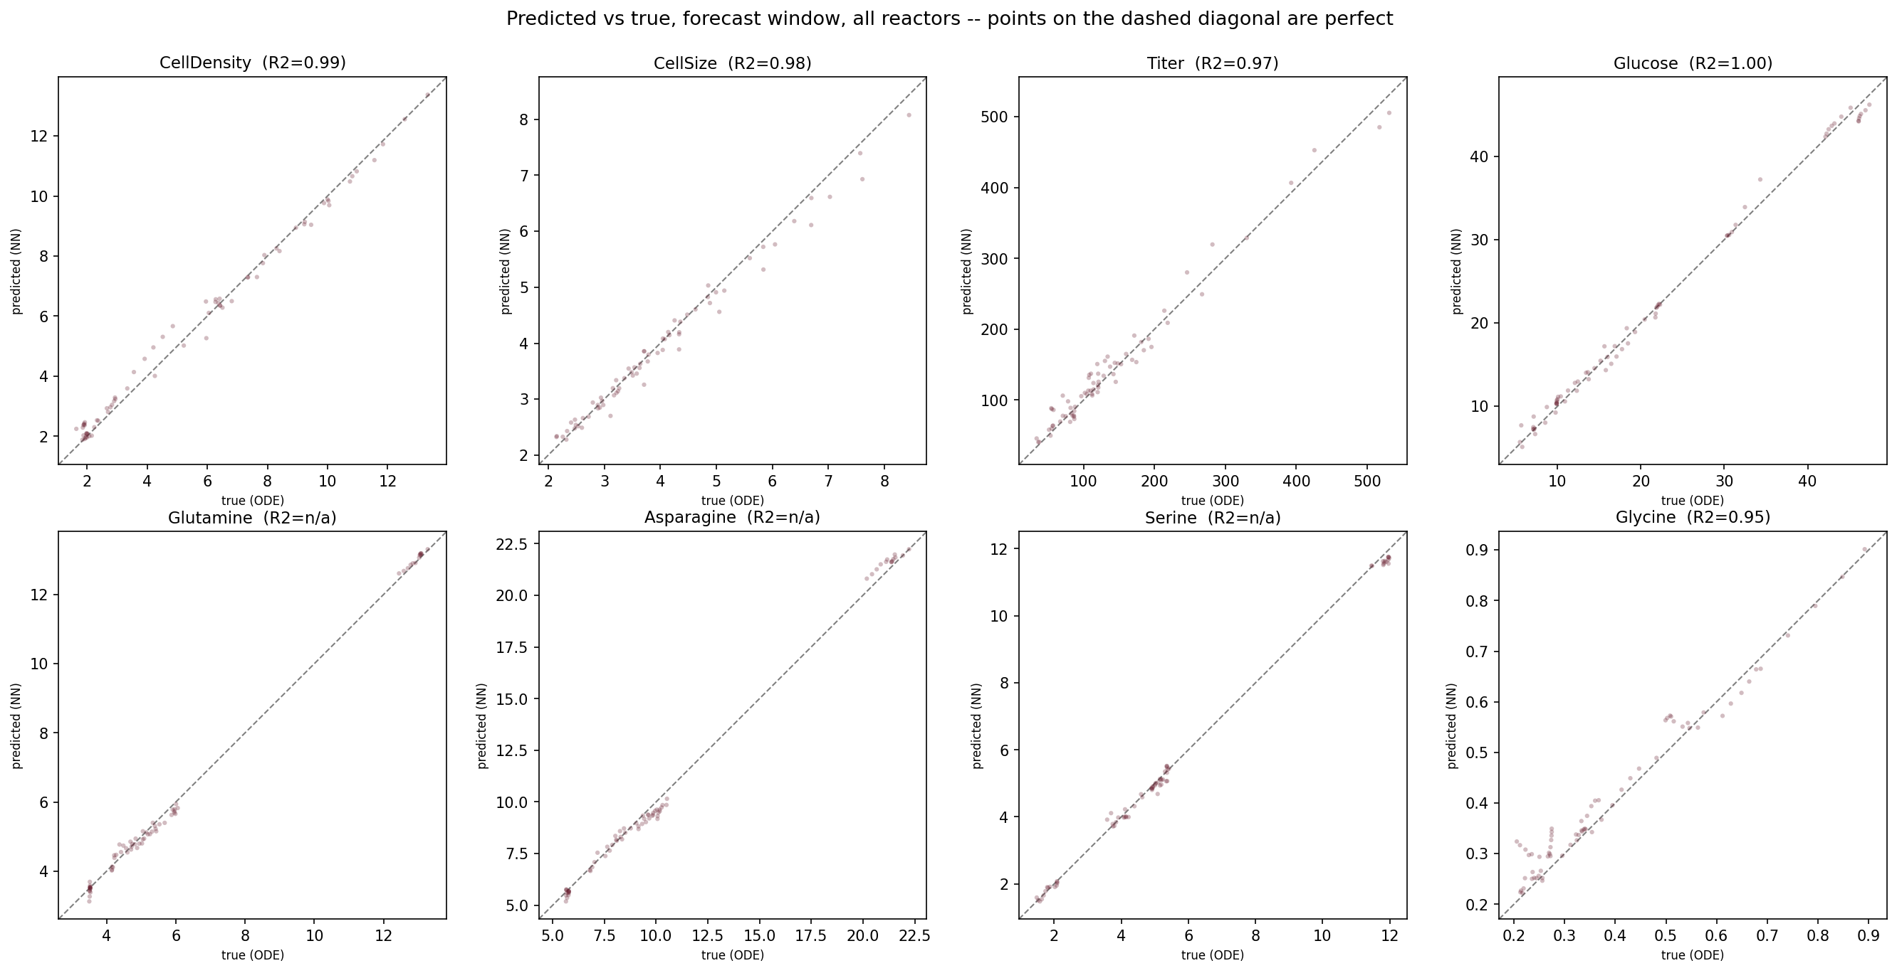
How the model does: predicted vs true
Points on the diagonal = perfect. Every variable hugs the line, including the three amino acids (bottom row), which now spread along the diagonal instead of collapsing to a flat blob.

Slide 8
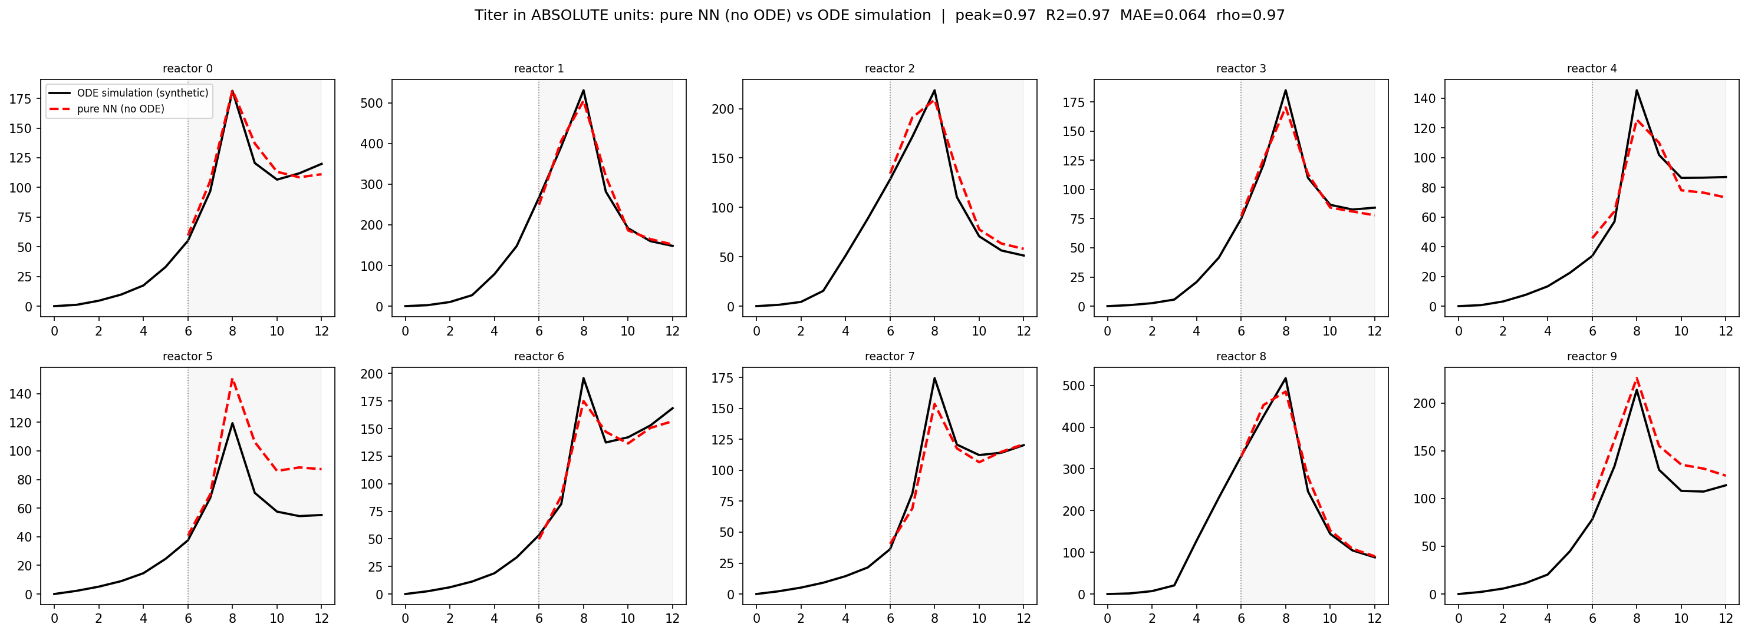
A forecast in action: titer
Black = the synthetic ODE run (our ground truth). Red dashed = the NN's forecast. The model sees only days 0–6 (left of the line), then predicts the peak and decline of days 6–12 on its own. R² 0.95. No real data is used, we test whether the NN reproduces the simulator.

Slide 9
A data-generation bug we found and fixed
Symptom. Three amino acids were flat in our synthetic data, but the real measurements show them changing a lot.
Cause. The starting pool was tied to a 210×-inflated feed, pinning each amino acid at its feed level.
Fix (no clamp). Separate the starting pool from the feed, size the feed minimally, and raise the glucose feed. Result: real dynamics and zero negative values, surfaced, never clamped.

Slide 10
Inference: NN vs the mechanistic model
~15 min → 0.0013 ms
A separate comparison: our fast synthetic generator (a simplified ODE, what we train on), not COSMIC-dFBA:
COSMIC-dFBA takes ~15 minutes per reactor (Sarat: 3.7 GHz CPU, no parallelization, 1-day resolution). The NN predicts the same run in 0.0013 ms, hundreds of millions of times faster.
method | ms/reactor | vs scipy
numerical ODE (scipy, CPU) | 25.25 | 1×
closed-form ODE (GPU) | 0.0005 | 47,000×
pure NN (GPU, small) | 0.0005 | 47,000×
Honest caveat (Sarat). Any empirical model beats a mechanistic flux-balance simulation, so this is expected. COSMIC-dFBA's niche is mechanistic insight; the speed enables real-time use, it is not the contribution.
A100, n = 20,000, small net (1 conv, hidden 32). The NN ties the exact closed-form ODE; this is our simplified generator, COSMIC-dFBA (~15 min) is off this chart entirely.

Slide 11
Why it matters
Media design
Real-time monitoring
A model that predicts state change better than random has learned what drives it. Read those importances out (sensitivity, attention, SHAP) and you get which conditions and media components matter. This does not depend on speed.
A fast, interpretable surrogate enables Process Analytical Technology and Real-Time Release Testing, prediction and explanation during a run, not offline.
Precedent: Patel & Patel (2026) use SHAP on Raman spectra to find the drivers of glucose and acetate, toward PAT/RTRT.

Slide 12
Physics in training, none at inference (the PINN)
Exactly the physics-informed design you suggested, not the ODE in the forward pass.
conc head
used at inference ✓
window
1D CNN
attention
flux head
training only (ODE penalty)
Result. A small physics weight (λ ≈ 0.1) steadies the cell-density forecast, correlation 0.79 → 0.89, with the solver absent at inference.
The ODE lives only in the loss; at inference we use the concentration head alone.

Slide 13
Scope and next steps
Data and scope
Real data and next steps
Trained on synthetic data, a physics analog of the real reactors. Real data is not used for training or magnitudes.
Real data only as a loose shape/trend check, never magnitude. Conditions largely differ (shared: perfusion rate, eta switch, operating factors, O₂).
Normalized after combining all data, so scaling is invertible and concentrations stay interpretable. Cross-sample variance preserved.
Lazy training: add data for each new condition as it is encountered and retrain (~4 min). The hard part is detecting out-of-distribution inputs, knowing when to add.
Success = profiles match the simulator. Window-level holdout, 1–2 windows per reactor. Cell density first (R² 0.99).
Hybrid ODE-in-forward inference timing; continuous-time PINN.

Slide 14
Where we landed
Two of your points, the loss curves and the benchmark, changed our conclusions for the better.
A physics-informed surrogate is built: accuracy is honest (R² 0.97–1.00 on 5 of 8 variables).
We found and fixed a data-generation bug, no clamp, zero negatives.
Everything is documented and reproducible for the next person.
en Primeur

