Slide 1
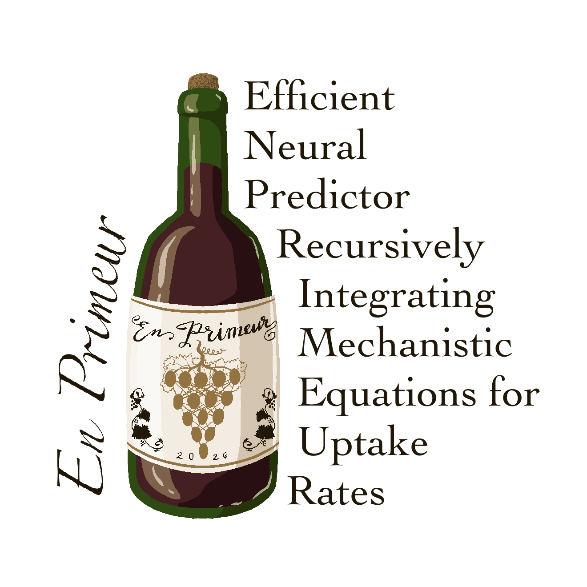
A fast neural surrogate of a
Mechanistic CHO bioreactor model
Forecasting final conditions from the first few days
Neve Callaway Lewis Lab meeting · 2026

Slide 2

We Can Train a Small Surrogate NN for COSMIC-dFBA
Reference model: COSMIC dynamic flux balance analysis (dFBA) solves a system of ODEs to predict daily cell culture dynamics from metabolic rates (feed, washout, uptake, and secretion).
Accurate, but computationally slow
EN PRIMEUR
Goal: Use a small neural network trained on COSMIC-dFBA simulations to rapidly forecast the remaining culture trajectory from early observations and operating conditions.
French term for the practice of tasting a young wine from the barrel and predicting the final vintage before purchase.
Similarly, this framework learns to forecast a bioreactor’s trajectory and final conditions from early-run data.
So, why EN PRIMEUR?
Faster inference
Differentiable
Reveals influential inputs (feature importance)
Guides media design and optimization
Confidence limits

Slide 3
Model architecture
The small model: one 1D conv layer, 32 hidden nodes. Every node drawn as a dot.
Weighted summary of all
6 previous days
Concentration head
input
1D CNN → Attention pool
+ DoE
hidden
next day
9 (x 6 days)
32 (x 6 days)
32
35
32
8
Arrows = flow between layers, not full connectivity. Gold dots = the 3 DoE (operating-condition) inputs.
Each prediction feeds back in to forecast the rest of the run. The hybrid and PINN variants add a flux head (32 → 8), feeding an ODE step or a physics penalty.

Slide 4
Performance Metrics
R² = how much of the true variation the model explains (1 = exact, 0 = no better than the mean). Unitless, and stricter than shape alone.
feature | R² | ρ
Cell density | 0.98 | 0.91
Cell size | 0.98 | 1.00
Titer | 0.95 | 0.97
Glucose | 0.99 | 0.97
Glycine | 0.95 | 0.53
Glutamine | n/a | 0.62
Asparagine | n/a | 0.63
Serine | n/a | 0.49
ρ = does the prediction move up and down with the truth (shape only). n/a on a flat signal: nothing to correlate.
5 of 8 variables score R² 0.95–0.99. 3 amino acids are too flat to score (n/a) but the model still tracks them.

Slide 5
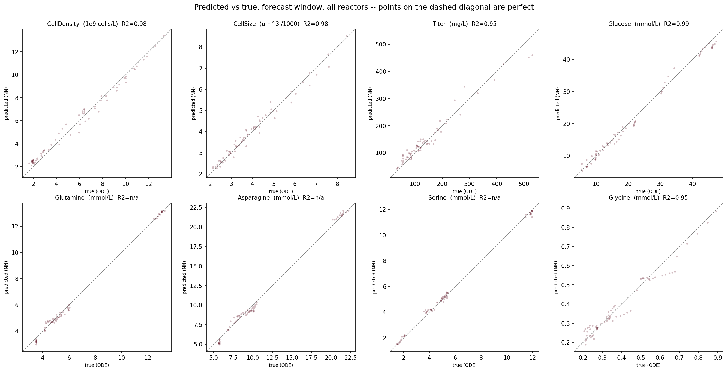
The Model’s Predicted v. True
Points falling on the diagonal = perfect. Every variable hugs the line, including the three amino acids (bottom row), which now spread along the diagonal instead of collapsing to a flat blob.

Slide 6
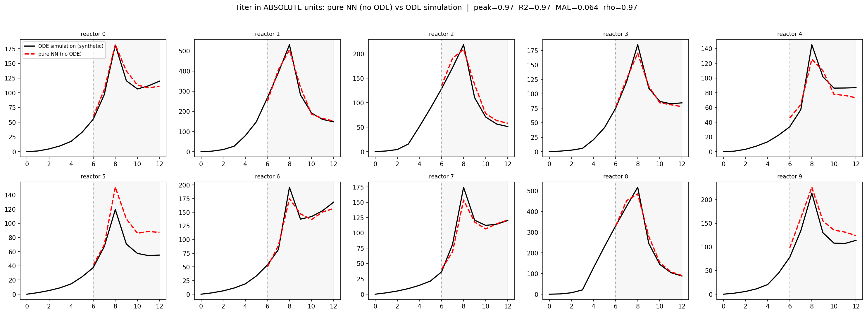
Titer Predictions
Black = the ground truth synthetically generated run. Red dashed = the NN's forecast. The model sees only days 0–6 (left of the line), then predicts the peak and decline of days 6–12 on its own.

Slide 7
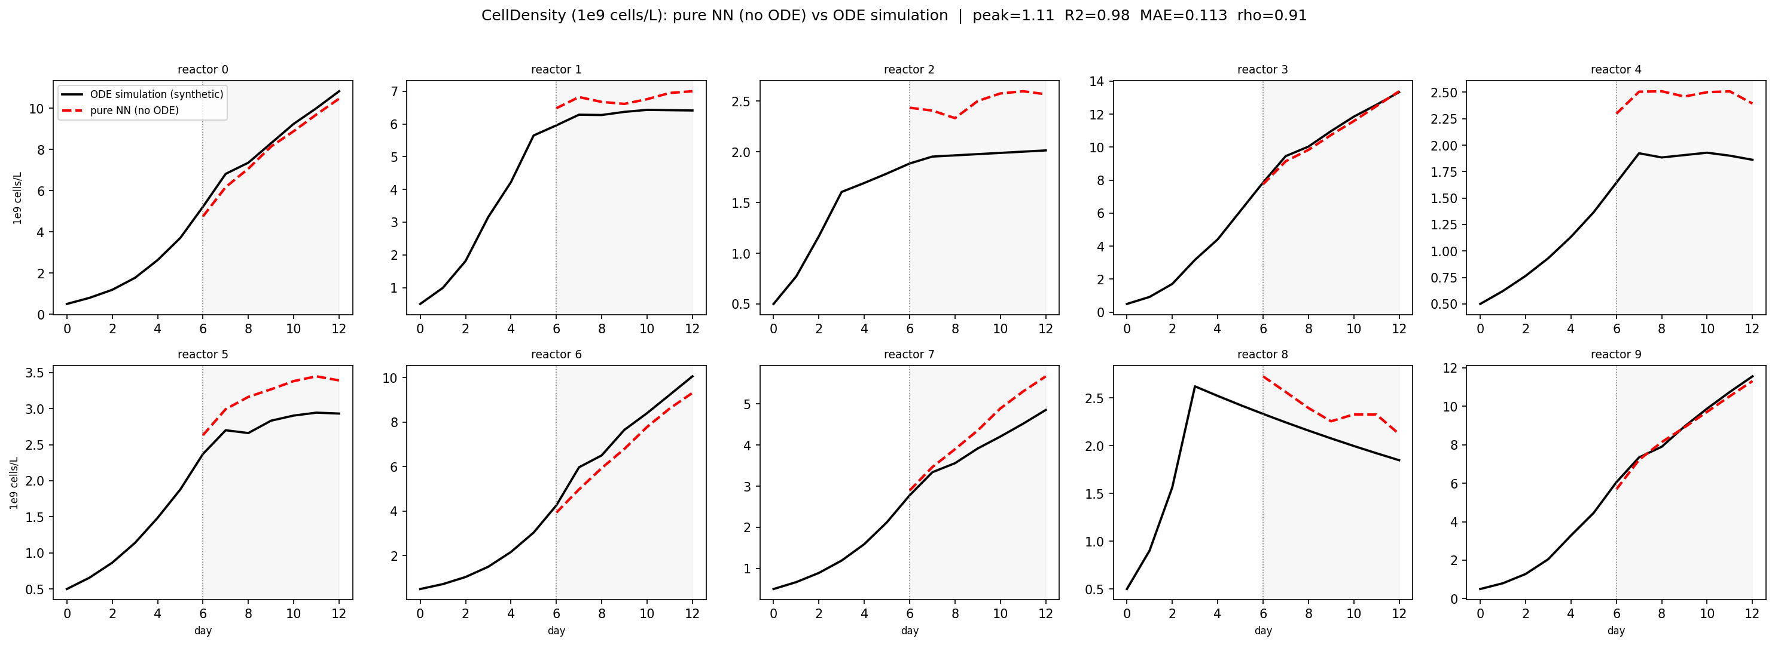
Cell Density Predictions
Black = the ground truth synthetically generated run. Red dashed = the NN's forecast. The model sees only days 0–6 (left of the line), then predicts the peak and decline of days 6–12 on its own.

Slide 8
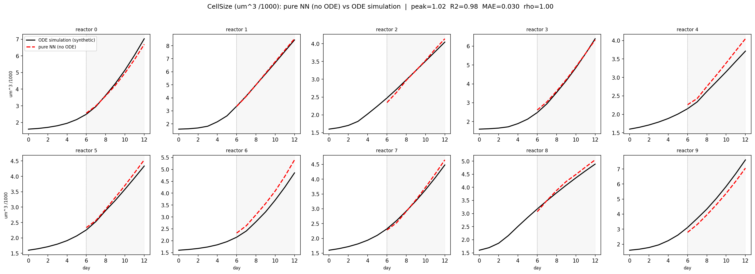
Cell Size Predictions
Black = the ground truth synthetically generated run. Red dashed = the NN's forecast. The model sees only days 0–6 (left of the line), then predicts the peak and decline of days 6–12 on its own.

Slide 9
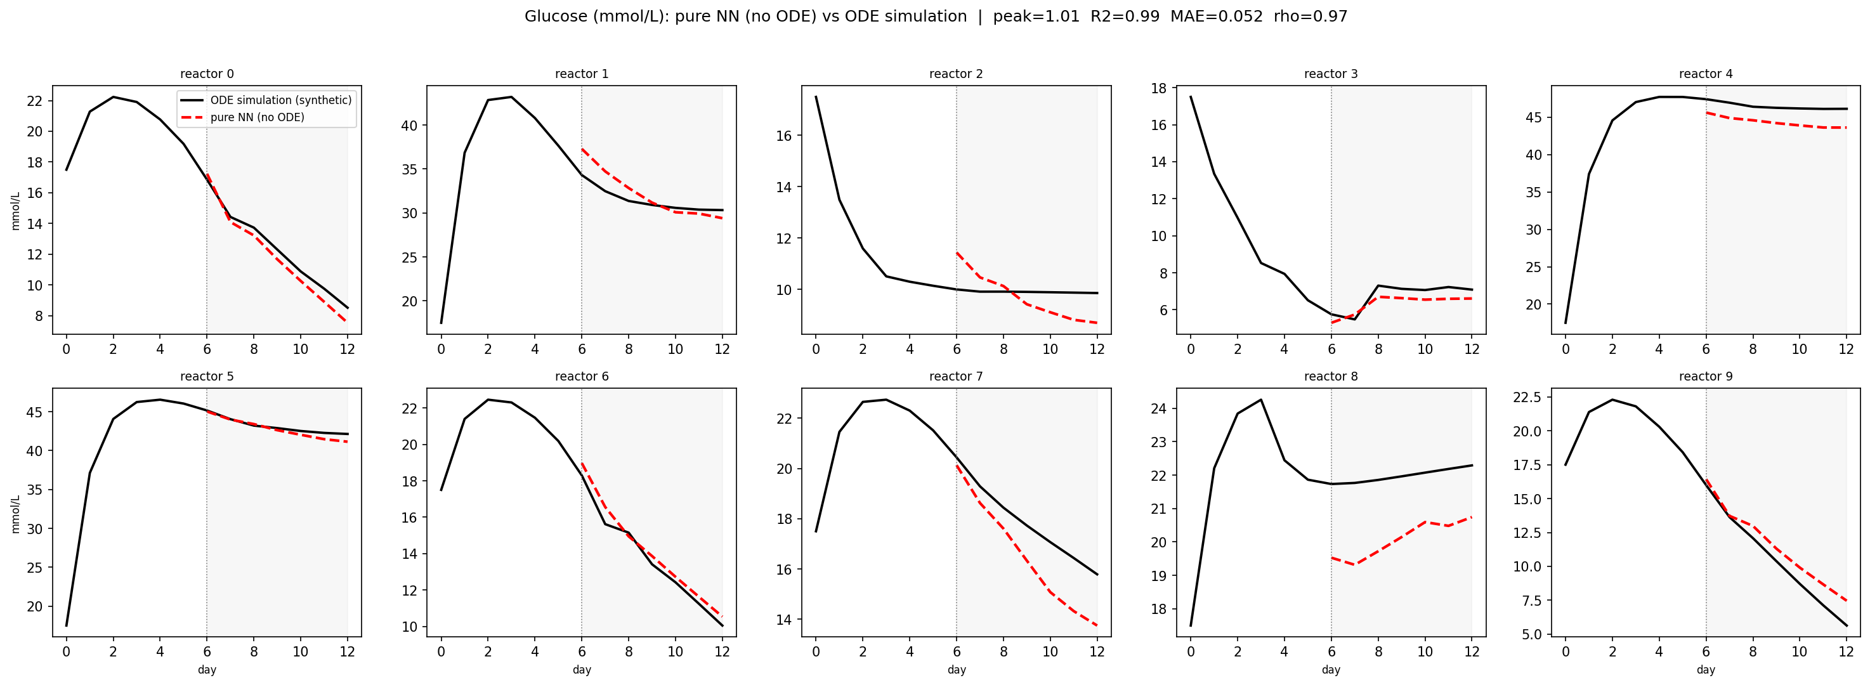
Glucose Predictions
Black = the ground truth synthetically generated run. Red dashed = the NN's forecast. The model sees only days 0–6 (left of the line), then predicts the peak and decline of days 6–12 on its own.

Slide 10
Inference: NN vs the mechanistic model
~15 min → 0.0013 ms
A separate comparison: our fast synthetic generator (a simplified ODE, what we train on), not COSMIC-dFBA:
COSMIC-dFBA takes ~15 minutes per reactor. The NN predicts the same run in 0.0013 ms, hundreds of millions of times faster.
method | ms/reactor | vs scipy
numerical ODE (scipy, CPU) | 25.25 | 1×
closed-form ODE (GPU) | 0.0005 | 47,000×
pure NN (GPU, small) | 0.0005 | 47,000×
Perspective (Sarat). Any empirical model will outperform a mechanistic flux-balance simulation in speed, so this result is expected.
Setup: 1 GPU, 20,000 reactors, small net (1 conv, hidden 32). On this chart the NN ties the exact closed-form ODE, but this is our simplified generator (the fast ODE we train on).

Slide 11
Why it matters
It's a differentiable, statistical model, not a mechanistic solver, so it can do things the solver can't:
1 Fast done
2 Differentiable inherent
Milliseconds vs ~15 min per run. Cheap enough to run thousands of times, scan conditions, retrain on demand.
You can take gradients, so you can optimize for a target (e.g. maximize titer) and see how sensitive the output is to each input. A solver can't.
3 Feature importances next step
4 Confidence limits next step
Read out which conditions and media components drive the outcome, i.e. which knobs matter, toward media design.
The model can report how confident it is: prediction intervals, not just a single number.

Slide 12
Three potential models, in order of how much physics they embed
1
2
3
Pure NN
Hybrid neural-ODE
Physics-informed (PINN)
Predicts next-day concentrations directly, no ODE or physics inside the model. It's the control: it shows the ODE isn't what makes the prediction accurate.
The network predicts per-cell fluxes, and a fixed ODE step integrates them into the next-day concentrations. Mass balance is guaranteed. The ODE runs in the forward pass.
Predicts concentrations directly. During training, the ODE is added to the loss as a soft penalty that nudges the model toward the physics; at inference it's gone entirely, so it runs as a plain, fast NN pass.

Slide 13
Scope and next steps
Data and scope
Real data and next steps
Trained on synthetic data, a physics analog of the real reactors. Real data is not used for training or magnitudes.
Real data only as a loose shape/trend check, never magnitude. Conditions largely differ (shared: perfusion rate, eta switch, operating factors, O₂).
Normalized after combining all data, so scaling is invertible and concentrations stay interpretable. Cross-sample variance preserved.
Find more?
Lazy training: add data for each new condition as it is encountered and retrain (~4 min).
Success = profiles match the simulator. Window-level holdout for validation, 1–2 windows per reactor.
Hybrid ODE-in-forward inference timing and continuous-time PINN could be explored

