Slide 1
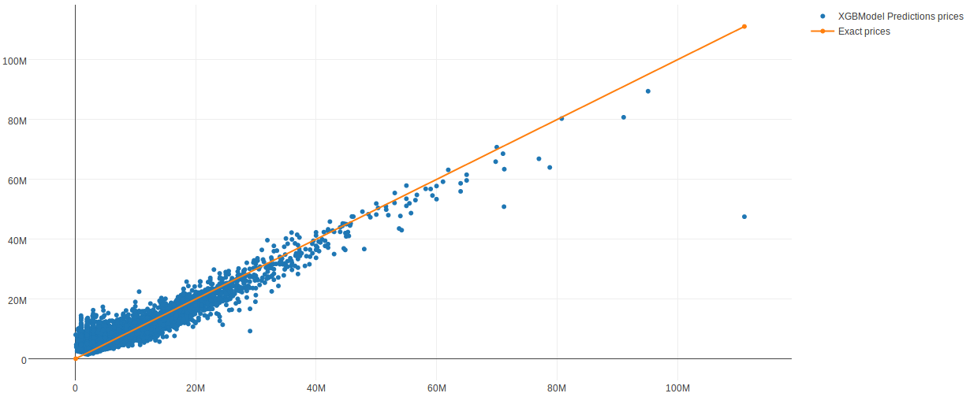
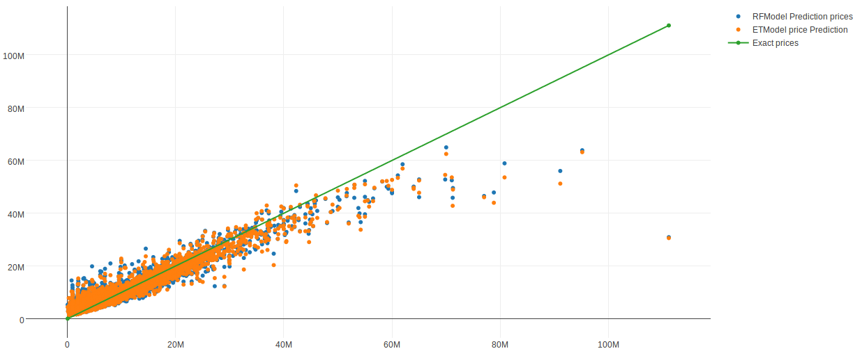

Realty price prediction
Author: Neven Jovic ra18/2014
Author:Nikola Skrobonja ra25/2014
Introduction
Results
Conclusions
Housing costs demand a significant investment from both consumers and developers. And when it comes to planning a budget—whether personal or corporate—the last thing anyone needs is uncertainty about one of their biggest expenses. It would be of great interest for buyers to have predictions about realty prices so renters, developers, and lenders are more confident when they sign a lease or purchase a building.
It would have maybe been wiser to take a different approach when cleaning data. Possibly through decision trees. Extra Trees and Random Forest gave similar results, so it would probably be better if we used a different model, to withdraw better conclusions. XGBoost outperformed these two models and gave the best result, showing better behavior for big price realtys. Imputation was used for filling missing values, but after doing this, more cleaning was needed due to unlogical data.
We can see how XGBoost behaves better at high priced realtys than RF and ET. Cross validation score for XGBoost is 0.673473.
On the graphical presentation above it is obvious that Random Forest and Extra Trees give the same results, which means that we didn’t gain much progress by using Extra Trees for stacking.
Methods & Materials
Materials used for predicting realty prices represent a dataset produced by one of Russia’s oldest banks Sberbank. This dataset contains large amounts of corupt data so a substantial amount of cleaning was necessary. Cleaning was executed by identfying outliers and high leverage data points through graphical represantations and removing foul data. The method used for predicting realty prices was boosting.
Models
We used Stacking. For first level three meta models used:
-XGBoost
-Random Forest
-Extra Trees
At second level we used predictions of three metal models as features for model at second level. As model we used Neural Network.
XGBoost gives us the best results , while Random Forest and Extra Trees have similar results.
References
[1] Robust Decision Trees: Removing Outliers from Databases, George H. John
[2] Data Mining Methods And Models, Daniel T. Larose

