Slide 1
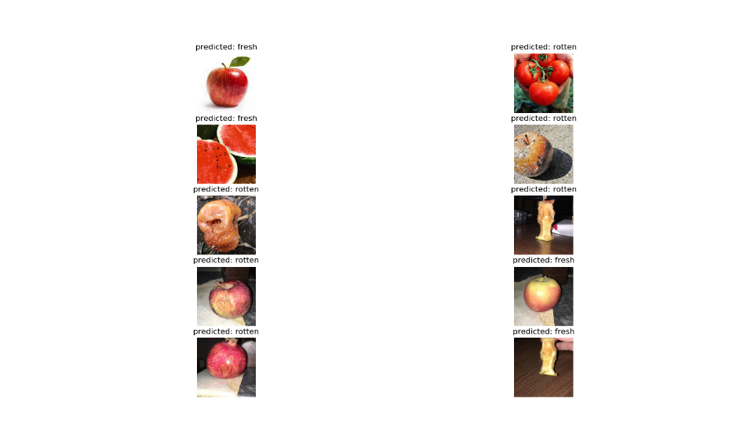
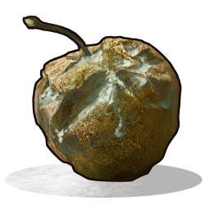
Realty price prediction
Author: Neven Jovic ra18/2014
Author:Nikola Skrobonja ra25/2014
Introduction
Results
Conclusions
With so small amount of data transfer learning method gave us pretty nice results bearing in mind that for traditional convolutional neural networks you would need a lot more of data not to overfit. No wonder why this method i becoming more and more popular in practice and by expanding ImageNet database we will have even better models for generalization.
We were classifying fruits and vegetables if they were fresh or rotten. These days in agriculture it is common to use mashine learning and other methods to classify their products and by classifying they can have different prices depending on the class.
We can see results here and it has only one mistake. Accuracy oft the model was 87% in 500 epochs.
On the graphical presentation above it is obvious that Random Forest and Extra Trees give the same results, which means that we didn’t gain much progress by using Extra Trees for stacking.
Methods & Materials
Materials used for classifying fruits and vegetables represent a self made dataset. This is a very small dataset with about 450 training pictures and about 200 validation pics. And because we had very poor dataset, we were forced to use different methods to get better results. The pictures were taken from Google Images, via web scraping.
Models
We used two methods for our classification to see difference between using tradicional fully connected neural networks and transfer learning method , when you have small amount of data. For transfer learinng we used pretrained model resnet18 which is trained on ImageNet data. We froze convolutional layes and replaced FC layer of the model with our custom FC neural network. Only our custom fc layes was training and the input in fc layes was extracted features from convolution. The input for the fully connected networks were preprocessed images. For preprocessing we used the split and merge technique. Preprocessing was done using k-means algorithm to segment the image into regions, where it would be easy to distinct the colors, thus making it easier to recognize whether or not the fruit is rotten or fresh. Region Adjacent Graphs was used to merge similar regions, where it would get the rotten parts of the fruit to be more recognizable.
References

