Slide 1
SQL
Database Systems (H)
Dr Chris Anagnostopoulos

Slide 2

Roadmap
Ta Dah!
Structured Query Language (SQL);
Create a database schema & relations in SQL;
Assign key/integrity/referential constraints in SQL;
SELECT clause for selection queries;
Multi-sets and Sets in SQL
Dealing with NULL values
Nested Correlated & Uncorrelated Queries

Slide 3
Philosophy of the Declarative Language
Structured Query Language by R. Boyce (known from BCNF) in 1974.
SQL is a declarative language, i.e.,
declare what to do rather than how to do it
different from procedural languages, e.g., Java, C, C++.
First official standard: SQL-92
Latest release: SQL:2016…
Advice: follow standard SQL to be compliant with most of the Database Systems ☺

Slide 4

SQL: Database Schema
Statement: CREATE SCHEMA
CREATE SCHEMA Company;
Each statement in SQL ends with a semicolon ‘;’

Slide 5
SQL: Create Table
A new relation (table is SQL):
Specify the name of the relation
Specify attributes, their types (domain), constraints
CREATE SCHEMA Company;
CREATE TABLE EMPLOYEE ...;

Slide 6
SQL: Attributes & Domains
Numeric data types
Integer numbers: INT
Floating-point (real) numbers: REAL or DECIMAL(n, m)
DECIMAL(3,2) has 3 digits; 2 digits after the decimal ‘.’ e.g., 9.99
Character/String data types
Fixed length: CHAR(n)
i.e., exactly n characters
e.g., CHAR(5) has exactly 5 characters like ‘Chris’
Variable length: VARCHAR(n)
i.e., from 0 to n characters
e.g., VARCHAR(5) has up to 5 characters like ‘C’, or, ‘Ch’, or ‘Chris’

Slide 7
SQL: Attributes & Domains
Bit-string data types (sequence of bits: e.g., 0101100)
Fixed length: BIT(n)
Varying length: BIT VARYING(n)
Boolean data type
Values of TRUE or FALSE or NULL
SQL is a 3-valued logic…(yes, no, and maybe)
DATE data type
Ten positions for YEAR, MONTH, and DAY in the form
YYYY-MM-DD
More, like TIMESTAMP, DATE INTERVALS, …
Visit: https://www.postgresql.org/docs/9.5/static/datatype.html

Slide 8
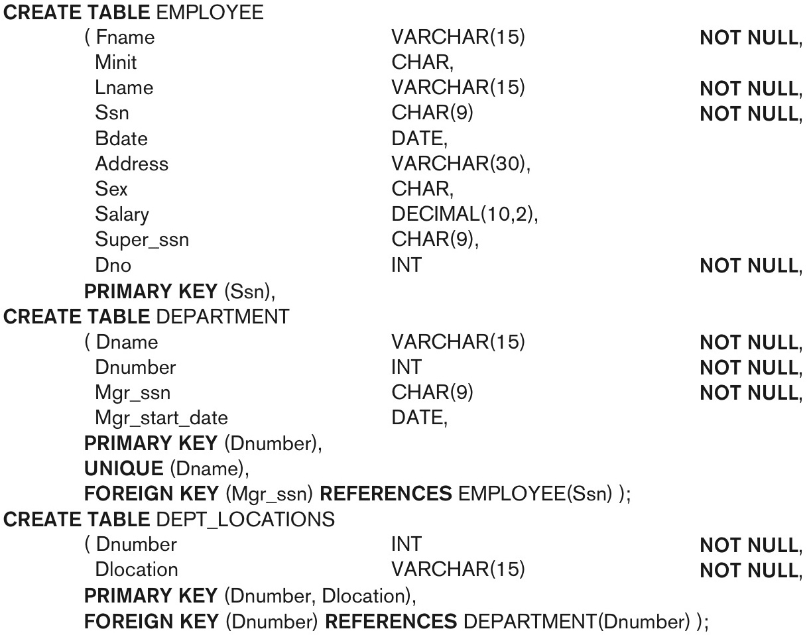
SQL: CREATE TABLE
attributes
domain (type)
constraints

Slide 9
SQL: Value Constraints
Default value of an attribute
DEFAULT {value}
NULL is not permitted for a attribute (NOT NULL)
e.g., DNO INT NOT NULL DEFAULT 1;
CHECK clause (range domain constraint)
e.g., Dnumber INT NOT NULL CHECK(Dnumber > 0 AND Dnumber < 21);

Slide 10
SQL: Key Constraints
Key constraint: a primary key value is unique (no duplicates);
Entity Integrity constraint: a primary key cannot be NULL;
Primary Key Clause:
Dnumber INT NOT NULL, PRIMARY KEY (Dnumber);
UNIQUE clause, specifies candidate keys
Dname VARCHAR(15) NOT NULL, UNIQUE (Dname);

Slide 11
SQL: Referential Constraints
FOREIGN KEY clause in EMPLOYEE
FOREIGN KEY (Super_ssn) REFERENCES Employee(Ssn)
FOREIGN KEY clause in DEPARTMENT
FOREIGN KEY (Mgr_ssn) REFERENCES Employee(Ssn)
Triggered actions for Mgr_ssn, Super_ssn when Ssn is updated or deleted:
Action: ON DELETE SET NULL/ DEFAULT/ CASCADE
Action: ON UPDATE SET NULL/ DEFAULT /CASCADE
CASCADE option propagates DELETE / UPDATE to all referential tuples!
e.g., when the primary key Ssn is updated, then all foreign keys refer to it should be updated: ON UPDATE CASCADE
e.g., when the primary key Ssn is deleted, then all foreign keys refer to this tuple should be deleted: ON DELETE CASCADE

Slide 12

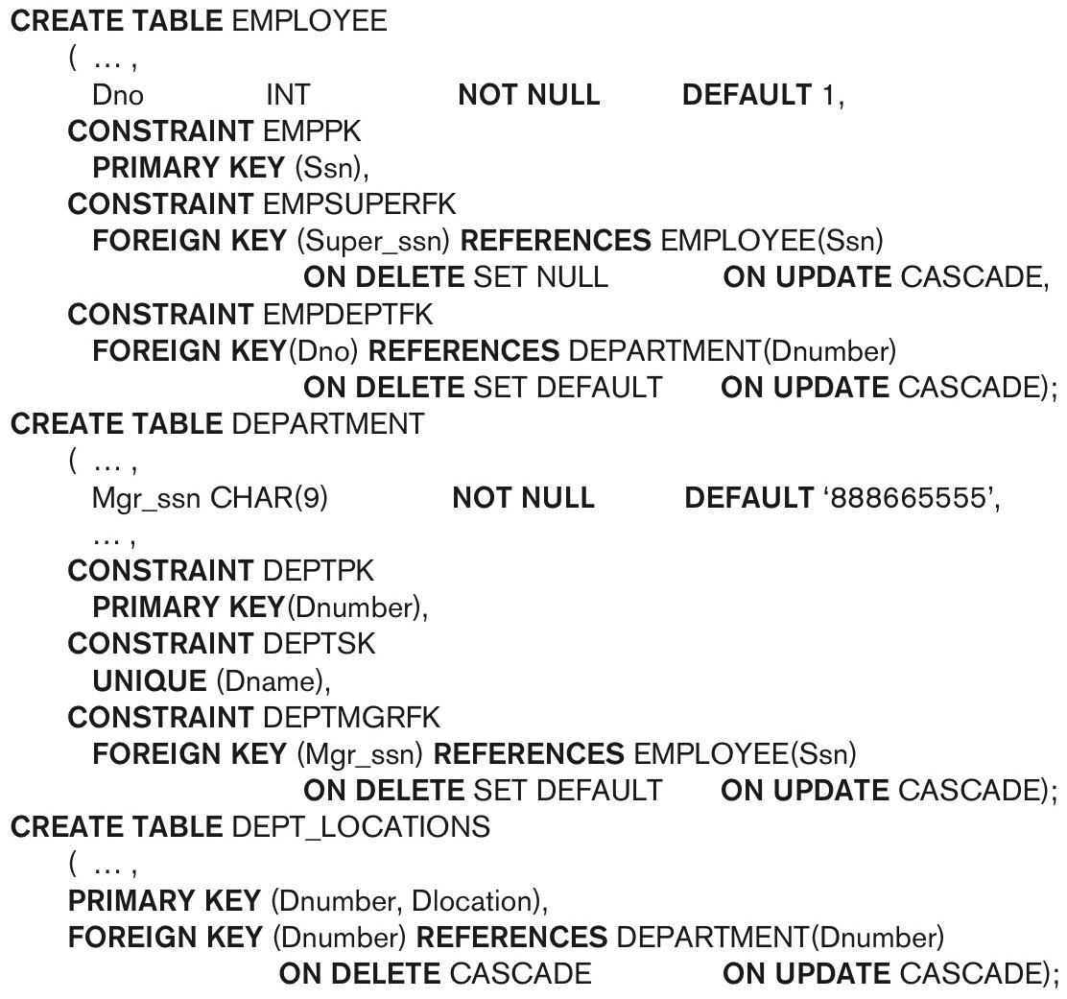
In-Class Quiz
Q1: What is happening when we delete a department?
Q2: What is happening when we delete an employee?

Slide 13

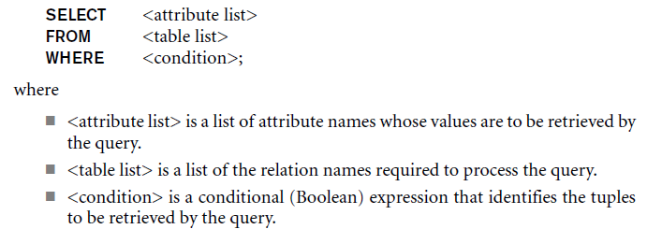
SELECT-FROM-WHERE
Declare what to retrieve, i.e., which are the attributes of interest
Declare from where to retrieve, i.e., which is the table/relation
Declare with what condition to retrieve, i.e., which are the conditions
But, not saying how to implement this, e.g.,
how to load the data from disk to memory,
how to search and check if a tuple satisfies the condition, etc.

Slide 14
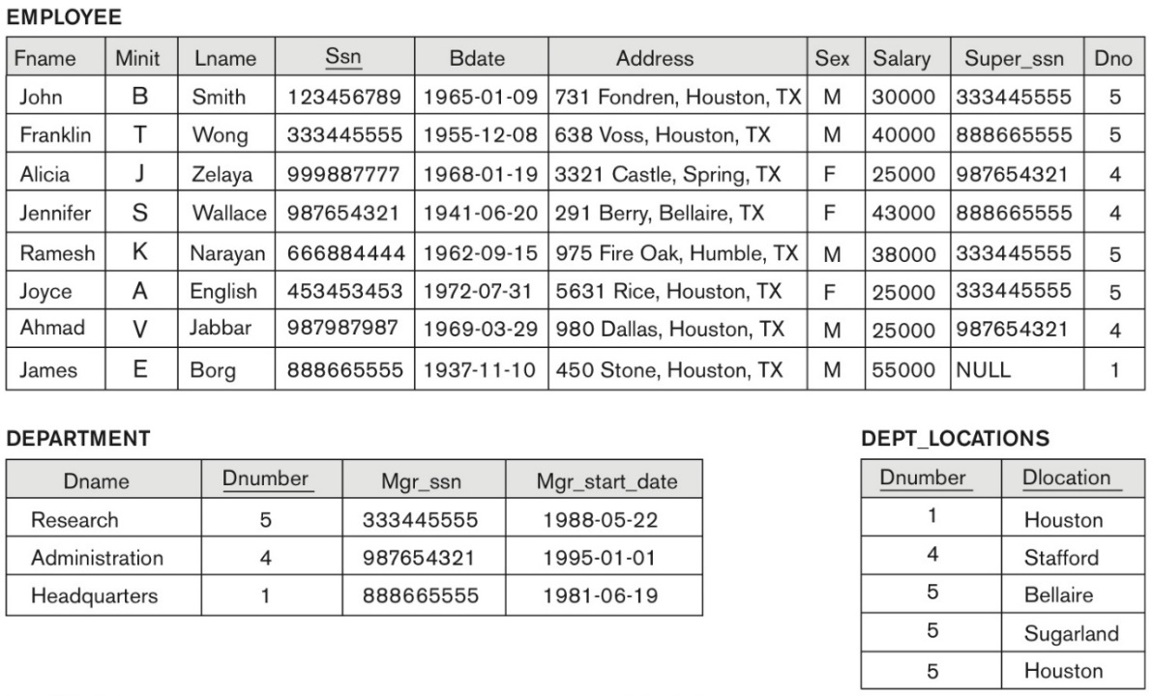
SELECT-FROM-WHERE
Query 0: Which are the addresses of employees working in the department 4 or their salary is less that 31000.
SELECT Address
FROM EMPLOYEE
WHERE DNO = 4 OR Salary < 31000

Slide 15
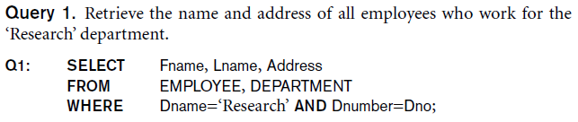
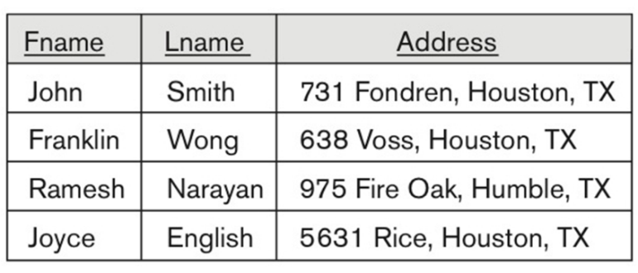
SELECT-FROM-WHERE: Join & Select

Slide 16
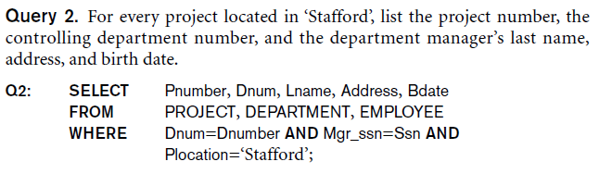


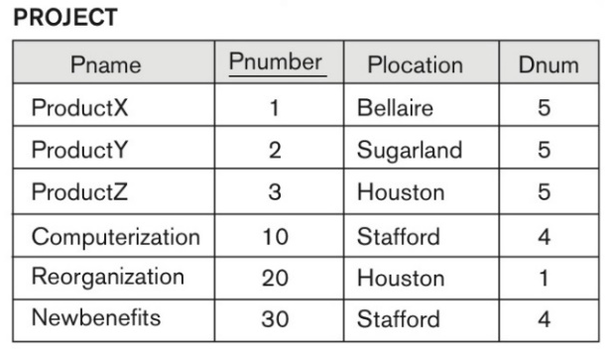
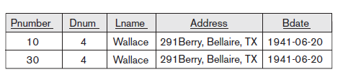

Slide 17
Table as a Variable
//in Java.
int e = 5;
int s = 7;
//in SQL
EMPLOYEE AS e
EMPLOYEE AS s
A relation might play different roles within a query, e.g., employee might be a supervisee and employee might be a supervisor…(used in recursive references…)
SELECT …
FROM EMPLOYEE AS E, EMPLOYEE AS S
WHERE…

Slide 18

Query 3. For each employee, retrieve the employee’s first and last name and the first and last name of his or her immediate supervisor.
SELECT E.Fname, E.Lname, S.Fname, S.Lname
FROM EMPLOYEE AS E, EMPLOYEE AS S
WHERE E.Super_ssn=S.Ssn;
E
{John Smith, Franklin Wong}
S

Slide 19

In-Class Activity [A1]
Query 4: For each employee, if their supervisor is a manager of a department, show the department name and department number.

Slide 20
In-Class Activity [A1]
John is supervised by 33344555, who is Franklin. Franklin is manager of department Research (No. 5).
Franklin is supervised by 888665555, who is James. James is manager of HQ (No. 1)
…
SELECT D.Dname, D.Dnumber
FROM EMPLOYEE AS E, EMPLOYEE AS S, DEPARTMENT AS D
WHERE E.Super_ssn=S.Ssn AND S.Ssn = D.Mgr_Ssn;

Slide 21
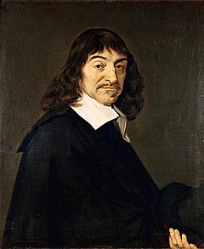
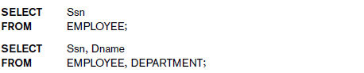
If WHERE is Missing…
R. Cartesius;1648
Missing WHERE: no condition on tuple selection
If FROM involves two or more relations, avoid; unreasonable tuples.
Why? CROSS (Cartesian) PRODUCT: all possible tuple combinations!
Each tuple from EMLOYEE is concatenated with each tuple from DEPARTMENT…disaster, computationally heavy, and meaningless!

Slide 22
Missing WHERE is Catastrophe
R. Cartesius;1648
SELECT Ssn, Dname
FROM EMPLOYEE, DEPARTMENT
John…Research
John…Administration
John…HQ
Franklin…Research
Fraklin…Administration
…

Slide 23

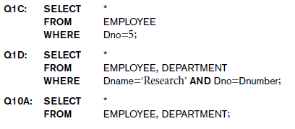
Use of the Asterisk
If bored listing all the attributes, then use asterisk (*), i.e., all attributes are of interest ☺
Select all the information about those employees working at the department 5
Select all the information (employee and department) from those employees working at the department ‘Research’
Select all the information about employees and departments with no meaning ☺

Slide 24
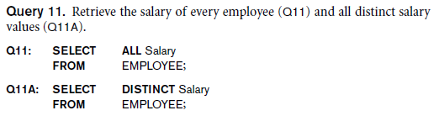
Tables as Multi-Sets in SQL
Set: has only unique elements, e.g., S = {a, b, c}
Multiset: might have duplicates, e.g., M = {a, a, a, b, c, c}
Operators: UNION, EXCEPT, INTERSECT
Query 5: Retrieve the salary of each employee, and all the distinct salaries
Salary
10000
10000
25000
30000
25000
30000
30000
Salary
10000
25000
30000

Slide 25

In-Class Activity [A2]
List all project numbers for projects that involve employees, whose last name is ‘Smith’, either as workers or as managers of departments controlling these projects.
Idea: split this into two sub-queries and then use the set UNION operator over the partial results.
Project
‘Smith’ is
manager
‘Smith’
is worker

Slide 26
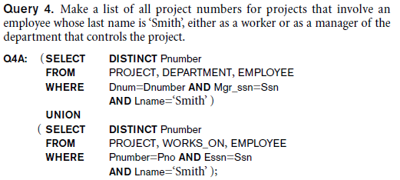
In-Class Activity [A2]
Step 1: Retrieve the projects where an employee with surname ‘Smith’ is working on;
Associate EMLOYEE with PROJECT via WORKS_ON

Slide 27
In-Class Activity [A2]
Step 2: Retrieve the projects where an employee with surname ‘Smith’ is a manager of the department which controls these project(s);
Associate EMLOYEE with DEPARTMENT to get the manager, and then DEPARTMENT with PROJECT to get the controlled projects by this department.

Slide 28
In-Class Activity [A2]
Step 3: UNION over the two sets of project numbers:

Slide 29
Three-Valued Logic
SQL is a three-valued logic: TRUE (1), FALSE (0) and UNKNOWN(0.5)
Recall: Each NULL value is different from any other NULL value!
Principle: Any value compared with NULL evaluates to UNKNOWN
Example:
WHERE Address = NULL …evaluates to UNKNOWN;
WHERE Address <> NULL …evaluates to UNKNOWN;
WHERE NULL = NULL …evaluates to UNKNOWN
Always adopt: IS NULL or IS NOT NULL

Slide 30
AND | TRUE | FALSE | UNKNOWN
TRUE | TRUE | FALSE | UNKNOWN
FALSE | FALSE | FALSE | FALSE
UNKNOWN | UNKNOWN | FALSE | UNKNOWN
min
OR | TRUE | FALSE | UNKNOWN
TRUE | TRUE | TRUE | TRUE
FALSE | TRUE | FALSE | UNKNOWN
UNKNOWN | TRUE | UNKNOWN | UNKNOWN
max
NOT
TRUE | FALSE
FALSE | TRUE
UNKNOWN | UNKNOWN
1-x

Slide 31


Comparison Involving NULL
SELECT Fname, Lname
FROM EMPLOYEE
WHERE Super_ssn = NULL
Query 6: Retrieve the first and last names of all employees who do not have supervisors.
it produces no tuples!
Hence, wrong reasoning!
Why?

Slide 32

In-Class Activity [A3]
CREATE TABLE Recruitment(
ID INT NOT NULL,
Name VARCHAR(10),
RecruiterID INT,
PRIMARY KEY(ID),
FOREIGN KEY(RecruiterID)
REFERENCES Recruitment(ID)
);
Task 1: List all the names of the employees.
Task 2: List the names of the employees who are not recruited by employee with ID = 2.
Which is the problem here?
ID | Name | RecruiterID
1 | Chris | NULL
2 | Philip | 3
3 | Stella | NULL
4 | John | 2
5 | Teresa | 3
6 | Iona | 5

Slide 33
In-Class Activity [A3]
{Chris, Philip, Stella, John, Teresa, Iona}
SELECT Name, RecruiterID
FROM Recruitment
WHERE RecruiterID <> 2
{Philip, Teresa, Iona}
We imply…{Chris, Stella, John} are recruited by Philip.
SELECT Name, RecruiterID
FROM Recruitment
WHERE RecruiterID IS NULL
OR RecruiterID <> 2
{Chris, Philip, Stella, Teresa, Iona}
ID | Name | RecruiterID
1 | Chris | NULL
2 | Philip | 3
3 | Stella | NULL
4 | John | 2
5 | Teresa | 3
6 | Iona | 5

Slide 34

Nested (Inner) Query
Nested query is a query within another (outer) query;
SELECT-FROM-WHERE block within another outer WHERE clause.
Nested query’s output is input to outer’s WHERE via: IN, ALL, EXISTS
Nested Uncorrelated Query: first execute the nested query, and then execute the outer query using inner’s output.
Correlated Query: for each tuple of the outer query, we execute the nested query.
WHERE <comparison>
Outer SQL
nested
SQL

Slide 35
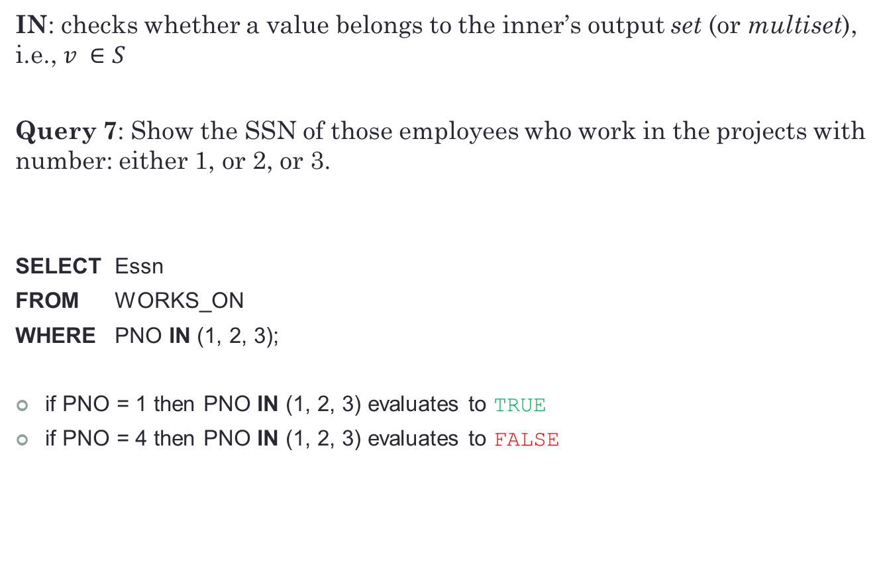
Nested Uncorrelated Query: Operator IN
IN: checks whether a value belongs to the inner’s output set (or multiset), i.e., $v ∈S$
Query 7: Show the SSN of those employees who work in the projects with number: either 1, or 2, or 3.
SELECT Essn
FROM WORKS_ON
WHERE PNO IN (1, 2, 3);
if PNO = 1 then PNO IN (1, 2, 3) evaluates to TRUE
if PNO = 4 then PNO IN (1, 2, 3) evaluates to FALSE

Slide 36
Nested Uncorrelated Query: Operator IN
Query 8: Show the names of those employees who work in the department ‘Research’.
SELECT FNAME
FROM EMPLOYEE
WHERE DNO IN ( SELECT DNUMBER
FROM DEPARTMENT
WHERE DNAME = ‘Research’);
SELECT FNAME
FROM EMPLOYEE
WHERE DNO IN ( 5 );
Evaluates to 5

Slide 37
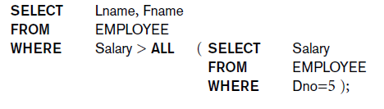
Nested Uncorrelated Query: Operator ALL
ALL: compares a value with all the values from the inner’s output set.
Query 9: Show the last and first names of those employees whose salary is greater than the salaries of all employees in Department 5.
First, find all salaries from employees in Department 5;

Slide 38
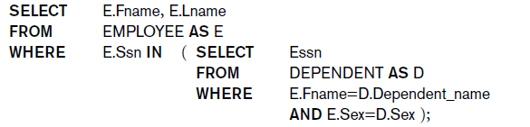
Nested Correlated Query
For each tuple of the outer query, we execute the inner query!
Relation as a variable: global scope (outer) and local scope (inner).
Query 10: Retrieve the name of each employee who has a dependent with the same first name and is the same gender as that employee.
For each outer employee E, retrieve the dependents D and check!

Slide 39
Nested Correlated Query
Lemma 1: Correlated queries using IN can be collapsed into one single block.
Query 11: Retrieve the name of each employee who has a dependent with the same first name and is the same gender as that employee.
SELECT E.Fname, E.Lname
FROM EMPLOYEE AS E, DEPENDENT AS D
WHERE E.Ssn=D.Essn
AND E.Sex=D.Sex
AND E.Fname=D.Dependent_name;

Slide 40

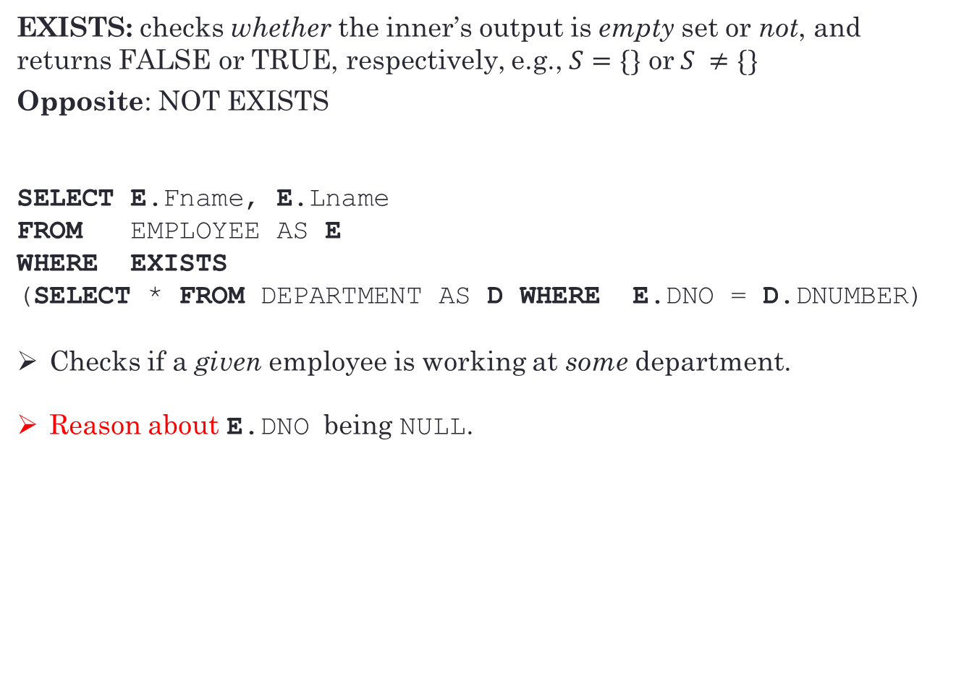
Nested Correlated Query: Exists
EXISTS: checks whether the inner’s output is empty set or not, and returns FALSE or TRUE, respectively, e.g., $S=\{\}$ or$S ≠\{\}$
Opposite: NOT EXISTS
SELECT E.Fname, E.Lname
FROM EMPLOYEE AS E
WHERE EXISTS
(SELECT * FROM DEPARTMENT AS D WHERE E.DNO = D.DNUMBER)
Checks if a given employee is working at some department.
Reason about E.DNO being NULL.

Slide 41
Nested Correlated Query: Exists
SELECT E.Fname, E.Lname
FROM EMPLOYEE AS E
WHERE EXISTS
(SELECT *
FROM DEPARTMENT AS D
WHERE E.DNO = D.DNUMBER AND D.DNAME = ‘Research’)
Describe this…

Slide 42
In-Class Quiz
SELECT E.Fname, E.Lname
FROM EMPLOYEE AS E
WHERE EXISTS
(SELECT * FROM DEPENDENT AS P WHERE E.SSN = P.Essn)
AND EXISTS
(SELECT * FROM DEPARTMENT AS D WHERE E.SSN = D.Mgr_SSN)
Checks if a given employee:
has at least a dependent and
manages a department, i.e., there exists a department, which is managed by that employee.

Slide 43

In-Class Activity [A4]
STUDENT (Name, StudentID, Class)
COURSE (Name, CourseID, Credits, School)
GRADES (StudentID, CourseID, Grade)
/*Grade: {‘A’, ‘B’, ‘C’, ‘D’, ‘E’}*/
Task: Retrieve the names of all students who have a Grade of ‘A’ in all of their courses.

Slide 44
In-Class Activity [A4]
STUDENT (Name, StudentID, Class)
COURSE (Name, CourseID, Credits, School)
GRADES (StudentID, CourseID, Grade)
/*Grade: {‘A’, ‘B’, ‘C’, ‘D’, ‘E’}*/
SELECT S.Name
FROM STUDENT S
WHERE NOT EXISTS
(SELECT * FROM GRADES G
WHERE G.StudentID = S.StudentID
AND NOT (G.Grade = ‘A’)
)
There does not exist a grade which is not ‘A’, i.e., all grades are ‘A’

Slide 45


In-Class QUIZ [What We Get]
SELECT *
FROM EMPLOYEE
WHERE EXISTS (SELECT NULL FROM EMPLOYEE);
SELECT *
FROM EMPLOYEE
WHERE EXISTS (SELECT * FROM EMPLOYEE
WHERE NULL IS NULL);
Fact: SQL, in evaluating EXISTS, simply counts rows and ignores the value(s) in the subquery—even if they are NULL!

Slide 46
In-Class QUIZ [What We Get]
SELECT * FROM EMPLOYEE WHERE
EXISTS (SELECT 0
FROM EMPLOYEE
WHERE 1 IS NULL OR NULL);
SELECT * FROM EMPLOYEE WHERE
NOT EXISTS (SELECT 0
FROM EMPLOYEE
WHERE 1 IS NOT NULL OR NULL);

