Slide 1
Pandas - Data Manipulation

Slide 2
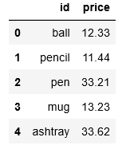


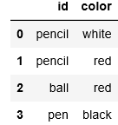
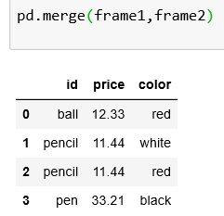
Data Manipulation - Merging
The merge() function is used to combine data through the connection of the rows using one or more keys (id field in this example).
Merged files without specifying any column
The returned dataframe consists of all rows that have an ID in common

Slide 3
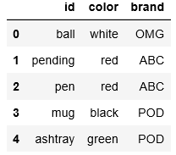


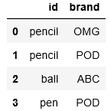
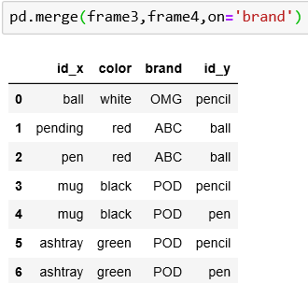
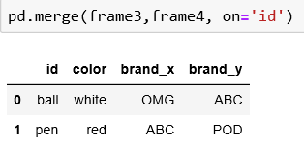
Data Manipulation - Merging
When two dataframes have columns with the same name, it is necessary to explicitly define the name of the key column in the on option.
Criteria for merging: ID
Criteria for merging: brand

Slide 4
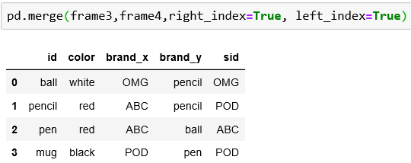
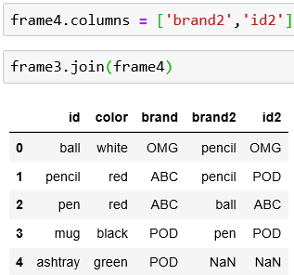
Data Manipulation - Merging
Instead of considering the columns of a dataframe as keys, indexes could be used as keys for merging. Set left_index or right_index options to True to activate which indexes to consider.
The join() function is more convenient when you want to merge by indexes. When some columns in frame3 have the same name as the columns in frame4, rename the columns in frame4 before launching the join() function.

Slide 5
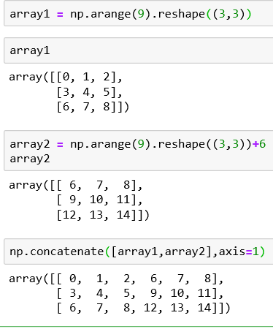
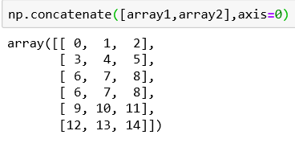
Data Manapulation - Concatenating
Concatenation is another type of data combination.
NumPy provides a concatenate() function to combine arrays

Slide 6
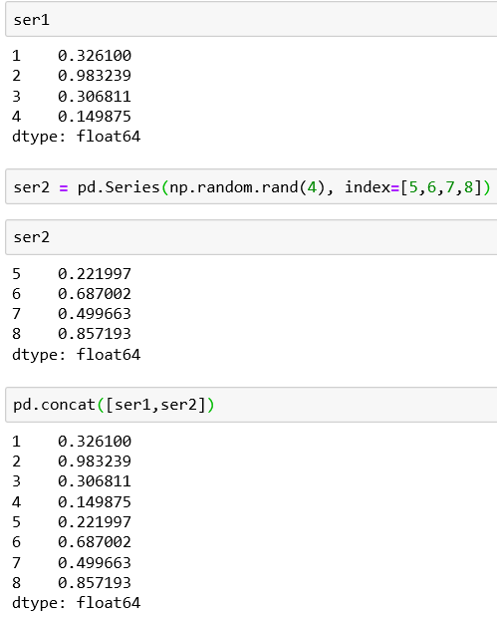
Data Manipulation - Concatenating Series
With pandas library and its data structure like series and dataframe, having labelled axes allows further generalisation of the concatenation of arrays.
The concat() function

Slide 7
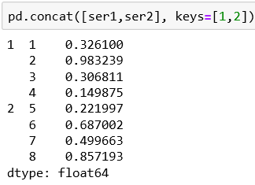
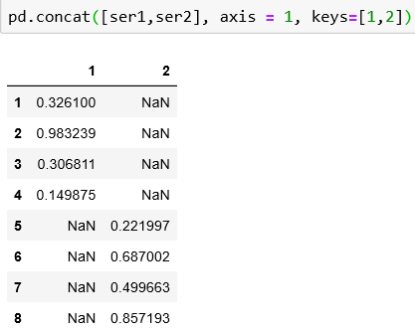
Data Manipulation - Concatenating Series
To create a hierarchical index on the concatenation, use the keys option.
In the case of combinations between series along the axis = 1 the keys become the column headers of the dataframe.

Slide 8
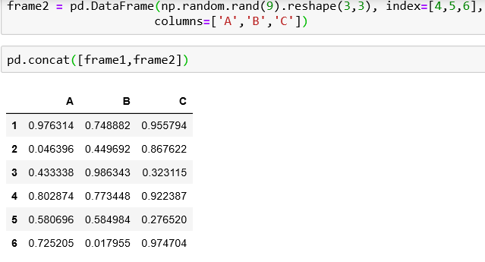
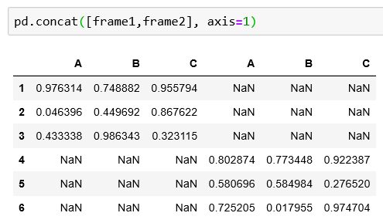
Data manipulation - Concatenating Dataframes
The same logic of concatenation applied to the series can be applied to the dataframe

Slide 9
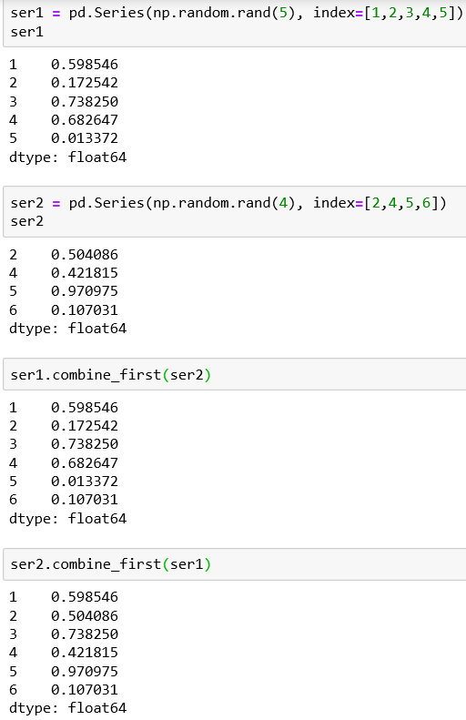
Combining
Sometimes, a combination of data cannot be obtained either with merging or with concatenation.
This can be applied to series using the combine_first() function
For example we want the two datasets to have indexes that overlap partially or entirely.

Slide 10
Data Manipulation - Pivoting
After putting together the data in order to unify the values collected from different sources, the values can be arranged and rearranged by column values on rows or vice versa. This is operation is know as pivoting.
In pivoting you have two basic operations:
Stacking – rotates or pivots the data structure converting columns to rows
Unstacking – converts row to columns

Slide 11
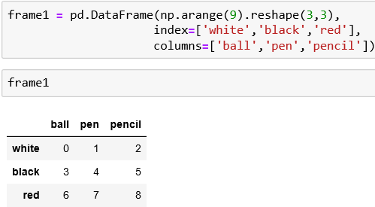
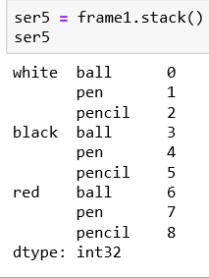
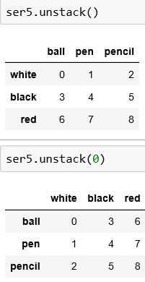
Data Preparation - Pivoting
Reassemble the table with unstack() function
Initial dataframe
You can also unstack on a different level
Using the stack() function on the dataframe, you get the pivoting of columns in rows, thus producing a series

Slide 12
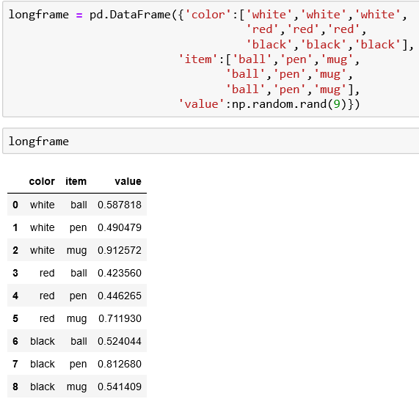
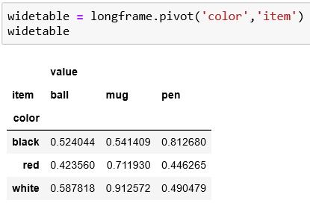
Pivoting from ‘Long’ to ‘Wide’ format
Pivoting a type of dataset that have entries on various columns, sometimes duplicated lines – e.g.. A log file that is accumulating data.
This can be difficult to read and in fully understanding the relationship between the key values and the rest of the columns.
Instead of long format, the data can be arranged in a table that is wide using the pivot() function.
Pivot() function allows you to transform a dataframe from the long to the wide type. More efficient and takes less space
Long type: difficult to read and understanding in more complex data

Slide 13
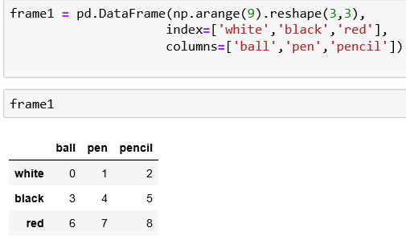
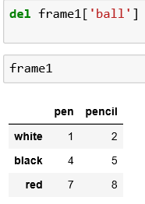
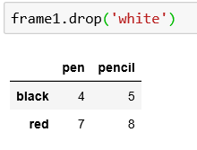
Data preparation - Removing
The last stage of data preparation is the removal of columns and rows.
In order to remove a column, use del command applied to the dataframe with the column name specified.
To remove a row, use the drop() function with the label of the corresponding index as argument
Removing a row called white
Removing a column called ball
Initial dataframe

Slide 14
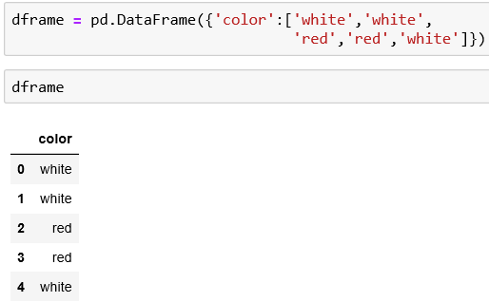
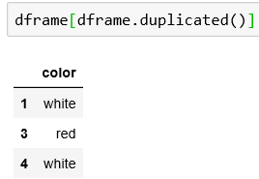
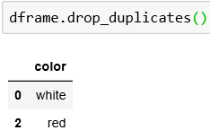
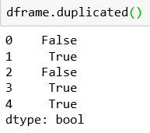
Data Transformation – Removing Duplicates
The duplicated() function detect the rows that are duplicated. It returns True if a row is duplicate and False if it is not.
The drop_duplicates() function will return the dataframe without duplicate rows
delete duplicated rows
Identify the duplicate rows and in this case these are rows 1, 3 and 4
Initial dataframe
Detect duplicated rows

Slide 15
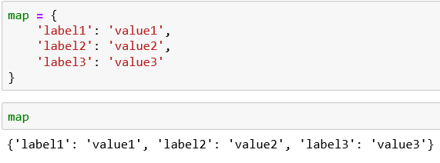
Data Transformation - Mapping
Mapping is the creation of a list of matches between two different values, with the ability to bind a value to a particular label or string.
The replace() function replaces values
The map() function creates a new column.
The rename() function replaces the index values.

Slide 16
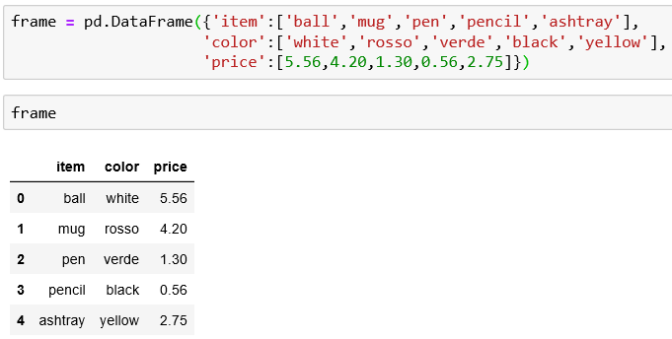
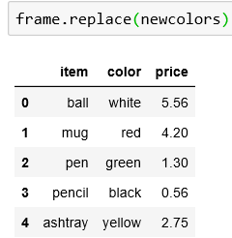

Replacing values via mapping
To replace the incorrect values, first define a mapping of correspondences containing as a key the new value.
Use the replace() function with the mapping as argument to replace the incorrect values
Initial dataframe with incorrect values: rosso and verde

Slide 17
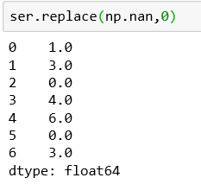
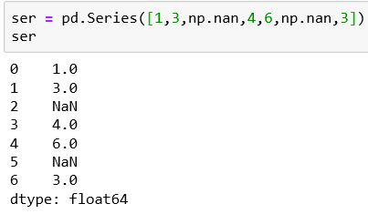
Replacing values via mapping

Slide 18
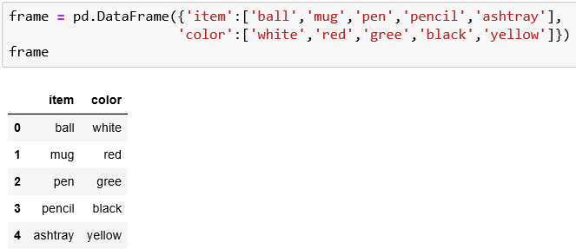
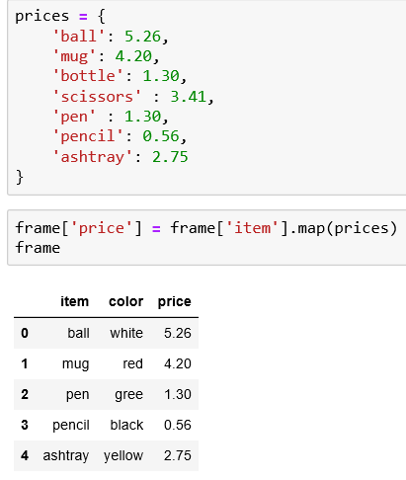
Adding Values via Mapping
The map() function applied to a series or to a column of a dataframe accepts a function or an object containing a dict with mapping.
Define a dictionary object that contains a list of prices for each type of item.
Add the price column to the frame using map()
Initial dataframe without the price column

Slide 19
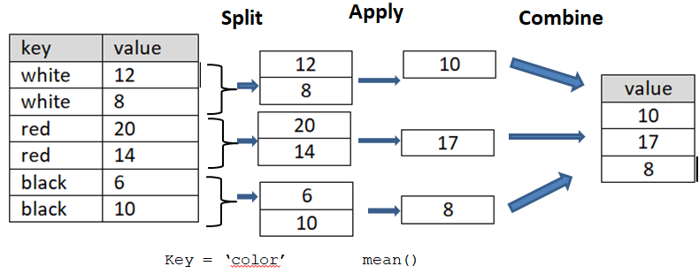
Data Aggregation
Last stage of data manipulation.
Involves a transformation that produce a single integer from an array.
Pandas provide a flexible tool for data aggregation: GroupBy
The process of GroupBy is divided into various phases:
Splitting – Division into groups
Applying – Application of a function on each group
Combining – Combination of all the results obtained by different groups.

Slide 20

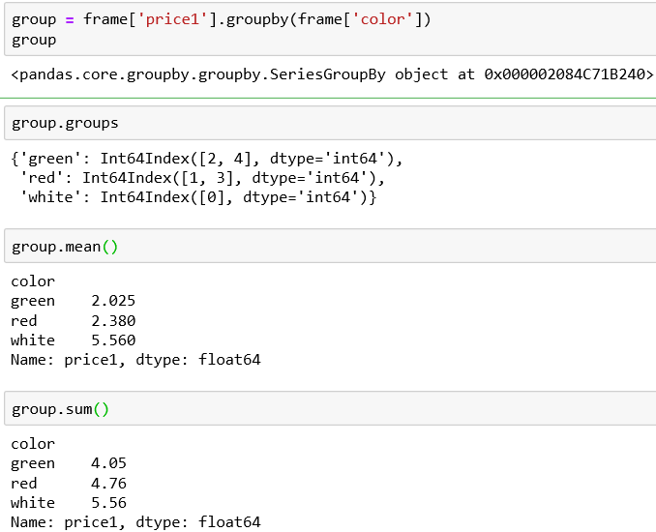
Data Aggregation – Grouping to a single column of data
Define a dataframe containing numeric and string values
Access the price1 column and call the groupby() function with the color
Dataframe divided into groups of rows
mean of groups in price1
Sum of groups in price1

Slide 21
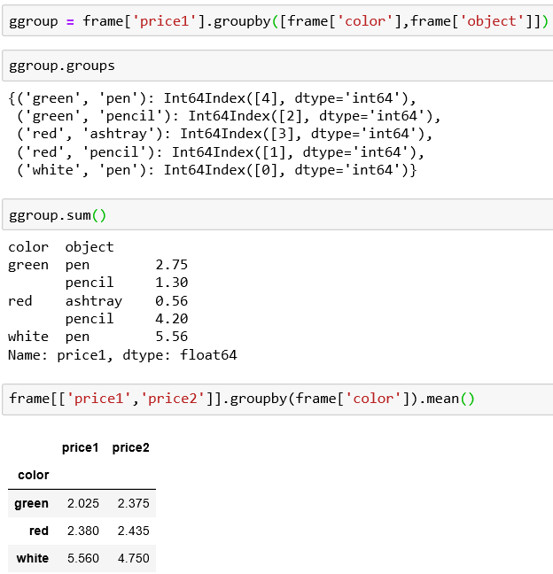
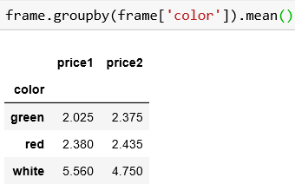
Data Aggregation – Hierarchical Grouping – using various columns

