Slide 1
Decision making

Slide 2
Decision making
If statements
If-Else statements
If-Elif-Else statements
If-Elif statements
Nested If statements

Slide 3
If statements
Comparison Operators
Relational Operator | Description
< | Less than
> | Greater than
>= | Greater than or equal to
<= | Less than or equal to
== | Equal to
!= | Not equal to
Allow your programme to make a decision and change the route that is taken through the programme.
The first line of the if statement will test the condition, and if that condition is met (if the first condition is True) then the line of code directly below it are run. If it is not met (the first condition is False) it will test the second condition, if there is one, and so on.
The if statement’s condition often includes a relational operator that compares two values, variables or expressions.
A Boolean expression is an expression that evaluates to either True or False
Logical operators combine while comparison operators compare.
Logical Operators
Operator | Description
and | Both conditions must be met
or | Either condition must be met
not | Reverses the truth of a Boolean expression

Slide 4
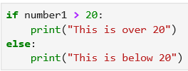
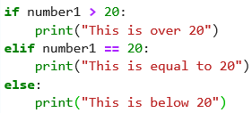
If-Else If – Elif - Else
If – Else
If number1 is over 20, it will display the message “This is over 20”, otherwise it will display the message “This is below 20”
If – Elif – Else
If number1 is over 20, it will display the message “This is over 20”, otherwise it will check the next condition. If number1 is equal to 20, it will display the message “This is equal to 20”. Otherwise, it will display the message “This is below 20”. The else at the end is optional. When else is included, the statement will select exactly one of several options. When else is not present, the statement selects at most one of several options.

Slide 5
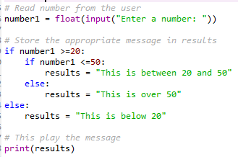
Nested If statements
The first line asks a user to enter a number that is saved in variable called number1.
If number1 is 20 or more then it will test another if statement to see if number1 is less than or equal to 50. If it is, it will print the message that is in the variable called result “This is between 20 and 50”.
If number1 is not less than or equal to 50, the message will be “this is over 50”.
If number1 is not over 20, it will display the message “This is below 20

Slide 6
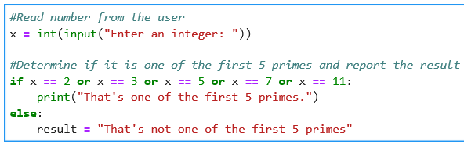
If-Else statement with comparison and logic operators
This code uses the or operator to determine whether or not a value entered by the user is one of the first 5 prime number. The and and not operators can be used in a similar manner when constructing a complex condition

