Slide 1
Files and Exceptions

Slide 2
File
Files are suitable for storing results that are needed for an extended period of time, and for holding input values for a programme that will run several times.
Files are classified as text file or binary file
Text files: Can only contains characters using an encoding system such as ASCII and UTF-8. can be viewed and modified using any text editor.
Binary files: sequence of bits. Can contain any type of data, not just characters. E.g. images, sound, videos.

Slide 3

Opening a File
A file must be opened before data values can be read from it and before new data value are written to it.
Files are opened by calling the open function.
The open function takes two arguments: The string that contains the name of the file and the string that indicates the access mode for the file.
Access modes: read (denoted by “r”), write (denoted by “w”) and append (denoted by “a”)
A file object is returned by the open function.
Once a file is opened, methods can be applied to the file object to read data from the file or to write data to the file.
The file should be closed once all of the values have been read or written using the close function.

Slide 4
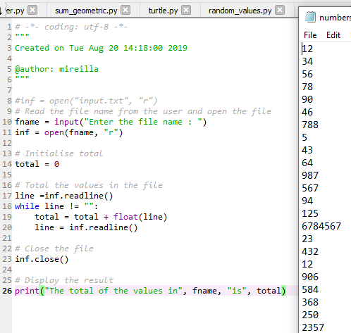

Reading Input from a File
Our list: numbers
Can only read from a file when it is in read mode otherwise it crashes if it is in any other mode.
Readline method reads one line from the file and returns it as a string, much like the input function reads a line of text typed on the keyboard.
Readline returns an empty string when there is no further data to read from the file.

Slide 5
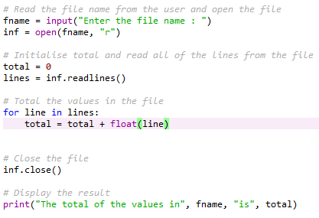
Reading Input from a File
Sometimes it is helpful to read all of the data from the file instead of reading one line at a time..
The read method or the readlines method can help accomplish that.
The read method will return the entire content of the file as one string – further processing is required to break the string into smaller pieces
Readlines returns a list where each element is one line from the file. Once all the lines have been read, a loop can be used to process each element in the list.

Slide 6
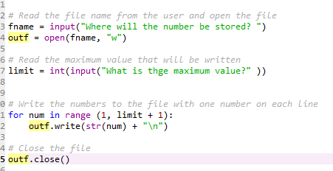
Writing Output to a File
When a file is opened in write mode, a new empty file is created
So if that file already existed then it will be deleted and all data in it will be lost.
Open an existing file in append mode to write data at the end of that file.
If the file opened in append mode does not exist, then a new file will be created.
The write method can be used to write data opened either to write mode or append mode.
It takes one argument, a string. Convert other value types to string using the str function.
Unlike print method, the write method does not automatically move to the next line. \n denotes end of line marker.
This programme writes the numbers from 1 up to (including) a number entered by the user to a file

Slide 7
Reading and Writing to a .csv File
.CSV (Comma Separated Values) is associated with importing and exporting spreadsheets and databases.
Allows greater control over data
When opening a .csv file, you must specify how that file will be used. The options are:
Code | Description
‘w’ | Creates a new file and writes to that file. If the file already exist, a new file will be created, overwriting the existing file
‘x’ | Creates a new file and writes to that file. If the file already exits, the programme will crash rather than overwriting it.
‘r’ | Opens for reading only and will not allow you to make any changes.
‘a’ | Opens for writing, appending to the end of the file

Slide 8
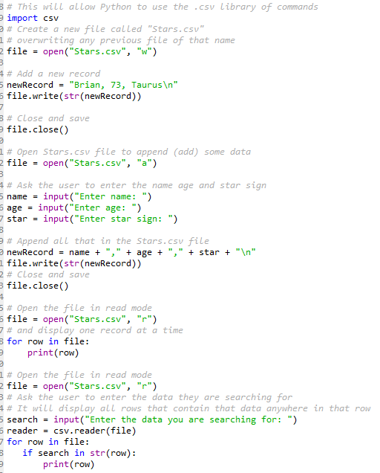

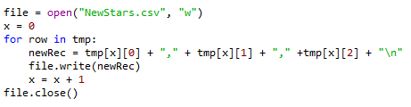
Reading and Writing to a .csv File
A .csv file cannot be altered, only added to. If you need to alter the file, you need to write it to a temporary list. This code reads the original file and write it to a list called “tmp”
Writes from a list to a new csv file called “NewStars.csv”

Slide 9
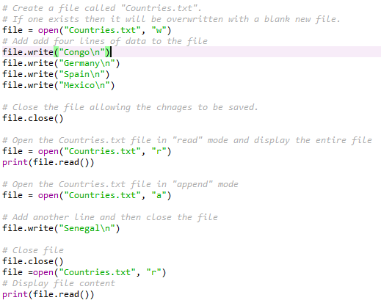
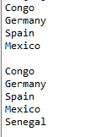
More code example - Writing and reading
The file.close() function at the end of the code tells Python the task of creating or reading is complete.

Slide 10
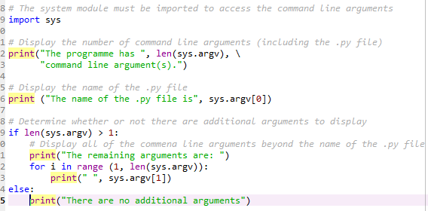

Command Line Arguments
Being able to provide input from the command line is beneficial when writing scripts that use multiple programmes to automate some tasks and programmes that are scheduled to run periodically.
Any command line argument provided when the programme was executed are stored into a variable named argv (argument vector) that resides in sys (system)
This programme demonstrates accessing the argument vector.

Slide 11
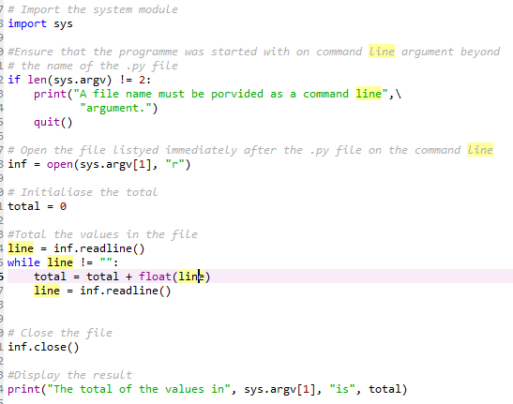
Command Line Arguments
Command line arguments can be used to supply any input values to the programme that can be typed on the command line such as integers, floating-point numbers, and strings

Slide 12
Exceptions
Exceptions are those errors that the user can make. For example, a user can supply a non-numeric value when a numeric value was expected.
By default a Python programme will crash when an exception occurs.
So the programmer must indicate where an exception might occur in order to catch it.
The programmer must also indicate what code to run to handle the exception when it happens.
Try and except are used.
The code that might cause an exception that we want to catch is place inside the try block
The try block is immediately followed by one or more except blocks.
When an exception occurs inside a try block, execution immediately jump to the appropriate except block without running any remaining statements in the try block.
An except block that does not specify a particular exception will catch any type of exception (that is not caught by another except block associated to the same try block.
The except block only execute when an exception occurs.

Slide 13
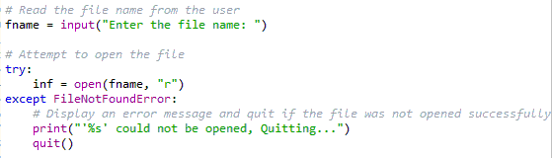
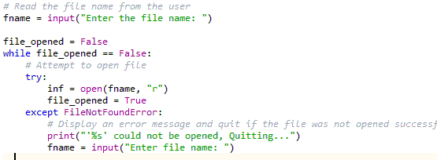
Exceptions example code
Quits when the file requested by the user is not found which is not always ideal.
A user can re-enter the name of the file. However this can also cause an exception. A loop is used to run until the user enters the name of the file successfully. The try and except are inside the loop

