Slide 1
Managing Variables and Side Effects in Programming

Slide 2
Local vs. Global Scope
Understanding the distinction between local and global scope is crucial in preventing side effects due to variable name conflicts.
Modifications made to local variables within functions do not affect the global variables unless explicitly stated using the global keyword or if the function's return value is used to update the global variable.

Slide 3
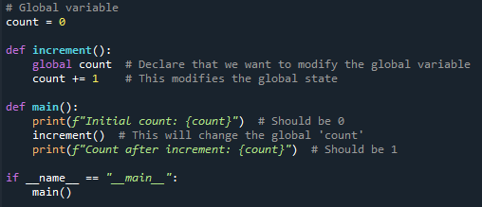

Code with Side Effects
Side effects occur when an operation modifies state outside its local environment.
Debugging difficult because the behaviour of the program depends on the order and context of operations
Global Variable: The variable count is defined outside of any function, making it a global variable. This means it can be accessed and modified from anywhere in the program.
Function with Side Effect: The function increment() is designed to modify the global variable count. It uses the global keyword to indicate that it intends to modify the global variable count, rather than creating a local variable of the same name. It alters this variable outside its local scope.
Modifying Global State: When increment() is called, it increments the value of count, which modifies the state outside its local environment (i.e., the global state).
Output: The main() function demonstrates the side effect by printing the value of count before and after calling increment(). You can see how calling increment() changes the global variable's value.

Slide 4
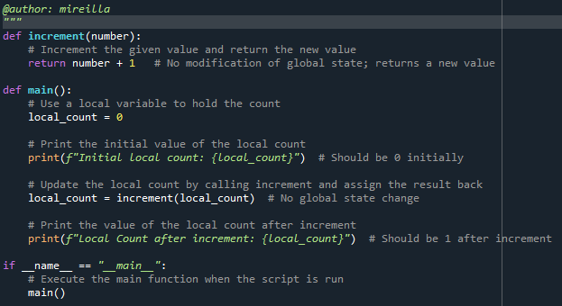

Code without Side Effects
To avoid side effects, you can return a new value rather than modifying global state.
In this code, increment () returns a new value instead of altering a global variable, thus avoiding side effects and making the code easier to understand and maintain.
This practice is common in functional programming, which emphasises avoiding side effects to create more predictable and testable code.

Slide 5
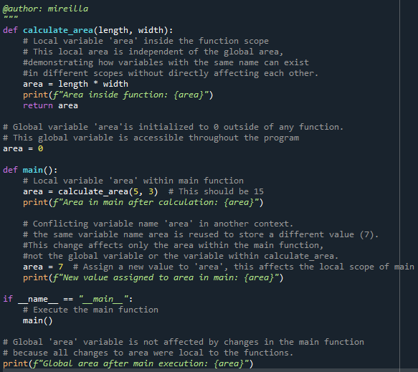
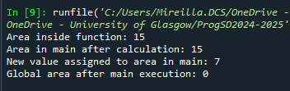
Another example of Code Side Effects

Slide 6
Challenges of Using Multiple Variables with the Same Name
Leads to confusion and difficult-to-trace bugs. Variables with the same name can exist in different scopes (e.g., global, function-level) without directly interfering with each other. However, this can lead to confusion if not carefully managed
Use descriptive and unique variable names, especially in large programs or shared environments, to reduce the risk of name conflicts and unintended side effects.
Debugging Challenges: Keep functions small and focused with clear input and output parameters to help maintain clarity and prevent side effects.

Slide 7
Challenges in Jupyter Notebooks
Notebooks allow non-linear code execution, leading to inconsistent variable states.
Variables can be overwritten across cells, causing unexpected results.
Understanding the order of cell execution is critical.

Slide 8
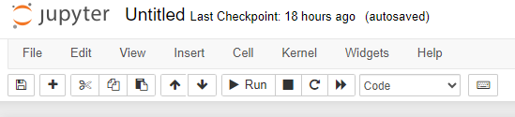
Best Practices for Managing Variables
Use unique and descriptive variable names to avoid conflicts.
When using Jupyter Notebook, Run cells sequentially and avoid jumping around without resetting the kernel.
Regularly reset the kernel to ensure code is executed in a clean state.

Slide 9
Conclusion and Key Takeaways
Proper variable management is essential for robust code.
Understanding side effects and state management helps avoid common pitfalls.
Apply best practices consistently to ensure code reliability.

