Slide 1

Introduction to Data Science and Systems
Lecture 4: Optimisation I
- Parameters, objective functions, classification of optimisation problems
Dr Nicolas Pugeault

Slide 2
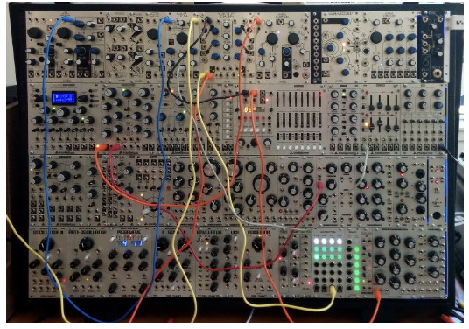
What is optimisation?
Optimisation is the process of adjusting things to make them better.
we want to do this automatically by an algorithm.
there are a plethora of algorithms which can then do the automatic adjustment efficiently.
optimisation is search, and optimisation algorithms search efficiently using mathematical structure of the problem space.
What is often called "artificial intelligence" often comes down to optimisation.
For electronic music instrument needs
"Enticingly technical synthesizer 1, Control Voltage, Mississippi Street, Portland, Oregon, USA"
Notes:
Knobs, buttoms

Slide 3
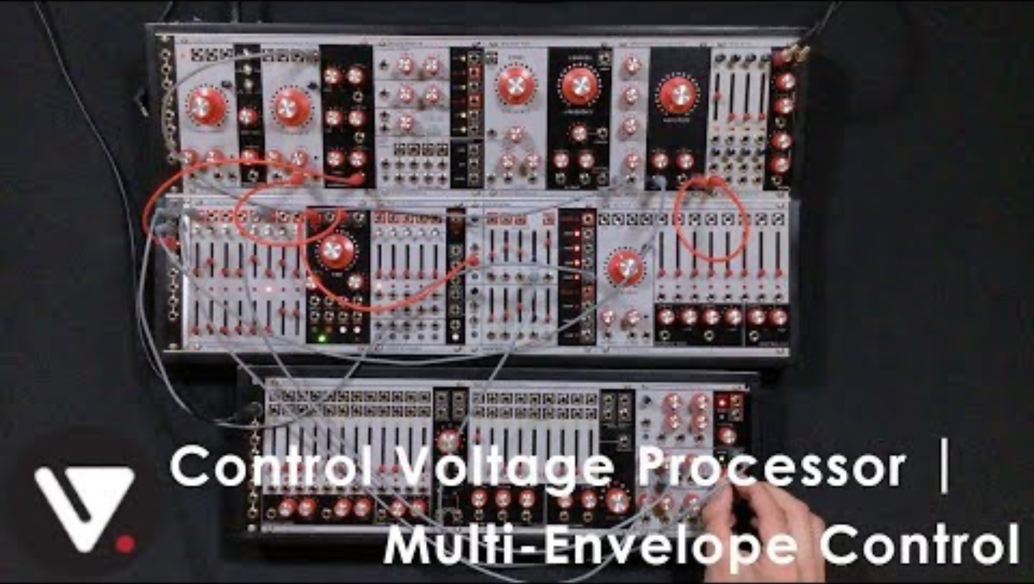
What is optimisation?
For electronic music instrument needs
"Enticingly technical synthesizer 1, Control Voltage, Mississippi Street, Portland, Oregon, USA"
Notes:
Knobs, buttoms

Slide 4
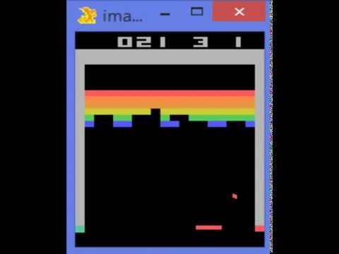
Example: Deep Neural Networks

Slide 5
Intended Learning Outcomes
Concepts
What an objective function, constraint function and a parameter vector is in the context of optimisation
The difference between discrete and continuous optimisation
Convex and nonconvex optimisation and how to recognise them
What constrained optimisation is and the difference between soft and hard constraints
Key properties of objective functions, including convexity and continuity
Algorithms
What linear least squares is
How iterative optimisation works
The principles of heuristic optimisation
The properties of random search, with the metaheuristics: locality, memory, temperature and population

Slide 6
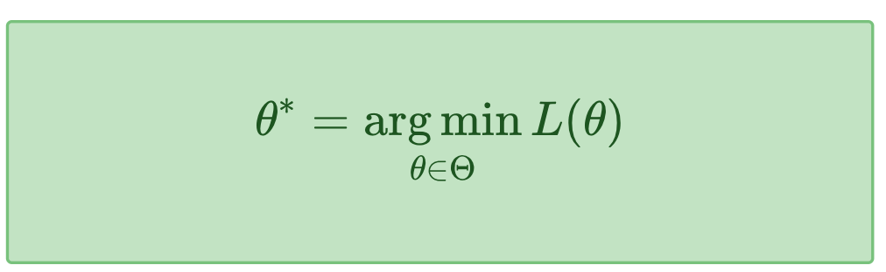
Key components of an optimisation problem
parameters: the things we can adjust, which might be a scalar or vector or other array of values, denoted θ.
objective function: a function that maps the parameters onto a single numerical measure of how good the configuration is L(θ).
θ∗ is the configuration that we want to find; the one for which the objective function is lowest.
Notes:
There are two parts to an optimisation problem:

Slide 7
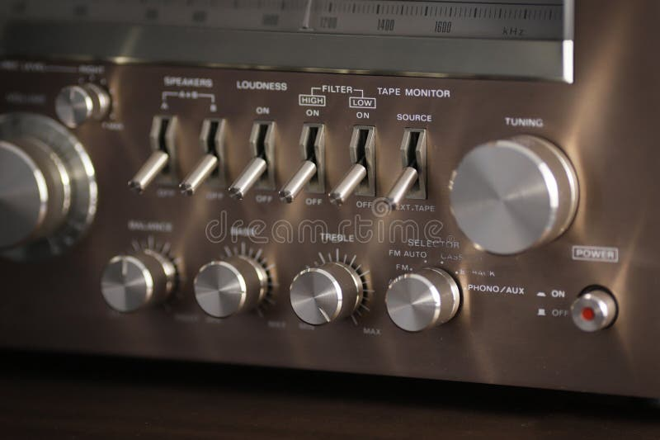
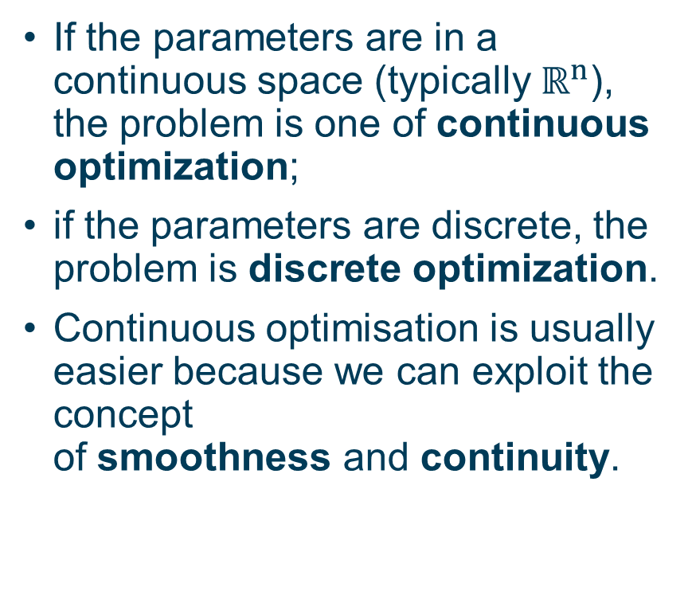
Discrete vs. continuous
If the parameters are in a continuous space (typically $ℝ^{n}$), the problem is one of continuous optimization;
if the parameters are discrete, the problem is discrete optimization.
Continuous optimisation is usually easier because we can exploit the concept of smoothness and continuity.

Slide 8

Evaluating the objective function
It may be expensive to evaluate the objective function. For example:
the computation might take a long time (invert a 10000x10000 matrix);
or it might require a real-world experiment to be performed (do the users like the new app layout?);
or it might be dangerous (which wire on the bomb should I cut next?);
or it might require data that must be bought and paid for (literally expensive).
mathematical structure might help guide the search (analytic solution)

Slide 9
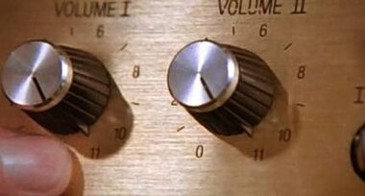
Constraints
constraints: the limitations on the parameters. This defines a region of the parameter space that is feasible, the feasible set or feasible region.
For example, the synthesizer has knobs with a fixed physical range, say 0-10; it isn't possible to turn them up to 11.
Most optimisation problems have constraints of some kind;

Slide 10
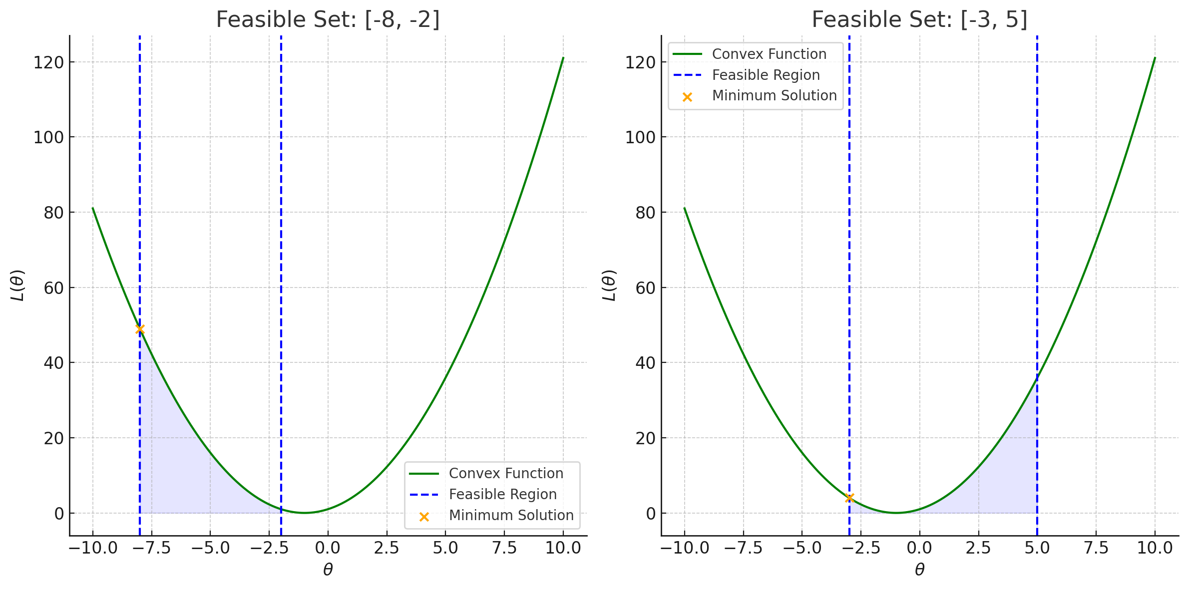
Constraints
We usually think of the objective function as a cost which is minimised.
Loss function (more popular)
We want the cost subject to a certain parameter span, e.g. [a, b]
x
x
x

Slide 11
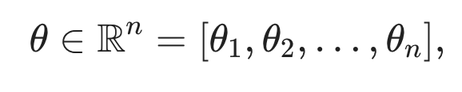
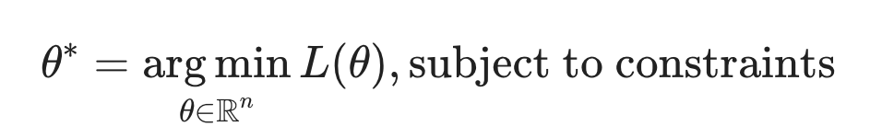
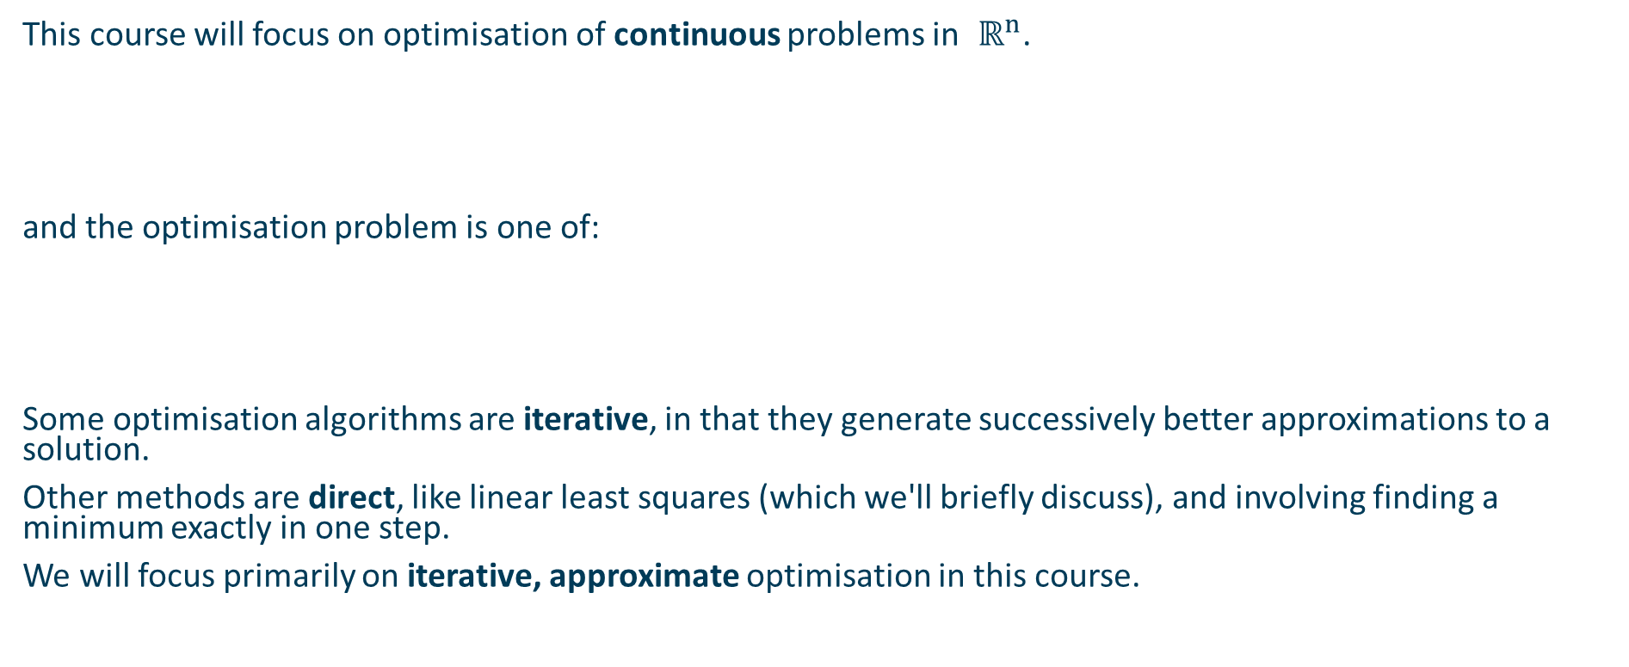
Focus: continuous optimisation in real vector spaces
This course will focus on optimisation of continuous problems in $ℝ^{n}$.
and the optimisation problem is one of:
Some optimisation algorithms are iterative, in that they generate successively better approximations to a solution.
Other methods are direct, like linear least squares (which we'll briefly discuss), and involving finding a minimum exactly in one step.
We will focus primarily on iterative, approximate optimisation in this course.

Slide 12
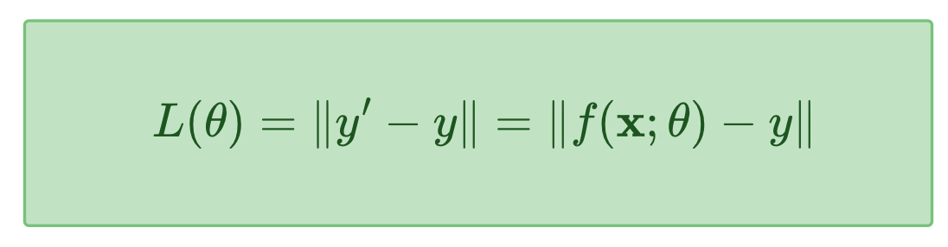
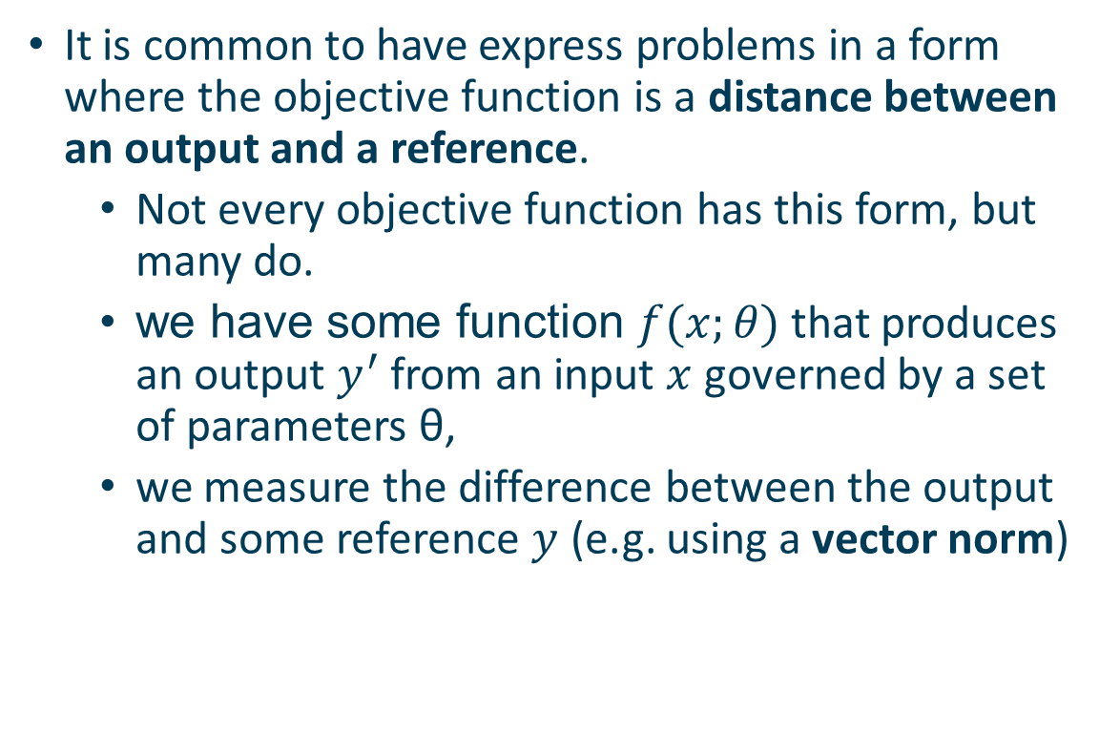
Special case: Minimising differences
It is common to have express problems in a form where the objective function is a distance between an output and a reference.
Not every objective function has this form, but many do.
we have some function $f(x;θ)$ that produces an output $y^{′}$ from an input $x$ governed by a set of parameters θ,
we measure the difference between the output and some reference $y$ (e.g. using a vector norm)

Slide 13
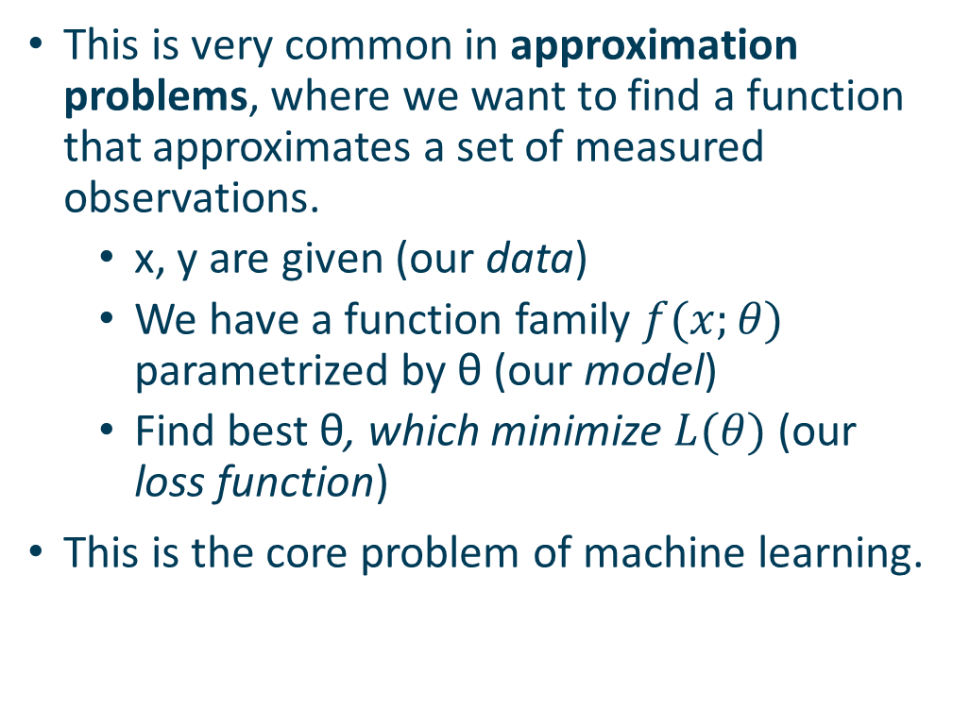
Special case: Approximation problems
This is very common in approximation problems, where we want to find a function that approximates a set of measured observations.
x, y are given (our data)
We have a function family $f(x;θ)$ parametrized by θ (our model)
Find best θ, which minimize $L(θ)$ (our loss function)
This is the core problem of machine learning.

Slide 14
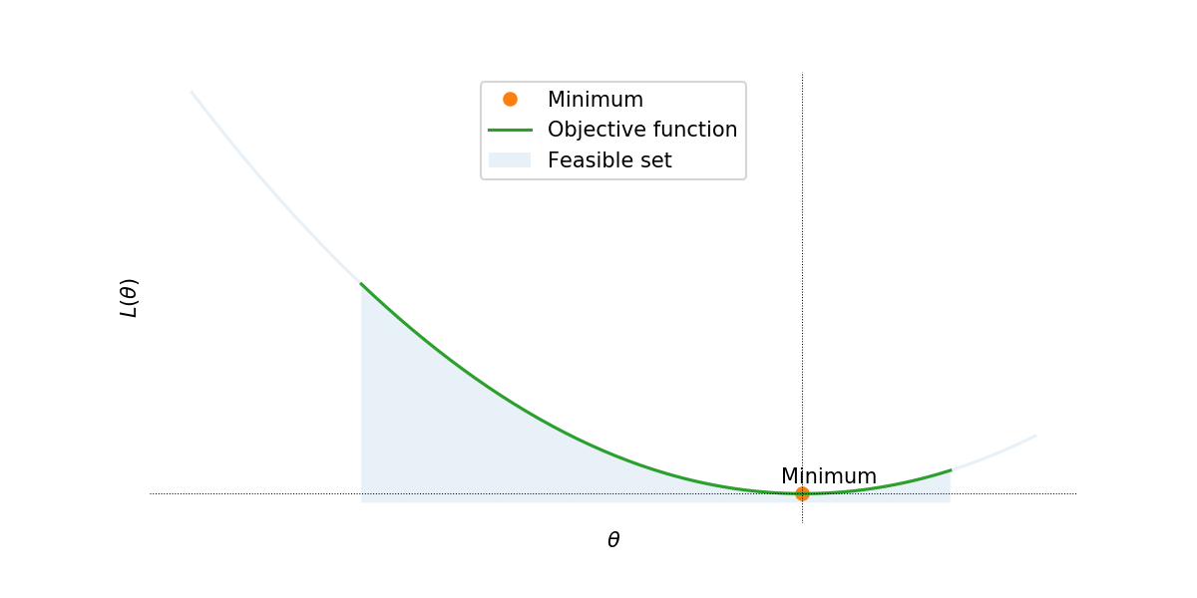

Example 1 - A simple optimisation problem
Example
L is a square function, e.g. $L\left(θ\right)=θ^{2}+2θ+1$
Parameter θ
Subject to: θ in [a,b]
a b

Slide 15
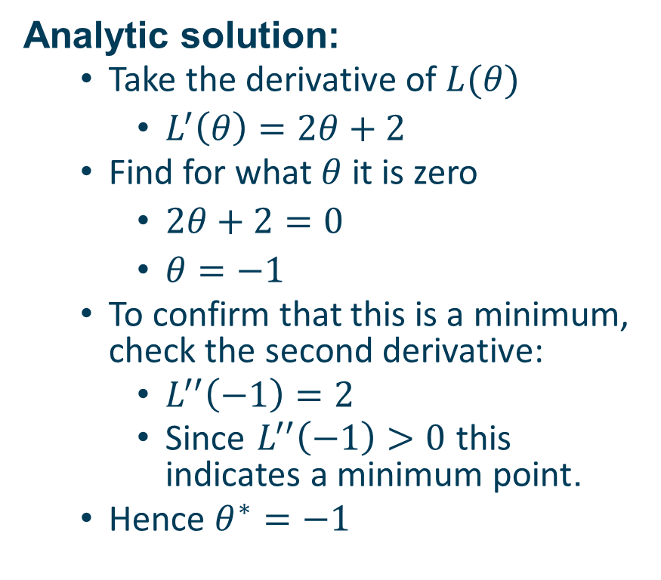
Example 1 - Analytic solution
Example
L is a square function, e.g. $L\left(θ\right)=θ^{2}+2θ+1$
Parameter θ
Subject to: θ in [a,b]
Analytic solution:
Take the derivative of $L(θ)$
$L^{′}\left(θ\right)=2θ+2$
Find for what $θ$ it is zero
$2θ+2=0$
$θ=−1$
To confirm that this is a minimum, check the second derivative:
$L^{′′}\left(−1\right)=2$
Since $L^{′′}\left(−1\right)>0$ this indicates a minimum point.
Hence $θ^{∗}=−1$
a b

Slide 16
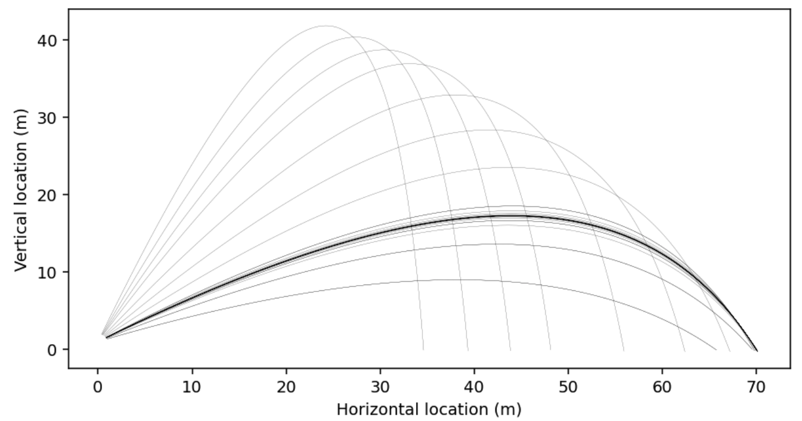
Example 2 - Throwing a stone
For example, if I wanted to optimise how far I could throw a stone, I might be able to adjust the throwing angle. This is the parameter I could tweak (just one parameter θ=[α], in this case).
The objective function must be a function which depends on this parameter.
I would have to simulate throwing the ball to work out how far it went and try and make it go further and further.
Please refer to the Jupyter Notebook for details on how this was plotted.

Slide 17
Example 3 - Geometric median
Problem: Find the median of a >1D dataset.
We have direct solution:
The standard median is computed by sorting and then selecting the middle element (with various rules for even sized datasets).
This doesn't work for higher dimensions, and there is no straightforward direct algorithm.
But there is an easy definition of the median: it is the vector that minimises the sum of distances to all vectors in the dataset. → optimisation problem

Slide 18
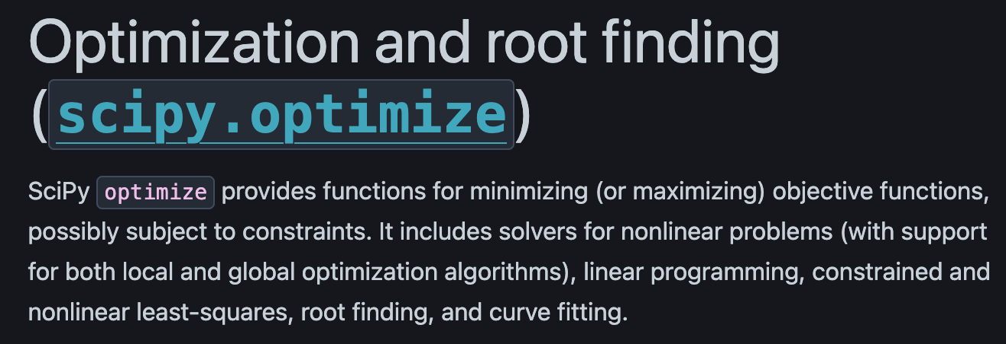
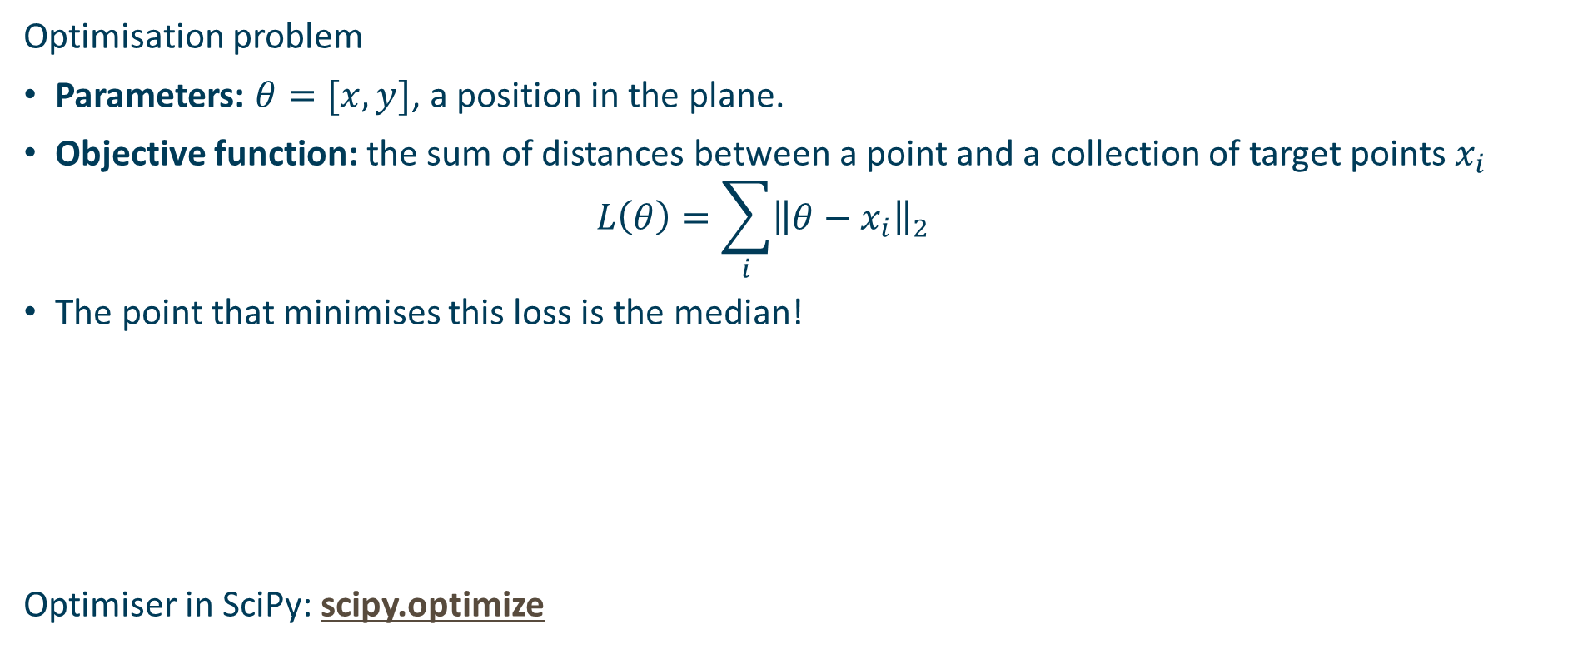
Example 3 - Geometric median
Optimisation problem
Parameters: $θ=[x,y]$, a position in the plane.
Objective function: the sum of distances between a point and a collection of target points $x_{i}$
$$L\left(θ\right)=\sum_{i}{{\left\|θ−x_{i}\right\|}_{2}}$$
The point that minimises this loss is the median!
Optimiser in SciPy: scipy.optimize

Slide 19
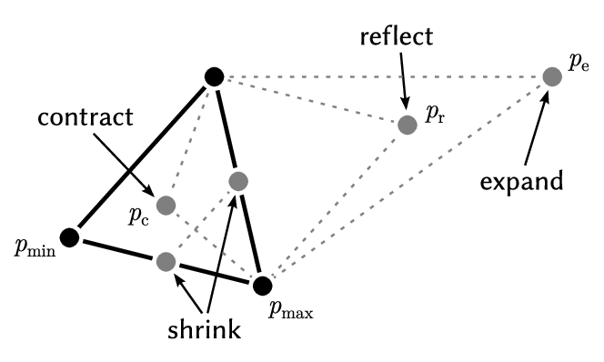
Nelder-Mead Method
Key Steps:
Initialisation: Start with a simplex (triangle in 2D, tetrahedron in 3D, etc.).
Reflection: Reflect the worst vertex across the centroid of the others.
Expansion: If reflection improves the function, expand further.
Contraction: If reflection fails, contract towards the centroid.
Shrink: If contraction fails, shrink the simplex towards the best point.
Nelder, John A.; R. Mead (1965). "A simplex method for function minimization". Computer Journal. 7 (4): 308–313. doi:10.1093/comjnl/7.4.308.

Slide 20
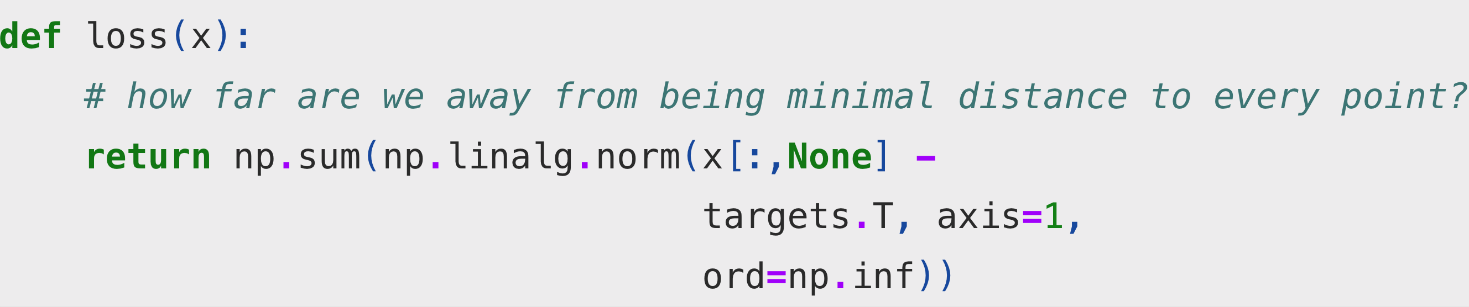
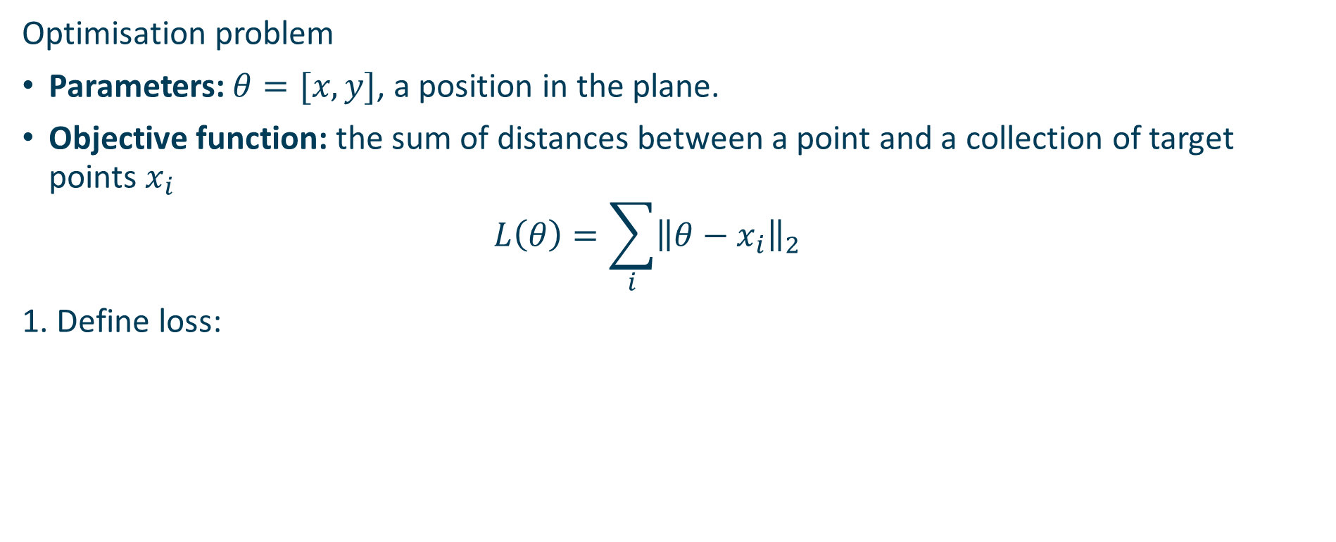
Example 3 - Geometric median
Optimisation problem
Parameters: $θ=[x,y]$, a position in the plane.
Objective function: the sum of distances between a point and a collection of target points $x_{i}$
$$L\left(θ\right)=\sum_{i}{{\left\|θ−x_{i}\right\|}_{2}}$$
1. Define loss:

Slide 21
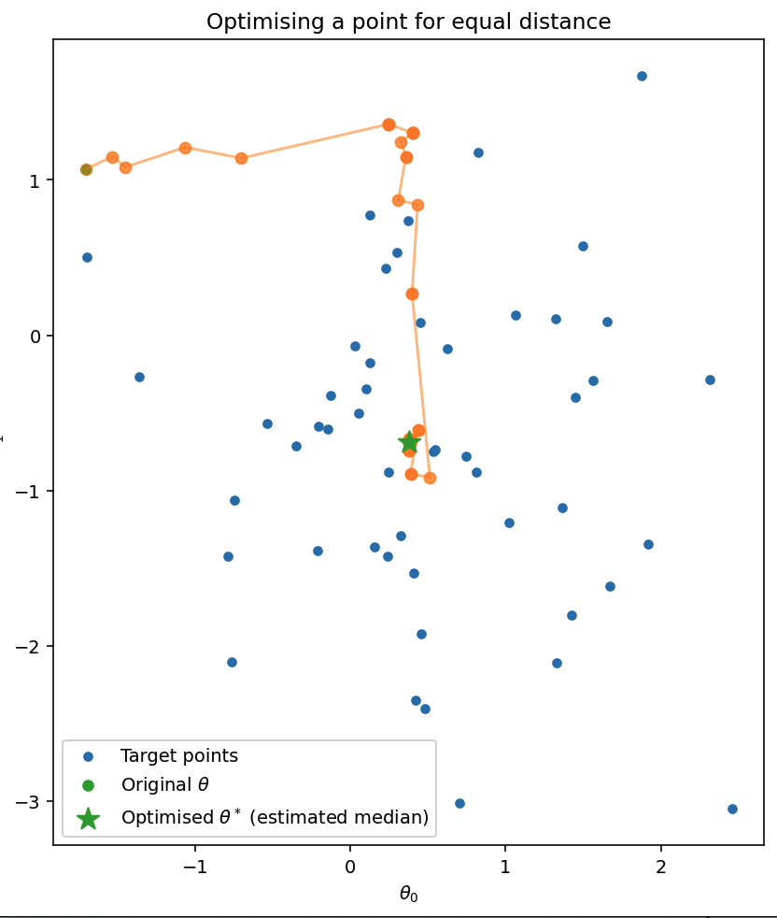
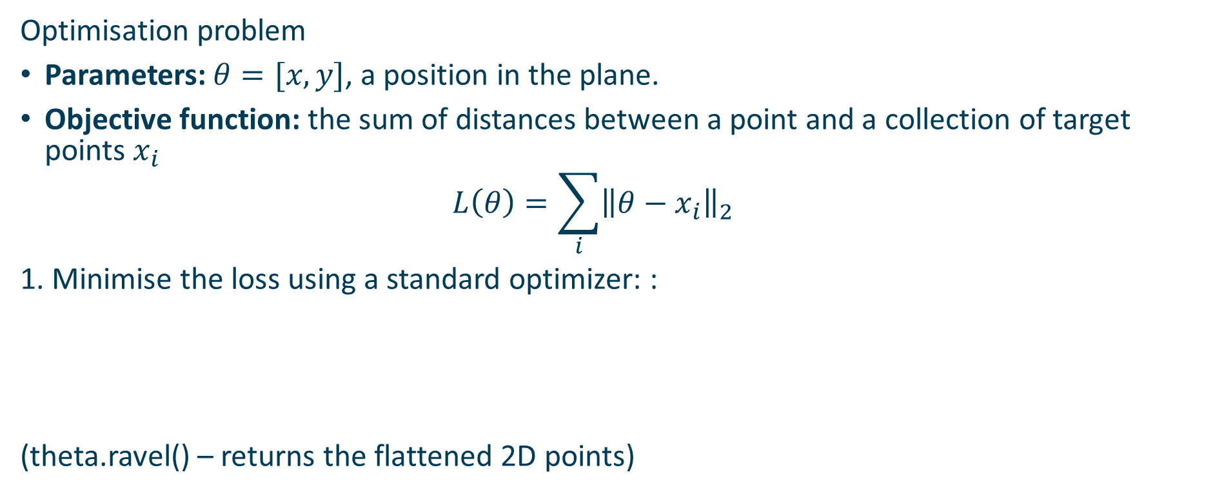
Example 3 - Geometric median
Optimisation problem
Parameters: $θ=[x,y]$, a position in the plane.
Objective function: the sum of distances between a point and a collection of target points $x_{i}$
$$L\left(θ\right)=\sum_{i}{{\left\|θ−x_{i}\right\|}_{2}}$$
1. Minimise the loss using a standard optimizer: :
(theta.ravel() – returns the flattened 2D points)

Slide 22
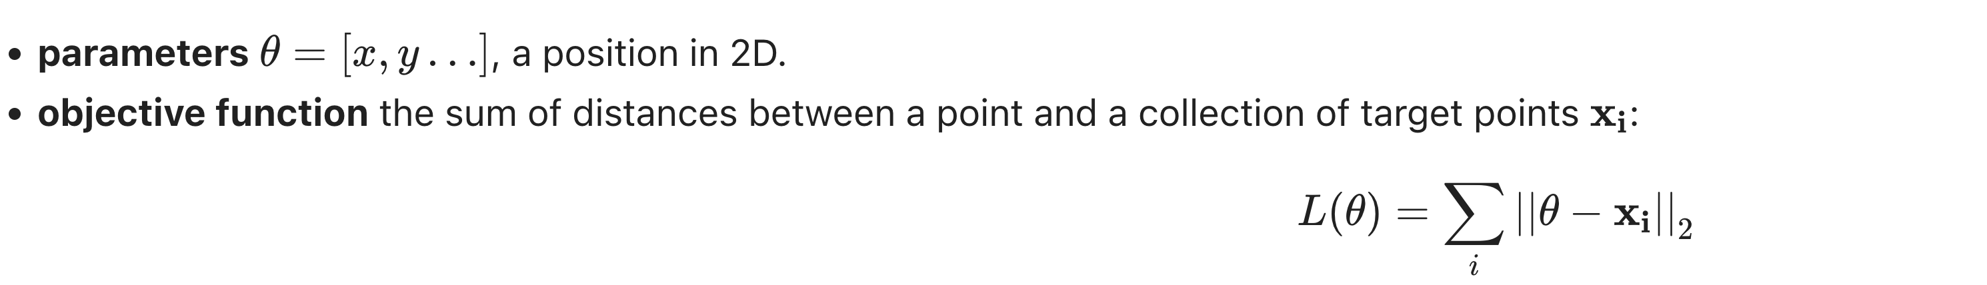
Geometric median: an example of optimisation in R2
Optimisation problem:
2. minimise the loss using a standard optimizer:
theta.ravel() – return the flatten random 2D points

Slide 23
Properties of optimisation
Every optimisation problem has two parts:
Parameters, the things that can be adjusted.
Objective function, which measures how good a particular set of parameters are.
An optimisation problem usually also has:
Constraints, that define the feasible set of parameters.
The objective function is a function of the parameters which returns a single scalar value, representing how good that parameter set is.

Slide 24
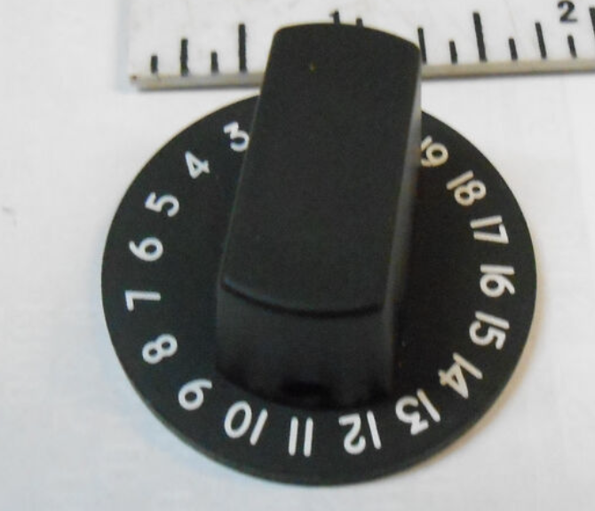
Constrained optimisation
If a problem has constraints on the parameters beyond purely minimising the objective function then the problem is constrained optimisation.
For example, in the synthesizer above, it's not much use if the optimal solution requires one the knobs to be turned to an impossible value; the parameter space is limited in extent on every dimension.
This limits the feasible set of the parameters.

Slide 25
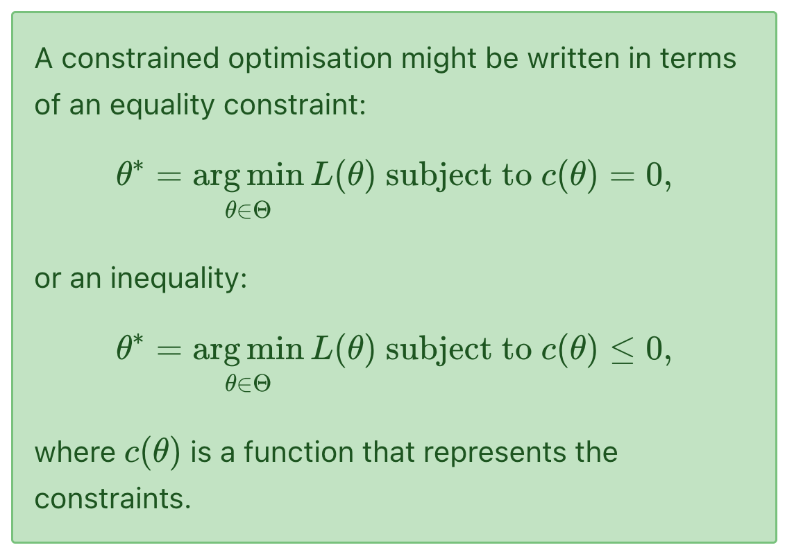
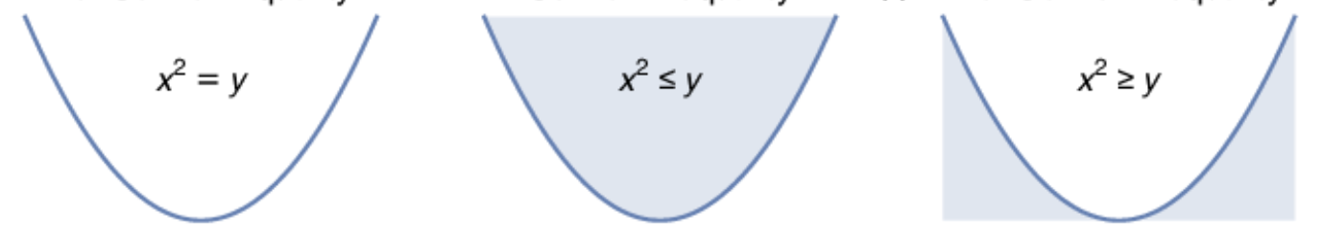
Constrained optimisation
An equality constraint can be thought of as constraining the parameters to a surface, to represent a tradeoff.
For example, c(θ)=∥θ∥₂−1 forces the parameters to lie on the surface of a unit sphere.
An inequality constraint can be thought of as constraining the parameters to a volume, to represent bounds on the values.
For example, c(θ)=∥θ∥∞−10 forces the parameters to lie within a box extending (-10, 10) around the origin -- perhaps the range of the knobs on the synthesizer.

Slide 26
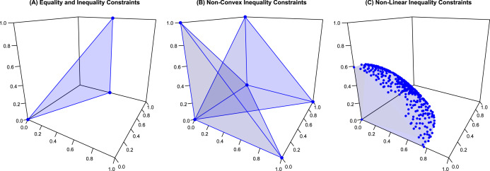
Constrained optimisation
An equality constraint can be thought of as constraining the parameters to a surface, to represent a tradeoff.
For example, c(θ)=∥θ∥₂−1 forces the parameters to lie on the surface of a unit sphere.
An inequality constraint can be thought of as constraining the parameters to a volume, to represent bounds on the values.
For example, c(θ)=∥θ∥∞−10 forces the parameters to lie within a box extending (-10, 10) around the origin -- perhaps the range of the knobs on the synthesizer.

Slide 27
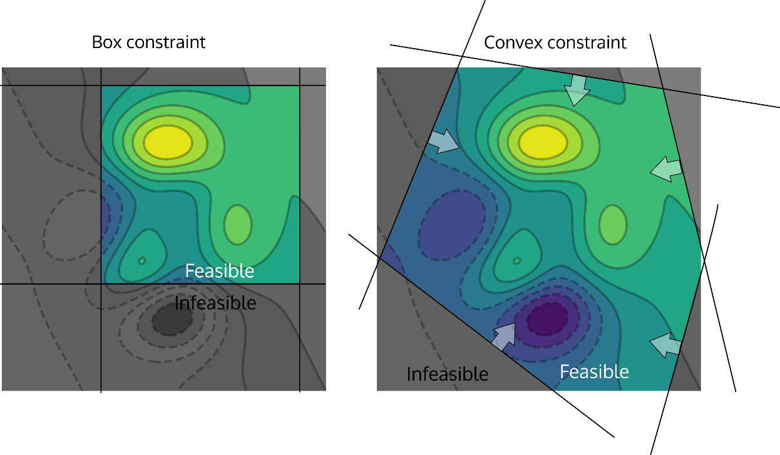
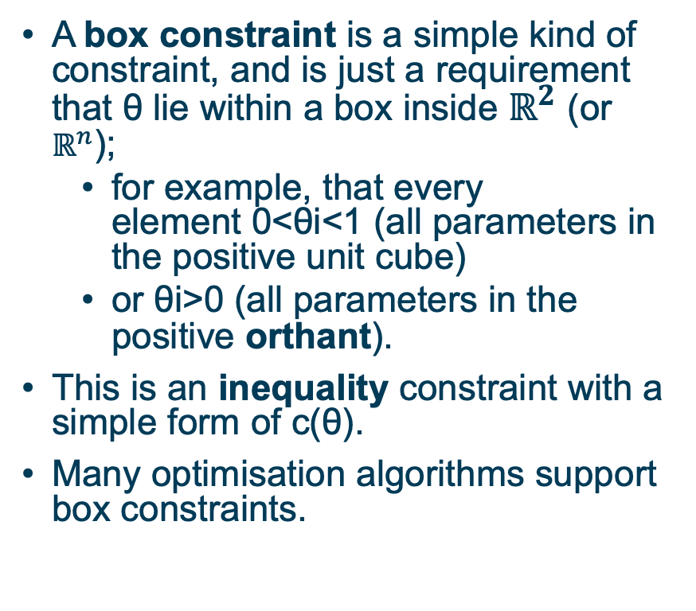
Common constraint types
A box constraint is a simple kind of constraint, and is just a requirement that θ lie within a box inside $ℝ^{2}$ (or $ℝ^{n}$);
for example, that every element 0<θi<1 (all parameters in the positive unit cube)
or θi>0 (all parameters in the positive orthant).
This is an inequality constraint with a simple form of c(θ).
Many optimisation algorithms support box constraints.

Slide 28
Common constraint types
A convex constraint is another simple kind of constraint, where the constraint is a collection of inequalities on a convex sum of the parameters θ.
Box constraints are a specific subclass of convex constraints.

Slide 29
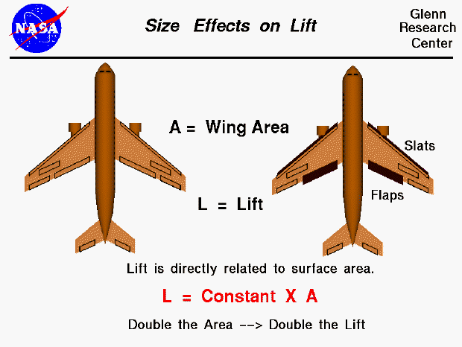
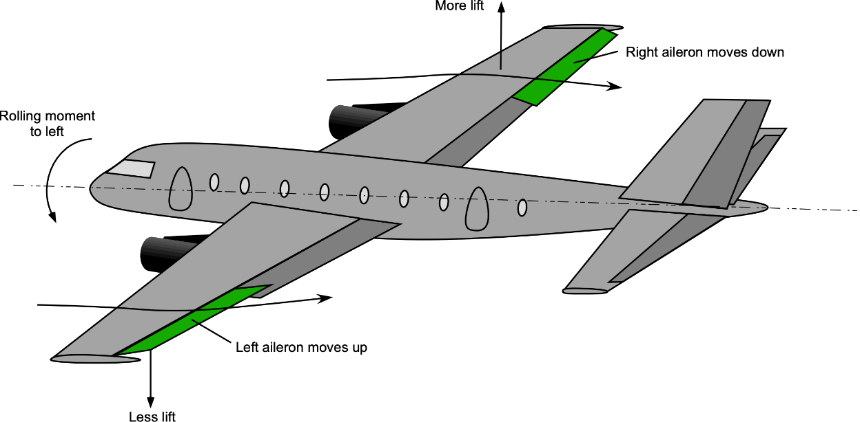
Common constraint types
Unconstrained optimization does not apply any constraints to the parameters, and any parameter configuration in the search space is possible.
In many problems, pure unconstrained optimisation will lead to unhelpful results (-- which might be true but impossible to construct).
"the airplane will get the best lift if the wing is two hundred miles long"

Slide 30
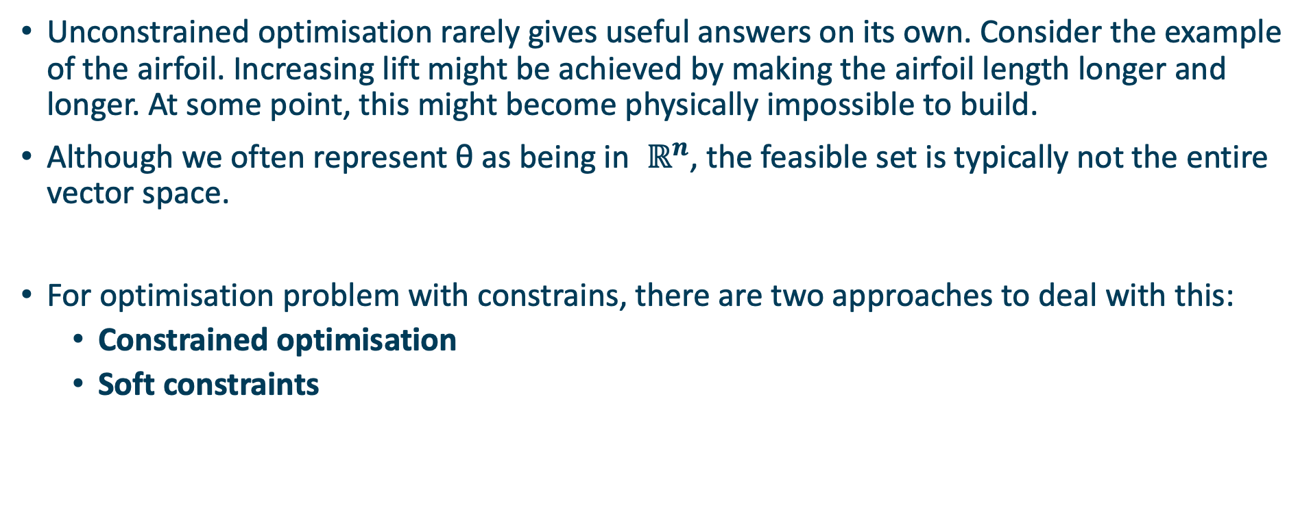
Constraints and penalties
Unconstrained optimisation rarely gives useful answers on its own. Consider the example of the airfoil. Increasing lift might be achieved by making the airfoil length longer and longer. At some point, this might become physically impossible to build.
Although we often represent θ as being in $ℝ^{n}$, the feasible set is typically not the entire vector space.
For optimisation problem with constrains, there are two approaches to deal with this:
Constrained optimisation
Soft constraints

Slide 31
Hard constraints
Use an optimisation algorithm that supports hard constraints inherently.
This is straightforward for certain kinds of optimisation, but trickier for general optimisation.
Typically, constraints will be specified as either a convex region or a simple (hyper)rectangular region of the space (a box constraint).
Pros:
Guarantees that solution will satisfy constraints.
May be able to use constraints to speed up optimisation.
Cons:
may be less efficient than unconstrained optimization (convexity).
Fewer algorithms available for optimisation.
may be hard to specify feasible region with the parameters available in the optimiser.

Slide 32
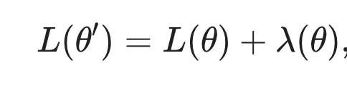
Soft constraints
Apply penalties to the objective function to "discourage" solutions that violate the constraints:
where λ(θ) is a penalty function with an increasing value as the constraints are more egregiously violated.
This is particularly appropriate if the constraints really are soft (it doesn't perhaps matter if the maximum airfoil length is 1.5m or 1.6m, but it can't be 10m).
In this case, the penalties are just terms added to the objective function. The optimiser stays the same, but the objective function is modified.
Pros
any optimiser can be used
can deal with soft constraints sensibly
Cons:
may not respect important constraints, particularly if they are very sharp
can be hard to formulate constraints as penalties
cannot take advantage of efficient search in constrained regions of space

Slide 33
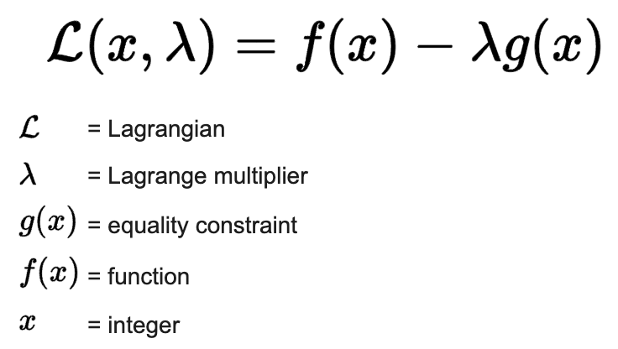
Relaxation of objective functions
Penalisation
Terms which augment an objective function to minimise some other property of the solution, typically to approximate constrained optimisation.
Relaxation
approximation of a difficult problem by a nearby problem that is easier to solve.
E.g., A linear programming relaxation of an integer programming problem removes the integrality constraint and so allows non-integer rational solutions
Lagrange multipliers:
A Lagrangian relaxation of a complicated problem
in combinatorial optimization penalizes violations
of some constraints, allowing an easier relaxed problem to be solved.

Slide 34
Properties of optimisation
Every optimisation problem has two parts:
Parameters, the things that can be adjusted.
Objective function, which measures how good a particular set of parameters are.
An optimisation problem usually also has:
Constraints, that define the feasible set of parameters.
The objective function is a function of the parameters which returns a single scalar value, representing how good that parameter set is.

Slide 35
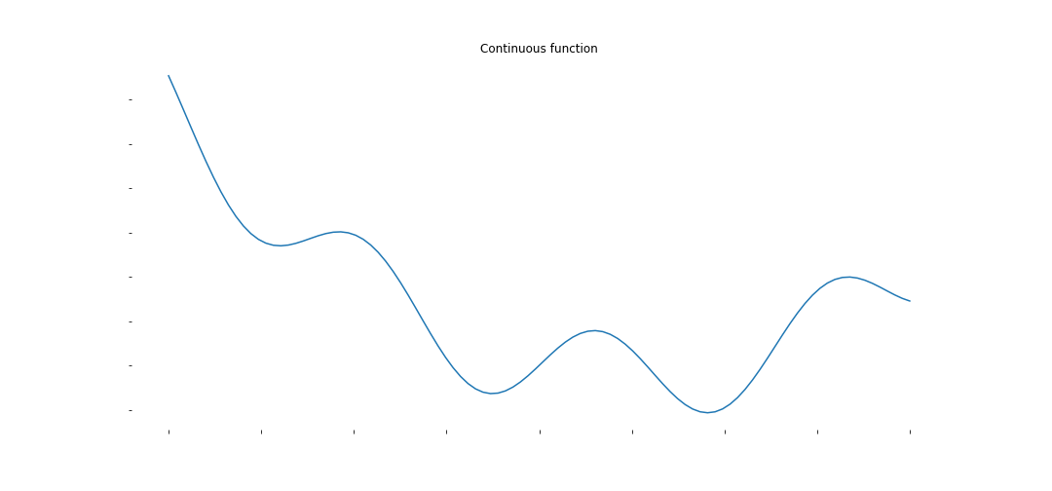
Properties of the objective function: Continuity
An objective function is continuous if for some very small adjustment to θ there is an arbitrarily small change in L(θ). This means that there will never be "nasty surprises" if we move slowly enough through the space of θ; no sudden jumps in value.

Slide 36
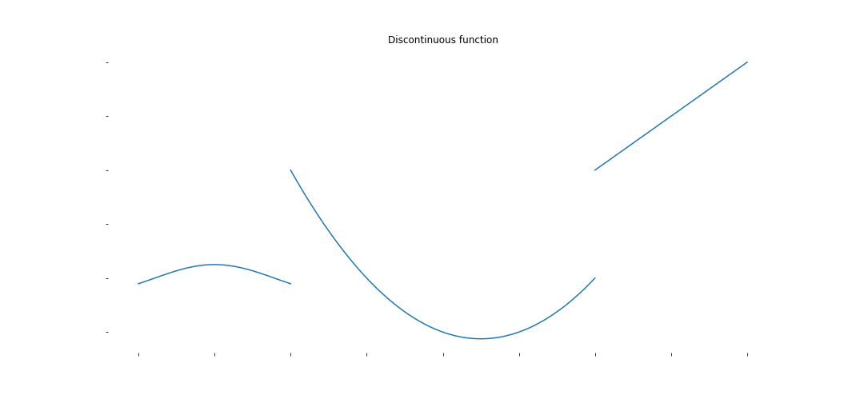
Continuity
If a function is discontinuous, local search methods are not guaranteed to converge to a solution.
Optimisation for discontinuous objective functions is typically much harder than for continuous functions. This is because there could be arbitrary changes in the objective function for any adjustment to the parameters.

Slide 37
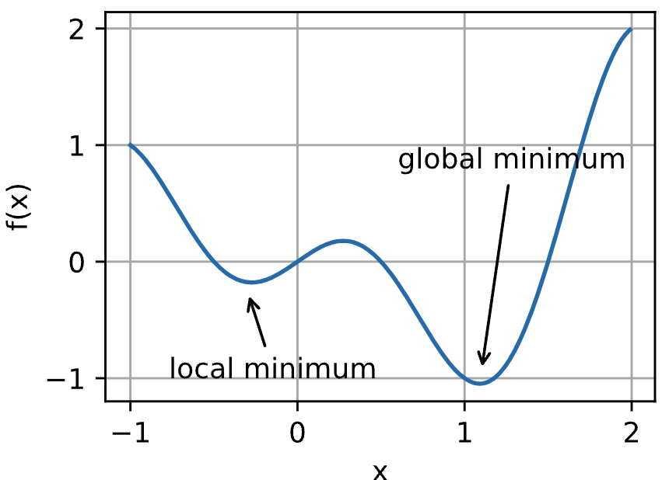
Properties of the objective function: Local and global minima
Local Minima is any point where the objective functions increases in every direction around that point (that parameter setting).
Global Minima is the smallest overall value of a set, function, etc., over its entire range.
Iteration optimisation may only minimize the objective function locally, rather than globally, as the gradient of the objective function’s solutions approaches or becomes zero (vanish). (will be covered later)

Slide 38
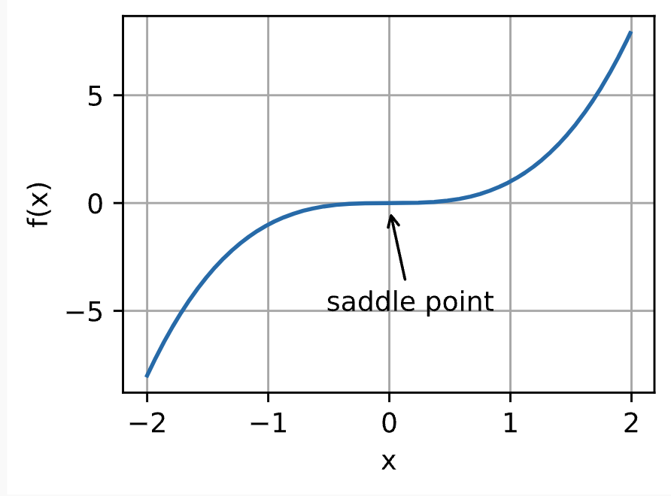
Properties of the objective function: Saddle points
Besides local minima, saddle points are another reason for gradients to vanish.
A saddle point is any location where all gradients of a function vanish but which is neither a global nor a local minimum.

Slide 39
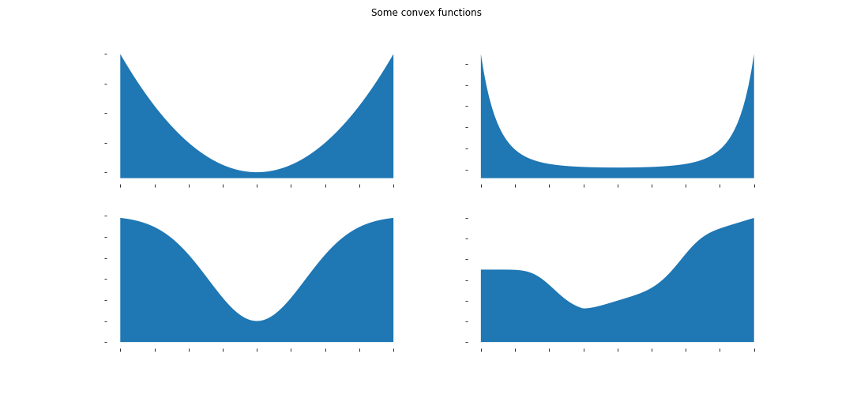
Properties of the objective function: Convexity
Convexity implies that finding any minimum is equivalent to finding the global minimum -- the guaranteed best possible solution.
In a convex problem, if we find a minimum, we can stop searching. If we can show there is no minimum, we can also stop searching.

Slide 40
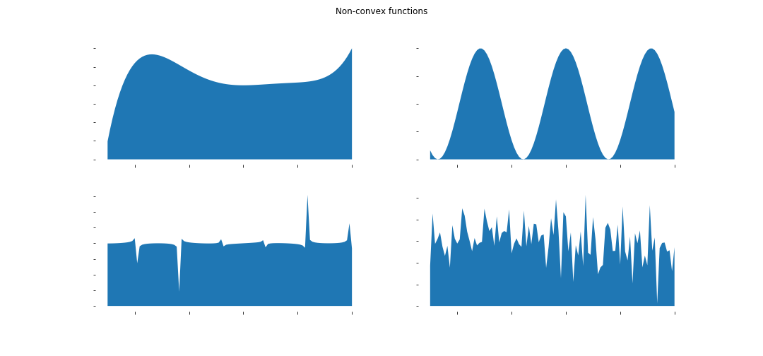
Properties of the objective function: Convexity
Convexity implies that finding any minimum is equivalent to finding the global minimum -- the guaranteed best possible solution.
In a convex problem, if we find a minimum, we can stop searching. If we can show there is no minimum, we can also stop searching.

Slide 41
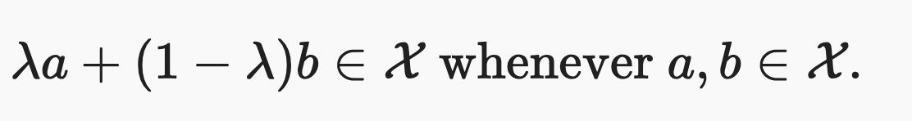
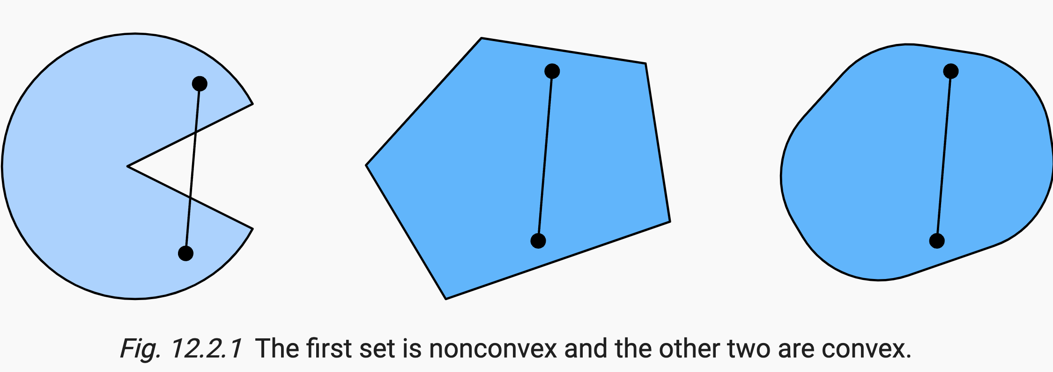
Convexity
Convex Sets
Simply put, a set X in a vector space is convex if for ANY a,b∈X the line segment connecting a and b is also in X. In mathematical terms this means that for all λ∈[0,1] we have

Slide 42
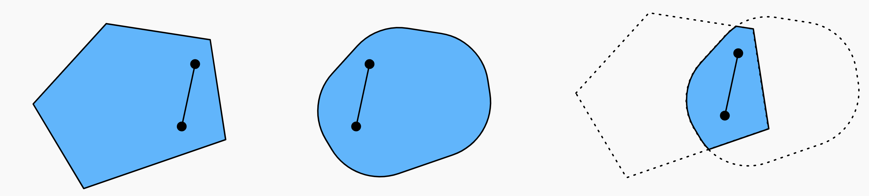
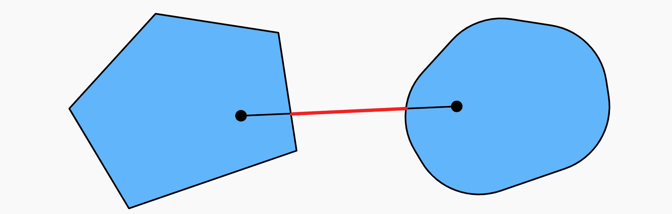
Convexity
The intersection between two convex sets is convex.
The union of two convex sets need not be convex.

Slide 43
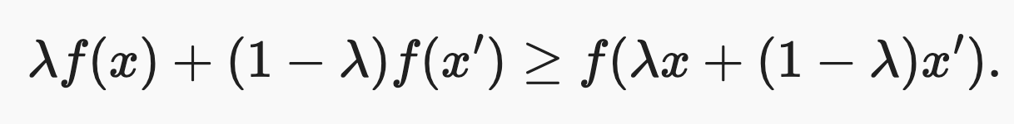
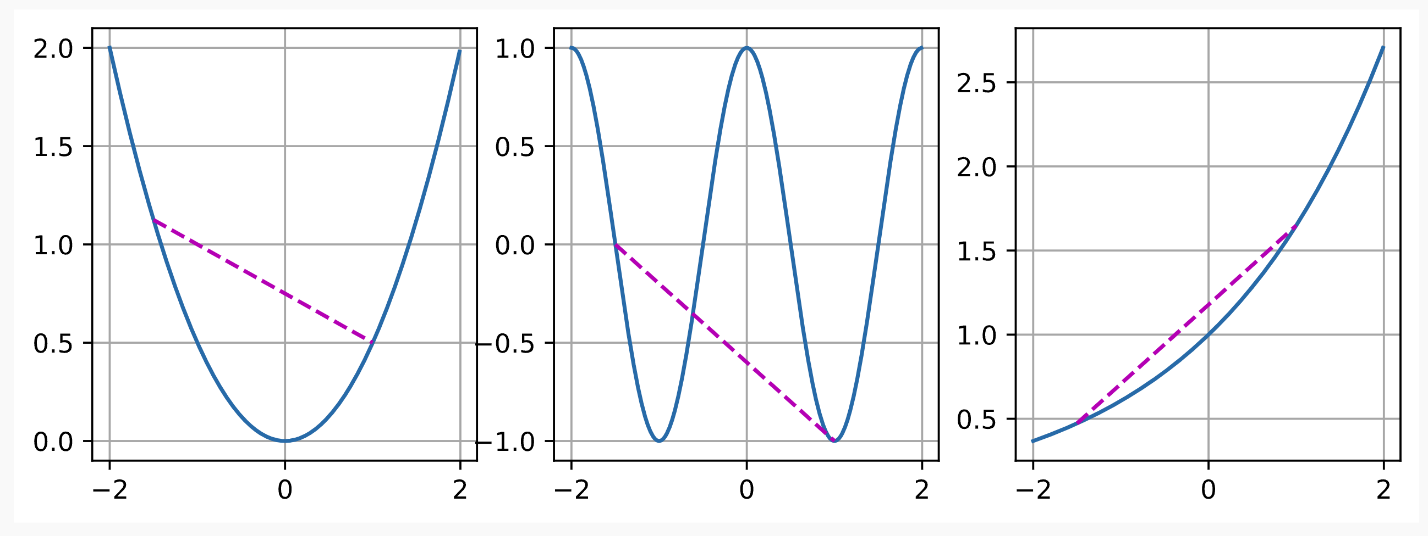
Convexity
Convex Functions
Now that we have convex sets we can introduce convex functions f. Given a convex set X, a function f:X→R is convex if for all x,x′∈X and for all λ∈[0,1] we have

Slide 44
Properties of the Convex functions
P1. Local Minima Are Global Minima
We can prove it by contradiction, see: https://d2l.ai/chapter_optimization/convexity.html.
It means that if we minimize functions we cannot “get stuck”.
Note, though, that this does not mean that there cannot be more than one global minimum or that there might even exist one. (A line)

Slide 45
Convex optimisation
If the objective function is convex and any constraints form convex portions of the search space, then the problem is convex optimisation.
Methods:
Linear Programming (scipy.optimize.linprog):
Objective function and constraints are linear.
Example: Maximising profit given resource constraints.
Quadratic Programming (supported by scipy.optimize.minimize):
Quadratic objective function with linear constraints.
Example: Portfolio optimisation where risk is minimised given expected returns.
Specialised Cases:
Semi-Quadratic Programming: Involves semi-definite constraints.
Quadratically Constrained Quadratic Program: Quadratic objective and quadratic constraints.
Example: Optimal control problems in engineering.
Nonconvex problems require the use of iterative optimisation methods

Slide 46
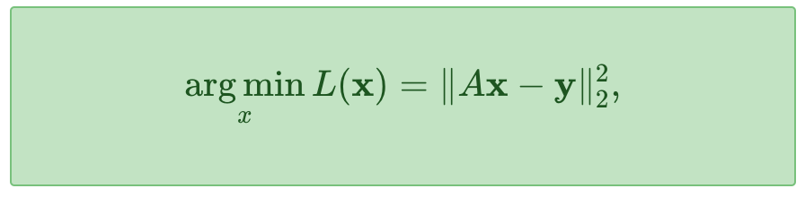
Example: Linear Least Squares
An example is linear least squares, which solves objective functions of the form:
It finds x that is closest to the solution Ax=y in the sense of minimising the squared L2 norm. The squaring of the norm just makes the algebra easier to derive.
This equation is convex -- it is a quadratic function and even in multiple dimensions it must have a single, global minimum, which can be found directly.
Quadratic functions only ever have zero or one minimum.

Slide 47

Direct convex optimisation: least squares
Direct Solution：normal equations methods
Optimal: Ax=y
Notes:
symmetric matrix

Slide 48


Example - normal equations methods
Given
Use normal equations methods to solve the below optimization task:
Hint

Slide 49






Example - normal equations methods
Solution

Slide 50

Application: Line fitting

Slide 51


Application: Line fitting
We will examine this process for the simplest possible linear regression example: finding gradient m and offset c for the line equation：
such that the squared distance to a set of observed (x,y) data points is minimised.
This is a search over the θ=[m,c] space, and the objective function is:

Slide 52

Application: Line fitting
This is a search over the θ=[m,c] space, and the objective function is:
We can solve this directly using the pseudo-inverse via the SVD. This is a problem that can be solved directly in one step.

Slide 53
Non-convex loss: Iterative optimisation
If the loss is not convex, we do not have algorithms that give us a direct solution, we need to use iterative optimisation
Iterative optimisation involves making a series of steps in parameter space.
There is a current parameter vector (or collection of them) which is adjusted at each iteration, hopefully decreasing the objective function, until optimisation terminates after some termination criteria have been met.
Iterative optimisation algorithm:
choose a starting point x_0
while objective function changing
adjust parameters
evaluate objective function
if better solution found than any so far, record it
return best parameter set found

Slide 54

Iterative optimisation - grid search
Regular search: grid search
The parameter space is simply sampled by equally dividing the feasible set in each dimension, usually with a fixed number of divisions per dimension.
The objective function is evaluated at each θ on this grid, and the lowest loss θ found so far is tracked.

Slide 55

Iterative optimisation - grid search
Revenge of the curse of dimensionality
While this is fine in 1D (just check 8 points) and 2D (just check 64 points), it breaks down completely if you have a 100 dimensional parameter space. This would need:
8**100 = 2037035976334486086268445688409378161051468393665936250636140449354381299763336706183397376
evaluations of the objective function!

Slide 56
Iterative optimisation - grid search
Pros
Works for any continuous parameter space.
Requires no knowledge of the objective function.
Trivial to implement.
Cons
Incredibly inefficient
Must specify search space bounds in advance.
Highly biased to finding things near the "early corners" of the space.
We need better optimisation algorithms for larger problems!

Slide 57
Iterative optimisation - Simple stochastic: random search
The simplest such algorithm, which makes no assumptions other than we can draw random samples from the parameter space, is random search.
The process is simple:
Guess a random parameter θ
Check the objective function L(θ)
If L(θ)<L(θ∗) (the previous best parameter θ∗), set θ∗=θ
There are many possibilities for a termination condition, such as stopping after a certain number of iterations after the last change in the best loss.

Slide 58
Iterative optimisation - Simple stochastic: random search
Pros
Random search cannot get trapped in local minima, because it uses no local structure to guide the search.
Requires no knowledge of the structure of the objective function - not even a topology.
Very simple to implement.
Better than grid search, almost always.
Cons
Extremely inefficient and is usually only appropriate if there is no other mathematical structure to exploit.
Must be possible to randomly sample from the parameter space (usually not a problem, though).
Results do not necessarily get better over time. Best result might be found in the first step or a million steps later. There is no way to predict how the optimisation will proceed.

Slide 59
Meta-heuristics
There are a number of standard meta-heuristics than can be used to improve random search.
These are:
Locality which takes advantage of the fact the objective function is likely to have similar values for similar parameter configurations. This assumes continuity of the objective function.
Temperature which can change the rate of movement in the parameter space over the course of an optimisation. This assumes the existence of local optima.
Population which can track multiple simultaneous parameter configurations and select/mix among them.
Memory which can record good or bad steps in the past and avoid/revisit them.

Slide 60

Using locality - Hill climbing
Hill climbing: local search
Hill climbing is a modification of random search which assumes some topology of the parameter space, so that there is a meaningful concept of a neighbourhood of a parameter vector; that we can make incremental changes to it.
Simple hill climbing adjusts just one of the parameter vector elements at a time, examining each "direction" in turn, and taking a step if it improves things.
Stochastic hill climbing makes a random adjustment to the parameter vector, then either accepts or rejects the step depending on whether the result is an improvement.

Slide 61

Using locality - Hill climbing
Pros
Not much more complicated than random search
Can be much faster than random search
Cons
Hard to choose how much of an adjustment to make
Can get stuck in minima
Struggles with objective function regions that are relatively flat
Requires that the objective function be (approximately) continuous

Slide 62

Locality + Temperature: Simulated annealing
Simulated annealing extends hill-climbing with the ability to sometimes randomly go uphill, instead of always going downhill.
It uses a temperature schedule that allows more uphill steps at the start of the optimisation and fewer ones later in the process. This is used to overcome ridges and avoid getting stuck in local minima.
It allowing random "bad jumps" early in a
process can help find a better overall
configuration.
Image: hill climbing would get stuck in the local minimum at the left. Simulated annealing would sometimes accept "bad" local changes to ride over hills and get to a better minimum.

Slide 63
Locality + Temperature: Simulated annealing
The "temperature schedule" comes from the idea of annealing metals.
Molten metals have molecules bouncing around all over the place. As they cool, the random bouncing gets smaller and smaller as the molecules lock together into a tight lattice. Fast cooling results in less well structured metals than slow cooling.
Simulated annealing searching for a maximum. The objective here is to get to the highest point. In this example, it is not enough to use a simple hill climb algorithm, as there are many local maxima. By cooling the temperature slowly the global maximum is found.

Slide 64
Population - Genetic Algorithms
Another nature-inspired variant of random search is to use a population of multiple competing potential solutions, and to apply some analogue of evolution to solving optimisation. This involves some of:
mutation (introducing random variation)
natural selection (solution selection)
breeding (interchange between solutions)
This class of algorithms are often called genetic algorithms for obvious reasons.

Slide 65
Genetic Algorithms
All genetic algorithms maintain some population of potential solutions (a set of vectors θ1,θ2,θ3,…), and some rule which is used to preserve some members of the population and cull others.
The parameter set is referred to as the genotype of a solution.
Simple population approaches
small random perturbations and a simple selection rule like "keep the top 25% of solutions, ordered by loss".
Each iteration will perturb the solutions slightly by random mutation, cull the weakest solutions, then copy the remaining "fittest" solutions a number of times to produce the offspring for the next step. (random local search with population)

Slide 66

Genetic Algorithms - crossover
Crossover rules
crossover "merges" two possible parameter vectors θmum and θdad to form a new child parameter θbaby
Crossover works well when the parameter vector can be partitioned into distinct components, where offspring can plausibly inherit good qualities from both parents.
It works less well when the crossover simply becomes a mishmash of parent qualities which average out.
Image: The 2006 NASA ST5 spacecraft antenna. This complicated shape was found by an evolutionary computer design program to create the best radiation pattern. Source: Wikipedia, public domain

Slide 67
Genetic algorithm
Animation from Flexible Muscle-Based Locomotion for Bipedal Creatures Geijtenbeek, T., van de Panne, M. & Stappen, A.F. van der (2013)

Slide 68
Genetic Algorithms
Pros
Easy to understand and applicable to many problems.
Requires only weak knowledge of the objective function
Can be applied to problems with both discrete and continuous components.
Some robustness against local minima, although hard to control.
Great flexibility in parameterisation: mutation schemes, crossover schemes, fitness functions, selection functions, etc.
Cons
Many, many "hyperparameters" to tune which radically affect the performance of the optimisation. How should you choose them?
No guarantee of convergence; ad hoc.
(Very) slow compared to using stronger knowledge of the objective function.
Many evaluations of objective function are required: one per population member per iteration.

Slide 69

Memory+Population: Ant Colony Optimisation
Ant colony optimisation combines memory and population heuristics. It uses the idea of stigmergy to optimise problems:
stigmergy: A mechanism of spontaneous, indirect coordination between agents or actions, where the trace left in the environment by an action stimulates the performance of a subsequent action. [wiktionary.org]

Slide 70

Ant Colony Optimisation
In terms of optimisation this means:
having a population of parameter sets ("ants")
having a memory of good paths through the space ("pheromones")
ACO is particularly well suited to path-finding and route-finding algorithms, where the memory structure of the pheromone trail corresponds to the solution structure.
Notes:
Ants who find good parts of the space (i.e. low objective function) leave a trail of positive "pheromones", by storing marker vectors. Other ants will move towards those pheromones, and eventually follow paths that lead to good solutions. Over time (i.e. as iterations increase), the pheromones evaporate so that the ants don't get constrained into one tiny part of the space. Instead of using the physical environment, we use auxiliary data structures to memorise good paths through the parameter space, to avoid repetitious searching.

Slide 71
Ant Colony Optimisation
Pros
Can be very effective in spaces where good solutions are separated by large, narrow valleys.
Can use fewer evaluations of the objective function than genetic algorithm if pheromones are effective.
When it works, it really works.
Cons
Moderately complex algorithm to implement.
No guarantee of convergence; ad hoc.
Even more hyperparameters than genetic algorithms.
People think you work with ants.

Slide 72
Quality of optimisation
Convergence
An optimisation algorithm is said to converge to a solution.
In convex optimisation, this means that the global minimum has been found and the problem is solved. In non-convex optimisation, this means a local minimum has been found from which the algorithm cannot escape.
Guarantees of convergence
Some optimisation algorithms are guaranteed to converge if a solution exists; while others (like most heuristic optimisation algorithms) are not guaranteed to converge even if the problem has a solution.
For example, a random search might wander the space of possibilities forever, never finding the specific configuration that minimises (or even reduces) the loss.

Slide 73
Use the right algorithm
Best case
If you know the problem is least-squares use a specialised least-squares solver. You might be able to solve directly, for example with the pseudo-inverse.
If you know the problem is convex, use a convex solver. This is radically more efficient than any other choice if its applicable.
If you know the derivatives of the objective function, or can compute them using automatic differentiation, use a first-order method (or second order, if you can) – next week’s topic!
If you don't know any of these things, use a general-purpose zeroth-order solver like simulated annealing or a genetic algorithm.
Worst case

Slide 74

Thank you for you attention! Contact: Nicolas.Pugeault@Glasgow.ac.uk

