Slide 1

Introduction to Data Science and Systems
Lecture 5: Optimisation II
Dr Nicolas Pugeault

Slide 2
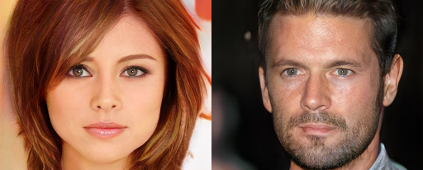
Deep neural networks

Slide 3
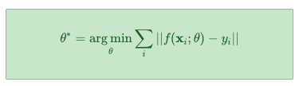
Deep neural networks
Deep learning or deep neural networks have become a major part of modern machine learning research.
They have had astonishing success in fields like speech recognition, machine translation, image classification and image synthesis.
The basic problem of deep learning is one of finding an approximating function.

Slide 4

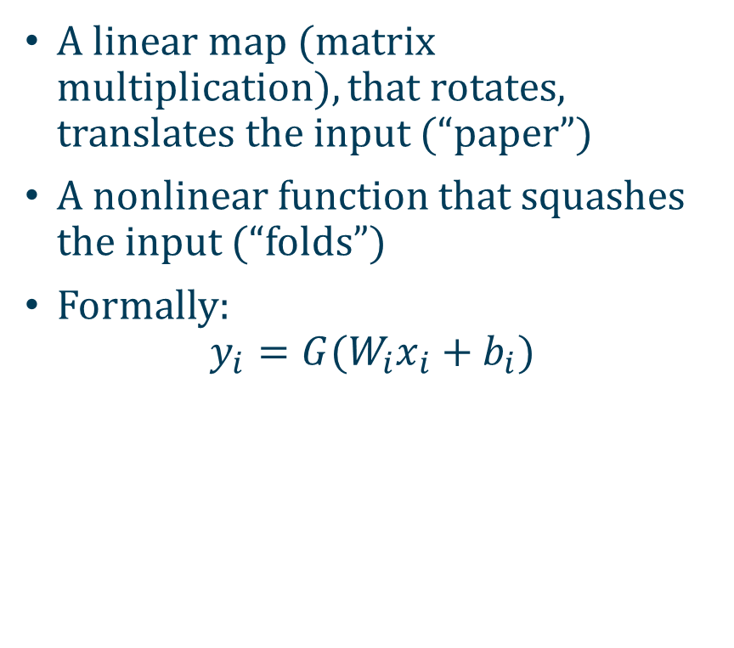
Deep Neural Networks as Origami
A linear map (matrix multiplication), that rotates, translates the input (“paper”)
A nonlinear function that squashes the input (“folds”)
Formally:
$$y_{i}=G(W_{i}x_{i}+b_{i})$$

Slide 5
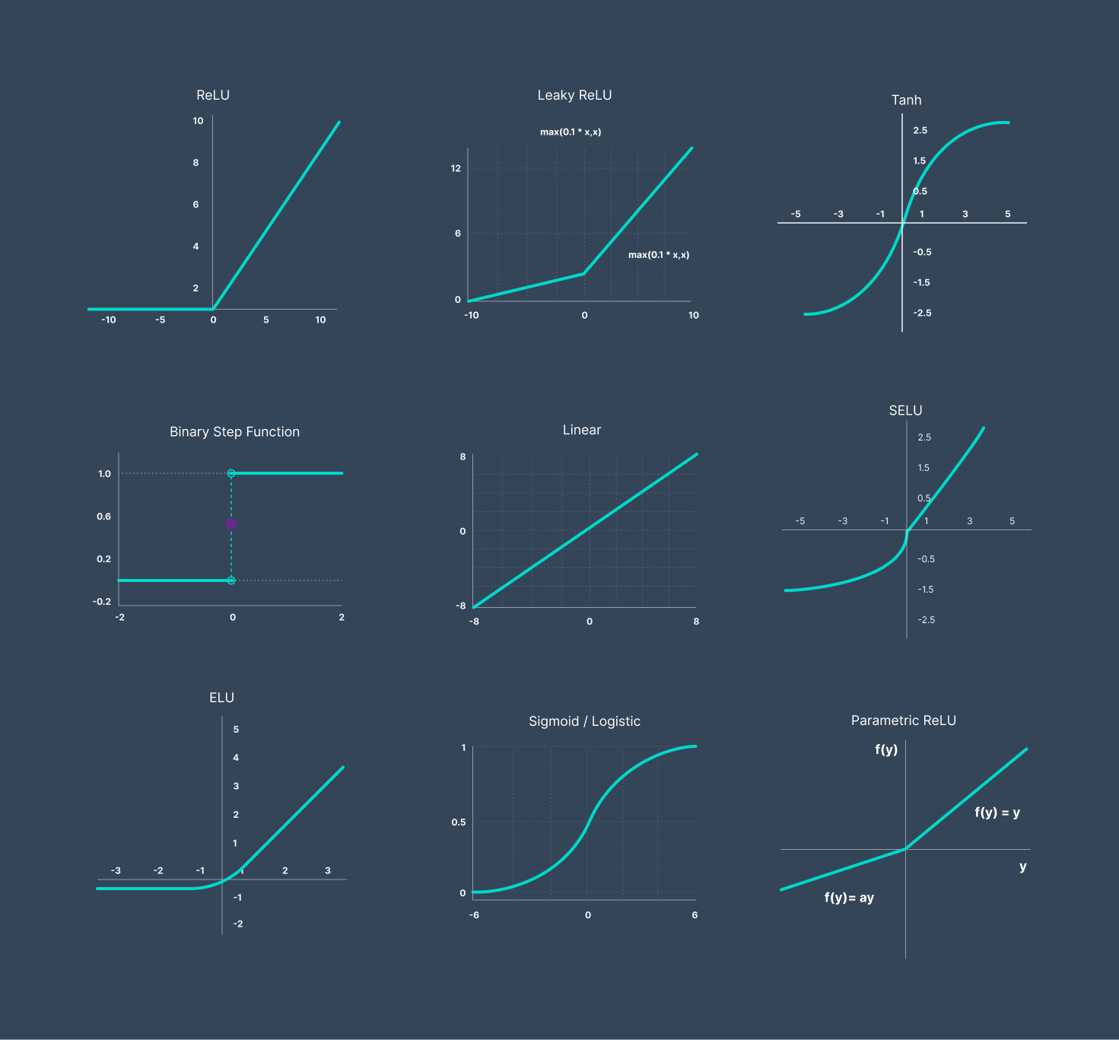
Activation function
nonlinear (activation) function G(x)
nonlinear functions are essential in neural networks because they allow the network to model complex, real-world data by introducing nonlinearity.
Without them, a neural network would be limited to solving simple linear problems, no matter how deep or wide the network is.

Slide 6
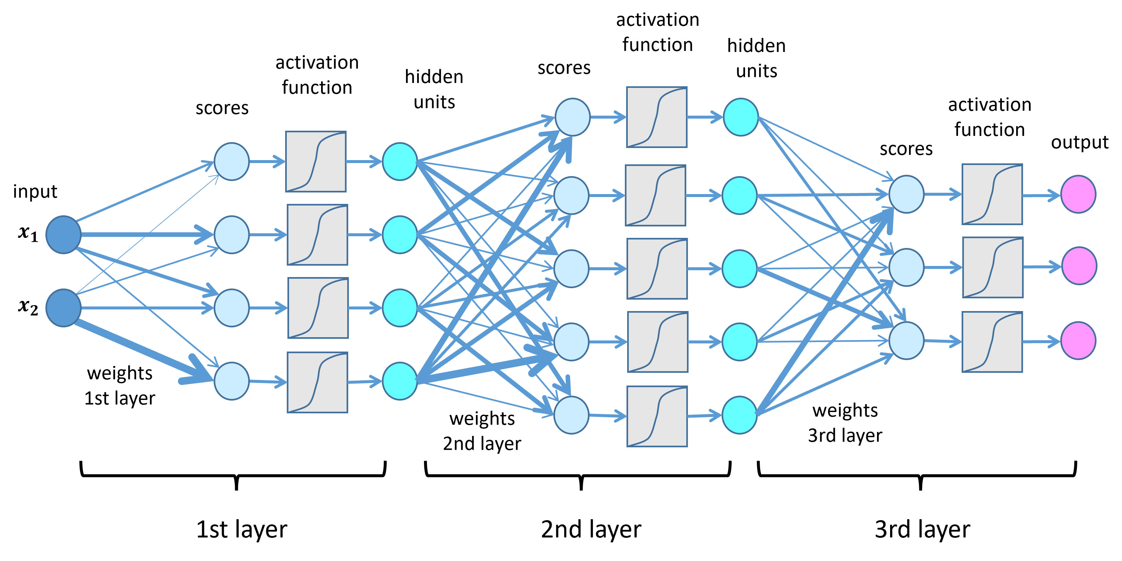

A 3-layer deep neural network (DNN)
DNN: $f\left(g\left(h\left(x\right)\right)\right)$
[x1,x2]
[o1,o2,o3]
h(x1,x2)
g(h1,h2,h3,h4)
f(g1,g2,g3,g4,g5)

Slide 7
Why not use heuristic search?
Heuristic search methods like random search, simulated annealing and genetic algorithms are easy to understand, easy to implement and have few restrictions on the problems they can be applied to. However …
They can be very slow; it may take many iterations to approach a minimum and require significant computation to compute each iteration.
There is no guarantee of convergence, or even of progress. The search can get stuck, or drift slowly over plateaus.
There are a huge number of hyperparameters that can be tweaked (temperature schedules, size of population, memory structure, etc.). How should these be chosen? Optimal choice of these parameters becomes an optimisation problem in itself.

Slide 8
Why not use heuristic search?
For optimisation problems like deep neural networks, heuristic search is hopelessly inadequate. -- 1000b parameters
Instead, first-order optimisation is applied.
First-order algorithms, that we will discuss today, can be orders of magnitude faster than heuristic search.
Gravity applies a force perpendicular to the plane of the surface. The surface applies a force to the ball along the direction of the surface normal, the vector that points "straight out" from the surface. This results in a force component in the direction of the steepest slope of the surface, accelerating the ball in that direction

Slide 9
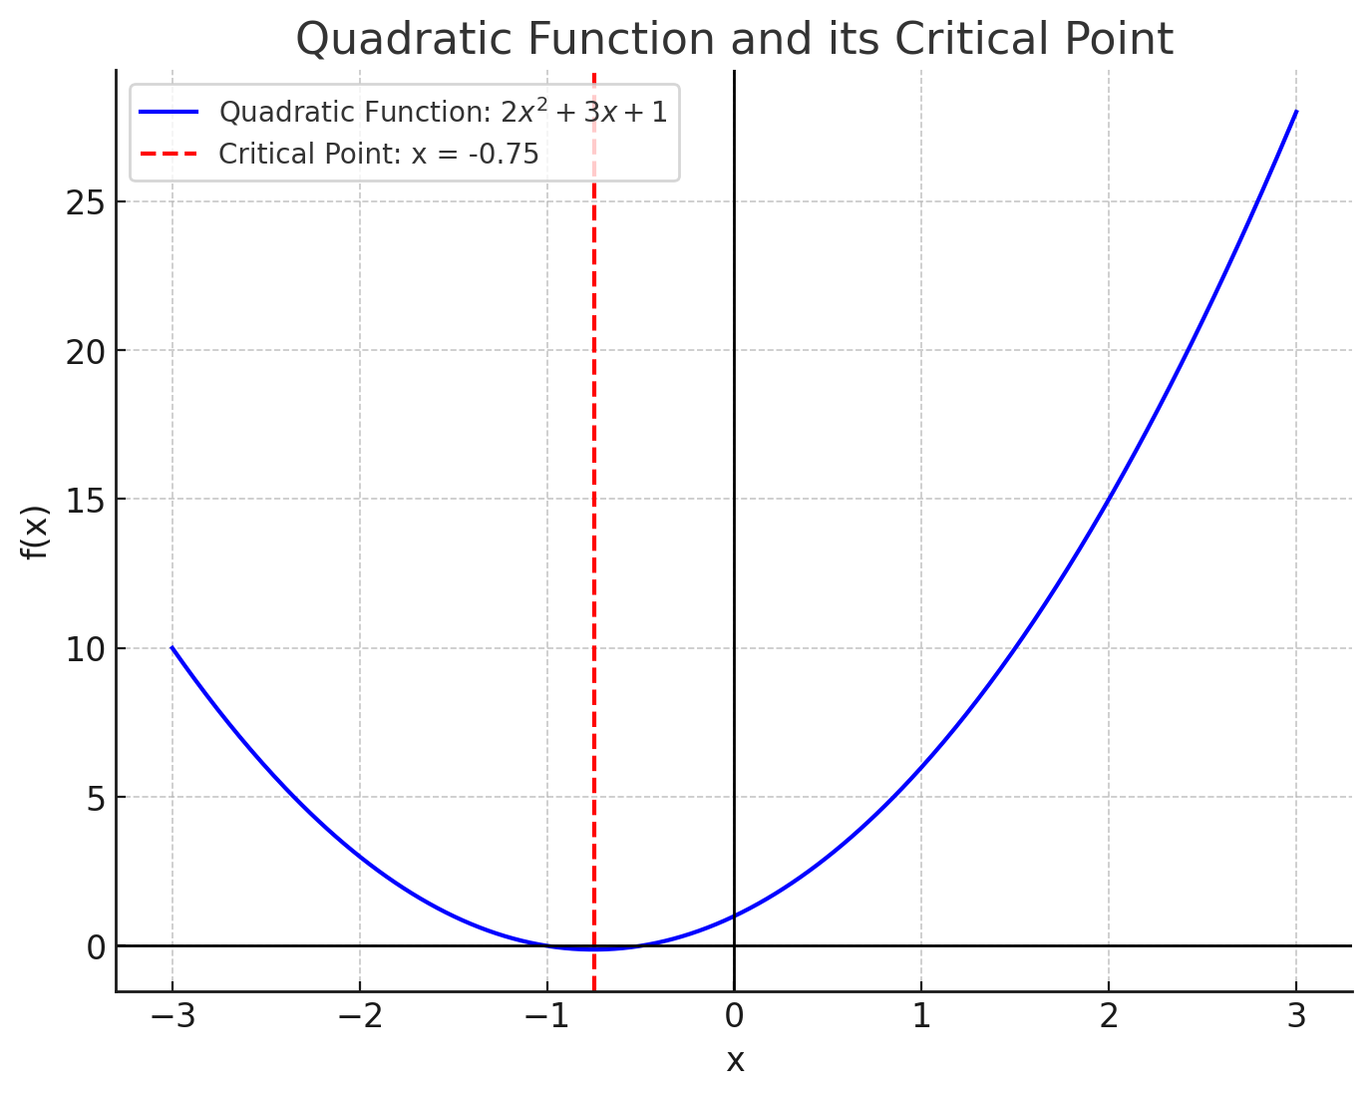
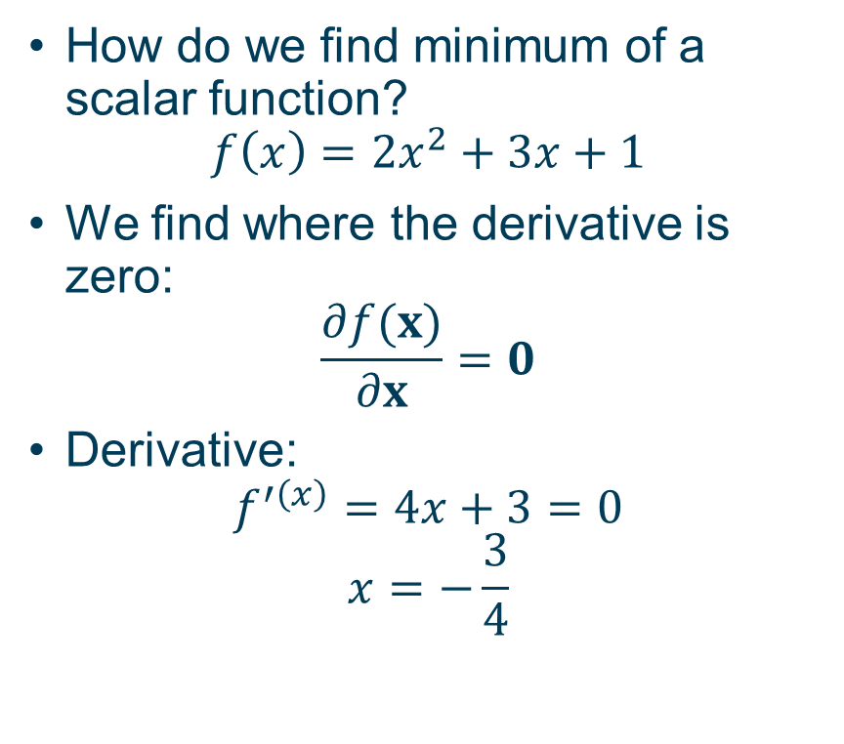
The derivative of a scalar function
How do we find minimum of a scalar function?
$$f\left(x\right)=2x^{2}+3x+1$$
We find where the derivative is zero:
$$\frac{∂f(x)}{∂x}=0$$
Derivative:
$$f^{′\left(x\right)}=4x+3=0$$
$$x=−\frac{3}{4}$$

Slide 10
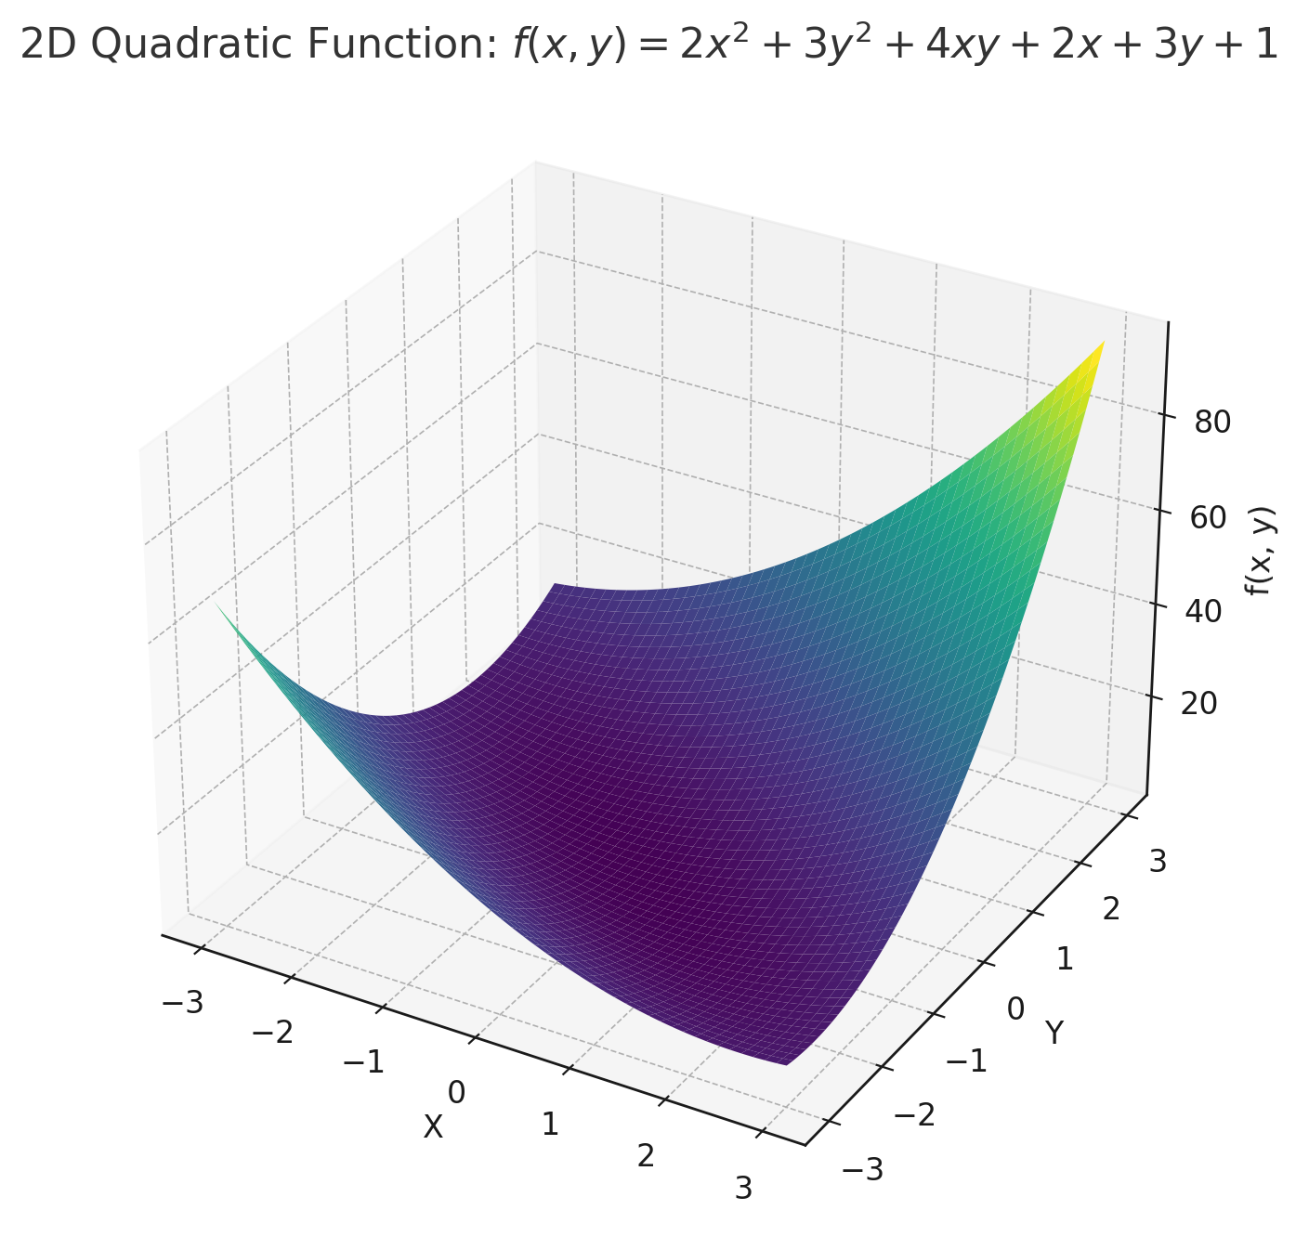
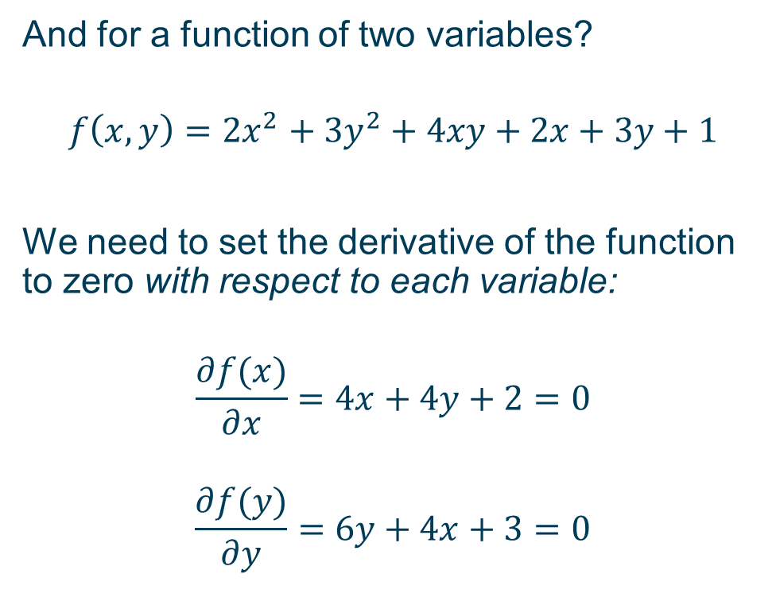
The derivative of a scalar function
And for a function of two variables?
$$f\left(x,y\right)=2x^{2}+3y^{2}+4xy+2x+3y+1$$
We need to set the derivative of the function to zero with respect to each variable:
$$\frac{∂f(x)}{∂x}=4x+4y+2=0$$
$$\frac{∂f(y)}{∂y}=6y+4x+3=0$$

Slide 11
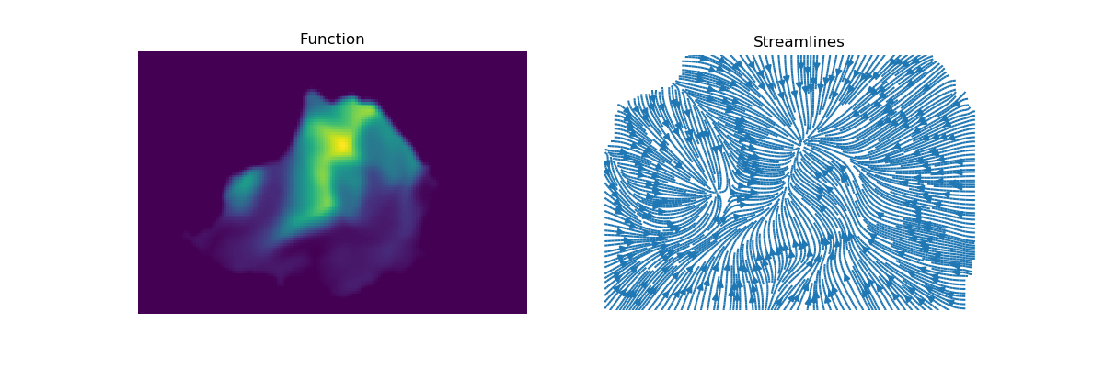
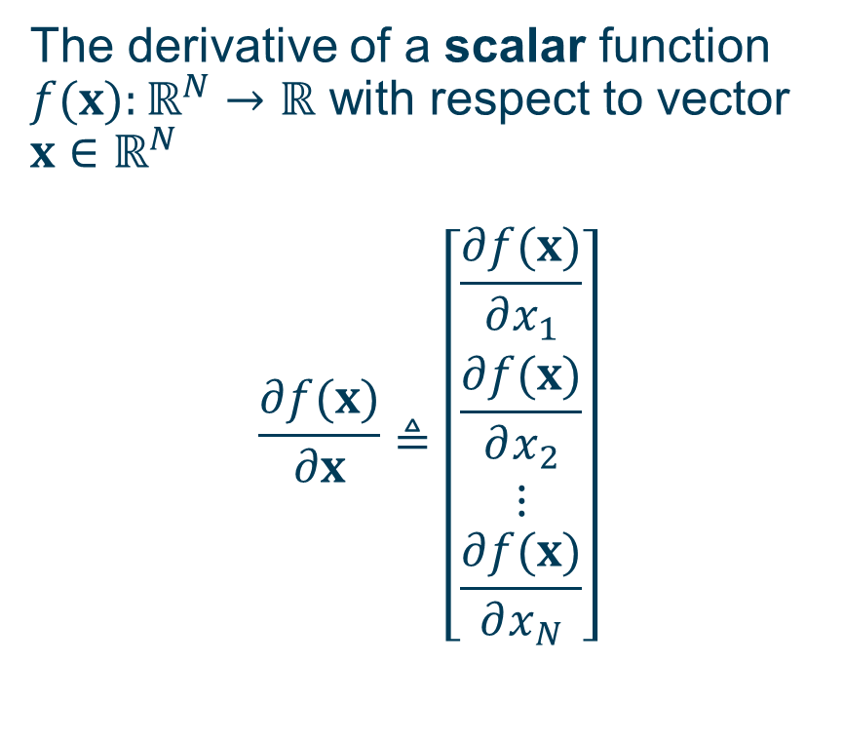
The derivative of a scalar function
The derivative of a scalar function $f(x):ℝ^{N}→ℝ$ with respect to vector $x∈ℝ^{N}$
$$\frac{∂f(x)}{∂x}≜\left[\begin{matrix}\frac{∂f(x)}{∂x_{1}} \\ \frac{∂f(x)}{∂x_{2}} \\ ⋮ \\ \frac{∂f(x)}{∂x_{N}}\end{matrix}\right]$$

Slide 12


The derivative of a scalar function
Derivative of a vector function $f\left(x\right):ℝ^{N}→ℝ^{M}$ with respect to vector $x∈ℝ^{N}$.
$$\frac{∂f\left(x\right)}{∂x}≜\left[\begin{matrix}\frac{∂f\left(x\right)}{∂x_{1}} \\ \frac{∂f\left(x\right)}{∂x_{2}} \\ ⋮ \\ \frac{∂f\left(x\right)}{∂x_{N}}\end{matrix}\right]=\left[\begin{matrix}\frac{∂f_{1}\left(x\right)}{∂x_{1}} & \frac{∂f_{2}\left(x\right)}{∂x_{1}} & … & \frac{∂f_{M}\left(x\right)}{∂x_{1}} \\ \frac{∂f_{1}\left(x\right)}{∂x_{2}} & \frac{∂f_{2}\left(x\right)}{∂x_{2}} & … & \frac{∂f_{M}\left(x\right)}{∂x_{2}} \\ ⋮ & ⋮ & ⋮ & ⋮ \\ \frac{∂f_{1}\left(x\right)}{∂x_{N}} & \frac{∂f_{2}\left(x\right)}{∂x_{N}} & … & \frac{∂f_{M}\left(x\right)}{∂x_{N}}\end{matrix}\right]$$

Slide 13
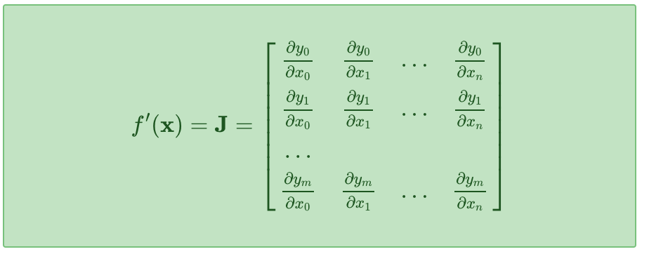
Jacobian: matrix of derivatives
We can collect this derivative information into a matrix called the Jacobian matrix, which characterises the slope at a specific point x.
This simply tells us how much each component of the output changes as we change any component of the input -- the generalised "slope" of a vector-valued function.

Slide 14

Gradient vector: one row of the Jacobian
∇f(x) is the gradient vector of a (scalar) function of a vector, the equivalent of the first derivative for vector functions.
This tells us how much f(x) would vary if we made tiny changes to each dimension independently.
We will work with scalar objective functions L(θ) of parameter vectors θ.
∇L(θ) is a vector which points in the direction of the steepest change in L(θ).

Slide 15
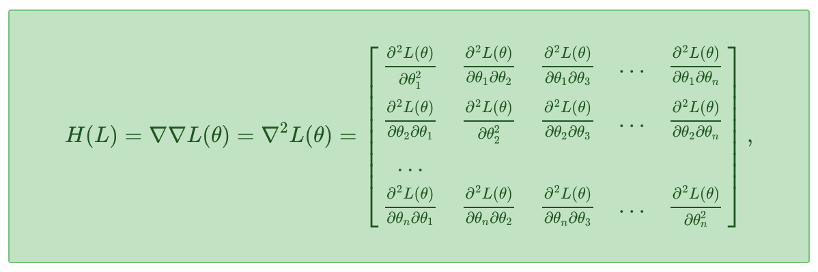

Hessian: Jacobian of the gradient vector
$∇^{2}L(θ)$ is the Hessian matrix of a (scalar) function of a vector, the equivalent of the second derivative for vector functions.
Following our rule above, it's just the Jacobian of a vector valued function, so we know:
$∇^{2}L(θ)$ is matrix valued map $ℝ^{n}→ℝ^{n×n}$

Slide 16
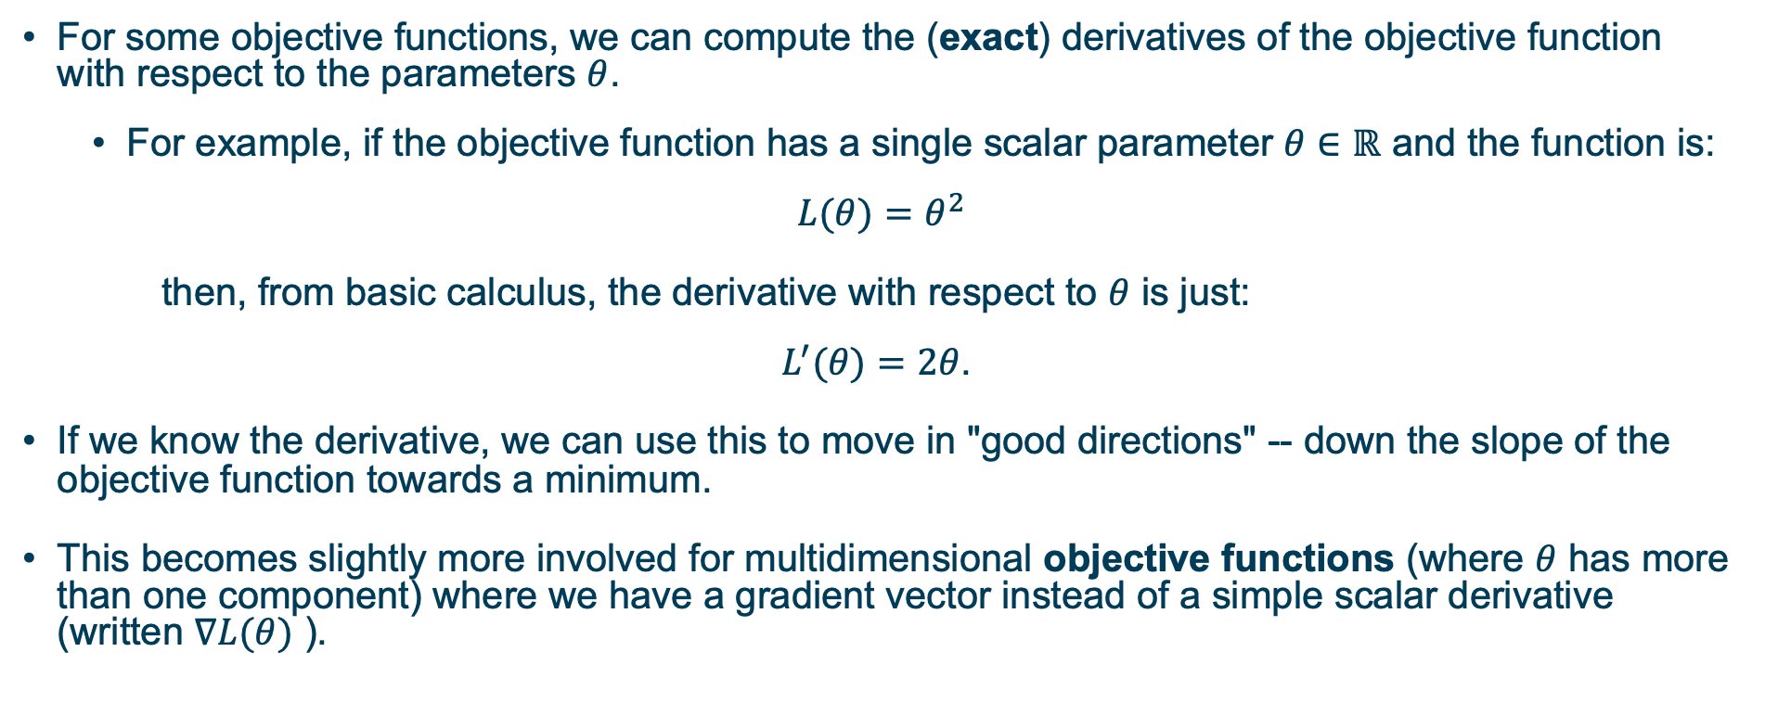
Differentiable objective functions
For some objective functions, we can compute the (exact) derivatives of the objective function with respect to the parameters $θ$.
For example, if the objective function has a single scalar parameter $θ∈ℝ$ and the function is:
$$L(θ)=θ^{2}$$
then, from basic calculus, the derivative with respect to $θ$ is just:
$$L^{′}(θ)=2θ\text{.}$$
If we know the derivative, we can use this to move in "good directions" -- down the slope of the objective function towards a minimum.
This becomes slightly more involved for multidimensional objective functions (where $θ$ has more than one component) where we have a gradient vector instead of a simple scalar derivative (written $∇L(θ)$ ).

Slide 17
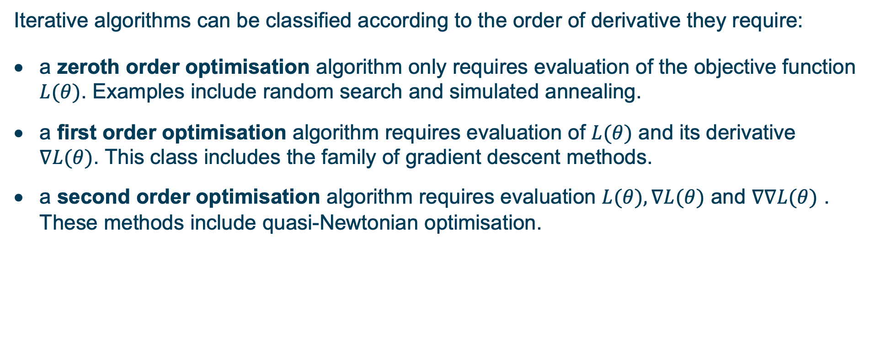
Orders: zeroth, first, second
Iterative algorithms can be classified according to the order of derivative they require:
a zeroth order optimisation algorithm only requires evaluation of the objective function $L(θ)$. Examples include random search and simulated annealing.
a first order optimisation algorithm requires evaluation of $L(θ)$ and its derivative $∇L(θ)$. This class includes the family of gradient descent methods.
a second order optimisation algorithm requires evaluation $L(θ),∇L(θ)$ and $∇∇L(θ)$ . These methods include quasi-Newtonian optimisation.

Slide 18
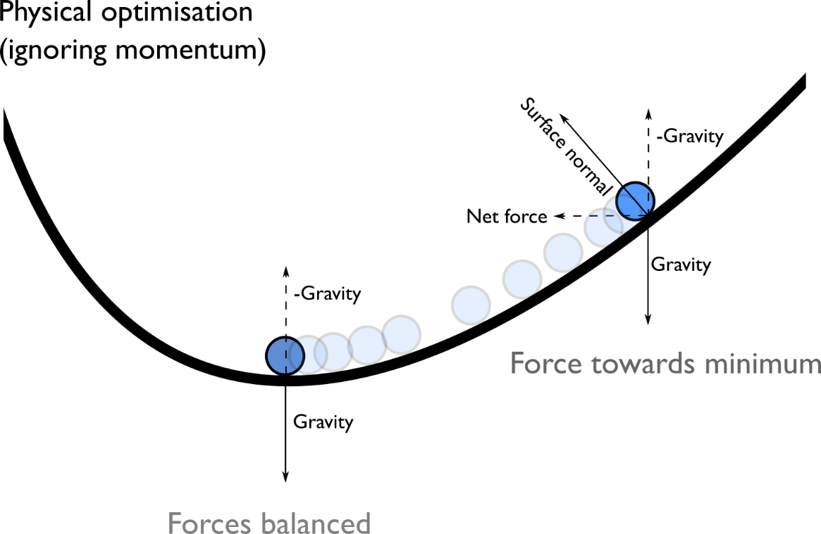
Optimisation with derivatives
If we know (or can compute) the gradient an objective function, we know the slope of the function at any given point. This gives us both:
the direction of fastest increase and
the steepness of that slope.
This is the major application of calculus.
Knowing the derivative of the objective function is sufficient to dramatically improve the efficiency of optimisation.
This gradient vector always points in the direction of the steepest slope.

Slide 19
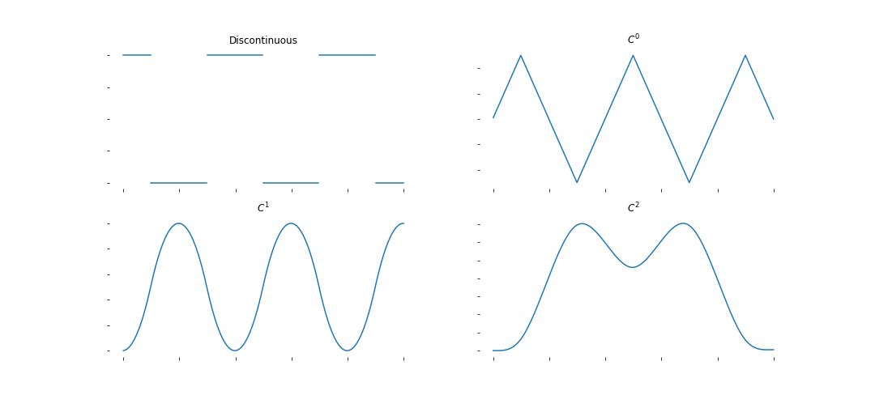
Differentiability
A smooth function has continuous derivatives up to some order. Smoother functions are typically easier to do iterative optimisation on, because small changes in the current approximation are likely to lead to small changes in the objective function.
We say a function is C^{n} continuous if the nth derivative is continuous (smoothness class).
Image: left-to-right, top-to-bottom discontinuous, C0, C1, C2 continuous functions

Slide 20
continuous derivatives vs differentiable
There is a difference between having continuous derivatives and knowing what those derivatives are.
First order optimisation uses the (first) derivatives of the objective function with respect to the parameters. These techniques can only be applied if the objective function is:
At least continuous i.e. no step changes anywhere in the function or its derivative
differentiable (Analytically we can derive the derivative) i.e. gradient is defined everywhere
(though we will see that these constraints can be relaxed a bit in practice).
Many objective functions satisfy these conditions, and first-order methods can be vastly more efficient than zeroth-order methods. For particular classes of functions (e.g. convex) there are known bounds on number of steps required to converge for specific first-order optimizers.

Slide 21
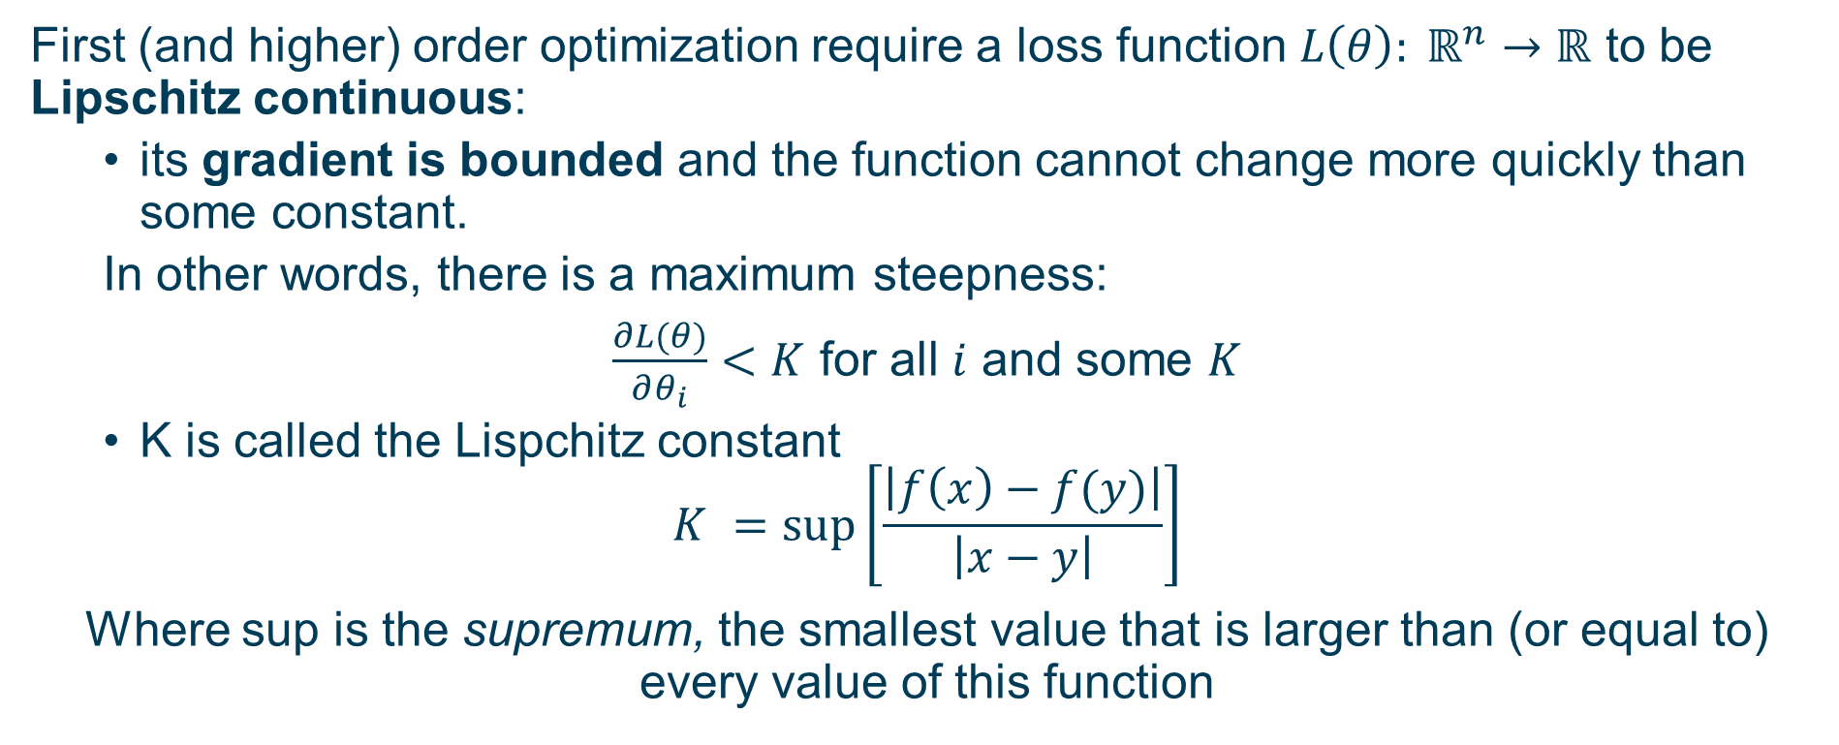
Lipschitz Continuity
First (and higher) order optimization require a loss function $L\left(θ\right): ℝ^{n}→ℝ$ to be Lipschitz continuous:
its gradient is bounded and the function cannot change more quickly than some constant.
In other words, there is a maximum steepness:
$\frac{∂L(θ)}{∂θ_{i}}<K$ for all $i$ and some $K$
K is called the Lispchitz constant
$$K =sup\left[\frac{\left|f\left(x\right)−f(y)\right|}{\left|x−y\right|}\right]$$
Where sup is the supremum, the smallest value that is larger than (or equal to) every value of this function

Slide 22
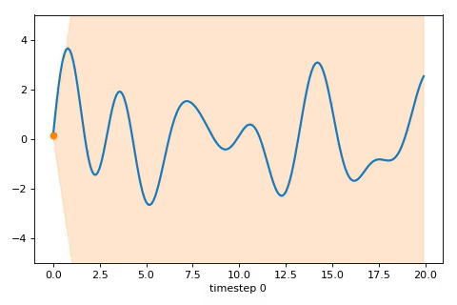
Small Lipschitz constant

Slide 23
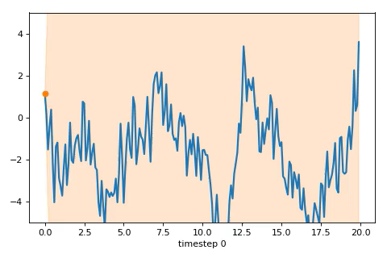
Large Lipschitz constant

Slide 24
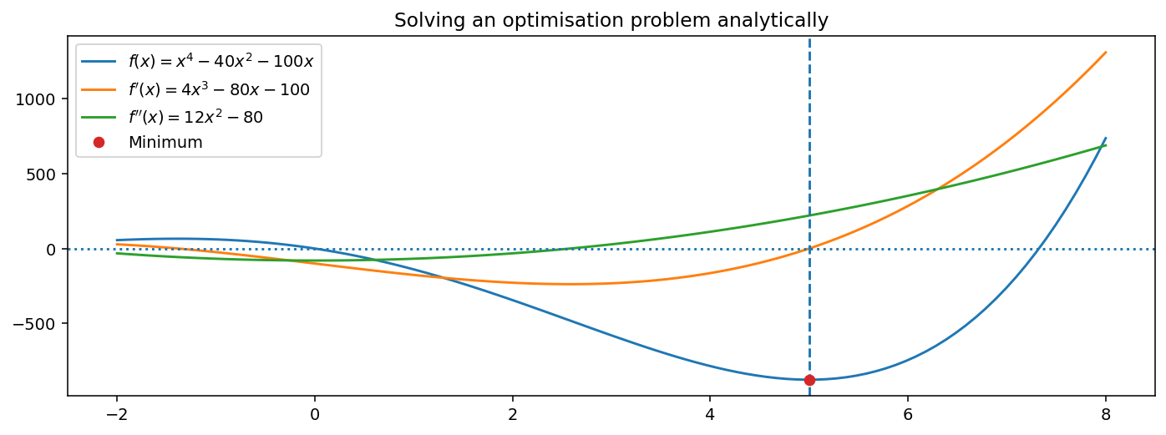
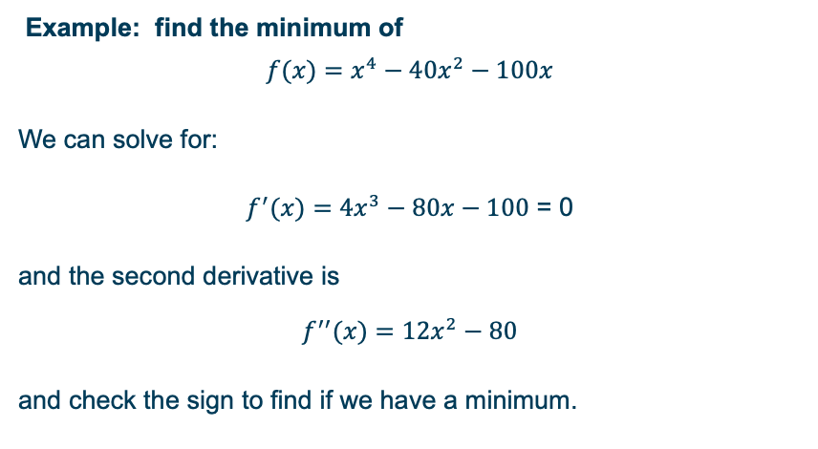
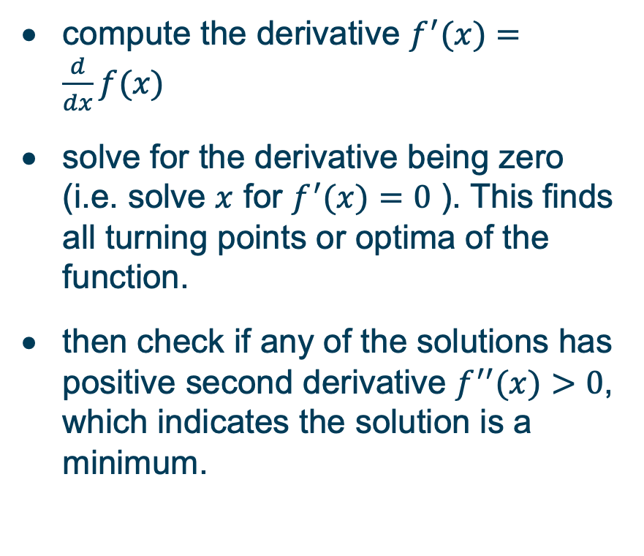
Analytical derivatives
compute the derivative $f^{′}(x)=\frac{d}{dx}f(x)$
solve for the derivative being zero (i.e. solve $x$ for $f^{′}(x)=0$ ). This finds all turning points or optima of the function.
then check if any of the solutions has positive second derivative $f^{′′}(x)>0$, which indicates the solution is a minimum.
Example: find the minimum of
$$f(x)=x^{4}−40x^{2}−100x$$
We can solve for:
$f^{′}(x)=4x^{3}−80x−100$ = 0
and the second derivative is
$$f^{′′}(x)=12x^{2}−80$$
and check the sign to find if we have a minimum.

Slide 25
Gradient : physical optimisation
Considering a ball rolling on a (smooth) surface, which represents the value of the objective function across a 2D domain (i.e. if we had a parameter vector θ with two elements).
Gravity applies a force in the direction of the steepest slope of the surface, accelerating the ball in that direction.
The gradient can be understood by thinking of it as a vector that points in the direction of the steepest ascent (or descent) on a surface representing a function

Slide 26

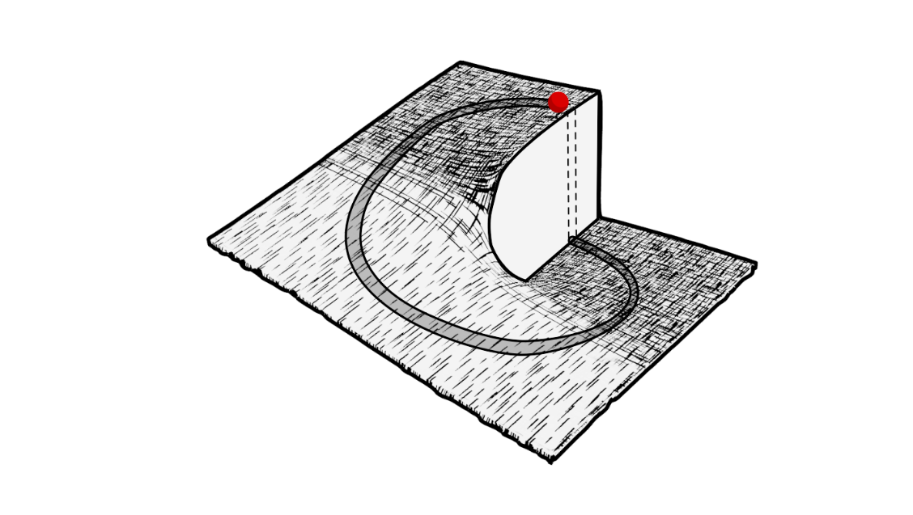
Gradient : physical optimisation
This gradient vector always points in the direction of the steepest slope.
Downhill is not always the shortest route, but can safely find a good local minima

Slide 27

Gradient descent
The basic first-order algorithm is called gradient descent and it is very simple, starting from some initial guess θ⁽⁰⁾:
where δ is a scaling hyperparameter -- the step size. The step size might be fixed, or might be chosen adaptively according to an algorithm like line search.
This means is that the optimiser will make moves where the objective function drops most quickly.

Slide 28
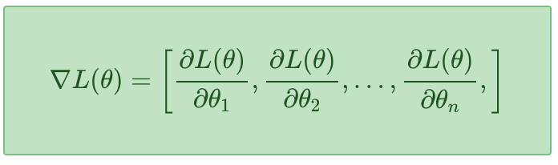
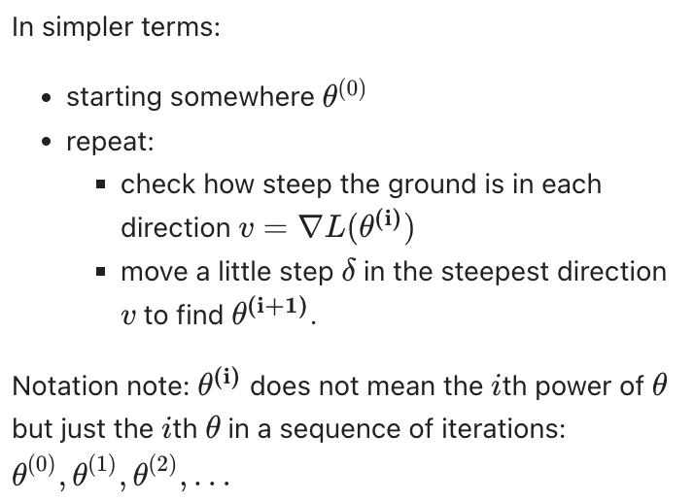
Gradient descent

Slide 29
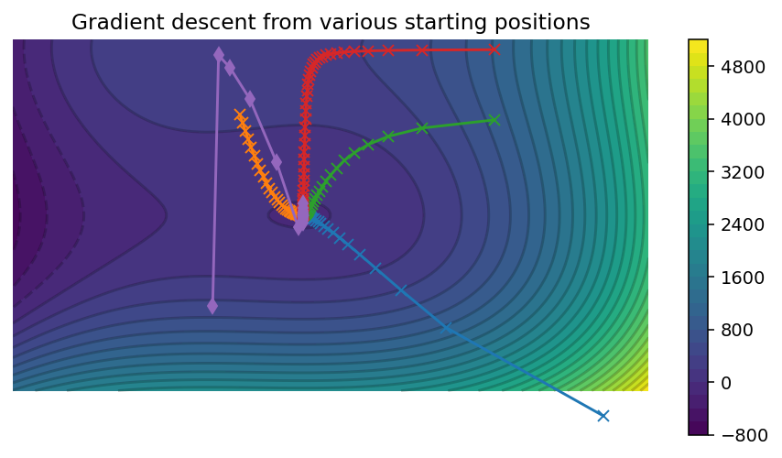
Gradient descent from different initial conditions

Slide 30
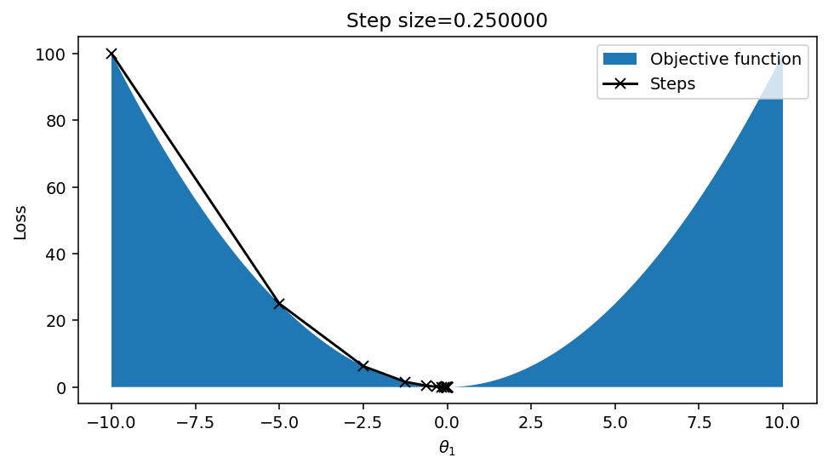
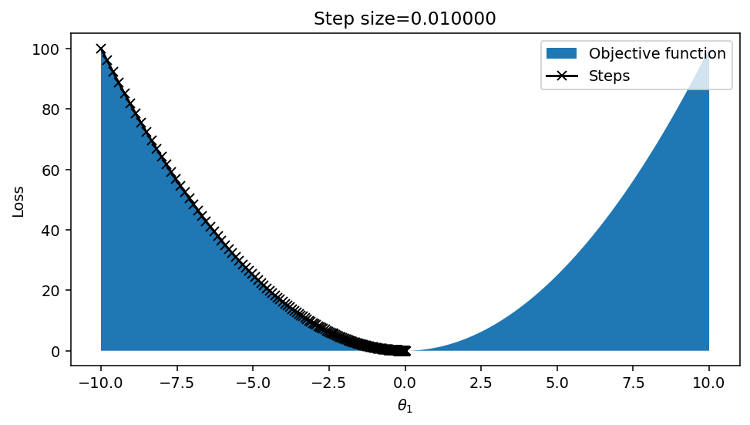
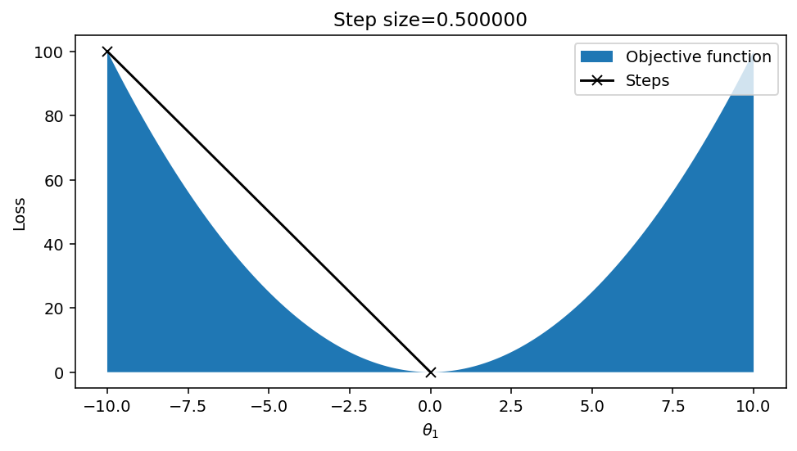
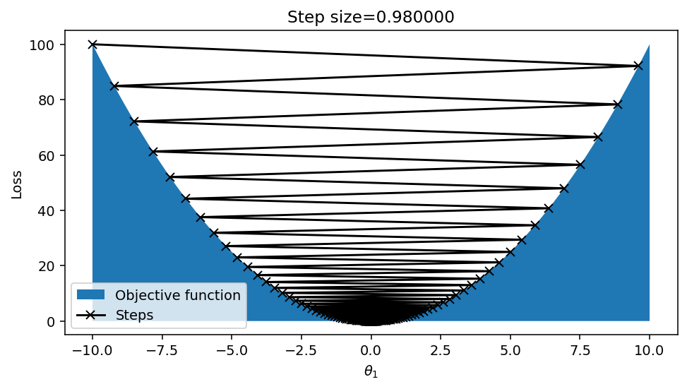
Why step size matters
Converged in 19 steps
、
Converged in 2 steps
Converged in 606 steps
Converged in 301 steps

Slide 31
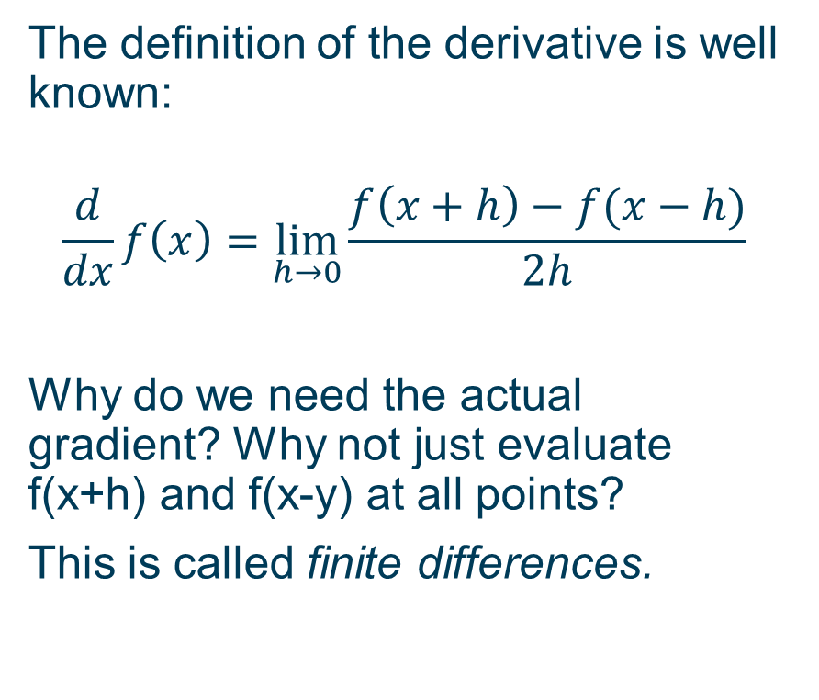
Why not use numerical differences?
The definition of the derivative is well known:
$$\frac{d}{dx}f\left(x\right)=\lim_{h→0}{\frac{f\left(x+h\right)−f(x−h)}{2h}}$$
Why do we need the actual gradient? Why not just evaluate f(x+h) and f(x-y) at all points?
This is called finite differences.

Slide 32
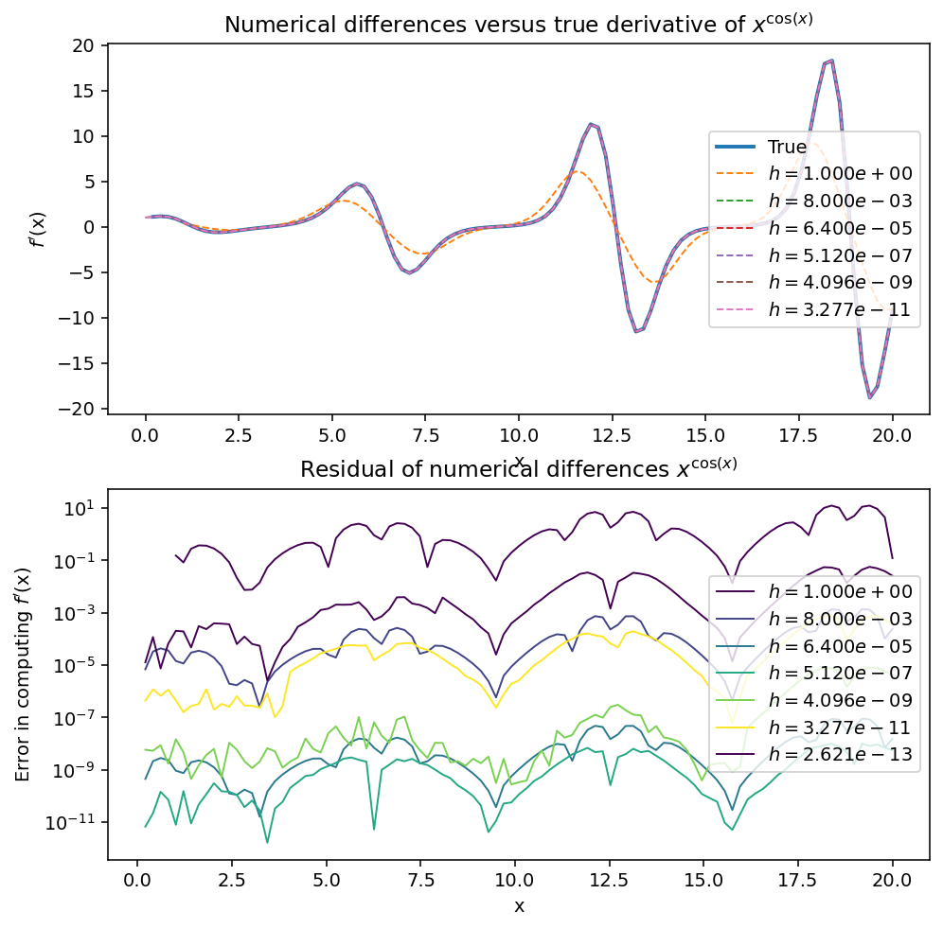
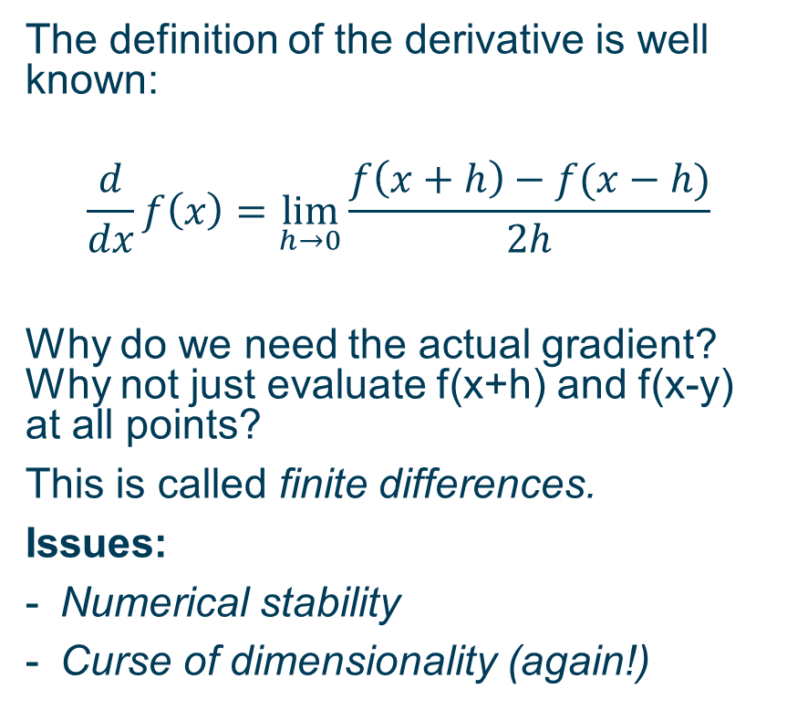
Why not use numerical differences?
The definition of the derivative is well known:
$$\frac{d}{dx}f\left(x\right)=\lim_{h→0}{\frac{f\left(x+h\right)−f(x−h)}{2h}}$$
Why do we need the actual gradient? Why not just evaluate f(x+h) and f(x-y) at all points?
This is called finite differences.
Issues:
Numerical stability
Curse of dimensionality (again!)

Slide 33
Improving gradient descent
The gradient of the loss function L′(θ)=∇L(θ) must be computable at any point θ. Automatic differentiation helps with this.
Gradient descent can get stuck in local minima. This is an inherent aspect of gradient descent methods, which will not find global minima except when the the function is convex and the step size is optimal. Random restart and momentum are approaches to reduce sensitivity to local minima.
Gradient descent only works on smooth, ‘differentiable’ objective functions. Stochastic relaxation introduces randomness to allow very steep functions to be optimised.
Gradient descent can be very slow if the objective function (and/or the gradient) is slow to evaluate. Stochastic gradient descent can massively accelerate optimisation if the objective function can be written as a simple sum of many subproblems.
Gradient descent can be very efficient, and often much better than zeroth-order methods. However, it has drawbacks:

Slide 34
Programming language advances
Vectorised programming
Example: NumPy, eigen, nd4j, J
Provides native operations over tensors, potentially with GPU acceleration.
Differentiable programming
Examples: autograd, JAX, pytorch, tensorflow
Automatically differentiates vectorised code, producing exact derivatives of tensor algorithms.
Probabilistic programming
Examples: pymc, stan, edward, Uber, Pyro, webppl
Allows values to be uncertain, with (tensor, differentiable) random variables as first class values.

Slide 35
The magic behind modern advances in data science
Automatic differentiation can take a function, usually written a subset of a full programming language, and automatically construct a function that evaluates the exact derivative at any given point. This makes it feasible to perform first-order optimisation.
Some of the most common implementations of this technique are in deep learning software packages like TensorFlow, Theano, Torch/PyTorch.
These provide a way of defining a computational graph (implicitly or explicitly) which defines the operations to be performed, and from which the corresponding derivative computation can be derived.
These implementations tend to be focused on the operations used in neural networks, like matrix multiplication and elementwise nonlinear functions, and they tend not to include branching or iteration (or support very limited forms of conditional/looping expressions).

Slide 36
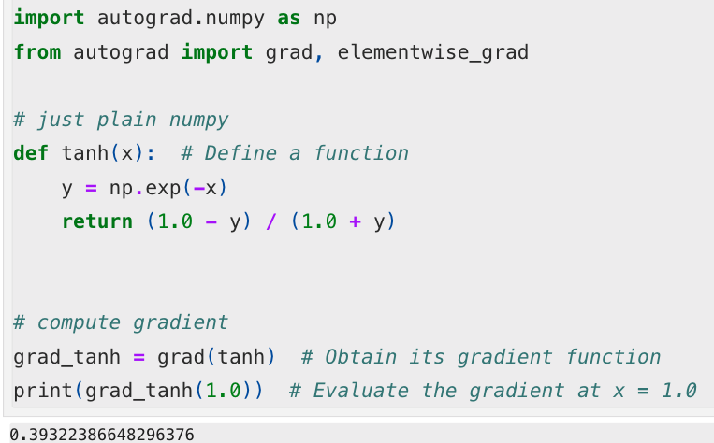
Autograd
Other software, like autograd provides automatic differentiation for virtually any NumPy code. The example below is from the autograd documentation. It is a drop in replacement which just "magically" estimates derivatives (although only some operations are supported).

Slide 37
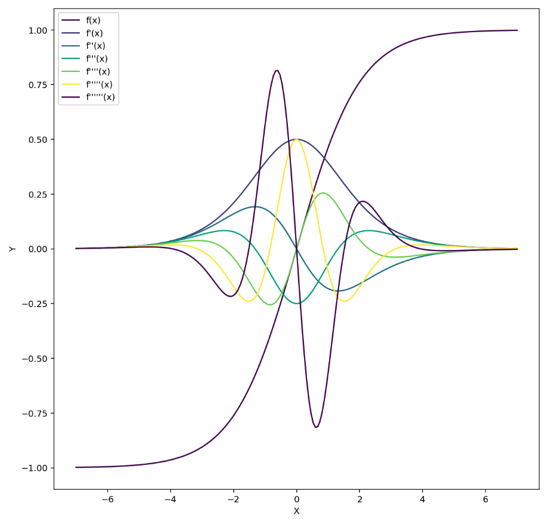
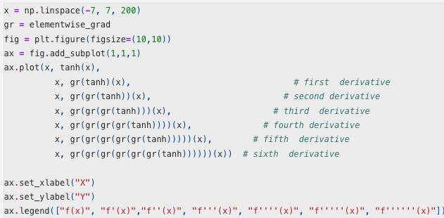
Autograd
Use Autograd

Slide 38
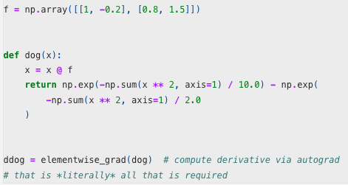
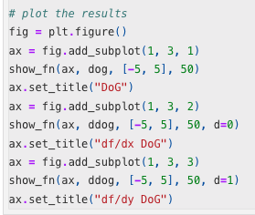
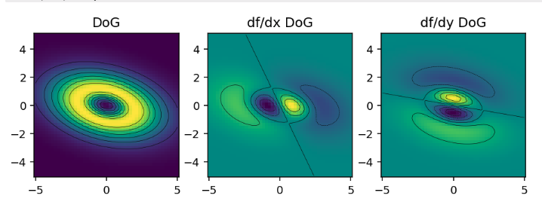
Autograd
Vectorised example

Slide 39
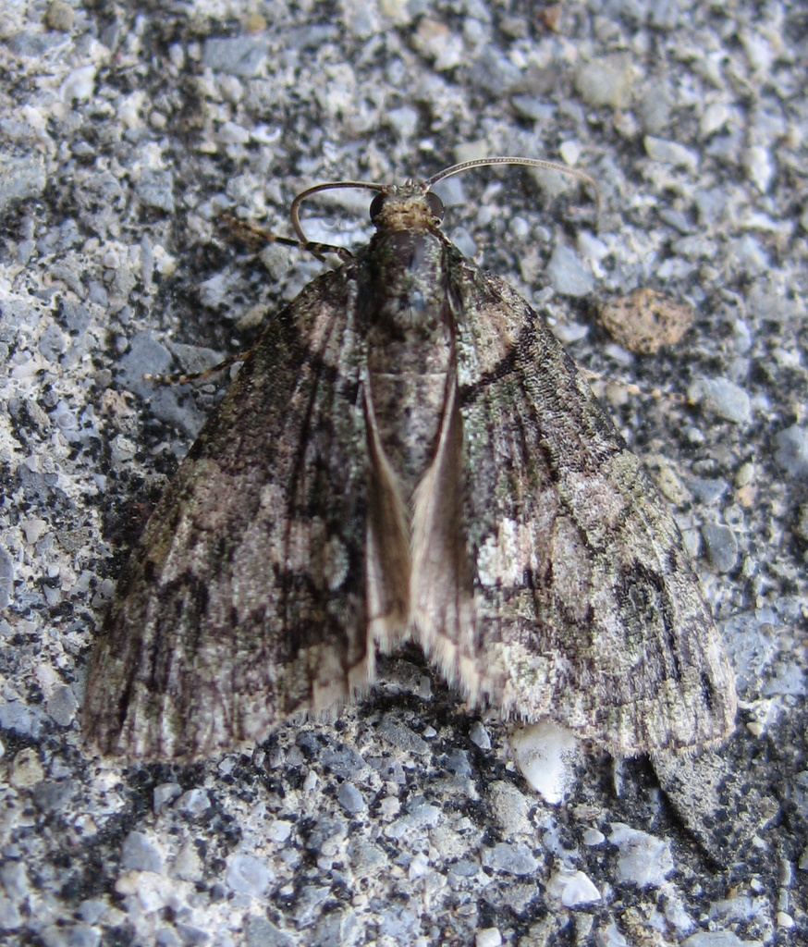
Stochastic relaxation
How do animals evolve camouflage?
It either gets eaten by a predator who sees it or the predator does not see it → discontinuous fitness function!
Answer: although every specific case is a simple binary choice, it is averaged over many random instances, where the conditions will be slightly different
(maybe it is nearly dark, maybe the predator has bad eyes, maybe the weather is foggy)
Averaging over all of those cases, some very minor change in colouring might offer an advantage.
This is called stochastic relaxation
See "The Blind Watchmaker" by Richard Dawkins, for a discussion of this topic.

Slide 40
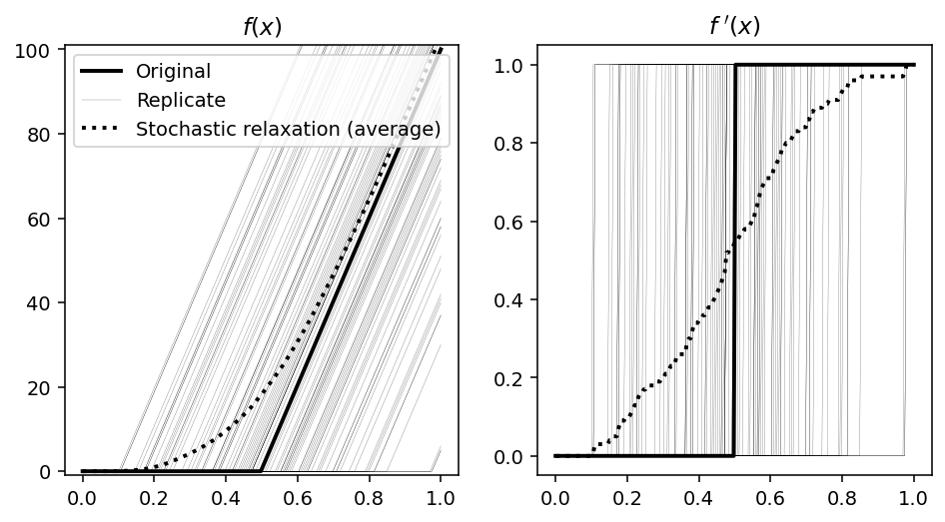
Stochastic relaxation Example
Issue: Gradient descent can only be applied to function with continuous gradient (Lipschitz continuous)
If our loss function is a step function, we would not be able to optimise on it.
But if, for example we approximate a step functions with different randomly perturbated thresholds, then the average becomes continuous.

Slide 41
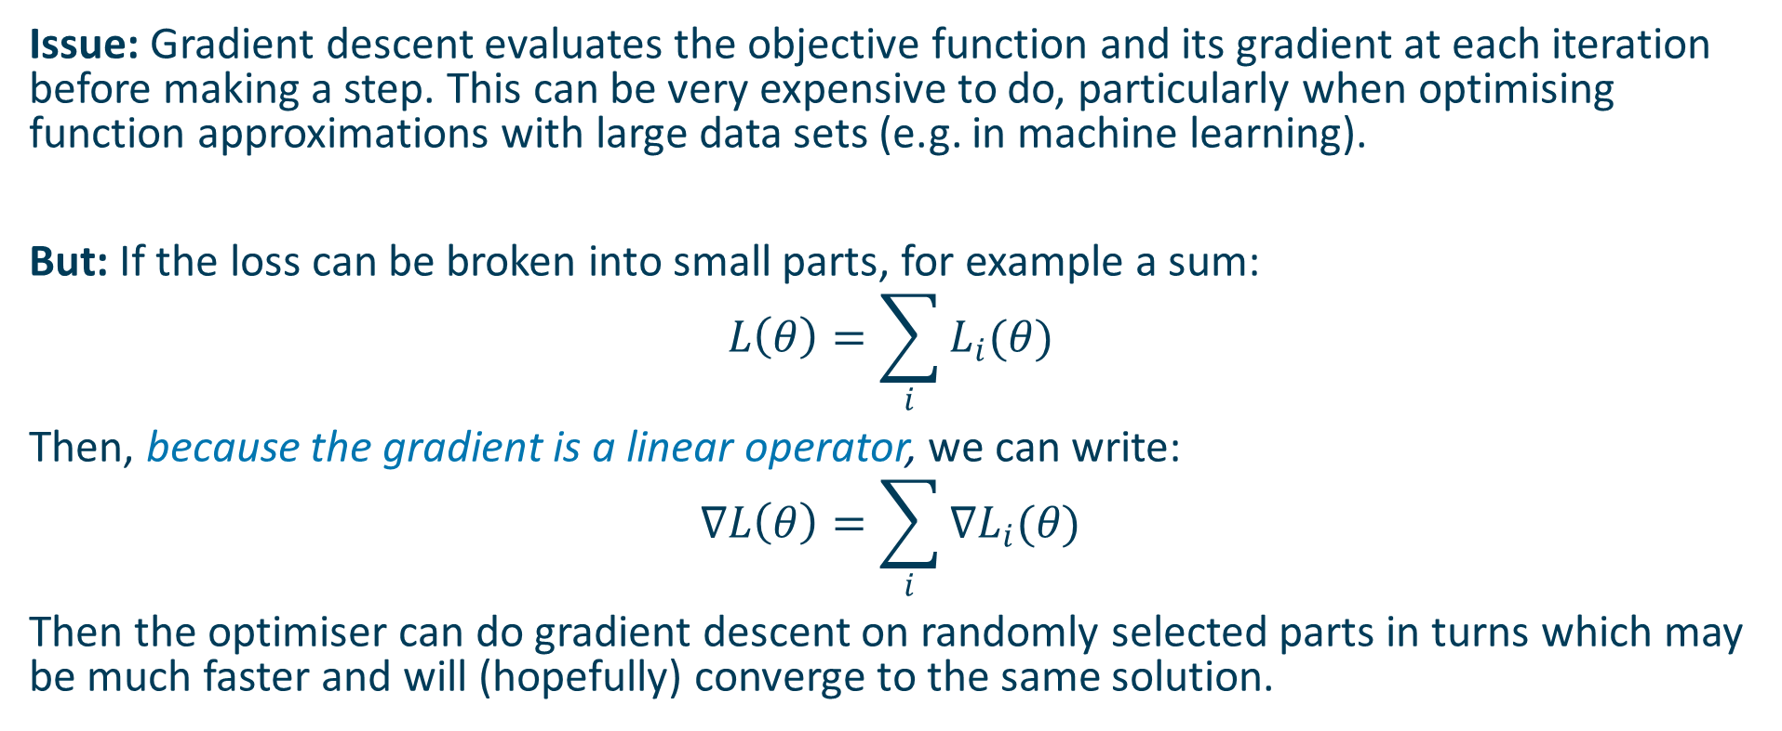
Stochastic Gradient Descent
Issue: Gradient descent evaluates the objective function and its gradient at each iteration before making a step. This can be very expensive to do, particularly when optimising function approximations with large data sets (e.g. in machine learning).
But: If the loss can be broken into small parts, for example a sum:
$$L\left(θ\right)=\sum_{i}{L_{i}(θ)}$$
Then, because the gradient is a linear operator, we can write:
$$∇L\left(θ\right)=\sum_{i}{∇L_{i}(θ)}$$
Then the optimiser can do gradient descent on randomly selected parts in turns which may be much faster and will (hopefully) converge to the same solution.

Slide 42
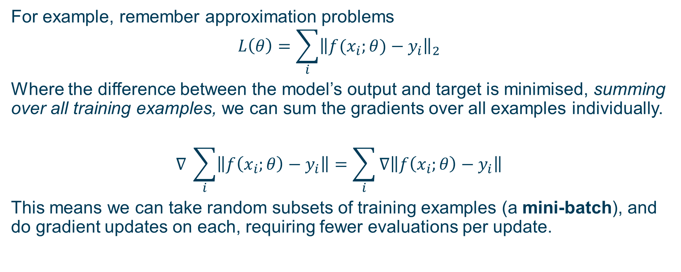
Stochastic Gradient Descent
For example, remember approximation problems
$$L\left(θ\right)=\sum_{i}{{\left\|f(x_{i};θ)−y_{i}\right\|}_{2}}$$
Where the difference between the model’s output and target is minimised, summing over all training examples, we can sum the gradients over all examples individually.
$$∇ \sum_{i}{\left\|f\left(x_{i};θ\right)−y_{i}\right\|=\sum_{i}{∇\left\|f\left(x_{i};θ\right)−y_{i}\right\|}}$$
This means we can take random subsets of training examples (a mini-batch), and do gradient updates on each, requiring fewer evaluations per update.

Slide 43
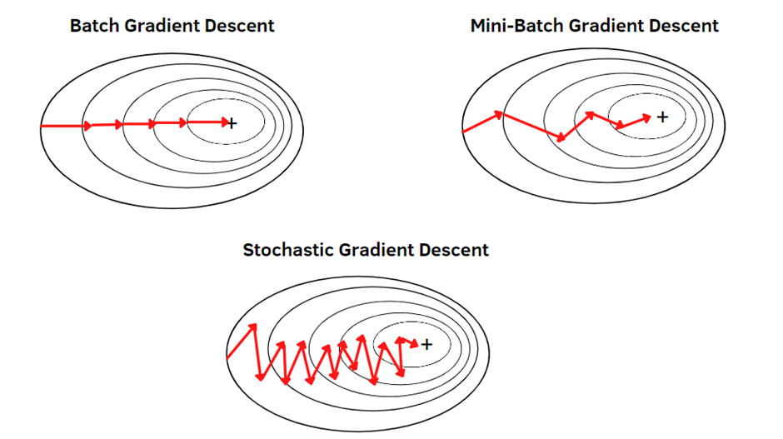
GD vs SGD vs mini-batch SGD
In original SGD, you use only ONE training examples before updating the gradients.
When the training set is large, SGD can be faster.
But the parameters will “oscillate” toward the minimum rather than converge smoothly.
Mini-batch is a middle ground between batch GD and SGD.

Slide 44
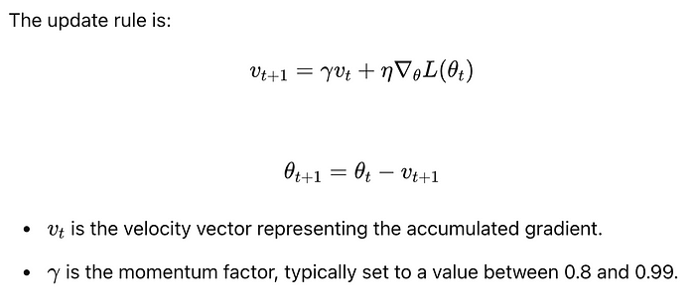
Momentum
Because mini-batch gradient descent makes a parameter update after seeing just a subset of examples, the direction of the update has some variance, and so the path taken by mini-batch gradient descent will “oscillate” toward convergence.
Using momentum can reduce these oscillations. Momentum accumulates the gradient of the past steps to determine the direction to go.
Notes:
Pros: Faster convergence and can help escape local minima.
Cons: Requires careful tuning of the momentum factor γ\gammaγ.

Slide 45
Second-order derivatives
If the first order derivatives represent the "slope" of a function, the second order derivatives represent the "curvature" of a function.
For every parameter component θi the Hessian stores how the steepness of every other θj changes.

Slide 46
Hessian: Jacobian of the gradient vector
$∇^{2}L(θ)$ is the Hessian matrix of a (scalar) function of a vector, the equivalent of the second derivative for vector functions.
Following our rule above, it's just the Jacobian of a vector valued function, so we know:
$∇^{2}L(θ)$ is matrix valued map $ℝ^{n}→ℝ^{n×n}$

Slide 47

Second-order derivatives
Imagine I am on a hill.
The altitude I am at is the value of the objective function.
The parameters I can vary are my position North/South and East/West.
The gradient vector is the change in altitude as I take a step North or a step East, which are the two parameters. This is the local steepness at the place I am at on the hill.
The Hessian captures how much steeper the hill get stepping Northwards as I go North and also how much steeper the hill gets Eastwards as I step North; similarly for stepping East. So there is a 2x2 matrix describing these changes in steepness.

Slide 48

Eigenvalues of the Hessian & types of critical points
The Hessian matrix captures important properties about the type of critical point that we saw in the previous lecture. In particular, the eigenvalues of the Hessian tell us what kind of point we have.
If all eigenvalues are all strictly positive, the matrix is called positive definite and the point is a minimum.
If all eigenvalues are all strictly negative (negative definite) and the point is a maximum.
If eigenvalues have mixed sign the point is a saddle point.
If the eigenvalues are all positive/negative, but with some zeros, the matrix is semidefinite and the point is plateau/ridge.

Slide 49

Newton-Conjugate Gradient
Newton‘s Method: Uses second-order information (Hessian matrix) to account for curvature.
Conjugate Gradient (CG):
Efficiently solves linear systems involving the Hessian without direct inversion.
Newton-CG typically converges faster than gradient descent because it uses second-order information (the Hessian), making it more effective, especially for problems with high curvature.
A full computation of the Hessian matrix (second-order derivatives) is both memory-intensive and computationally costly for large datasets. Evaluating the Hessian matrix requires d² computations, and d² storage.

Slide 50

Why Newton-CG converges faster?
Adjust the step size and direction more accurately
Near a local minimum, Newton‘s method converges quadratically—meaning the error decreases exponentially with each iteration, requiring fewer steps to achieve a highly accurate solution.
See: IDSS - optimisation III - lecture codes.ipynb

Slide 51
Use the right algorithm
If you know the problem is least-squares use a specialised least-squares solver. You might be able to solve directly, for example with the pseudo-inverse.
If you know the problem is convex, use a convex solver. This is radically more efficient than any other choice if its applicable.
If you know the derivatives of the objective function, or can compute them using automatic differentiation, use a first-order method (or second order, if you can)
If you don't know any of these things, use a general purpose zeroth-order solver like simulated annealing or a genetic algorithm.

Slide 52
Use the right algorithm
If you know the problem is least-squares use a specialised least-squares solver. You might be able to solve directly, for example with the pseudo-inverse.
If you know the problem is convex, use a convex solver. This is radically more efficient than any other choice if its applicable.
If you know the derivatives of the objective function, or can compute them using automatic differentiation, use a first-order method (or second order, if you can)
If you don't know any of these things, use a general-purpose zeroth-order solver like simulated annealing or a genetic algorithm.

Slide 53

Thank you for you attention! Contact: Nicolas.Pugeault@Glasgow.ac.uk

Slide 54
Example Optimisation exam question
December 2023 Exam paper

Slide 55


Slide 56


Slide 57


Slide 58


