Slide 1

Introduction to Data Science and Systems
Probabilities II – Bayes’ Rule
Dr Nicolas Pugeault

Slide 2
Today’s learning outcomes
conditional, marginal and joint distribution
what entropy is and how it can be computed
Bayes' rule and how to apply it problems
what bigrams are and how they can be used
Notes:
By the end of this unit you should know:

Slide 3

Part 1 - Joint, marginal and conditional probabilities

Slide 4

Last week: Romeo & Juliet in letters
The code in the lecture notes loads a text file (in this case, Romeo and Juliet), and converts into a vector of numerical codes. It keeps only letters and spaces and converts everything to lowercase.
Rom. Give me a torch. I am not for this ambling.
Being but heavy, I will bear the light.
Mer. Nay, gentle Romeo, we must have you dance.
Rom. Not I, believe me. You have dancing shoes
With nimble soles; I have a soul of lead
So stakes me to the ground I cannot move.

Slide 5

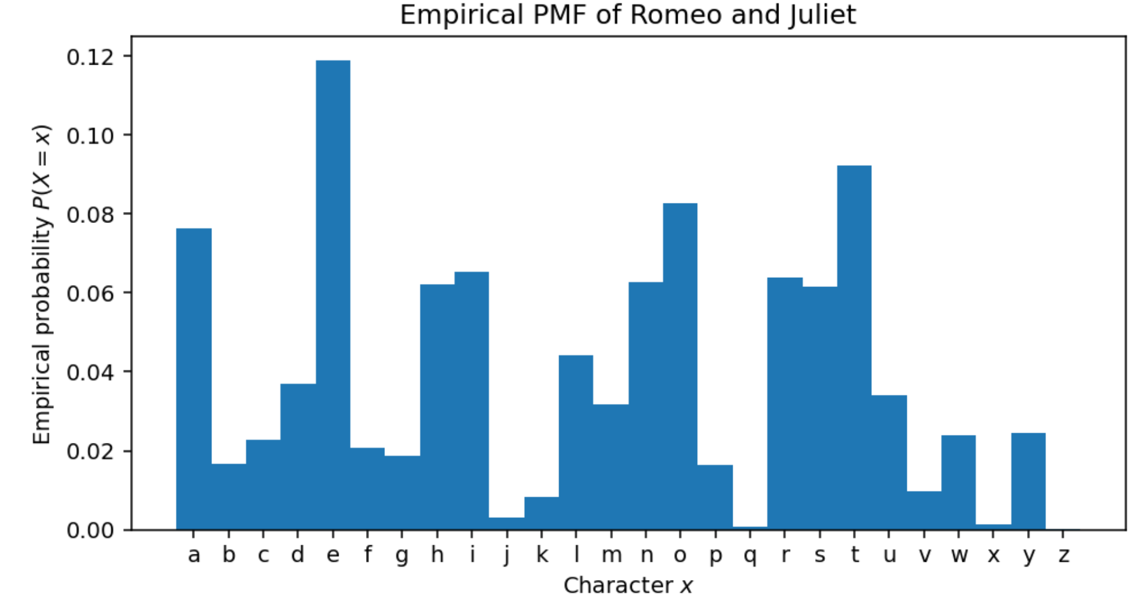
Letters PMF in Romeo & Juliet

Slide 6

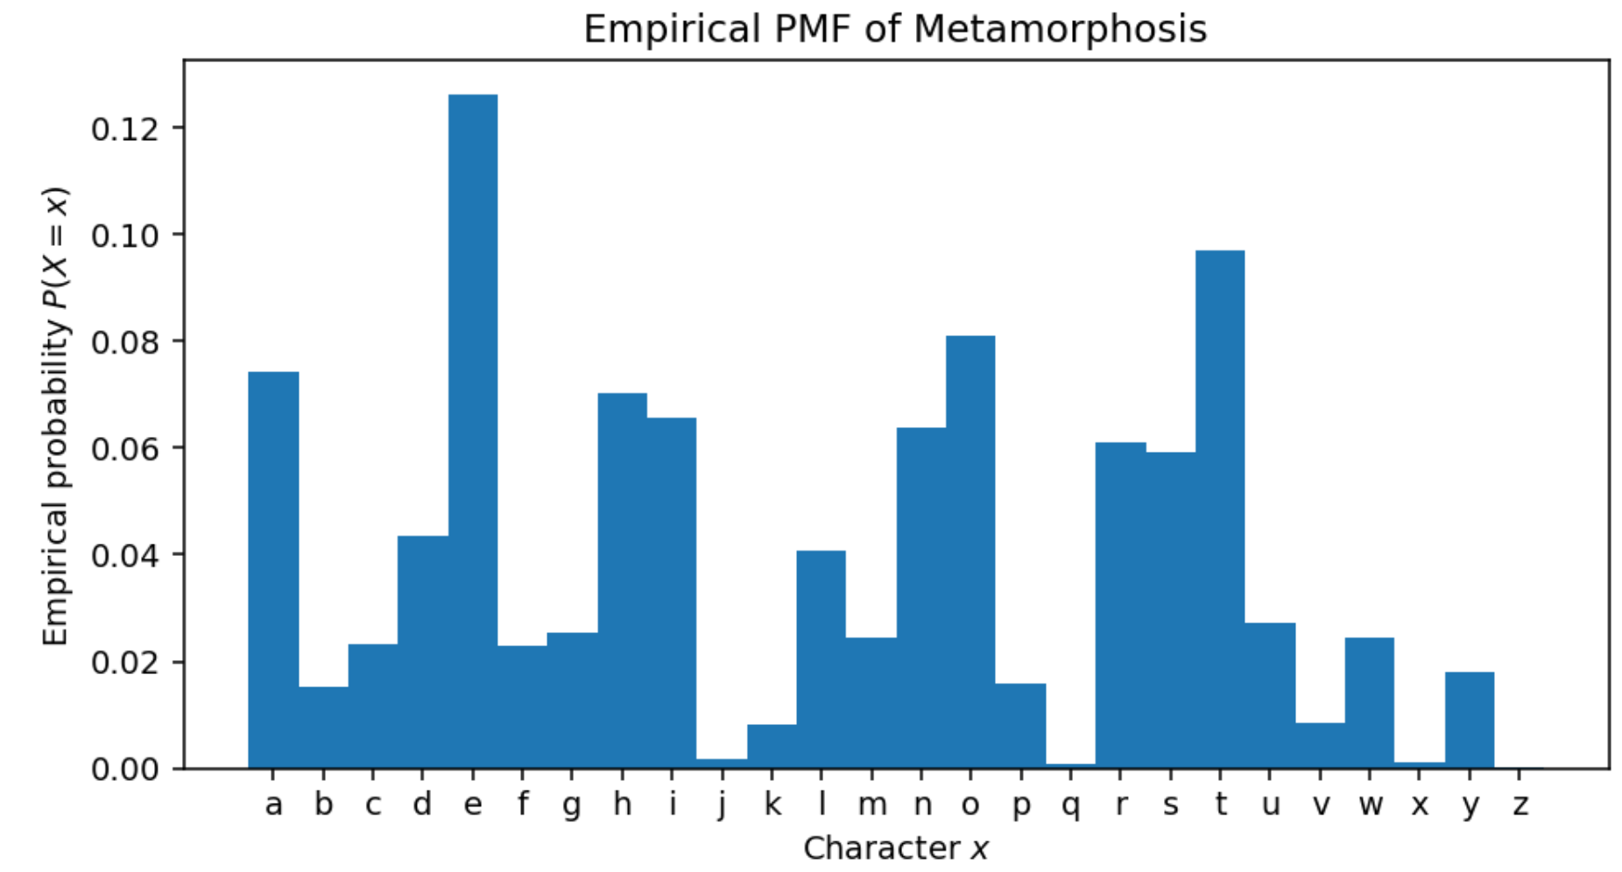
Letters PMF in Metamorphosis

Slide 7

Text generation from letter distribution
The results are similar (both are English texts), but there are some subtle differences; there slightly more q characters in Kafka compared to Shakespeare; the frequencies of h and i are reversed.
As always, given a PMF, we can draw samples from it with our standard procedure, though the results aren't very exciting:
https://en.wikipedia.org/wiki/Infinite_monkey_theorem

Slide 8

Likelihood function
When talking about likelihood, we often write L(x_{i}) to mean the likelihood of xi. The likelihood is not a probability. It is a function of data, and L(x_{i})=f_{X}(x_{i})
For example, consider the empirical PMF of Romeo and Juliet. This gives the probability of seeing any given character. The likelihood of seeing all of the characters, given our per-character probability model, is:
Rom. Give me a torch. I am not for this ambling.
Being but heavy, I will bear the light.
Mer. Nay, gentle Romeo, we must have you dance.
Rom. Not I, believe me. You have dancing shoes
With nimble soles; I have a soul of lead
So stakes me to the ground I cannot move.

Slide 9
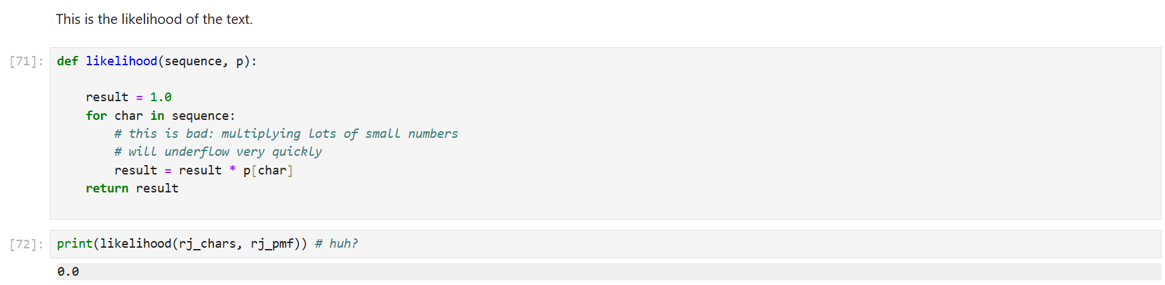
Romeo & Juliet: Text likelihood with underflow error!

Slide 10
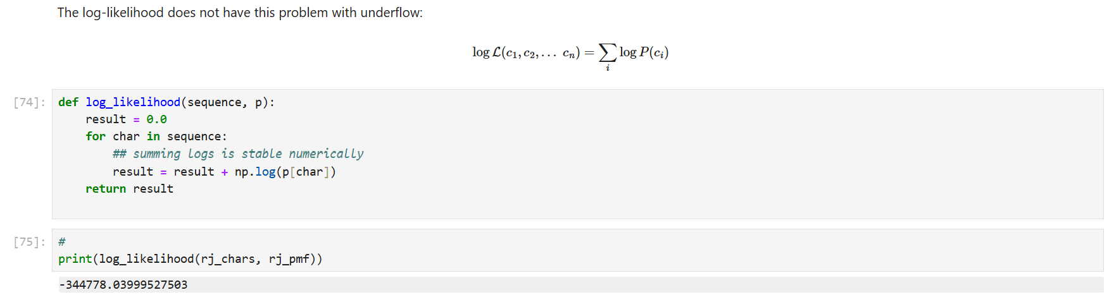
Romeo & Juliet: Text log-likelihood

Slide 11
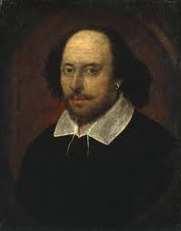
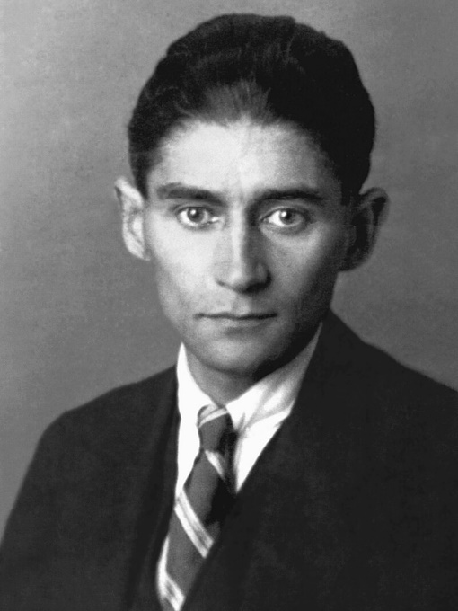
Who wrote Romeo & Juliet: A statistical approach
We could imagine that writing plays and novels is an activity that mysterious entities do by generating random characters according to a PMF.
Given an "unknown" text (in this case Macbeth), how likely is it that:
It was generated by a mysterious entity using the PMF for Romeo and Juliet
It was generated by a mysterious entity using the PMF for Metamorphosis
Neither of these will be exactly true, but we can precisely quantify to what extent Macbeth appears to have been generated by a similar process to these two reference texts.
Of course, our model is just the distribution of characters, so is a fairly weak model of different styles.

Slide 12
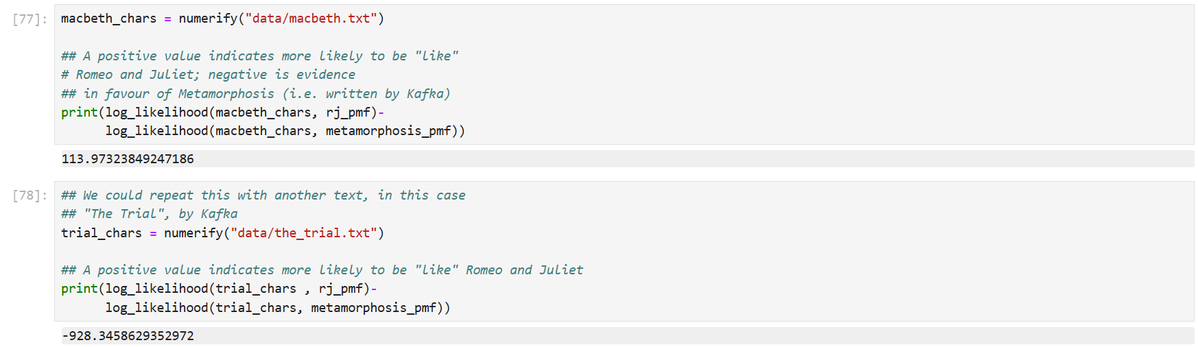
Comparing Log-Likelihoods
Notes:
We could imagine that writing plays and novels is an activity that mysterious entities do by generating random characters according to a PMF. Under this (very simplified!) assumption, we could now take an "unknown" text (in this case Macbeth) and then look at how likely it would have been to have been generated under two models:
A It was generated by a mysterious entity using the PMF for Romeo and Juliet
B It was generated by a mysterious entity using the PMF for Metamorphosis
Neither of these will be exactly true, but we can precisely quantify to what extent Macbeth appears to have been generated by a similar process to these two reference texts.
This is a very rough proxy for whether or not they were generated by the same mysterious entity -- i.e. author. Our model is just the distribution of characters, so is a fairly weak model of different styles. However, it is sufficient to do the comparison here.

Slide 13
Better text representation: bigrams
We can look at these in the case of the character model of text we saw earlier. From the vector of character codes that make up "Metamorphosis" we can take every pair of characters, in the order they appear.
That is, we consider two characters c_{i-1} and c_{i} at some index i. This is called a bigram model, and there are unigram, trigram, n-gram generalisations of the idea.
A "gram" refers to a unit like a character or word, and we are discussing a character bigram model.
c_{i-1}
c_{i}
Rom. Give me a torch. I am not for this ambling.
Being but heavy, I will bear the light.
Mer. Nay, gentle Romeo, we must have you dance.
Rom. Not I, believe me. You have dancing shoes
With nimble soles; I have a soul of lead
So stakes me to the ground I cannot move.

Slide 14
Joint probabilities
The Joint probability of two random variables X and Y is written:
P(X,Y)
And gives the probability that X and Y take specific values simultaneously
E.g.
P(X=x) ˄ P(Y=y)

Slide 15
Marginal probabilities
The marginal probability is the derivation of P(X) from P(X,Y) by integrating (summing) over all the possible outcomes of Y:
This allows us to compute a distribution over one random variable from a joint distribution by summing over all the possible outcomes of the other variable involved.

Slide 16
Marginalisation
Marginalisation just means integration over one or more variables from a joint distribution: it removes those variables from the distribution.
Two random variables are independent if they do not have any dependence on each other. If this is the case then the joint distribution is just the product of the individual distributions: P(X,Y)=P(X)P(Y).
This is not true in the general case where the variables have dependence.

Slide 17

Conditional probabilities
The conditional probability of a random variable X given a random variable Y is written as P(X|Y) and can be computed as:
This tells us how likely the outcomes of X are if we already know (or fix) the outcomes of Y.
Read as "probability of X taking on the value x given that Y has taken on the value y".
The conditional probability is P(X|Y)=P(X) and P(Y|X)=P(Y) if X and Y are independent.

Slide 18
Or visually
State space (all possible outcomes)
What is P(X)?
What is P(X,Y)?
What is P(X v Y)?
Let us marginalise P(X,Y) over Y
What is P(X| Y)?
Y
X
X ˄ Y

Slide 19
Example: Back to the Scorpion
We have a grid of outcomes with 6 rows and 8 columns, for a total of 48 possible outcomes.
State space (all possible outcomes)

Slide 20
Example: Back to the Scorpion
We have a grid of outcomes with 6 rows and 8 columns, for a total of 48 possible outcomes (from (1,1) to (6,8)).
Event X (“south”) is true if the first coordinate is 4 or more.
Event X

Slide 21
Example: Back to the Scorpion
Event Y
We have a grid of outcomes with 6 rows and 8 columns, for a total of 48 possible outcomes (from (1,1) to (6,8)).
Event X (“south”) is true if the first coordinate is 4 or more.
Event Y (“East”) is true if the second coordinate is 6 or more.

Slide 22
Example: Back to the Scorpion
What is P(X=true)?
What is P(Y=true)?
What is P(X=true and Y=true)?
What is P(X=true or Y=true)?
What is P(X,Y)?
Marginalise P(X,Y) over Y.
What is P(X=true | Y=true)?

Slide 23
Example: Back to the Scorpion
What is P(X=true)?
24/48 = 0.5
What is P(Y=true)?
18/48 = 3/8 = 0.375
What is P(X=true and Y=true)?
9/48 = 3/16 = 0.1875
What is P(X=true or Y=true)?
Not independent, so 0.5+0.375-01875=0.6875

Slide 24
Example: Back to the Scorpion
What is P(X,Y)?
A matrix of probabilities for combinations of values for X and Y:
 | Y = true | Y = false
X = true | 9/48 | 15/48
X = false | 9/48 | 15/48

Slide 25
Example: Back to the Scorpion
What is P(X,Y)?
A matrix of probabilities for combinations of values for X and Y:
Marginalise P(X,Y) over Y.
This gives P(X)
 | Y = true | Y = false
X = true | 9/48 | 15/48
X = false | 9/48 | 15/48
 | P(X)
X = true | 9/48+15/48=24/48=0.5
X = false | 9/48+15/48=24/48=0.5

Slide 26
Example: Back to the Scorpion
What is P(X | Y)?
P(X | Y) = P(X,Y)/P(Y)
We calculated P(X,Y) before
We marginalise P(X,Y) over X
And finally calculate P(X | Y)
P(X,Y) | Y = true | Y = false
X = true | 9/48 = 3/16 | 15/48 = 5/16
X = false | 9/48 = 3/16 | 15/48 = 5/16
 | P(Y)
Y = true | (3+3)/16 = 3/8
Y = false | (5+5)/16 = 5/8
P(X|Y) | Y = true | Y = false
X = true | 3/16 x 8/3 = 0.5 | 5/16 x 8/5 = 0.5
X = false | 3/16 x 8/3 = 0.5 | 5/16 x 8/5 = 0.5

Slide 27
Back to Bigrams
From the vector of character codes that make up "Metamorphosis" we can take every pair of characters, in order that they appear.
The joint distribution of bigrams P(c_{i}, c_{i−1}) is given by the normalized count of each character pair.
The marginal distribution P(c_{i}) can be computed from P(c_{i},c_{i−1}) by summing over every possible character c_{i−1}, and likewise to marginalise to find P(c_{i−1})
The conditional distribution P(c_{i}|c_{i−1}) is given by the joint distribution, divided by the counts of P(c_{i−1}). It tells us how likely we are to observe a specific character c_{i} given that we have observed a character c_{i−1} just beforehand.

Slide 28
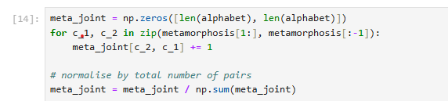
Bigrams: Joint probability
The joint probability for a bigram is P(c_{i}, c_{i-1})

Slide 29
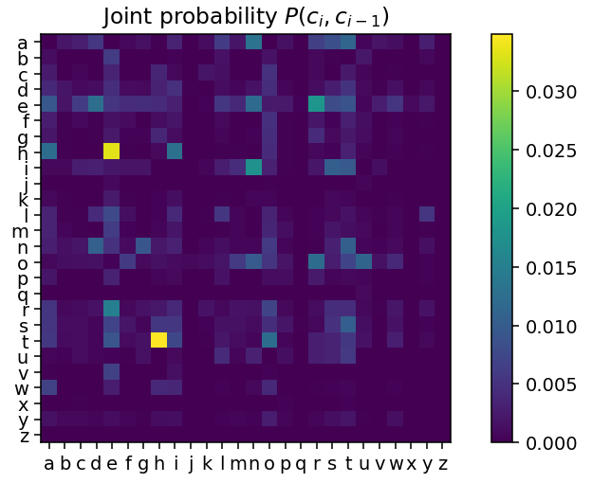
Bigrams: Joint probability
This tells us how likely each possible pair of characters is.
Some combinations are much more likely than others.

Slide 30

Bigrams: Marginalisation

Slide 31
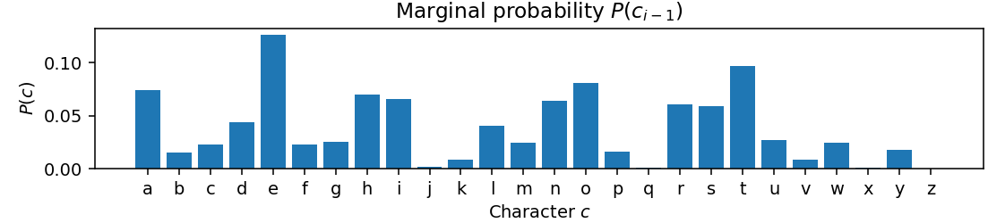
Bigrams: Marginalisation

Slide 32
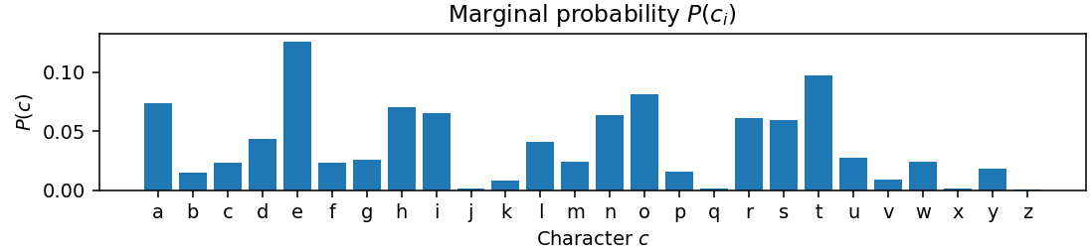
Bigrams: Marginalisation

Slide 33
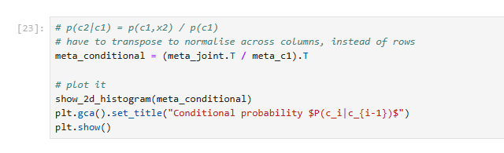
Bigrams: Conditional probabilities
The conditional probability P(c_{i}|c_{i-1}) is given by:

Slide 34
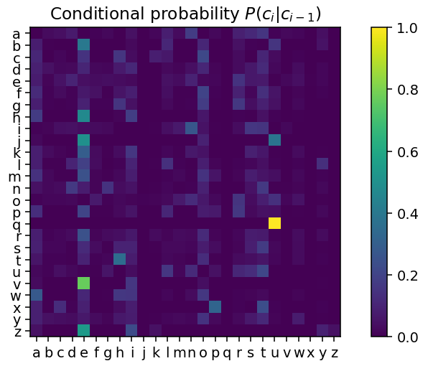
Bigrams: Conditional probabilities
The conditional probability P(c_{i}|c_{i-1}) is given by:

Slide 35
Bigrams: Conditional probabilities
This tells us what character to expect, given the character we know we saw before.
It lets us predict the next character. We can look along the rows to do this look-up: each row sums to 1.0.
For example, look at row "q": the probability is concentrated on the entry in column "u" -- "u" always follows "q" in English.

Slide 36
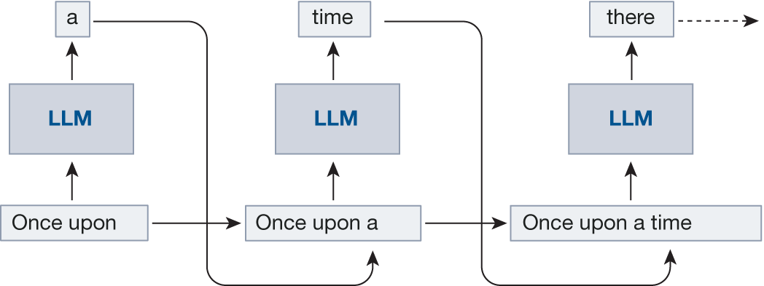
Aside: Conditional probabilities and LLM
In effect, this is the same strategy used by Large Language Models (eg, GPT) for generating text:
They generate one word at a time by sampling from the distribution of words conditioned to the previous text
This is including the user query and the previously generated words!
This process is called autoregressive
https://www.nature.com/articles/s41586-023-06647-8

Slide 37
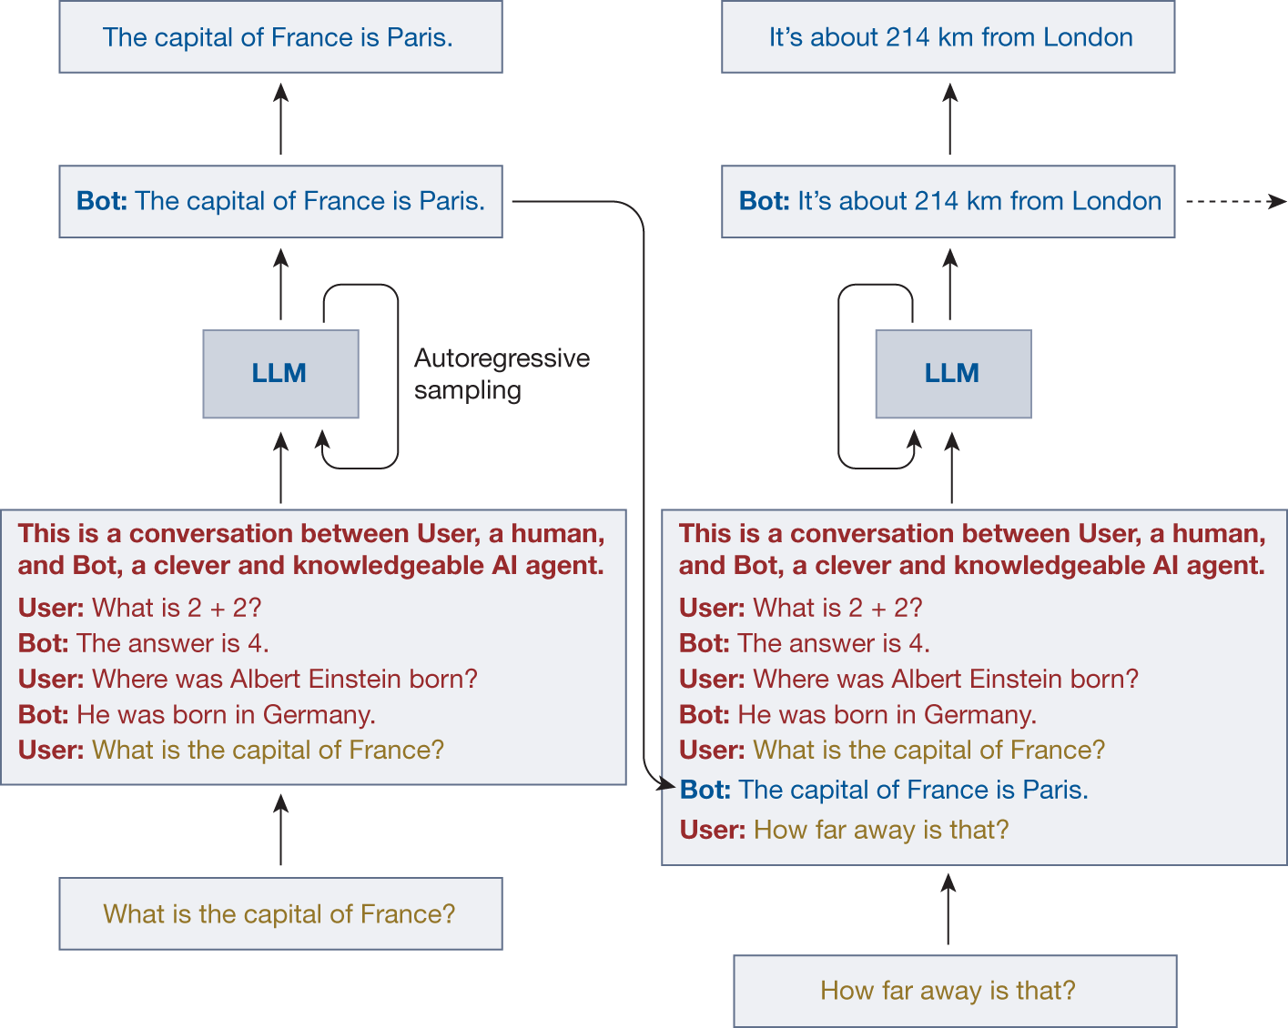
Aside: Conditional probabilities and LLM
In effect, this is the same strategy used by Large Language Models (eg, GPT) for generating text:
They generate one word at a time by sampling from the distribution of words conditioned to the previous text
This is including the user query and the previously generated words!
This process is called autoregressive
https://www.nature.com/articles/s41586-023-06647-8

Slide 38

Part 2 - Bayes’ theorem

Slide 39


☣ Plague ☣
A new test is developed that can detect Plague X with 95% accuracy.
We'll assume that 95% accuracy means:
a 5% false positive rate, i.e. 5% of the time people who don't have the disease test positive
a 5% false negative rate, i.e. 5% of the time people have the disease test negative
One in one hundred thousand (1:100000) people are known to have Plague X
we might know this because it's universally fatal within one year, and one in a hundred thousand people died of it last year, for example.
You go for the test, and it comes back positive for Plague X.
How likely are you to have Plague X?
https://www.menti.com/alquw5aa3won
Or code: 2987 1383

Slide 40
Bayes’ rule Inverting conditional distributions
We often want to know the probability of some event A given some other event B; that is P(A|B). But we are often in a situation where we can only compute P(B|A).
This case is usually:
we know how the mysterious entity behaves P(B|A);
we know what data we saw P(B);
we know what the mysterious entity is likely to be up to in general P(A);
and we want to work out what the mysterious entity is doing P(A|B).

Slide 41
Bayes’ rule Inverting conditional distributions
We often want to know the probability of some event A given some other event B; that is P(A|B). But we are often in a situation where we can only compute P(B|A).
In general P(A|B)≠P(B|A); and the two expressions can be completely different.
Typically, this type of problem occurs where we:
want to know the probability of some event given some evidence (how likely is it that I have a disease given that my blood test came back positive?)
but we only know the probability of observing evidence given the event (if you have this disease, the blood test will come back positive 95% of the time).

Slide 42

Bayes’ rule Inverting conditional distributions
We often want to know the probability of some event A given some other event B; that is P(A|B). But we are often in a situation where we can only compute P(B|A).
Bayes' rule gives the correct way to invert the probability distribution:
This follows directly from the axioms of probability. Bayes' Rule is a very important rule, and has some surprising consequences.

Slide 43
Bayes’ rule Nomenclature
P(A|B) is called the posterior -- what we want to know, or will know after the computation
P(B|A) is called the likelihood -- how likely the event A is to produce the evidence we see
P(A) is the prior -- how likely the event A is regardless of evidence
P(B) is the evidence -- how likely the evidence B is regardless of the event.
Bayes' rule gives a consistent rule to take some prior belief and combine it with observed data to estimate a new distribution which combines them.

Slide 44

Bayes’ rule Nomenclature
We often phrase this as some hypothesis H we want to know, given some data D we observe, and we write Bayes' Rule as:
H and D are random variables in this expression.
(the probability of the hypothesis given the data) is equal to (the probability of the data given the hypothesis) times (the probability of the hypothesis) divided by (the probability of the data).
In other words, if we want to work out how likely a hypothesis is to be true given observations, but we only know how likely we are to have seen those observations if that hypothesis was true, we can use Bayes' rule to solve the problem.

Slide 45
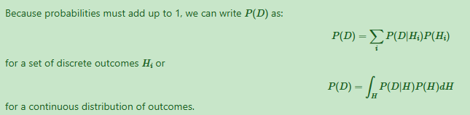
Bayes’ rule Marginalising the evidence
We can say that the posterior probability is proportional to the product of the prior and the likelihood. But to evaluate its value, we need to compute P(D), the evidence.
It is difficult to see what this represents at first. But one way to think of it is as the result of marginalising the P(D) from the joint distribution P(H,D); that is integrating P(H,D) over every possible outcome of H, for each possible D.
This trick is essential in understanding Bayes’ Rule!

Slide 46

Bayes’ Rule Binary cases
In general this can be difficult to compute. For binary simple cases where there are only two possible outcomes (H can only be 0 or 1), Bayes' rule can be written as:

Slide 47
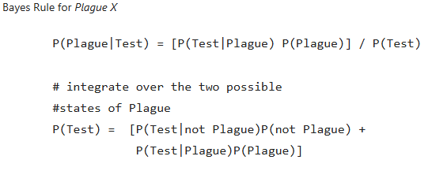
Bayes’ rule Back to Plague X

Slide 48

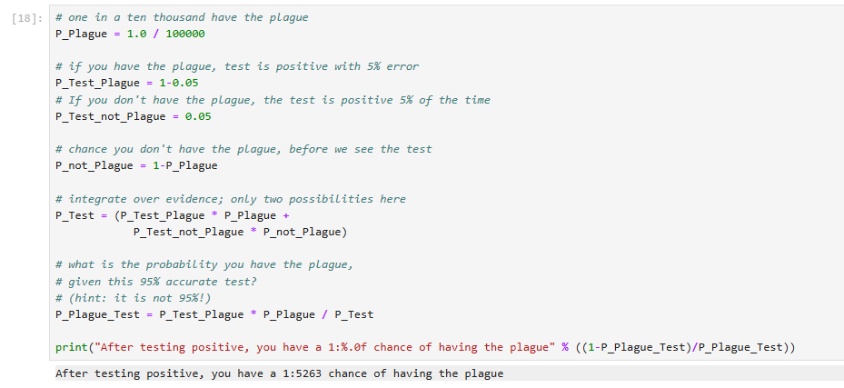
Bayes’ rule Answering the Plague X question

Slide 49

Poll results

Slide 50
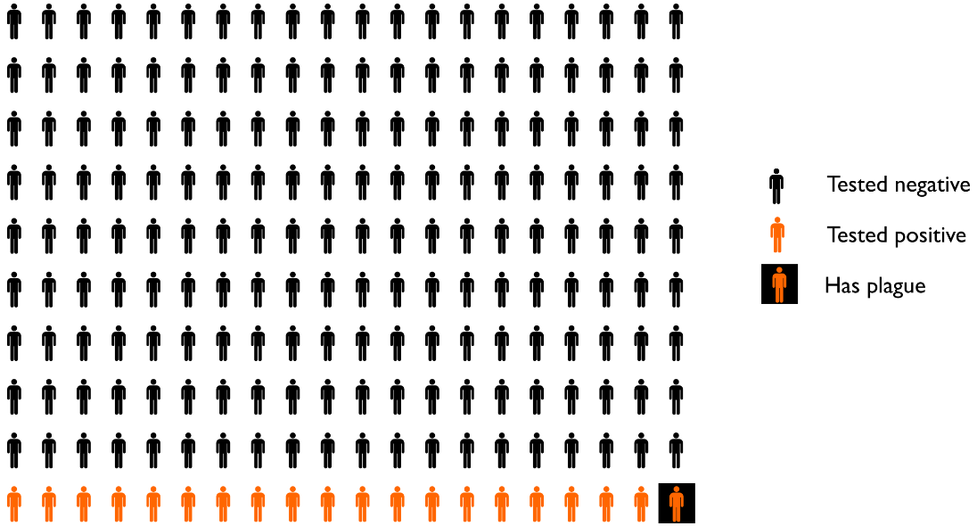
Bayes’ rule Natural frequency
There is an approach to explaining problems like this which makes it much less likely to make poor judgements.
Natural frequency explanations involve imagining concrete populations of a fixed size (10000 people in a room, for example), and considering the proportions of the populations as counts (how many people in the room have the plague?).
We can use this to visualise the problem above and explain the apparent paradox.
The graph on the right shows the case P(plague)=0.005 (1 in 200), again with a 5% accurate test.

Slide 51
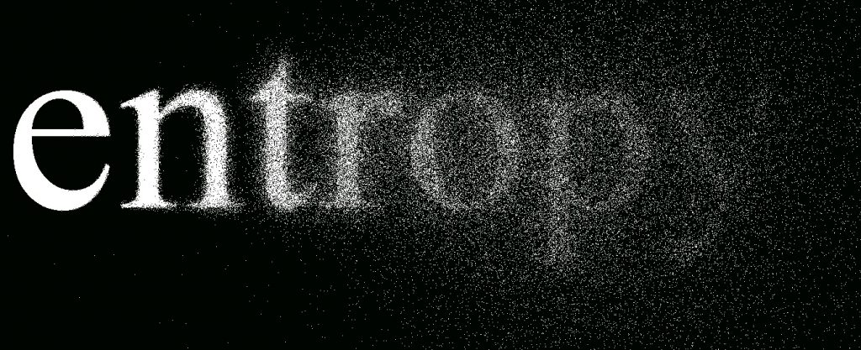
Part 3 - Entropy

Slide 52
Entropy
A key property of a probability distribution is the entropy. Intuitively, this is a measure of the "surprise" an observer would have when observing draws from the distribution, or alternatively, the (log) measure of a number of distinct "states" a distribution could represent.
A flat, uniform distribution is very "surprising" because the values are very hard to predict; a narrow, peaked distribution is unsurprising because the values are always very similar.

Slide 53
Entropy
This is a precise quantification -- it gives the information in a distribution. The units of information are normally bits; where 1 bit of information tells you the answer to exactly one yes or no question.
The entropy tells you exactly how many of bits are needed (at minimum) to communicate a value from a distribution to an observer who knows the distribution already.
Alternatively, you can see the number of distinct states the distribution describes as p=2^{H(X)} -- this value is called the perplexity, and it can be fractional.

Slide 54

Entropy
The entropy of a (discrete) distribution of a random variable X can be computed as:
This is just the expected value of the log-probability of a random variable (the "average" log-probability).

Slide 55
Example: Tossing coins
Consider a coin toss: this is sampling from a discrete random variable that can take on two states, heads and tails.
If we call our two possible states 0 (heads) and 1 (tails), we can characterise this with a single parameter q, where P(X=0)=q and P(X=1)=(1−q)
(this follows from the fact that as P(X=0)+P(X=1) must equal 1 -- the coin must land on one side or the other. We ignore edge landings!).

Slide 56

Example: Tossing coins
If this process is very biased and heads are much more likely than tails (q<<0.5), an observer will be unsurprised most of the time because predicting heads will be a good bet.
If the process is unbiased (q=0.5), an observer will have no way to predict if a head or tail is more likely.
We can write the entropy of this distribution:

Slide 57
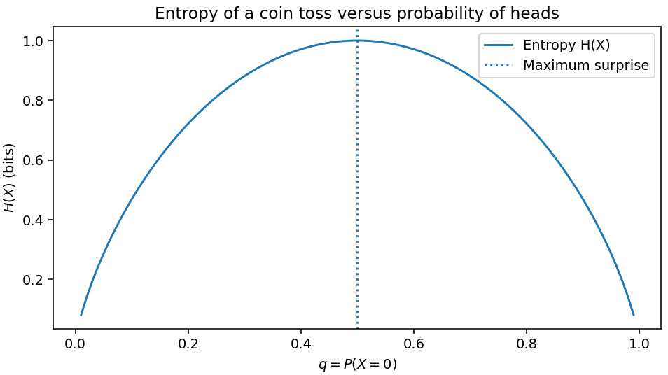
Entropy of a coin toss

Slide 58
Entropy of a coin toss
This corresponds with our intuition: an unbiased coin toss is the most surprising distribution.
Entropy is a critically important concept in information theory which relates probability to the problems of communication.
We can measure how well Bayesian updating is going by measuring the drop in entropy of the posterior belief; as we add evidence, we should become less surprised about the possible outcomes.

Slide 59
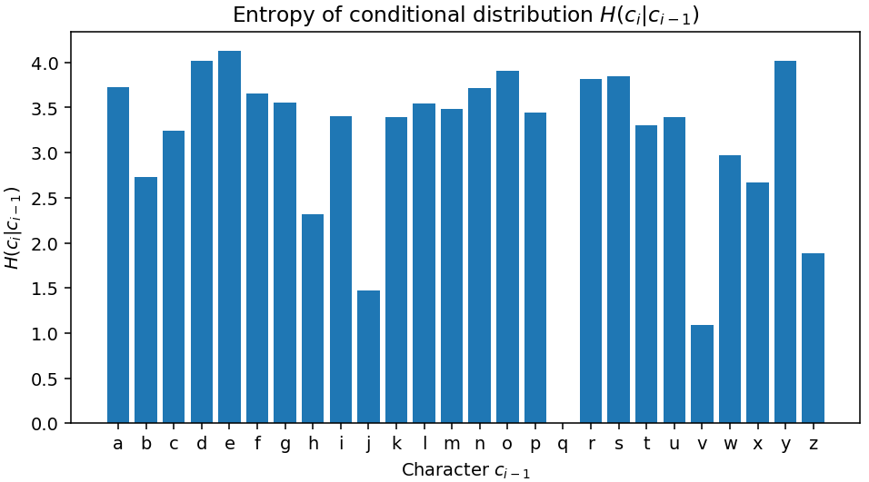
Example 2: Back to our bigrams
In our letter-based bigram example, we can compute the entropy of each conditional distribution P(c_{i}|c_{i−1}).
This will tell us how surprised we will be by the characters that might follow a character c_{i}.

Slide 60
Interpreting entropy
We can see that observing a "q" means the next character isn't surprising at all: we know for sure that it will be a "u", and thus the entropy is 0. There is only one configuration of the world for the next character (under this model) if we have just seen a "u".
Likewise, seeing a space character gives us very little information, and the next character could be anything: the character after a space will surprise us -- there are lots of configurations of the world that might follow a space. That surprise is as much surprise as we would get by tossing about 4 coins, or an entropy of about 4 bits.

Slide 61
Summary
We can represent probabilities between multiple random variables using joint, marginal and conditional probabilities
Bayes’ rule allows to invert a conditional probabilities, and crucially to update our belief (posterior) when new evidence is available.
Entropy allows to model uncertainty and will be useful to assess how effective a Bayesian update was at increasing our knowledge.

Slide 62

Thank you Contact: Nicolas.Pugeault@Glasgow.ac.uk

