Slide 1
Programming & System Development (M)
September 2025
Dr. Mireilla Bikanga Ada
Dr. Mary Ellen Foster
Mrs Fionnuala Johnson
© 2008 David A Watt, University of Glasgow

Slide 2
Aims
To enhance existing skills and practical processes for programming in Python and Java, which are the main languages used in the MSc programme
To improve skill at using online information to pick up new languages, APIs or tools
To become familiar with common tools needed to build working systems, including repositories, virtual machines and servers.
To develop knowledge of the use of the LINUX operating system and experience of using the tools available under LINUX for programming system administration, and cybersecurity.

Slide 3
Learning Outcomes
1. Demonstrate familiarity with the relevant modern programming environments;
2. Use the command line and a text editor competently, ideally with experience with a modern IDE;
3. Develop well-structured programs in Java and Python, and be proficient in looking for online help, and be prepared to pick up new skills independently;
4. Explain the importance of concise and informative documentation, and use modern documentation tools;
5. Provide evidence of program correctness through thorough testing;

Slide 4
Learning Outcomes
6. Describe and use version control processes, and be able to checkout and use a repository (e.g. git);
7. Launch, edit and use Jupyter notebook, Colab, Conda.;
8. Use basic SQL from Java and Python, and be able to set up a basic server;
9. Describe the basics of user interaction with the Linux shell, file navigation, system monitoring, printing;
10. Explain how to install and configure software under Linux, and be able to write and execute simple Linux shell scripts..

Slide 5
Lectures’ contents
Introduction
Python Basics, Decision Making & Object-Oriented Programming (OOP) in Python, Intro to Conda, Google Colab
Python – Repetition, functions, Data structures
Python – Files & Exception, SQLite3, PyTorch
Data Processing – Pandas , Numpy
Data Visualisation - Matplotlib
Java and Unix
Java and Unix
Java and Unix
Java and Unix
Java and Unix
Revision week

Slide 6
Assessments
Tutorial exercises
Sample solutions available.
The graded assessments and their weighting in this course are as follows:
Participation in peer review (tAPP): weighting 0.05 (5%)
Assessed Exercise (invigilated): Broken down into the following exercises
Assessed Exercise 1 (10% - Python) Date: 03/10/2025
Assessed Exercise 2 (15% - Python) Date: 10/10/2025
Assessed Exercise 3 (15% - Java OR Unix) Date: 24/10/2025
Total weight for Assessed Exercises: weighting 0.40 (40%)
Programming Assessment: weighting 0.15 (15%) Date: 31/10/2025
Lab Exam – Date: TBC – On campus and invigilated
weighting 0.4. (40%)

Slide 7
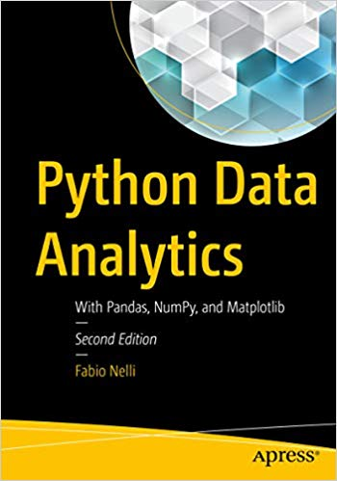
Reading (1)
Fabio Nelli Python Data Analytics Apress (2018)
Jhon Dierre
Linux Shell - Scripting with Bash
Paul Smart
Shell Scripting and Advanced Linux Commands
Beginners Guide

Slide 8
Reading (2)
http://www.dcs.gla.ac.uk/bootcamp/
Username “student”
Password “Letmein”

Slide 9
Modified Team-Based Learning Approach
Pre-Lecture material
Read the material before coming to the lecture
Take the quiz or any test
Lecture Material – Problem Solving Tasks (1 hour per session)
You are given some problems to solve based on what you have read
Try to solve the problems alone first
Then discuss with your team members.
Produce a solution as a team
Give your solution to another team for peer – evaluation
Tutorial/Labs (2 hour per session)
Support each other.

Slide 10
Other Things to know
Tutorials/Labs: released at least a week before to give you the chance to attempt before the next class. Solutions some time after!
Always have the following items with you in lectures:
Paper
Pen/pencil

Slide 11
Important note about lab groups
Lab sections 1, 2, 3 and 4 are divided into teams.
Each student is a member of one team.
Students within the same team:
May support each other during the labs
Participate in the group peer review of team Application exercises (tAPP)

Slide 12
Any Question?

