Slide 1

W11-01: Answering Exam Questions
COMPSCI4064 (H) and COMPSCI5088 (M)
Dr. Richard McCreadie

Slide 2
Exam Basics
We are evaluating what you (should) have learned from the course
We only evaluate you on what we have taught (what is on or linked to from the Moodle)
Course assessment planning considers the entire set of topics covered and we cannot assess everything, this means if we previously assessed something via exercise, it very likely will not turn up during the exam
Honors and Masters students have a slightly different exam
The Masters one should be a little harder (as masters is a higher qualification)
Both are 60-mark exams
You have 1 hour 30 minutes (Fixed time Exam)
(no additional submission time this year as its done via Moodle Quiz)
Marking is declarative, i.e. there are valid answers and the markers check whether your answer matches (fully or partially)

Slide 3
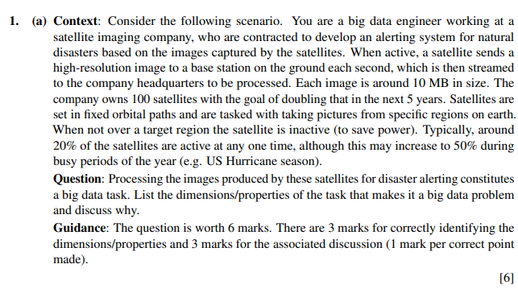
Question Format
Questions are divided into three components
Context: This provides some background information about the scenario that the question should be answered in relation to
Question: The question you should directly answer.
Guidance: How the marks are awarded for the question.
Context caries over between sub-questions of each major question
So the context for 1. (a) may be relevant for 1. (b), but not for 2. (a)

Slide 4
Question Types
Be aware of the language used in the ‘Question’ block
Discuss…, Describe…: For these types of questions you are expected to write a short paragraph. A good rule of thumb is take the number of marks for the question and divide by 2, that is approximately the number of sentences to write.
Lists…: Other types of questions can usually be answered using a bullet-point list of some short, check the guidance statement to see if there is a clear ‘X points are expected’ statement, if so write one bullet per point.

Slide 5
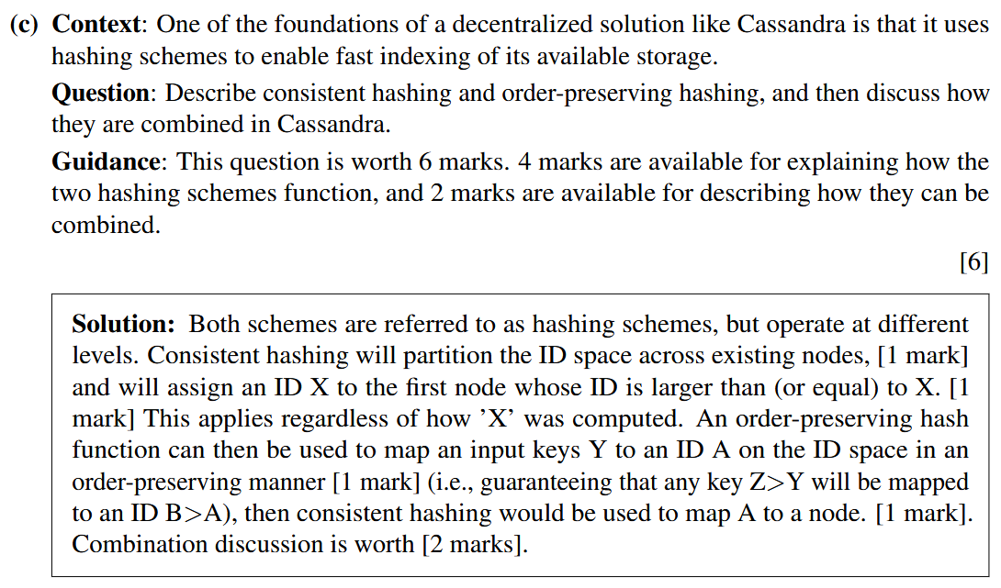
Describe Example
For describe type questions, we are looking for your answer to cover particular points
See how there are [X Mark] statements in the answer
The answer scripts are what the markers are given
Markers are seeing if what you wrote matches closely enough to the correct answer to award the mark

Slide 6
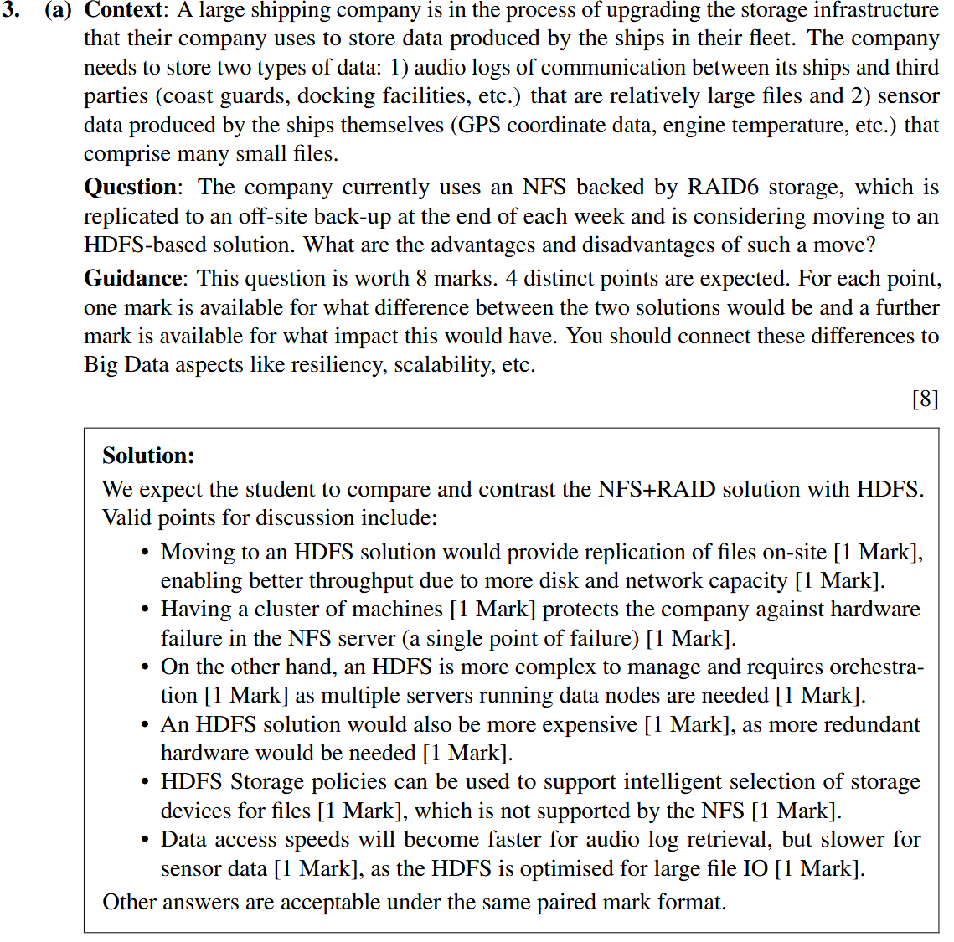
List Example
If you see ‘X… points are expected’, the question is probably expecting a list answer
You can be shorter in the writing for these
Often there will be multiple marks per bullet
The markers are usually looking for a near match against the answer sheet for these

Slide 7



Course Coordinator Dr. Richard McCreadie Email: richard.mccreadie@glasgow.ac.uk Room: SAWB 304
#UofGWorldChangers
@UofGlasgow

