Slide 1
COMPSCI5012 Internet Technology (ITECH)
Dr Nikela Papadopoulou

Slide 2
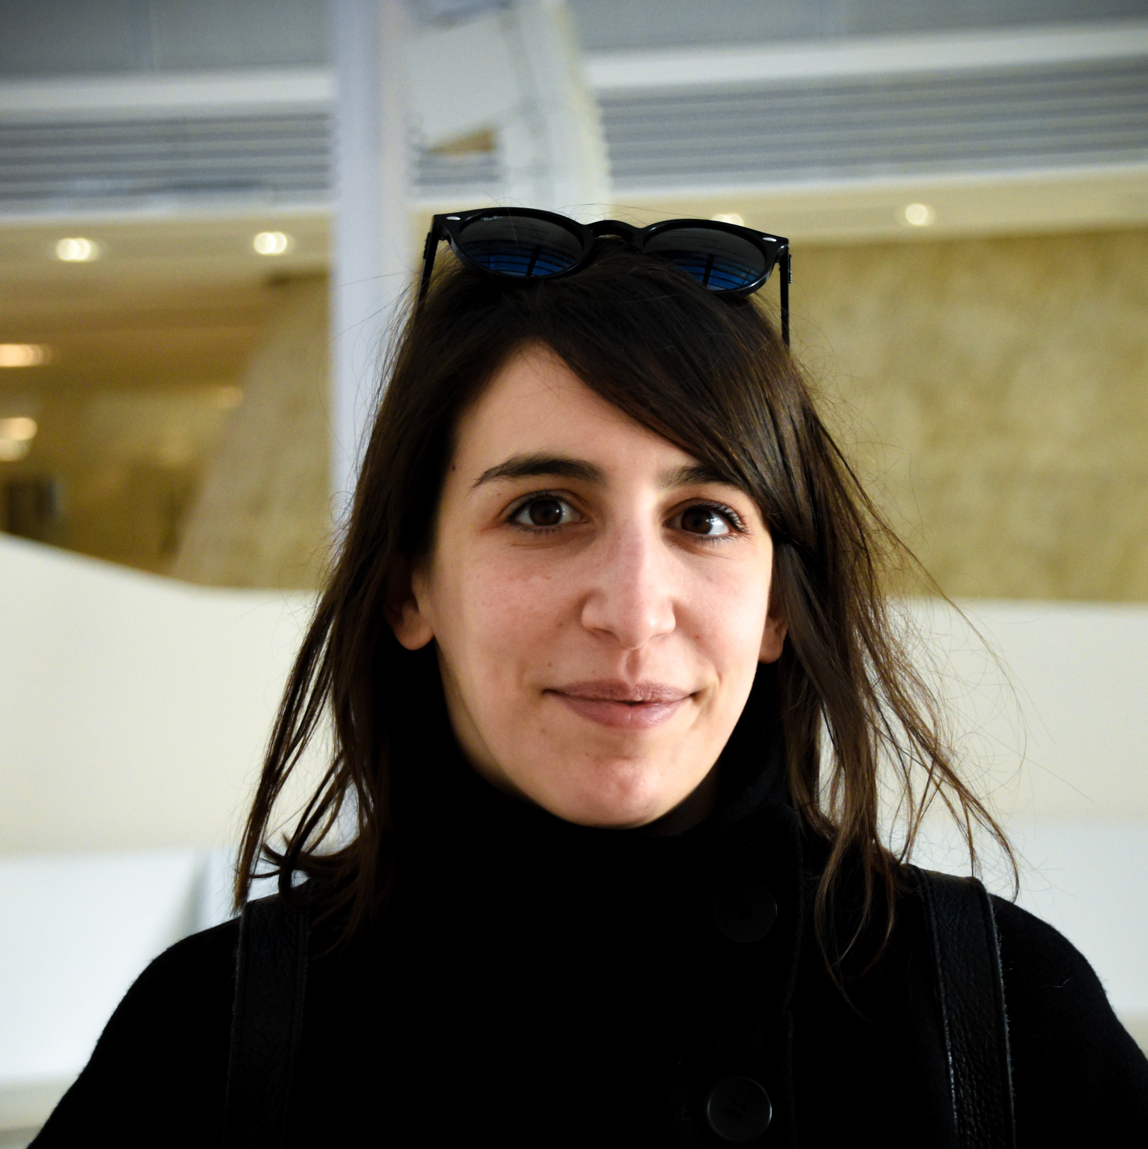
Internet Technology (ITECH)
Course Schedule:
Lectures: Tuesdays & Thursdays 16.00-17.00, at JMS 438AB
Labs: Mondays 10.00-14.00 at BORR 1028
Lecturers:
Dr Nikela Papadopoulou (pronounced "Nee-KEH-lah")
Lecturer in Low Carbon and Sustainable Computing
Website: https://nikela.github.io
Email: Nikela.Papadopoulou@glasgow.ac.uk
Office: F133 @ 18 Lilybank Gardens (SAWB)
Office Hours: Wednesdays 10.00-11.00
More people will join the teaching team as we go!
Teaching Assistants: Ghadeer Alsharif and Zhaohan Meng (LB01/LB02) Kangheng Liang and Shuhao Zhang (LB03/LB04)

Slide 3

Course Aims
Keyword: Web application development
To provide an overview of the ongoing developments in web application development.
To promote the disciplined design and development of distributed web applications.
To strengthen students understanding of the context and rationale of distributed systems.
To explain the messaging and protocols used as a communication mechanisms in web applications.
To develop the ability to implement and deploy distributed web applications.
To promote the design of accessible and sustainable web applications.
Course Spec: https://www.gla.ac.uk/coursecatalogue/course/?code=COMPSCI5012
ThePhoto by PhotoAuthor is licensed under CCYYSA.

Slide 4
By the end of the course...
1. Illustrate and describe the n-tier client-server architecture of web applications
2. Explain the role of messaging and protocols within the design of web applications
3. Explain the opportunities and challenges relating to developing web applications in a distributed environment
4. Identify and critically analyse the requirements of a web application
5. Design and specify the architecture of a web application, incorporating accessibility principles
6. Evaluate and assess specifications and designs of web applications, including their accessibility and sustainability
7. Construct, build and deploy a web application, considering sustainable development practices

Slide 5

Course Textbook
We will use Django as the main development framework
Python, HTML and CSS
Git and GitHub

Slide 6
Course structure (per week)
Lectures (2 hours)
Tuesdays 4pm-5pm, Thursdays 4pm-5pm
No lecture on Tuesday 27/1
No lectures on Weeks 5 and 11
Some guest lectures to be announced!
Please check the course announcements via Moodle
Own study including working on coursework (7 hours)
Study lecture material
Prepare/Work on quizzes
Work your way through the “Tango with Django” book at the labs
Work on your group coursework
Drop-in Labs (1 hour)
Mondays 10:00-11:00 / 11:00 – 12:00 / 12:00 – 13:00 / 13:00 – 14:00
Use if you get stuck – Tutors and lecturers will be there to help
Can use to meet with coursework group
See SCHEDULE on Moodle!

Slide 7
Assessments
Individual coursework (30%)
3 x 15-minute one-shot Lab Quizzes (10% each)
Use them as checkpoints – if you don't do well on a quiz, revise material
Quiz questions are similar to what you will be asked to answer during the exam
Some will have negative marking
Quizzes open on Thursdays for 5 days until 4pm on Tuesday
Deadlines: Tuesdays 4pm on 3 February, 24 February, 17 March
Group coursework (50%)
Design, develop, and deploy a web application using Django
Phase 1: Design specification (15%) - Deadline: 4.30pm 12 February
Phase 2: Implementation (35%)
Project video presentation (5%) – Deadline: 4.30pm 19 March
Project application (30%) – Deadline: 4.30pm 19 March
Individual Exam (20%)
During April/May

Slide 8
Group work
For the group coursework, you will work in groups of 3. Please register with a group on Moodle until Monday 20/1 8pm.
You cannot change groups unless you have very good reasons.
Each group must have exactly 3 members.
If you are unable to find a peer to join your group, you will be automatically assigned to a group that is missing a member.
You must split the coursework effort equally and fairly across the group.
All members of a group will usually receive the same mark. If there are issues in your group, you are encouraged to resolve the issue internally by negotiation first. If this is not possible, the course coordinators should be asked to intervene as soon as possible.
The mark awarded to individual members of the group may be adjusted to reflect the individual’s contribution using Deltas (we might adjust to H if there was no contribution).

Slide 9
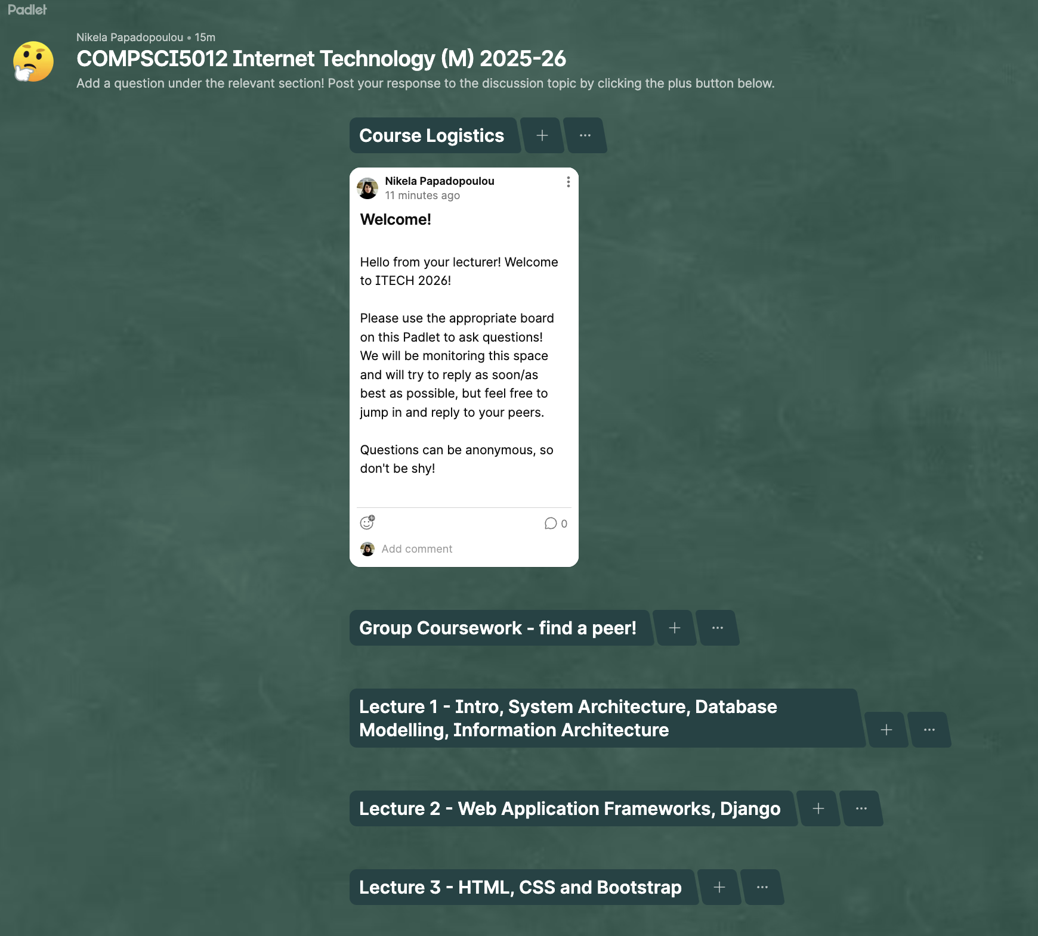
Support and Communication
Course announcements (one-way communication): Moodle
Questions and discussion (two-way communication):
Ask questions in person during the lectures and labs
Use Padlet for questions outside the lectures and labs
Ask
Do not DM or email the course coordinators or the lab assistants
Unless
You have a problem that will affect your performance
Problems with your group and group project’s progress
(in which cases, email the course coordinators)

Slide 10
Code of conduct
You are encouraged to ask questions during the lectures by raising your hands
Only one person talks at any one time
We will all treat each other with respect and dignity. Bullying and harassment will not be tolerated.

Slide 11
Expectations
What we expect from you
We will do our best to...
Attend lectures
Do your own study
Complete quizzes/ group coursework
Read around the subject and try things for yourself
Ask questions in lectures and labs. This is your chance ☺
Plan your learning hours carefully
Make lecture notes and videos available on Moodle
Give you follow up references and additional reading material
Make sure labs are running smoothly with good GTA support
Make reasonable adjustments
Arrange extra support if normal route (padlet, GTAs, etc.) is exhausted
Respond to email on student-specific issues

Slide 12
Types of Feedback in ITECH
Offline Q&A on Padlet
Online Q&A during lectures
1-1 support by GTAs during labs
Detailed feedback on your group projects

Slide 13
Plagiarism and Cheating
If you copy someone else's code without attribution and present it as your own work this is plagiarism
If you plagiarise, you will be reported for academic misconduct and sanctions applied.
Sanctions can be a grade reduction, receiving an H for the assessment or the whole course.
For serious or repeated offences you can be expelled from the university.

Slide 14
Usage of AI
You may use AI to support your work
If you use GenAI for anything beyond background reading, you must acknowledge how you used it and attribute it appropriately
You remain responsible for the accuracy and originality of your work: unacknowledged usage of AI is considered plagiarism

Slide 15
What now?
No labs on week 1
Attend the first lecture

