Slide 1

Introduction to Data Science and Systems
Probabilities I – Introduction to probabilities
Dr Nicolas Pugeault

Slide 2
Today’s learning outcomes
what probability is, and different philosophical interpretations of it
what inverse and forward probability are
what a random variable, distribution, probability mass/density function are
what the empirical distribution is and how it is computed from data
what expectation/expected value is
the axioms of probability theory
Notes:
By the end of this unit you should know:

Slide 3
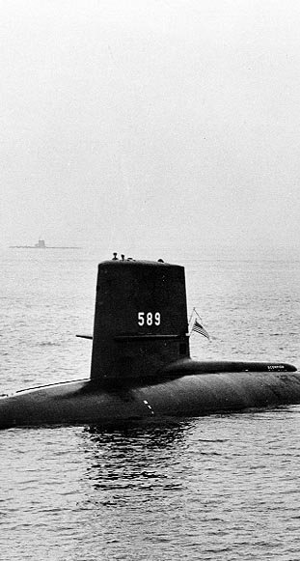
Example: the lost submarine
The USS Scorpion was a nuclear armed submarine that disappeared on 30th June 1968 somewhere in the Atlantic. [This was a year in which four submarines were inexplicably lost at sea -- the 1968 submarine mystery.]
The search for the submarine was one of the first times probabilistic methods were used for searching. The US Navy needed to find the submarine and recover it as fast as possible. Probabilistic methods allow us to reason precisely about things we are uncertain about -- like where the submarine is. Probability gives a concrete, computable representations for an uncertain world.
Notes:
The USS Scorpion was a nuclear armed submarine that disappeared on 30th June 1968 somewhere in the Atlantic. [This was a year in which four submarines were inexplicably lost at sea -- the 1968 submarine mystery.]
The search for the submarine was one of the first times probabilistic methods were used for searching. The US Navy needed to find the submarine and recover it as fast as possible. Probabilistic methods allow us to reason precisely about things we are uncertain about -- like where the submarine is. Probability gives a concrete, computable representations for an uncertain world.

Slide 4
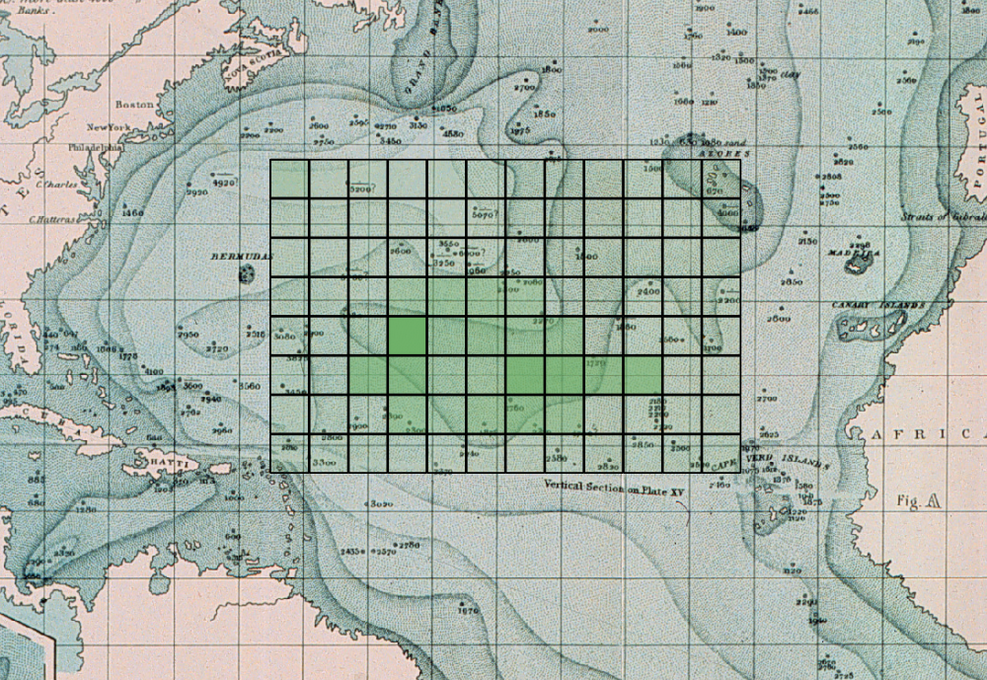
Example: the lost submarine
Imagine dividing the possible search areas into grid squares: what is the probability that the submarine lies within a specific square?
A map like this might be produced, where squares are colored according to their probability:

Slide 5

Part 1. Probability
This section of the course is concerned with stochastic elements; the role of uncertainty, randomness and statistics in computation.
The fundamental mathematical principles are drawn from probability theory, which gives us simple and powerful ways of manipulating uncertain values and let us do useful operations like inferring the most likely hypotheses given some observations.
Probability theory is a simple, consistent, and effective way to manipulate uncertainty.

Slide 6
What is probability?
Experiment (or trial): An occurrence with an uncertain outcome.
For example, losing a submarine -- the location of the submarine is now unknown.
Outcome: The result of an experiment; one particular state of the world.
For example: the submarine is in ocean grid square [2,3].
Sample Space: The set of all possible outcomes for an experiment.
For example, ocean grid squares {[0,0], [0,1], [0,2], [0,3], ..., [8,7], [8,8], [8,9], [9,9]}.
Event: A subset of possible outcomes with some common property.
For example, the grid squares which are south of the Equator.
Probability: The probability of an event with respect to a sample space is the number of outcomes from the sample space that are in the event, divided by the total number of outcomes in the sample space. Since it is a ratio, probability will always be a real number between 0 (representing an impossible event) and 1 (representing a certain event).
For example, the probability of the submarine being below the equator, or the probability of the submarine being in grid square [0,0] (in this case the event is just a single outcome).

Slide 7
Some definitions (cont’d)
Probability distribution: A mapping of outcomes to probabilities that sum to 1. This is because an outcome must happen from a trial (with probability 1) so the sum of all possible outcomes together will be 1. A random variable has a probability distribution which maps each outcome to a probability.
For example P(X=x), the probability that the submarine is in a specific grid square x.
Random variable: A variable representing an unknown value, whose probability distribution we do know. The variable is associated outcomes of a trial
For example, X is a random variable representing the location of the submarine.
Probability density/mass function: A function that defines a probability distribution by mapping each outcome to a probability fX(x),x→R. This could be a continuous function over x (density) or discrete function over x (mass).
For example fX(x) would be a probability mass function for the submarine, which maps each grid square to real number representing its probability.

Slide 8
Some definitions (cont’d)
Observation An outcome that we have directly observed; i.e. data.
For example, a submarine was found in grid square [0,5]
Sample An outcome that we have simulated according to a probability distribution. We say we have drawn a sample from a distribution.
For example, if we believe that the submarine was distributed according to some pattern, generate possible concrete grid positions that follow this pattern.
Expectation/expected value The "average" value of a random variable.
The submarine was on average in grid square [3.46, 2.19]

Slide 9



In prose:
A random variable X has a probability distribution P(X) which assigns probabilities 0 ≤ P(X=x) ≤ 1 to outcomes x which belong to a sample space 𝕩.
That probability distribution is defined by a probability density/mass function fX(x) which assigns probabilities to outcomes such that the sum of probabilities over all outcomes is 1,
We can observe specific outcomes drawn from a distribution as a result of trials.
We can sample (simulate) new outcomes xj′ given a distribution P(X).
Assuming outcomes have values we can evaluate the average expected value E[X] across infinitely many trials.

Slide 10
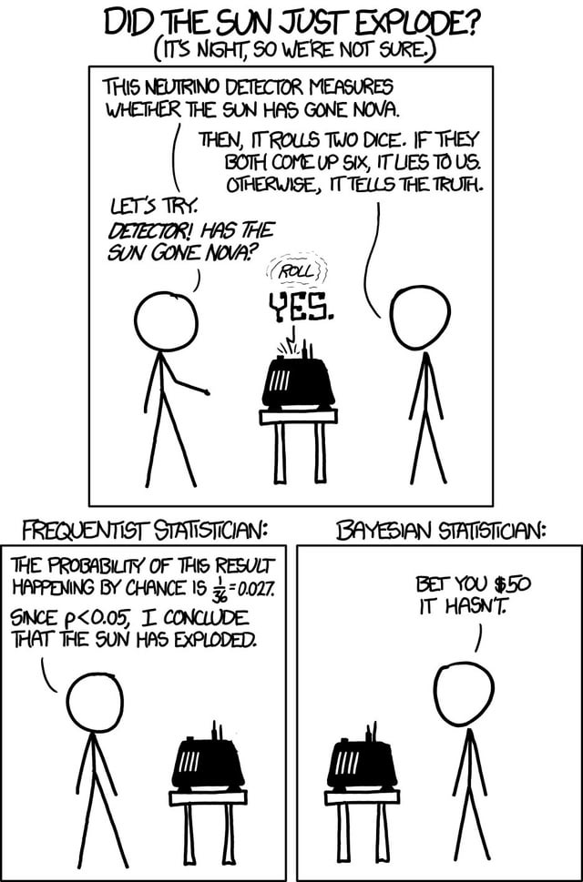
Part 2. Philosophy of probability
There are two schools of thought regarding probability and its uses. We will be (largely) following the Bayesian interpretation, but its worth understanding what that entails.
- Bayesian/Laplacian view
- Frequentist view

Slide 11
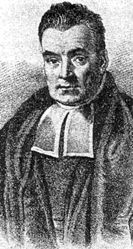
Bayesian/Laplacian view on probability
Bayesians treat probability as a calculus of belief;
probabilities are measures of degrees of belief. P(A)=0 means a belief that event A cannot be true and P(A)=1 is a belief that event A is absolutely certain.
In the Bayesian perspective, it makes sense to say "the probability it is raining outside is 0.3" (the probability quantifies our belief about the weather given the information we have). Note that is not a statement that we believe that the weather is 0.3 rainy (whatever that means)

Slide 12
Bayesian/Laplacian view on probability (cont’d)
Bayesians allow for belief in states to be combined and manipulated via the rules of probability. The key process in Bayesian logic is updating of beliefs.
Given some:
prior belief (it's Glasgow, it's not likely to be sunny) and some
new evidence (there seems to be a bright reflection inside) we can
update our belief to calculate the posterior -- our new probability that it is sunny outside.
Bayesian inference requires that we accept priors over events, i.e. that we must explicitly quantify our assumptions with probability distributions. It is an extension of logic to uncertain information.

Slide 13
Bayesian/Laplacian view on probability (example)
For example, in the submarine search:
the prior might be that the submarine is probably in the south Atlantic (given the last radio broadcast received).
Evidence might be the result of sonar surveys from search ships.
After each survey, the posterior probability of the submarine being in the survey area could be updated. This represents our belief about where the vessel might be.

Slide 14
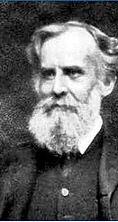
Frequentist view of probability
There is an alternative school of thought that considers probabilities to only be the long-term behaviour of repeated events.
A frequentist does not accept phrases like "what is the probability it is sunny just now?" as there is no long-term behaviour involved (it is only "now" once). It does not make sense in this world view to talk about the probability of events that can only happen once.
It does make sense in a frequentist view to ask things like "what is the probability it will be sunny on any given day?" since we can measure this event (sunny or not) for many different days.
For example, frequentists would not assign a probability to the USS Scorpion being in a specific grid square; this is not an experiment that can be repeated.

Slide 15
Objectivity and subjectivity
Frequentist versus Bayesian debates quickly enter philosophical territory. The diversity of viewpoints and depth of arguments cannot be done justice here.
Very briefly, Bayesian probability theory is sometimes said to be subjective because it requires the specification of prior belief, whereas frequentist models of probability do not admit the concept of priors and thus is objective.
An alternative view is that the Bayesian model explicitly encodes uncertain knowledge and states universal formal rules for manipulating that knowledge, as formal logic does for definite knowledge. Frequentist methods are objective in the sense that they make statements about universal truths (e.g. asymptotic behaviour), but they do not form a calculus of belief, and thus can't answer many questions of importance directly.

Slide 16
Frequentist vs Bayesian (summary)
Bayesian
Includes priors
Probability is a degree of belief
(Parameters of population considered to be random variables, data to be known)
Frequentist
No priors
Probability is the long-term frequency of events
(Parameters of population assumed to be fixed, data to be random)

Slide 17
Superiority of probabilistic models
Regardless of the philosophical model you subscribe to, there is one thing you can be sure of: probability is the best.
There are other models of uncertainty than probability theory that are sometimes used. However, all other representations of uncertainty are strictly inferior to probabilistic methods in the sense that a person, agent, computer placing "bets" on future events using probabilistic models has the best possible return out of all decision systems when there is uncertainty.
Any theory with as good a gambling outcome as would be achieved using probability theory is equivalent to probability theory.

Slide 18
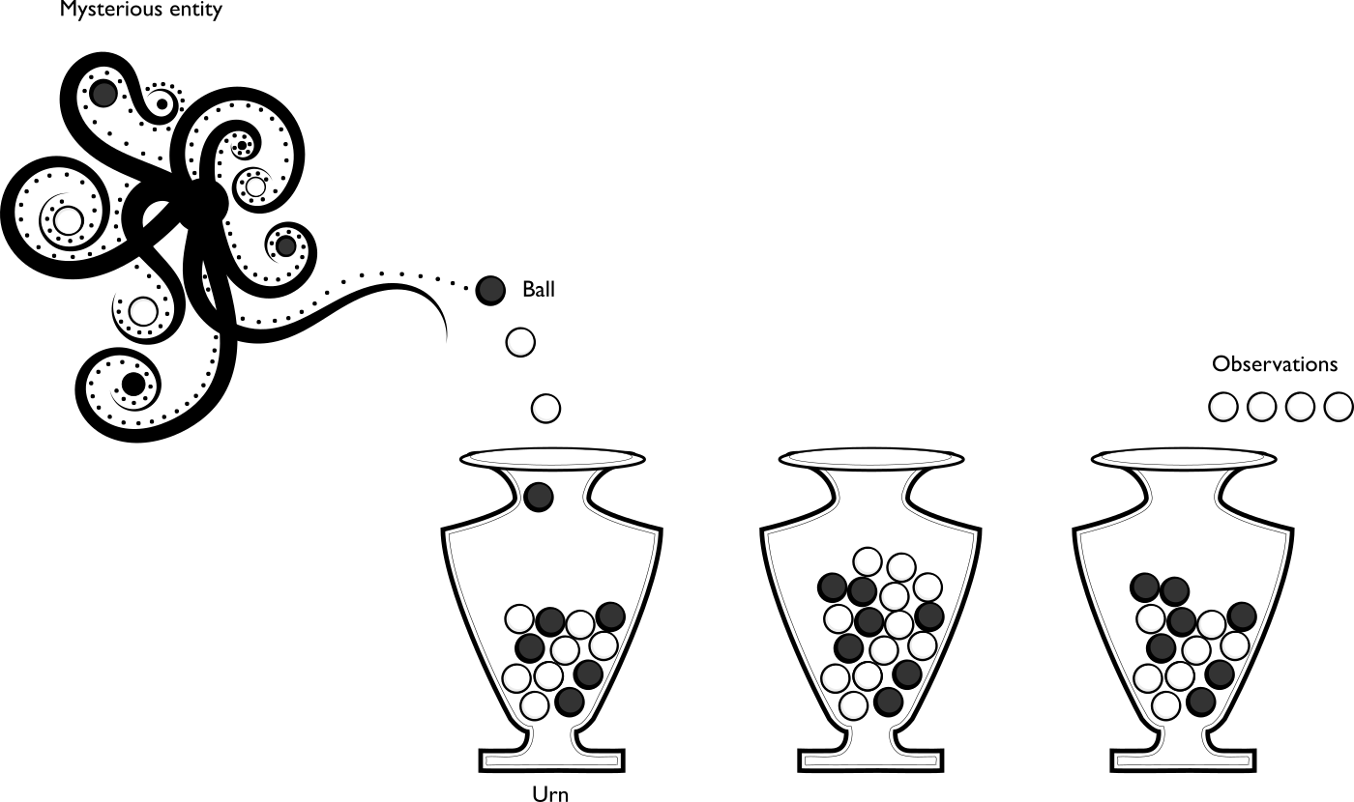
Generative models
Consider an urn, into which a number of balls have been poured (by some mysterious entity, say). Each ball can be either black or white.
You pull out four random balls from the urn and observe their colour. You get four white balls.
Notes:
A key idea in probabilistic models is that of a generative process; the idea that there is some unknown process going on, the results of which can be observed. The process itself is governed by unobserved variables that we do not know but which we can infer.

Slide 19
Generative models
There are lots of questions you can ask now:
What is the probability that the next ball that is drawn will be white?
This is a forward probability question. It asks questions related to the distribution of the observations.
What is the distribution of white and black balls in the urn?
This is an inverse probability question. It asks questions related to unobserved variables that govern the process that generated the observations.
Who is the mysterious entity?
This is an unknowable question. The observations we make cannot resolve this question.
Notes:
There are a huge number of processes that can be framed as urn problems (urns where balls are replaced, problems where there are multiple urns and you don't know which urn the balls came from, problems where balls can move between urns, and so on).

Slide 20
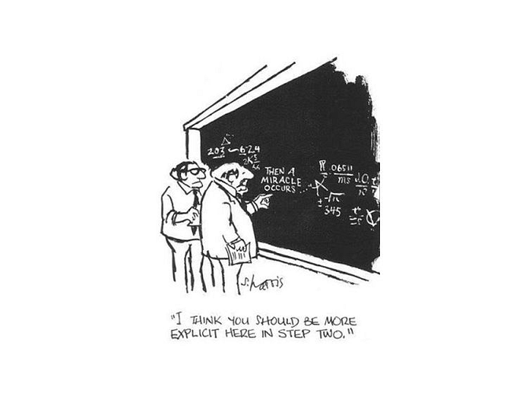
Part 4. A formal basis for probability theory
Sidney Harris (1977), The New Yorker

Slide 21
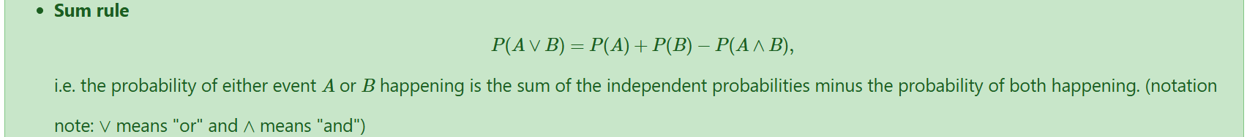
Axioms of probability

Slide 22

Random variables and distributions
A random variable is a variable that can take on different values, but we do not know what value it has; i.e. one that is "unassigned".
However, we have some knowledge which captures the possible states the variable could take on, and their corresponding probabilities.
Probability theory allows us to manipulate random variables without having to assign them a specific value.

Slide 23
Random variables and distributions
A random variable is written with a capital letter, like X.
A random variable might represent:
the outcome of dice throw (discrete);
whether or not it is raining outside (discrete: binary);
the latitude of the USS Scorpion (continuous);
the height of person we haven't met yet (continuous).

Slide 24
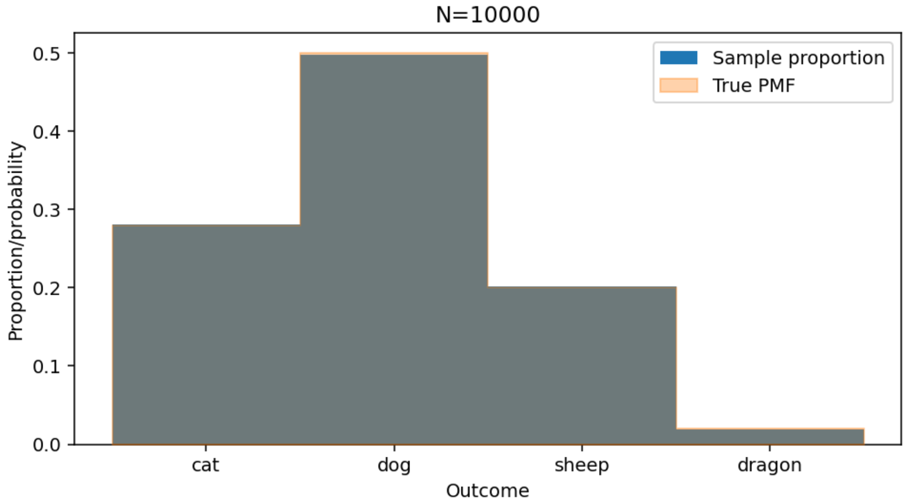
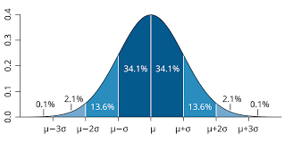
Distributions
A probability distribution defines how likely different states of a random variable are.
We can see X as the experiment and x as the outcome, with a function mapping every possible outcome to a probability.
We write P(X=x) (note the case!), and use the shorthand notations:
P(X=x) the probability of random variable X taking on value x
P(X) shorthand for probability of X=x
P(x) shorthand for probability of specific value X=x
Notes:
We can see an outcome as a random variable taking on a specific value i.e. P(X=x). Note that by convention we use P(A) to mean the probability of event A, not a random variable A (an event is a set of outcomes; random variables only assign probabilities to outcomes).

Slide 25
Discrete and continuous
Random variables can be continuous (e.g. the height of a person) or discrete (the value showing on the face of a dice).
Discrete variables: The distribution of a discrete random variable is described with a probability mass function (PMF) which gives each outcome a specific value; imagine a Python dictionary mapping outcomes to probabilities. The PMF is usually written f_{X}(x), where P(X=x)=f_{X}(x).
Continuous variables: A continuous variable has a probability density function (PDF) which specifies the spread of the probability over outcomes as a continuous function f_{X}(x).
It is not the case that P(X=x) = f_{X}(x) for PDFs.

Slide 26
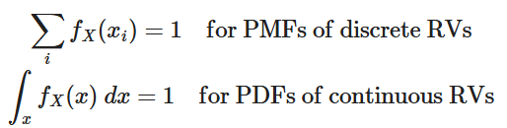
Integration to unity
A probability mass function or probability density function must sum/integrate to exactly 1, as the random variable under consideration must take on some value; this is a consequence of unitarity.
Every repetition of an experiment has exactly one outcome.

Slide 27
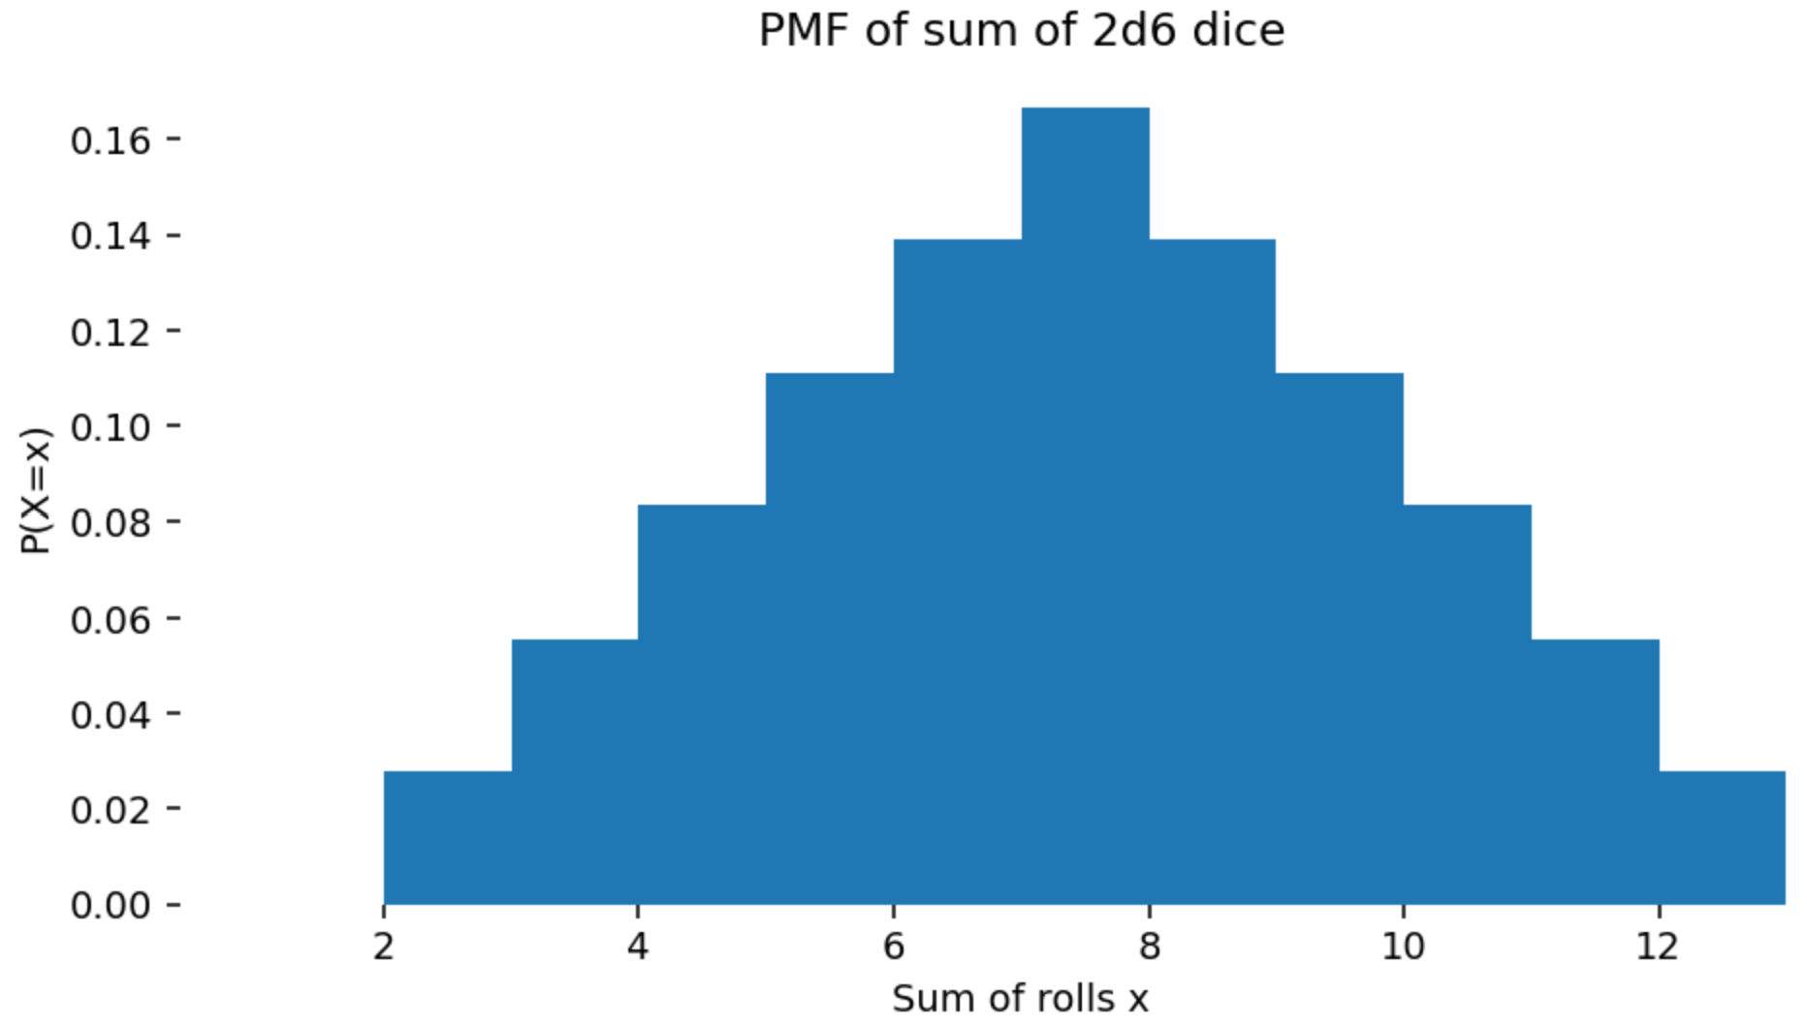

PMF example: Sum of dice rolls
A very simple discrete PMF is the expected value of the sum of two six-faced dice.
P(X=x)=f_{X}(x) takes on values for each possible outcome x $∈$ {2,3,4,5,6,7,8,9,10,11,12}

Slide 28

5. Expectation
The expectation is the "average" of a random variable. it represents what we'd "expect to happen"; the most likely overall "score".
It can be thought of as a weighted sum of all the possible outcomes of an experiment, where each outcome is weighted by the probability of that outcome occurring.
For example, in the "pair of dice" scenario, we can compute the expected value of the number of "dots" showing in total after a roll. We compute the probability of each number of dots showing and multiply by that number of dots, and summing the result. This is the expected number of dots showing, on average, or the expectation.

Slide 29
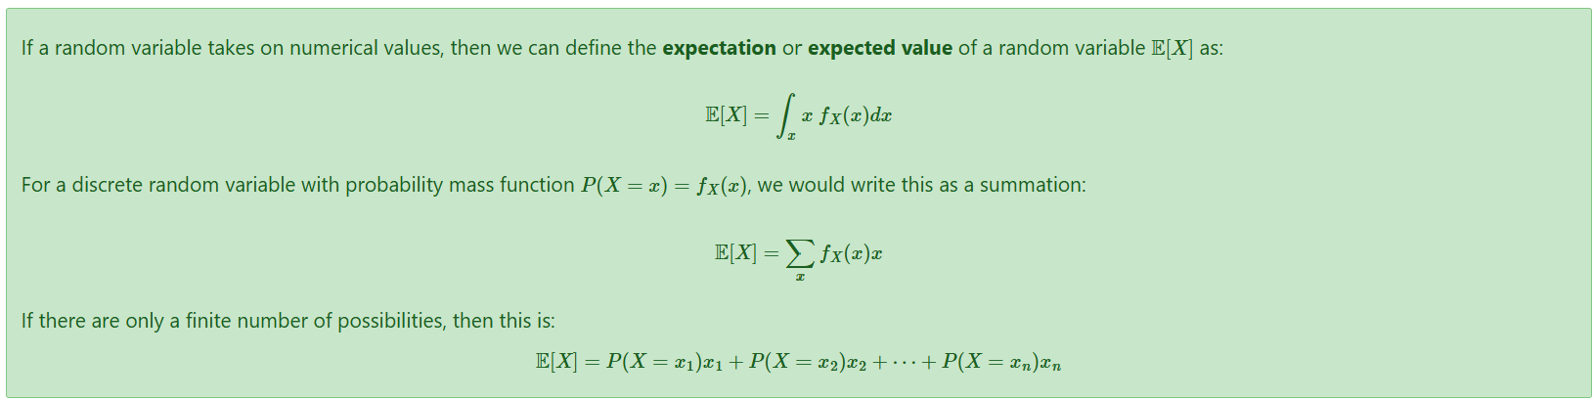
Expectation – definition

Slide 30
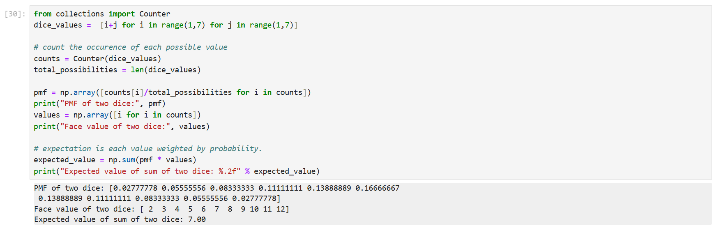
Expectation: Dice example

Slide 31
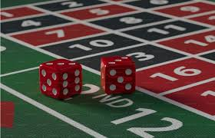
Expectation
This is an intuitive property.
Imagine you meet a street hustler, who asks you to play the two dice game.
He offers you a chance to buy in for £8; you win as many pounds as the show on the top faces of the dice after throwing them.
Is this a fair game?
No. The expected return is only £7, and you have to put in £8 to play, so the expected result is a £1 loss (sometimes stated as "negative expected value" or -ve EV). If it was £7 to buy in, the game would be fair, in the sense that you and the hustler would not transfer money on average.

Slide 32
Expectation and mean
Expectation corresponds to the idea of a mean or average result.
The expected value of a random variable is the true average of the value of all outcomes that would be observed if we ran the experiment an infinite number of times. This is the population mean -- the mean of the whole, possibly infinite, population of a random variable.
Many important properties of random variables can be defined in terms of expectation.
The mean of a random variable X is just E[X]. It is a measure of central tendency.
The variance of a random variable X is var(X)=E[(X−E[X])2]. It is a measure of spread.

Slide 33
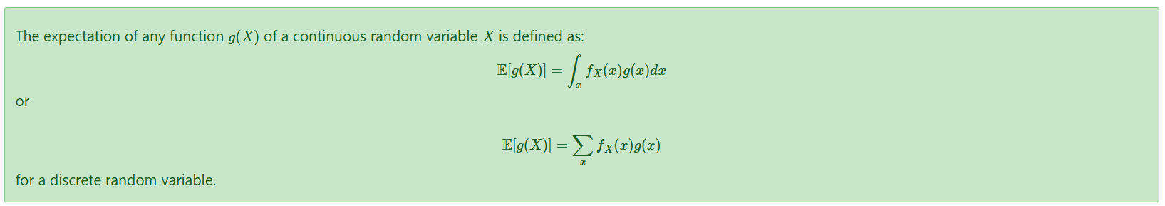
Expectation of functions of X
We can apply functions to random variables, for example, the square of a random variable.
Notes:
That is, we just take the sum/integral of each outcome, passed through the function g(x), weighted by the probability of the outcome x. g(x) could be thought of a "scoring" function, which assigns a real number to every outcome of X. Note that g(x) has no effect on the probability density/mass function fX(x). It doesn't affect the probability of the outcomes, just the value assigned to those outcomes.

Slide 34
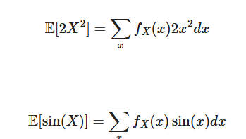
Expectation of functions of X
For example, we can compute simple expectations like these:
Notes:
That is, we just take the sum/integral of each outcome, passed through the function g(x), weighted by the probability of the outcome x. g(x) could be thought of a "scoring" function, which assigns a real number to every outcome of X. Note that g(x) has no effect on the probability density/mass function fX(x). It doesn't affect the probability of the outcomes, just the value assigned to those outcomes.

Slide 35


Expected values and decisions
Expected values are essential in making rational decisions, the central problem of decision theory. They combine scores (or utility) with uncertainty (probability).
The expected value gives us a way of deciding, for example, how much it would be worth paying to play a dice game.
If the units were pounds, we'd break even if we paid £2.33 to play the game and make a profit (on average) if we paid £2.00 to play the game.
The expected average profit is just the stake we pay to play each game minus the expected value of one round of the game:

Slide 36
6. Samples and sampling
Samples are observed outcomes of an experiment; we will use the term observations synonymously, though samples usually refer to simulations and observations to concrete real data.
We can sample from a distribution; this means simulating outcomes according to the probability distribution of those variables.
We can also observe data which comes from an external source that we might believe is generated by some probability distribution.
For example, we can sample from the sum of dice PMF by rolling two dice and summing the result. This is a sample or a draw from this distribution. For discrete random variables, this is easy: we simply produce samples by drawing each outcome according to its probability.

Slide 37
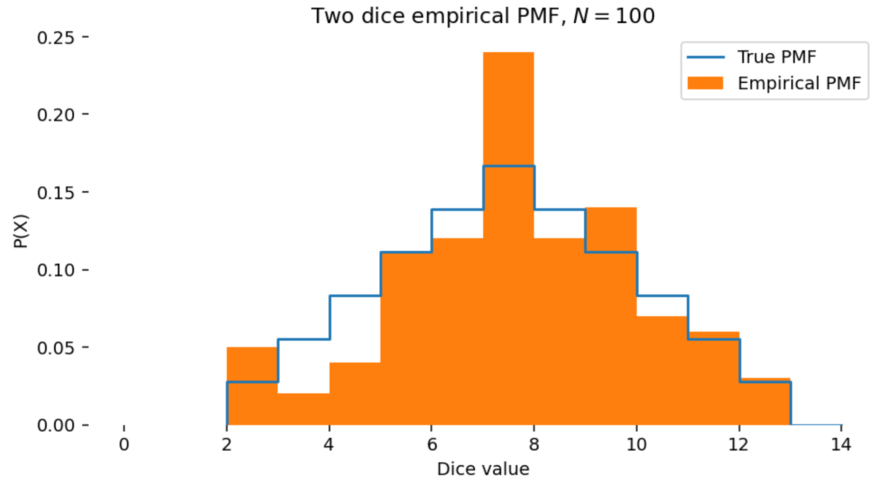
The empirical distribution
For discrete data, we can estimate the PMF that might be generating observations by counting each outcome seen divided by the total number of trials. This is called the empirical distribution.
This can be thought of as the normalized histogram of counts of occurrences of outcomes.

Slide 38
Computing the empirical distribution
For discrete random variables, we can always compute the empirical distribution from a series of observations.
For example, from the counts of a specific word in a corpus of text (e.g. in every newspaper article printed in 1994). We just count the number of times each word is seen and divide by the total number of words.
Note that the empirical distribution is a distribution which approximates an unknown true distribution. When N is large it approximates the true PMF assuming the samples are drawn in an umbiased way.
However, this approach does not work usefully for continuous random variables, since we will only ever see each observed value once (think about why!).

Slide 39
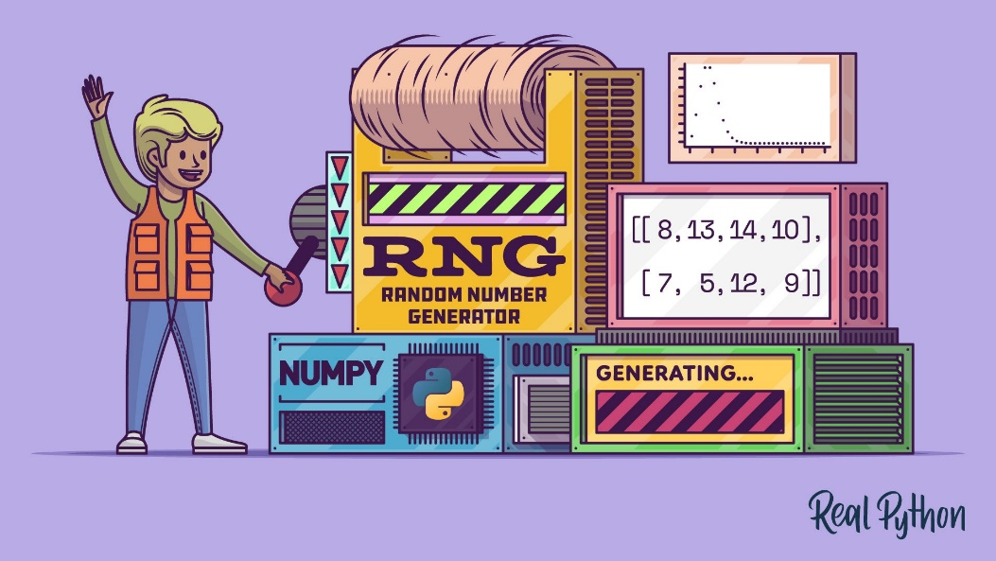
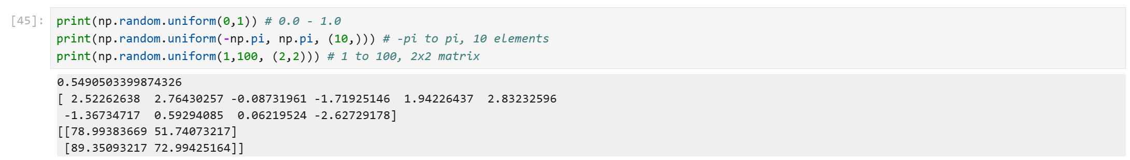
Random numbers
There are algorithms which can generate continuous random numbers which are uniformly distributed in an interval, such as from 0.0 to 1.0.
These are actually pseudo-random numbers in practice (computers are deterministic!) but approximate the statistical properties of true random sequences.
We must be careful: computers generate pseudo-random floating-point numbers; and not true random real numbers. While this makes little difference much of the time, they are quite different things.
https://realpython.com/numpy-random-number-generator/
Notes:
There are algorithms which can generate continuous random numbers which are uniformly distributed in an interval, such as from 0.0 to 1.0. These are actually pseudo-random numbers in practice, since computers are (hopefully) deterministic. They designed to approximate the statistical properties of true random sequences. Inherently, all such generators generate sequences of discrete symbols (bits or integers) which are then mapped to floating point numbers in a specific range; this is quite tricky to get right.
We must be careful: computers generate pseudo-random floating-point numbers; and not true random real numbers. While this makes little difference much of the time, they are quite different things.

Slide 40
Uniform sampling
A uniformly distributed number has equal probability of taking on any value in its interval and zero probability everywhere else.
Although this is sampling from a continuous PDF, it is the key building block in sampling from arbitrary PMFs.
A uniform distribution is notated X∼U(a,b), meaning X is random variable which may take on values between a and b, with equal possibility of any number in that interval.
The symbol ∼ is read "distributed as", i.e. "X is distributed as a uniform distribution in the interval [a,b]".
Note that in practice these are not uniform across the reals in a given interval if we are using floating point, because we can only ever sample valid floating point values.

Slide 41
Discrete sampling
For a discrete probability mass function, we can sample outcomes according to any arbitrary PMF by partitioning the unit interval.
Algorithm:
choose any arbitrary ordering for the outcomes x₁,x₂,…
assign each outcome a "bin" which is a portion of the interval [0,1] equal to its probability, so that the interval is divided into consecutive non-overlapping regions [P(x₁)→P(x₁)+P(x₂) , P(x₁)+P(x₂)→P(x₁)+P(x₂)+P(x₃) , …]
draw a uniform sample in the range [0,1]
whichever "outcome bin" it lands in is the sample to draw
By the definition of a PMF, the sum of all the probabilities will be 1.0, so it will fill the interval [0,1] perfectly with no gaps.
Notes:
This is like sticking posters on a wall with an area proportional to the probability of each outcome, and then throwing darts at the wall.

Slide 42
Discrete sampling example
0.28+0.5+0.2
= 1-0.02
0.28
0.28+0.5
cat
dog
sheep
0
1

Slide 43

Example: Romeo & Juliet
The code in the lecture notes loads a text file (in this case, Romeo and Juliet), and converts into a vector of numerical codes. It keeps only letters and spaces and converts everything to lowercase.
Rom. Give me a torch. I am not for this ambling.
Being but heavy, I will bear the light.
Mer. Nay, gentle Romeo, we must have you dance.
Rom. Not I, believe me. You have dancing shoes
With nimble soles; I have a soul of lead
So stakes me to the ground I cannot move.

Slide 44

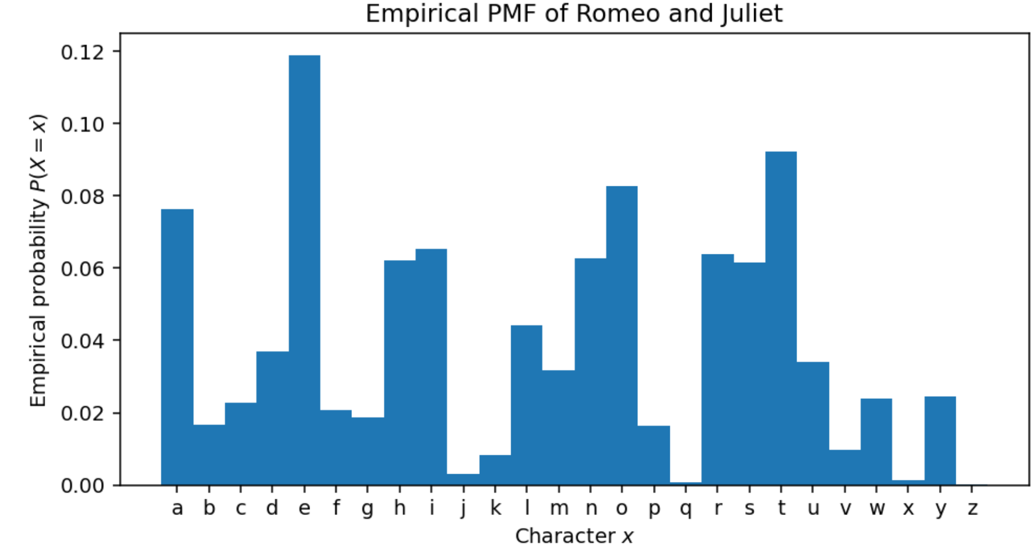
Letters PMF in Romeo & Juliet

Slide 45

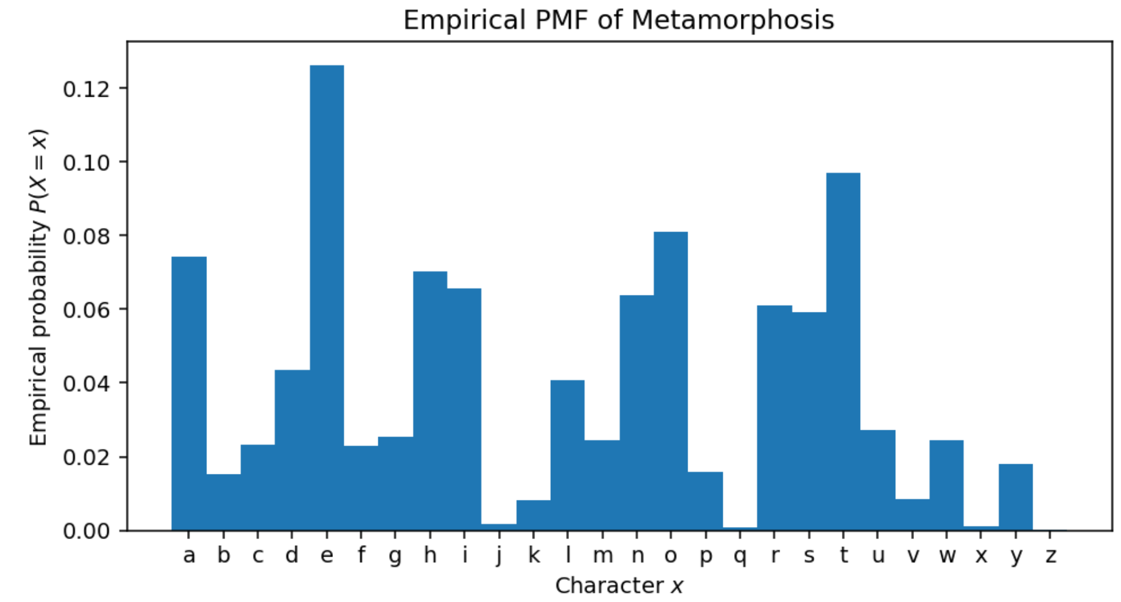
Letters PMF in Metamorphosis

Slide 46
Judging a book (without its cover!)
The results are similar (both are English texts), but there are some subtle differences; there slightly more q characters in Kafka compared to Shakespeare; the frequencies of h and i are reversed.
As always, given a PMF, we can draw samples from it with our standard procedure, though the results aren't very exciting:

Slide 47
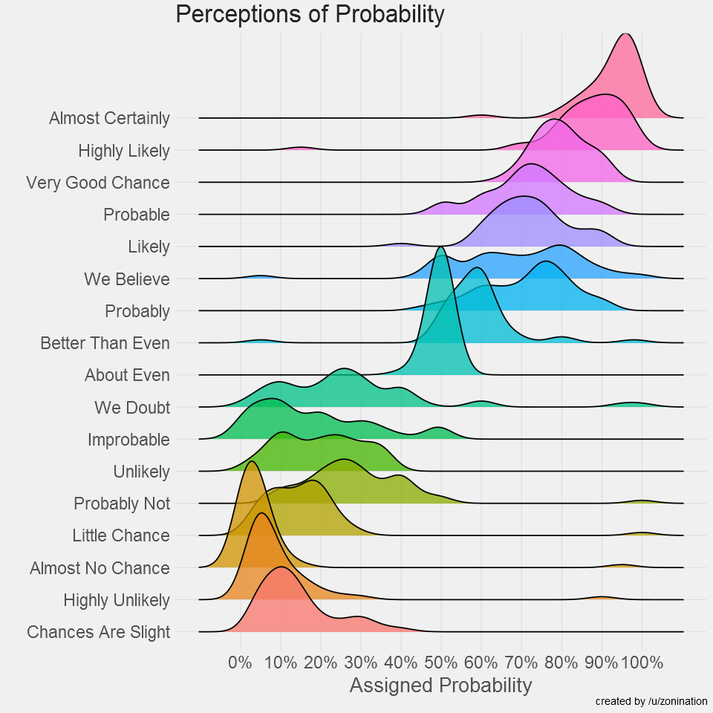
7. Perceptions of probabilities
Raw probabilities (e.g. P(X=x)=0.9999) are not always intuitive.
The graph below shows the probability that a sample of people imagined, given specific verbal cues.
What about 1 in a million events? What about the probability of the sun rising tomorrow?
Even if people had responded accurately, the linear visualisation from 0% to 100% makes it very hard to see extreme values.
Notes:
Probabilities can be used to represent belief. But the raw numbers (e.g. P(X=x)=0.9999) are not always a useful to make judgments, communicate results, or in some cases, even to do computations.
The graph below shows the probability that a sample of people imagined, given specific verbal cues. The results are very interesting, but notice that the graph has almost no points close 0.0 or 1.0 -- what about 1 in a million events? What about the probability of the sun rising tomorrow?
One of the problems is that even if people had responded accurately, the linear visualisation from 0% to 100% makes it very hard to see extreme values.

Slide 48
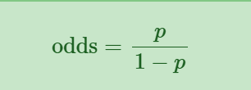
Odds & log odds
The odds of an event with probability p is defined by: The odds are a more useful unit for discussing unlikely scenarios (odds of 1:999, or 999:1 against, is easier to understand than p=0.001).

Slide 49
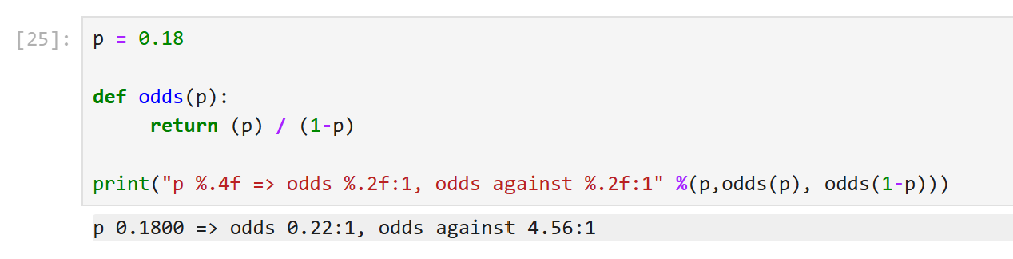
Odds: example

Slide 50
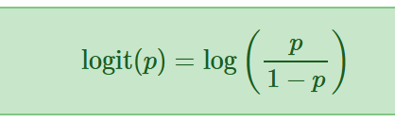
Log odds
Log-odds or logit are particularly useful for very unlikely scenarios:
The logit scales proportionally to the number of zeros in the numerator of the odds.

Slide 51
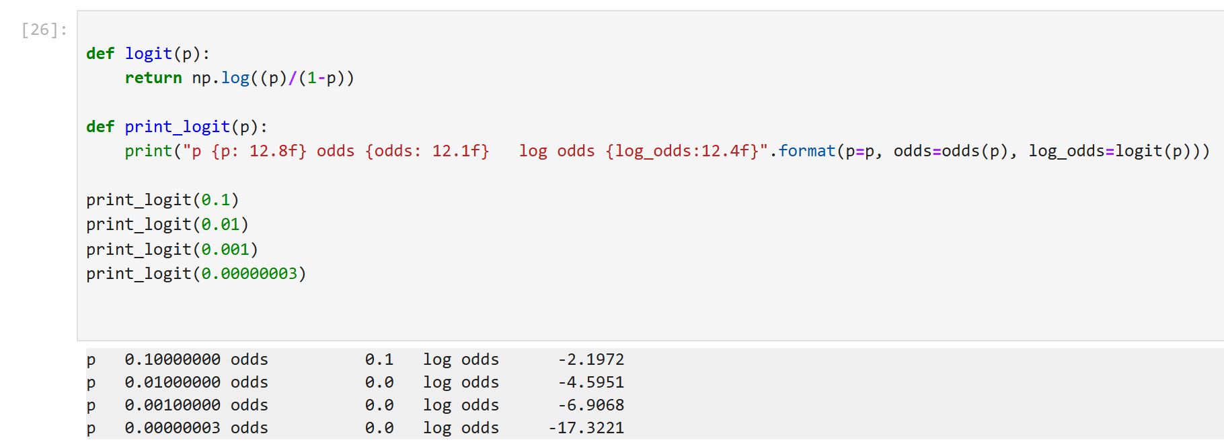
Log odds example
Both of these are typically used to display results, rather than to do computations. But log-probabilities are widely used for computation as well as display. They help solve numerical problems in probability calculations.

Slide 52
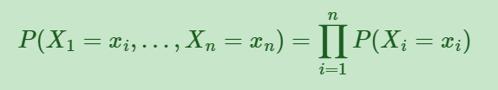
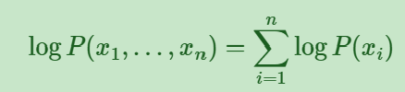
Log-probabilities
The probability of multiple independent random variables taking on a set of values can be computed from the product: P(X,Y,Z)=P(X)P(Y)P(Z) and in general:
Underflow: multiplying values <1 leads to numerical issues: we will get floating point underflow. Instead, it is numerically more reliable to manipulate log probabilities, which can be summed instead of multiplied:
The log-likelihood is just log⁡ P(B|A), which is often more convenient than the raw likelihood.
Notes:
This is simply a numerical convenience which avoids underflow. The log-likelihood is just log⁡P(B|A), and is often more convenient to work with than the raw likelihood.

Slide 53

Likelihood function
When talking about likelihood, we often write L(x_{i}) to mean the likelihood of xi. The likelihood is not a probability. It is a function of data, and L(x_{i})=f_{X}(x_{i})
For example, consider the empirical PMF of Romeo and Juliet. This gives the probability of seeing any given character. The likelihood of seeing all of the characters, given our per-character probability model, is:

Slide 54
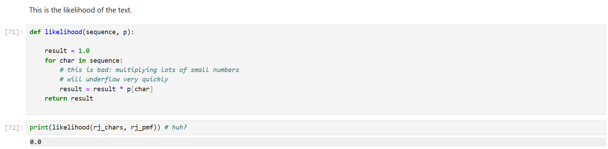
Example: Romeo & Juliet

Slide 55
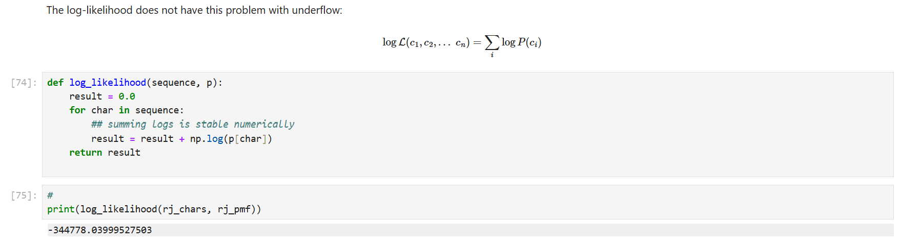
Example: Romeo & Juliet

Slide 56
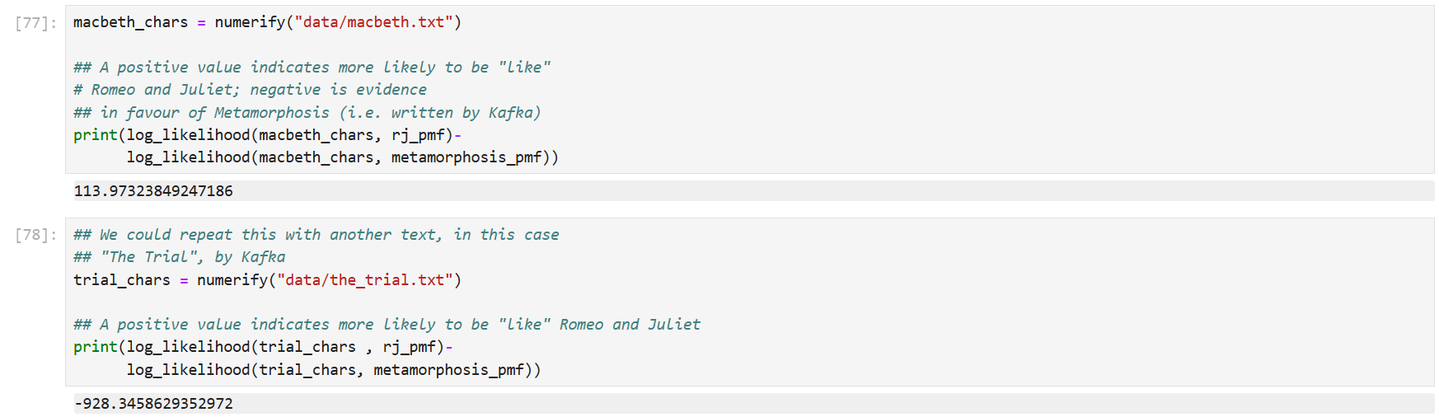
Comparing Log-Likelihoods
Notes:
We could imagine that writing plays and novels is an activity that mysterious entities do by generating random characters according to a PMF. Under this (very simplified!) assumption, we could now take an "unknown" text (in this case Macbeth) and then look at how likely it would have been to have been generated under two models:
A It was generated by a mysterious entity using the PMF for Romeo and Juliet
B It was generated by a mysterious entity using the PMF for Metamorphosis
Neither of these will be exactly true, but we can precisely quantify to what extent Macbeth appears to have been generated by a similar process to these two reference texts.
This is a very rough proxy for whether or not they were generated by the same mysterious entity -- i.e. author. Our model is just the distribution of characters, so is a fairly weak model of different styles. However, it is sufficient to do the comparison here.

Slide 57

Thank you Contact: Nicolas.Pugeault@Glasgow.ac.uk

