Slide 1
Web Application Frameworks & Django
Internet Technology
ITECH
Notes:
Lets get started by recapping the main concepts we have learnt so far –
N-tier architectures
Separation of Concerns
Top-Down vs. Bottom Up Design
Abstraction enables us to deal with complexities – and defer details – separate concerns – assign responsibilities
In passing, I also mentioned that there were ANTI-PATTERNS.. Paralysis by analysis (might result from top down)… while Spaghetti code (is likely to result from bottom up)
Pipe and Filter Architectures
Dataflow diagrams

Slide 2
Week 2 Learning Objectives
By the end of Week 2 you should:
Understand the complexity of web development and why we need frameworks
Map the elements of your architecture design to Django modules
With a little help of the Tango with Django book and your own study

Slide 3
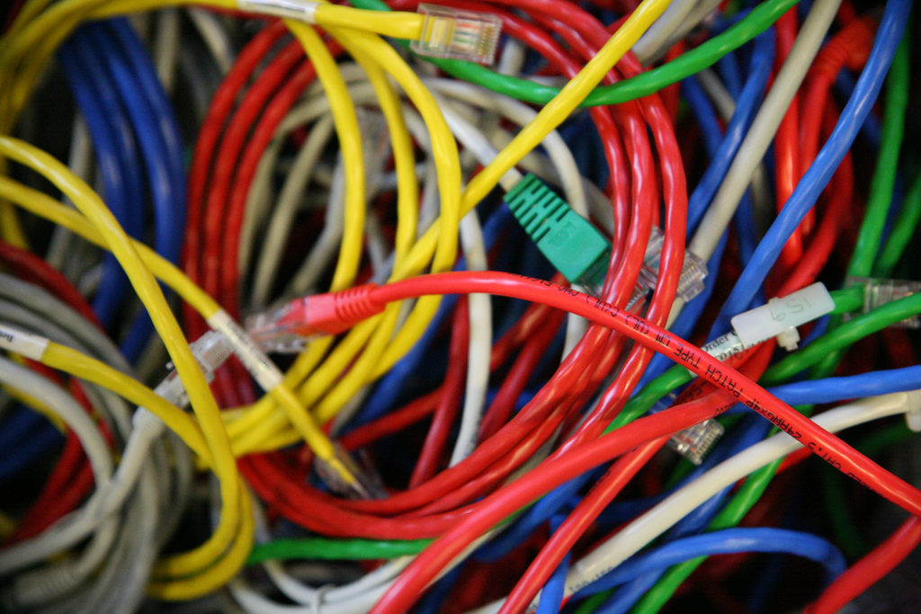
Web Dev Complexity
Notes:
Already in the high level SA presented, there are lots of moving parts, lots of components, that have to communicate with each other. This creates complexity (it also reduces complexity too – which we will go into detail in a later lecture.
However, the problem is even worse and compounded because of a number of things…

Slide 4
Web Development Complexity
Collision of Languages
Markup Languages
Programming Languages
Database Query Languages
Shifting Standards
Document Object Model
XML/JSON
Web Browser Compatibility
Browser wars encourage new ‘unique’ features
HTTP is a Stateless Protocol
But most applications require the persistence of state
Notes:
Other factors also introduce complexity on a number of different fronts.
Markup languages are designed for the processing, definition and presentation of text. The language specifies code for formatting, both the layout and style, within a text file. The code used to specify the formatting are called tags. HTML is a an example of a widely known and used markup language.
Other factors also introduce complexity on a number of different fronts.

Slide 5
Signs of Hope
Web development has become a serious business
In line with this, the methods of development are maturing and increasingly adopting good practices of ‘classical’ Software Engineering:
Application Programmer Interfaces (APIs)
Libraries
Frameworks
Tools
Standards
Notes:
Through the course, we will be look at a number of different api’s, libraries, toolkits, and standards so that we can rapidly build a web application

Slide 6
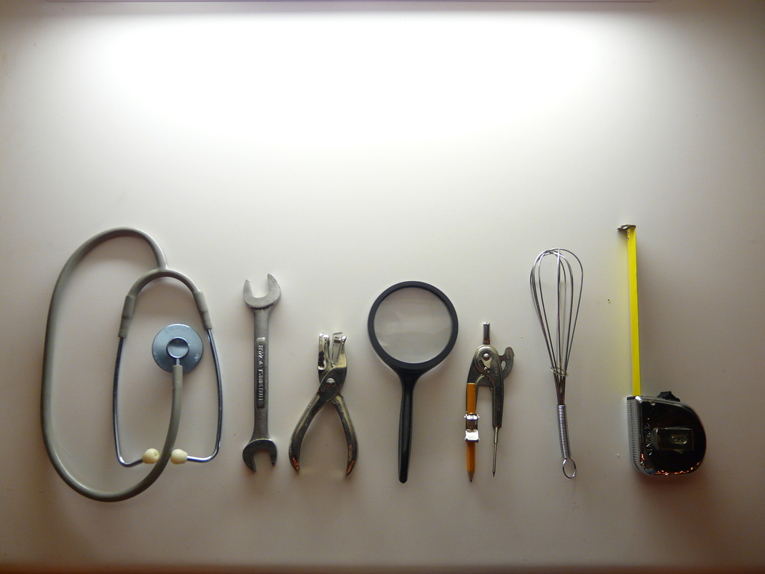
Tools
Notes:
Consequently, you will be exposed to a number of different tools -

Slide 7
Web Development Tools
Web development tool support is not yet as advanced as with classic software development
Most languages have several complex IDEs (Integrated Development Environments) to chose from
Eclipse, .Net Framework, Django, etc
The nature of web development is disjoint
a developer must become familiar with a set of distinct and (typically) non-integrated tools

Slide 8
What you code in…
An important tool is the IDE
Its choice and your expertise in its usage can seriously affect your productivity
Syntax Awareness
Auto-completion
Snippets
Scripts & Macros
Integration with other development tools (revision control)
Some IDEs have plugins for scripting languages (e.g. Eclipse has a PHP plug-in)

Slide 9
Frameworks
Frameworks provide design and partial implementations for a particular domain of applications
Drawing Applications (provide drawing primitives)
Distributed Middleware
Web Applications
Frameworks allow developers to create applications more efficiently by providing default functionality, whilst allowing them to extend and override to suit their specific purposes

Slide 10
Classic Framework Definitions
There are several interpretations of a framework:
A framework is a set of classes that embodies an abstract design for solutions to a family of problems
A framework is the reusable design of a system or a part of a system expressed as a set of abstract classes and the way the instances of those classes collaborate
A framework is a set of prefabricated software building blocks that programmers can use, extend, or customize for specific computing solutions;
Frameworks are large abstract applications in a particular domain that can be tailored for individual applications
A framework is a reusable software architecture comprising both design and code
Notes:
Note the commonalities – abstracted design/applications… prefabrication

Slide 11
Framework Characteristics
Inversion of Control
Framework is responsible for the application control flow
Default Behaviour
Framework must provide some ‘useful’ functionality related to the application domain
Extensibility
Hot-spots designed to be extended
Allow developer to customize their application specifically for a particular purpose
Non-modifiable Framework Code
Key components of the framework cannot be altered
Not strictly non-modifiable, but typically just used, though contributions back to the framework are often subject to the framework creators or open source community

Slide 12
Framework Characteristics
Advantages:
Enables rapid development
Concentrate on unique application logic
Reduces boiler plate code
Disadvantages:
Impose a certain model of development (80% easy / 20% hard)
Frameworks can introduce code bloat
Levels of abstraction generally introduce performance penalties
Difficult to overcome the steep learning curve
Traditionally poorly documented

Slide 13
Framework vs Libraries?
A framework is about reusing behaviours by how abstract classes and components interact with each other
A framework calls your application code
A library is a collection of classes which provide reusable functionality
Your application code calls the library

Slide 14
Degrees of Activeness
Passive Framework:
Just a set of starting files that you unpack
And then use to build your application
Semi active frameworks
Generates your starting project code
Then you customize and fill in the app logic
Active Frameworks
They go beyond semi-active, and work in the background by generating additional code, without explicit commands from the developer

Slide 15
Pre-Fabricated Things
Web frameworks typically provide (some of) the following features:
User authentication, authorization, security
Database abstraction (or Object-Relational Mapping)
Template system
Ajax sub-framework
Session Management
An Architecture usually based on Model-View-Controller

Slide 16
MVC Architecture
Model
Data/Logic
Query /
Get State
State Change /
Set State
Change Notification /
Update Event
User Action/
Gesture
View
Controller
Representation
User Interaction
View Selection
Change View
Method Invocations
Events

Slide 17
Model-View-Controller
The model, this layer contains codes that operate on the application data.
Any actions that wanted to be executed on the raw data must go through this layer. Definitions of how the application work with data (commonly retrieve, create, update, or delete) are written here.
The view, this is the presentation layer.
It defines how your pages should look like to the user, how the application presents data, or how a user can submit certain instructions to be executed by the application.
The controller, this component acts as the orchestrator of the application.
It controls the flow of the program. It receives user commands, processes it, and then contacts the model, and finally instructs the view to display appropriately to the user.
http://www.slepi.net/blog/programming/design-principles-in-ruby-on-rails.html

Slide 18
MVC pros and cons
Advantages
Enable independent development & testing
Easier to maintain
Provides reusable views & models
Synchronized views and multiple simultaneous views
Helps enforce logical separation of concerns
Disadvantages
Some initial overheads splitting out concerns
Increased overheads in development (i.e. 3 classes vs 1)
Especially for very simple applications
Debugging it can sometimes be a problem
Potential for excessive updates
Requires the developers to think and understand patterns

Slide 19
Why use WAFs?
To enable rapid development that matches the rapid release cycle of the web
To reduce the development effort of programming in different languages/technologies
Database access (possibly Object-Relational Mapping)
Templating HTML
To manage the complexity of the increasingly large and sophisticated web applications by including library support for:
User Authentication
Session Management
Creating a Web Service

Slide 20
Why use WAFs?
To reduce 'boiler plate’ code in web applications
Particularly access and manipulation of DB
Session management across multiple pages
Often referred to as CRUD operations
Web-apps have matured to a point were software engineering practices (patterns (e.g. MVC) and frameworks) are becoming
increasingly useful,
necessary and
the norm.

Slide 21
Common Framework Functionality
Web Template System
to provide pre-defined pages that load dynamic content
Caching
to reduce perceived lag
Security
to provide authentication and authorization functionality
Database access and mapping
To speed up working with databases and avoid using SQL

Slide 22
Common Framework Functionality
URL Mapping
To enable handling of URLs and friendlier URLS
Ajax handlers and handling
To create more dynamic pages that are more responsive
Automatic configuration
To decrease the setup hassles, usually uses introspection and/or following conventions
Form Management
To speed up the creation of forms and handling of forms

Slide 23
WAF Caveats
They require an investment in learning the framework
Learning vs. Building Trade-off
Sacrifice some flexibility for rapid development
Flexibility vs. Efficiency Trade-off
Knowledge of one framework does not necessarily transfer to another
Early stages of web framework eco-systems
There are many competing options at present
Eventually the most popular (few) will emerge

Slide 24
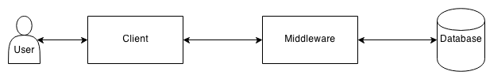
High Level System Architecture
Web application frameworks sit in the middleware, for building the application server.

Slide 25
Many Web App Frameworks
Java
Spring, Struts, Grails, Google Web Toolkit, Jboss, etc
PHP
Symfony, Cake, Alloy, AppFlower, Lithium, Seagull, Solar, etc
Python
Django, Flask, TurboGears, Pylons, Pyramid, Grok, Zope, etc
Ruby
Rails, Camping, MonkeyBars, Merb, Ramaze, Nitro, etc
Perl
Catlyst, Dancer, Reaction, Interchange, Mason, etc
ASP.NET, ColdFusion,C++, Tcl, Javascript, Ocaml,Scala, Groovy, etc
http://en.wikipedia.org/wiki/Comparison_of_web_application_frameworks

Slide 26
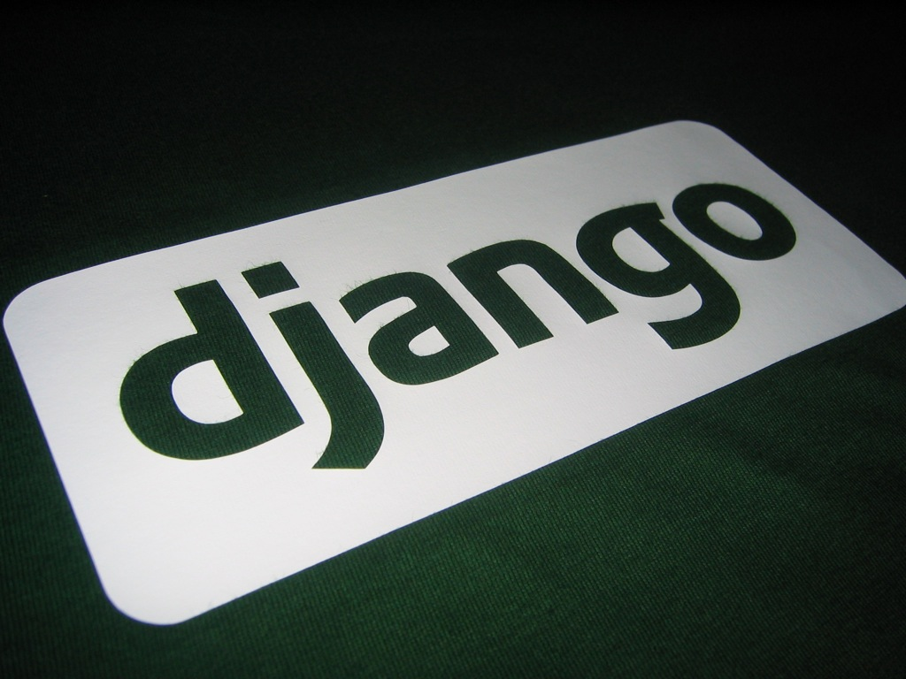
Django

Slide 27
Django
Pronounced JANG-oh
“Django is a high-level Python Web framework that encourages rapid development and clean, pragmatic design”
Claimed to be the web framework for perfectionists with deadlines – you may differ!
Notes:
Django is a tool! Other technologies can be used to accomplish the same end-goal, yet in this course we’ll focus on Django because is fairly easy to understand
We will go over different web app technologies in the following lectures

Slide 28
Django
A Python Based Web Application Framework
Its primary goal is to ease the creation of complex, database-driven websites
Emphasizes reusability and pluggability of components and rapid development
Provides an optional administrative CRUD (create, read, update and delete) interface
This is created dynamically through introspection.
Deviates from MVC employing Model View Template

Slide 29
Django
History:
Created by Adrian Holovaty and Jacob Kaplan-Moss at World Online news for efficient development
Open Sourced in 2005, first major release in 2008
Primary Focus:
Dynamic and database driven websites
Content based websites
Examples:
eBay, Amazon, GumTree, etc
The Guardian, Herald, etc
Match, Twitter, etc
Django is being used by…
Instagram, Spotify, Disqus, YouTube, to name a few.

Slide 30
Why Django for Web Dev
Lets you divide code modules into logical groups
Providing flexibility and easier to change
Underpinned by the MVC/MVT design pattern
Provides automatically generated web administration
Easier to manage the database
Provides many pre-packaged APIs for common tasks
Notes:
[GAC] Django motivation

Slide 31
Why Django for Web Dev
Provides a template system to define HTML templates
Avoids code duplications
Subscribes to the Don’t-Repeat-Yourself (DRY) principle
Allows you to define what the URL will be for a given view
Loosely Coupled Principle
Allows you to separate business logic from the presentation
Separation of Concerns

Slide 32
Overall Design Philosophy
Loose Coupling
Less Code
Quick Development
Don’t Repeat Yourself (DRY)
Explicit is better than implicit
A core Python principle
Consistency
See http://docs.djangoproject.com/en/dev/misc/design-philosophies/ for more details and more philosophies
Notes:
http://docs.djangoproject.com/en/dev/misc/design-philosophies/
Loose coupling: The various layers of the framework shouldn’t “know” about each other unless absolutely necessary. For example, the template system knows nothing about Web requests, the database layer knows nothing about data display and the view system doesn’t care which template system a programmer uses.
Explicit is better than implicit: Fields shouldn’t assume certain behaviours based solely on the name of the field. This requires too much knowledge of the system and is prone to errors. Instead, behaviours should be based on keyword arguments and, in some cases, on the type of the field.

Slide 33
Django Modules
Administration Interface (CRUD)
Create, Read, Update and Delete
Authentication Systems
Forms Handling
Session Handling
Syndication Frameworks
RSS and Atom feeds
Caching
Internationalization and Localization
And much, much more…
Notes:
[GAC] CRUD: Create, Read, Update and Delete -> basic functions of persistent storage

Slide 34
Model View Controller in Django
Models describe your database
Views determines what the user sees
Controller is handled by
the Django Framework
URL parser maps URLs to views
Templates describe how the data is presented
Additional to the MVC, i.e. MVCT
Notes:
[GAC] From Wikipedia, Model–view–controller (MVC) is a software architectural pattern for implementing user interfaces on computers. It divides a given software application into three interconnected parts, so as to separate internal representations of information from the ways that information is presented to or accepted from the user.[1][2]
Traditionally used for desktop graphical user interfaces (GUIs), this architecture has become popular for designing web applications.

Slide 35
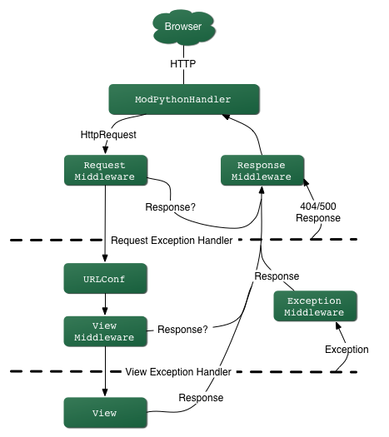
Django Internal Control Flow
Notes:
[GAC] ??

Slide 36
Simplified Internal Flow
Client
Django/Middleware
Backend
URLS
Wrapper
Services
Backend
Template
Views
Models
Database

Slide 37
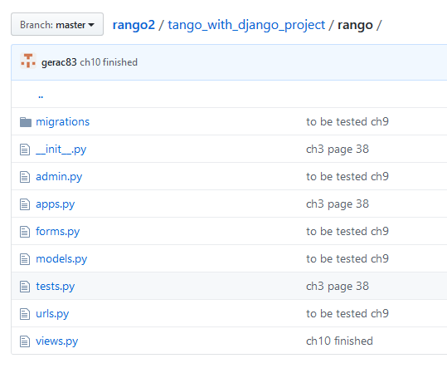
Internal Sections/Components

Slide 38
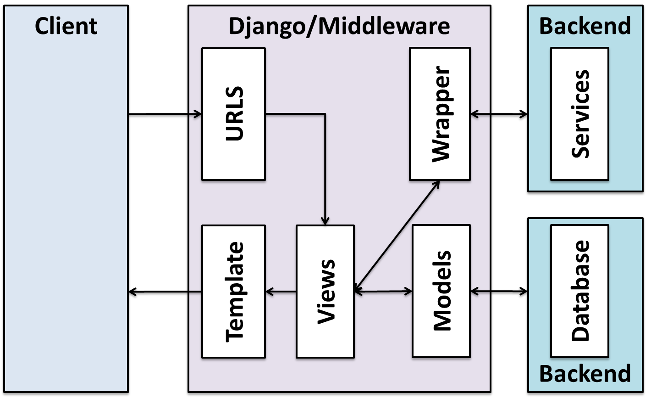
Internal Sections/Components
Building Data Models (models.py):
The models specify the entities and relationships in the database – these provide an Object Relational Mapping to the actual database tables
Django constructs the database given the models defined

Slide 39
Internal Sections/Components
Defining Views (views.py):
Views are responsible for handling and processing the specific request, collating the data from databases/external services, then selecting the template, for the response to be generated

Slide 40
Internal Sections/Components
Controlling flow (urls.py):
To specify what view function should handle a particular URL (or part of), URL patterns are used to find matches with the URL, and to route this request to the appropriate view
The use of pattern matching means that different instantiations can be handled by a common pattern

Slide 41
Internal Sections/Components
Providing Templates
The templates mean the response format (HTML,XML,etc) is decoupled from the data to be presented

Slide 42
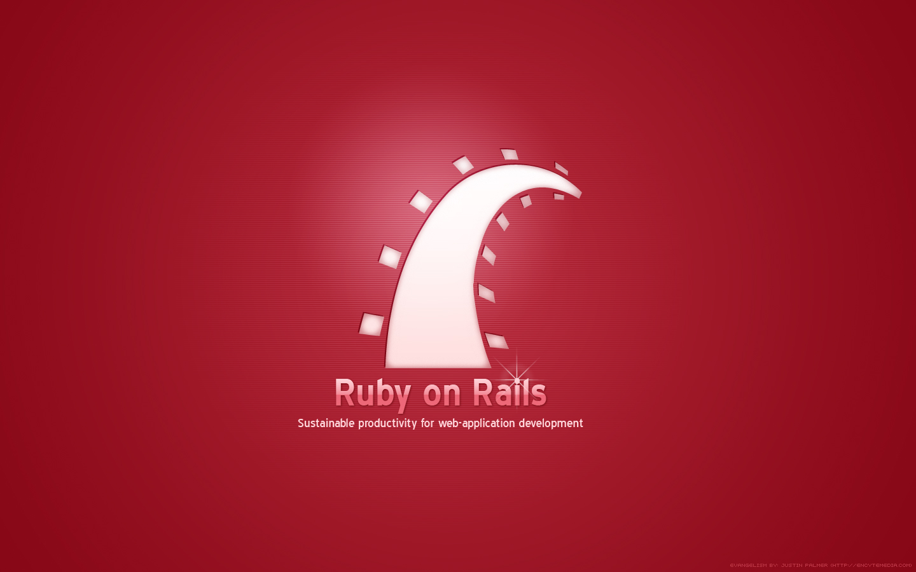

Slide 43
Ruby on Rails
A Ruby-based web framework
Sparked interest in developing web applications rapidly
Development of competing frameworks in other languages
Made popular by “Blog in 15 minutes” and other screen casts
Web development could be:
Fast,
Fun,
Straightforward.

Slide 44
Rail Design
Employs several key design principles:
Convention over Configuration
Decreases the number of decisions a developer needs to make
Only specify unconventional aspects of the application
Don’t Repeat Yourself
Store information only in one unambiguous place
Model-View-Controller
A set of design patterns that allows the separation between data models, user interfaces and the control logics of the application
https://speakerdeck.com/anildigital/solid-design-principles-in-ruby

Slide 45
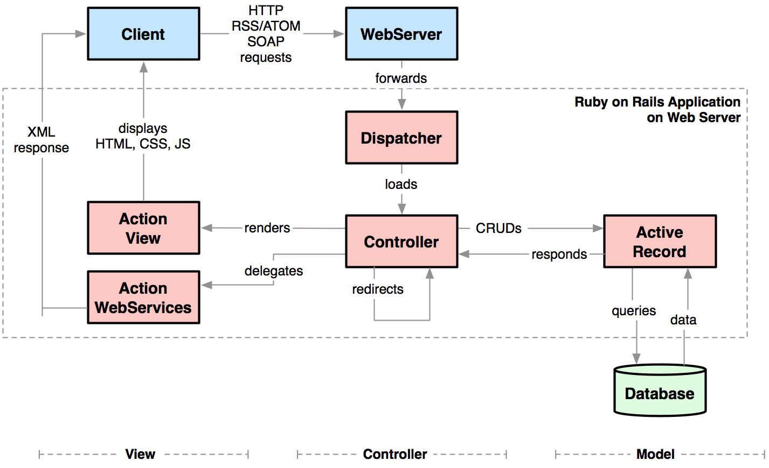
Ruby on Rails Architecture

Slide 46
Ruby on Rails Example
Build a Blog in 8 minutes with Ruby On Rails Ruby 2.4.2 Rails 5.1.4
https://www.youtube.com/watch?v=U5j-lnRWSNE
Notes:
This is an optional ten minute video. You need to explain it a bit though as there are no words. Basically the guy is making templates, creating models – and then using scaffolding to build all the related infrastructure

Slide 47


Slide 48
Symfony
A PHP based Web Application Framework
Its main goal is to speed up the creation and maintenance of web applications and replace repetitive coding tasks
Follows the MVC paradigm
Integrates with many existing technologies
Heavily inspired by WAFs such as:
Ruby on Rails,
Django, and
Spring.

Slide 49
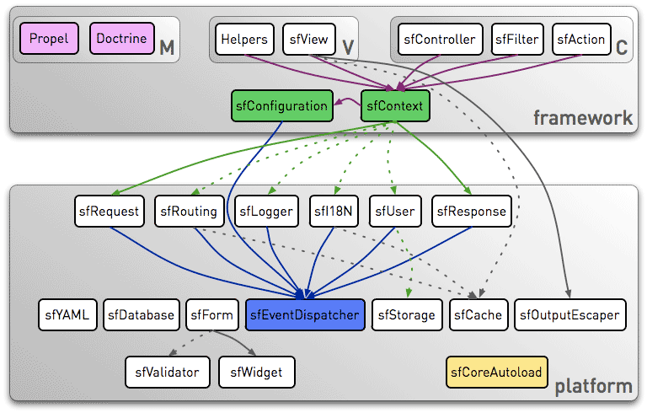
http://symfony.com/blog/the-symfony-1-1-architecture
Notes:
(This is not really to be discussed in detail, only to point out that without these different frameworks, there are different components and structures. And that MVC is employed in some way, and there is lot of functionality that is provide common to most web apps.
Each class in the symfony platform is useable without the whole MVC architecture. The symfony platform classes have no dependency, and the only prerequisite to use them is the registration of the symfony autoloader:
The sfConfiguration class provides a way to configure and to customize your applications.
The sfContext class acts as a registry that holds references to all core objects. And thanks to the factories.yml configuration file, you can customize all the registry classes very easily, just by editing a YAML file.
The symfony MVC framework is provided by a set of additional classes on top of the symfony framework as shown below:
The Model layer is provided by third-party libraries, Propel or Doctrine. Even if symfony 1.1 is bundled with the Propel plugin, it's very easy to switch to Doctrine by installing the sfDoctrinePlugin. Both ORMs provide the same level of integration with symfony.
The View layer is provided by the sfView class, a bunch of helpers, and templates written by the developer.
The Controller layer is based on a filter chain and actions defined by the developer.

Slide 50
From Full Frameworks to Lightweight Frameworks
Django / Ruby on Rails: "Everything included"
ORM, templates, admin, auth, migrations
Great for large integrated apps
Heavy for small experiments or microservices
Flask: "Start small, add only what you need"
A microframework – routing and a minimal core

Slide 51

So Many Frameworks…
Which one to choose?
Notes:
http://www.flickr.com/photos/cityhunter12/2370829473/sizes/l/in/photostream/

Slide 52
How to choose?
Ruby On Rails and Django are all good in many aspects
Documentation is excellent, with similar learning curves
Why go for Django?
makes life easier in terms of the structuring of files/folders (less is more)
Has easier form management
Templates in Django are more flexible (i.e. have inheritance to extend them, built in tags, filters, etc)
Django uses Python which is great (Yahoo uses php, Google uses python)
Tends to be more minimalist (no frills)
Sometimes the documentation is too minimalist, which requires exploring the code.
Notes:
http://dev.markhaus.com/blog/2010/10/symfony-vs-django/

Slide 53
But what about Ruby on Rails?
Ruby on Rails is… more or less the same, but a different language.
It has a big community, where you can find almost everything
But, you often find what you need made by a clueless noob
Perhaps, offers a false sense of ability, that you can do anything without effort.
When you realize the truth…… it is often too late.
Which leads to many rules being broken to kludge things together
Notes:
http://blog.ifabio.com/2010/03/02/django-rails-symfony-a-different-point-of-view/

Slide 54


Slide 55
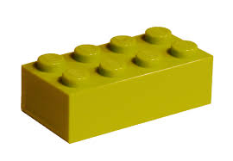
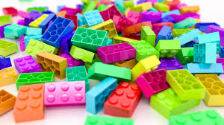

Flask
Flask: a lightweight web application framework in Python
Philosophy: Minimal core, maximum flexibility
Lets you choose your own:
Database layer (SQLAlchemy, Peewee, etc.)
Auth system
Extensions (Flask-Login, etc.)
=
=

Slide 56
Why Flask
Lightweight: start from the essentials, add components as needed/if needed
Easy to learn: small framework, easy for beginners, quick to prototype
Customizable: plug in an extension, get a new feature
Great for building APIs

Slide 57
Django vs Flask
 | Django | Flask
Popularity | High | High
Difficulty | Moderate | Low
Architecture | Clear structure | Easily extensible
Templates | Built-in template language | Jinja2 templates
Databases | Built-in ORM, supporting specific databases | ORM support through extensions
URLs | Powerful routing - complex | Routing and logic in one file - simple

Slide 58
Summary
Using Web Application Frameworks saves you a lot of effort because they save you from coding common functionality repeatedly and integrate good SE practices
There are a lot of WAFs out there to choose from, each with their own benefits and disadvantages
But at the end of the day you can do more-or-less whatever you like with any of these frameworks, it all depends on your context.
Django is a Python based framework that allows you to develop web applications quickly using modules and MVT

